Slide 1

References
Chris Piech
CS106A, Stanford University

Slide 2
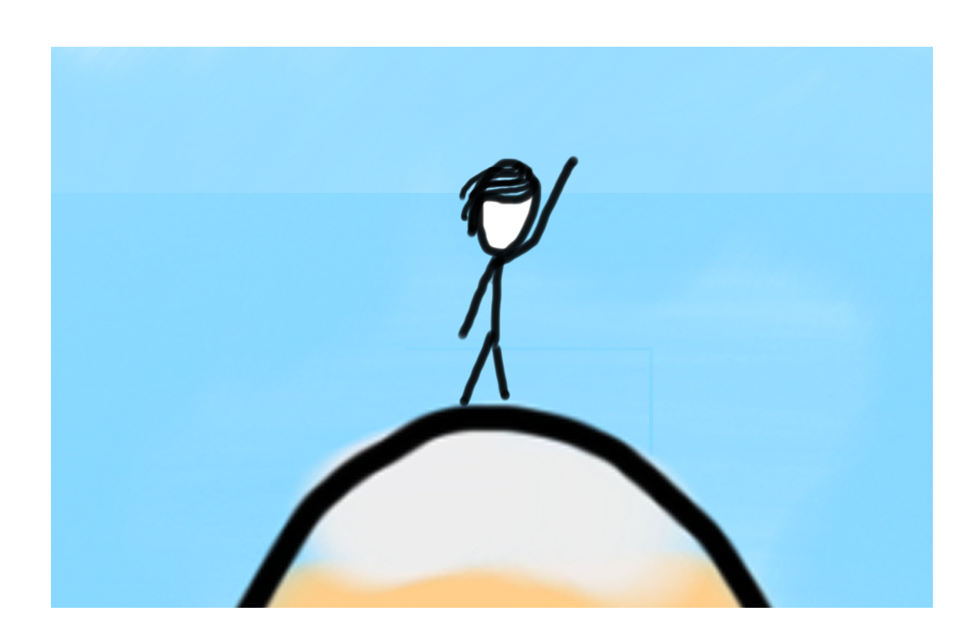
Learning Goals
Be able to write a large program
Be able to trace memory with references

Slide 3
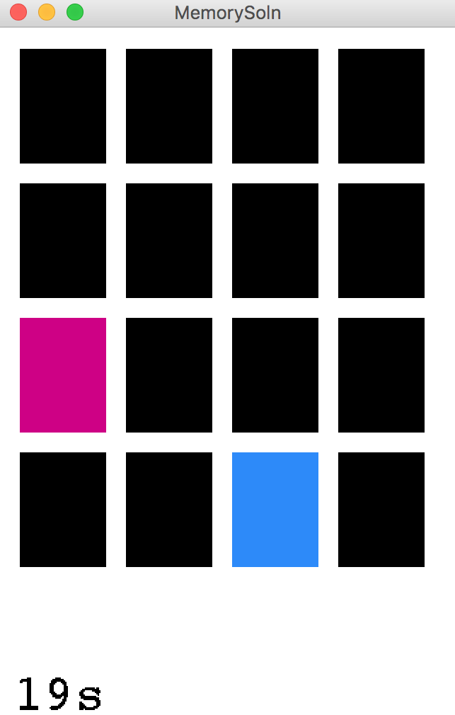
Today, we build!

Slide 4
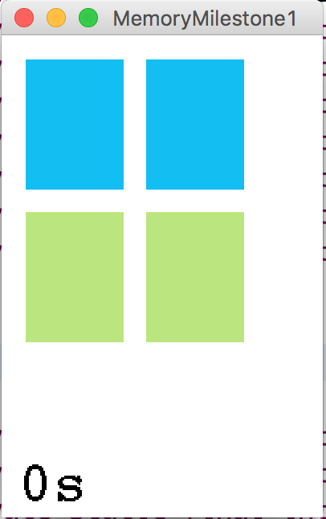
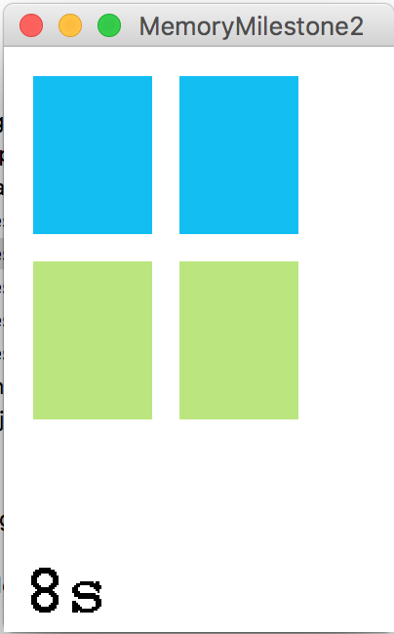
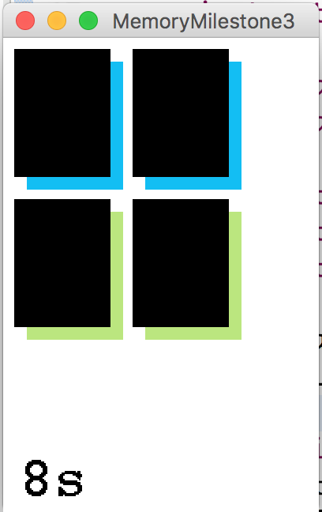
Milestones
Milestone 1
Milestone 2
Milestone 3

Slide 5
Advanced memory model

Slide 6
Recall: Memory model
private void run() {
int money = 5;
retireEarly();
println(money);
}
private void retireEarly(){
int money = 1200000;
println(money);
}

Slide 7
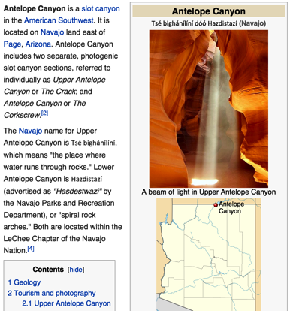
How do you share wikipedia articles?
Antelope Canyon Article
Key:
https://en.wikipedia.org/wiki/Antelope_Canyon

Slide 8
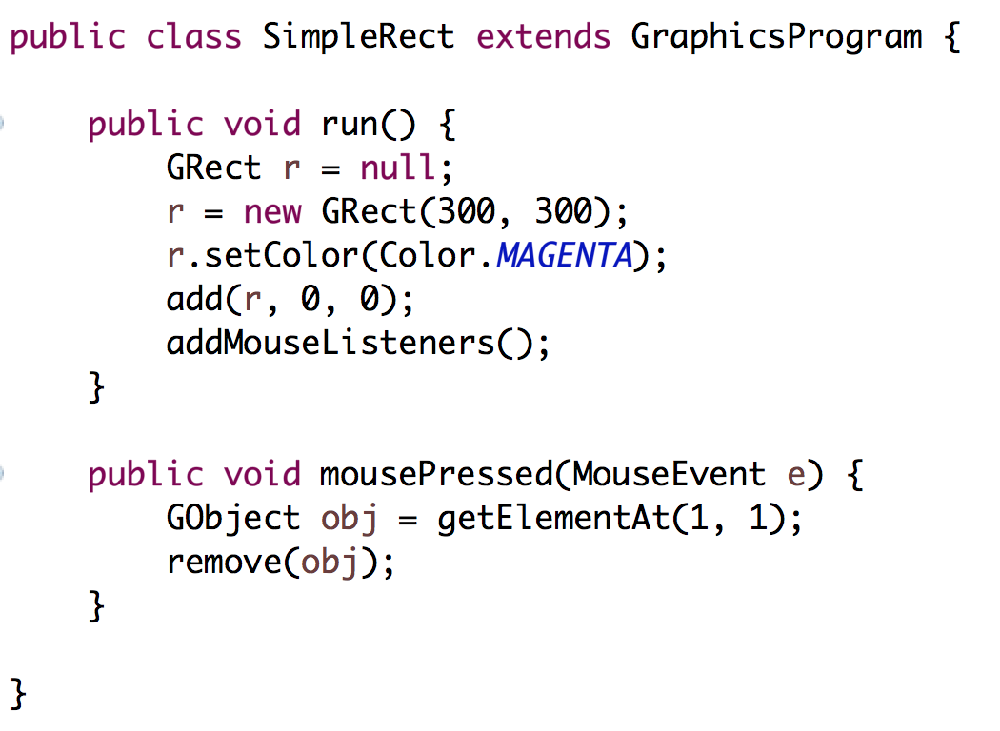

Slide 14

Memory
Heap
Instance Variables
www.memory.com/12
canvas
memory.com/12
run
r
www.memory.com/12

Slide 15
Memory
Heap
Instance Variables
www.memory.com/12
canvas
memory.com/12
run
r
www.memory.com/12

Slide 16
Memory
Heap
Instance Variables
12
canvas
12
run
r
12

Slide 20
Memory
Heap
Instance Variables
12
canvas
94
mousePressed
e
94
x = 72
y = 94
time = 192332123
obj
12

Slide 21
Finish Up

Slide 22
Learning Goals
Be able to write a large program
Be able to trace memory with references

