Slide 1
Goal
Knowledge Tracing
Ability to Automate Feedback
Ability to Automate Feedback
Ability to Automate Feedback
Markov Decision Process
Richness Hull
Previous
Work
Median Score Peer Grading
Correct /
Incorrect
Elementary
Programming
Undergrad
Programming
Natural
Language
Correct /
Incorrect
Elementary
Programming
Undergrad
Programming
Natural
Language
Correct /
Incorrect
Elementary
Programming
Undergrad
Programming
Natural
Language
Richness of Assignment
Richness of Assignment
Richness of Assignment

Slide 2
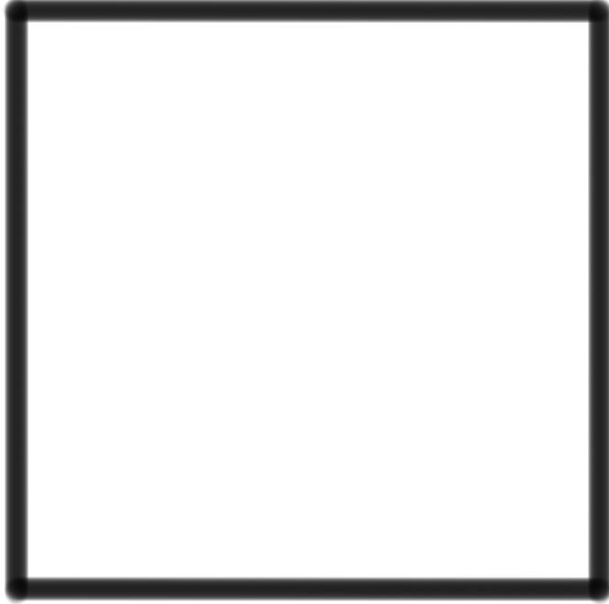

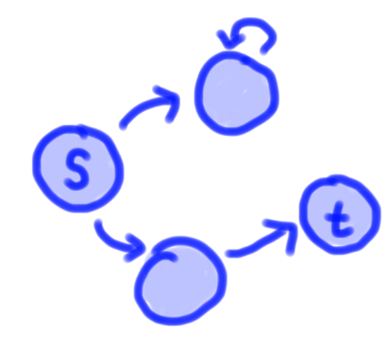
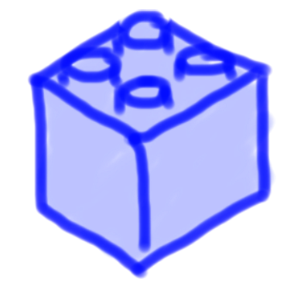
The design prin
of the common
is natural form
with language
dimension amo
int func(int a,
return a +
}
Correct /
Incorrect
Elementary
Programming
Control
Flow
General
Programming
Natural
Language

Slide 3
High
High
Goal
Deep Knowledge Tracing
Problem Solving Policies
Assignment Embedding
Equivalence Class
Ability to Automate Quality Feedback
Tuned Peer Grading
Ability to Automate Quality Feedback
Richness Hull
Low
Low
Correct /
Incorrect
Elementary
Programming
Undergrad
Programming
Natural
Language
Correct /
Incorrect
Elementary
Programming
Undergrad
Programming
Natural
Language
Complexity of Assignment
Richness of Assignment

Slide 4
Quality
World Population Percentile

Slide 5
Hidden concept 1
Hidden concept 2
Hidden concept 3
Hidden concept 4
Simulated Data
Hidden concept 5
Khan Data
Scatter plots
Pythagorean
theorem
1 | Linear function intercepts | 24 | Interpreting function graphs | 47 | Constructing inconsistent system
2 | Recognizing irrational numbers | 25 | Systems of equations w. Elim. 0 | 48 | Pythagorean theorem proofs
3 | Linear equations 3 | 26 | Solutions to systems of equations | 49 | Scientific notation intuition
4 | Multiplication in scientific notation | 27 | Views of a function | 50 | Line graph intuition
5 | Parallel lines 2 | 28 | Recog func 2 | 51 | Multistep equations w. distribution
6 | Systems of equations | 29 | Graphing proportional relationships | 52 | Fractions as repeating decimals
7 | Equations word problems | 30 | Exponent rules | 53 | Cube roots
8 | Slope of a line | 31 | Angles 2 | 54 | Scientific notation
9 | Linear models of bivariate data | 32 | Understand equations word problems | 55 | Pythagorean theorem 2
10 | Systems of equations with elimination | 33 | Exponents 2 | 56 | Functions 1
11 | Plotting the line of best fit | 34 | Segment addition | 57 | Vertical angles 2
12 | Integer sums | 35 | Systems of equations w. substitution | 58 | Solving for the x intercept
13 | Congruent angles | 36 | Comparing proportional relationships | 59 | Recognizing functions
14 | Exponents 1 | 37 | Solutions to linear equations | 60 | Square roots
15 | Interpreting scatter plots | 38 | Finding intercepts of linear functions | 61 | Slope and triangle similarity
16 | Repeating decimals to fractions 2 | 39 | Midpoint of a segment | 62 | Distance formula
17 | Graphical solutions to systems | 40 | Volume word problems | 63 | Converting decimals to fractions 2
18 | Linear non linear functions | 41 | Constructing scatter plots | 64 | Age word problems
19 | Interpreting features of linear functions | 42 | Solving for the y intercept | 65 | Pythagorean theorem 1
20 | Repeating decimals to fractions 1 | 43 | Graphing systems of equations | 66 | Comparing features of functions 0
21 | Constructing linear functions | 44 | Frequencies of bivariate data | 67 | Orders of magnitude
22 | Graphing linear equations | 45 | Comparing features of functions 1 | 68 | Angle addition postulate
23 | Computing in scientific notation | 46 | Angles 1 | 69 | Parallel lines 1
Lines
Angles
Functions
Exponents
Systems of
Equations
Line graphs
Fractions

Slide 6
Scatter plots
Pythagorean
theorem
Lines
Angles
Functions
Exponents
Systems of
Equations
Line graphs
Fractions
1 | Linear function intercepts | 24 | Interpreting function graphs | 47 | Constructing inconsistent system
2 | Recognizing irrational numbers | 25 | Systems of equations w. Elim. 0 | 48 | Pythagorean theorem proofs
3 | Linear equations 3 | 26 | Solutions to systems of equations | 49 | Scientific notation intuition
4 | Multiplication in scientific notation | 27 | Views of a function | 50 | Line graph intuition
5 | Parallel lines 2 | 28 | Recog func 2 | 51 | Multistep equations w. distribution
6 | Systems of equations | 29 | Graphing proportional relationships | 52 | Fractions as repeating decimals
7 | Equations word problems | 30 | Exponent rules | 53 | Cube roots
8 | Slope of a line | 31 | Angles 2 | 54 | Scientific notation
9 | Linear models of bivariate data | 32 | Understand equations word problems | 55 | Pythagorean theorem 2
10 | Systems of equations with elimination | 33 | Exponents 2 | 56 | Functions 1
11 | Plotting the line of best fit | 34 | Segment addition | 57 | Vertical angles 2
12 | Integer sums | 35 | Systems of equations w. substitution | 58 | Solving for the x intercept
13 | Congruent angles | 36 | Comparing proportional relationships | 59 | Recognizing functions
14 | Exponents 1 | 37 | Solutions to linear equations | 60 | Square roots
15 | Interpreting scatter plots | 38 | Finding intercepts of linear functions | 61 | Slope and triangle similarity
16 | Repeating decimals to fractions 2 | 39 | Midpoint of a segment | 62 | Distance formula
17 | Graphical solutions to systems | 40 | Volume word problems | 63 | Converting decimals to fractions 2
18 | Linear non linear functions | 41 | Constructing scatter plots | 64 | Age word problems
19 | Interpreting features of linear functions | 42 | Solving for the y intercept | 65 | Pythagorean theorem 1
20 | Repeating decimals to fractions 1 | 43 | Graphing systems of equations | 66 | Comparing features of functions 0
21 | Constructing linear functions | 44 | Frequencies of bivariate data | 67 | Orders of magnitude
22 | Graphing linear equations | 45 | Comparing features of functions 1 | 68 | Angle addition postulate
23 | Computing in scientific notation | 46 | Angles 1 | 69 | Parallel lines 1

Slide 7
Hidden concept 1
Hidden concept 2
Hidden concept 3
Hidden concept 4
Hidden concept 5

Slide 8
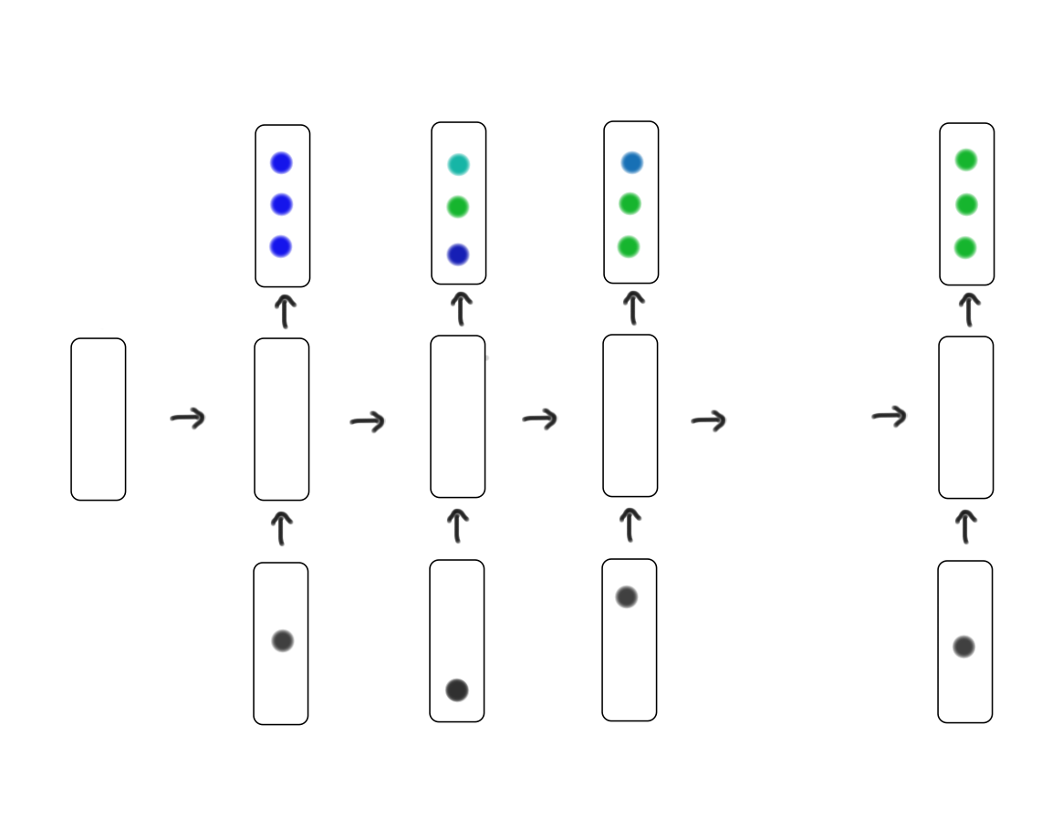
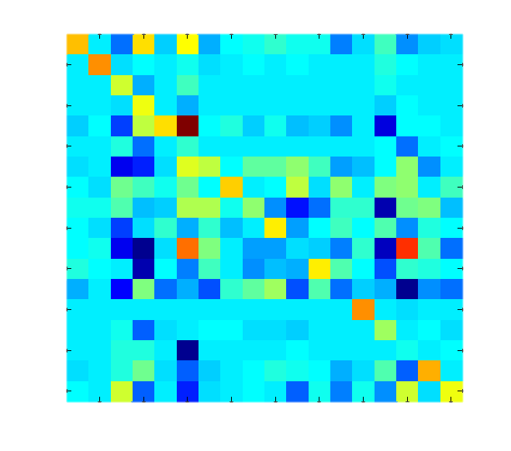
Loss = Loss(y) + Loss(Q)
Loss = Loss(Q)
y
Q-value
Q-value
Neural Net
Neural Net
h
h
x
x

Slide 9







Understanding Curriculum Navigation
1
1. Deep Knowledge Tracing
2. Poison Path
Understanding Problem
Navigation
2
3. Equivalence Classes
Ability to Understand
*
4. Program Embedding
Understanding Solution
Space
5. Tuned Peer Grading
4
4
3
Not Applicable
Work left to be done
Peer
Grading
5
5
5
5
Correct/
Incorrect
Maze
Programs
Control Flow Programs
General Programs
Natural Language

Slide 10
Understanding Curriculum Navigation
1
1. Deep Knowledge Tracing
2. Poison Path
Ability to Understand
Understanding Problem
Navigation
2
3. Equivalence Classes
*
4. Program Embedding
Understanding Solution
Space
Not Applicable
4
4
3
Work left to be done
Correct/
Incorrect
Maze
Programs
Control Flow Programs
General Programs

Slide 11
Code.org A
Code.org B
s = 1.42
s = 1.82
Stanford A
Stanford B
Coursera Machine
Learning A
s = 2.14
s = 1.82*
s = 2.67

Slide 12
ML A

Slide 13
0
5000
10000
15000
10000
15000

Slide 14
“starter code elbow”
1 equivalence class
10 equivalence classes
19 equivalence classes

Slide 15
linear regression with gradient descent
With canonicalization
neural net training with backpropagation
Without canonicalization
Baseline better
logistic regression objective
Codewebs better

