Slide 1
MoneySmart.sg
Data Team Coding Challenge
Christopher Poon
March 2019

Slide 2
Background and Purpose
Main Purpose:
Sample Dataset had been received and the requirement is to answer mock queries from the Sales Team.
This deck is to showcase my ability to
Analyse a dataset
Answer critical business questions
Develop compelling visualizations to tell a story.
Provide actionable insights to drive sales.
There are assumptions and data manipulations made which will be elaborated in the next few slides.

Slide 3
Data Observations and Assumptions
1. Deriving Customer Groups from Customer ID
Example: Customer ID = AG-10900
Customer Group = AG
Observation:
There are 291 Customer Groups in the data.
Purpose:
I had observed that there is pattern and convention in the Customer_ID field and the potential to extract first 2 characters to create Customer Group field.
The value in this field is that it can be used to understand spend by customer group to identify customer potential in order to engage each group differently.

Slide 4
Data Observations and Assumptions
2. Deriving Product Group and Sub-Groups from Product ID.
Example: Product ID = TEC-AC-10000023
Product Group = TEC
Product Sub-group = AC
Observation:
3 Product Groups
18 Product Sub Groups
Purpose:
These groupings are essential and valuable to the understanding of product dynamics and spend by product group.
The findings on these analyses can be used to cull products which has the lowest sales contribution and consistently does not have good sales or understand which customer groups are frequent buyers of certain product groups.

Slide 5
Data Observations and Assumptions
3. Deriving Order Group from Order_ID.
Example: Order ID = CA-2016-152156
Order Group = CA
Observation:
There are 2 main Order Groups in the data.
Assumption : This field can be used to identify location of sales.
Purpose:
This will be used to aggregate orders up to a higher level.
The main purpose is to understand where the orders are coming from.
It can also be used to understand if there is a particular affiliation between Customer groups and Order Groups.

Slide 6
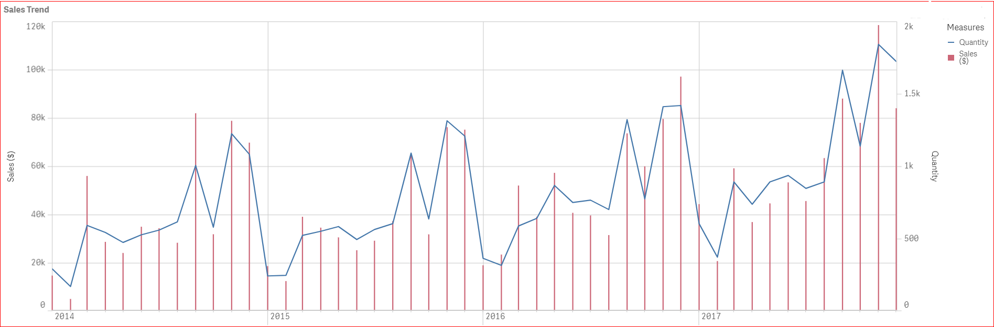
Sales and Seasonality
Nov 2017 had been observed with the highest sales achieved since Jan 2014.
Historically, the month of November had been observed to achieved the highest sales in the year.
Seasonality had been observed to have a positive sales impact in Q4 and a negative impact in Q1 on a yearly basis.

Slide 7
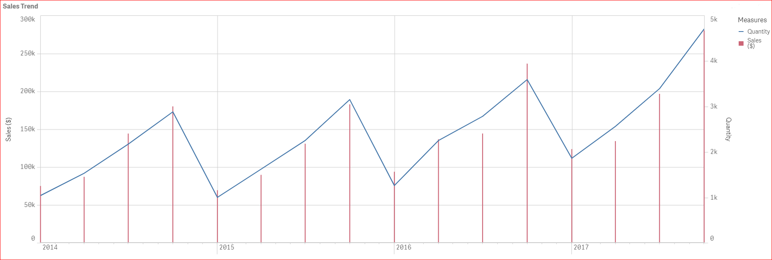
Sales and Seasonality
Seasonality had been observed to have a Positive sales impact in Q4 and a Negative impact in Q1 on a yearly basis.
There is an opportunity to concentrate marketing effort in Q4 to result in improved sales in Q1.

Slide 8
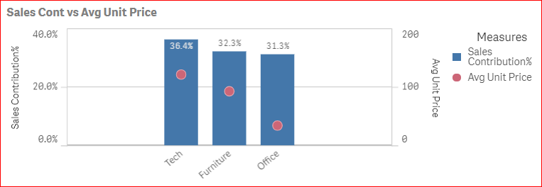
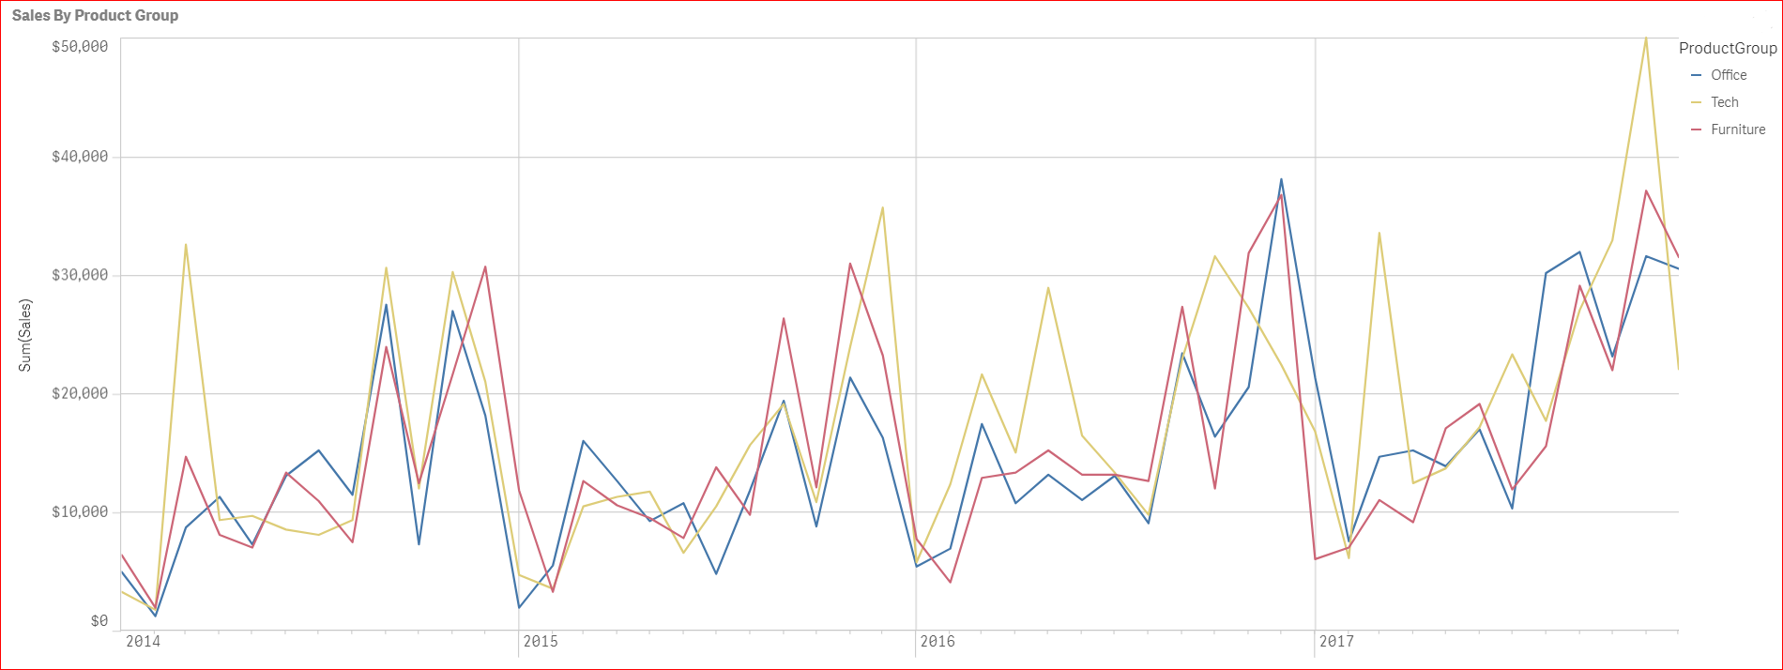
Sales by Product
Tech Product Group is the biggest contributor of sales ~ 36% in overall sales from Jan 2014 to Dec 2017.
It also has the highest average unit price per item.
Action: Advisable to concentrate marketing effort in this product group as it will have the biggest yield and ROI.
Latest Sales Performance (Dec 2017)
In the latest month of data (Dec 2017), all product groups had declined in sales with Tech leading the decline.
In the same month, Furniture products had finished the strongest with the item - Hon GuestStacker Chair having the best overall sales $2,493.
Recent bestseller : Hon GuestStacker Chair

Slide 9
How to monitor Sales Performance
4 Main Guiding Principles
Benchmark performance vs last year (E.g. YoY Growth%)
Identify Product Groups which contributes the most % Sales.
Monitoring the high potential Product Group will can help make decisions in advance to improve sales with a better ROI.
Identify Customer Groups which contributes the most % Sales.
Understanding high potential Customer Groups allows actions to be put in place to engage differently with different customer profile. (Pre-cursor to Customer Segmentation)
Extract Actionable Insights from the dashboards.
These 4 guiding principles for designing BI Dashboards are based on my extensive commercial and BI experience in working closely with the senior executives.

Slide 10
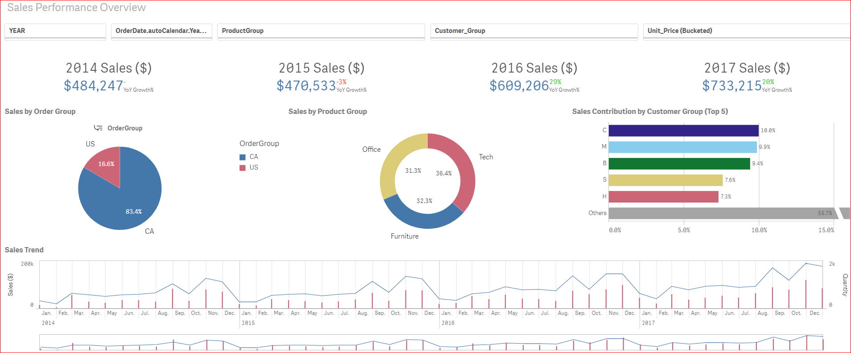
1. Benchmark Performance vs LY (Growth%)
Every dimension in the dashboard is clickable.
Example, if Tech is clicked on, it will update all KPIs accordingly.
Actionable Insight: It informs the business whether the Sales achievement is performing well with a reference point.

Slide 11
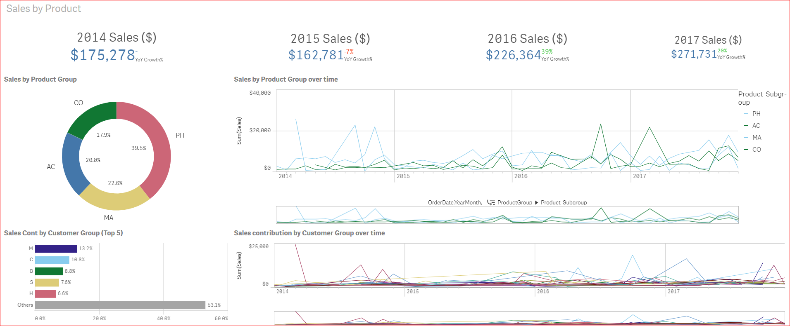
2. Identify Product Group Potential
It is business critical for Sales managers to understand which Products Groups are driving Sales in the portfolio.
Manager can see PH Product group is contributing the most sales. The design is such that it is easy to view the performance trend on the right – to ensure that there are enough data points to ascertain a dip in performance.
The insight here is to take action in advance once a dip in performance for the product group is identified.

Slide 12
3. Identify Customer Group Potential
As can be seen here, the Top 5 Customer groups provides close to 50% of the business. (Actionable Insight)
Business critical so marketing effort can be focused on them for better ROI.
The Sales trend on the right will provide an indication and can assist in making decisions in advance once the trend is observed to be dipping with 3 data points.

Slide 13
Summary
Throughout my career, these are the 4 design principles I adhered to when I am developing and designing BI dashboards.
It provides tracking performance with a reference point (to ascertain improvement)
Another way of getting a performance benchmark is to procure market/industry data.
It guides the business on where to place their effort on the 2 driving forces in sales; Products and Customers.
These guiding principles allows business (sales & marketing) effort to be targeted towards the high potential areas.
Geographical based data on sales is the next step to identify areas of high potential to target effort.
Working on targeted areas will definitely yield and maximise ROI on the business spend.

