Slide 1
MSDS Practicum - II
Christopher Pragash
Presentation Topic: IoT Analytics in Aquaponics Farm
MSDS 696 X70 Practicum II
Regis University

Slide 2
Agenda
Project Proposal
Approach
Regis Values – Community Benefits
Machine Learning in Aquaponics
PoC Environment
Intro to Boodskap IoT Platform
Dataset Definition
Machine Learning in Boodskap
Naïve Bayes
Random Forest
Summary of findings
References

Slide 3
Project Proposal : IOT Machine Learning in Aquaponics
Introduction to Aquaponics: An aquaponics farm is a vertical farming system, wherein fruits and vegetables are grown using nutrients from fish waste. An aquaponics system will typically include a fish tank, a settling basin to remove solids, a bio-filter to breakdown fish byproducts, a hydroponics growing system which may include a tank or other water contact system, and a recirculating system.
Challenge in Aquaponics: Commercial aquaponics farming integrates many different IoT sensors, (such as light sensors, dissolved oxygen sensors, pH sensors and temperature sensors), which monitor the farm ecosystem and motors (such as water pumps, air pumps), that maintain the ecosystem. The main goal of this project is to use machine learning to build a self-controlled autonomous aquaponics farm.

Slide 4
Approach
The project will use an IoT platform (https://boodskap.io/), which is a comprehensive, integrated platform for IoT solutions.
Sensors will be configured to send live data to the boodskap.io platform.
Using built-in visualization components, live data will be visualized in the platform.
Use stream analytics to filter outliers and only preserve meaning full data.
Once data is being fed into the system, machine learning will be used for developing predictive and prescriptive solutions for the farm.

Slide 5
Regis Values
Community benefits of Aquafarm
Land conservation
Highly beneficial in densely populated areas.
Organic – no preservatives

Slide 6
Machine Learning in Aquaponics
Various factors affect growth of fish and thereby the produce in an aquaponics farm.
Using sensors the following major parameters will be measured:
Salinity
Temperature
Dissolved Oxygen (DO)
pH
Ammonia
Nitrate
Combination of these parameters change the “Activity” of the fish. Following activities are tracked: "SpawnsWell", "GrowsWell", "Reproduces", "FeedsWell", "Stunts", "FeedsLow", "WontFeed", "LowMortality", "HiMortality", "MassiveMortality", "Lethal“.
Using historical data, machine learning can be used to:
Predict the type of activity based on different parameters using classification algorithms. (Scope of this project)
Predict the affect of combination of parameters on other parameters, such as Temperature on dissolved oxygen, using regression algorithms. (Future Scope)
Use Image classification algorithms to identify the growth characteristics of fish & produce (Future Scope)

Slide 7
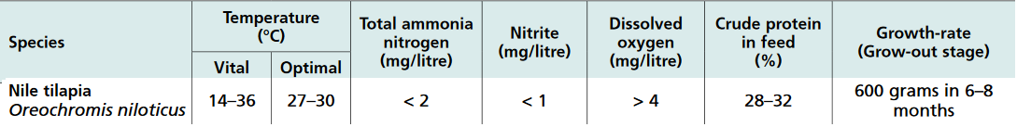
PoC Environment
Tilapia Fish Types:
Nile
Blue
Mozambique
Why Tilapia (ref: http://www.fao.org/3/a-i4021e/i4021e03.pdf ):
Native to East Africa, tilapias are one of the most popular freshwater species to grow in aquaculture systems worldwide.
They are resistant to many pathogens and parasites and handling stress.
They can tolerate a wide range of water quality conditions and do best in warm temperatures.
Although tilapias briefly tolerate water temperatures extremes of 14 and 36 °C, they do not feed or grow below 17 °C, and they die below 12 °C.
The ideal range is 27–30 °C, which ensures good growth rates.
Optimal parameters (ref: http://www.fao.org/3/a-i4021e/i4021e03.pdf ):

Slide 8
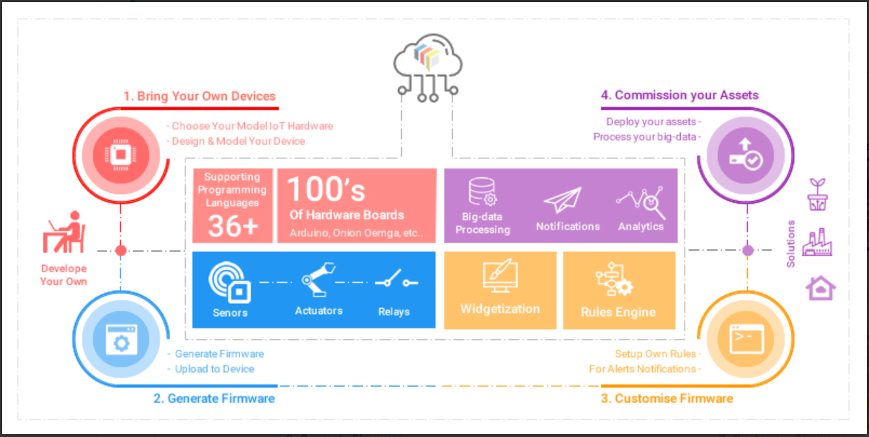
Boodskap IOT Platform

Slide 9
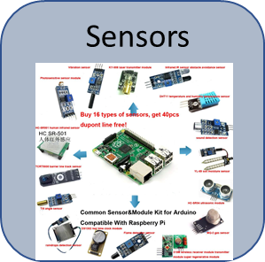
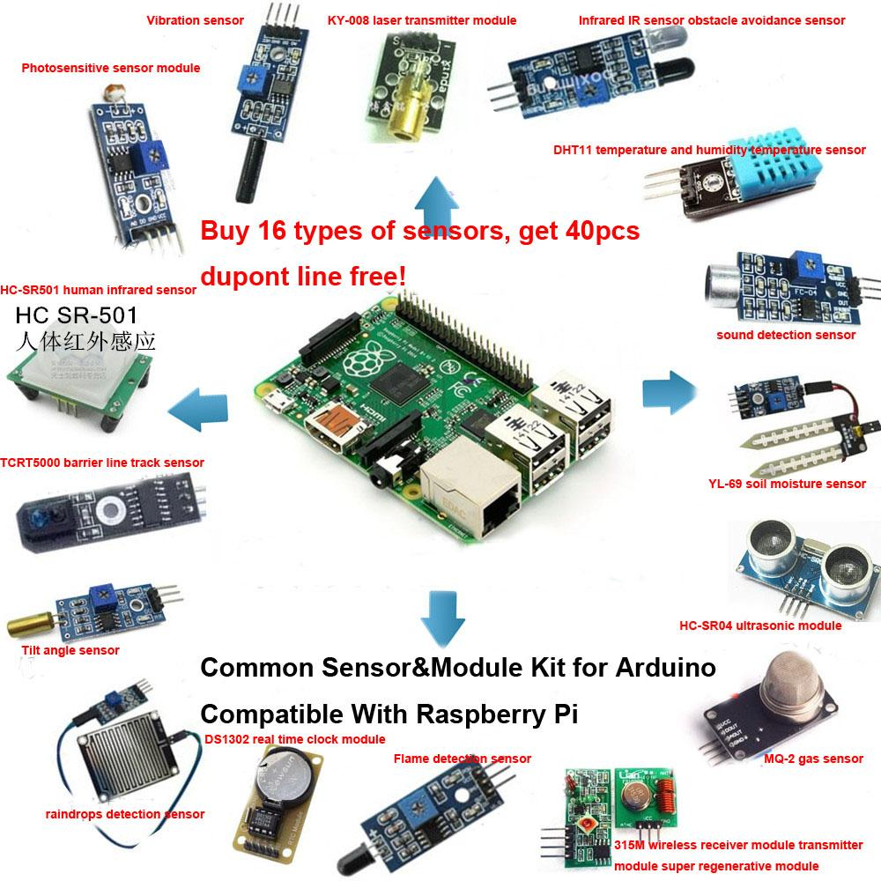
Data Pipeline
Sensors
Boodskap IOT Platform
Train / re-train
Machine Learning
Persist Data
Persist only Useful Data
Visualize Model Predictions
Stream Analytics
Rest API / JSON format
Event / Message Hub
Send filtered Data
Visualize incoming Data
Data Visualization

Slide 10
DataSet
8 Parameters in the dataset:
Categorical variable – Species:
Nile, Blue, Mozambique
def species = ["0", "1", "2"]; //(as factor)
Salinity
Temperature
DissolvedOxygen
pH
Ammonia
Nitrate
Categorical variable – Activity:
"SpawnsWell", "GrowsWell", "Reproduces", "FeedsWell", "Stunts", "FeedsLow", "WontFeed", "LowMortality", "HiMortality", "MassiveMortality", "Lethal";
def activities = ["0", "1", "2", "3", "4", "5", "6", "7", "8", "9", "10"]; //(as factor)
Output variable for machine learning classification
Sample data point:
data << "2,?,?,1.76,?,?,?,?";
Represents:
Tilapia – Mozambique (species), data from sensor monitoring dissolved oxygen (1.76)

Slide 11
Code walkthrough
Overview:
Define dataset
Define classifier (Naïve Bayes, Random Forest, etc)
Populate dataset with valid data
Train the model with the classifier
Test using the model

Slide 12
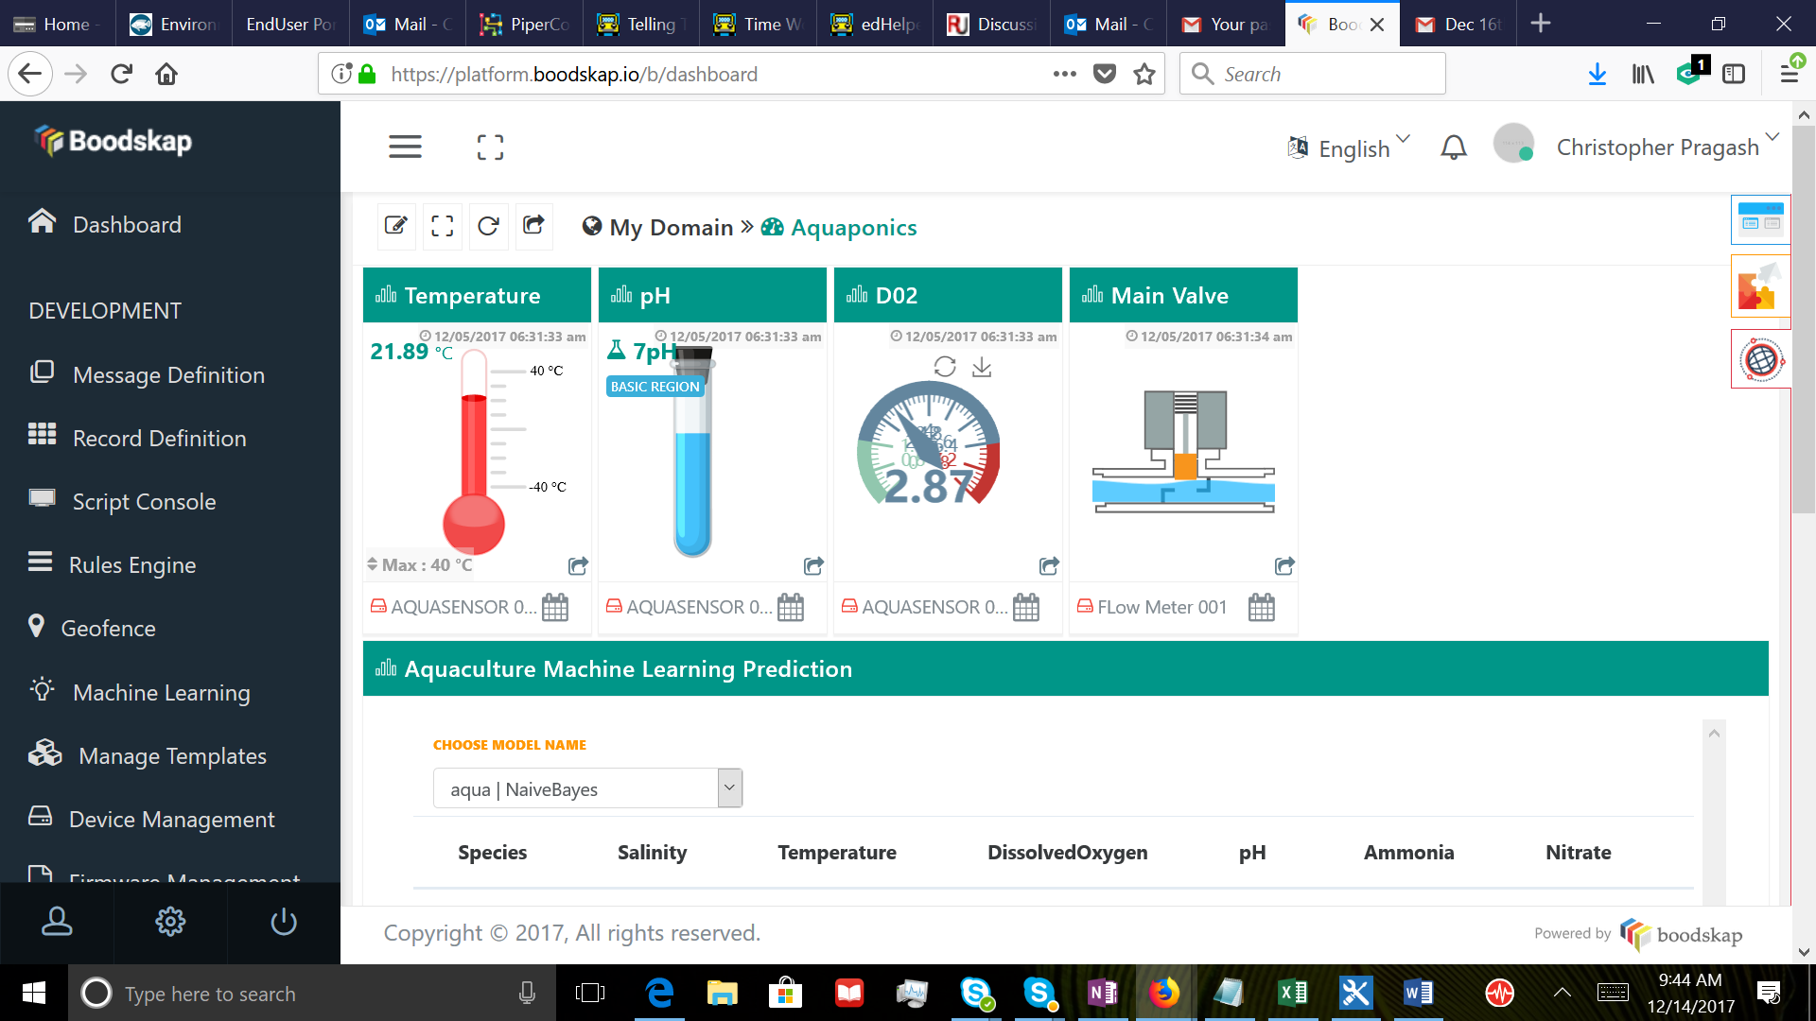

Slide 13
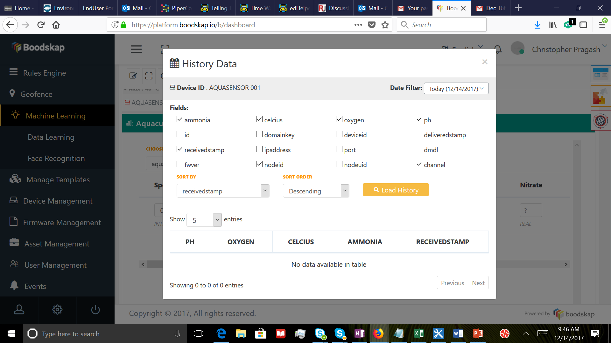

Slide 14
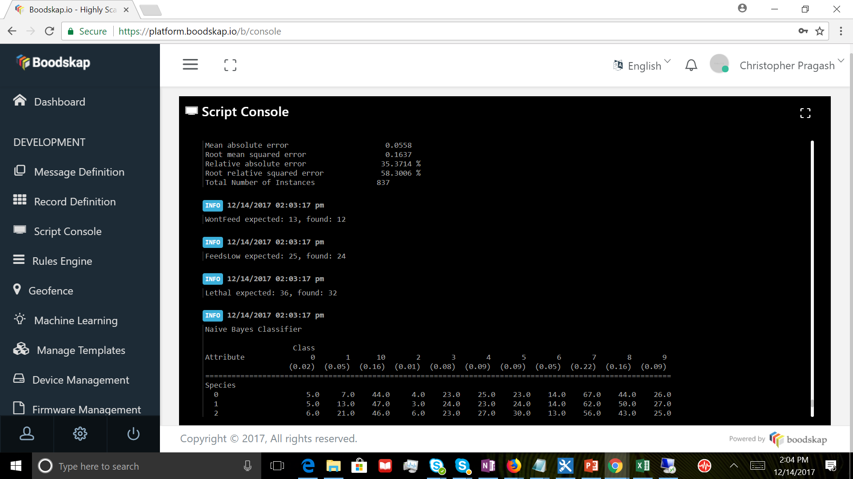

Slide 15
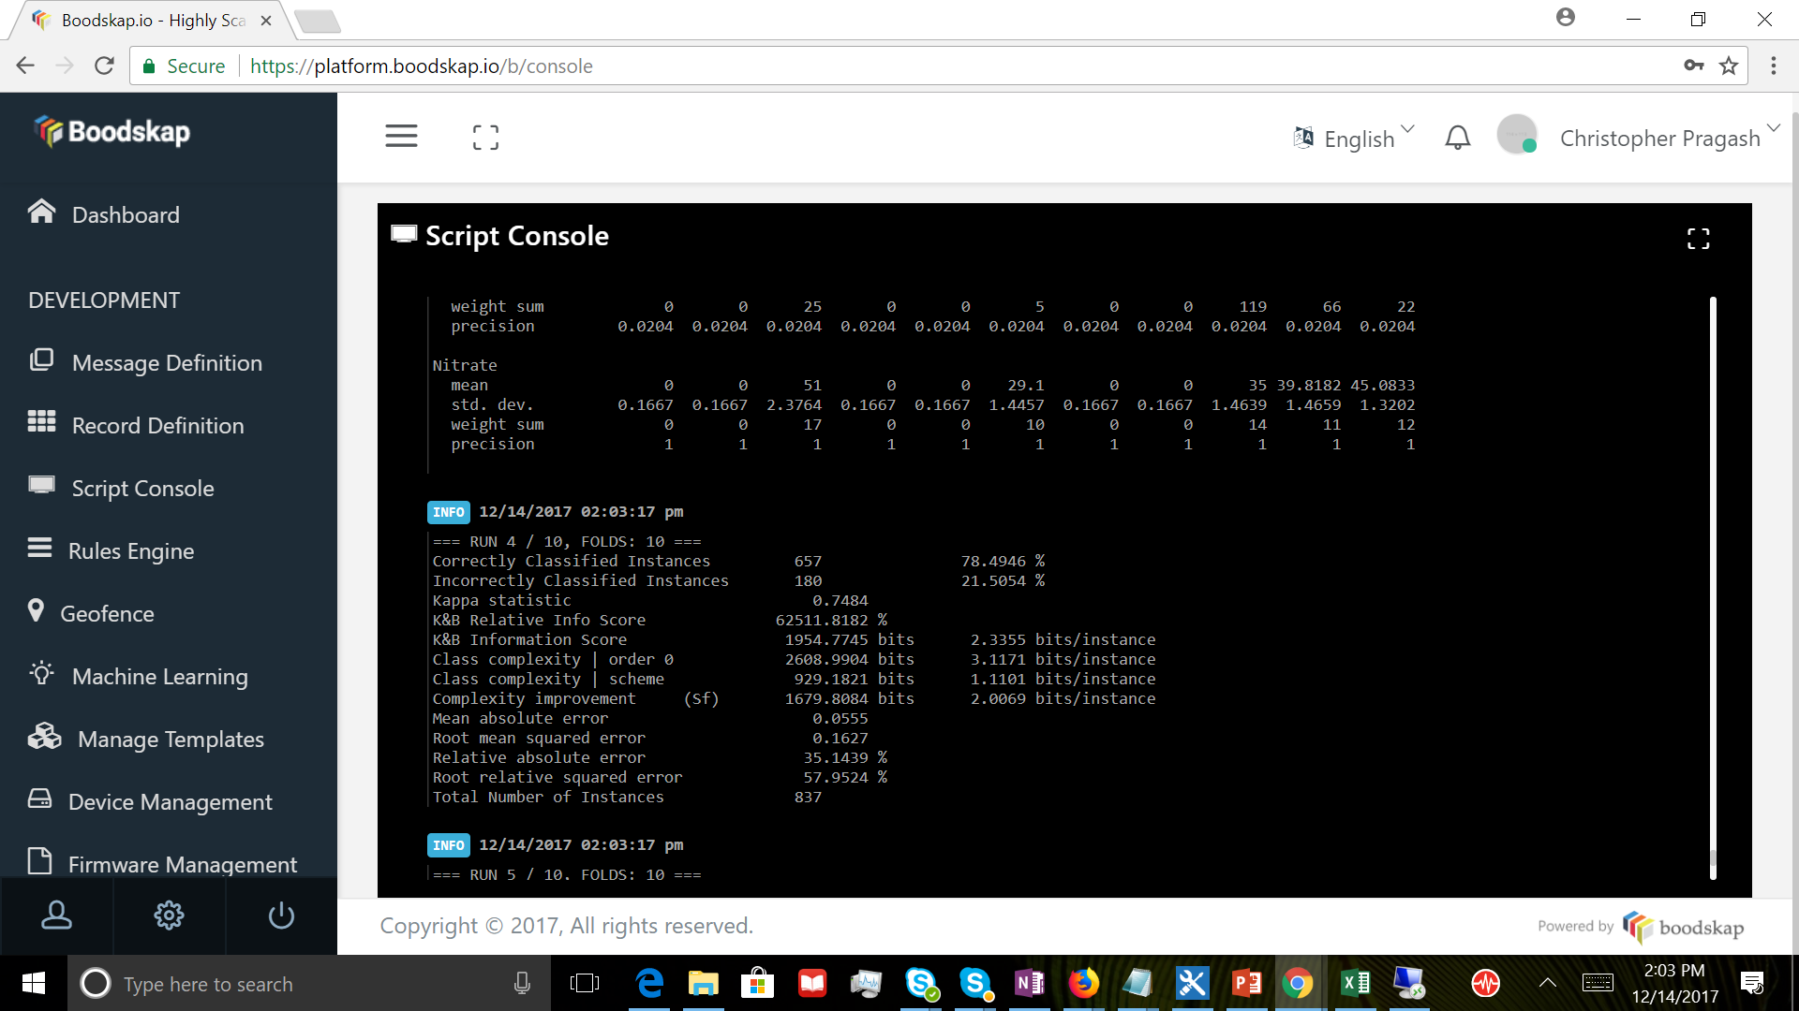

Slide 16
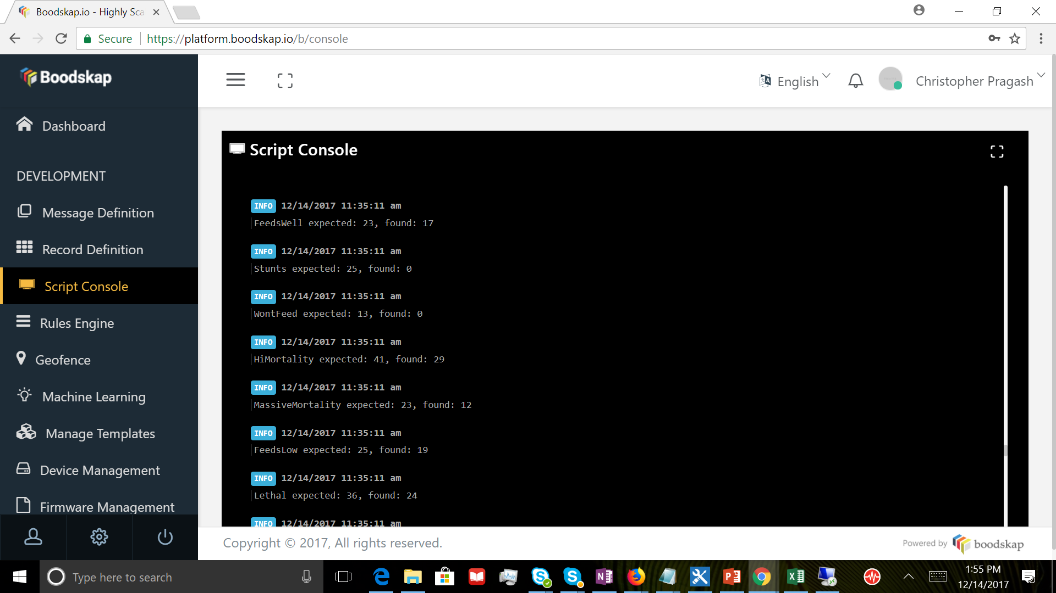

Slide 17
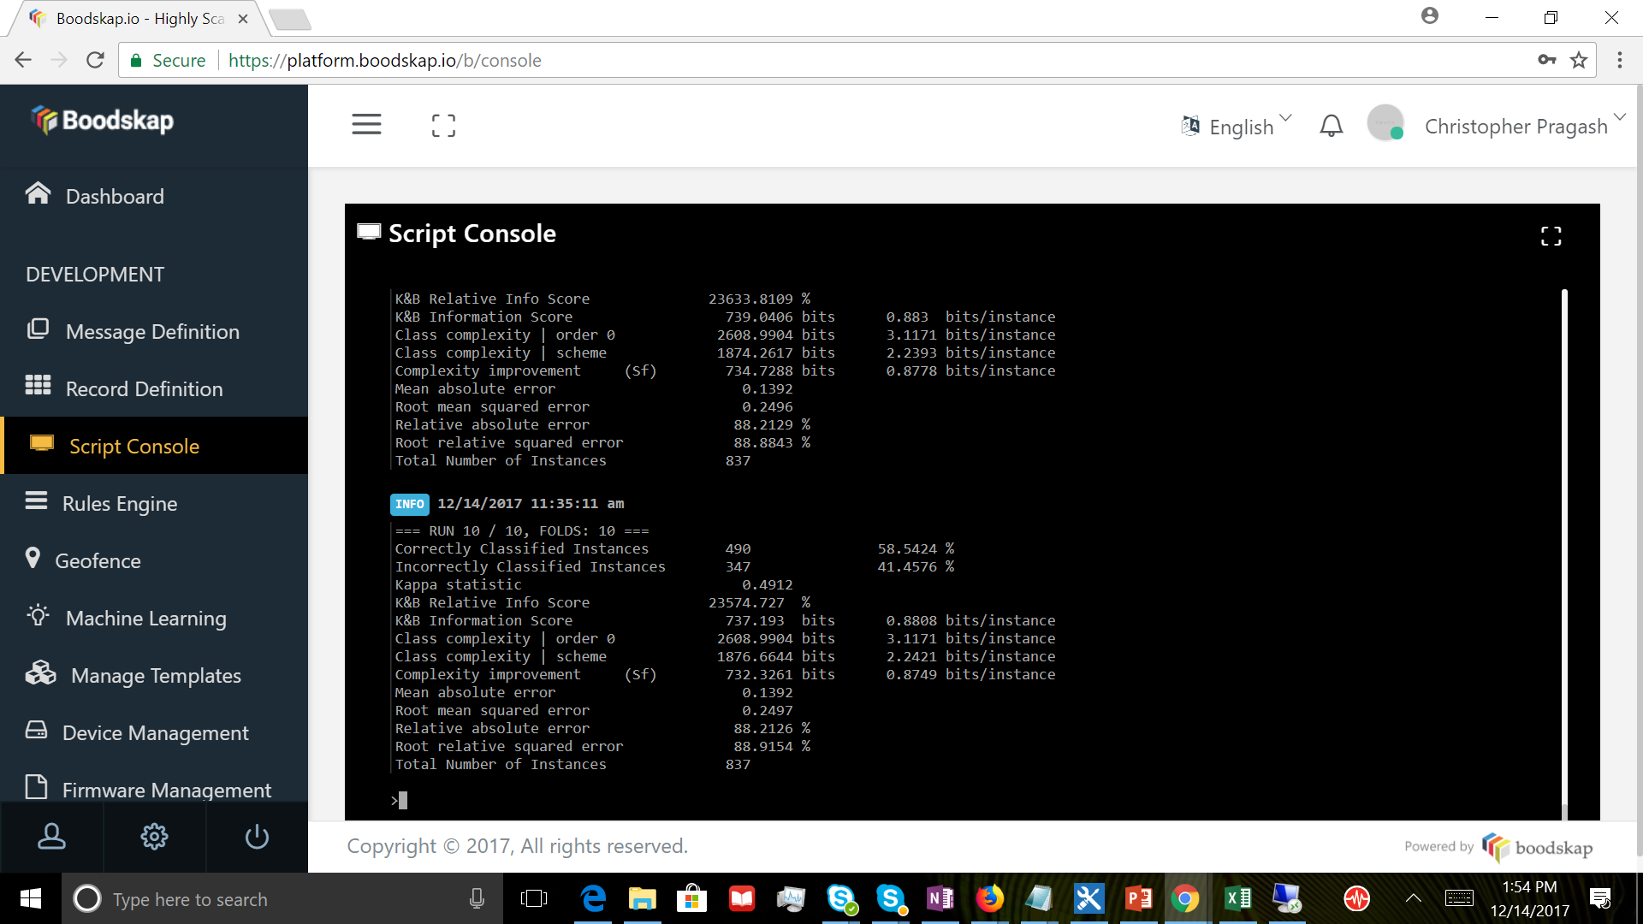

Slide 18
Summary of Findings
Naïve Bayes classification works better in this scenario
Not all scenarios have been captured in the dataset – thus Random forest has a lower accuracy rate.
Naïve Bayes has an accuracy of about 79%
Random Forest about 58%
Very complicated to account for all composite situations, such as effect of light on dissolved oxygen.

Slide 19
References
Fish in aquaponics: http://www.fao.org/3/a-i4021e/i4021e03.pdf
http://www.tilapia-farming.com/2012/12/09/environment-conditions-for-raising-tilapia/
http://www.springer.com/cda/content/document/cda_downloaddocument/9783319568768-c2.pdf?SGWID=0-0-45-1604544-p180764896

