Slide 1

Group 5 CSC 4402 SEMESTER PROJECT
Martin Ivanchev, Chris Vasquez, leslyanne Warrington, Stephen Watson

Slide 2

DOMAIN APPLICATION

Slide 3
DOMAIN application
The application of our database is as an analysis tool for airlines
Database queries allow an airline to examine flight patterns
Useful for purposes such as:
Optimizing troublesome routes
Detecting and investigating planes aircraft with maintenance issues
Beneficial as it can help save money and inform future business decisions
Cutting down on delays also improves airline reputation

Slide 4
DOMAIN application
Stores three entities:
Airports
Airlines
Delayed flights
Airlines operate flights, and flights are completed between two airports
Assumed that no flights start and end at the same airport

Slide 5
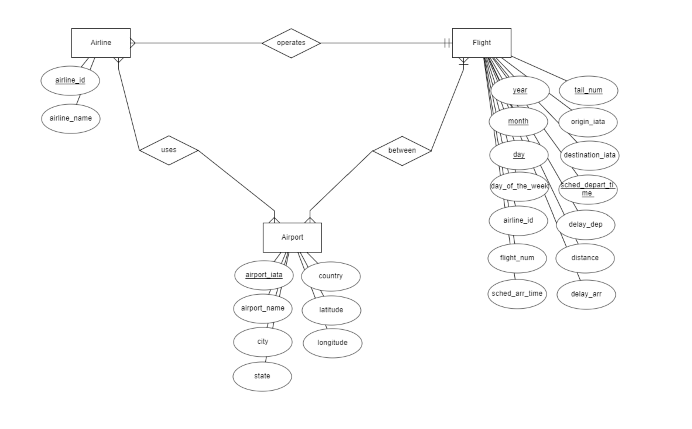

Slide 6

DATABASE DESIGN

Slide 7
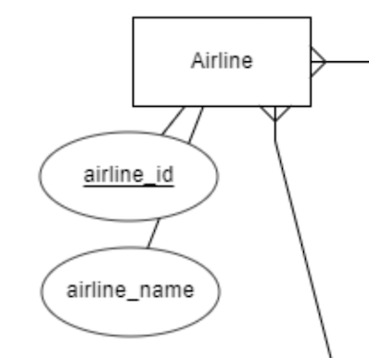
DATABASE design
Airlines table
create table airlines(
airline_id varchar(2),
airline_name varchar(50),
primary key (airline_id)
);

Slide 8
DATABASE design
Airlines table
BCNF
all fields are single-valued (1NF)
airline_id → airline_name, where airline_id is a primary key

Slide 9
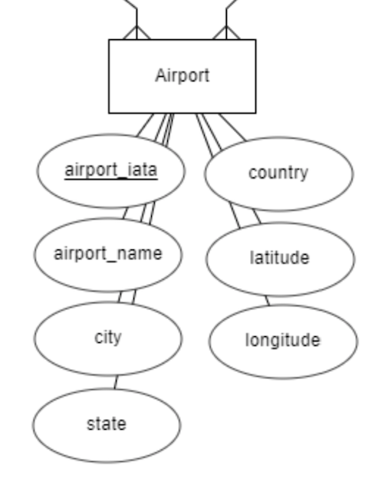
DATABASE design
Airport table
create table airports(
airport_iata varchar(3),
airport_name varchar(50),
city varchar(30),
state varchar(2),
country varchar(5),
lati decimal(5, 5),
longi decimal(5, 5),
primary key (airport_iata)
);

Slide 10
DATABASE design
Airport table
BCNF
airport_iata is a primary key

Slide 11
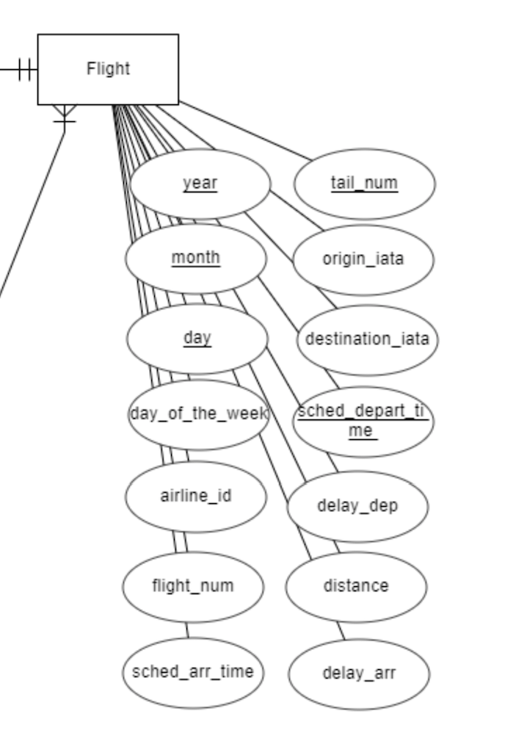
DATABASE design
Flights table
create table flights(
year integer,
month integer,
day integer,
week_day integer,
airline_id varchar(2),
flight_num integer,
tail_num varchar(10),
origin_iata varchar(3),
dest_iata varchar(3),
sched_dep_time integer,
delay_dep integer,
distance integer,
sched_arr_time integer,
delay_arr integer,
primary key (year, month, day, tail_num, sched_dep_time)
);

Slide 12
DATABASE design
Flights table
3NF
Every determinant is part of a candidate key

Slide 13

Database creation

Slide 14
DATABASE CREATION
Created with data retrieved from Kaggle, detailing the 2015 USA Flight Delays and Cancellations
~55MB Database (Reduced from the provided 500MB Database)
10 queries written are examples of how an airline could utilize the database for their benefit
Note: the output samples included contain only the first five results of the query

Slide 15
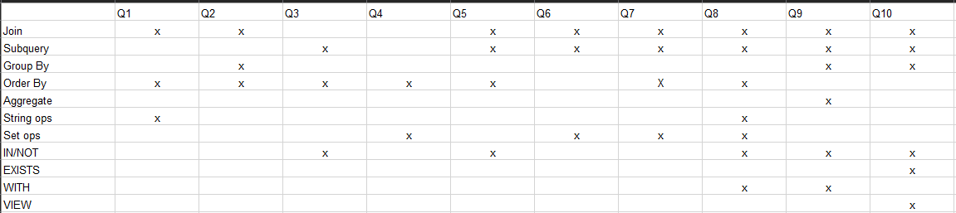
Query Matrix

Slide 16
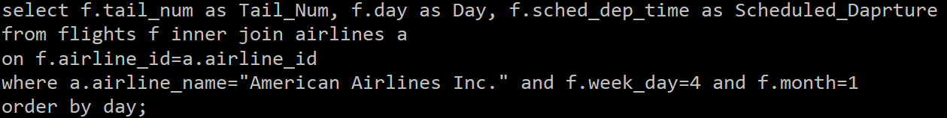
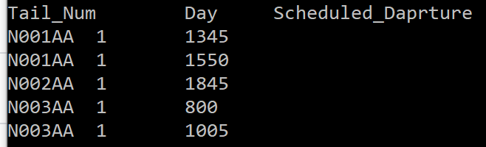
DATABASE DESIGN
Q1 ::: Find all American Airlines flights, their scheduled departures, and tail numbers that are on Wednesdays in January ordered by day in the month
Query 1
Notes:
Utilizes basic SQL methods such as:
Inner join to join two tables according to their airline_ids
Where clause
Order by clause

Slide 17
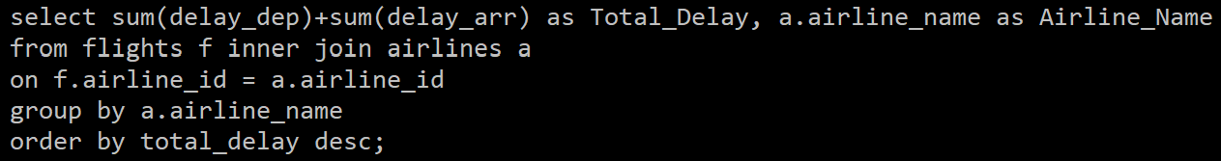
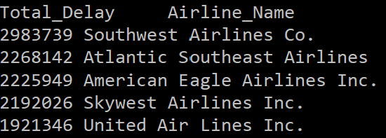
DATABASE DESIGN
Q2 ::: Find the TOTAL Delay of each airline based on their respective flights and list from greatest to least
Query 2

Slide 18
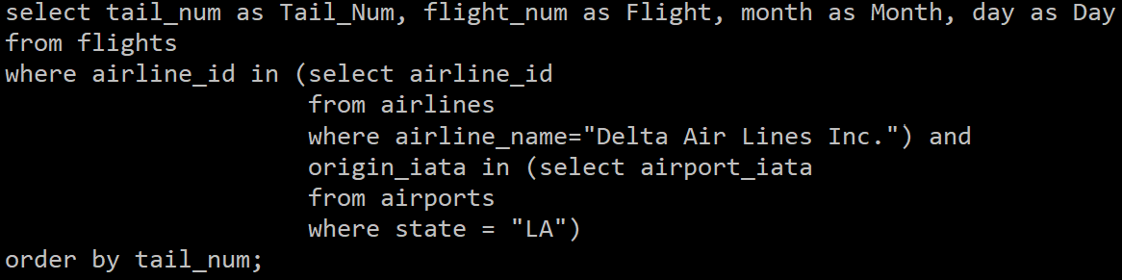
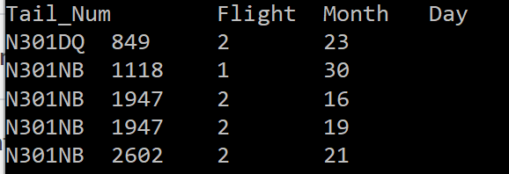
DATABASE DESIGN
Q3 ::: Find all Delta Air Lines flights and their designated planes that depart from LA ordered lexicographically
Query 3

Slide 19
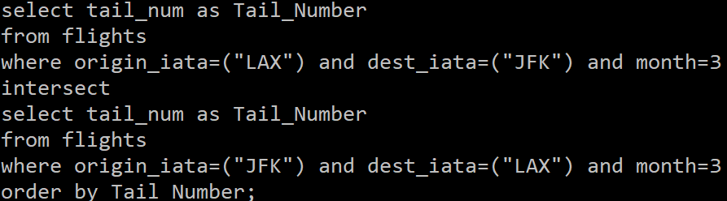
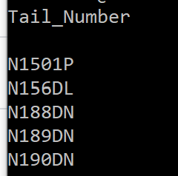
DATABASE DESIGN
Q4 ::: Find the tail number of all planes that have flown from LAX to JFK and from JFK to LAX in the month of March
Query 4

Slide 20
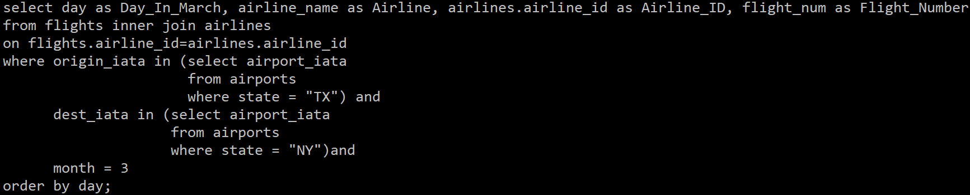
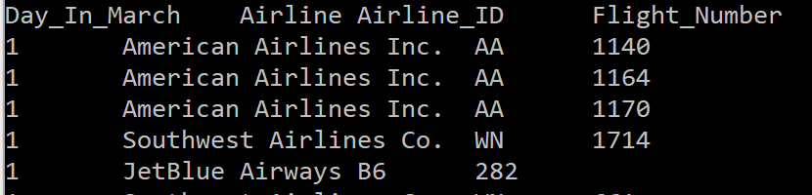
DATABASE DESIGN
Q5 ::: Find all flights and their airline that depart from Texas and arrive in New York in March 2015, ordered by day in the month
Query 5
Notes:
Utilizes basic SQL methods such as:
Inner join

Slide 21
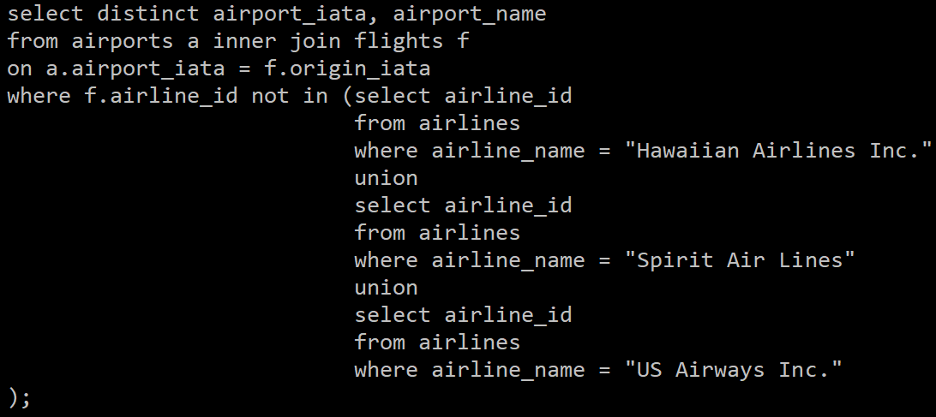
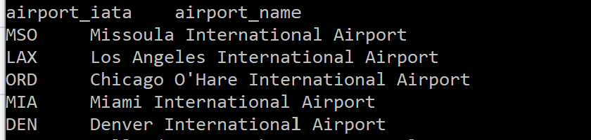
DATABASE DESIGN
Q6 ::: Find all airports that did not have departing flights from Hawaiian Airlines, Spirit Air Lines, or US Airways Inc.
Query 6

Slide 22
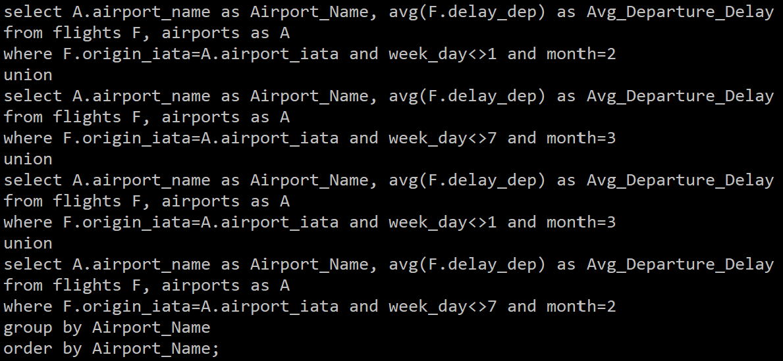
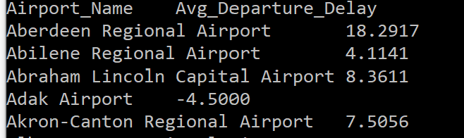
DATABASE DESIGN
Q7 ::: Find the average delay for departure in each airport from the months of February and March during week days
Query 7

Slide 23
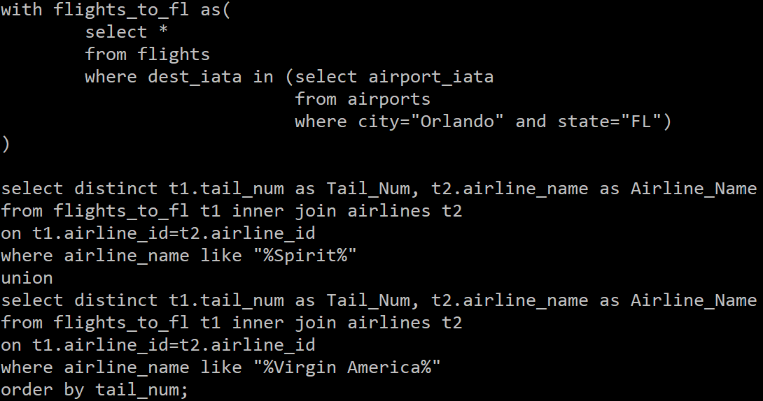
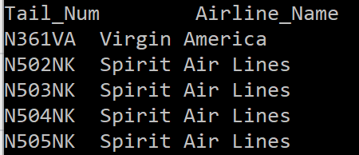
DATABASE DESIGN
Q8 ::: Find all planes that have flown for Virgin America or Spirit Air Lines, arrived in FL, Orlando, and order numerically by tail number
Query 8
Notes:
Utilizes intermediate SQL methods such as:
With clause
Subqueries
Set operations (such as a Union)

Slide 24
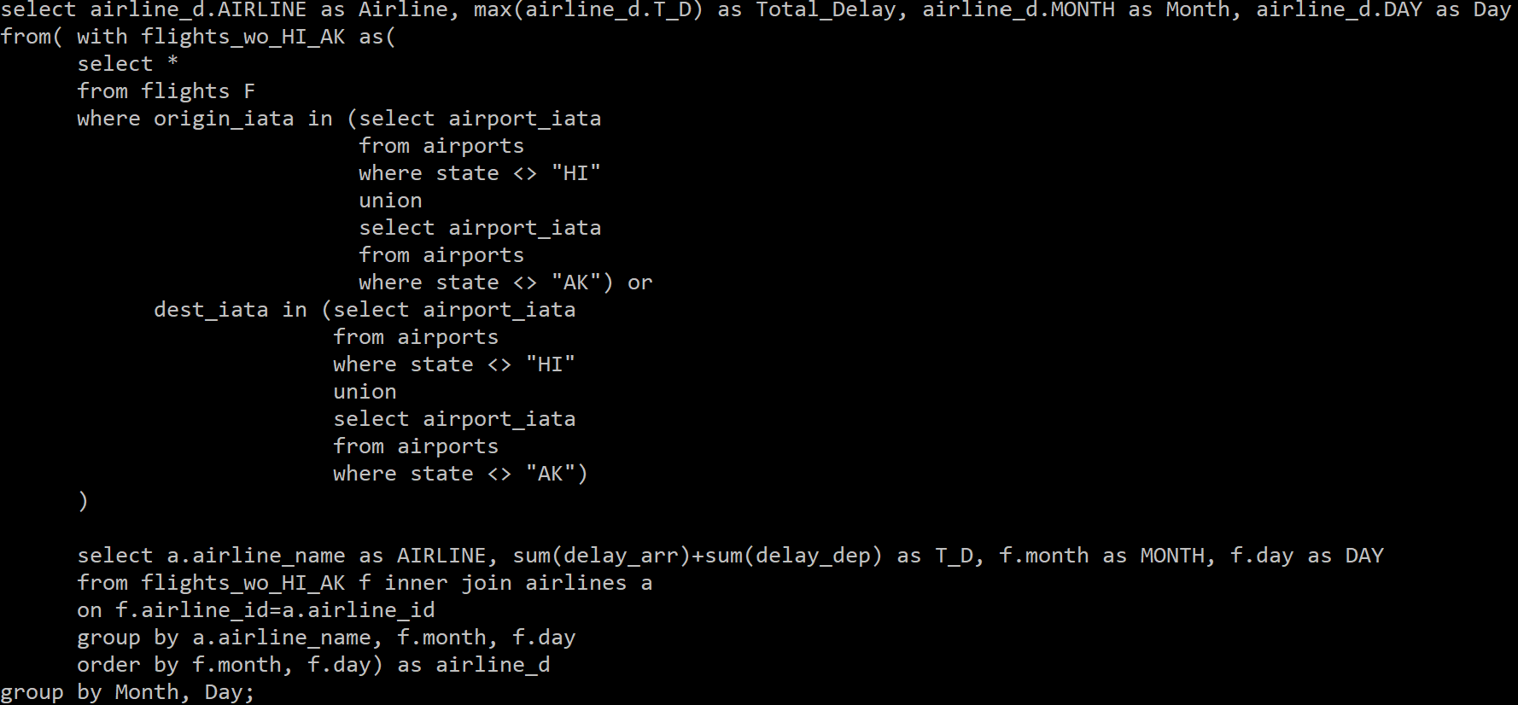
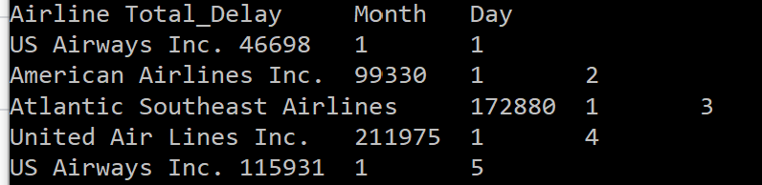
DATABASE DESIGN
Q9 ::: List the airline with the greatest TOTAL delay for each month and day and order by month, day excluding delays caused by flying to or from HI or AK
Query 9

Slide 25
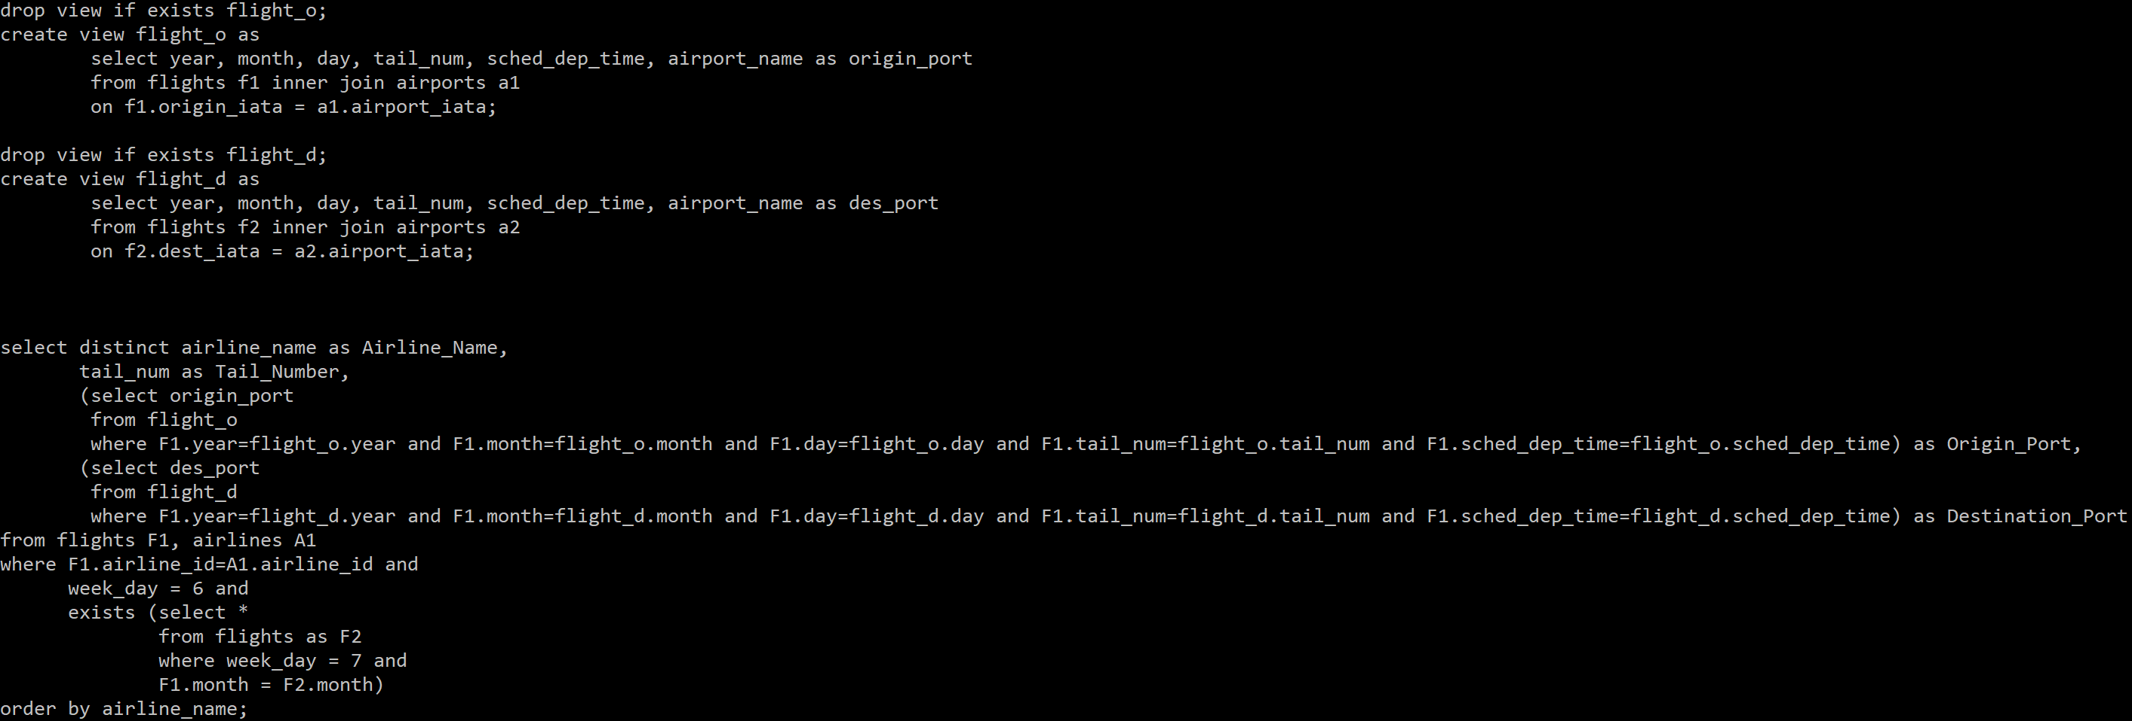
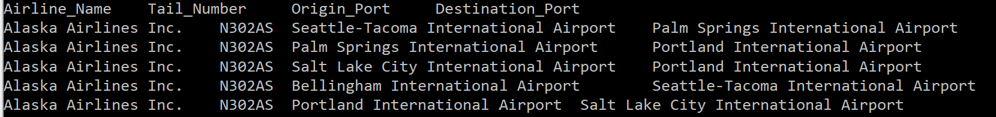
DATABASE DESIGN
Q10 ::: Find all planes that flew on both a Saturday and Sunday of the same month and the airport that it departed from and arrived at and order by airline
Query 10
Notes:
Utilizes advanced SQL methods such as:
Views
Subqueries
Set operations (such as a Union)

Slide 26
WHAT WE LEARNED!

