Slide 1
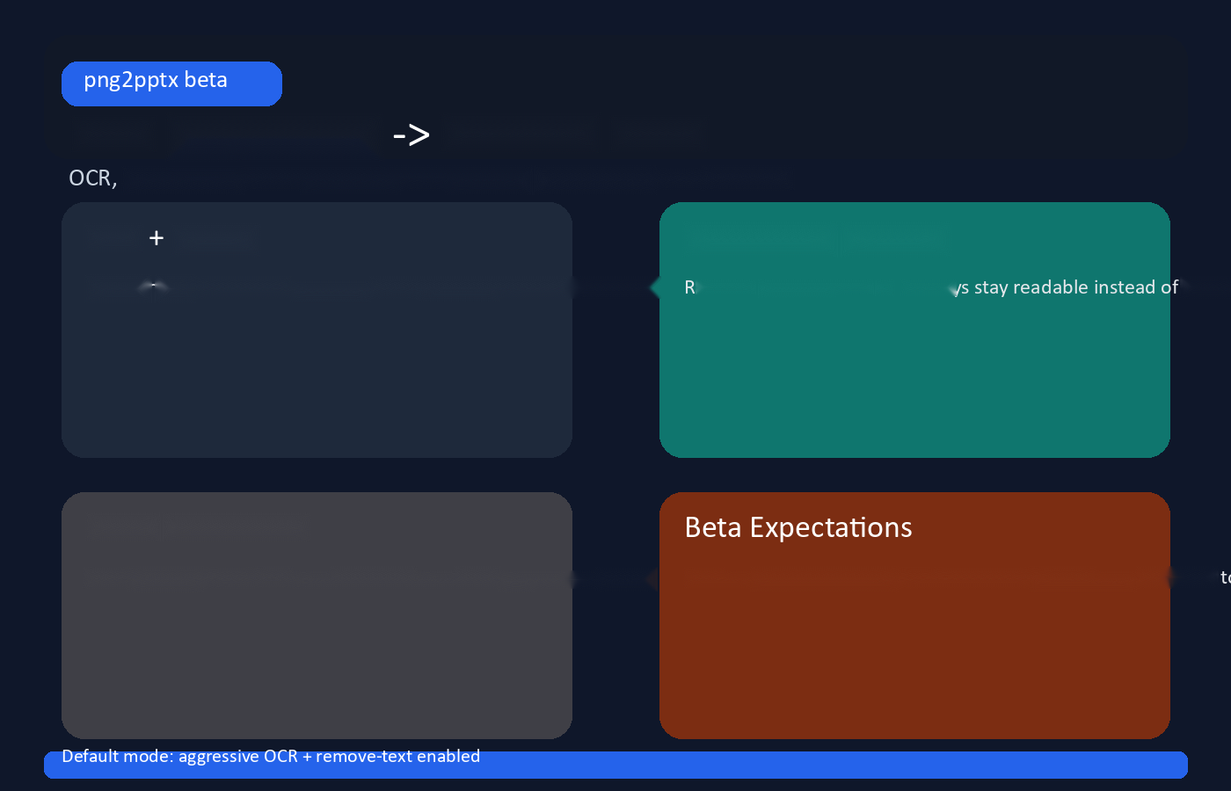
PNG infographic editable PPTX
positioning, color sampling, and optional background text removal.
OCR Layout
Background Cleanup
Recover text blocks and preserve their positions for editable slides.
Remove baked-in text so overlays
doub
Batch Conversion
Turn multiple PNGs into one deck with one slide per source image. Best on infographic-style art. Decorative layouts may still need

