Slide 1
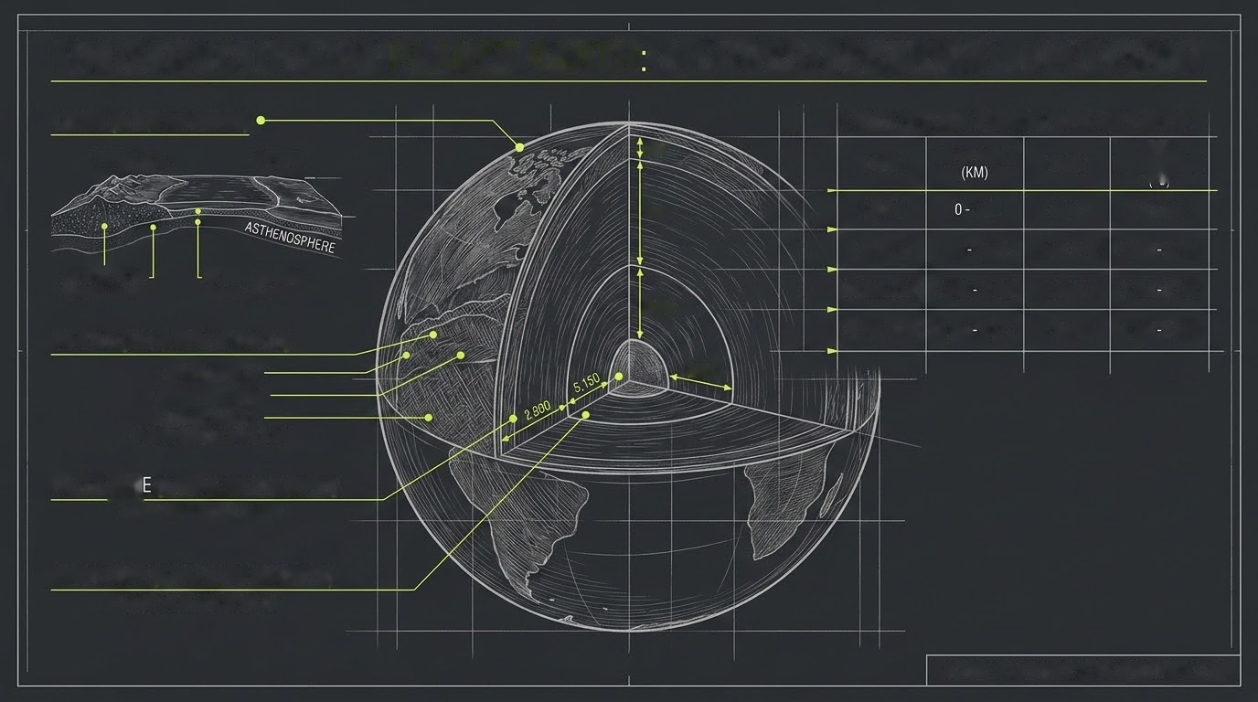
THE STRUCTURE OF PLANET EARTH: A CROSS-SECTIONAL BLUEPRINT
CRUST (0-100 KM DEPTH)
LAYER SPECIFICATIONS: TYPICAL RANGES
100
LAYER DEPTH RANGE STATE TEMPERATURE
CONTINENTAL OCEANIC
100
CRUST
100
Solid
0- 1,000
MANTLE 100 2,890 Plastic Solid 1,000 3,700
LITHOSPHERE ASTHENOSPHERE
OUTER CORE 2,890 5,150 Liquid
3,700 4,700
(Granite, Basalt)
(Granite, Basalt)
2,890
MANTLE (100-2,890 KM DEPTH)
INNER CORE 5,150 8,371
Solid
4,700 5,400
UPPER MANTLE
6,371
TRANSITION ZONE
LOWER MANTLE
SILICATE ROCK, PLASTIC SOLID
OUTER CORE (2,890-5,150 KM DEPTH)
LIQUID IRON-NICKEL ALLOY
INNER CORE (5,150-6,371 KM DEPTH)
SOLID IRON-NICKEL ALLOY
ETCHED BLUEPRINT: SPEC SHEET NO. E-001

