Slide 1
Recovery in the News
Class Activity
based
on
Gopher to the Rescue! A Volcano Recovery Story
by
Terry Catasús Jennings
Visual Aids for Teacher Materials
Presenter Notes included

Slide 2
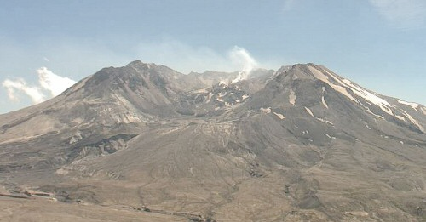
Mount St. Helens After Eruption
Notes:
This is the way Mount St. Helens was after the eruption
Gray, Crusty Ash.

Slide 3
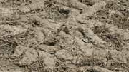
Gopher Tunnels

Slide 4
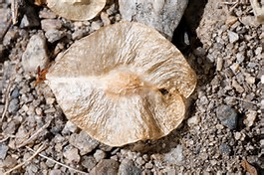
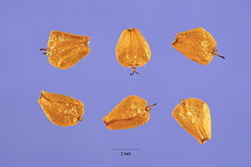
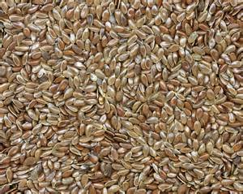
What Blew In On the Wind
Black Cottonwood Seed
Deciduous Tree
Red Alder Seed
Deciduous Tree
Grass and Shrub Seeds

Slide 5
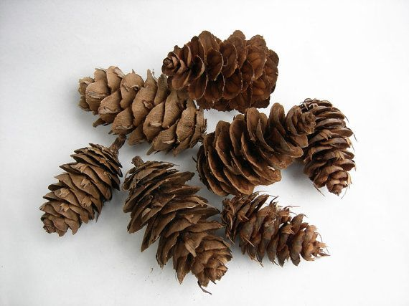
Conifer Seeds

Slide 6
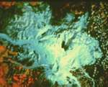
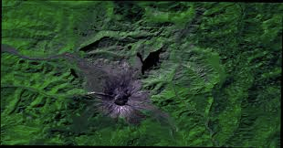
30 years later
May 1980
Notes:
We already saw these pictures of Mount St Helens after the eruption and thirty years later.
This is the opportunity to tell your students of the area that was crusted over with ash.
The damaged area was 24 square miles.
Discuss with your students about how squirrels and rabbits and other small mammals have small legs and can’t go into the damaged area. They have to wait until the vegetation creeps up the mountain as the vegetation recovers. And the conifers crawl up the mountain as well because their seeds fall at their feet. Need animals to disperse it here.

