Slide 1
Rapids GroupBy
Tonglin Chen
Tianming Cui
Christopher Patterson
Yadu Kiran

Slide 2
Design Overview

Slide 3
Data structure
Provided data set is in column major.
Matrix is flattened to 1D array for easy memory copying
Input: 1) Key matrix : A matrix with M rows and N columns; rows of this matrix are the “keys” of the reduce-by-key operation
2) Value matrix : A matrix with M rows and K columns
3) Operation array: An array of K reduction operations
Output: 1) Keys: P rows and N columns, where P is the number of unique keys from the input Keys matrix; Row “i” of the output Keys matrix corresponds to row “i” of the output Values matrix.
2) Values: P rows and K columns, where P is the number of unique keys from the input Keys matrix;Row “i” of the output Values matrix corresponds to row “i” of the output Keys matrix;

Slide 4
Data structure example
Sample key and value matrix
key/entry | 0 | 1 | 2
0 | 1 | 2 | 3
1 | 1 | 2 | 3
2 | 4 | 5 | 6
3 | 9 | 2 | 4
4 | 8 | 9 | 1
5 | 4 | 5 | 6
Value | Max | Count
0 | 1 | 2
1 | 3 | 4
2 | 5 | 9
3 | 7 | 3
4 | 1 | 1
5 | 8 | 9

Slide 5
Expected output on (max, count)
Output Key and Value Matrix
key/entry | 0 | 1 | 1
0 | 1 | 2 | 3
0 | 4 | 5 | 6
2 | 8 | 9 | 1
3 | 9 | 2 | 4
Value | Max | Count
0 | 3 | 2
0 | 8 | 2
2 | 1 | 1
3 | 7 | 1

Slide 6
Sort Implementation (Previous Work)

Slide 7

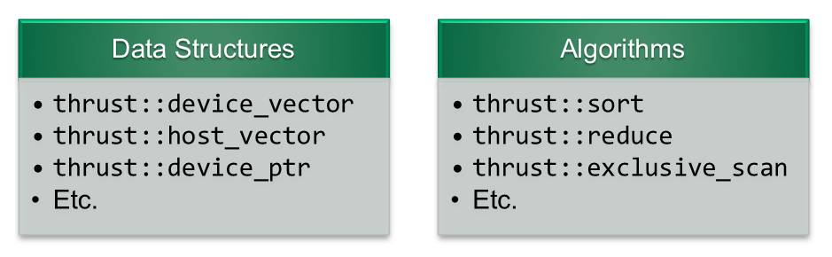
Thrust
Library providing parallel data structures and algorithms
Reduce, scan, copy, etc.
Customizable for different data representations
Reduce by key for sorted key input
Special reduction operations for add, min, max, etc.
Allows for quick implementation for our case of many value operations
Less control over more advanced CUDA features
Shared memory
Streams
etc.
Notes:
Thrust gives us STL like data structures for parallel algorithms
Provides many algorithms such as reductions, copy, scan
Much of these are customizable
Useful for our case with key matrix, multiple columns per key
Reductions can be done by keys if sorted
Reductions also allow for special operators like addition, min, max and division
Simple to use, respectable performance
We don’t have as good control over cuda features
Shared memory
Streams
But we can mix in our own kernels if needed

Slide 8
GroupBy
Process:
Sort keys
Give each key an identifier for easier compaction.
Sort column data based on step 1, perform reductions w/ ops
Reduce by key to get unique keys
Copy back original n columns for each unique key from step 4 into output key matrix
Copy back output value data from step 3
Input:
mxn matrix (keys)
Each row corresponding to a key
Unknown number of unique keys
mxk matrix (values)
Row corresponds to key
# Columns = # operations per key
k array (operations)
Output:
pxn matrix (keys)
Each row corresponding to a unique key
pxk matrix (values)
Output of operation values for each unique key
Notes:
We start with an mxn matrix of m keys. n values representing one key
We don't know how many unique keys there are in our dataset
We want to make this matrix compact to represent p unique keys
Process:
Sort the original keys
Hash these as it can be done quickly and makes reductions and other operations easier
Compact the hashed array to be just our unique hash keys
Use an index array of the original rows in that compaction
Use compacted index array to copy back unique key rows

Slide 9
GroupBy
Identify Keys
Original Rows
Index of Unique Keys
3
0
2
4
1
5
1
2
2
3
4
4
Sorted Keys
Original Rows
3
0
4
1
3
0
2
4
1
5
0 | 0 | 0
0 | 1 | 0
0 | 1 | 0
1 | 0 | 1
1 | 1 | 1
1 | 1 | 1
Identify bound kernel +
thrust inclusive_scan
unique_by_key
Original Values
Original Keys
Custom thrust sort
0 | 1 | 0
1 | 1 | 1
0 | 1 | 0
0 | 0 | 0
1 | 0 | 1
1 | 1 | 1
44
6
5
10
18
6
Column Values (one of k columns)
Result (one of k)
10
44
5
18
6
6
10
49
18
12
Reduce_by_key
with operation
(sum)
Notes:
First, we copy original key data to the device - in column major format
Perform a custom thrust::sort to compare with multiple key columns
Also save original row information
launch kernel to compare between neighbor values
At boundary, put 1 in a new array at boundary location
Inclusive scan on this array to give unique ids for each key
Performing unique by key gives us indice rows into original key matrix to copy back just unique keys to host
Copy sorted value data using original rows array
Reduce by key with ids and sorted value column to perform operations

Slide 10
Hash-based Implementation

Slide 11
Hash Table Structure
Consists of 2 list and 1 matrix:
KeyIdx (signed integer type): store the original key index or -1 (Non-Written State)
Count: Store the number of entries appeared for the corresponding key (useful for calculating mean)
Results: The result hash table, an array with length of num_ops * hash_table_size (Column Major)
KeyIdx | Count | Mean | Max
1 | 8 | 20 | 60
-1 | 0 | 0 | lowest_value_of_type
7 | 3 | 21 | 34
4 | 4 | 30 | 20
-1 | 0 | 0 | lowest_value_of_type

Slide 12
Inserting to the Hash Table
First we initialize the hash table to all KeyIdx=-1, min to the highest possible value of type, max to the lowest possible value, and others to 0.
Then each thread is responsible for one data entry (in each iteration with grid stride loop). Each thread calculate the position with Hashed key, and try to insert to hash table using atomic operations. If the thread inserts to an empty entry, or if the position is having the same key, update the entry. Otherwise go to the next location.
KeyIdx | Count | Mean | Max
1 | 8 | 20 | 60
-1 | 0 | 0 | lowest_value_of_type
7 | 3 | 21 | 34
4 | 4 | 30 | 20
-1 | 0 | 0 | lowest_value_of_type

Slide 13
Hash Function Issues
We need a hash function which can generate a hash code from a set of particular keys.
There are different available hash functions, but the following one will be best(or at least one of the best):
HashCode = 1st bit of the key * 31^1 + 2nd bit of the key * 31^2 + … + Nth bit of the key *31^N
Which can be implemented with high efficiency as:
//hash_key = ((hash_key<<5)-1) + key_columns[i*num_key_rows+idx];

Slide 14
Relaunching The Hash Kernel
Sometimes the hash table is not large enough for the first run, since we don’t know how many unique keys we have in the input data. So it will be a good idea to make the kernel be able to relaunch the kernel with a larger hash table.
Setting a flag in the unify memory.
Launch kernel in the kernel.

Slide 15
Deciding The Length of Hash Table
Relaunching the kernel can lead to a significant overhead.
We developed a strategy based on the assumption that each different key is UNIFORMLY distributed in the data. Consider that we have N different keys, and we do K experiments and observe X different keys in those experiments. X is in a discrete state space {0, 1, ..., N} and in each individual experiment the transition of X follows this Markov Chain:
1
(N-1)/N
(N-2)/N
(N-3)/N
0
1
2
3
...
1/N
2/N
3/N
Notes:
Relaunching the kernel can lead to a significant overhead. So we need to make sure it only happens at very few conditions, and make sure we relaunch the kernel as few times as possible. So we need to have a good sampling strategy.

Slide 16
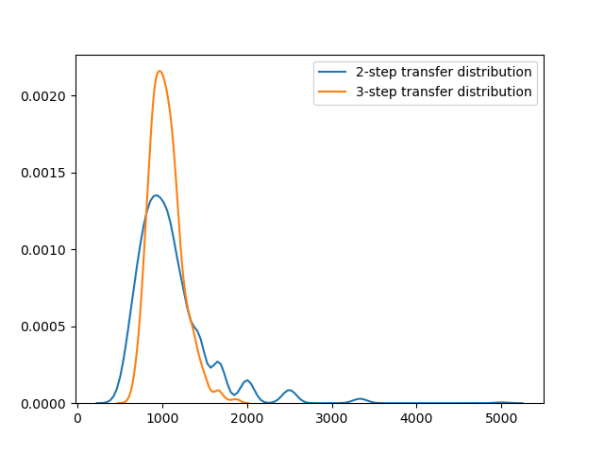
Deciding The Length of Hash Table
For 2 experiments, the probability of observing x key is P(x=1) = 1/N, P(x=2) = (N-1)/N
For 3 experiments, the probability is P(x=1) = 1/(N^2), P(x=2)=3(N-1)/(N^2), P(x=3)=(N-1)(N-2)/(N^2).
For CPU sampling, the strategy is continuously doing 2 experiments and stop until 10 x=1 appears or reaching 1% of total data entries.
For GPU sampling, we have 10 blocks of 1024 threads and does 1% of total data entry times of 3 experiments and use P(x=2) to estimate the N using cuRAND.

Slide 17
Copying Data Back to Host
Thrust copy_if function used to identify indices of each hash table row used
Depending on unique keys and input size, final hash table may be sparse.
This array of hash table indices used to resolve where each unique key resides in the original input key matrix.
Unique key rows are copied to the output key matrix
Hash table indices are also used to copy back results from hash table operations.
rmean is calculated at this point using the sum stored in the hash table and count of values for each unique key calculated during hashing
This operation output is copied back to host into the output value matrix

Slide 18
Verification

Slide 19
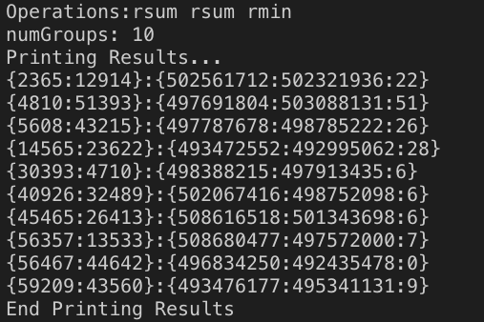
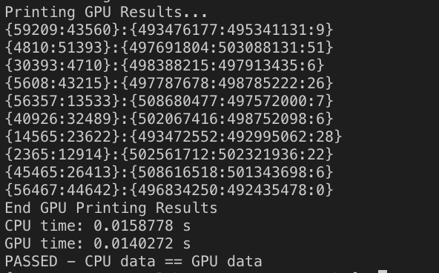
Verification
CPU Data
GPU Data
Notes:
During each execution(For each pair of the keys), we compare the results of the CPU implementation with the GPU implementation and see if they match.

Slide 20
Performance

Slide 21
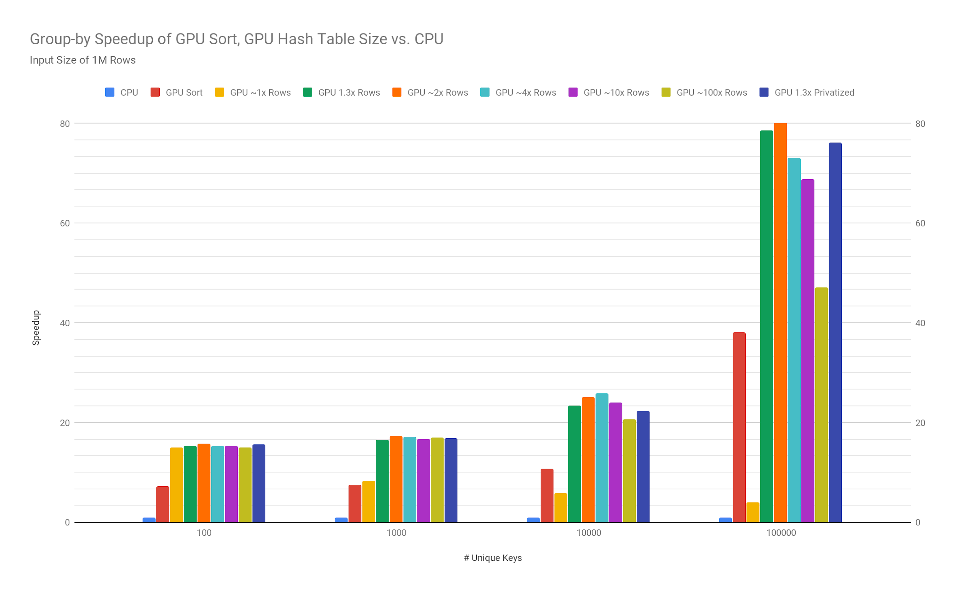
Notes:
When the number of unique keys is large, the speedup is significant.

Slide 22
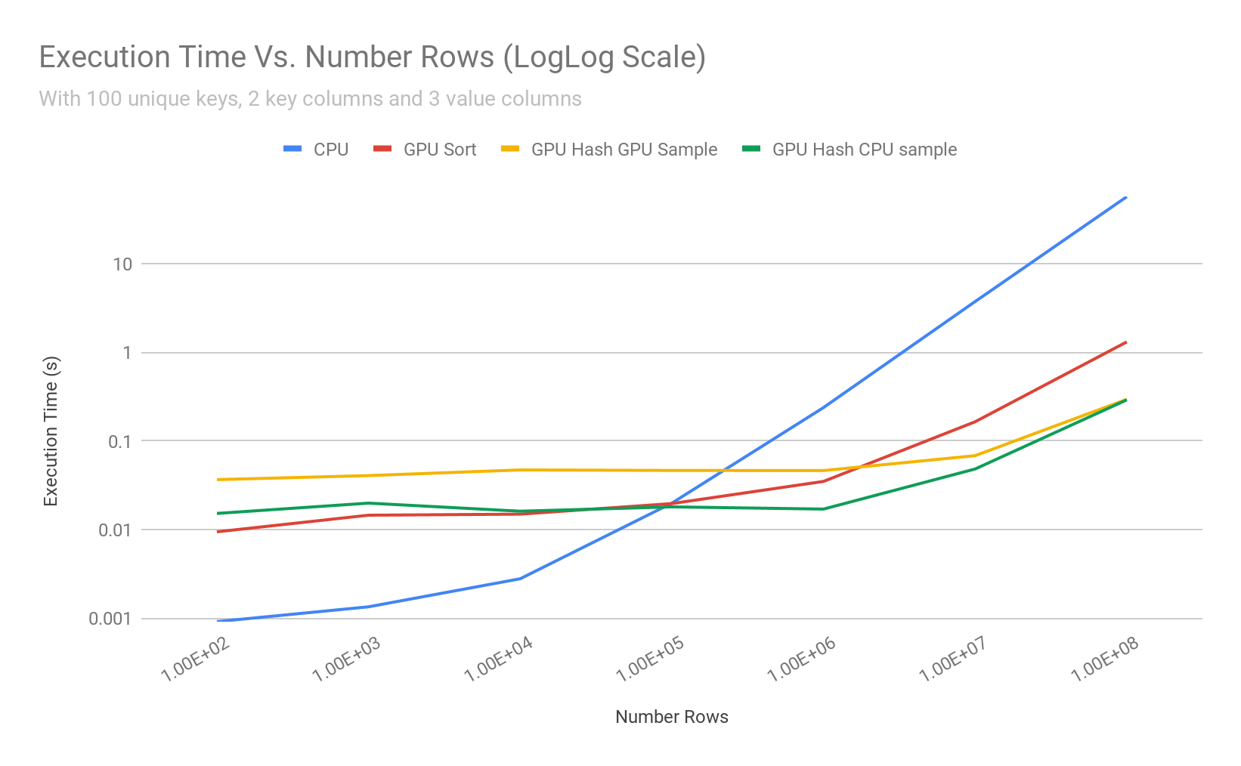
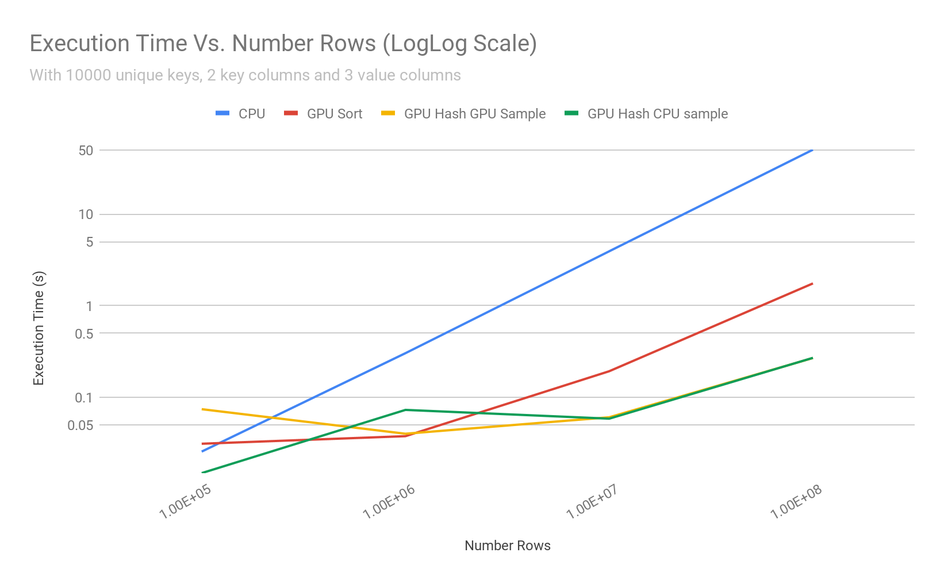

Slide 23
Privatization: Why it didn’t work?
Like what we observed in the previous MP implementation, doing privatization here does not provide a significant speedup.
Modern GPUs usually have some cache designed to store the temporary data. With a large input dataset, the kernel has a high chance of finding the corresponding data from the cache instead of accessing the global memory.
If the number of unique keys is large, block hash table (~1000 length) will be filled up quickly and threads will have to do a lot of global operations. If the number of unique keys is small, it is likely that the hash table is already in L2 cache so there is no significant improvement.

Slide 24
Profiling Result (100M elements, 10k unique keys) on Tesla P100, GPU Sampling
Total GPU kernel execution time is about 0.3 s
161.95 ms is spent on CUDA memory copying from Host to Device.
42.195 ms is spent on actual filling the hash table.
15.027 ms is spent on predicting the size of hash table. Predicted result is 23788. No relaunch happens.
Notes:
Most of the time is spent on copying memory, the calculation part is rather fast.

Slide 25
Observed results
The execution time of our group-by implementation on random simulated matrix
-- Hashed based GPU version runs much faster and more consistent than previous implementation
-- We see over double the speedup when compared to the Sort based implementation
Setting hash table size to ~1.3-4x size of input matrix vital for performance. 1.3x is good value when keeping memory and performance in mind.
For # of unique keys less than 1/1000 of data entries, usually no relaunch is happening.
Adding more execution cores on Tesla GPU won’t improve the results, probably memory bandwidth is the bottleneck.
Notes:
#ifndef TESLA
constexpr unsigned int GRIDDIM = 40;
#else
constexpr unsigned int GRIDDIM = 112;
#endif
constexpr unsigned int BLOCKDIM = 1024;

Slide 26
Heterogeneous Computing
While the GPU performs all the tasks, the CPU is sitting completely idle.
Task Partitioning is not viable since all the tasks need to be sequential in order.
Data Partitioning is a possibility. But many of the tasks are data dependent and require communication/synchronization.
Most likely candidate for data partitioning is the “Operations” phase since operation on each row can be done independent of the others

Slide 27
Heterogeneous Computing - Obstacles
Thrust functions are synchronous in nature. So we need to spawn a different CPU thread to handle data partitioning.
Child thread cannot use the same thrust functions due to memory access privileges. The thread needs to be the original parent thread that carried out all the previous tasks. This causes synchronization issues.
Many parts of the code need to be rewritten.
Data partitioning the “Operations” task involves partitioning the output matrices by the rows. However, the data is organized in column major.
Therefore, we would have to transpose the matrix before performing the “Operations” task. We suspect this would eliminate any potential benefit we may see from heterogeneous computing.

Slide 28
Conclusions

Slide 29
Take Home Message
When matrix size is small---- C++ STL (Standard Template Library) is faster than the GPU implementation
When matrix contains many unique keys (>10% input size)-- GPU code over 70x faster! (about double performance from before!)
Thrust may be good but the overhead and other considerations allow us to improve with more specialized techniques
Further works may investigate the effect of other memory alignment strategies.

