Slide 1
Added Functionality Using Design Patterns
Christopher Ramirez, Justin Lee, Jene Rene, Precious Iheanacho

Slide 2
Discount Functionality
Preparation:
Update Database to include a discount table with attributes:
discountName: the name of the discount: VARCHAR(30)
discountCode: unique code used at checkout to apply discount to cart: VARCHAR(8)
active: status of the discount: BOOLEAN
fraction: percentage of product price being discounted from product. Value range is (0,1], 1 being the full price of the product for BOGO type discounts. : DOUBLE
Update product table to include an additional attribute `discount`.
Add a foreign key constraint to linking the discount table to the products table through the discount code.
Create classes:
DiscountBean class
DiscountService class
DiscountServiceImpl class
Concrete Discount classes

Slide 3
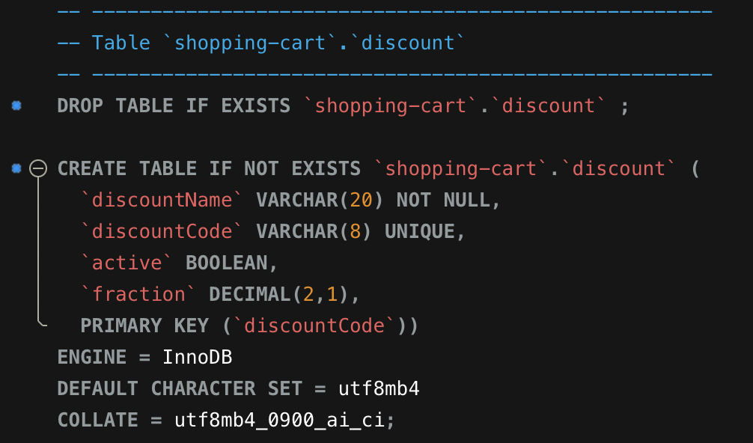
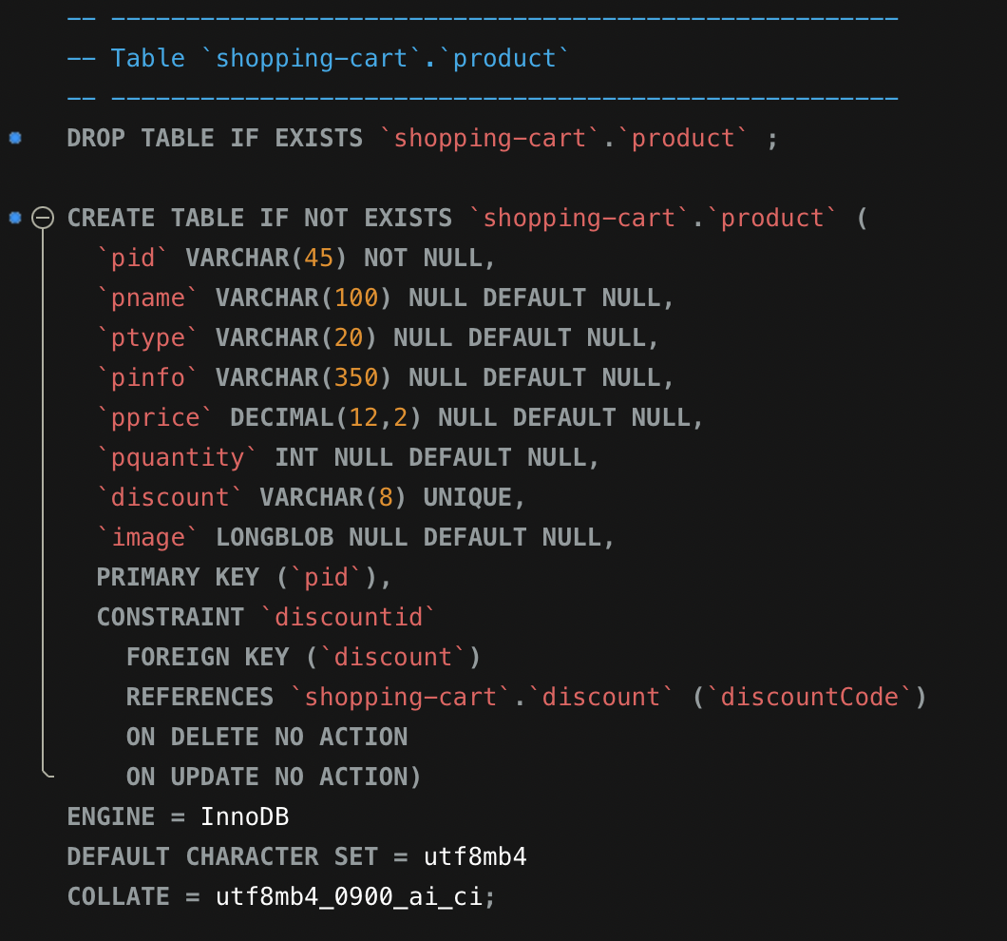
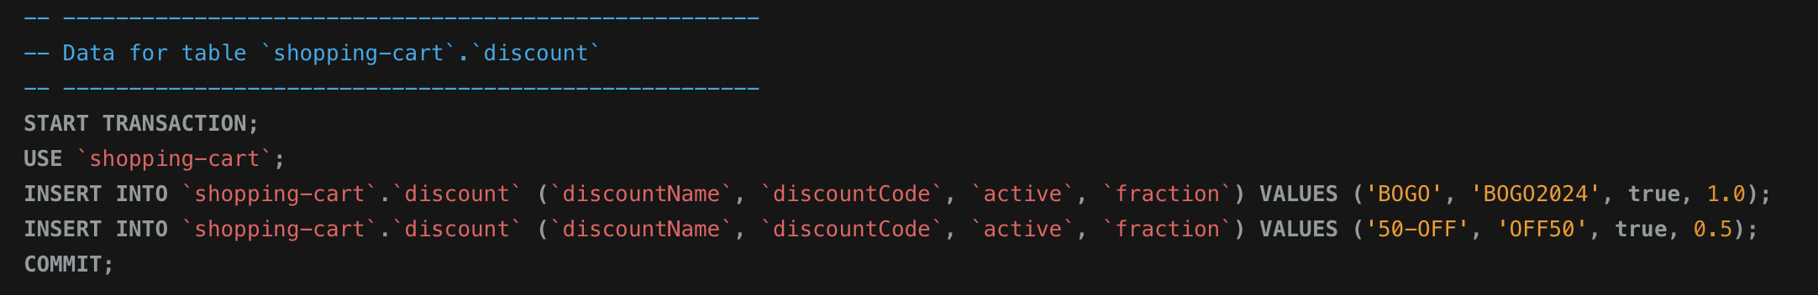
Database Adjustments

Slide 4
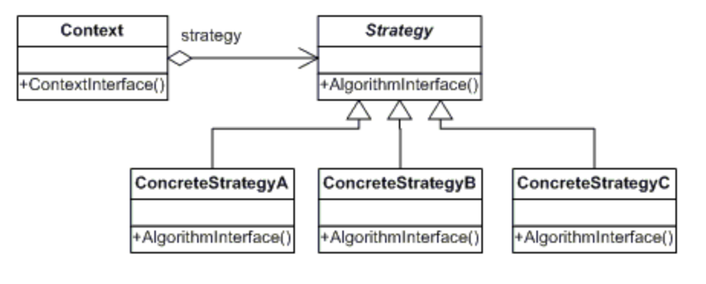
Strategy Pattern
DIscountService
DiscountServiceImp
+applyDiscount()
+applyDiscount()
DIscountBOGO
DiscountPercentage
DiscountShipping
+applyDiscount()
+applyDiscount()
+applyDiscount()

Slide 5
SOLID
Our approach maintains SOLID principles in the following ways:
Single Responsibility Principle – The discount classes have one single responsibility; apply a discount to the cart.
Open/Closed Principle – Our approach is dynamic and expansive. New discounts can be added as concrete classes stemming from the DiscountServiceImp Interface.
Liskov Substitution – each concrete class has a method for applying the appropriate discount to the cart. Therefore, each concrete class can substitute the base class DiscountServiceImp.
Interface Segregation Principle – our DiscountServiceImp Interface has one single responsibility.
Dependency Inversion Principle – classes are depending on abstraction instead of concretion.

