Slide 1


Concurrency

Slide 2
What is Concurrency?
Notes:
One Example for Explaining what is Concurrency.
suppose you have a list of items and you have to search for a specific item

Slide 3
What is Concurrency?
Concept of executing multiple tasks simultanenously by utilizing all available resources more effectively
Notes:
One Example for Explaining what is Concurrency.
suppose you have a list of items and you have to search for a specific item

Slide 4
Concurrent v/s Sequential

Slide 5
Concurrent v/s Sequential
BEGIN

Slide 6
Concurrent v/s Sequential
BEGIN
Statement
Statement
Statement

Slide 7
Concurrent v/s Sequential
BEGIN
Statement
Statement
Statement
END

Slide 8
Concurrent v/s Sequential
BEGIN
BEGIN
Statement
Statement
Statement
END

Slide 9
Concurrent v/s Sequential
BEGIN
BEGIN
Statement
Statement
Statement
Statement
Statement
Statement
END
END

Slide 10
Time Difference

Slide 11
Time Difference
2 Go Program which fetches the weather of provided cities through JSON response from API, one sequential and other concurrent can be useful for noticing the Time Difference.

Slide 12
Time Difference
2 Go Program which fetches the weather of provided cities through JSON response from API, one sequential and other concurrent can be useful for noticing the Time Difference.
Weather for Surat is 299.14 K
Weather for Kolkata is 300.12 K
Weather for Kharagpur is 300.16 K
Weather for Mumbai is 301.14 K
Execution time: 473.975608ms
Weather for Surat: 299.14 K
Weather for Kolkata: 300.12 K
Weather for Kharagpur: 300.16 K
Weather for Mumbai: 301.14 K
Execution time: 316.347076ms
Sequential
Concurrent

Slide 13
Benefits of Concurrency
Notes:
It enable to run multiple applications at the same time.
It enables that the resources that are unused by one application can be used for other applications.
Without concurrency, each application has to be run to completion before the next one can be run.
It enables the better performance by the operating system. When one application uses only the processor and another application uses only the disk drive then the time to run both applications concurrently to completion will be shorter than the time to run each application consecutively.

Slide 14
Benefits of Concurrency
Running of multiple applications
Notes:
It enable to run multiple applications at the same time.
It enables that the resources that are unused by one application can be used for other applications.
Without concurrency, each application has to be run to completion before the next one can be run.
It enables the better performance by the operating system. When one application uses only the processor and another application uses only the disk drive then the time to run both applications concurrently to completion will be shorter than the time to run each application consecutively.

Slide 15
Benefits of Concurrency
Running of multiple applications
Better resource utilization
Notes:
It enable to run multiple applications at the same time.
It enables that the resources that are unused by one application can be used for other applications.
Without concurrency, each application has to be run to completion before the next one can be run.
It enables the better performance by the operating system. When one application uses only the processor and another application uses only the disk drive then the time to run both applications concurrently to completion will be shorter than the time to run each application consecutively.

Slide 16
Benefits of Concurrency
Running of multiple applications
Better resource utilization
Better average response time
Notes:
It enable to run multiple applications at the same time.
It enables that the resources that are unused by one application can be used for other applications.
Without concurrency, each application has to be run to completion before the next one can be run.
It enables the better performance by the operating system. When one application uses only the processor and another application uses only the disk drive then the time to run both applications concurrently to completion will be shorter than the time to run each application consecutively.

Slide 17
Benefits of Concurrency
Running of multiple applications
Better resource utilization
Better average response time
Better performance
Notes:
It enable to run multiple applications at the same time.
It enables that the resources that are unused by one application can be used for other applications.
Without concurrency, each application has to be run to completion before the next one can be run.
It enables the better performance by the operating system. When one application uses only the processor and another application uses only the disk drive then the time to run both applications concurrently to completion will be shorter than the time to run each application consecutively.

Slide 18
Concurrent Programming is done in Go
Through :

Slide 19
Concurrent Programming is done in Go
Through :
Goroutines

Slide 20
Concurrent Programming is done in Go
Through :
Goroutines
Channels

Slide 21
Concurrent Programming is done in Go
Through :
Goroutines
Channels
Waitgroups

Slide 22
Concurrent Programming is done in Go
Through :
Goroutines
Channels
Waitgroups
Mutexes

Slide 23
Goroutines

Slide 24
Goroutines
A Goroutine is a Function or method which executes independently and simultaneously in connection with any other Goroutines present in your program.
Main Function itself is a Goroutine.
Goroutines can communicate using the channels.

Slide 25
Goroutines
A Goroutine is a Function or method which executes independently and simultaneously in connection with any other Goroutines present in your program.
Main Function itself is a Goroutine.
Goroutines can communicate using the channels.
What are Channels? We will see it Later!

Slide 26
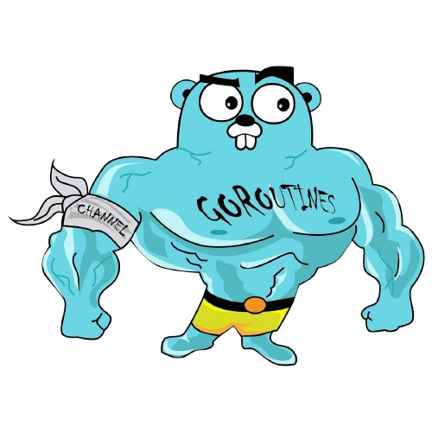
Declaration of Goroutine

Slide 27
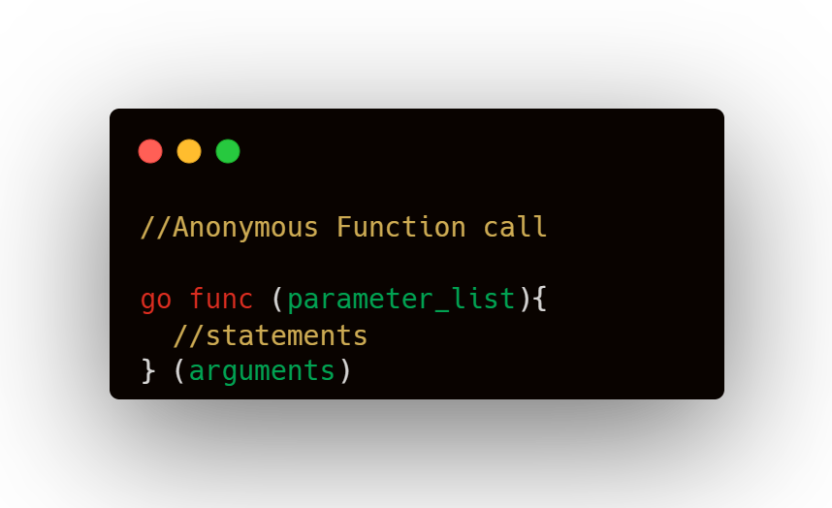
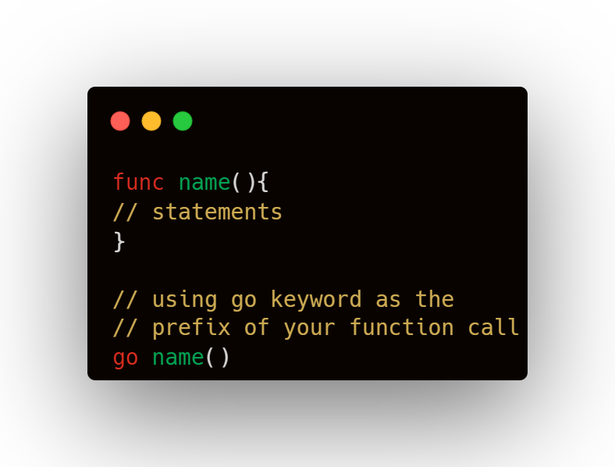
Declaration of Goroutine

Slide 28
Channels

Slide 29
Channels
A channel is a medium through which a goroutine communicates with another goroutine.

Slide 30
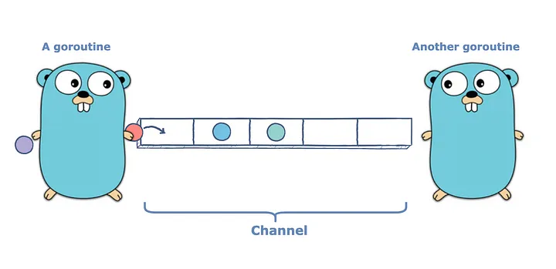
Channels
A channel is a medium through which a goroutine communicates with another goroutine.

Slide 31
Working with Channels

Slide 32
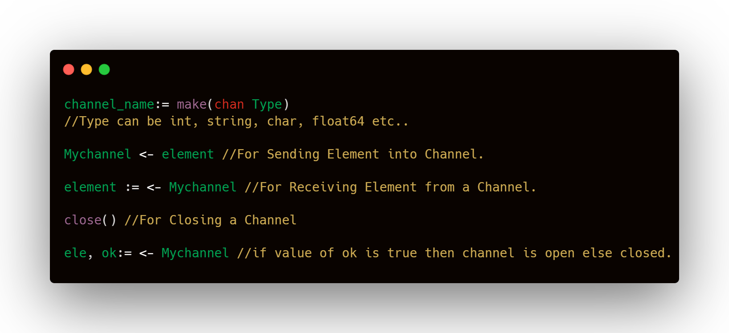
Working with Channels

Slide 33
Waitgroup

Slide 34
Waitgroup
A WaitGroup is a Go struct used to wait for a collection of goroutines to finish.

Slide 35
Waitgroup
A WaitGroup is a Go struct used to wait for a collection of goroutines to finish.
# Why we need Waitgroup??

Slide 36
Waitgroup
A WaitGroup is a Go struct used to wait for a collection of goroutines to finish.
# Why we need Waitgroup??
Let’s See Through a Live Example!

Slide 37
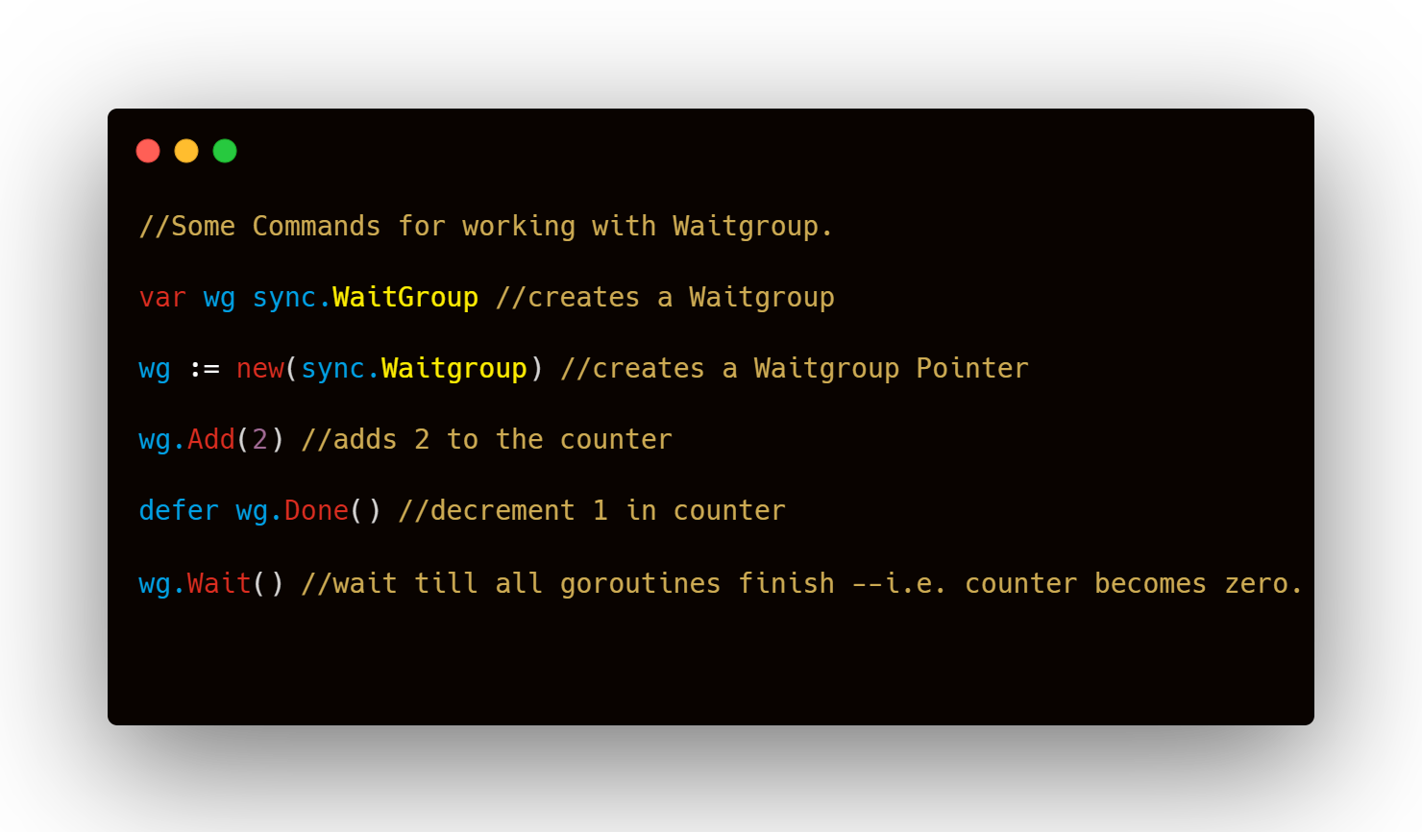

Slide 38
Mutex {Mutual Exclusion}

Slide 39
Mutex {Mutual Exclusion}
A Mutex is a method used as a locking mechanism to ensure that only one Goroutine is accessing the critical section of code at any point of time

Slide 40
Mutex {Mutual Exclusion}
A Mutex is a method used as a locking mechanism to ensure that only one Goroutine is accessing the critical section of code at any point of time
# Why we need Mutex??

Slide 41
Mutex {Mutual Exclusion}
A Mutex is a method used as a locking mechanism to ensure that only one Goroutine is accessing the critical section of code at any point of time
# Why we need Mutex??
Let’s See Through a Live Example Again!

Slide 42
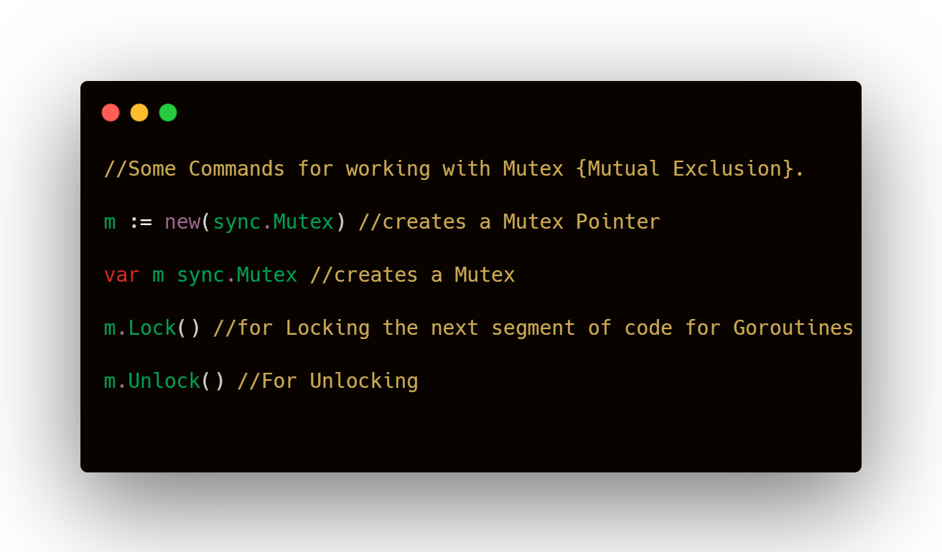

Slide 43
How it is Different from Python?

Slide 44
How it is Different from Python?
Python uses Global interpreter Lock (GIL). it’s a mutex (or a lock) that allows only one thread to hold the control of the Python interpreter.
This means that only one thread can be in a state of execution at any point in time.
Go’s goroutines provide a lightweight and efficient concurrency model.

Slide 45
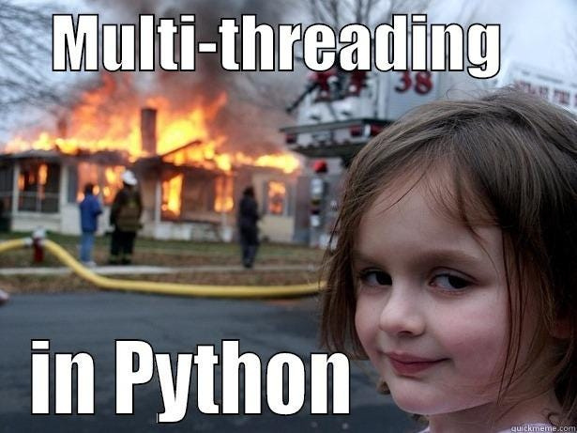
How it is Different from Python?
Python uses Global interpreter Lock (GIL). it’s a mutex (or a lock) that allows only one thread to hold the control of the Python interpreter.
This means that only one thread can be in a state of execution at any point in time.
Go’s goroutines provide a lightweight and efficient concurrency model.

Slide 46
How it is Different from Python?

Slide 47
How it is Different from Python?
Provided Go is way much Faster in terms of Concurrency and nowadays Modern Software Development mainly depends on Using Maximum Resources, Go Language has much Higher Advantage in terms of Concurrency.

Slide 48
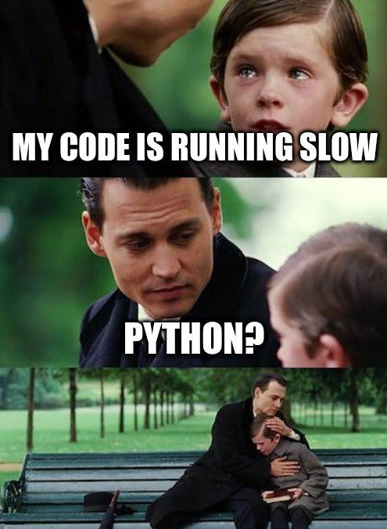

How it is Different from Python?
Provided Go is way much Faster in terms of Concurrency and nowadays Modern Software Development mainly depends on Using Maximum Resources, Go Language has much Higher Advantage in terms of Concurrency.

Slide 49
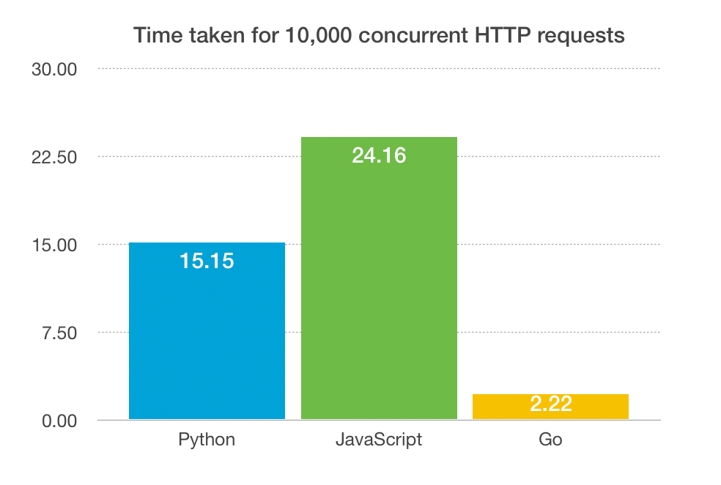
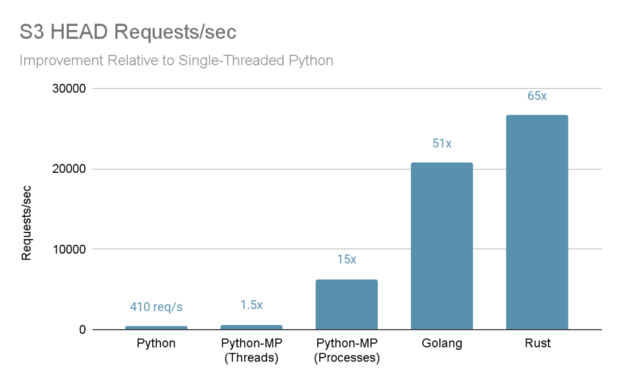
Concurrency Time & Resources Comparison
Source: https://www.badendelamore.com/how-fast-can-you-go/
Source: https://blog.purestorage.com/purely-technical/

Slide 50
References
https://go.dev/tour/concurrency/1/
https://youtu.be/B9uR2gLM80E?si=COUXtUoy5HMImIPC
https://medium.com/dev-bits/a-cup-of-gos-concurrent-programming-for-python-developers-a80e621c45ff
https://youtu.be/LvgVSSpwND8?si=DGyKamBDOo89DxYp
https://www.geeksforgeeks.org/using-waitgroup-in-golang/
https://www.geeksforgeeks.org/what-is-the-python-global-interpreter-lock-gil/
https://www.geeksforgeeks.org/channel-in-golang/

Slide 51

Q/A Session

Slide 52

Thank You !

