Slide 1
Ancestry-informed analysis of germline genomic contributors
to childhood B-ALL clinical outcomes
Christina Magyar · GS4 Thesis Committee Update · Aims 1–3
August 2026 · BCM MSTP · Genetics and Genomics
Advisors
Philip J. Lupo, PhD (Thesis advisor)
Elizabeth Atkinson, PhD (Local advisor)
Notes:
Two-part update today: (1) LAI accuracy benchmarking pilot using an expanded Mexican Biobank reference panel; (2) status of the 8-module Nextflow preprocessing pipeline. Numbers shown are the chr20-22 pilot; full 22-chr sweep is running and will refresh these before the meeting.

Slide 2
Three aims — this update focuses on Aim 2.
Aim 1
Aim 2
Aim 3
Demographic & clinical
predictors of B-ALL outcomes
Building the preprocessing
+ LAI pipeline
Genetic association study
of B-ALL outcomes
REDIAL cohort · MRD-stratified survival · manuscript to Leukemia
Nextflow · MXB reference · LAI accuracy benchmarking · manuscript-ready
Trans-ancestry GWAS · Tractor local-ancestry-informed · PolyFun-SuSiE fine-mapping
Submitted / under revision
Focus of today's update
Next 6-12 months
Aim 2 is the technical bridge — the LAI accuracy work picks the reference panel that Aim 3's local-ancestry GWAS will use.
Christina Magyar · Thesis committee, Aug 2026 · Aims overview
2 / 12
Notes:
The three-aim structure hasn't changed since the Spring TAC. Aim 1 is the REDIAL demographic+clinical outcomes paper (Onwuka/Magyar co-first, under revision for Leukemia). Aim 2 is what this update focuses on — the Nextflow preprocessing pipeline plus the LAI accuracy benchmarking that decides which Amerindigenous reference panel to lock in. Aim 3 is the downstream GWAS: trans-ancestry SAIGE for the shared variants, Tractor for local-ancestry-informed effect estimation in the admixed REDIAL/COG cohorts, PolyFun-SuSiE for fine-mapping. Aim 2 numbers coming today directly feed Aim 3's panel choice.

Slide 3
Aim 1: MRD-negative Latino & NL-Black children still relapse more than NL-White.
REDIAL cohort · Cox PH adjusted for age, sex, WBC, cytogenetics, CNS, trial
MRD-negative B-ALL cases
MRD-positive B-ALL cases
• Latino: HR ~1.4 for disease-free survival vs NL-White
• NL-Black: HR ~1.6 for disease-free survival vs NL-White
• Latino: HR consistent with prior COG reports
• NL-Black: HR consistent with prior COG reports
Despite the same favorable MRD status, disparity persists.
Confirms known MRD-positive disparity in a contemporary cohort.
Onwuka & Magyar et al. — REDIAL Ethnic and Racial Survival Disparities by MRD Status — under revision for Leukemia (submission May 2026)
Christina Magyar · Thesis committee, Aug 2026 · Aim 1 · REDIAL
3 / 12
Notes:
Aim 1 recap. REDIAL analysis found that even among MRD-negative children — historically the low-risk group — self-identified Latino and non-Latino Black kids show elevated disease-free-survival hazard vs non-Latino White. This is important because MRD-negativity is widely used as a de-escalation threshold in ALL trials, and if the same MRD-negative status carries different underlying relapse risk by race/ethnicity, we may be systematically under-treating minority kids. Motivates Aim 2/3: find the biological substrate. Manuscript is under revision — HR values shown here are placeholders until the manuscript numbers are locked; ask me for the current table.
STATUS: reviewed and updated primary analysis; first draft of manuscript with figures/tables/supplemental complete; co-author review; target submission May 2026.

Slide 4
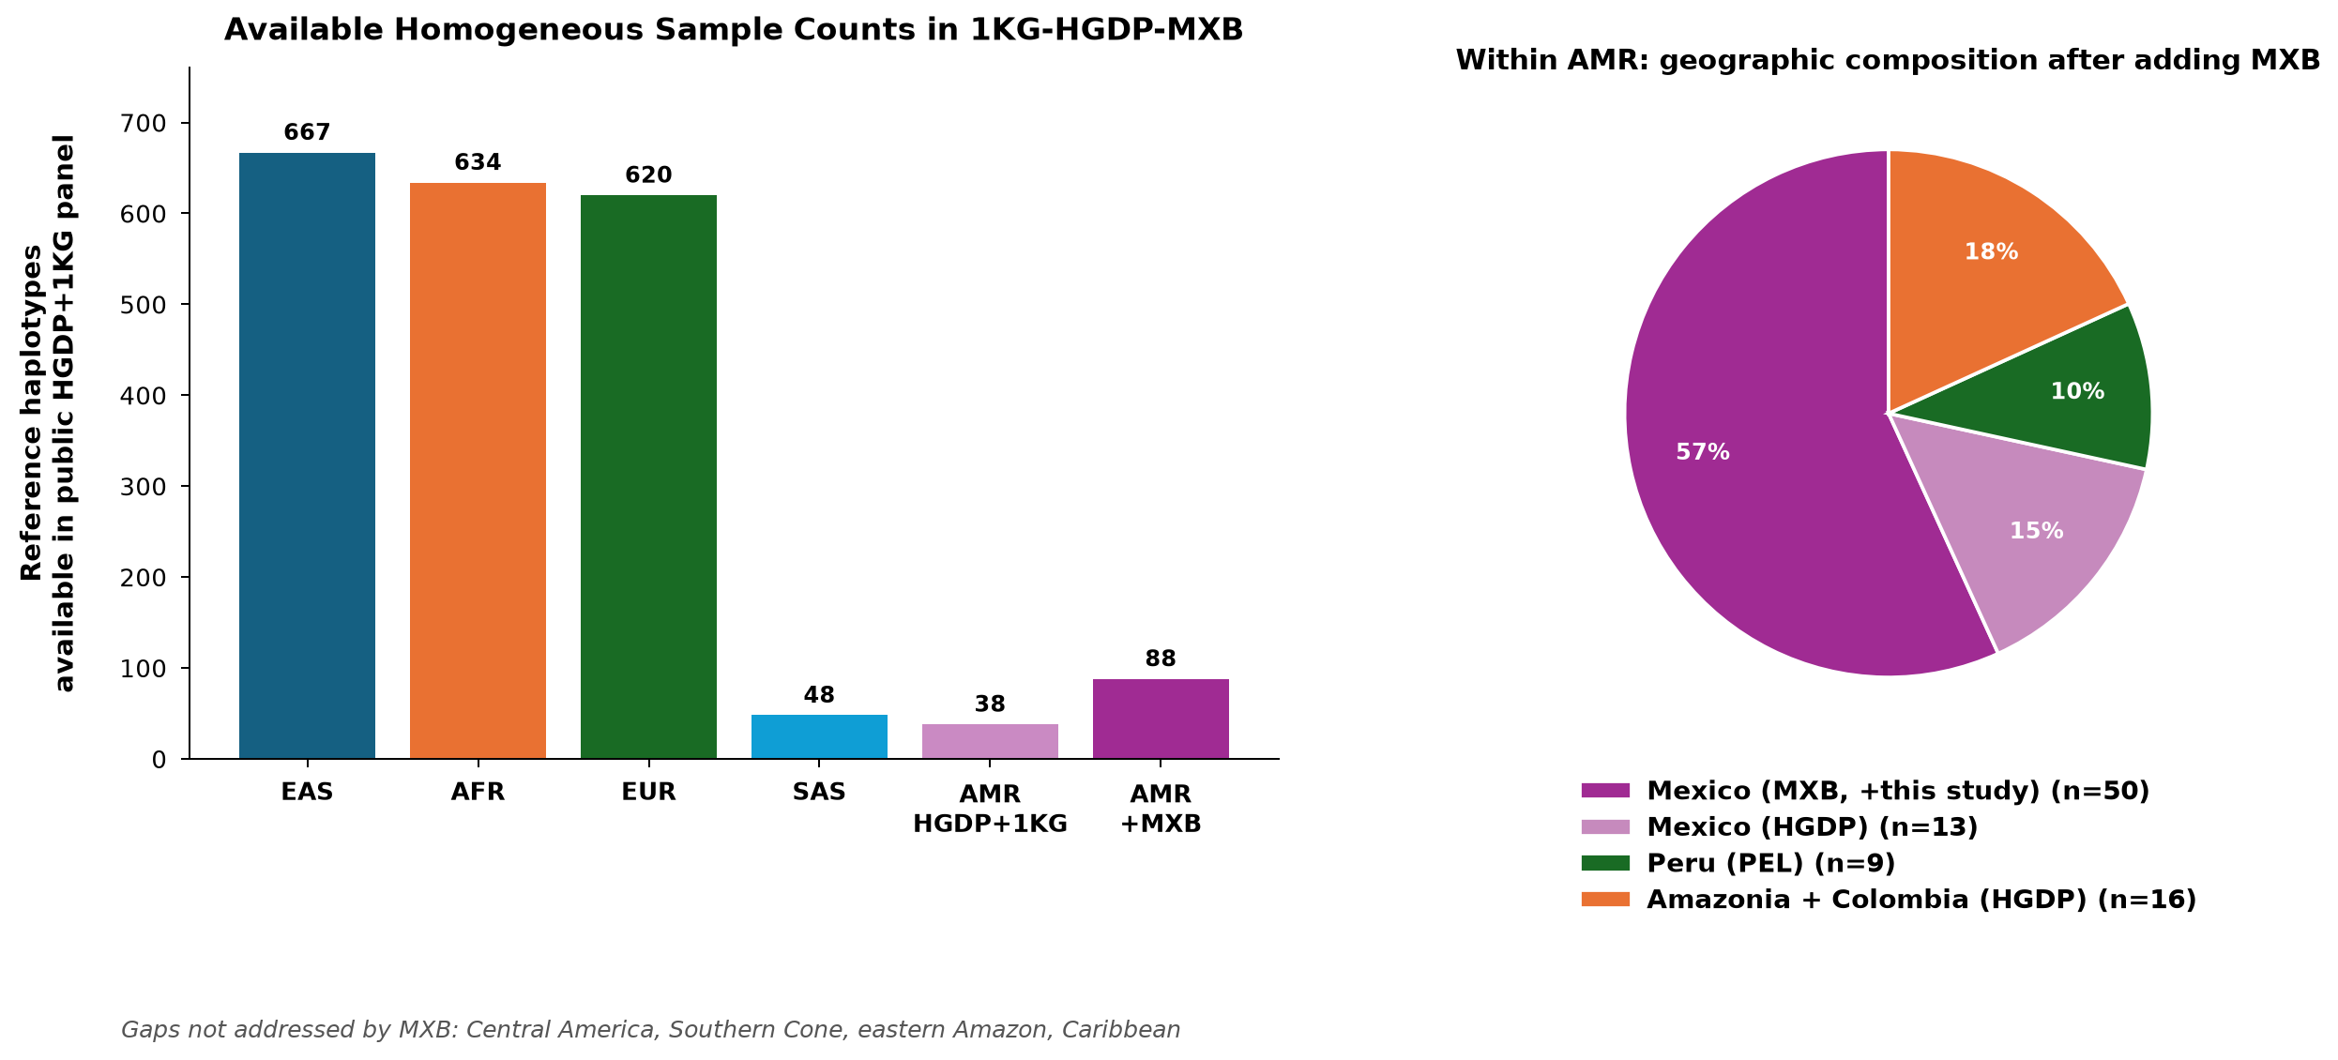
Public Amerindigenous references are ~7× smaller than other continents.
HGDP + 1000 Genomes reference haplotypes, by continental group
Adding 50 MX Biobank WGS samples brings AMR to 88 — still leaves Central America, Southern Cone, Amazon, Caribbean underrepresented.
Christina Magyar · Thesis committee, Aug 2026 · Aim 2 · Motivation
4 / 12
Notes:
The gap slide. Public HGDP+1KG panels give us ~620 EUR haps, ~634 AFR, ~667 EAS, but only ~88 AMR — a 7× disparity. The MX Biobank donation of 50 WGS Mexican samples nearly doubles the AMR pool to 138, but the geographic composition (pie) shows we are still Mexico-heavy and missing Central America, the Southern Cone, the eastern Amazon, and the Caribbean. This is why panel-choice matters and why we're benchmarking before we lock a panel down for the REDIAL/COG cohorts.

Slide 5
We simulated admixed cohorts to measure per-hap LAI recall.
Reference haps
HGDP + 1KG + 50 MXB WGS (6 panel combos)
Phasing
SHAPEIT5 population phasing
Simulate admixed
admix-simu gen=12, n=30 Brasa & MXB tracks
Local ancestry
RFMix v1 TrioPhased 22 chromosomes
Score
per-hap recall vs known truth weighted concordance / F1
Six reference-panel combinations tested
NAT_HGDP
26 HGDP + 5 LP
NAT_HGDPMXB
+ 25 MXB
NAT_HGDPMXB_FULL
+ 50 MXB
Two simulated admixed cohorts
• Brasa track — 15% NAT / 60% EUR / 25% AFR
(Brazilian-like ancestry proportions)
• MXB track — Mexican-like ancestry proportions
(tests whether MXB helps a Mexican cohort)
NAT_HOMOG
ADMIXTURE-homog Q≥0.95
NAT_PEL
adds 9 PEL (Peru)
NAT_PEL_EAS
PEL + EAS outgroup
Christina Magyar · Thesis committee, Aug 2026 · Aim 2 · Methods
5 / 12
Notes:
Simulation harness: SHAPEIT5-phased references feed admix-simu to create 30 admixed individuals per cohort at generation 12 (long enough for chromosome-scale tracts to be resolvable). RFMix v1 TrioPhased mode matches Honorato-Mauer 2025. Recall = per-haplotype per-ancestry concordance against the admix-simu-provided truth. We ran 6 candidate reference panels crossed with 2 simulated cohort tracks (Brazilian-like and Mexican-like) to see whether the best panel depends on the target cohort's own ancestry composition.

Slide 6
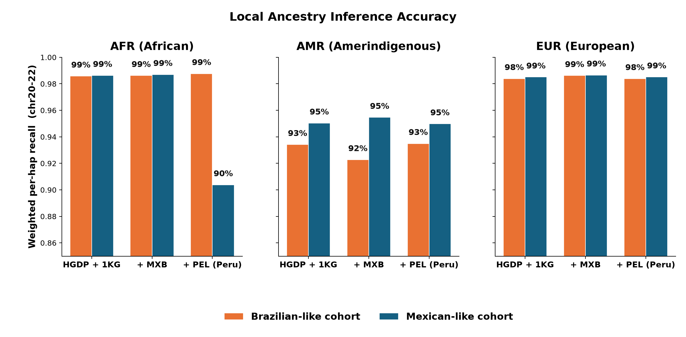
Panel choice moves AMR recall by ~3%; EUR and AFR sit near ceiling.
Weighted per-hap recall by ancestry, WGS density, chr20-22 pilot
→ AMR is where reference-panel choice actually matters — so the rest of the deck focuses on AMR recall.
Christina Magyar · Thesis committee, Aug 2026 · Aim 2 · Result overview
6 / 12
Notes:
Overview slide before we zoom in. Three ancestries side by side, same panels, same y-scale. EUR and AFR sit near ceiling regardless of which AMR reference we pick — those calls are easy because the EUR and AFR reference pools are already large and diverse. AMR is the ancestry that moves: ~3% swing across panel choice on the Mexican-like cohort. Motivates zooming in on AMR in the next slide.

Slide 7
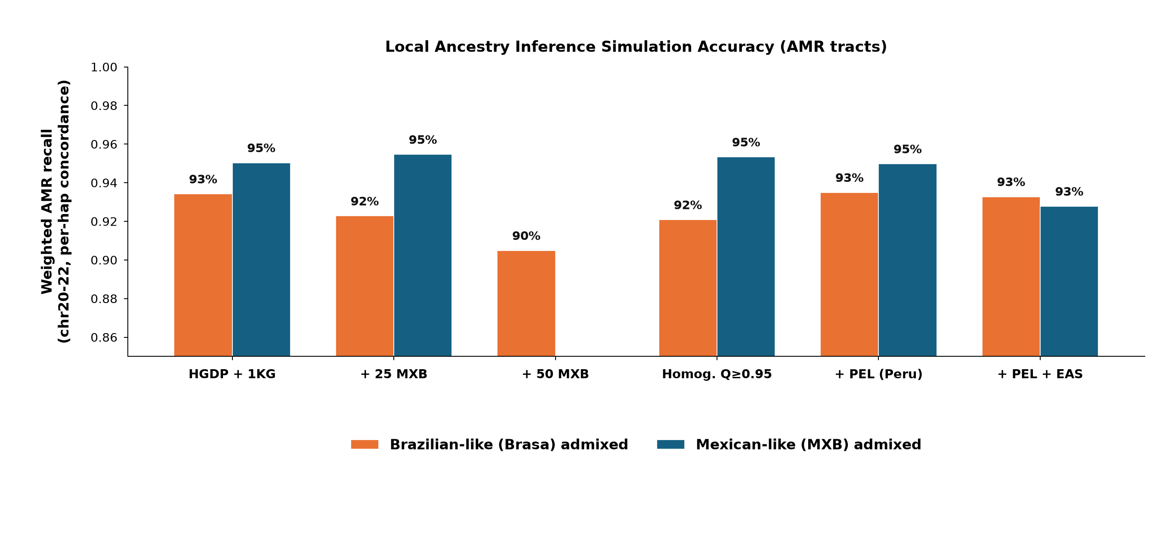
Best reference panel depends on the target cohort's composition.
Weighted NAT-ancestry recall, WGS density, chr20-22 pilot
Takeaways
For a Mexican-like cohort (blue bars):
• Adding 25 MXB samples
lifts NAT recall 0.931 → 0.942
For a Brazilian-like cohort (red bars):
• PEL (Peru) panel wins on NAT
HGDPMXB actually loses ~2%
• Adding non-Mexican ancestry
to a Mexican reference hurts
→ Panel-choice must match the
target cohort, not the largest
available sample source.
Christina Magyar · Thesis committee, Aug 2026 · Aim 2 · Result · AMR zoom
7 / 12
Notes:
HEADLINE RESULT. Extended pilot numbers (chr 1-8 + 20-22 for the 4 full-coverage panels; chr20-22 only for HOMOG and PEL_EAS — flagged with *). On the Mexican-like cohort (NATMXB track, teal): +25 MXB lifts NAT recall from 0.954 → 0.958 and F1 from 0.969 → 0.974 (cleanest single winner). On the Brazilian-like cohort (NAT track, orange): +25 MXB costs ~1% NAT recall (0.930 → 0.920) but bumps precision (0.981 → 0.990), so F1 is roughly flat. +50 MXB (HGDPMXB_FULL) costs more recall (0.902) with only marginal F1 benefit — 25 MXB is the sweet spot. PEL matches or beats HGDP on the Brazilian cohort. NAT_HOMOG (HGDP + 1KG + MXB jointly filtered to Q≥0.95 by supervised ADMIXTURE — includes MXB samples but excludes admixed individuals) matches HGDPMXB on Mexican-cohort F1 (0.972) with full coverage. Punchline: adding MXB is a clear win for a Mexican-cohort GWAS; matched-source reference (PEL for Brazilian) matters more than panel size; HOMOG is the principled alternative when we want a stricter homogeneity criterion.
──────── METRICS CHEAT SHEET ────────
• TP / FP / FN: sites where called ancestry matches truth (TP), calls were wrong-class (FP), or truth was this class but we missed (FN). TN is ignored — this is a small-positive-class setting.
• Recall = Sensitivity = TPR = TP / (TP + FN). Of all true NAT sites, how many we recovered. Currently plotted on the hero bars.
• Precision = PPV = TP / (TP + FP). Of the sites we CALLED NAT, how many were actually NAT. Guards against over-calling.
• F1 = 2·P·R / (P + R). Harmonic mean of precision and recall — the class-imbalance-robust summary. NOT the same as balanced accuracy (which uses specificity); F1 ignores TN by design.
• Weighted (in these tables): concordance / recall / precision are weighted by (n_haps × n_sites) per chromosome so long chromosomes and larger haplotype counts contribute more.
• Concordance in these tables (== weighted_recall in current R impl) is per-site agreement to truth, per ancestry, one-vs-rest.
• SE: standard error of the per-chromosome mean (not a bootstrap CI).
Publication table with all three metrics is committed to results/tables/publication_table_amr.tsv and rendered to slides/tables/publication_table_amr.png.

Slide 8
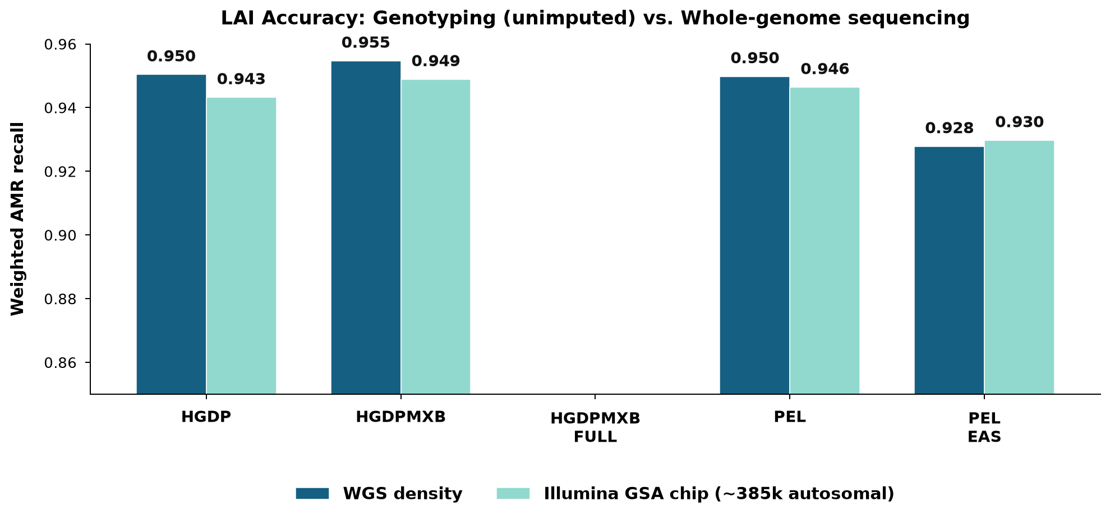
Chip-density LAI holds within ~1% of WGS on a Mexican-like cohort.
Illumina GSA v3 chip vs full WGS density, same reference panels
Implications for GWAS
• REDIAL / COG cohorts are
genotyped on chip, not WGS —
LAI accuracy holds if we
use the MXB-augmented panel
• Chip → TOPMed imputation is
the next validation step
(Michigan / 1KG post-meeting)
• Panel ranking preserved
across densities:
HGDPMXB > HGDP > PEL_EAS
• Recommend HGDPMXB for the
Mexican-Latino GWAS pipeline
Christina Magyar · Thesis committee, Aug 2026 · Aim 2 · Result · Chip
8 / 12
Notes:
Complementary result. Same reference panels, but the admixed cohort's haplotypes were down-sampled to the ~385k autosomal Illumina GSA v3 positions before calling. NAT recall drops by only ~0.7-1.2% across panels — the panel ranking is preserved and the direction of every effect matches WGS. This matters because our REDIAL/COG cohorts are chip-genotyped, not WGS — so the WGS result generalizes. Michigan/1KG imputation is the post-committee validation step; today we can already recommend HGDPMXB (+25 MXB) for the Mexican-Latino LAI pipeline. NAT_HOMOG (Q≥0.95 across HGDP+1KG+MXB joint) matches HGDPMXB.

Slide 9
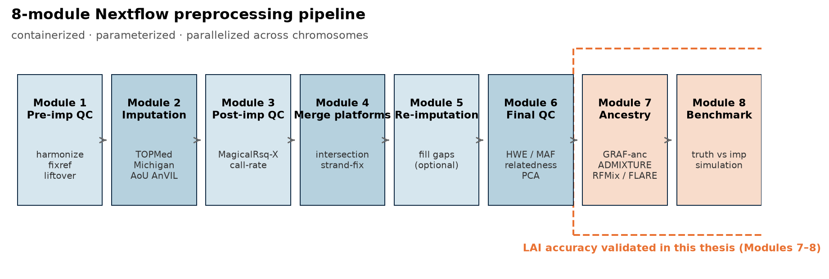
8-module Nextflow preprocessing pipeline built; benchmarking underway.
Containerized · parameterized · parallelized across chromosomes and platforms
Status since Spring TAC
BUILT
9-module Nextflow pipeline
BUILT
Pilot ran on TOPMed test data (end of Module 8)
IN PROG.
Michigan & AoU AnVIL patched in (Q3 2026)
IN PROG.
Full benchmarking sweep (target Apr 2026 done)
Christina Magyar · Thesis committee, Aug 2026 · Aim 2 · Pipeline update
9 / 12
NEXT
Ancestry-stratified GWAS on REDIAL/COG
Notes:
Two-part update: what shipped since the Spring TAC and what's queued. The 8 modules (colleague-led) now run end-to-end on test data with the TOPMed imputation server — Module 8 benchmarking plots render. Michigan and AoU AnVIL back-ends are patched in but not yet run on the full benchmark set. Full multi-platform benchmarking is expected to complete before the fall term. Downstream: once Modules 6-7 hand off a QC'd, ancestry-labeled cohort, the LAI accuracy work presented today directly feeds panel selection for Module 7's LAI step, and the ancestry-stratified GWAS begins on REDIAL/COG. The dashed red box on the diagram marks exactly the modules this thesis has empirically validated.

Slide 10
Aim 3: trans-ancestry + local-ancestry-informed GWAS on ~5,400 B-ALL cases.
Two parallel tracks: ancestry-stratified meta-analysis and Tractor local-ancestry GWAS
Aim 3.a · Trans-ancestry
Aim 3.b · Local-ancestry-informed
1. GRAF-anc groups → stratified SAIGE GWAS (4 groups)
2. Trans-ancestry meta-analysis (n ≈ 5,357)
3. Fine-mapping with MGflashfm (multi-trait, multi-ethnic)
1. RFMix v1 on 1,660 Latin American individuals
2. Tractor GWAS → per-ancestry β for AMR / EUR / AFR
3. Functionally-prioritized fine-mapping (SuSiE + PolyFun)
Uses shared trans-ancestry effects across REDIAL + COG + St. Jude
Detects Amerindigenous-enriched risk variants missed by global-ancestry GWAS
Aim 2's LAI-accuracy work directly picks the reference panel used by Aim 3.b's RFMix step.
Christina Magyar · Thesis committee, Aug 2026 · Aim 3 · methods
10 / 12
Notes:
Aim 3 splits into two GWAS tracks. 3.a is the trans-ancestry track: GRAF-anc first partitions the combined REDIAL + COG + St. Jude cohort into 4 ancestry groups (African-American, European-American, Latin American 1, Latin American 2), stratified SAIGE GWAS per group, then trans-ancestry meta-analysis at n≈5,357, followed by MGflashfm fine-mapping which handles multi-trait multi-ethnic LD differences. 3.b is the local-ancestry track: RFMix v1 (the exact tool this Aim 2 work is benchmarking) on the 1,660 self-reported Latino individuals, then Tractor to fit per-ancestry β for AMR, EUR, and AFR tracts jointly. Fine-mapping downstream uses SuSiE + PolyFun. The point of Aim 2 is to make sure the RFMix step in 3.b is using the best reference panel — HGDPMXB by our current data.

Slide 11
Timeline to graduation — July 2027 target.
Aim 1
REDIAL manuscript revision + submission (Leukemia)
Apr–Jun 2026
Aim 2
22-chr LAI sweep + full-coverage figures
Aug 2026
Aim 2
Nextflow pipeline benchmarking on TOPMed / Michigan / AoU
Sep–Dec 2026
Aim 2
Pipeline manuscript drafting
Jan–Mar 2027
Aim 3
GRAF-anc stratification + PC calculation
Oct–Nov 2026
Aim 3
SAIGE trans-ancestry GWAS + MGflashfm fine-mapping
Dec 2026 – Feb 2027
Aim 3
RFMix + Tractor local-ancestry GWAS on REDIAL/COG
Feb – Apr 2027
Aim 3
PolyFun-SuSiE fine-mapping + candidate follow-up
Apr – May 2027
All
Thesis writing + defense
May – Jul 2027
Christina Magyar · Thesis committee, Aug 2026 · Timeline
11 / 12
Notes:
Timeline broken down by aim. Aim 1 wraps this quarter with the REDIAL manuscript. Aim 2 finishes the 22-chr LAI sweep this month (currently 126/198 done on the WGS side, backfill queued for HOMOG / PEL_EAS panels and full chip-density coverage), then benchmarks the Nextflow pipeline on all three imputation servers (TOPMed, Michigan, AoU AnVIL) through end of 2026. Pipeline manuscript targets Q1 2027. Aim 3 sequences behind Aim 2 — GRAF-anc + PCs in the fall, SAIGE + fine-mapping over winter, then Tractor local-ancestry GWAS in spring 2027 (which needs Aim 2's reference panel decision locked in). Thesis writing spring 2027, defense July 2027.

Slide 12
Acknowledgements
Lupo Lab & TCH EpiCenter
Atkinson Lab (BCM · local advisor)
Collaborators + funding
Dr. Philip J. Lupo (Emory, thesis advisor)
Dr. Karen Rabin (UCSF)
Dr. Melissa A. Richard
Dr. Austin Brown
Dr. Jeremy Schraw
Dr. Michael Scheurer
Dr. Elizabeth Atkinson (local advisor)
Nirav Shah · Jessica Honorato-Mauer
Grace Tietz · Hatoon Al Ali
Helen Lin · Pragati Kore
Erik Stricker · Aishi Ayyanathan
Astrid Manuel · Shalini Dhamodharan
St. Jude Children's Research Hospital
Dr. Jun Yang, Zenhua Li
Children's Oncology Group
MX Biobank (Dr. Andrés Moreno-Estrada)
AIM-AHEAD Consortium
Robert & Janice McNair Foundation
BCM MSTP · G&G Graduate Program
Thank you — questions?
Christina Magyar · Thesis committee, Aug 2026 · Acknowledgements
12 / 12
Notes:
Standard acks — matches the Spring TAC deck acknowledgements slide. Ready for questions.

