Slide 1
Effectiveness of Pc-Ph as an Organic Solar Cell
Christopher Roman, David Gonzalez, Olivia Scott
Spatial Visualization / ENG 1070
August 4th

Slide 2
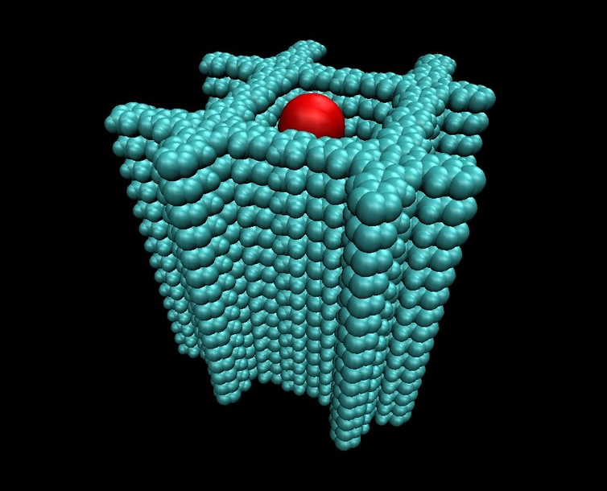
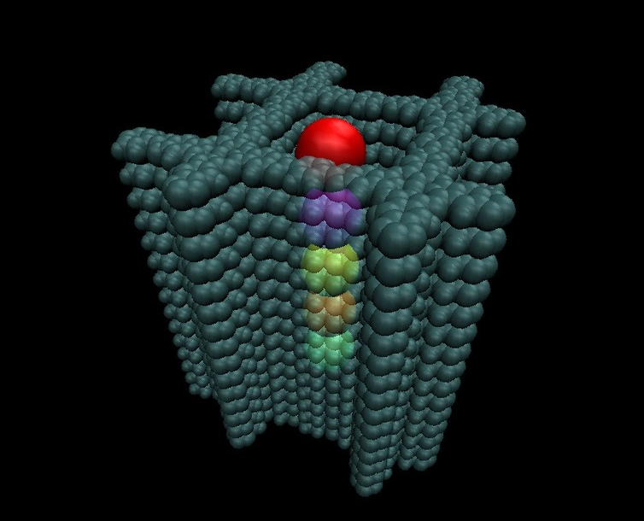
Introduction
Solar Cells
Solar energy
Improve efficiency and usage
COFs: Covalent Organic Frameworks
The future of solar energy?
Information from the solar cells packet
Notes:
Solar Cells
Solar energy is clean and potentially unlimited
Solar cells are fundamental to harnessing solar energy
Research needed to improve efficiency and usage of solar energy
COFs: Covalent Organic Frameworks
Potential for solar cell
Pairs of organic units (linkers and connectors) react to form a pre-determined structure
Key challenges in packing
Sticking to the sides
Capability of C60s to pack effectively in a COF pore is critical to the charge transfer ability of COFs
Hypothesis
As temperature increases, diffusion coefficient gets larger
Measured through simulations

Slide 3
Method
Receive information and data from Ace
Visualize COFs (drawings)
View COFs in VMD simulations
Analyze data points for diffusion coefficients and electron mobility
Analyze effectiveness of COF
Notes:
Receive information and data from Ace
Visualize COFs
Through orthographic projections and isometric drawings
View COFs in VMD simulations
Analyze data points for diffusion coefficients and electron mobility
Analyze overall effectiveness of COF

Slide 4
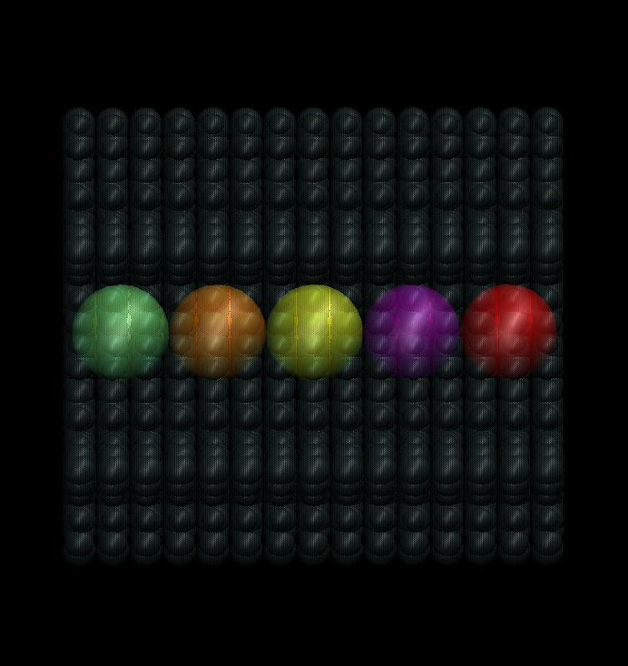
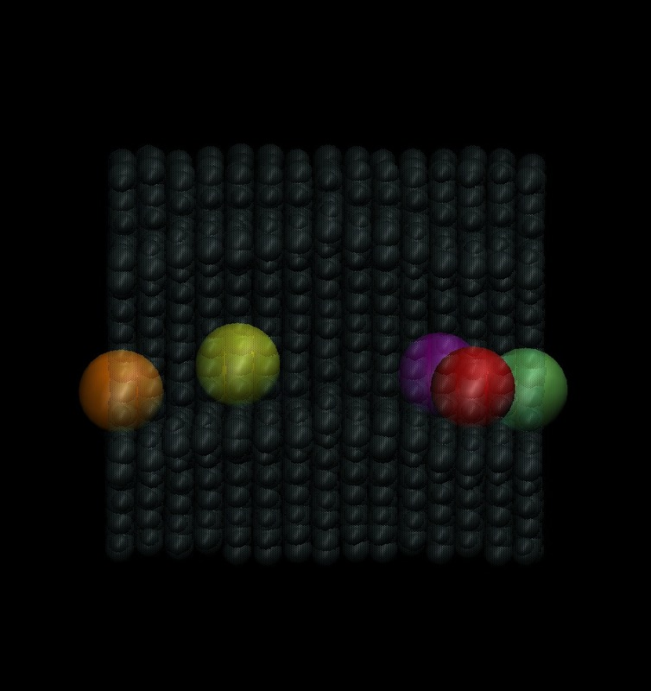
200K
Too low
Positions at Initial Time
Positions at Final Time
Notes:
200K is too low
When the C60 molecules move from their optimal position they cannot move fast enough to move back

Slide 5
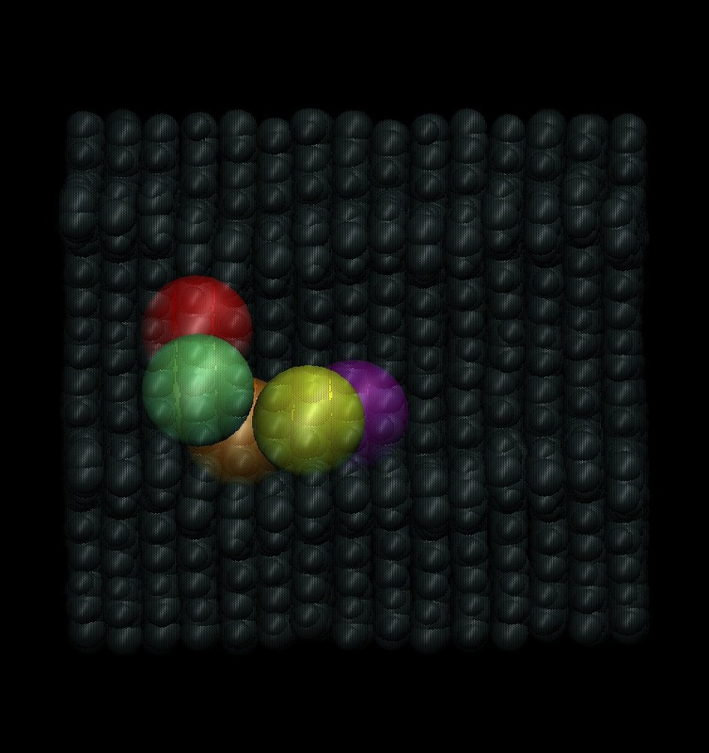
400K
Possible optimal temperature
Positions at Initial Time
Positions at Final Time
Notes:
Possible optimal temperature around 400K
Don’t move as much from their optimal position

Slide 6
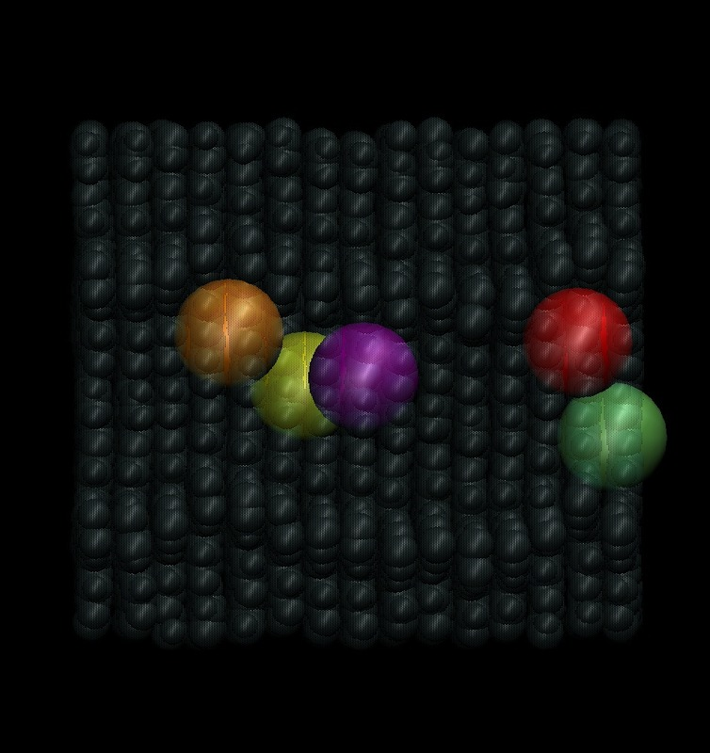
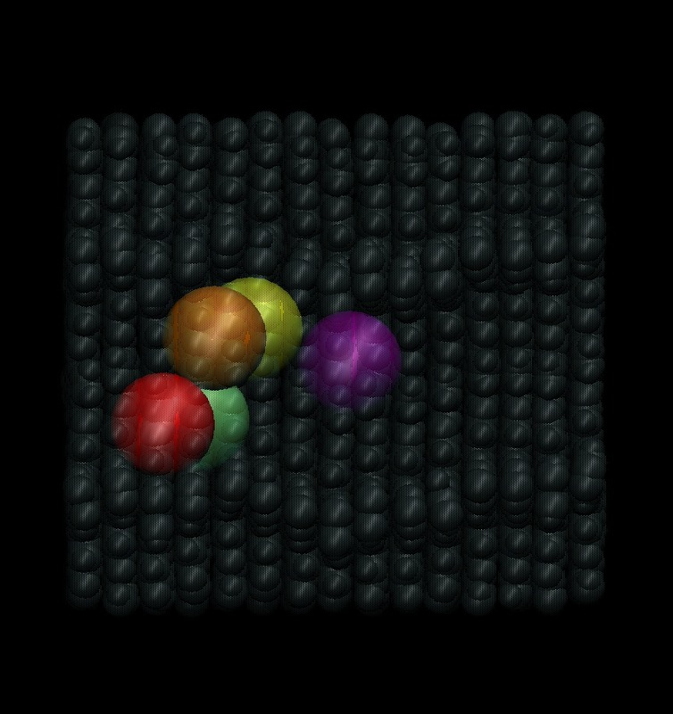
600K
Too high
Positions at Initial Time
Green Interacting with Red
on Other Side
Positions at Final Time
Notes:
600K is too high
The C60 molecules move too fast and don’t stay in their optimal position

Slide 7
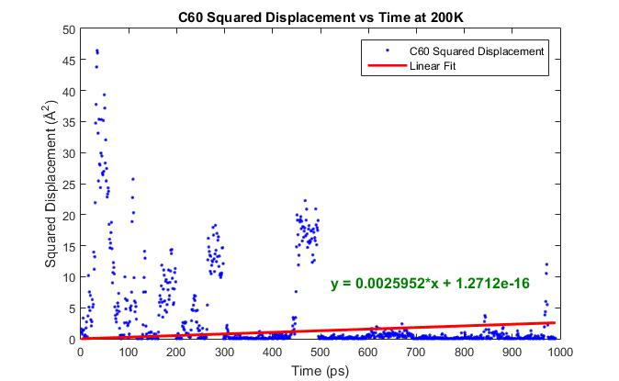
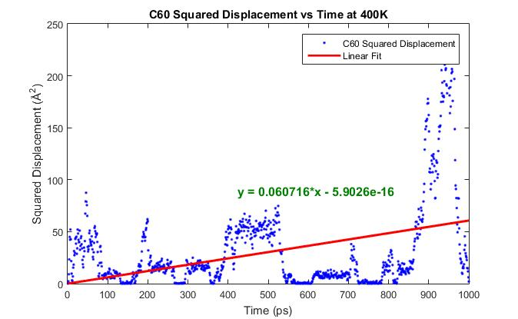
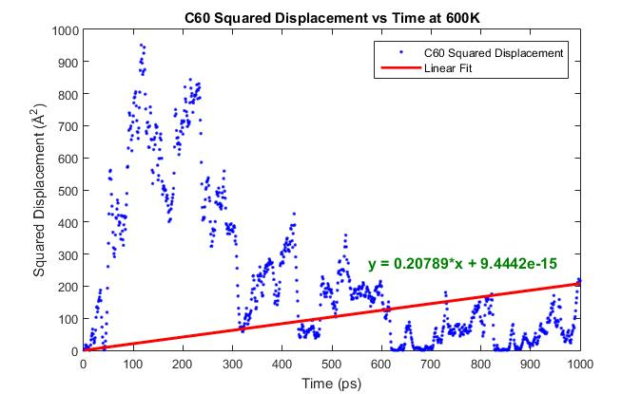
Diffusion Coefficients
600K
200K
400K
Notes:
The diffusion coefficient is the measure of how much squared distance a C60 molecule travels on average over a given unit of time. The diffusion coefficient, as seen in the graphs, is dependent on the temperature of the system.

Slide 8
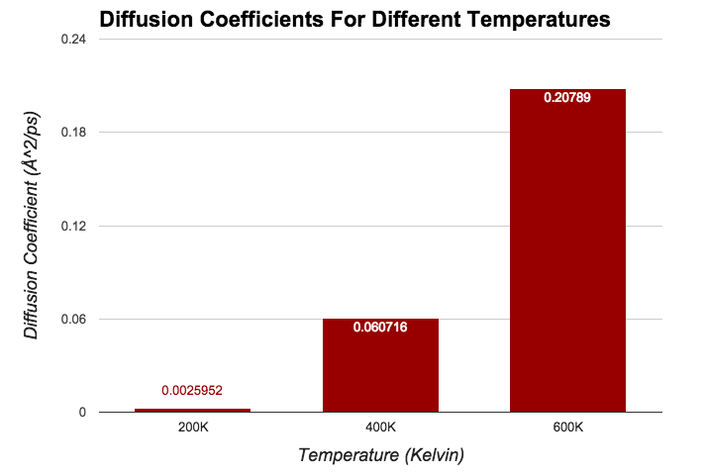
Notes:
At 200K, the diffusion coefficient is about 5 thousandths of an Angstrom squared per second. With this magnitude, the C60 molecules will take too long to actually settle into an effective alignment or position and will actually hurt the effectiveness of the solar cell.
For 600K, the diffusion coefficient is extremely high given the scale of the system. What this means for the solar cell is that the C60 molecules will move so quickly that they will not remain in an effective alignment for more than a moment as also hurt the effectiveness of the solar cell.
For 400K, the diffusion coefficient is at somewhat of a middle ground. At this temperature, the molecules have enough speed to get to more effective positions yet do not travel so quickly that they immediately break formation. If this solar cell were to be utilized, among these 3 temperatures, 400K would produce the best results.

Slide 9
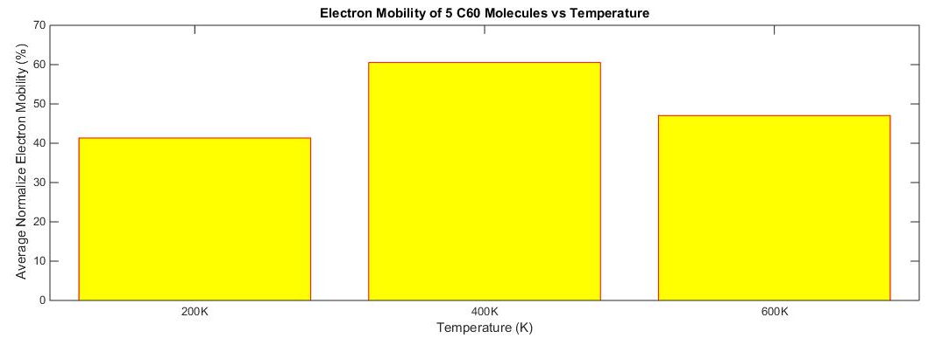
Electron Mobility
Mean₂₀₀ = 41.3376%
Mean₄₀₀ = 60.5208%
Mean₆₀₀ = 47.0571%
Notes:
Electron Mobility is somewhat of an abstract measurement, but it does give us a sense of which conditions produce better results.
The electron mobility is simply a measure of the ability of electrons to move from one C60 to the next.
Again, we see that a temperature of 400K produces a higher average electron mobility among the molecules than at the other two temperatures.
In actuality, electron mobility only depends on the distance between two like molecules, however, at certain temperatures, these distances may on average be shorter and more constant than at other temperatures.

Slide 10
Conclusions
Magnitude of diffusion coefficient increases as temperature increases.
Normalized electron mobility is highest at a median temperature: 400K.
The Verdict:
The Pc-Ph system, operating at optimal temperature, is still very inefficient.
There are still other COFs to be tested to fully conclude whether or not organic solar cells can ever be efficient.
Notes:
Just to restate some of the results to see what they actually say about the Pc-Ph structure.
The diffusion coefficient increases as temperature increases, meaning that the C60 molecule moves around more
The normalized electron mobility is highest at some median temperature; Can’t be too high or too low for highest efficiency
Now, based on the numbers for this specific structure, we can conclude:
The Pc-Ph structure is too wide, thus C60s aren’t being packed closely enough, as seen by the electron mobilities not being close to 100%, even when at close to “optimal temperature”

Slide 11
Acknowledgements
Dr. Clancy, BA & PH D in Chemistry
Samuel W. and M. Diane Bodman Professor in Chemical Engineering
Client for our project
Yaset Acevado
Instructor for course and graduate student mentor for project
Organizations that financially supported the project/course
Diversity Programs Engineering
Ryan Scholar Program

