Slide 1
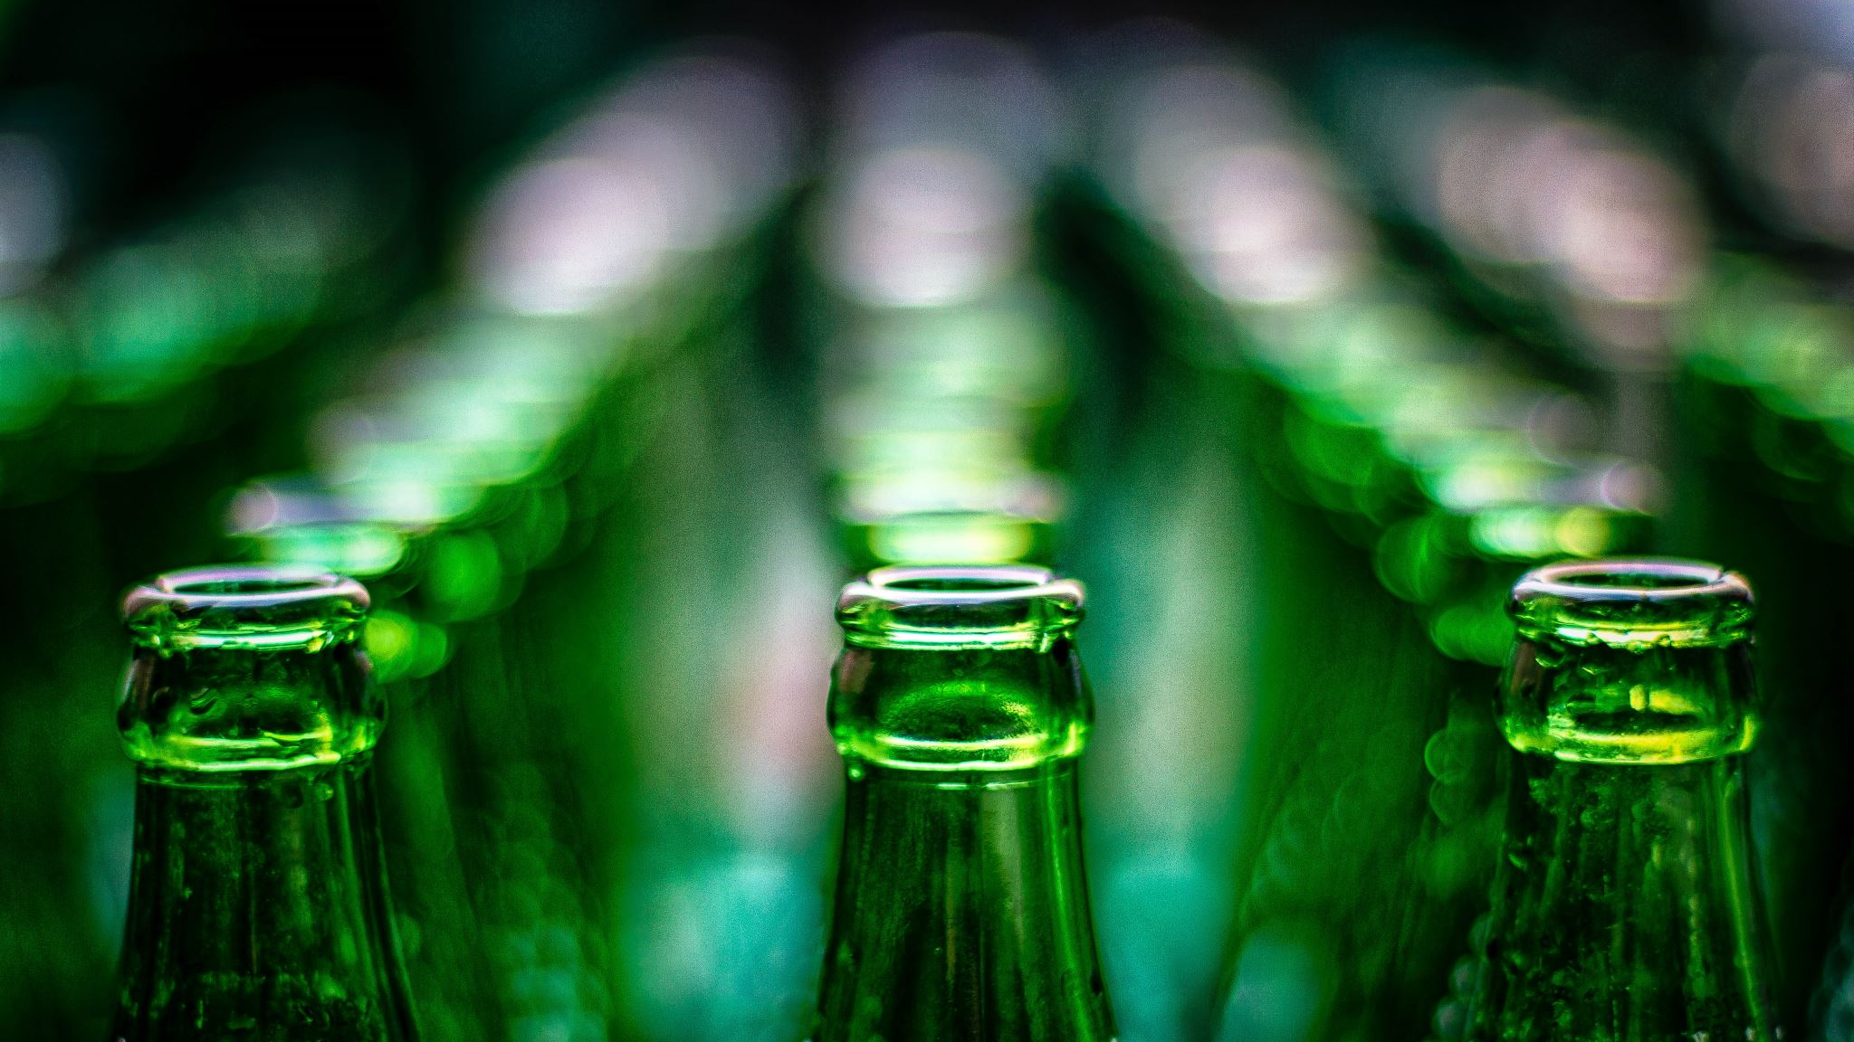
Student Alcohol Consumption
By: Chris Rooney, Eric Bixby, and Anthony Shishkin

Slide 2


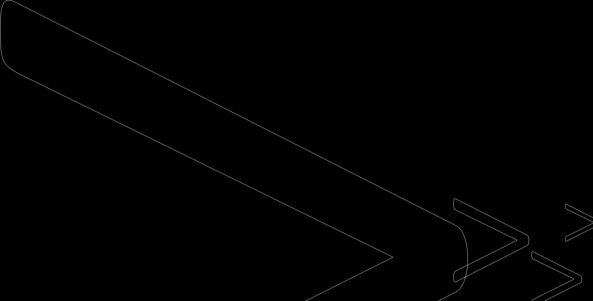
Alcohol Consumption in Students
The survey we used looked at alcohol consumption in relation to multiple other variables
The survey was done on high school age students in Portugal
Data Clean up
Switched certain variables to Binary
Removed the lowest correlated variables since there was so many
Our Goal:
We wanted to find what variables could be the best predictors for alcohol consumption

Slide 3
The Variables
sex - student's sex (binary: 0 - female or 1 - male)
age - student's age (numeric: from 15 to 22)
address - student's home address type (binary: 1 - urban or 0 - rural)
Pstatus - parent's cohabitation status (binary: 0 - living together or 1 - apart)
Medu - mother's education (numeric: 0 - none, 1 - primary education (4th grade), 2 – 5th to 9th grade, 3 – secondary education or 4 – higher education)
Fedu - father's education (numeric: 0 - none, 1 - primary education (4th grade), 2 – 5th to 9th grade, 3 – secondary education or 4 – higher education)
guardian - student's guardian (nominal: 0 - mother, 1 – father, or 2 - other)
traveltime - home to school travel time (numeric: 1 - <15 min., 2 - 15 to 30 min., 3 - 30 min. to 1 hour, or 4 - >1 hour)
studytime - weekly study time (numeric: 1 - <2 hours, 2 - 2 to 5 hours, 3 - 5 to 10 hours, or 4 - >10 hours)
failures - number of past class failures (numeric: n if 1<=n<3, else 4)
activities - extra-curricular activities (binary: 1 - yes or 0 - no)
internet - Internet access at home (binary: 1 - yes or 0 - no)
romantic - with a romantic relationship (binary: 1 - yes or 0 - no)
famrel - quality of family relationships (numeric: from 1 - very bad to 5 - excellent)
freetime - free time after school (numeric: from 1 - very low to 5 - very high)
goout - going out with friends (numeric: from 1 - very low to 5 - very high)
Dalc - workday alcohol consumption (numeric: from 1 - very low to 5 - very high)
Walc - weekend alcohol consumption (numeric: from 1 - very low to 5 - very high)
health - current health status (numeric: from 1 - very bad to 5 - very good)
absences - number of school absences (numeric: from 0 to 93)
G3 - final grade (numeric: from 0 to 20, output target)

Slide 4
Exploratory Data Analysis
The survey was done on 649 students
The average age was 16.74
It was mostly females, 383 compared to 266 males
The average alcohol consumption was 2.28 on the weekends, and 1.5 during the week
The average grades from 1-20 was 11.906

Slide 5
Clustering
We did clustering in JMP with 3 different k means
The goal was to find out how higher and lower drinking clusters would look with other variables
The clustering was done with k means = 4 and 6

Slide 6
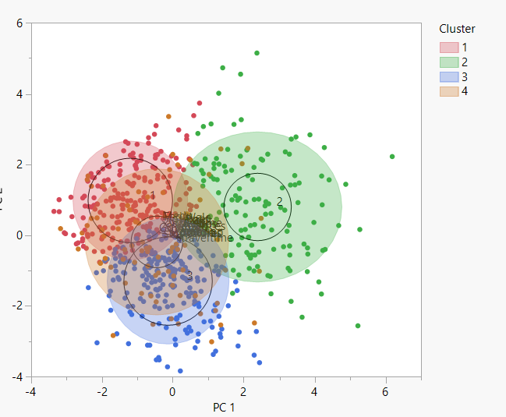
Clustering Results: K means = 4
Notes:
The goal was to see how lower or higher alcohol consumption, either daily or on the weekend, would change the clustering of other variables.
The most interesting was cluster 2, which had the highest mean for both Daily and Weekend alcohol consumption. This cluster had the lowest grade results, a mostly male population, the highest age, and quite low education from the parents. Cluster 2 also had a surprisingly high health mean, but this is probably due to the low age of those in the study, with the high alcohol consumption not greatly affecting health yet.
Cluster 3 had the lowest alcohol consumption, with a high amount of females. The most interesting things from this cluster were that it had the lowest health mean, the least failed classes, but just average school grade results.
The other two clusters were both around the average means with most of the variables.
The majority of these variables don't wield great results, as they hang around the average of their means.
For example, family relations doesn't dip below 3.8 for any of the clusters, and doesn't go much above 4.0
Some obvious variables change like going out and free time go up as alcohol consumption goes up.

Slide 7
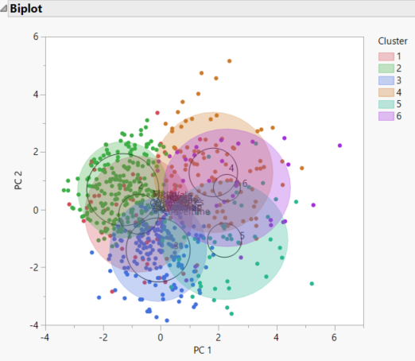
Clustering Results: K Means = 6
Notes:
The 6 means K clustering was not quite as interesting. The data seemed to be spread quite thin, and the clusters were much less unique. The graph shows this problem a little bit.
Cluster 4 had some of the more interesting results, with the highest alcohol consumption, highest health values, and it was the most male cluster. It was a lot like cluster 2 in the previous slide.
Cluster 5 was also really interesting. It had by far the lowest grade results, but below-average alcohol consumption. It also had a below-average education level from the parents.
In general, this clustering was not as good as the last. Most of the data sits right around each other, and the clusters are not that unique in providing a sample to look at alcohol consumption in reference to the other variables.
Like the previous cluster analysis, a lot of the other variables not mentioned didn't change as much as we thought. They don't seem to be as affected when alcohol goes way up or way down.

Slide 8

Memory Based Reasoning (MBR)
Sorted the data out to categorize each "diagnosis"
DALC/WALC 1-5
Randomly Grabbed 4 samples of each "diagnosis"
Randomly Generated values for two cases
Calculated Euclidean Distances to find the nearest neighbor.
Notes:
We used jump to create a neural network. Our neural network ended up using 19 of our 21 variables as factors, with weekend alcohol consumption as the response variable. We adjusted the learning rate to .01 and used all three of the activation functions provided by jump, TanH, Linear, and Gaussian in two layers.

Slide 9
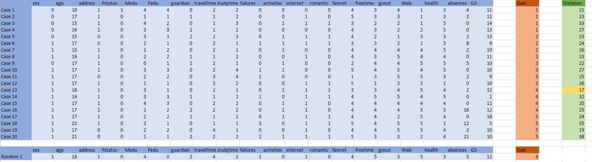
Memory Based Reasoning – Weekday Alcohol

Slide 10
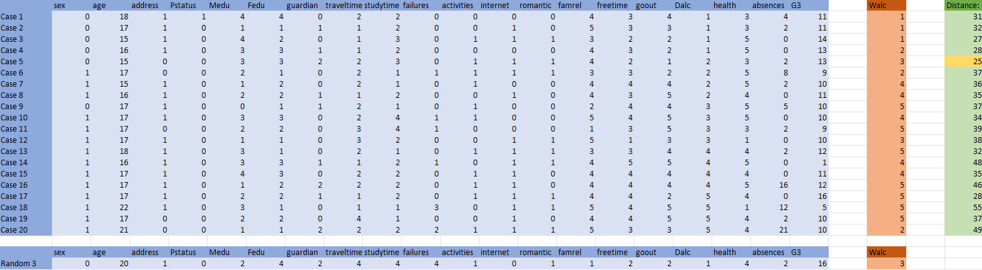
Memory Based Reasoning – Weekend Alcohol

Slide 11
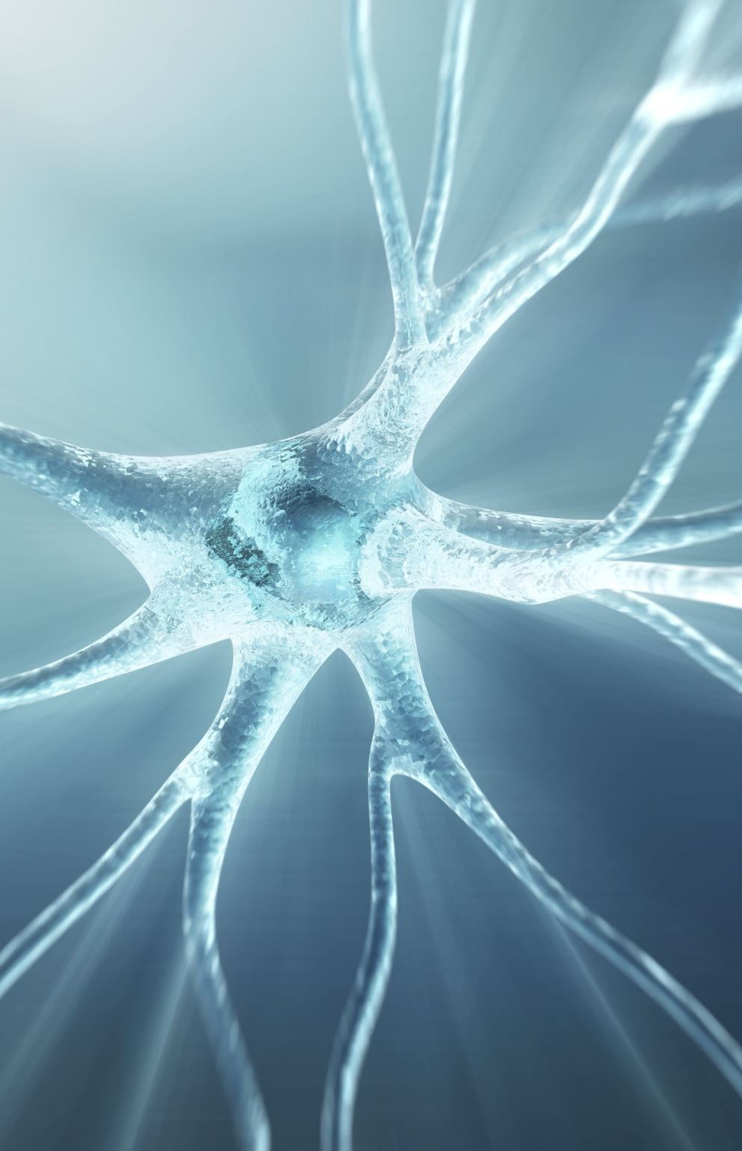
Neural Network
Used JMP to create a neural network
19 factors, 1 response (Walc)
Default holdback proportion
.01 learning rate
TanH, Linear, and Gaussian activation functions
Notes:
We used jump to create a neural network. Our neural network ended up using 19 of our 21 variables as factors, with weekend alcohol consumption as the response variable. We adjusted the learning rate to .01 and used all three of the activation functions provided by jump, TanH, Linear, and Gaussian in two layers.

Slide 12
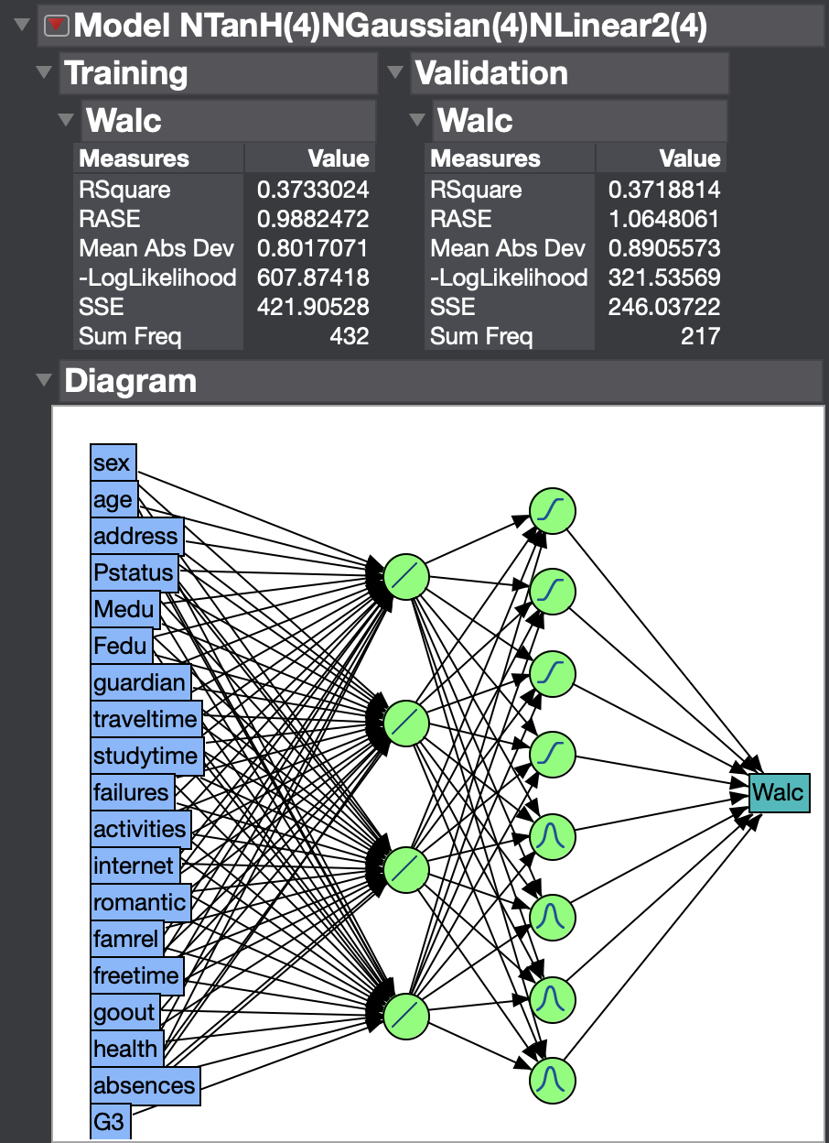
Output
z
Notes:
The best r-squred value we could get was about 37% as you can see up here. In the diagram you can see that we used 4 tanH neurons and 4 gaussian neurons in the first layer. In the second layer we used 4 linear neurons.

Slide 13
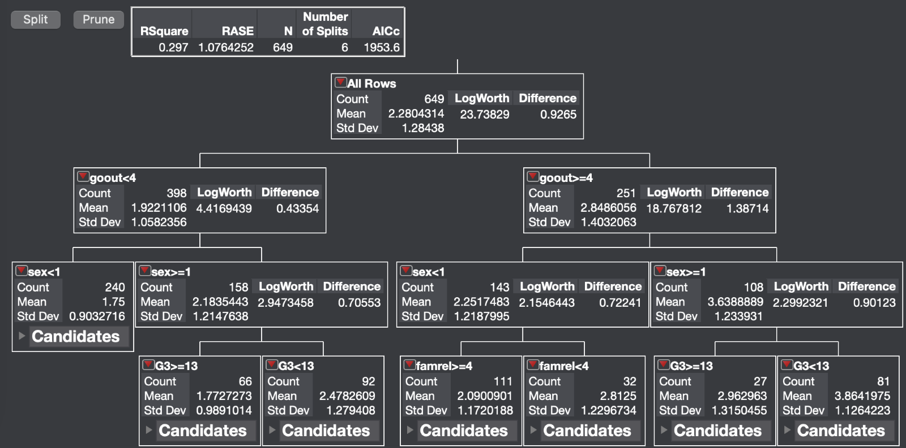
Weekend Alcohol Consumption Decision Tree
Notes:
Here is a decision tree we created for calculating weekend alcohol consumption. The first split was based on how frequently people go out with those who go out more frequently drinking more on the weekends. No surprise there. We can see that for both those who go out frequently and those who do not, their level of weekend alcohol consumption can be best predicted by their sex with females drinking during the weekends less. An interesting difference between males and females is that for males who go out frequently, their alcohol consumption is best predicted by their final grade in school while for females, their alcohol consumption is best predicted by the quality of their family relationships. Weaker family relationships and lower grades are associated with more drinking.

Slide 14
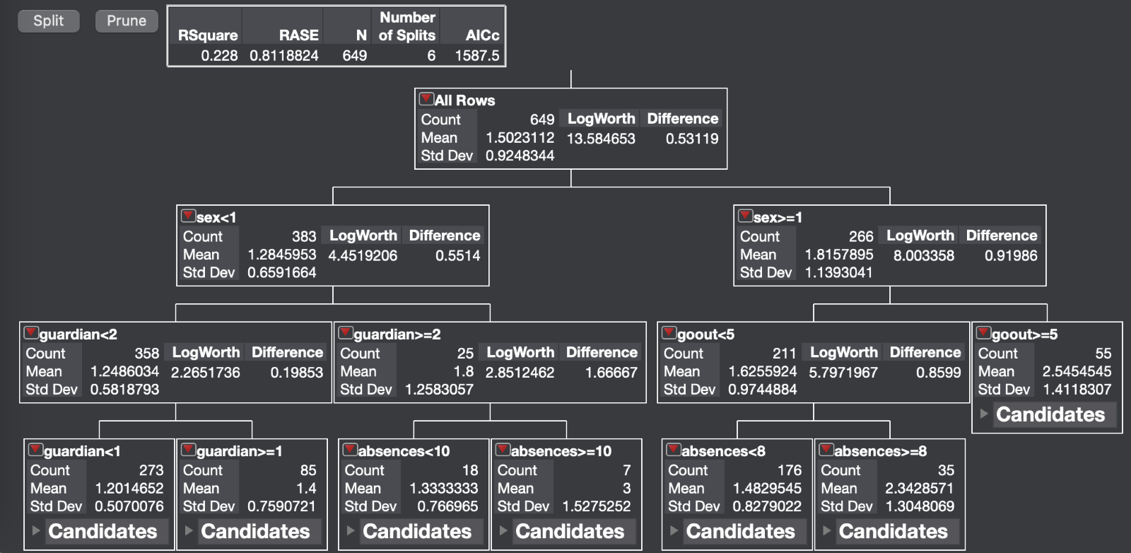
Weekday Alcohol Consumption Decision Tree
Notes:
For the weekday alcohol consumption decision tree, the first split was based on sex rather than frequency of going out. Males appear to be more likely than females to drink during the week. For females, their amount of drinking is more dependent on whether their guardian is either their mother or father or if their guardian is someone else. Females with their dad as their guardian are more likely to drink than if their mom is their guardian.

Slide 15
Conclusion
Clustering: Found that males, with below average grades, and good health were correlated with the highest alcohol consumption.
Decision trees: We found similar results in the decision trees. One difference between males and females is that grades were more of a factor on alcohol consumption for males while strength of family relationships was more important for females.

