Slide 1
Building beautiful Blazor apps with Tailwind CSS

Slide 2


Hi, I’m Chris… 👋
👨‍💻 Principal Software Developer @ Deployed
🏆 Microsoft MVP
💻 Blogger: chrissainty.com
📗 Author: Blazor in Action
🔧 Open Source..r?: Blazored

Slide 3
What is Tailwind CSS?

Slide 4

is a utility based CSS framework

Slide 5
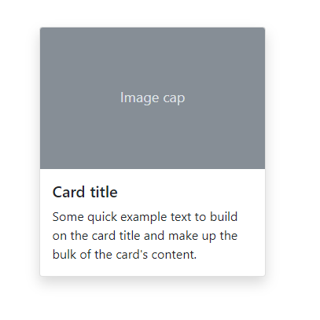
<div class="card">
<img class="card-img-top" src="..." alt="...">
<div class="card-body">
<h5 class="card-title">...</h5>
<p class="card-text">...</p>
</div>
</div>

Slide 6
<div class="flex flex-col shadow-lg">
<img class="rounded-t h-40" src="..." alt="...">
<div class="p-4 text-gray-800">
<h5 class="text-lg font-semibold mb-2">...</h5>
<p class="text-base">...</p>
</div>
</div>

Slide 7
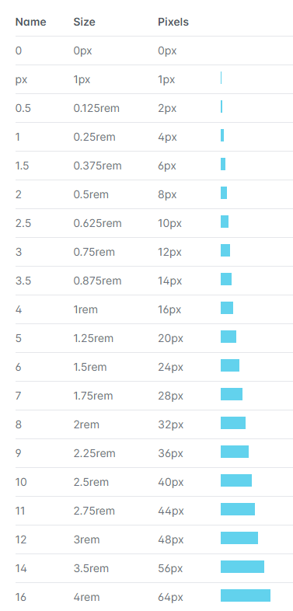
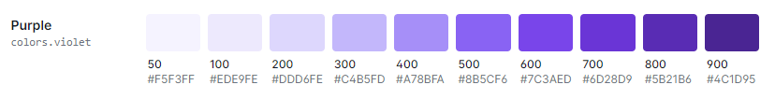
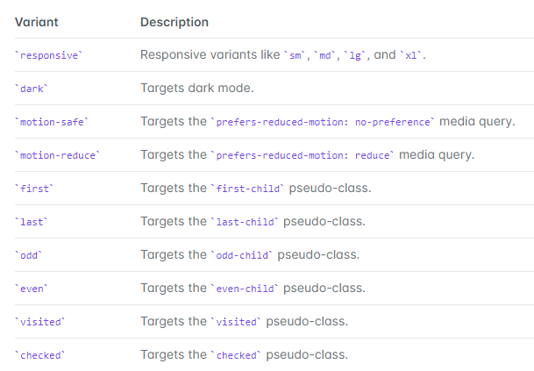

Slide 8

Utility classes are Lego blocks for UI design

Slide 9
That's great, Chris… But isn't this just inline styles?

Slide 10
Limitations of inline styles
Inline styles are magic numbers

Slide 11
Limitations of inline styles
Inline styles are magic numbers
Pseudo states such as hover and focus can't be used with inline styles

Slide 12
Limitations of inline styles
Inline styles are magic numbers
Pseudo states such as hover and focus can't be used with inline styles
Media queries can't be used with inline styles, meaning responsive design isn't possible

Slide 13
Limitations of inline styles
Inline styles are magic numbers
Pseudo states such as hover and focus can't be used with inline styles
Media queries can't be used with inline styles, meaning responsive design isn't possible
Tailwind uses CSS classes
they’re just really focused

Slide 14
Adding Tailwind to a Blazor project

Slide 15
Tailwind via CDN
<!doctype html>
<html>
<head>
<meta charset="UTF-8" />
<meta name="viewport" content="width=device-width, initial-scale=1.0" />
<link href="https://unpkg.com/tailwindcss@^2/dist/tailwind.min.css" rel="stylesheet">
<!-- ... -->
</head>
<body>
<!-- ... -->
</body>
</html>

Slide 16
Tailwind via CDN
<!doctype html>
<html>
<head>
<meta charset="UTF-8" />
<meta name="viewport" content="width=device-width, initial-scale=1.0" />
<link href="https://unpkg.com/tailwindcss@^2/dist/tailwind.min.css" rel="stylesheet">
<!-- ... -->
</head>
<body>
<!-- ... -->
</body>
</html>
You can't customise anything
You can't enable additional variants such as dark mode
You can't use third-party plugins
You can't remove unused styles

Slide 17
Tailwind CLI
No installation of NPM packages required
Watch mode for hot reload of CSS
JIT performance optimisations
PostCSS plugin support

Slide 19
Thank you for watching!
https://sainty.dev/ndcoslo2021

