Slide 1
Building beautiful Blazor apps with Tailwind CSS

Slide 2


Hi, I’m Chris… 👋
👨‍💻 Principal Software Developer @ Deployed
🏆 Microsoft MVP
💻 Blogger: chrissainty.com
📗 Author: Blazor in Action
🔧 Open Source..r?: Blazored

Slide 3
What is Tailwind CSS?

Slide 4

is a utility based CSS framework
Notes:
Very quick to build out UI
With Tailwind we apply atomic style classes that have a single responsibility
They are composed to create the desired look
We don't need to go off and write lots of CSS, most of the time with Tailwind, you never have to write any custom CSS classes

Slide 5
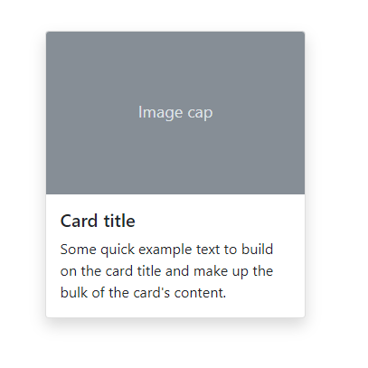
<div class="card">
<img class="card-img-top" src="..." alt="...">
<div class="card-body">
<h5 class="card-title">...</h5>
<p class="card-text">...</p>
</div>
</div>

Slide 6
<div class="flex flex-col shadow-lg">
<img class="rounded-t h-40" src="..." alt="...">
<div class="p-4 text-gray-800">
<h5 class="text-lg font-semibold mb-2">...</h5>
<p class="text-base">...</p>
</div>
</div>

Slide 7
is one big design system
Notes:
Tailwind's design system constrains you to help keep things consistent.
When using traditional CSS frameworks, ad-hoc classes often inconsistent with values for spacing for colours.

Slide 8
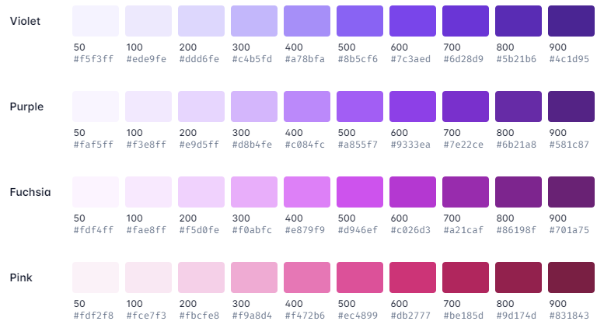
Colour Palette
Notes:
22 colours by default

Slide 9
Colour Palette
<p class="text-purple-700">...</p>
<div class="bg-gray-100">...</div>
Notes:
22 colours by default

Slide 10
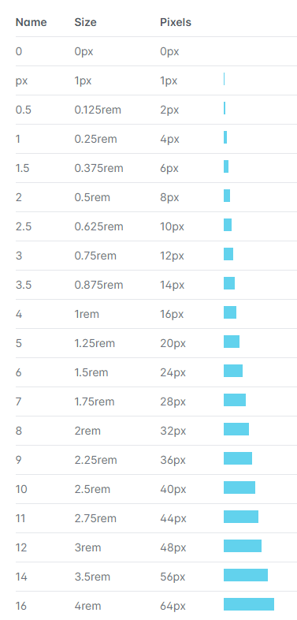
Spacing

Slide 11
Spacing
<h1 class="p-6">...</h1>
<div class="w-40 h-20">...</div>

Slide 12
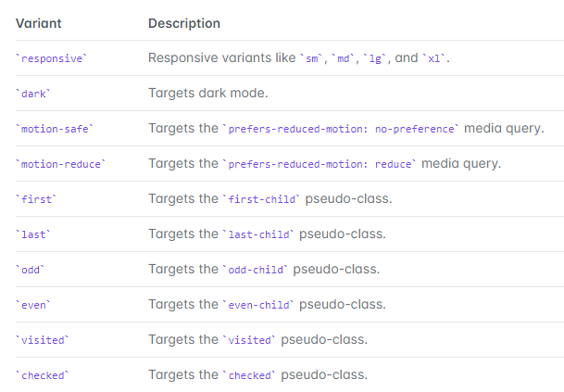
Variants

Slide 13
Variants
<button class="bg-red-500 hover:bg-red-800">...</button>
<div class="bg-white dark:bg-gray-800">...</div>

Slide 14
All this stuff is configurable
module.exports = {
theme: {
colors: {
blazorpurple: '#7019db',
blue: '#1fb6ff',
pink: '#ff49db',
orange: '#ff7849',
green: '#13ce66',
yellow: '#ffc82c',
gray-dark: '#273444',
gray: '#8492a6',
gray-light: '#d3dce6'
}
}
}
Notes:
tailwind.config.js

Slide 15

Utility classes are Lego blocks for UI design
Notes:
But with containstraints…

Slide 16
That's great, Chris… But isn't this just inline styles?

Slide 17
Limitations of inline styles
Inline styles are magic numbers
Notes:
Tailwind's utility classes provide a configurable design system which leads to a consistent UI

Slide 18
Limitations of inline styles
Inline styles are magic numbers
Pseudo states such as hover and focus can't be used with inline styles
Notes:
Tailwind provides state variants to achieve this

Slide 19
Limitations of inline styles
Inline styles are magic numbers
Pseudo states such as hover and focus can't be used with inline styles
Media queries can't be used with inline styles, meaning responsive design isn't possible
Notes:
Tailwind's has responsive utilities

Slide 20
Limitations of inline styles
Inline styles are magic numbers
Pseudo states such as hover and focus can't be used with inline styles
Media queries can't be used with inline styles, meaning responsive design isn't possible
Tailwind uses CSS classes
They’re just really focused

Slide 21
Adding Tailwind to a Blazor project – Option 1
Using the Tailwind Play CDN

Slide 22
Tailwind via CDN
<!doctype html>
<html>
<head>
<meta charset="UTF-8" />
<meta name="viewport" content="width=device-width, initial-scale=1.0" />
<!-- ... -->
</head>
<body>
<!-- ... -->
</body>
</html>

Slide 23
Tailwind via CDN
<!doctype html>
<html>
<head>
<meta charset="UTF-8" />
<meta name="viewport" content="width=device-width, initial-scale=1.0" />
<script src="https://cdn.tailwindcss.com"></script>
</head>
<body>
<!-- ... -->
</body>
</html>

Slide 24
Tailwind via CDN
<!doctype html>
<html>
<head>
<meta charset="UTF-8" />
<meta name="viewport" content="width=device-width, initial-scale=1.0" />
<script src="https://cdn.tailwindcss.com"></script>
</head>
<body>
<h1 class="text-2xl font-semibold">Tailwind via CDN</h1>
</body>
</html>

Slide 25
Tailwind via CDN - Customisation
<script src="https://cdn.tailwindcss.com"></script>
<script>
tailwind.config = {
theme: {
extend: {
colors: {
blazorpurple: '#7019db'
}
}
}
}
</script>

Slide 26
Tailwind via CDN - Customisation
<script src="https://cdn.tailwindcss.com"></script>
<script>
tailwind.config = {
theme: {
extend: {
colors: {
blazorpurple: '#7019db'
}
}
}
}
</script>
<div class="bg-blazorpurple">
<!-- ... -->
</div>

Slide 27
Tailwind via CDN - Plugins
<script src="https://cdn.tailwindcss.com?plugins=typography,forms"></script>

Slide 28
Adding Tailwind to a Blazor project – Option 2
Using the Tailwind CLI

Slide 29
Tailwind CLI
No installation of NPM packages required
Watch mode for hot reload of CSS
JIT performance optimisations
PostCSS plugin support
Notes:
PostCSS is a tool for transforming CSS into an abstract syntax tree that represents your CSS that you can then walk and navigate and modify. Once you're done modifying that tree, you can render it back to a CSS string

Slide 31
Thank you for watching!
https://sainty.dev/ndcporto2022

