Slide 1

Blazor! The future of frontend is here

Slide 2













Sponsors

Slide 3


Hi, I’m Chris…
Software Engineer
Microsoft MVP
Blogger - Blazor & ASP.NET Core
Writer for Progress Telerik & Visual Studio Magazine
OSS Maintainer and Contributor

Slide 4
Let’s Talk Blazor!

Slide 5
What is Blazor?
Front-end SPA framework
Brainchild of Steve Sanderson
Uses Razor, HTML and CSS
Applications are built using components
Uses a virtual DOM called a Render Tree
Works in all modern browsers, including mobile

Slide 6
Forms & Validation
JavaScript Interop
Code Sharing
Component Libraries
Authentication
Debugging
Server-side Rendering
NuGet
Dependency Injection
Assembly Shaking

Slide 7
BLAZOR SEPARATES HOW CHANGES ARE CALCULATED
FROM HOW THEY’RE APPLIED

Slide 8

Blazor
Browser Renderer
Component Model
Render Tree
Dependency Injection
etc…

Slide 9

Blazor
Browser Renderer
Component Model
Render Tree
Dependency Injection
etc…

Slide 10

Blazor
Native Renderer
Browser Renderer
Component Model
Render Tree
Dependency Injection
etc…

Slide 11


Blazor WebAssembly
Blazor Server

Slide 12


Slide 13

What is WebAssembly?
WebAssembly (Wasm) is a byte code format
Compilation target for higher level languages
It’s a web standard - No plugins
Supported in all major browsers, including mobile

Slide 14
C++
WASM
int factorial(int n) {
if (n == 0)
return 1;
else
return n * factorial(n-1);
}
get_local 0
i64.const 0
i64.eq
if i64
i64.const 1
else
get_local 0
get_local 0
i64.const 1
i64.sub
call 0
i64.mul
end

Slide 15
What is WebAssembly?
WebAssembly (Wasm) is a byte code format
Compilation target for higher level languages
It’s a web standard - No plugins
Supported in all major browsers, including mobile

Slide 16
Your application is NOT compiled to WebAssembly
Mono .NET Runtime
Mono.wasm

Slide 17

_
X
https://wasm.blazor.net/
App
HTML
CSS
Images
JS Files
WASM
Blazor
Static Files
Mono.wasm
mono.js
blazor.webassembly.js
DOM
Web API

Slide 18
Demo - Blazor WebAssembly

Slide 19
Runs on the client
Off loads work to the client - Great for scalability
Can Work offline
Trivial to make a Blazor WebAssembly app a PWA
Deployed as static files
Access to cheap/free hosting
Code Sharing
Use the same code on the front-end and back-end

Slide 20
Currently in Preview
Due for released May 2020
Payload Size
Currently very large but improvements are coming
Load Time
Have to download everything before the app can start
Restricted Runtime
Limited by the browser sandbox

Slide 21


Blazor WebAssembly
Blazor Server

Slide 22


HTML
CSS
Images
JS Files
_
X
https://server.blazor.net/
App
blazor.server.js
Blazor
SignalR Connection
DOM
.NET Core 3

Slide 23
Demo - Blazor Server

Slide 24
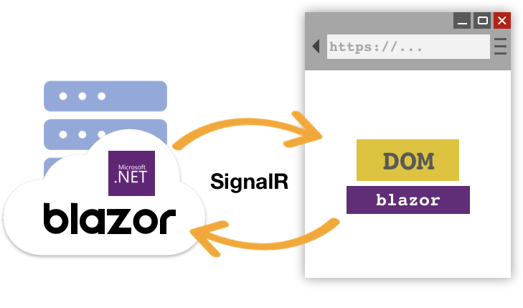
But, can it scale?
What’s the performance like?

Slide 25
Standard D1 v2 Instance (1vCPU & 3.5GB memory)
Over 5000 concurrent users
Standard D3 v2 Instance (4vCPU & 14GB memory)
Over 20,000 concurrent users

Slide 26
Production ready
Released with .NET Core 3
Fast load time
Server pre-rendering is an option
Small payload
No runtime to download
Access to full runtime
Running on the server so can access the full .NET Core 3 runtime
Code security
Code stays on the server – never passed to the client

Slide 27
Heavy load on server
Server has to do all the work
Doesn’t work offline
Everything is on the server
Latency
Distance between client and server matters – a lot (<= 100ms).
Requires a fast and stable internet connection
Slow connections will result in a slow app

Slide 28
Pro Tip: Best of Both Worlds

Slide 29
Getting started with Blazor
Requirements
.NET Core 3 - https://dot.net/get-core3
Visual Studio 2019 or VS Code - https://visualstudio.com
Resources
Blazor Official Site - https://blazor.net
Awesome Blazor - https://github.com/AdrienTorris/awesome-blazor
Docs - https://blazor.net/docs
Blazor Gitter - https://gitter.im/aspnet/Blazor
Blazor Workshop - https://aka.ms/blazorworkshop
My blog - https://chrissainty.com

Slide 30
Thank you for coming. Enjoy the rest of the conference!

