Slide 1
Coursera Capstone Project
By Chris Saldana

Slide 2

Background
Where to open a new independent pizzeria in San Antonio?

Slide 3
Introduction
Location is the most important aspect of a new restaurant
Desired Qualities
Nice area of the city
Minimal direct competitors
Reasonable rent prices
Analysis to use Foursquare API and Python Notebook to perform K-Means clustering

Slide 4
Data
San Antonio zip codes
Foursquare venue information
Pizza Places in San Antonio (30 mile radius)
Latitude and longitude coordinates
Python libraries for geocoding

Slide 5
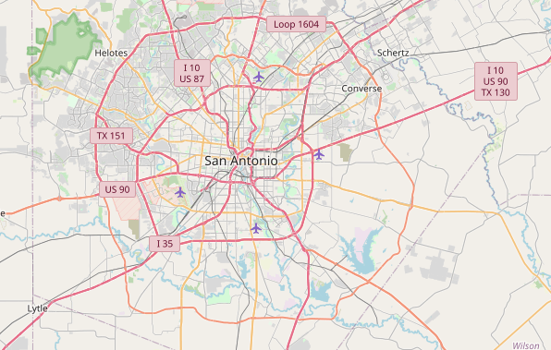
Methodology – SA Map
Utilize Python geocoder library

Slide 6
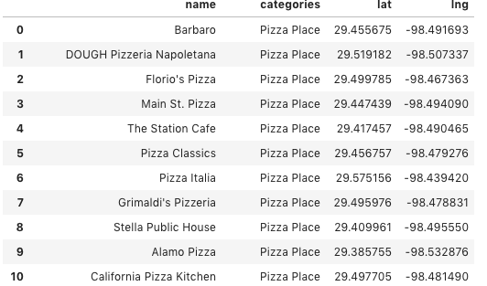
Methodology – SA Pizza Places
Utilize Foursquare API call
10 displayed below, 99 in total

Slide 7
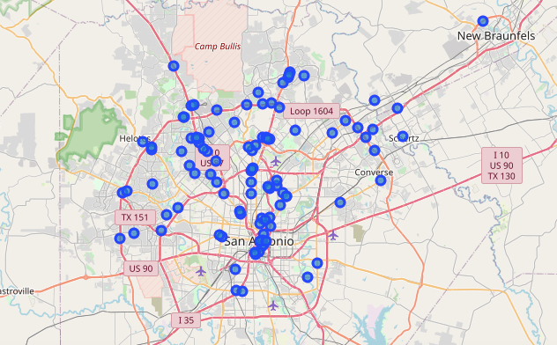
Methodology – Plot Venues

Slide 8
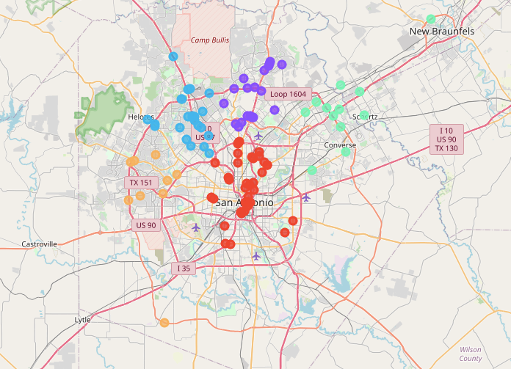
Methodology – K-Means
5 clusters applied

Slide 9
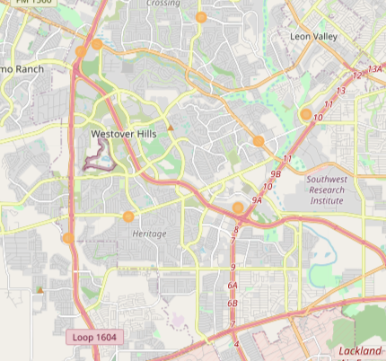
Results
Cluster 4 (Northwest SA) appears desirable due to low-density of competitors

Slide 10
Conclusion
Choose NW San Antonio to open a new independent pizzeria
Attributes satisfied
Low-density of direct competitors
Attractive part of San Antonio
Reasonable rent prices

Slide 11
Thank you!

