Slide 1
Republicans versus Democrats Pooled

Slide 2
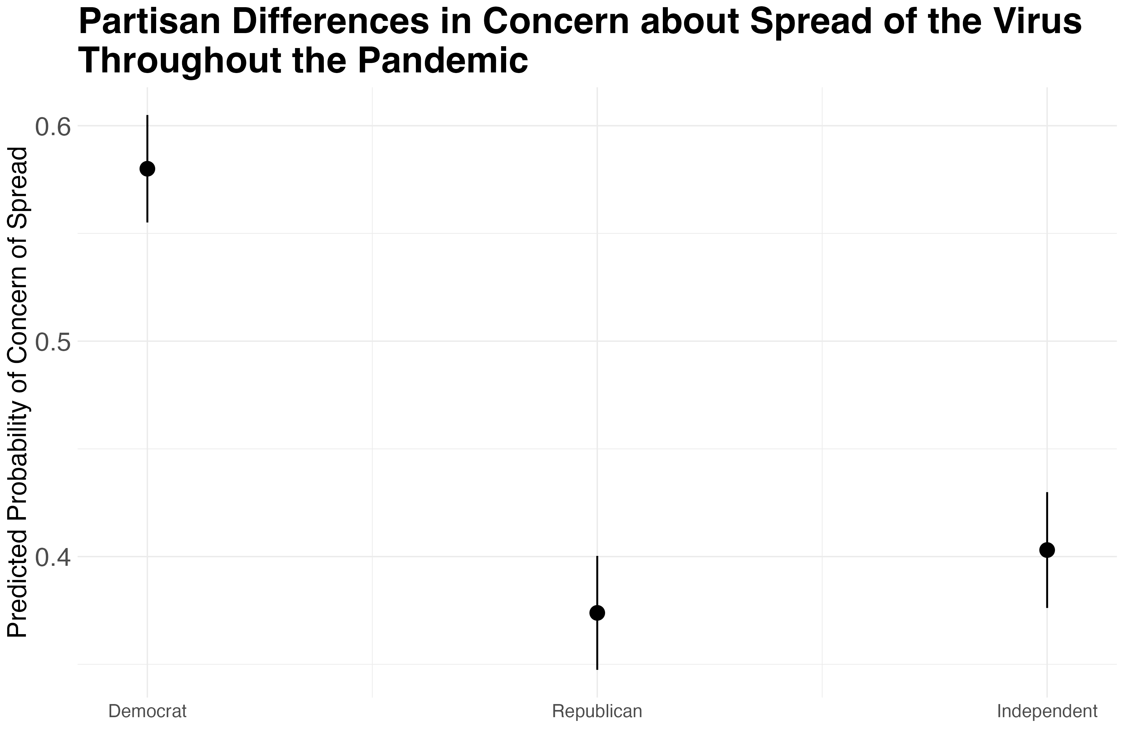
Concern

Slide 3
Contact Reduction

Slide 4
Reported Contact

Slide 5
Masked Contacts

Slide 6
Vaccination

Slide 7
Republicans versus Democrats Over Time

Slide 8
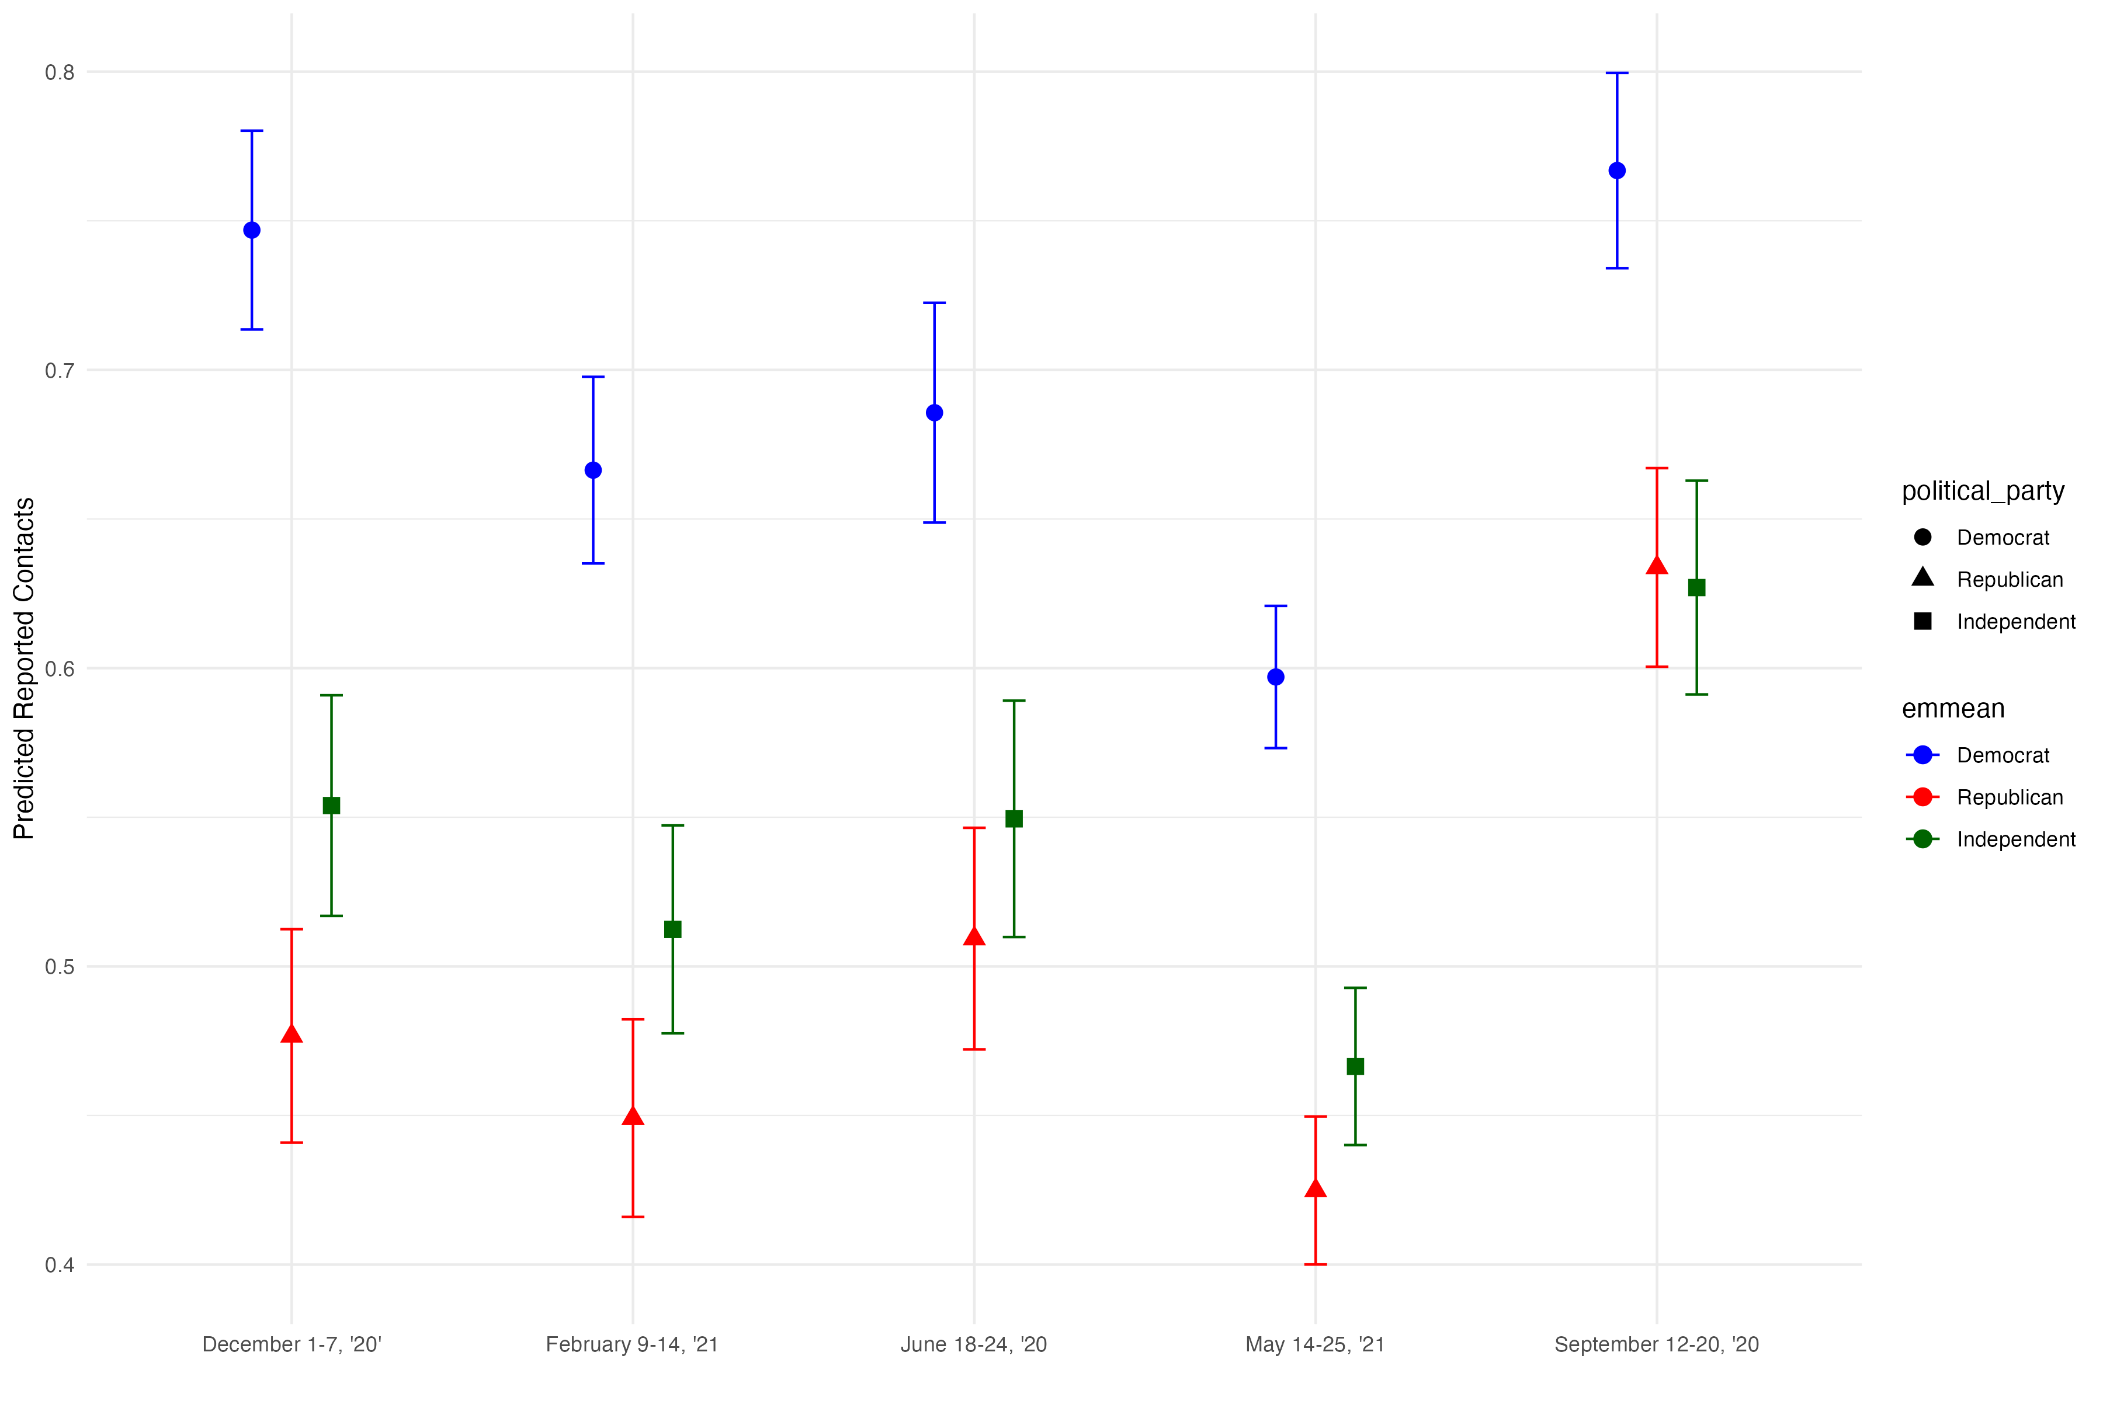
Concern

Slide 9
Contact Reduction

Slide 10
Reported Contact

Slide 11
Masked Contact

Slide 12
Being in an Opposing Party District Categorical

Slide 13
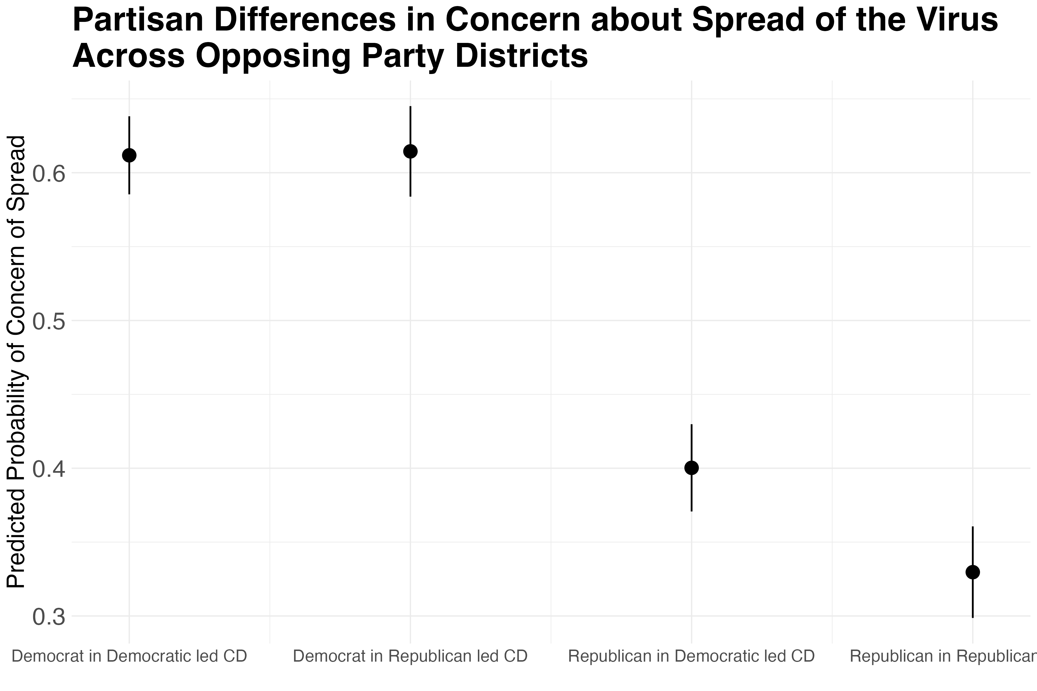
Concern
Notes:
No difference in concern for democrats regardless of district

Slide 14
Contact Reduction

Slide 15
Reported Contacts

Slide 16
Masked Contacts

Slide 17
Being in a Democratic District Relationships

Slide 18
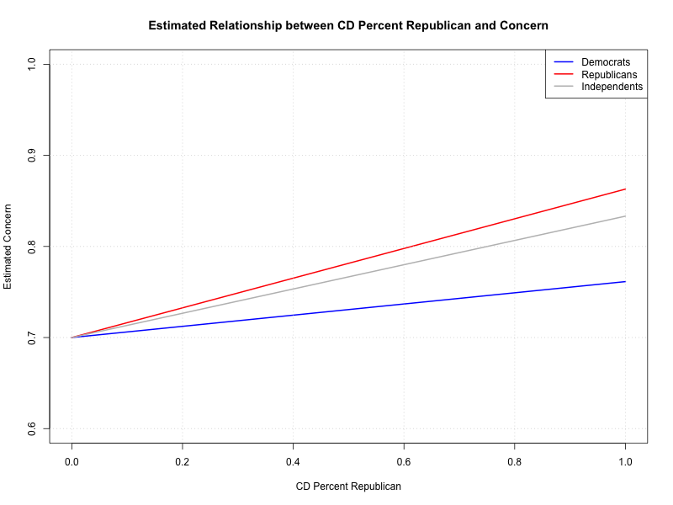
In Democrat Districts: Concern

Slide 19
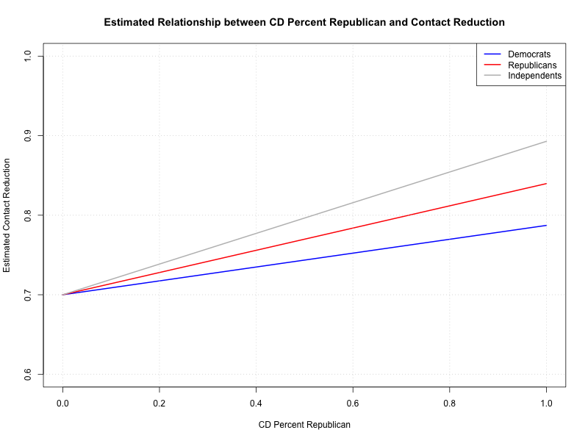
In Democrat Districts: Contact Reduction

Slide 20
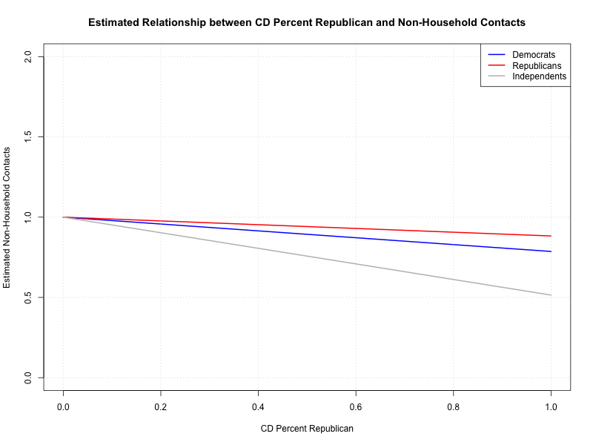
In Democrat Districts: Contacts
Notes:
Dem slope only becomes statistically significant after I control for county_mask_mandates

Slide 21
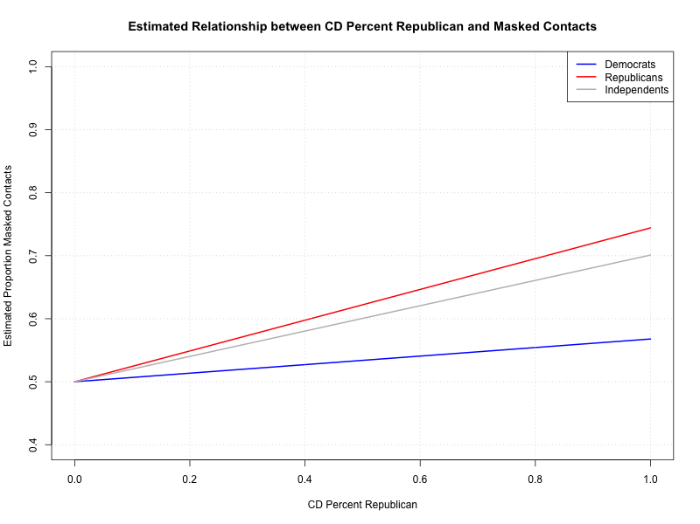
In Democrat Districts: Masked Contact
Notes:
This is the opposite of what Baxter found (they found that Republicans are less likely to wear masks in democratic districts). This is also consistent with concern.

Slide 22
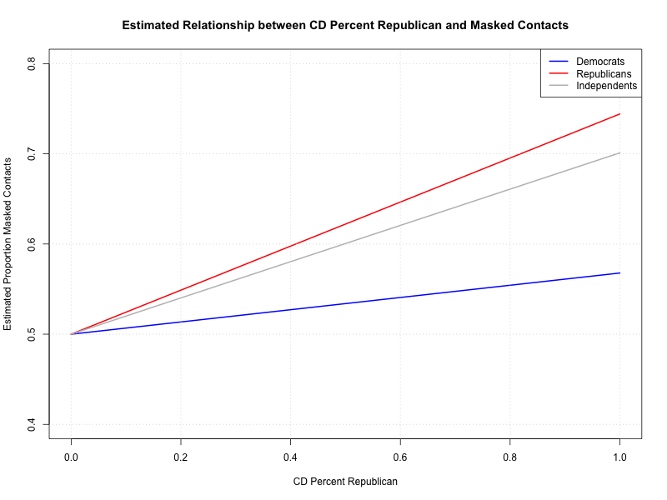
In Democrat Districts: Vaccines

Slide 23
Being in a Republican District Relationships

Slide 24
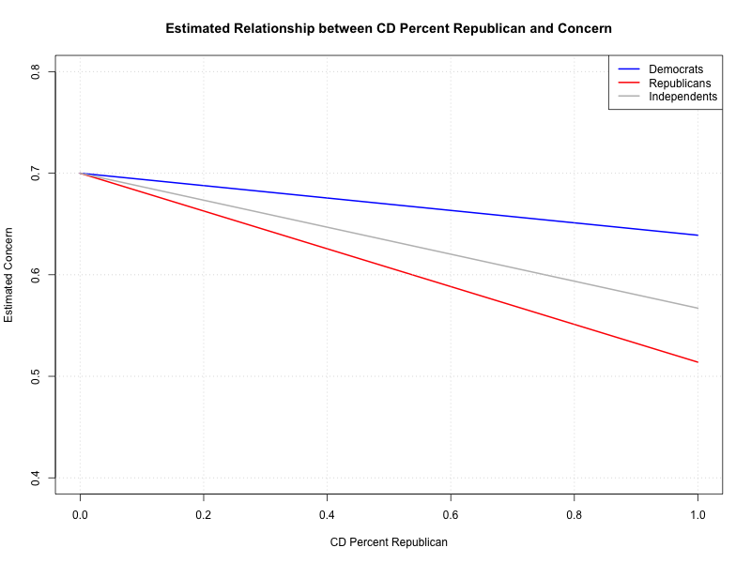
In Republican Districts: Concern

Slide 25
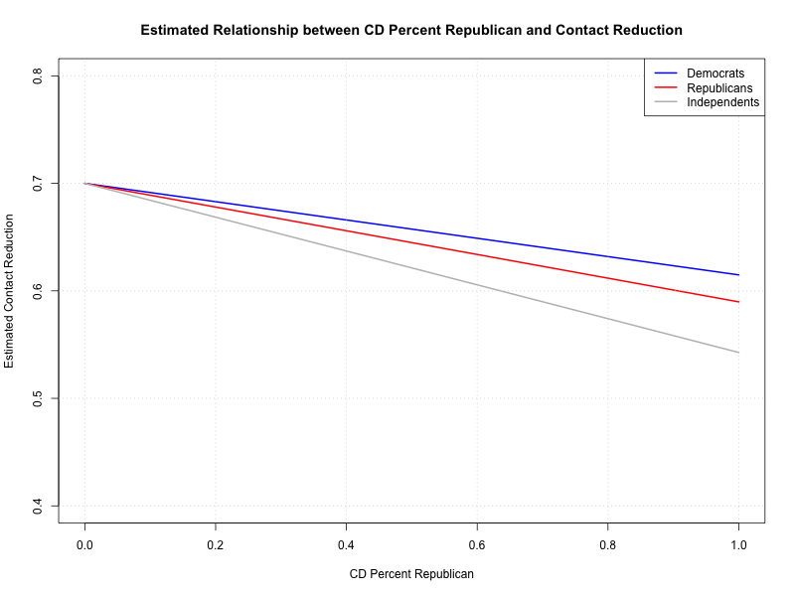
In Republican Districts: Contact Reduction

Slide 26
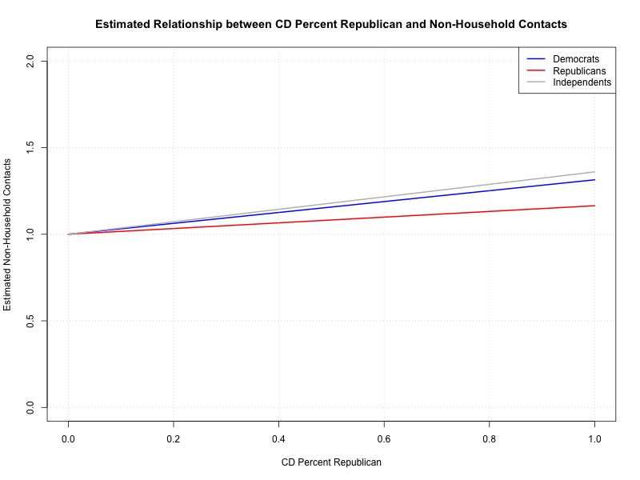
In Republican Districts: Contacts

Slide 27
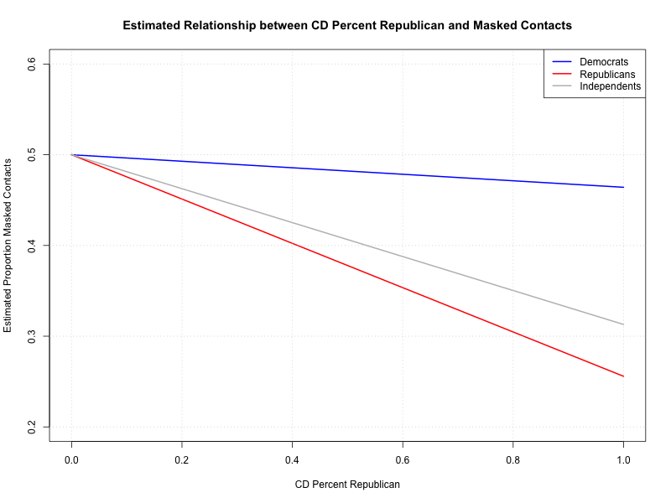
In Republican Districts: Masked Contact

Slide 28
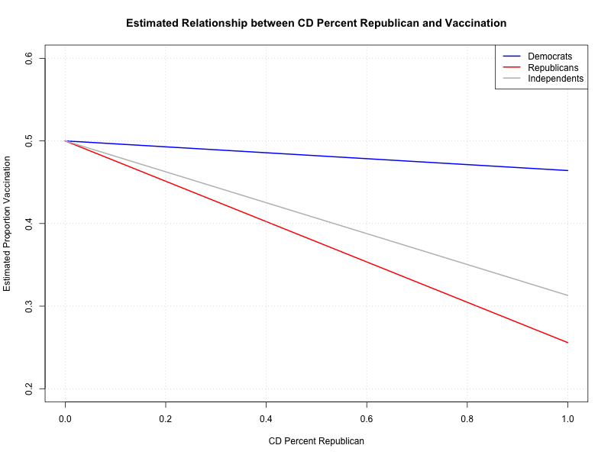
In Republican Districts: Vaccines

