Slide 1

Political Beliefs, Partisanship, and Health Behaviors during the COVID-19 Pandemic
Chris Soria¹
Audrey Dorélien²
Ayesha Mahmud¹
Dennis Feehan¹
University of California, Berkeley
University of Minnesota
Notes:
Three things I want to show
differences between republicans and democrats
differences between republicans and democrats in opposing party districts
differences in how they respond to incidence rates

Slide 2
Background
Mathematical models for studying COVID-19 transmission have typically not incorporated heterogeneity in behavior by political party affiliation (Lloyd-Smith, J.O., et al., 2005)
Excess mortality for COVID-19 was significantly higher for Republican voters than Democratic voters (Wallace, A., Goldsmith-Pinkham, P., & Schwartz, J. , 2023; Gallup, 2020)
Party affiliation is associated with health-related behaviors
Individual and local partisan context results (Baxter-King, R., et al., 2022)
Notes:
At individual level, republicans ….
Local partisan context influences indiRepublican mask-wearing declines with more local Republicans, while Democratic habits remain unchanged by partisan surroundings (Baxter-King, R., et al., 2022)

Slide 3
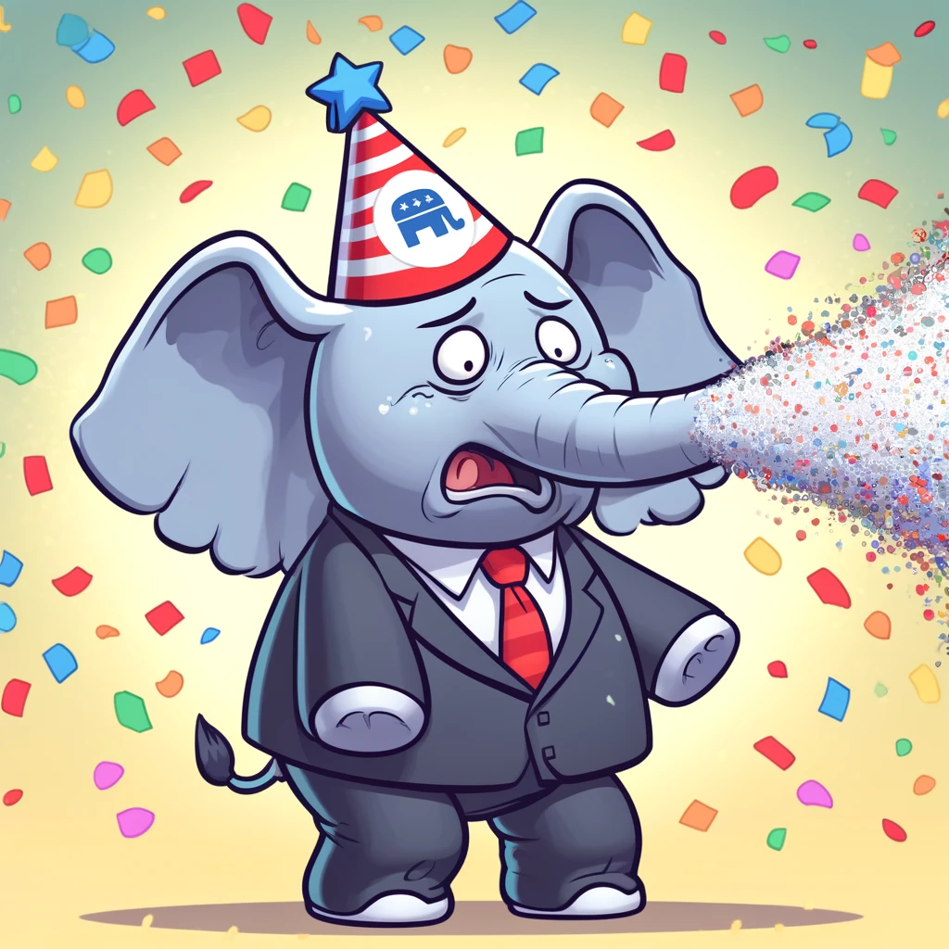
Our Contributions/ Research Questions
How did individual political orientation and the local partisan context impact health behaviors during the pandemic?
Behaviors: contact rates, mask use, vaccination
Partisanship and prevalence dependent behavior
3. What are the implications for the spread of infectious diseases in heterogeneous populations?
Notes:
How responsive are partisans to disease incidence/mortality?
The ultimate goal of this research is to develop infectious disease models that can incorporate political affiliation

Slide 4
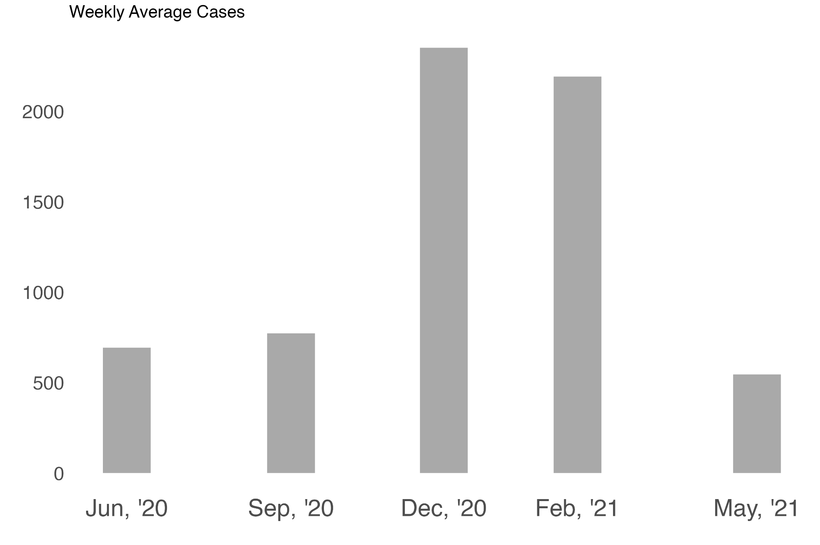
Berkeley Interpersonal Contact Surveys (BICS)
COVID-19 Deaths per ?
Wave | Sample Size
2 (June ‘20) | 2,309
3 (Sept ‘20) | 3,216
4 (Dec ‘20) | 2,976
5 (Feb ‘21) | 2,958
6 (May ‘21) | 5,345
Total | 16,804
Omicron variant leads to a record number of cases
The U.S. COVID-19 death toll surpasses 100,000
FDA authorizes the vaccine for children 5 through 11 years of age
Joe Biden takes office
FDA authorized the vaccine for emergency use
Source: Johns Hopkins Coronavirus Resource Center
Notes:
Context: The WHO has declared COVID-19 a global pandemic (3/11/20). Right before June, 2020, where we begin our study, the US COVID-19 death toll surpasses 100,000 in late May.

Slide 5

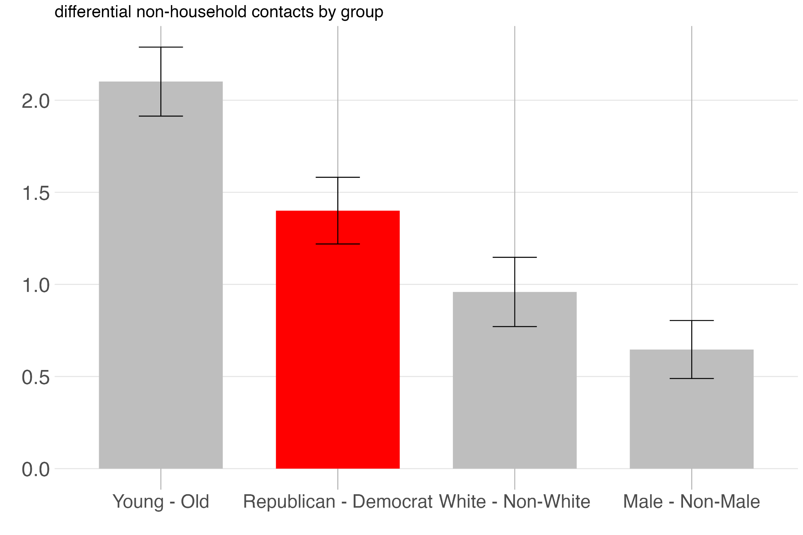
Partisan differences in contact rates are greater than racial and gender differences
Source: BICS Pooled Data (June 2020–May 2021)

Slide 6
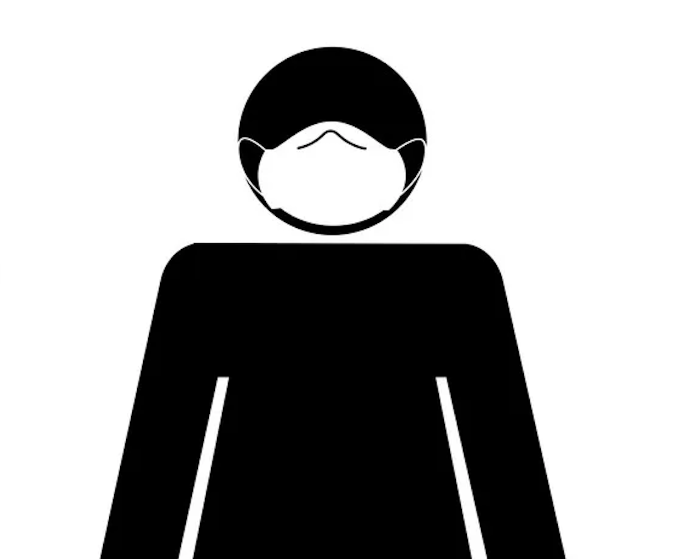
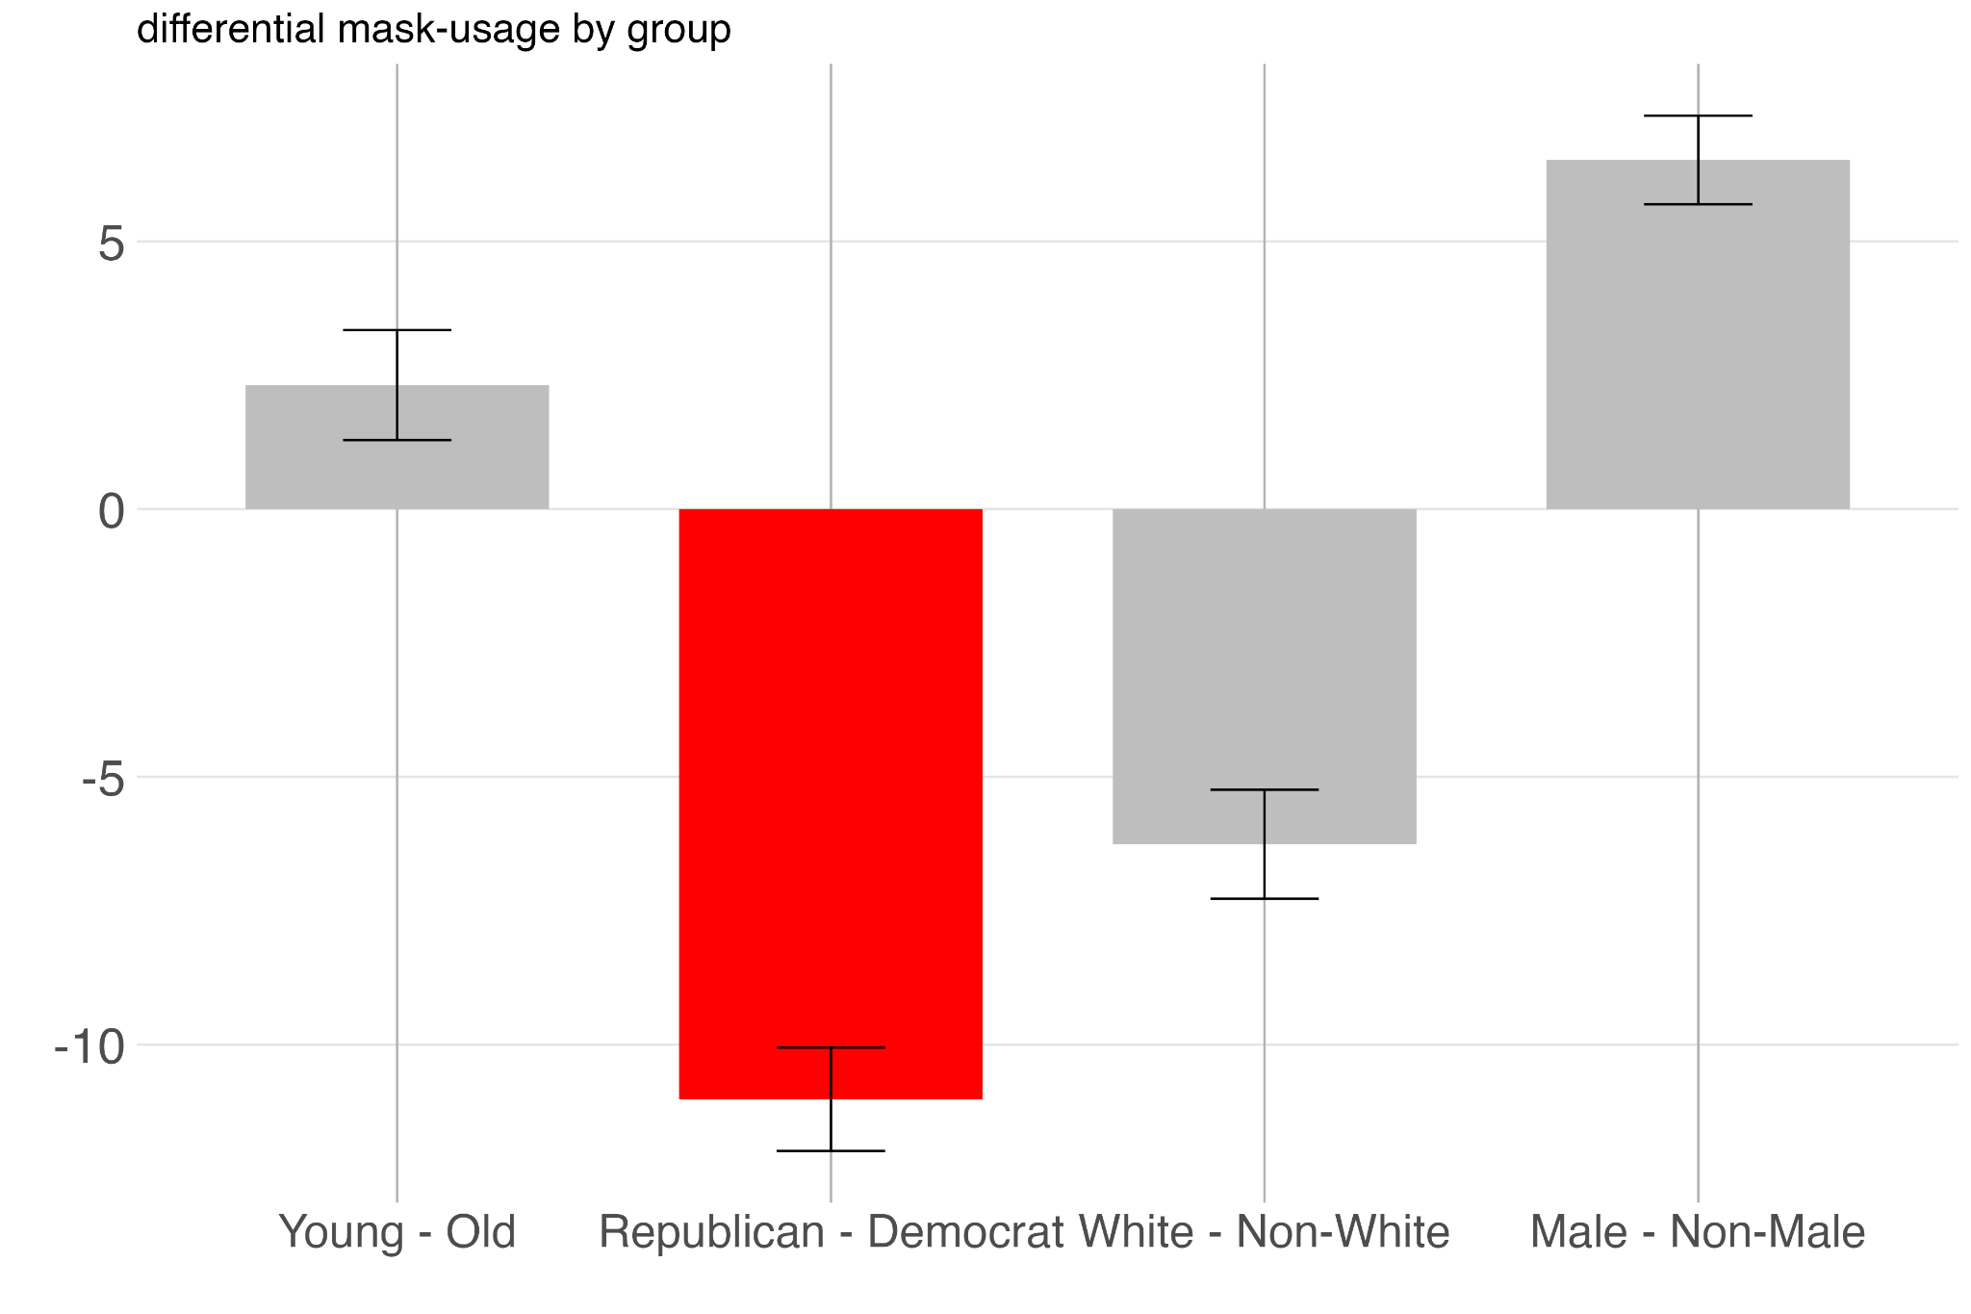
Biggest differences in mask usage are based on partisan differences!
Source: BICS Pooled Data (June 2020–May 2021)

Slide 7
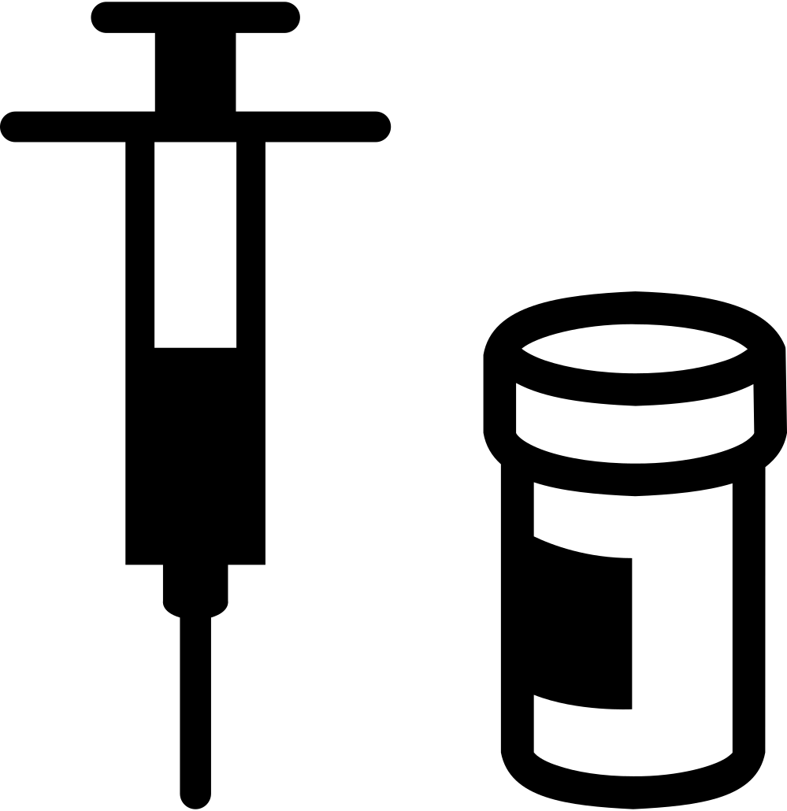
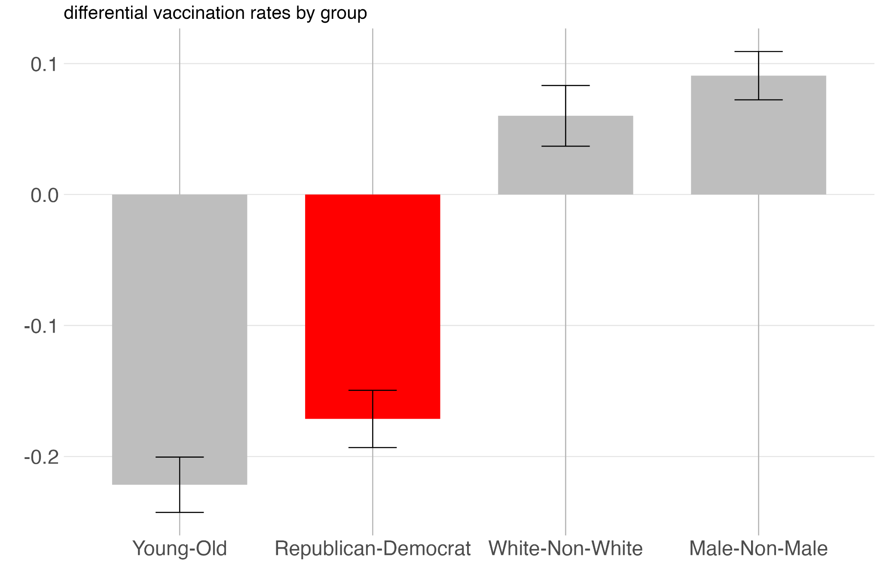
Partisan differences in vaccination rates are also large
Source: BICS (May 2021)

Slide 8
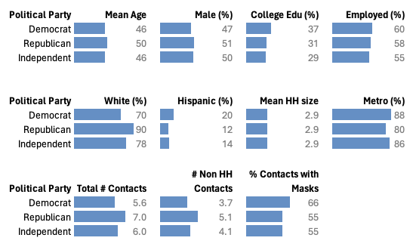
Republicans and Democrats are different but these differences don’t drive our results
Source: BICS Pooled Data (June 2020–May 2021)
Notes:
Rep less likely to be Hispanic and live in metro areas compared to Democrats.

Slide 9
Methods
Full List of Controls
Race
Gender
Age
Education
Household Size
County Urbanicity
County Mask Mandate
County Incidence Rate
Wave
Sample Source
Utilized multivariate linear models to extract estimated marginal means.
Sum of non-Household contacts
Percentage of contacts where the respondent wore a mask
Vaccination rates
Contextual factors
Analyzed at the county level: Rural vs. urban distinctions, incidence rates, and mask mandates.
Incidence rate models include county-fixed effects to control for local variations.

Slide 10
Results

Slide 11
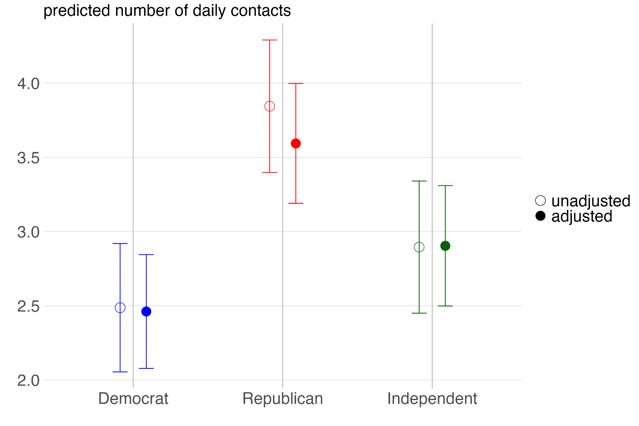
Democrats have fewer non-household contacts throughout the pandemic

Slide 12
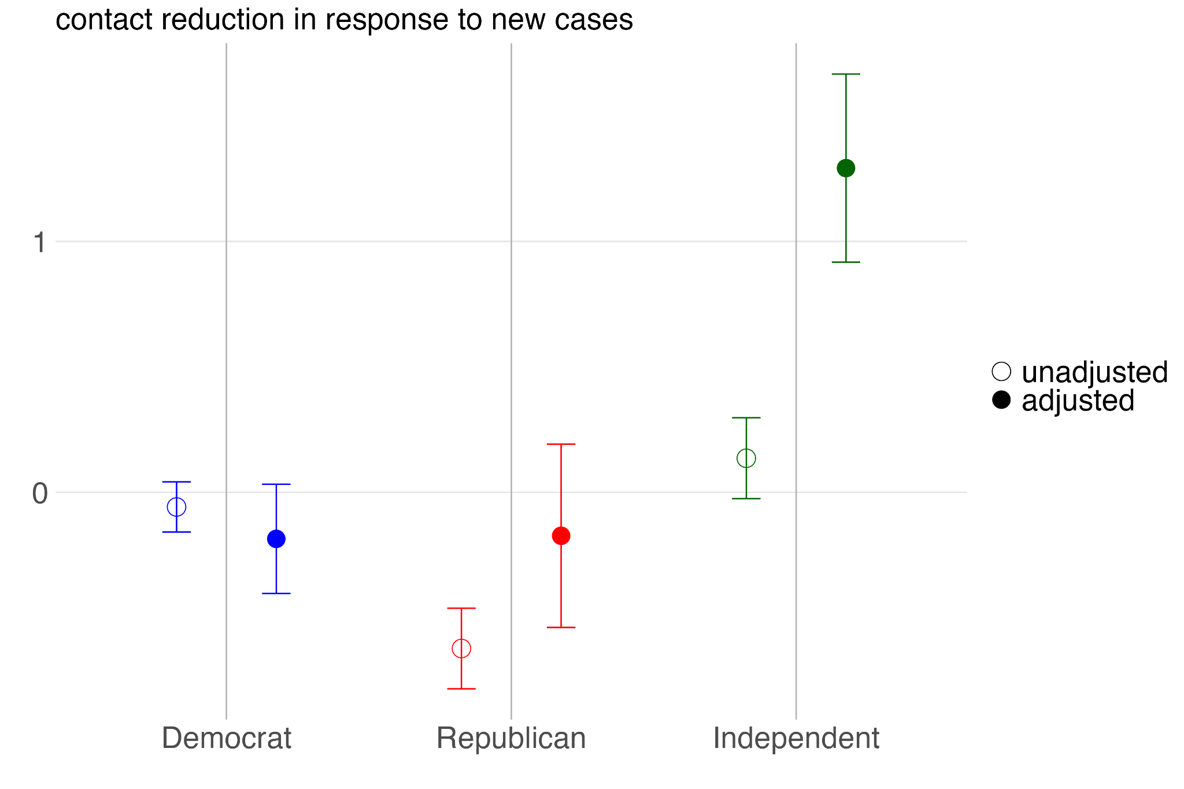
Republican non-household contact behavior is more influenced by incidence rates
A quadrupling of incidence rates leads to nearly a full contact reduction for Republicans.
Notes:
Delta = B/100 Delta = B * log(1.10) #10 percent increase in X
1 = B * log(x), x > 0
B = -0.67665 THEN
Delta = -0.67665 * log(2)
-1 = -0.67665*log(x)
log(x) = -0.67665/-1
X = exp( -0.67665/-1)
X= 1.967276

Slide 13
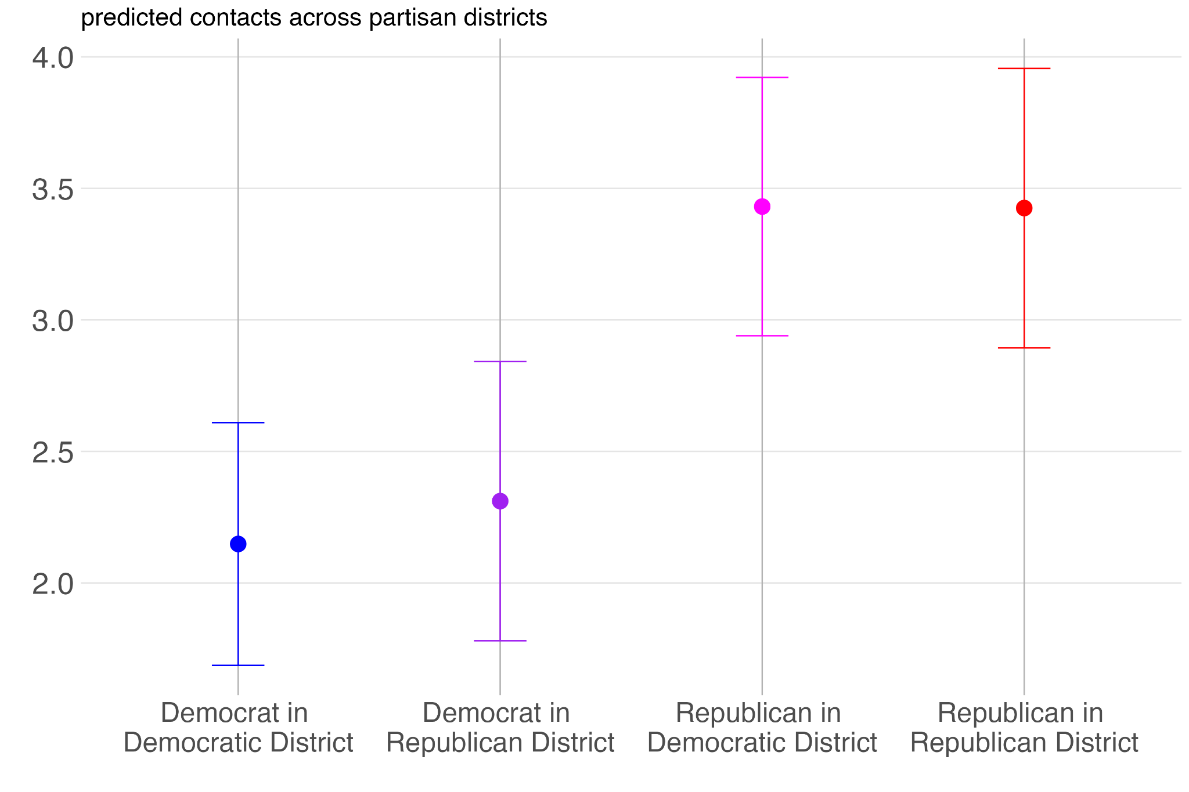
Partisan non-household contacts do not vary by local partisan context

Slide 14
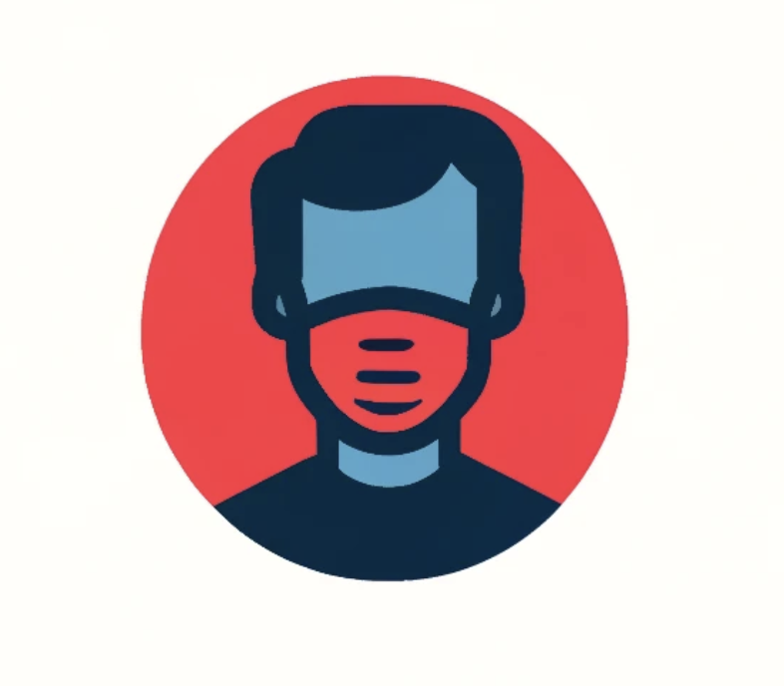
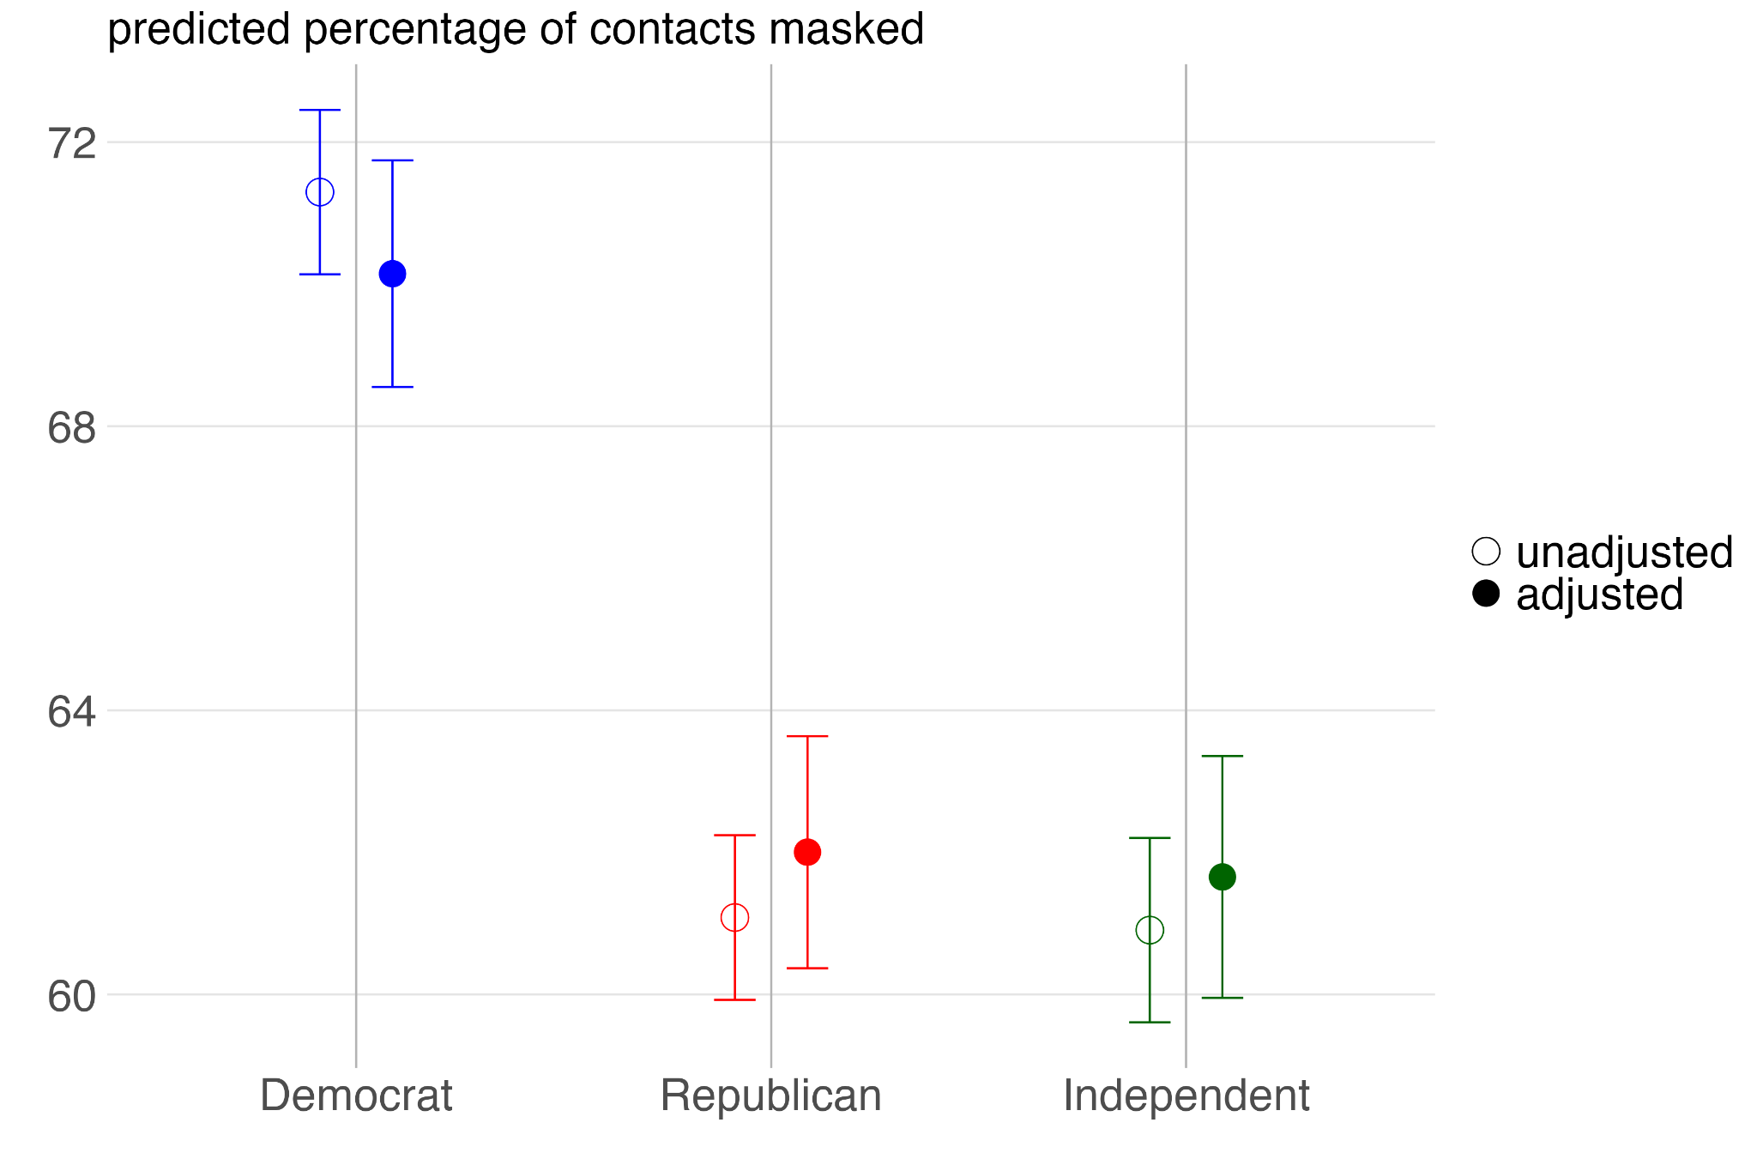
Democrats are more likely to report wearing a
mask throughout the pandemic

Slide 15
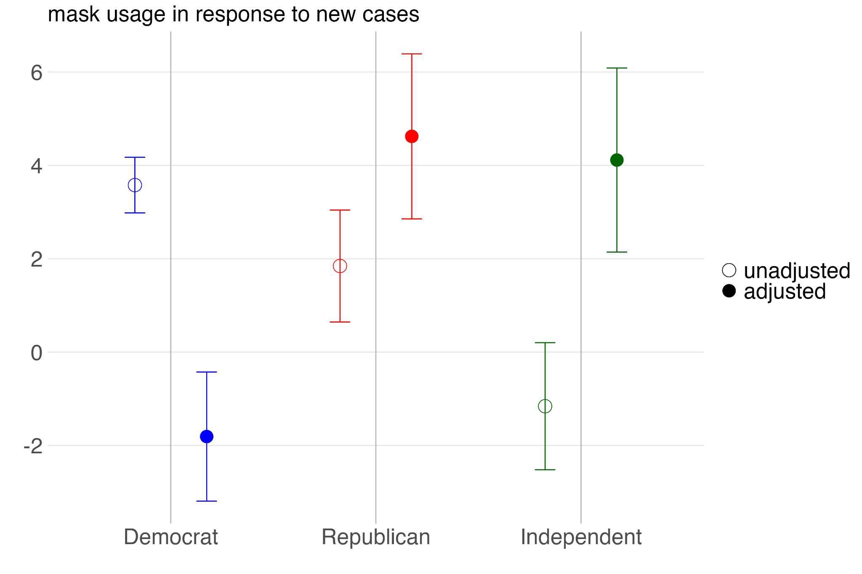
All groups react similarly to increased incidence when it comes to mask usage
Notes:
a 4 point increase in the incidence per capita is associated with a 1 percent increase in mask usage
AD- Regardless of party affiliation, there are no statistically significant differences in response. However the level of mask use is different.

Slide 16
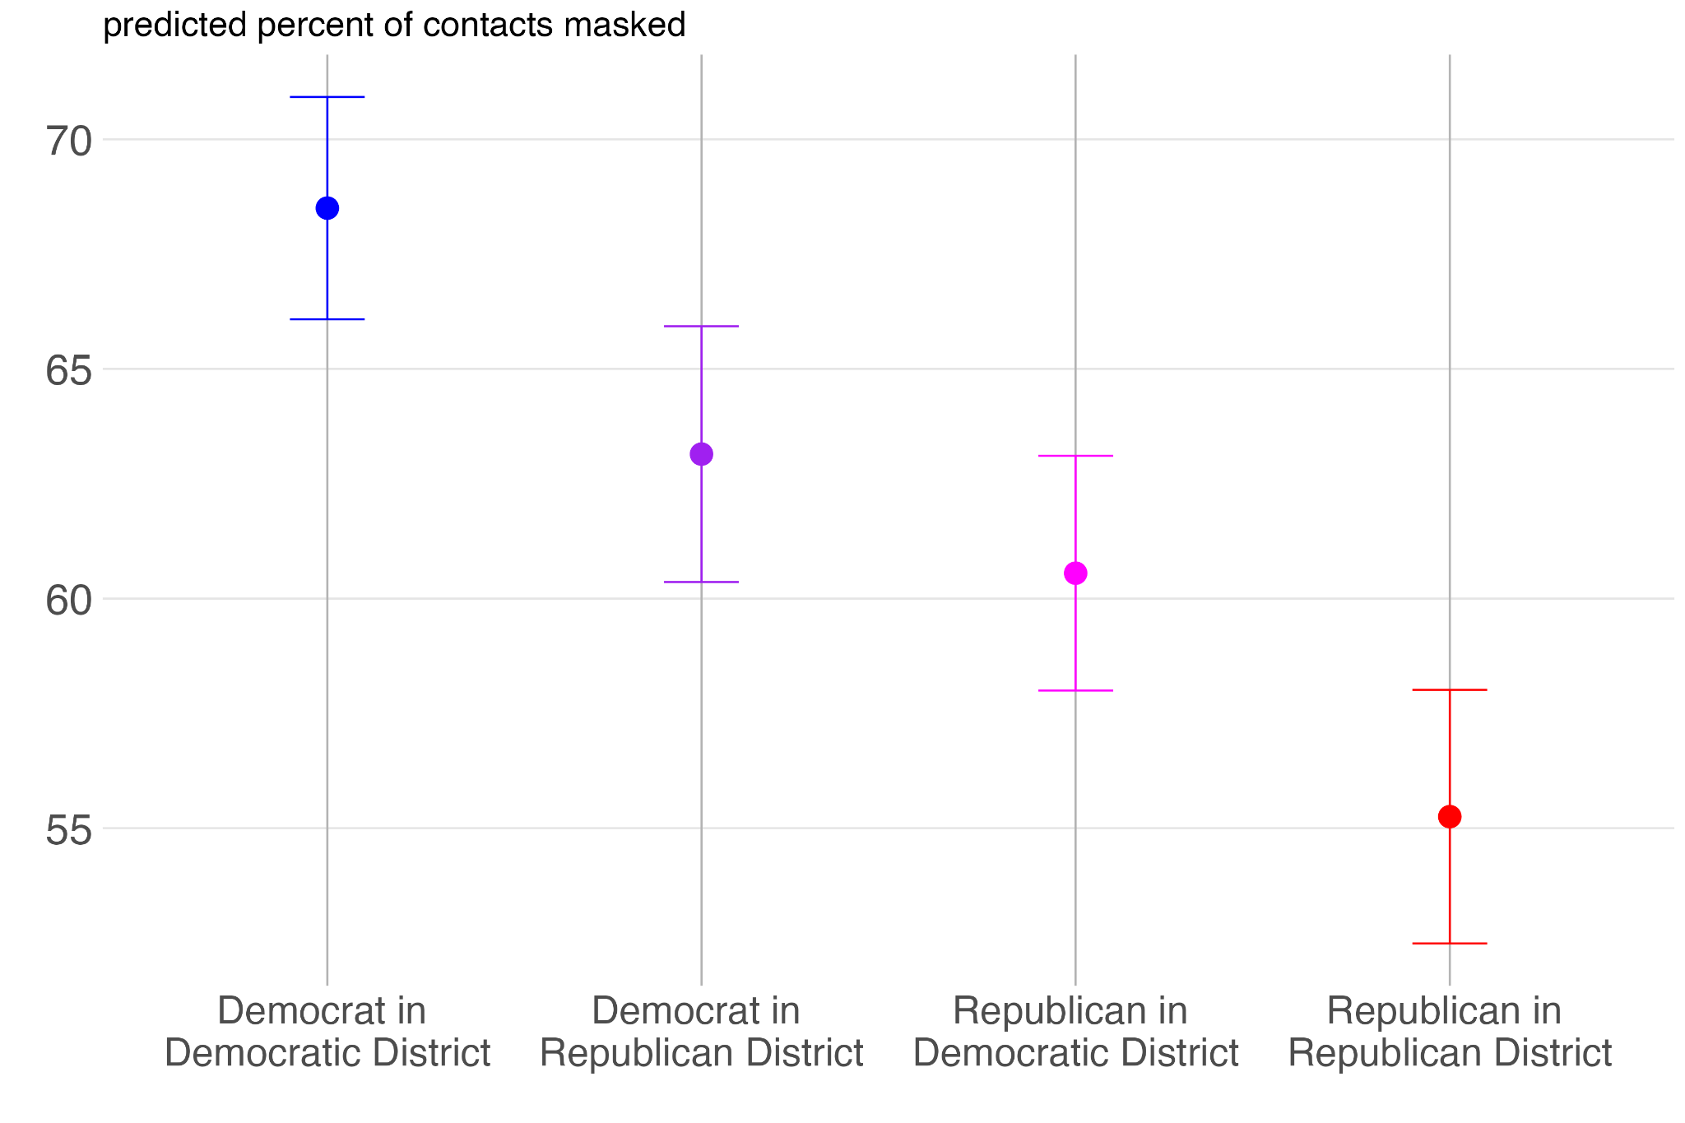
Local partisan context is associated with reported mask usage for both Democrats and Republicans
Notes:
Mention that this is different from Baxter

Slide 17
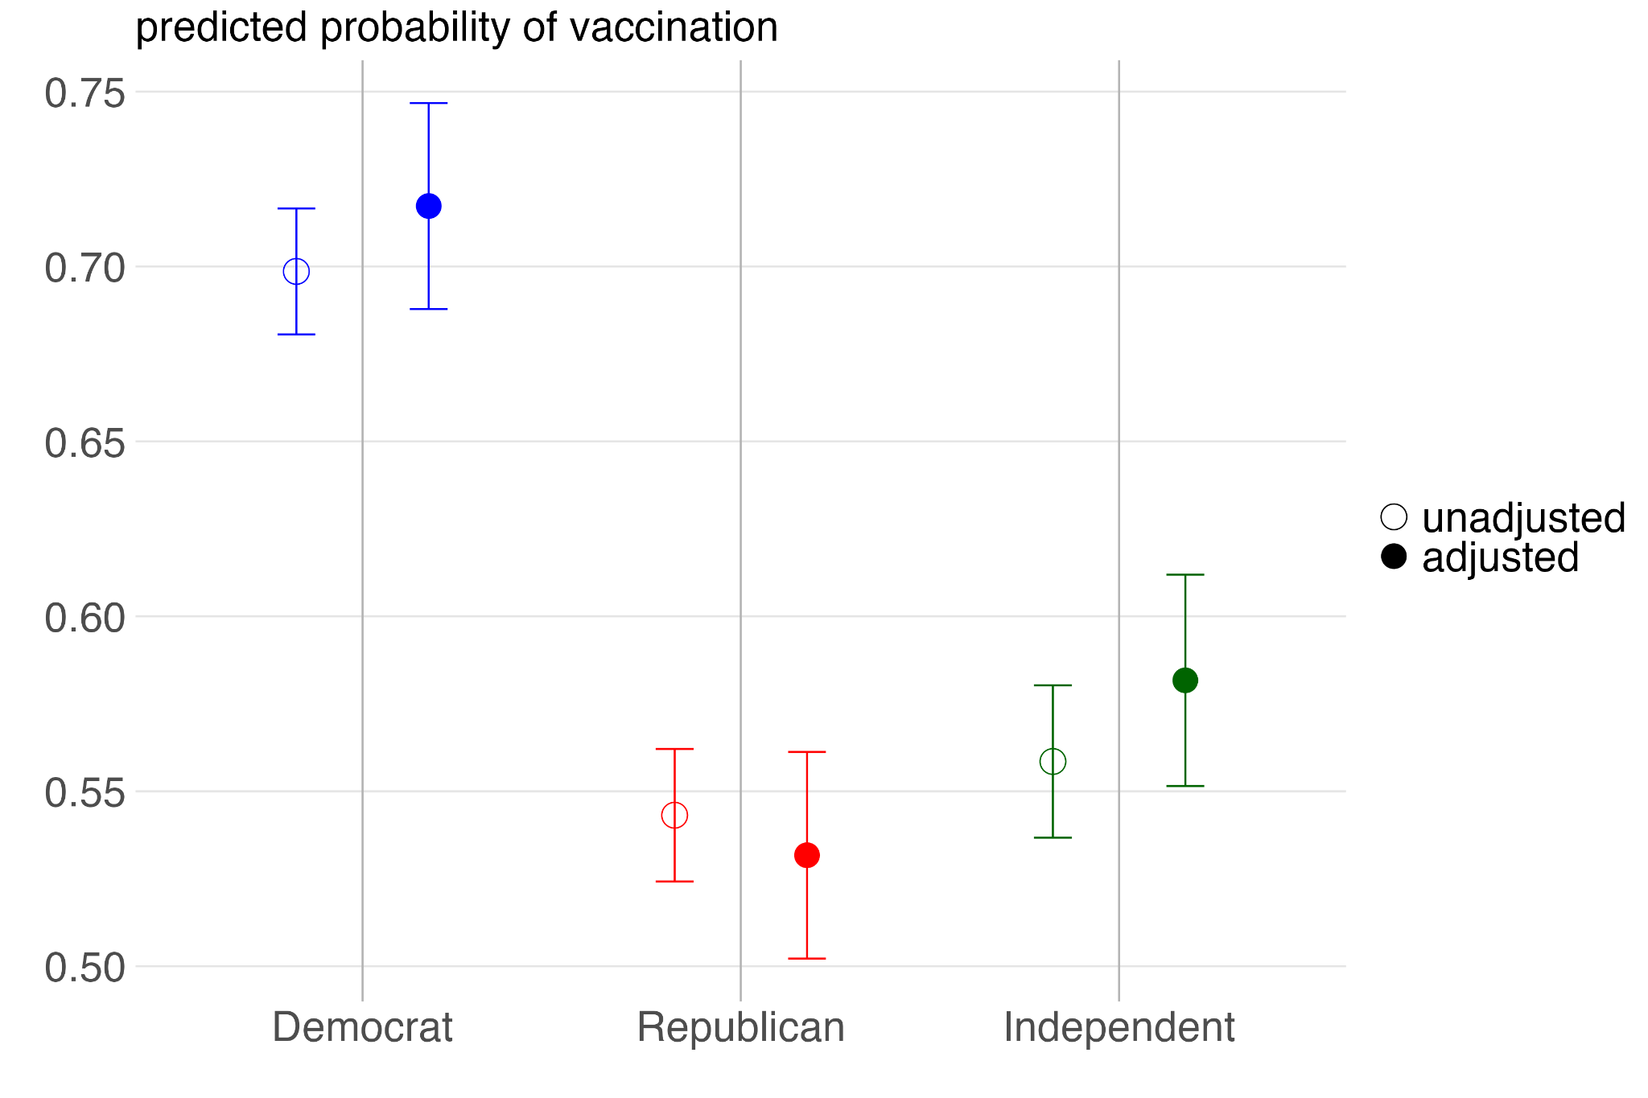
Democrats are more likely to report being vaccinated
Source: BICS May 2021
Notes:
How is vaccination defined? At least one dose?

Slide 18
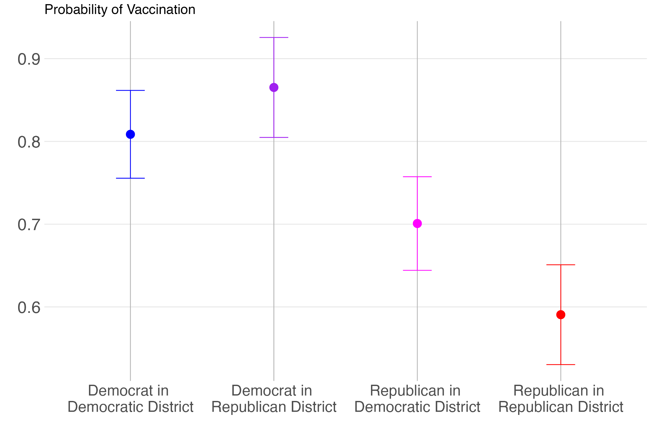
Republican are even more likely to report being vaccinated in Republican districts
Source: BICS May 2021

Slide 19
Why does this matter?

Slide 20
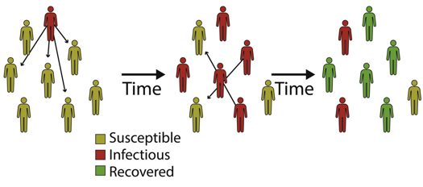

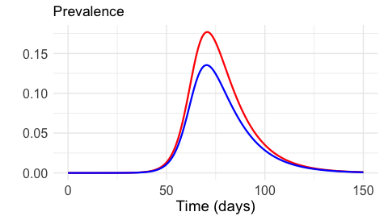
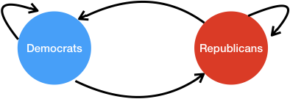
Epidemic dynamics are sensitive to changes in contact rates
Xavier et al. (2022)
Notes:
These models can help us understand how quickly a disease can spread by predicting the number of people who will become infected over time and how the disease will progress through a population. However, without a solid understanding of what factors contribute to contact rates and preventative behavior adoption we cannot produce accurate estimates. As I hope I’ve shown in the previous slides, political affiliation is a major predictor of behavior during the pandemic and therefore important to account for in disease modeling.

Slide 21
Conclusion
Democrats and Republicans differ greatly in their contact rates, mask usage, and vaccination rates during the pandemic
Democrats reported non-household contact rates, higher percentage of contacts with a mask, and higher probability of getting the vaccination
Democrats and Republicans differ in how responsive they are to new cases
Republicans contact rates were more sensitive to variations in incidence. They cut non-household contacts more dramatically and increased them soon after incidence rates began to drop.
Congressional district context matters for understanding partisan behavior
Democrats in Republican districts don’t change their contact patterns

Slide 22
Thank you!
Funding:
Berkeley Population Center pilot grant (NICHD P2CHD073964); Hellman Fellows Program (Dennis Feehan).
Dorélien acknowledges support from the Minnesota Population Center (P2C HD041023) funded through a grant from the Eunice Kennedy Shriver National Institute for Child Health and Human Development (NICHD)

Slide 23
Additional Slides

Slide 24
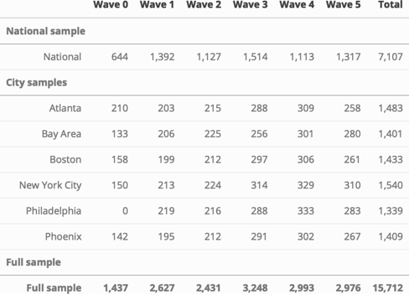
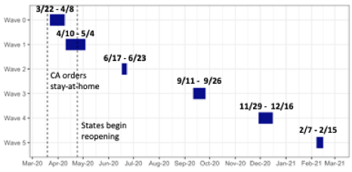
Berkeley Interpersonal Contact Surveys (BICS)
Notes:
National sample, + samples from 6 specific cities, obtained from online panel provider Lucid
questions about respondent and who respondent’s contacts are
information on interpersonal contact
face-to-face contacts relevant for potential transmission of COVID-19
household structure
5 waves of data collection repeated cross-section
n = about 21,100 across all 5 waves (CHANGE THIS)

Slide 25
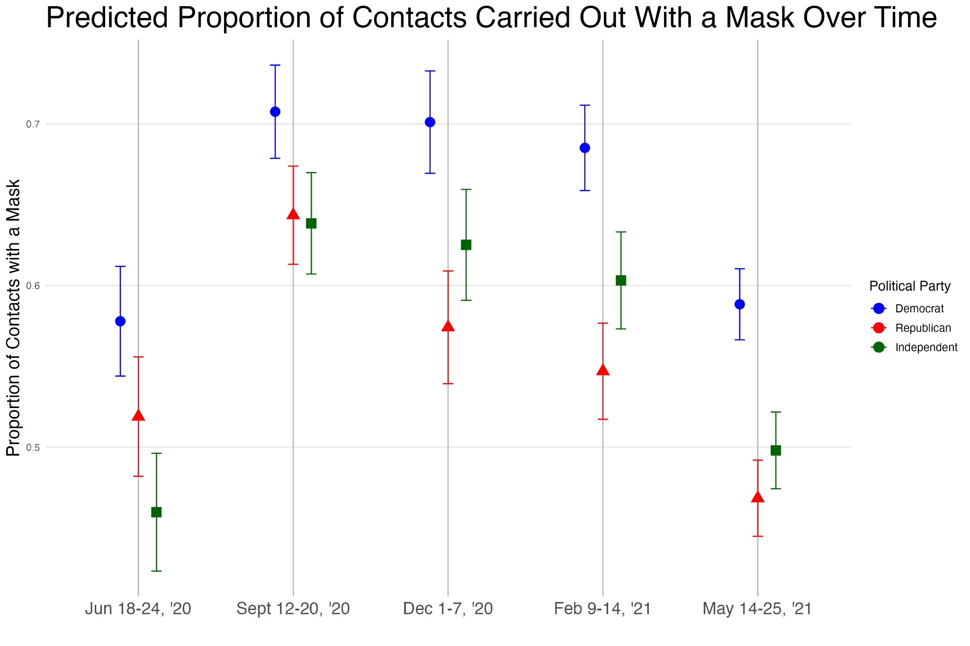
Republicans consistently report lower mask usage during their contacts compared to Democrats
Notes:
What I see:
Throughout the entire period Democrats are using masks more
As the pandemic continues, the gap between Democrats and Republicans widens

Slide 26
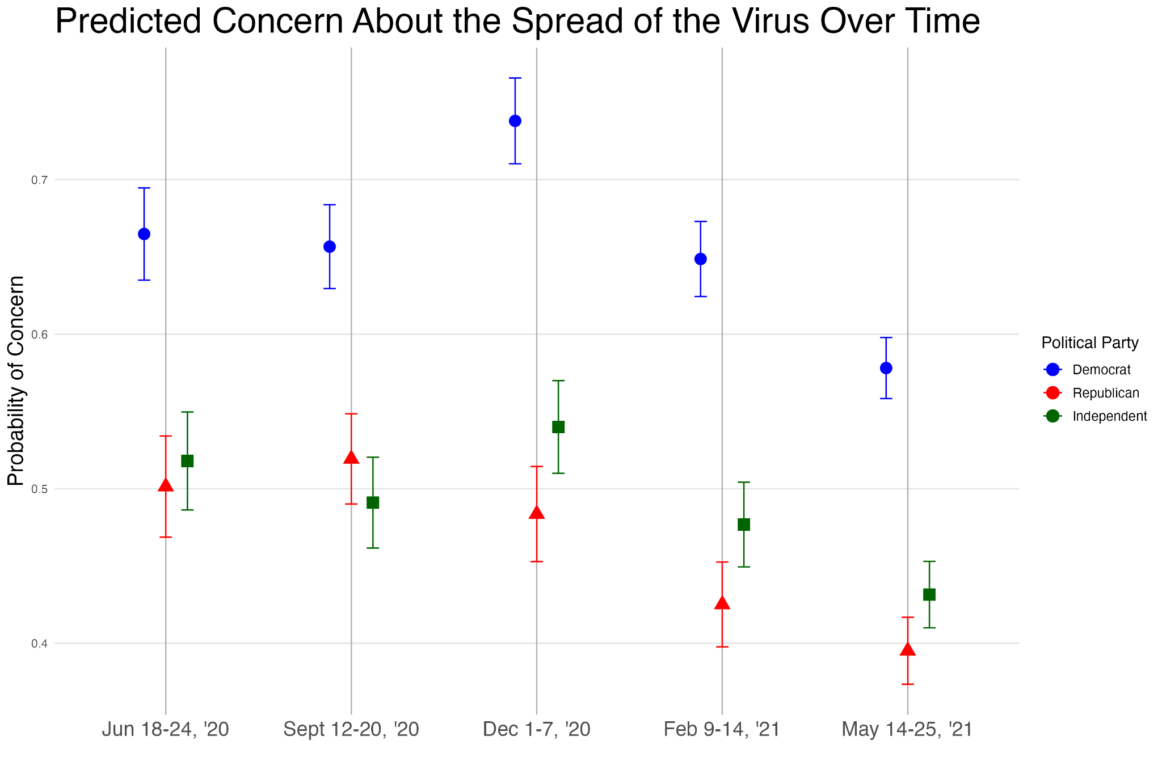
Republicans consistently report lower concern about the spread of the virus compared to Democrats
Notes:
What I see:
Democrat concern about the spread of the virus tracks with mortality rates
Republican concern about the spread of the virus drops consistently after sept 2020 even though mortality rates are higher (waning important)

Slide 27
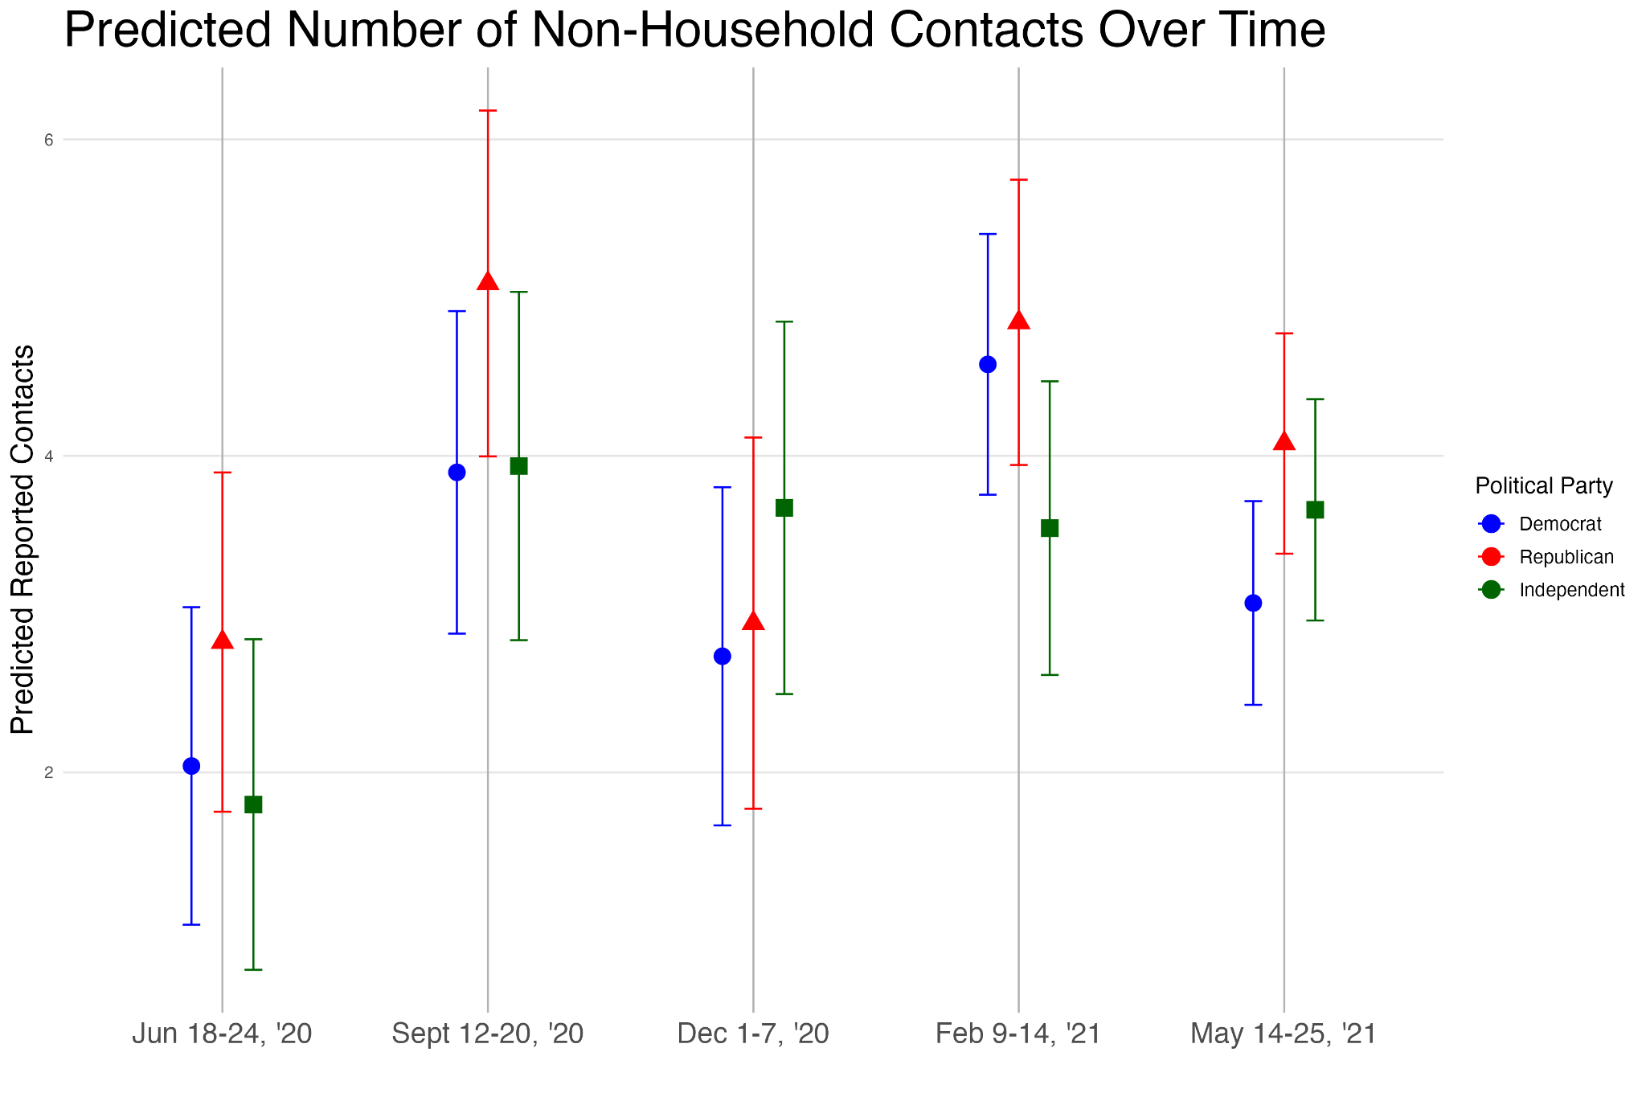
Republicans consistently report higher number of non-household member contacts compared to Democrats
Notes:
Things I see:
Republican contact rates are consistently higher
Democrat versus Republican differences are smallest when mortality rates are highest
Republicans are quicker to react to dropping mortality rates than Democrats (AD- this is interesting that their behavior does not match which their level of concern)

Slide 28
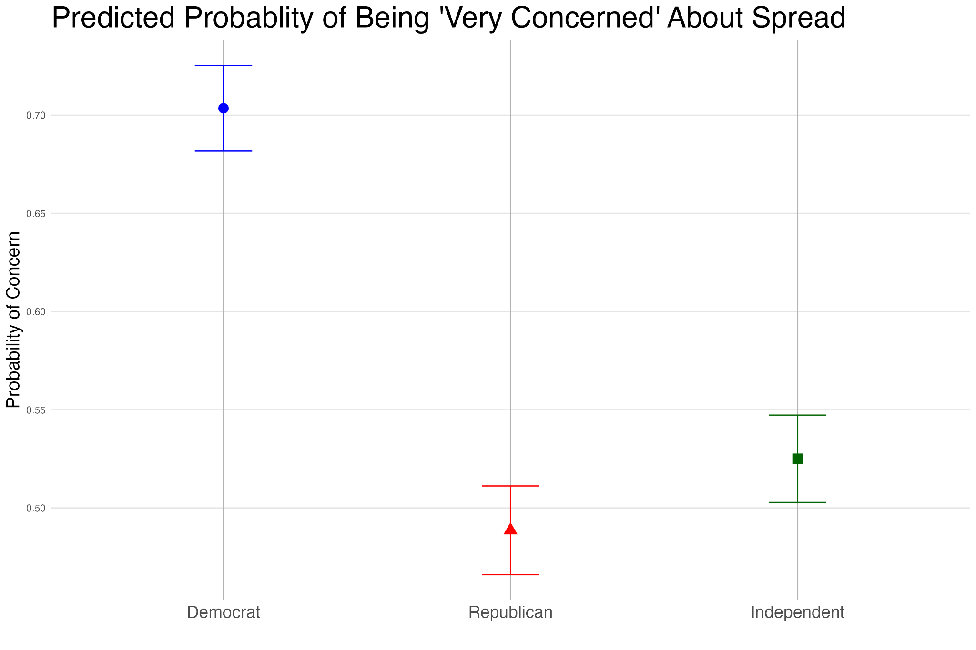
Democrats are more concerned about the spread of the virus throughout the pandemic
Notes:
We get similar results if we disaggregate by wave

Slide 29
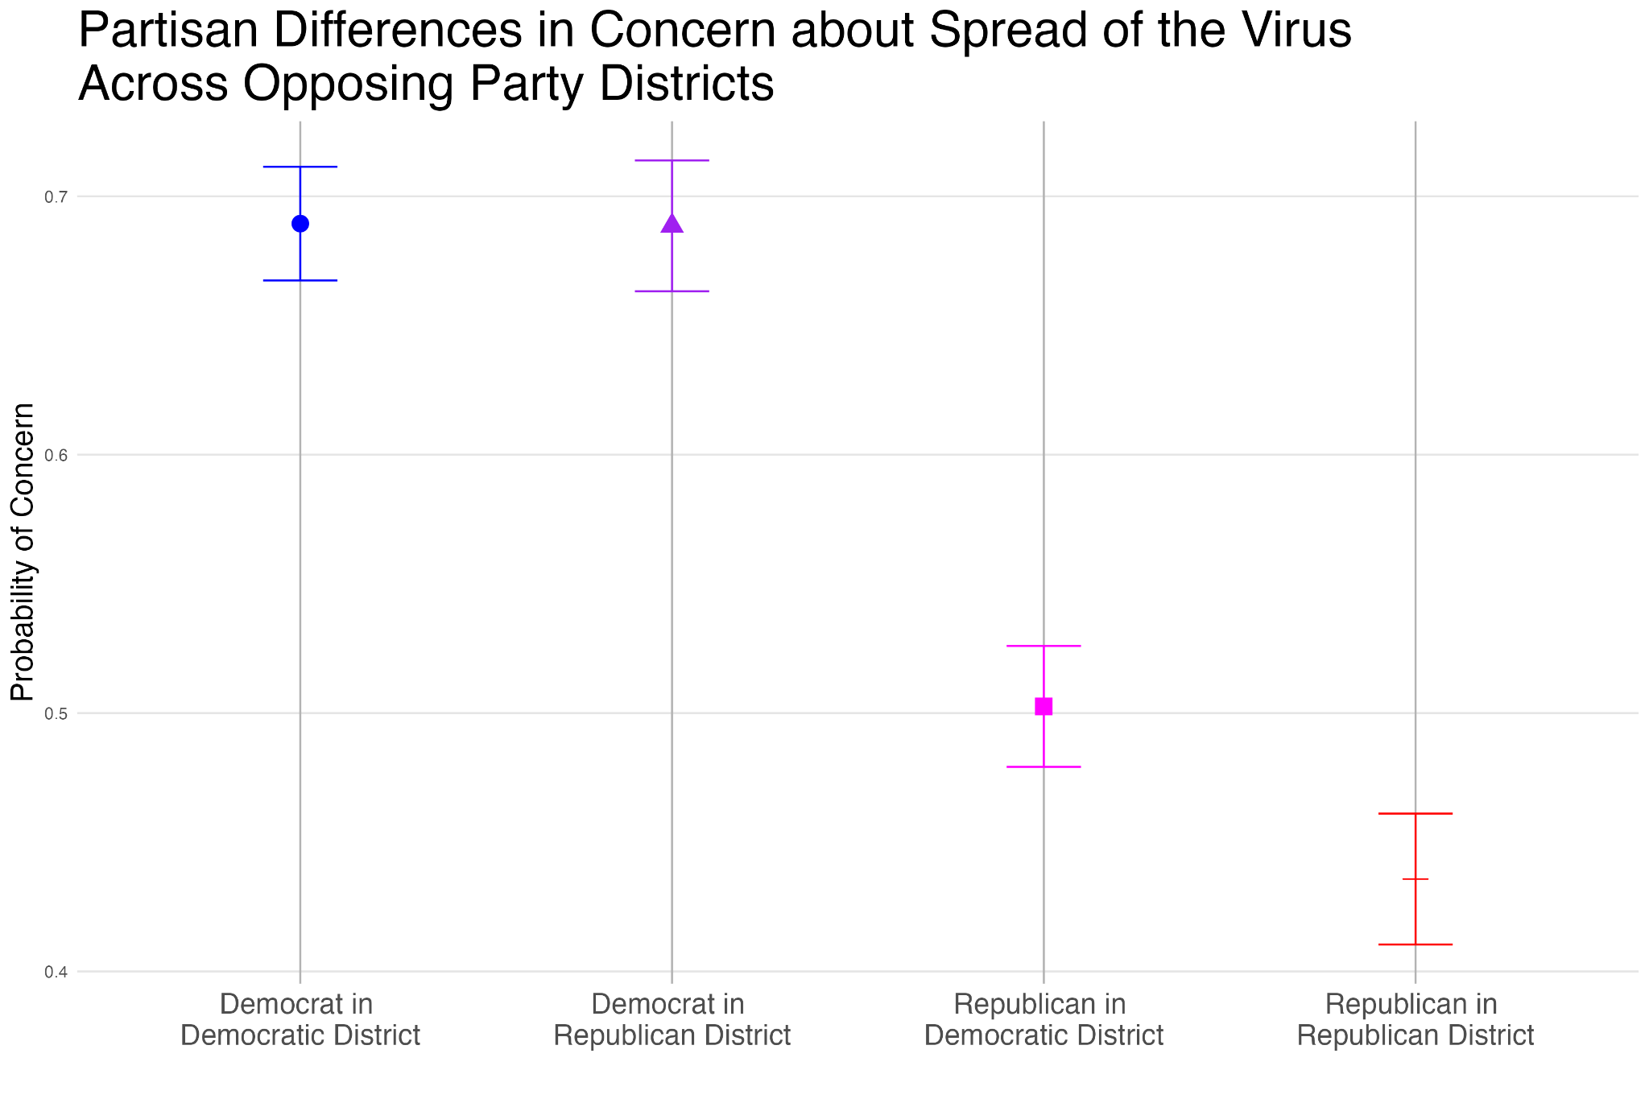
Republicans in democratic districts report greater level of concern than republicans in red districts
Notes:
AD- We should mention how this result fits with the Baxter results?

Slide 30
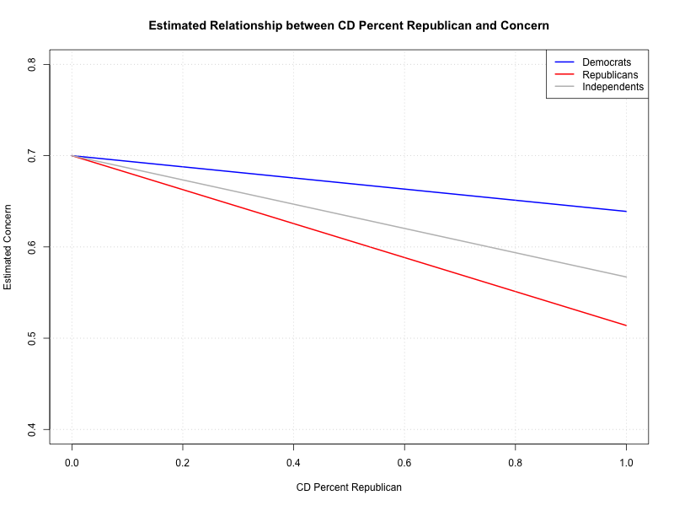
In Republican Districts: Concern
Notes:
The fact that concern also moves along with contacts and mask usage implies that this relationship isn’t due solely to policy differences but also perception of the pandemic.

Slide 31
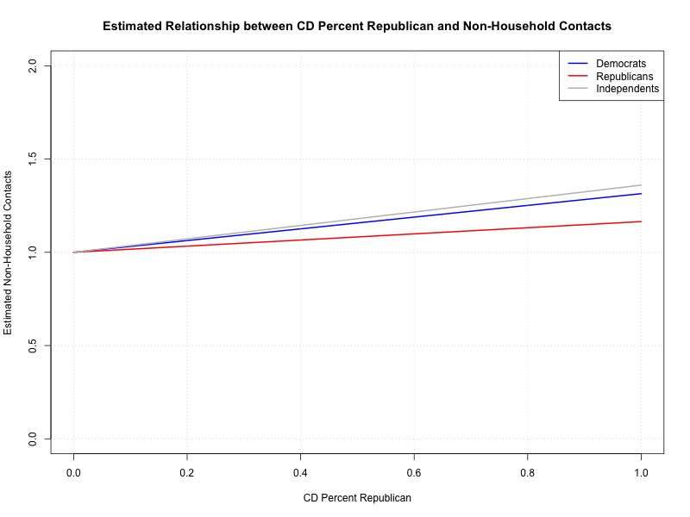
In Republican Districts: Contacts
Notes:
None of these are statistically significant. Contacts are not really changing much based on partisan context.

Slide 32
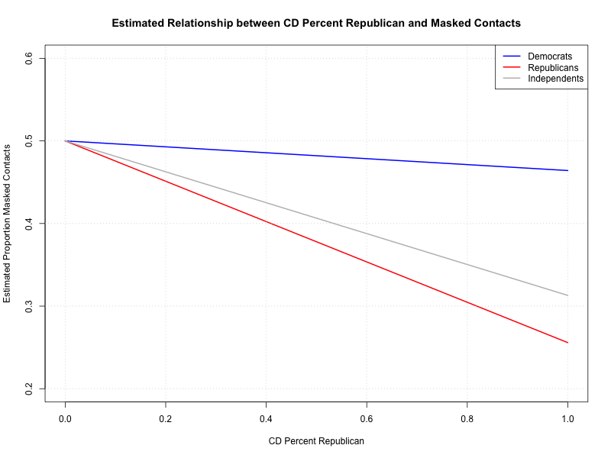
In Republican Districts: Masked Contact
Notes:
Democrats are not really changing their mask behavior based on context, but Republicans are (consistent with Baxter Paper)

Slide 33
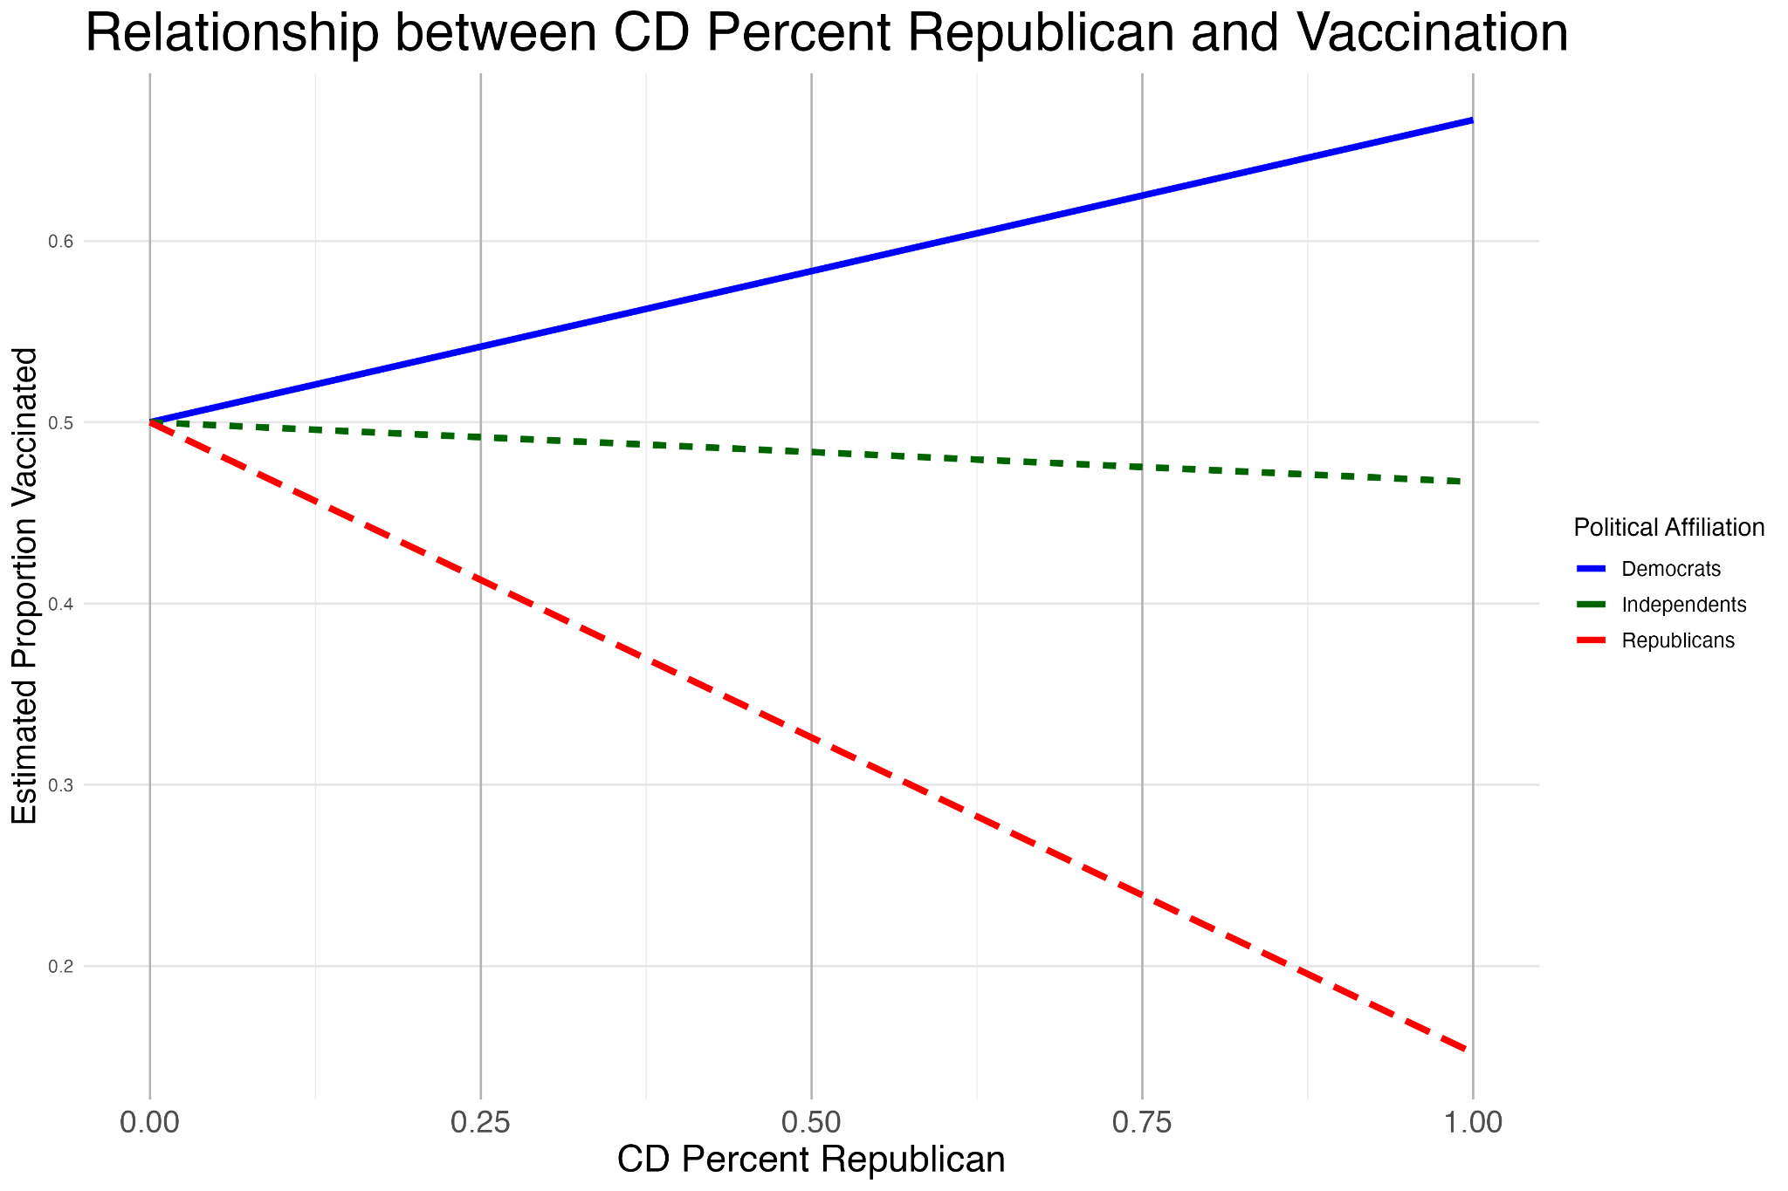
In Republican Districts: Vaccines
Notes:
Larry Jacobs

Slide 34
PAA talk big-picture outline (very rough)
Background + motivation
Bivariate descriptive results
2 plots (one slide each) with specific, interesting findings
1 slide with a summary of other findings (no time to show)
Model for multivariate results
rationale, basic description of predictors, etc
2 plots (one slide each) with specific findings
1 slide with a summary of other findings
Implications
developing model + next steps
solicit suggests
Thank you

Slide 35
