Slide 1
Republicans versus Democrats

Slide 2
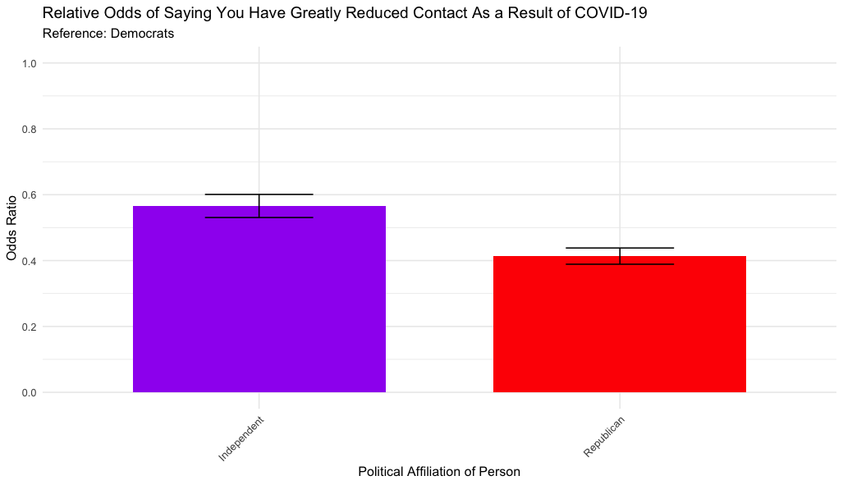
Who is more likely to say they reduced their contact?
Notes:
Republicans are less likely to reduce contact, according to what they say

Slide 3
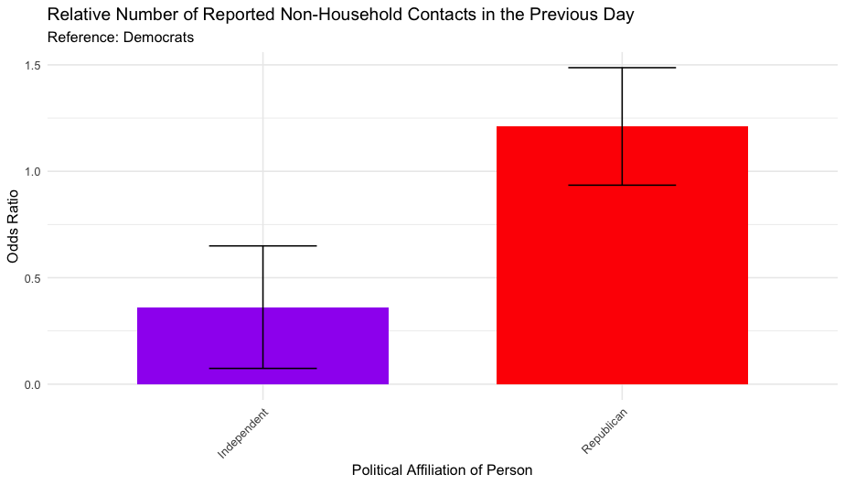
Who actually has lower rates of reported contact?
Notes:
Republicans report higher contacts throughout the pandemic

Slide 4
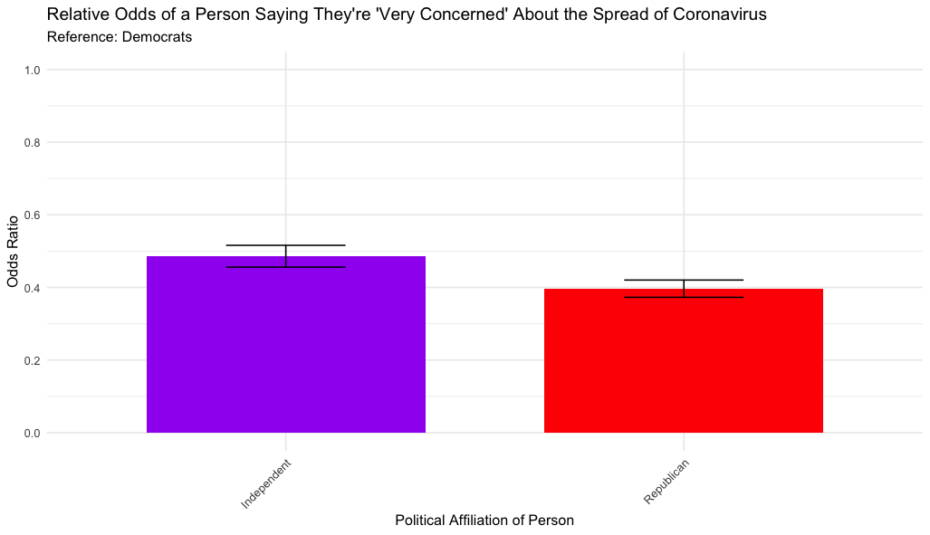
Who is more concerned about the pandemic?
Notes:
Republicans are less concerned about the spread of the virus

Slide 5
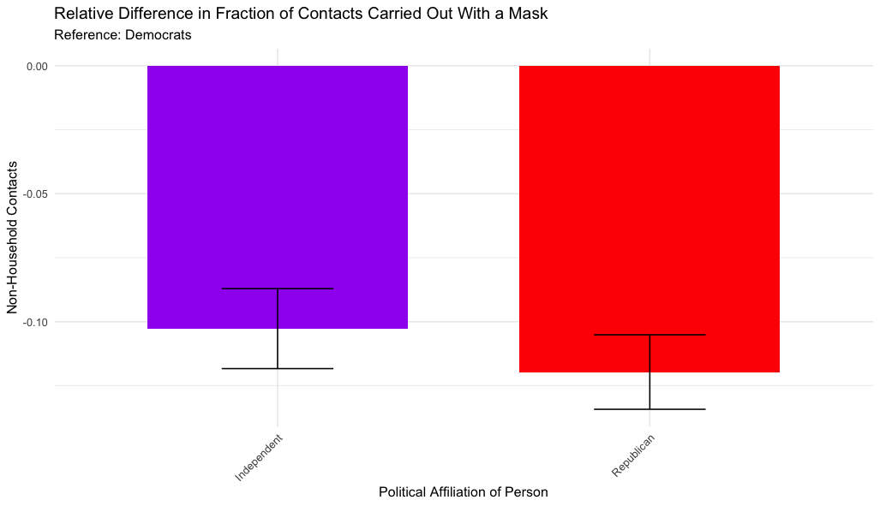
Does increased concern from Democrats translate to increased mask wearing?
Notes:
Republicans are less likely to wear masks

Slide 6
Being in an Opposing Party CD (regardless of your own affiliation)

Slide 7
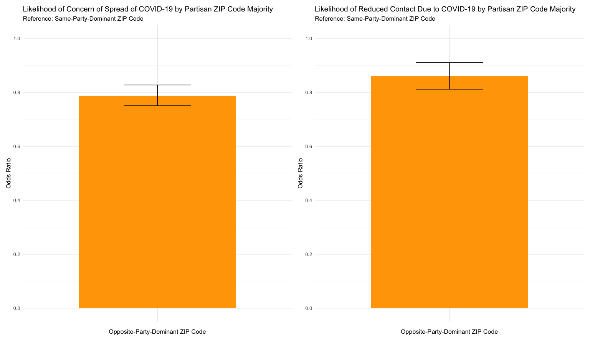
Are people in an opposing CD less likely to reduce their contact?
Notes:
They’re also less concerned about the spread

Slide 8
Are people in an opposing CD less likely to wear masks during their interactions?
Being in an opposite party CD means a very small increase in non-household contacts (.2 coef)
Being in an opposite party CD means you’re slightly less likely to wear a mask, but only if I don’t control for “Independent”
In a safety Index, being in an opposite party CD means you’re only very slightly less safe in your non-hh interactions overall

Slide 9
Being in Democrat in a Republican District (and visa versa)

Slide 10
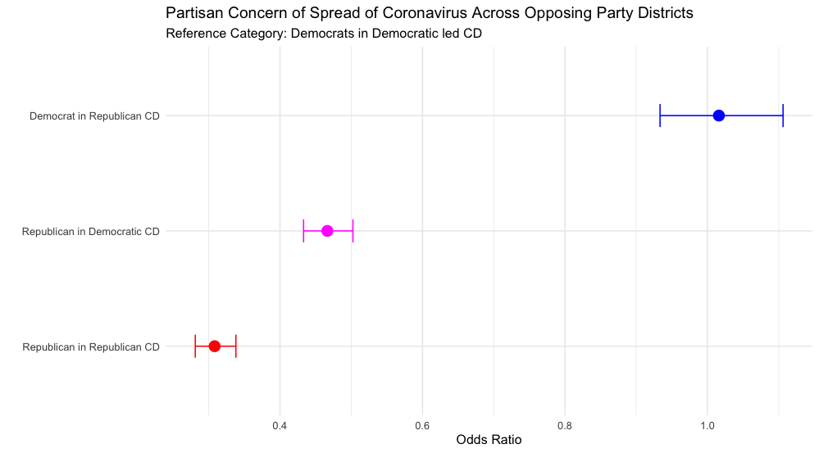
What do Democrats and Republicans say about their concern of spread when in each other’s districts?

Slide 11
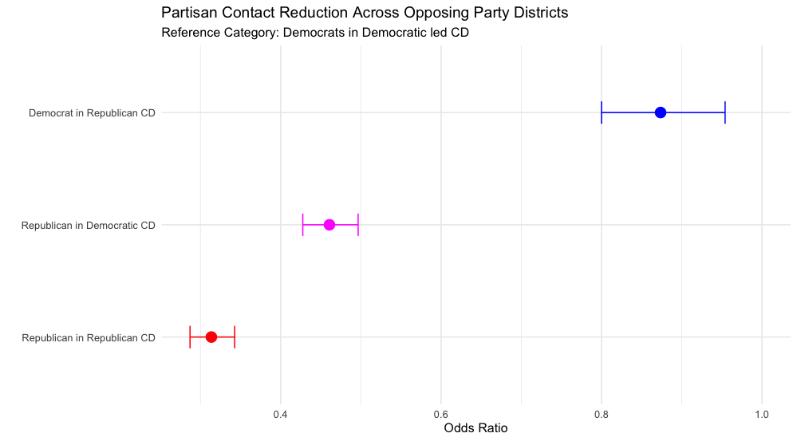
What do Democrats and Republicans say about their reduction of contact when in each other’s districts?
Notes:
Despite not being less concerned, democrats in Republican CD’s are less likely to SAY they reduced contact greatly as a result of the pandemic
Republicans in Democratic CD’s are relatively more likely than Republicans in Republican CD’s to say they reduced contact
Peer effects

Slide 12
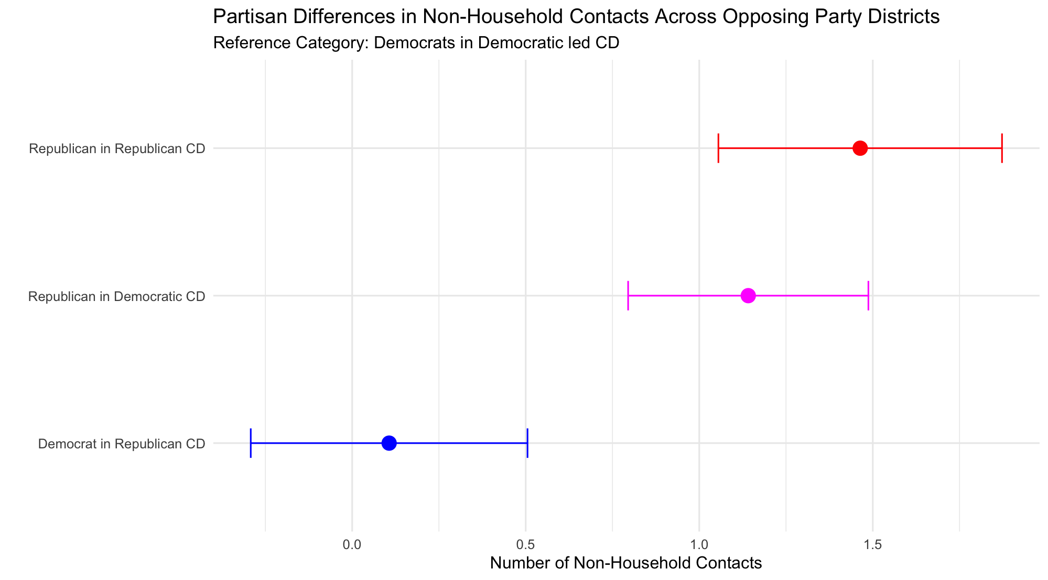
Do Democrats and Republicans report different levels of non-hh contact when in each other’s districts?

Slide 13
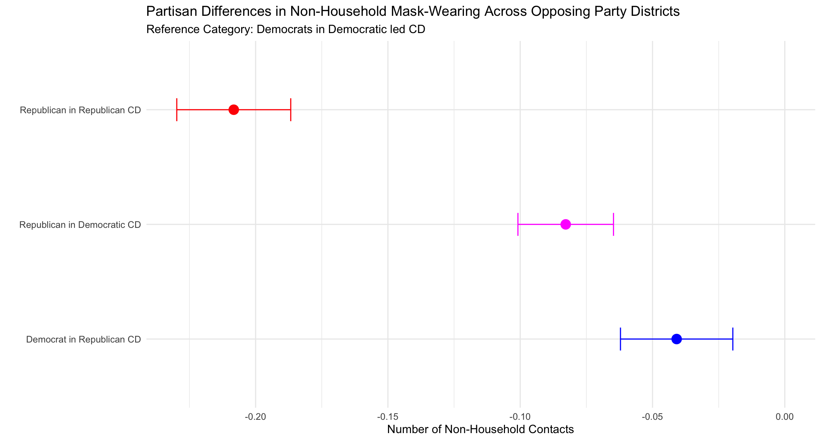
Do Democrats and Republicans report different levels of non-hh masked contact when in each other’s districts?

