Slide 1
Caribbean Hispanic Sociodemographic Heterogeneity: Comparing Older Adults by Country and U.S. Migration Status
William H. Dow
Chris Soria
Henry T. Dow

Slide 2
Introduction
Sociodemographic Comparison of Adults (age 60+)
Comparison of Hispanic immigrants
Sociodemographic differences are important for understanding disparities in aging health
Education and cognitive health (Li, et al., 2021)
Social isolation and epigenetic aging (Rentscher, et al., 2023)
Notes:
In this paper, we chose to focus on sociodemographic differences between migrants populations, specifically we were interested in comparing age 60 plus Mexican migrant populations to those from the Caribbean.
We chose sociodemographic differences because they’re important for understanding aging disparities between Hispanic migrant populations.
A couple of examples are education and social support.
For example, it’s well known that education is positively correlated with cognitive health. Li and team, in 2021, found for example that people without a high school degree are more likely to get diagnosed with dementia.
Another example is social isolation. Rentscher and collaborators in 2023 found that older socially isolated people were between biologically 1-2 years compared to people with stronger social support.
And so, this is why if your goal is to understand aging health it’s so important to understand how migrants differ in things like education and social support
Crimmins: https://pubmed.ncbi.nlm.nih.gov/32798771/
Rentsher: https://www-sciencedirect-com.libproxy.berkeley.edu/science/article/pii/S0889159123002660?via%3Dihub
Barger (social support and telomere length): https://www-sciencedirect-com.libproxy.berkeley.edu/science/article/pii/S0301051116300035
Li: https://pmc.ncbi.nlm.nih.gov/articles/PMC8418669/pdf/TRC2-7-e12204.pdf

Slide 3
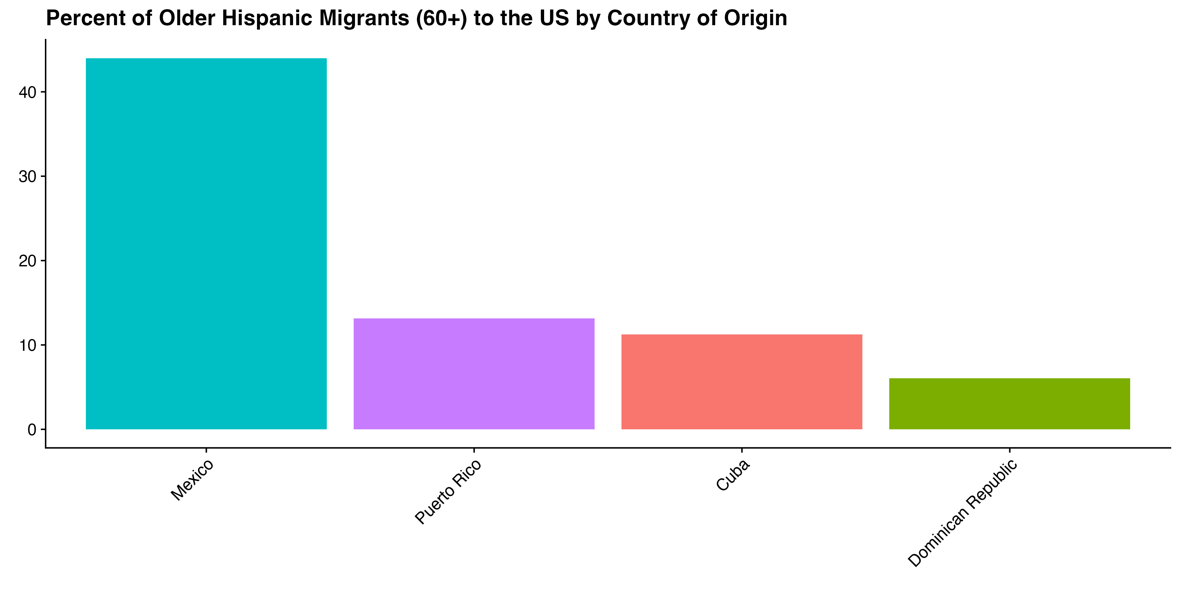
Background
Hispanic migrant health is often focused on Mexican immigrants
~44%
~30%
Notes:
However, a lot of the research on Hispanic migrant health is focused on Mexicans, in part because they are such a large segment of the migrant population. In fact, Mexican immigrants are about 44% of the Hispanic migrant population. However, Hispanic Caribbean migrants are also a large group, and together make just about 30% of the Hispanic migrants.

Slide 4
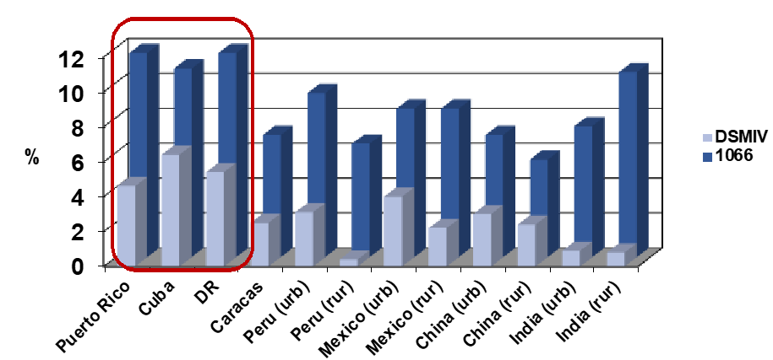
Research on Hispanic groups finds heterogeneity
Llibre Rodriguez J, et al. The Lancet, 2008; 372: 464
Notes:
Research that DOES focus on differences within Hispanic groups finds important differences.
Here we I’m showing data from the 10/66 study (which is not nationally representative and tends to skew towards urban residents), which finds that Hispanics in the Caribbean have generally higher rates of dementia despite having relatively higher life expectancies

Slide 5
Migrant selection
Migrant selection explains a lot of this variation
A key to understanding this comes from understanding how Hispanic immigrants differ from each other
Also to understand conditions of sending countries and selection patterns
Notes:
Some of these differences in older age health can be explained by selection.
In other words, to better understand migrant health, we need to understand not just how migrants compare to each other but how they compare to people who choose to remain in their home countries

Slide 6
Introduce the idea that selection is different based on country of origin
Puerto Rico became a US territory in 1898. In 1917 they were granted US citizenship.
The US occupied the Dominican Republic twice. Political instability in 1961 led to a surge of migration to the US.
Cuban Revolution in 1959 sparked one of the largest refugee movement in US history (Duany 2017). In 1966, given path to US residency.
Mexico revolution in the early 1900’s resulted in mass emigration. Bracero program in the 1940’s which ended in 1964.
Notes:
Puerto Rico became a US territory in 1898. In 1917, the Jones act granted US citizenship to Puerto Ricans which allowed them the ability to freely move to the US mainland. Today more than half of Puerto Ricans live outside of their country (mostly in the US) (Duany, 2008)
The United States occupied the Dominican Republic twice, from 1916 to 1924 and again in 1965. Instability caused by the fall of the Trujillo dictatorship in 1961 led to a surge of migration to the US.
Cuban Revolution in 1959 sparked one of the largest refugee movement in US history (Duany 2017). In 1966, Cubans who lived in the US were allowed to gain permanent residency and in 1995“wet foot, dry foot” policy gave any Cuban who reached US land were given a path to legal status.
Mexico also had a revolution in the early 1900’s which resulted in their population more than tripling in the US by 1930. This was followed by institutionalized migration in the form of the Bracero program in the 1940’s which ended in 1964.

Slide 7
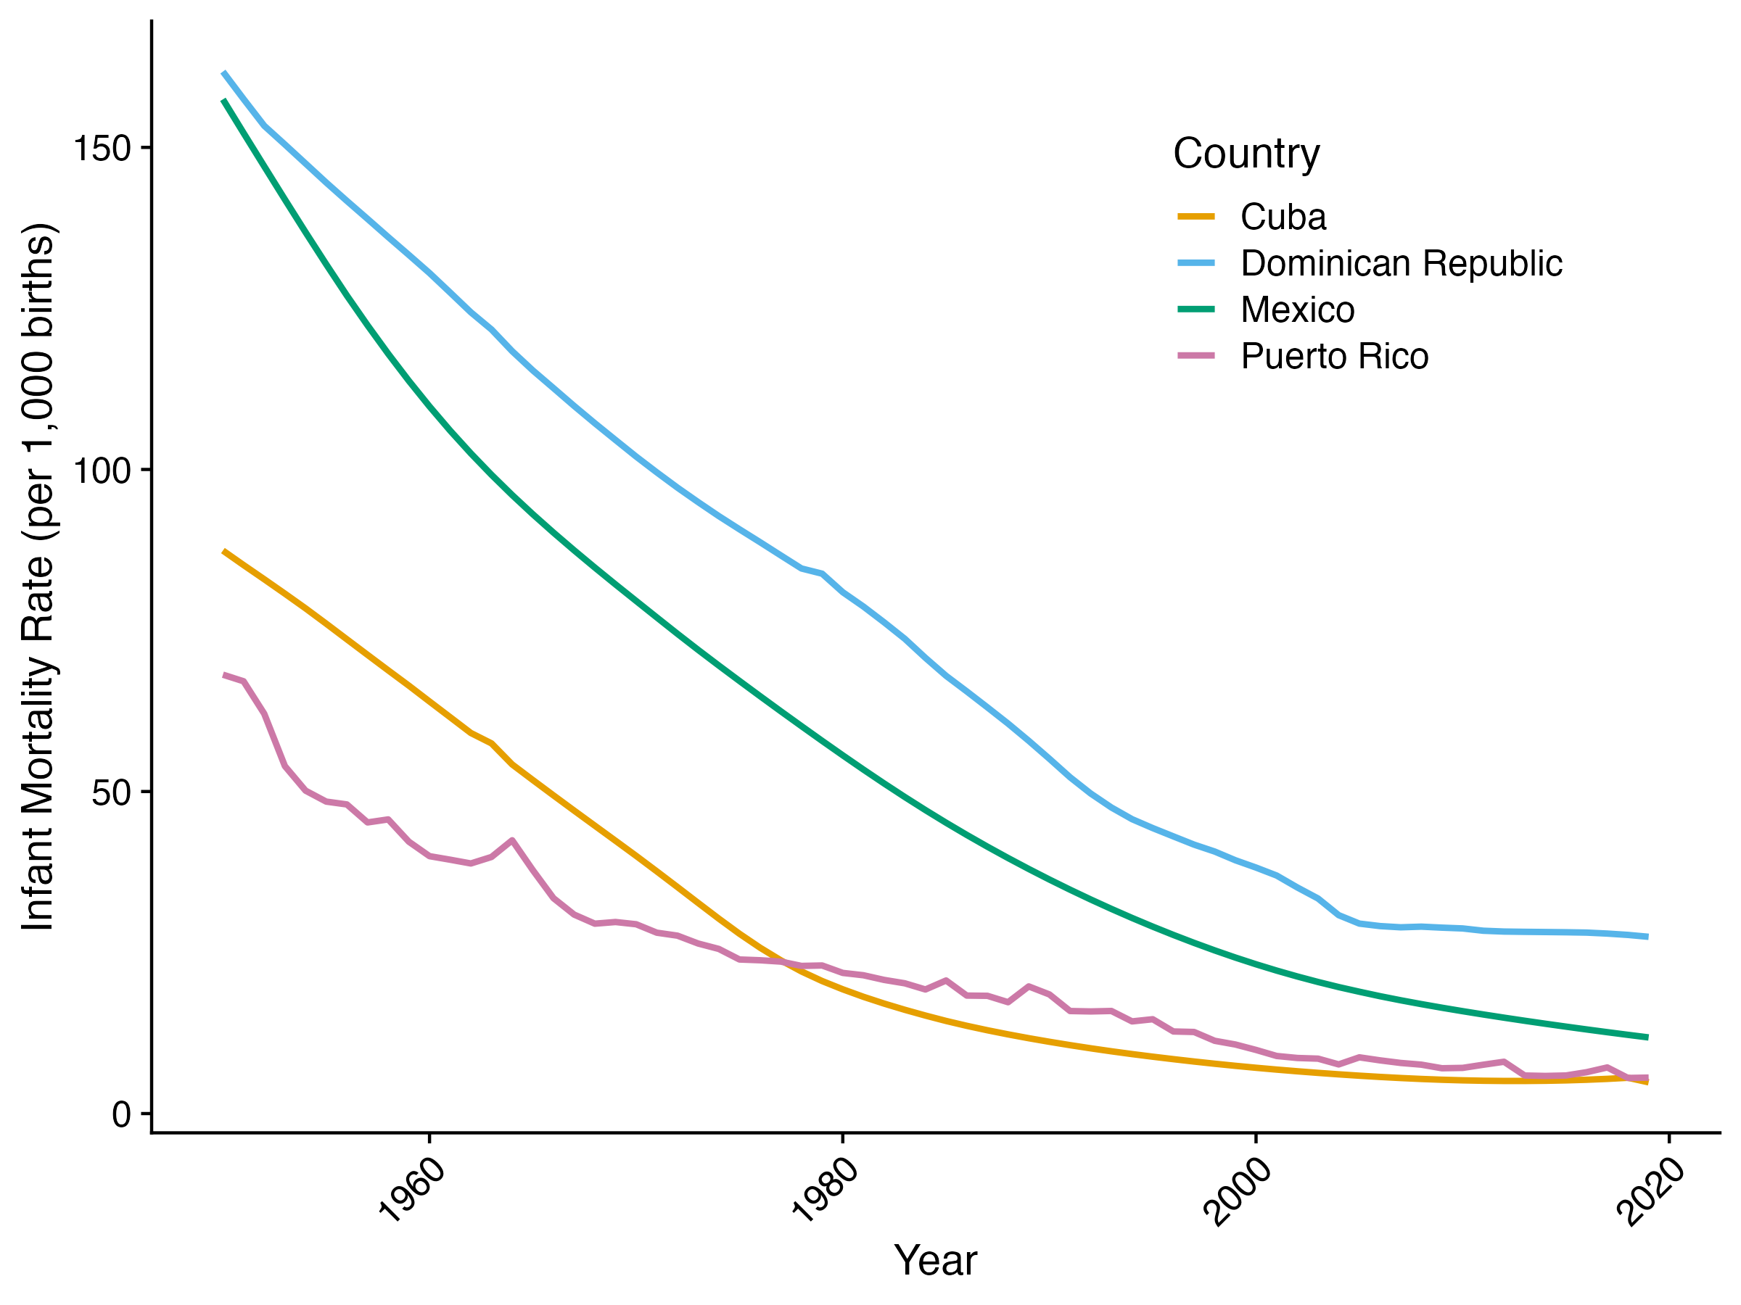
Countries are different but also changing over time
Notes:
It’s also important to note that the conditions in these countries have been rapidly changing, mostly for the better.
Here we plot the country’s infant mortality rate on the y axis and the year on the x axis and find also that the pace of change has differed between them.

Slide 8
Our Contributions
US Immigrants from Mexico compared to those from the Hispanic Caribbean (60+)
US Immigrants from these countries compared to their native country resident counterparts
US Immigrants from these countries sociodemographic profiles over time
Notes:
That leads us to our research questions in this paper, which is entirely descriptive.
1. US Immigrants from Mexico compared to those from the Hispanic Caribbean (60+)
2. We wanted to compare these movers to their home country stayers to get a better sense of the selection mechanisms at play
3. Lastly, we wanted to see how these selection patterns are changing over time

Slide 9
Countries of Interest
Mexico
Puerto Rico
Dominican Republic
Cuba
Migrant characteristics
Differences in Selection
Change over time

Slide 10

Data and Methods
International Census Data from IPUMS
US American Community Survey (2016-2020; 2008-2010)
Respondents above age 60
Education
At least a secondary degree education
Household composition
Marital status and Living Alone
Acculturation (for migrants)
English Speaking and Citizenship status

Slide 11

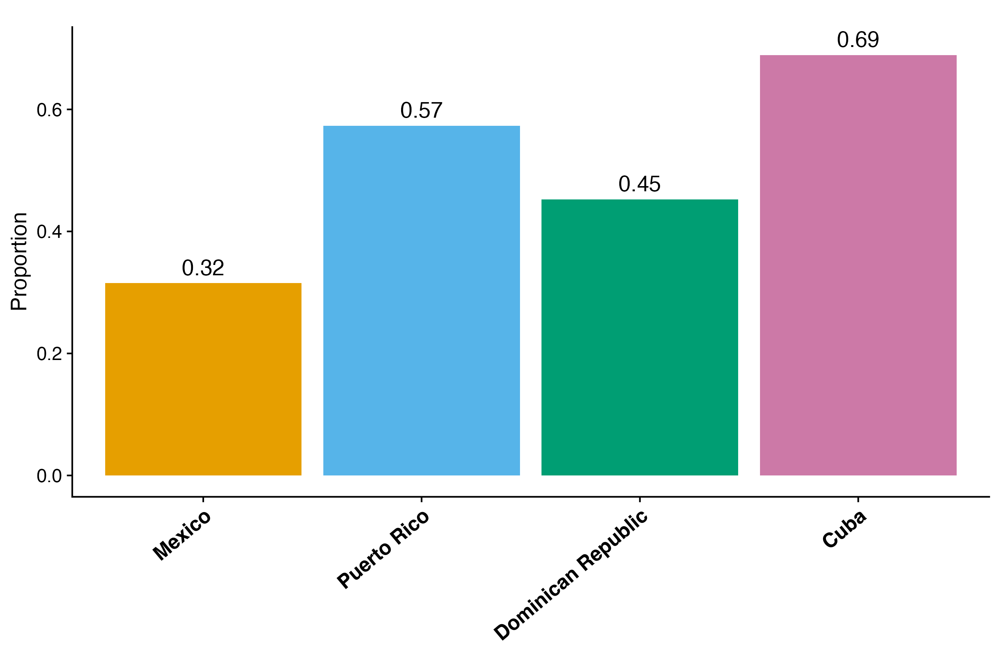
Caribbean Hispanic immigrants tend to be more educated than Mexican immigrants
2020
Proportion With At Least Secondary Degree
Notes:
These are really different groups, then how much of that is related to what’s going in their home countries
What stands out - Mexican migrants are the least likely to get at least a secondary degree, which is lower than the average for migrant from the Caribbean
- Specifically, Cuban migrants are the most likely to have at least a high school degree followed by Puerto Ricans, and lastly Dominicans

Slide 12
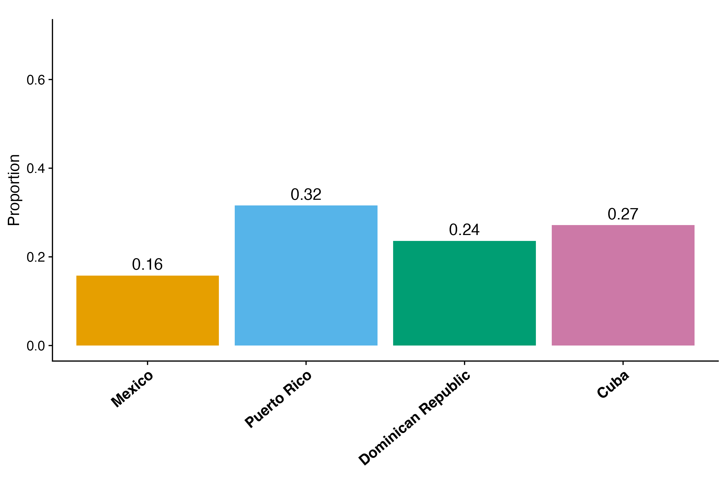
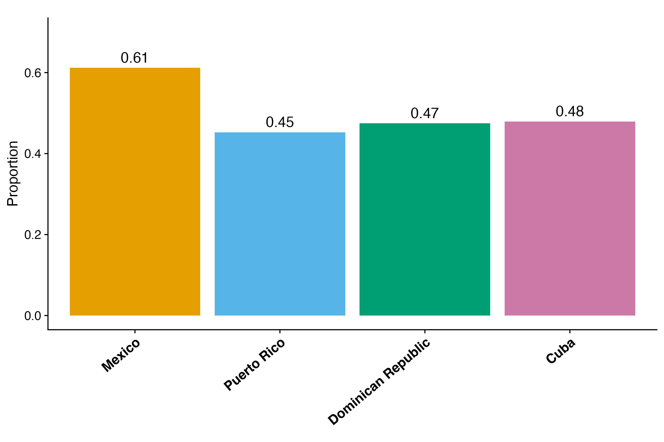
Mexican migrants are the least likely to live alone and most likely to be married
2020
Proportion Living Alone
Proportion Married
Notes:
When it comes to household composition, Mexican migrants again stand out compared to Caribbean migrants.
Only 16% of Mexican migrants above the age of 60 live alone. For comparison, Puerto Ricans are twice as likely to live alone.
And a similar pattern shows for proportion married. The majority of Mexican migrants report being married, which is less common amongst the Caribbean migrants.

Slide 13
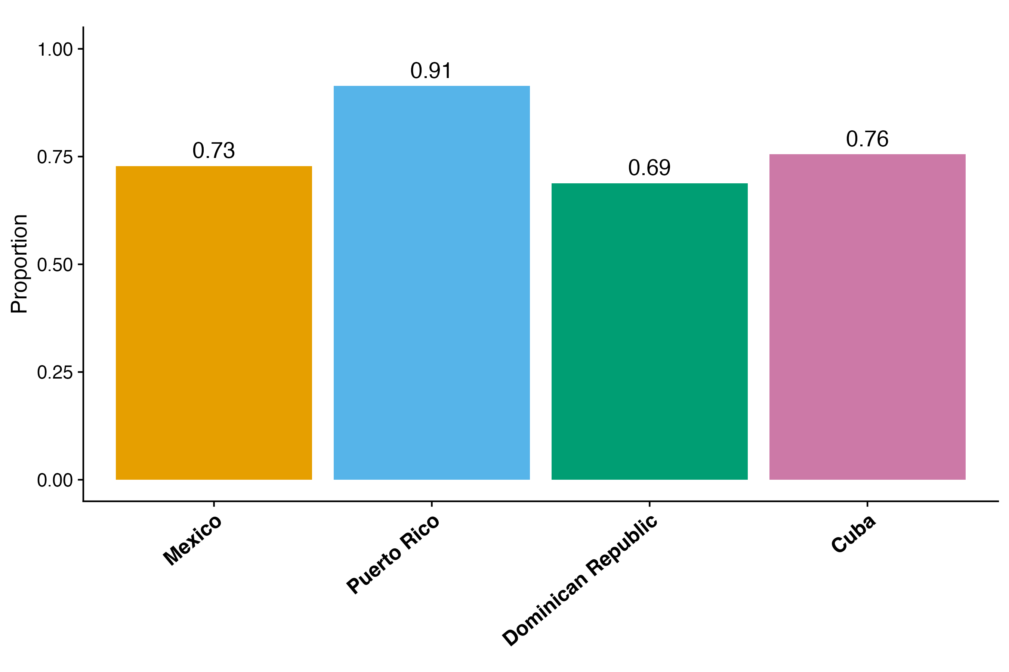
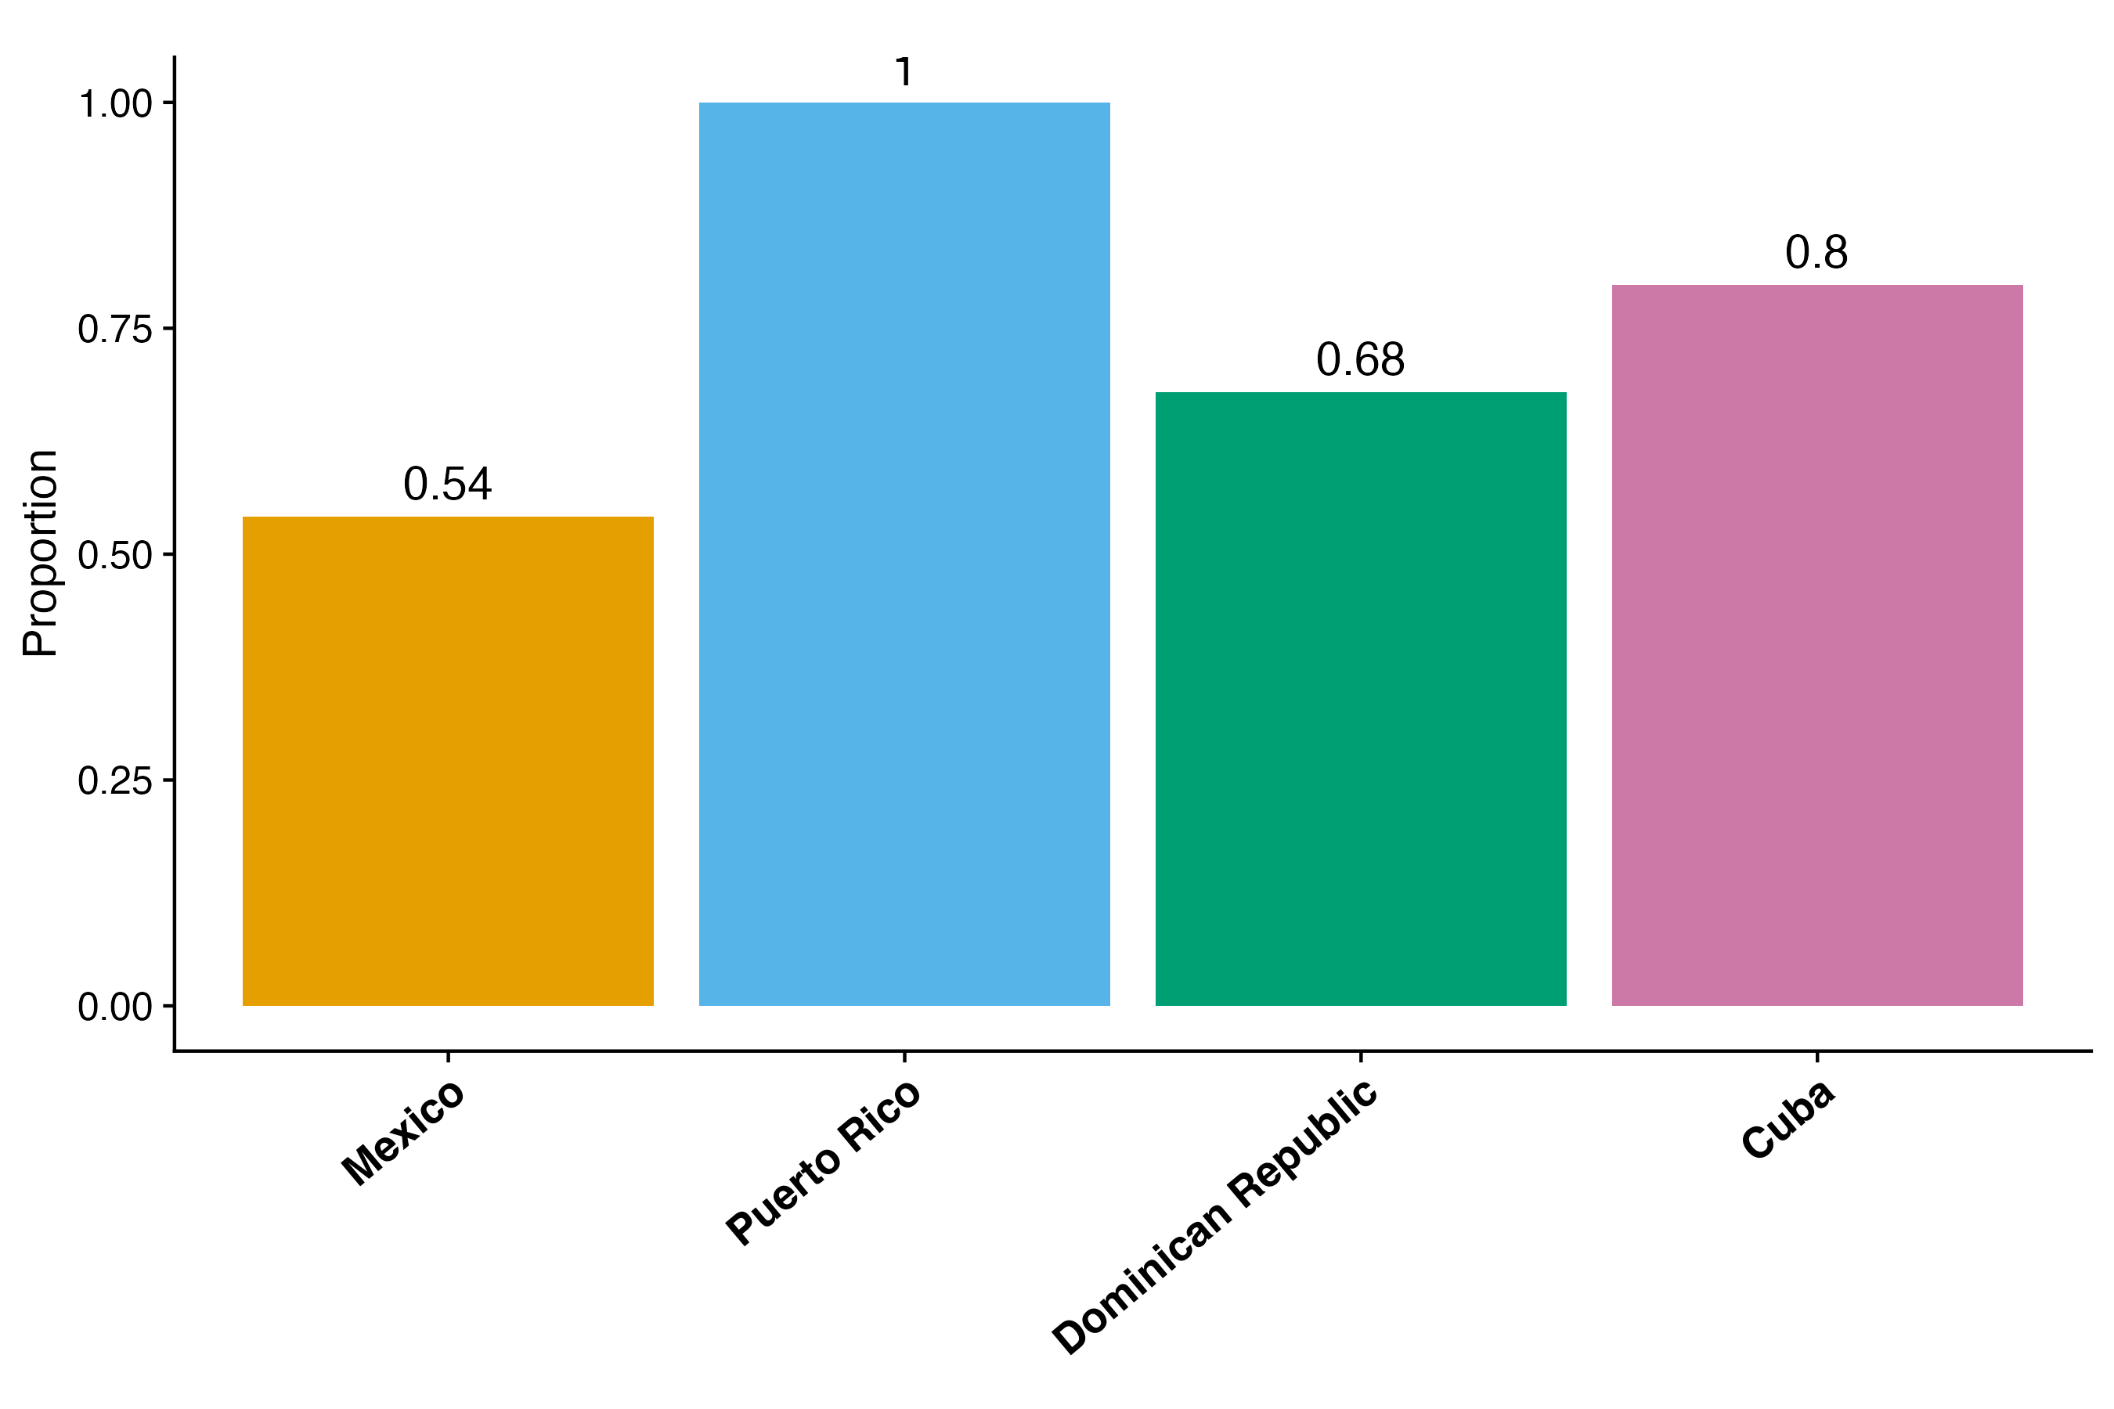
Mexican and Dominican migrants are the least likely to acculturate
2020
Proportion English Speakers
Proportion Naturalized Citizen
Notes:
When it comes to acculturation, we find once again that Caribbean migrants are distinct.
Although all groups tend to speak English at similar rates, except for Puerto Ricans who speak English over 90% of the time, Carribean migrants

Slide 14
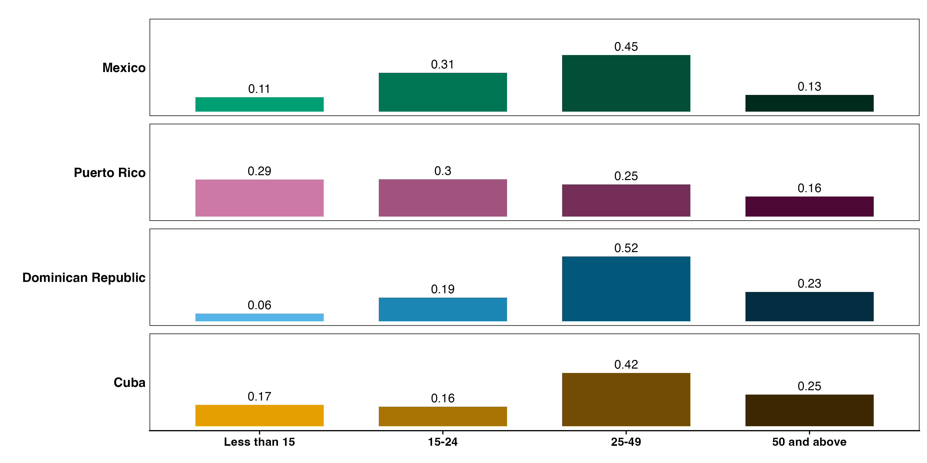
Most people migrated at working ages
2020
Notes:
Key points:
Age at migration varies between countries
What we see here is that certain groups are more likely to be accultured (learn English and become citizen) because of differences in age at migration
However, these differences do not explain variation between migrant groups
draw a circle around the areas that you want people to pay attention
add 50+ not very many people are migrating at age 50

Slide 15
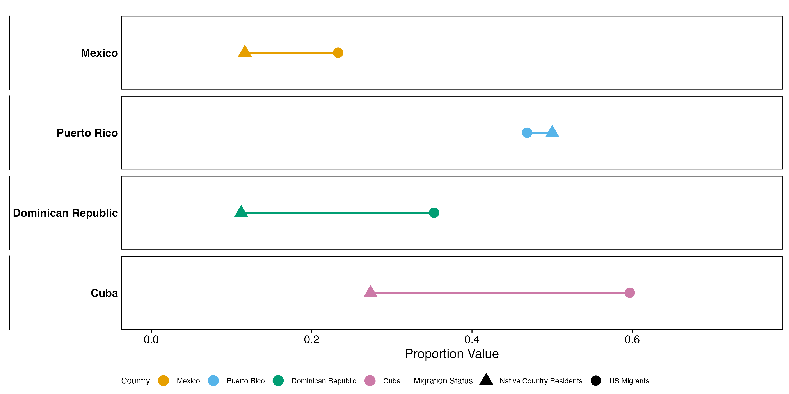
Migrants to the US are far more likely to have at least a secondary degree
Proportion With At Least Secondary Degree
Notes:
In the less than primary DR is the most selective
Looking at secondary, CU is bigger selection

Slide 16
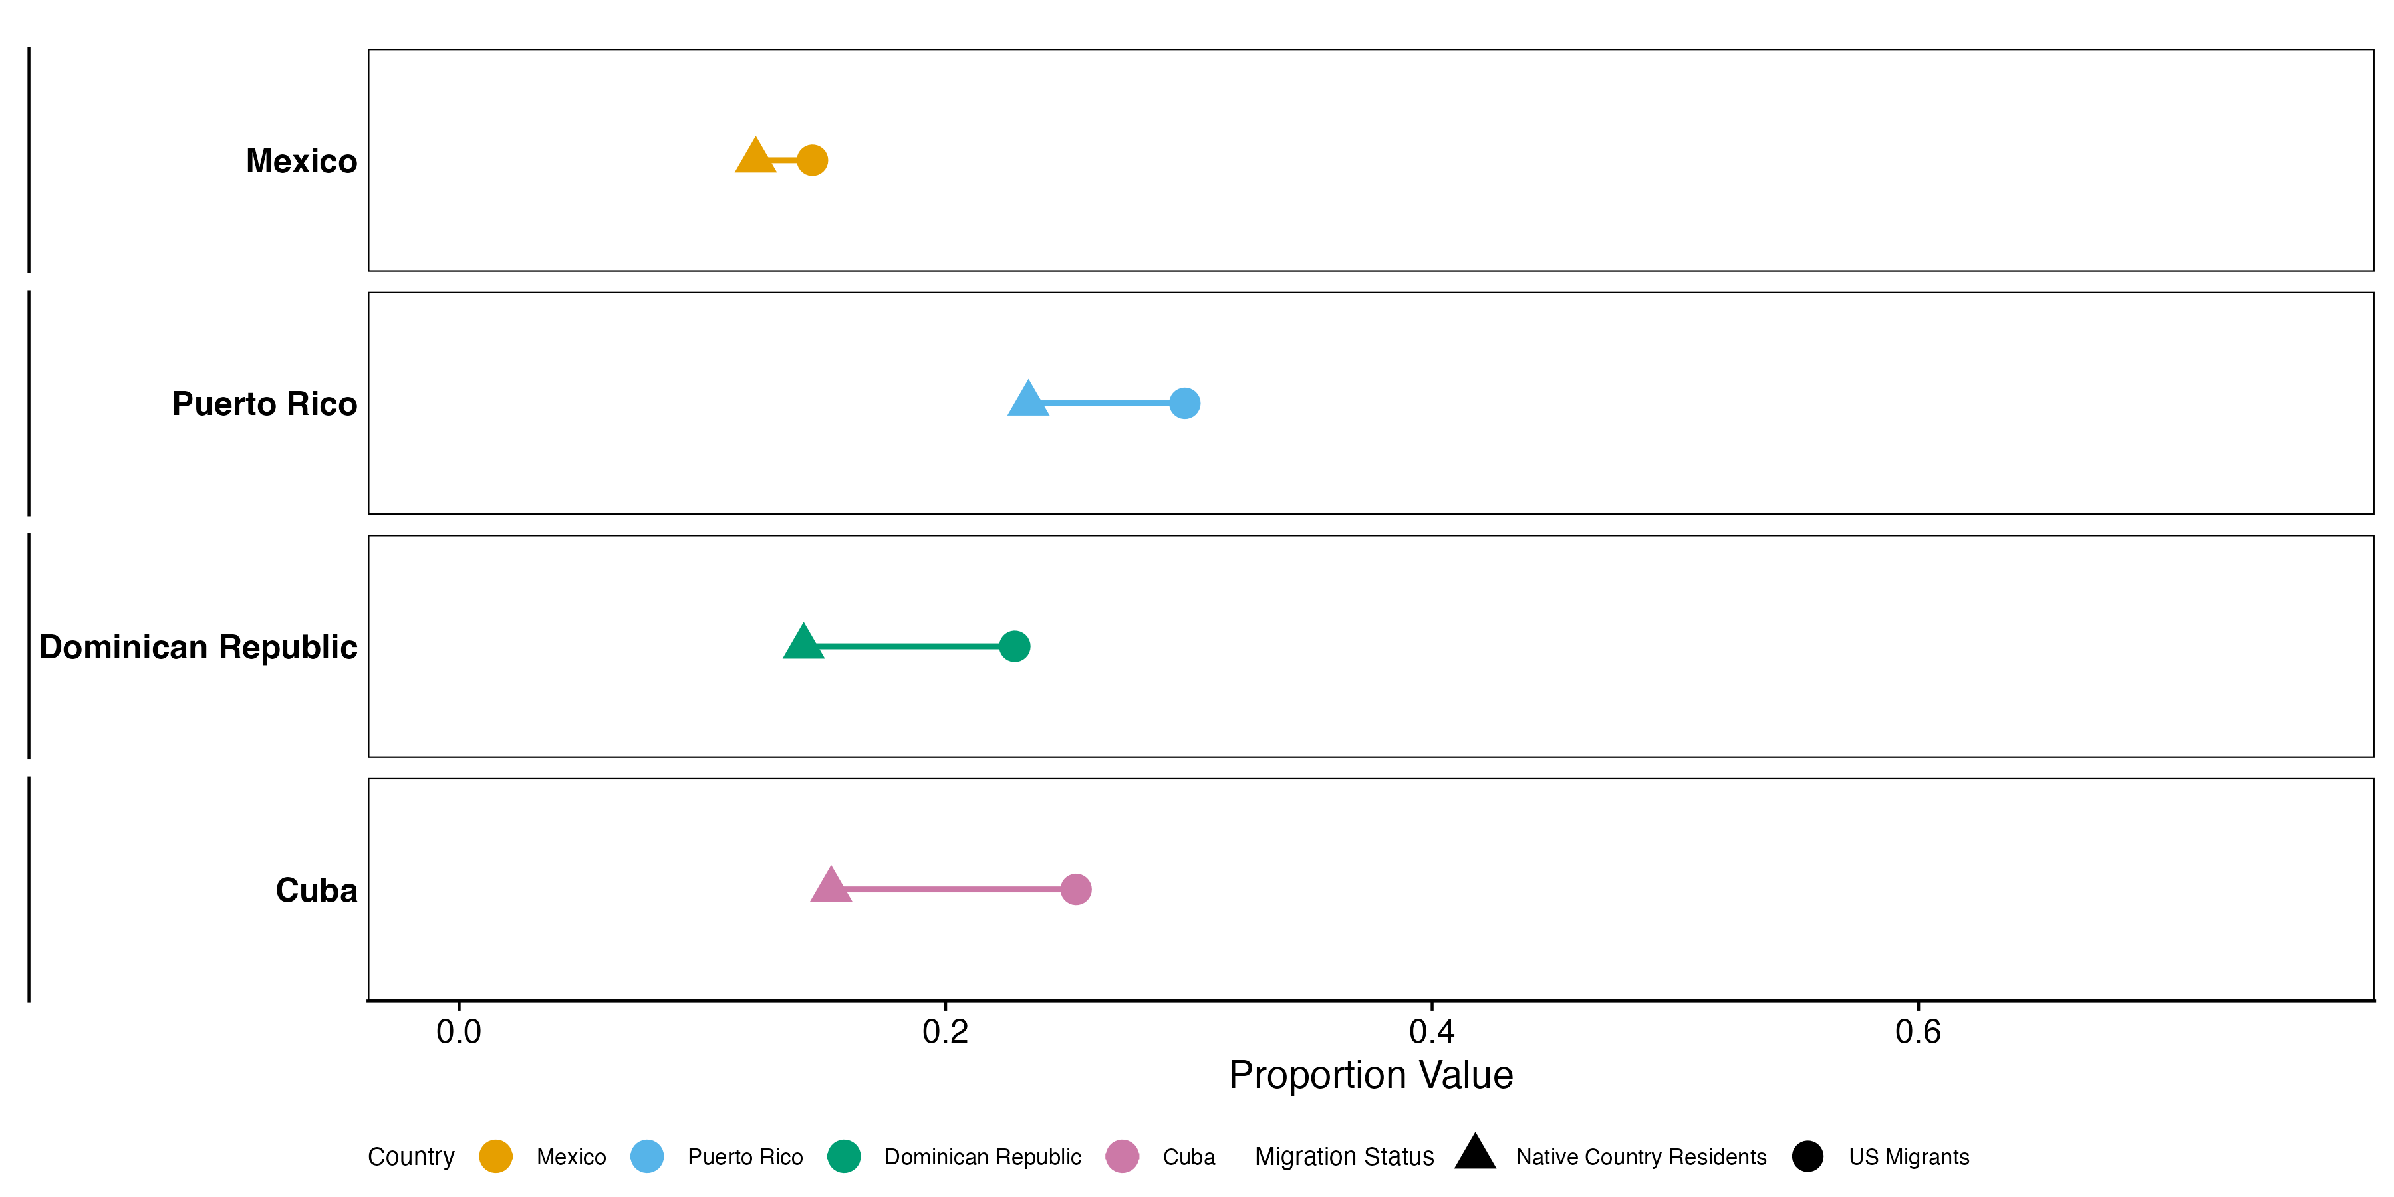
Native country residents are less likely to live alone
Proportion Living Alone
Notes:
Again, the biggest difference here is between Dominicans and Cubans
These are averages for men and women combined, if we look at women separately we see they’re more likely to live alone, but the overall pattern is the same

Slide 17
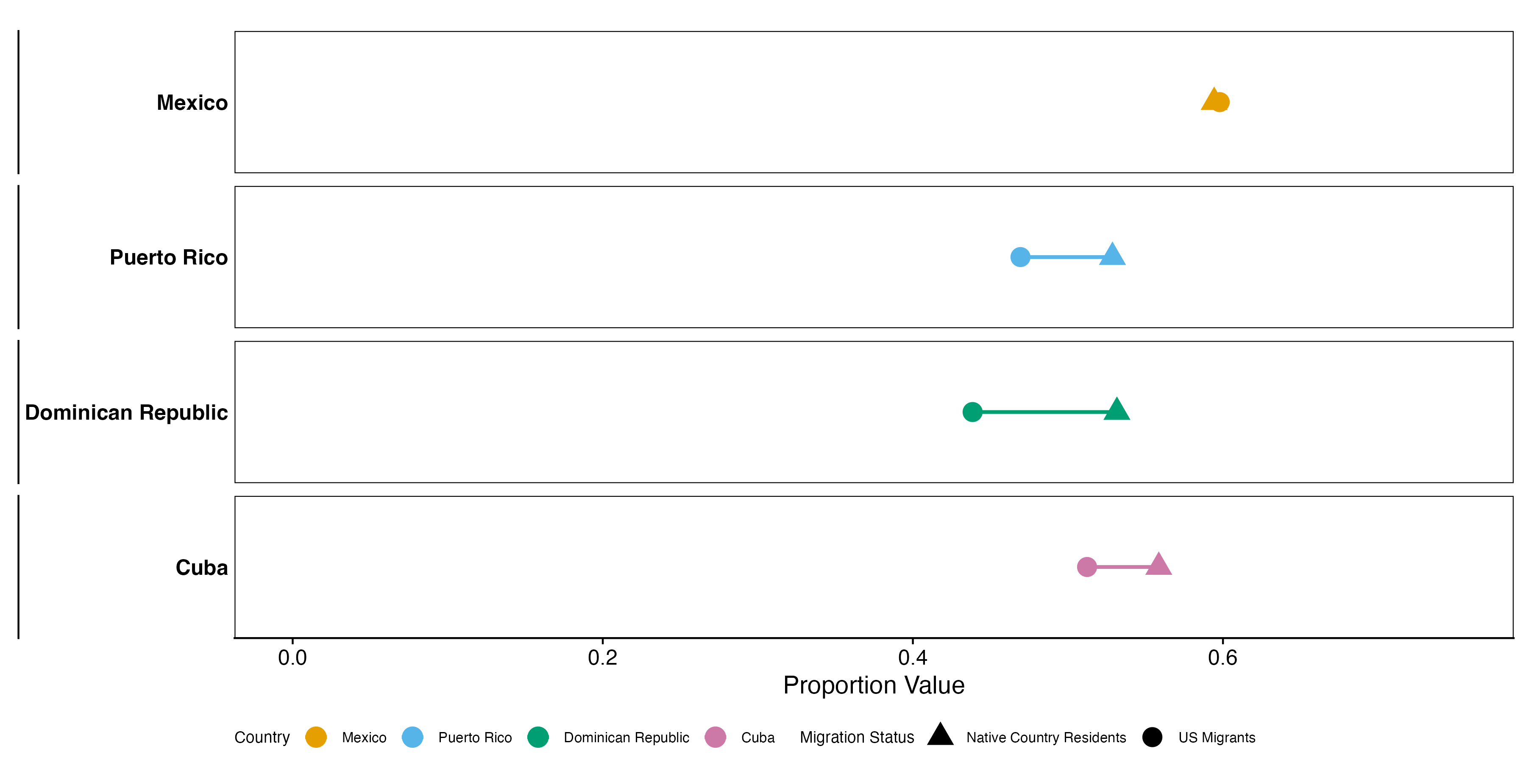
Native country residents are more likely to be married
Proportion Married
Notes:
Last there’s marriage and whether people are more likely to live with a partner.
Again, the biggest difference is between Dominican migrants in the US compared to Dominicans still residing in their country.

Slide 18
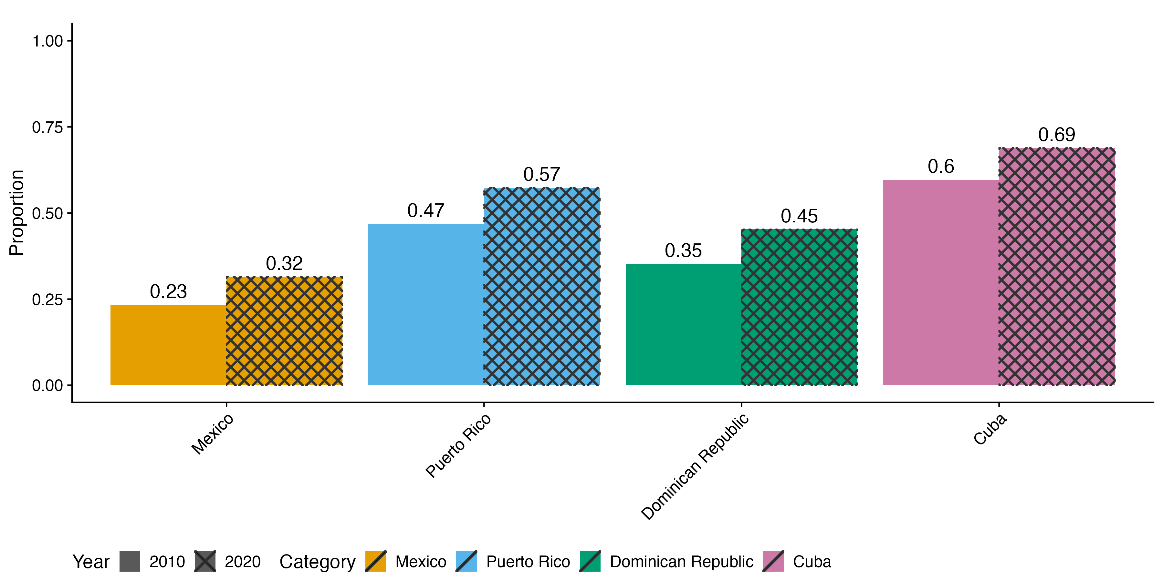
Strong cohort increases in migrant education, even from 2010 to 2020
Notes:
Things are rapidly changing. When we compare these migrant groups in 2010 to 2020, we generally see that they’re becoming more educated.
Again, this matters because education is such a strong predictor of dementia
This implies that studies that use data that’s not up to date might not reflect the true state of current migrant health given how quickly things are changing
In other words, if we want to understand the migrant population, we need current data not just on migrants but also on their native country resident counterparts

Slide 19
Discussion and Limitations
We have unique comparison of migrants to people in their home countries using nationally representative data
Mexican migrants are the least likely to acculturate and the least likely to live alone
Dominican and Cuban education selectivity is the strongest
Education profiles are rapidly changing
Limitations
Return migration
Health behaviors throughout the life course
We need nationally representative data that can be compared to the US population
Notes:
The next step is to analyze a nationally representative sample that combines both these very important sociodemographic
MHAS (Mexican Healthy Aging Survey)

Slide 20

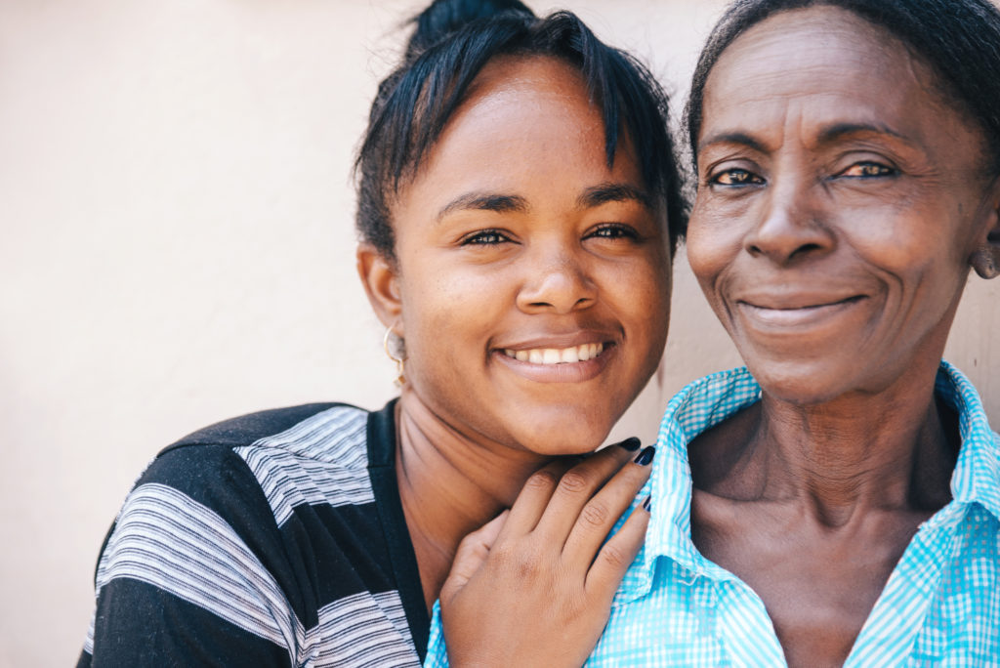
Future Direction
Compare with U.S. Caribbean immigrant population
New nationally representative samples of N=1500 adults ages 65+
Detailed cutting-edge surveys cross-harmonized with:
10/66
newer Harmonized Cognitive Assessment Protocol (HCAP) in U.S. Health and Retirement Study (HRS) and sister studies in Mexico, Chile, China, India, South Africa, Europe, etc.
Notes:
HCAP Network | Harmonized Cognitive Assessment Protocol
Information on return migration
We don’t have information on health (in a nationally representative)

Slide 21
Additional slides
Although migration within latin America is increasing
Only about 1% of the population in Mexico is foreign
https://www.oecd.org/en/publications/international-migration-outlook-2024_50b0353e-en/full-report/mexico_d1b0bd46.html
3% of Puerto Rico is foreign
https://www.census.gov/library/stories/2024/05/foreign-born-population-puerto-rico.html
4% of the Dominican republic is foreign
https://www.macrotrends.net/global-metrics/countries/DOM/dominican-republic/net-migration
.1% of Cuba is foreign
https://www.macrotrends.net/global-metrics/countries/CUB/cuba/net-migration

