Slide 1

Hispanic Migrant Sociodemographic and Disability Heterogeneity by Birth Country
William H. Dow
Chris Soria
Henry T. Dow
University of California at Berkeley
Notes:
Introduce self…
Today I'm going to present research in collaboration with William and Henry Dow on sociodemographic differences between older Hispanic adults in the United States, with a particular focus on contrasting Mexican migrants from different countries of origin.
Our goal is to highlight that these groups are different enough from each other to deserve their own spotlight in research.

Slide 2
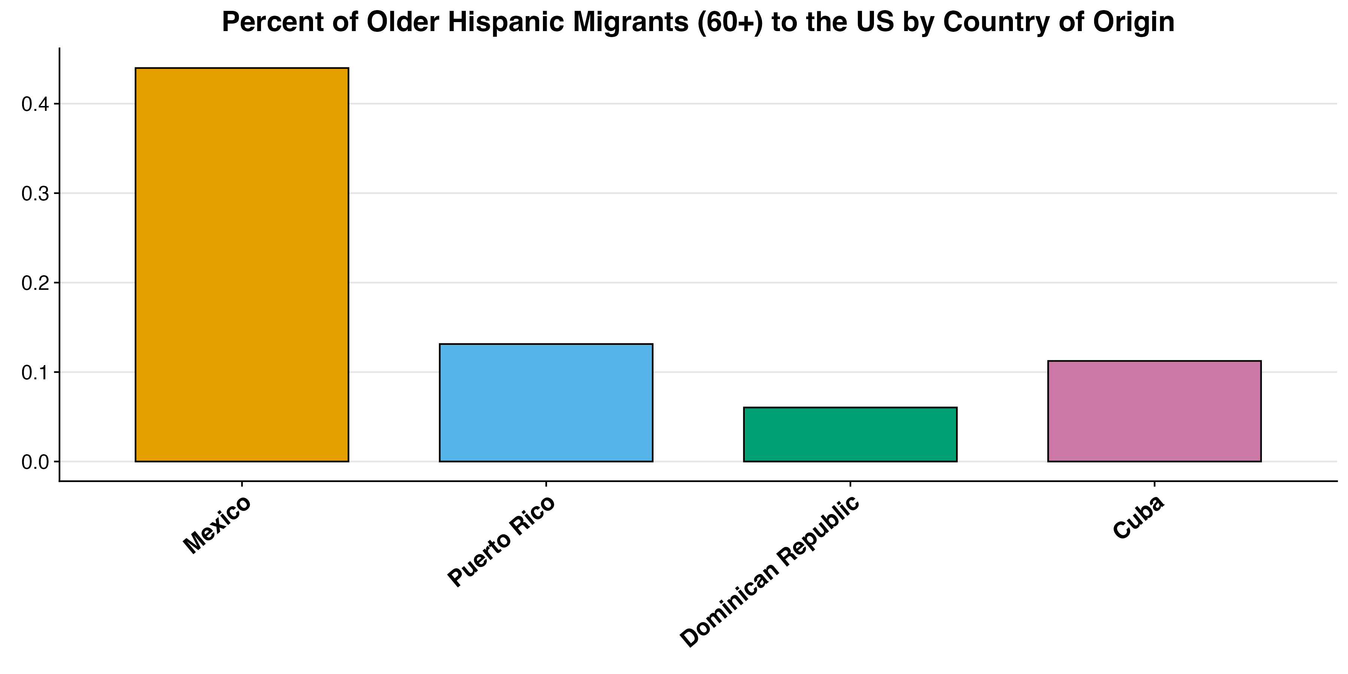
US Hispanic Immigrant Older Adults: 44% from Mexico, 30% from the Caribbean
Hispanic migrant health is often focused on Mexican immigrants
Caribbean sociodemographics are very different
~44%
~30%
Notes:
Mexican immigrants make up the largest group of older Hispanic migrants in the US at 44 percent, while Caribbean immigrants from Puerto Rico, the Dominican Republic, and Cuba represent a significant 30 percent of this population. It's important to distinguish between these two groups not just because they are large, but because their sociodemographic patterns are so different.
Research that groups all Hispanic migrants together provides useful insights but misses key differences between Mexican and Caribbean migrant communities. Without Caribbean migrants as a comparison group, researchers cannot tell which health experiences are shared more broadly across Hispanic migrants and which are unique to Mexican migrants. That Caribbean immigrants have been understudied is concerning, not just because they’re an important group themselves but also because they help us better understand what makes Mexican migrant health experiences distinct.
Ultimately, understanding these differing sociodemographics is important for us to understand healthy aging in these populations.

Slide 3
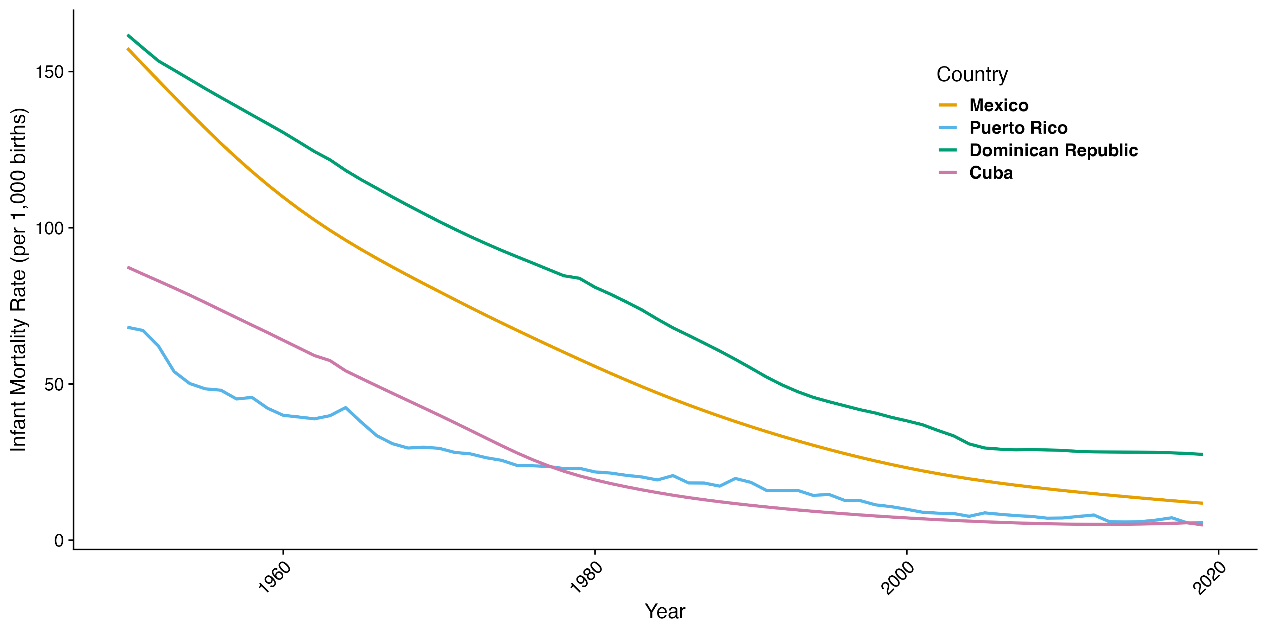
Infant Mortality Rates Show Very Different Early Childhood Conditions
Notes:
And these sociodemographic differences stem in part from very different home country conditions.
Looking at this graph, where we plot time on the x-axis and infant mortality on the y, we see that in 1950, around when many people in our study were born, people from these four countries had dramatically different early childhood environments.
These early life conditions are important because they'll have significant implications for health in later life.

Slide 4
Immigrant Health Differs by Birth Country
Growing literature documents heterogeneity in immigrant health by birth country
E.g., using NHIS, but small immigrant samples by birth country requires pooling across 15-20 years
We’re going to look at ACS (2016-20) for larger sample
Sociodemographic determinants of healthy aging in the ACS
Migration Timing: Year / Age
Education
Social Isolation: Marital Status / Living alone
Acculturation: English Speaking / Citizenship
Disability: Cognitive / Lack of Independence
Notes:
There is, however, a growing literature showing that these migrants do differ significantly in their health outcomes.
Researchers have used the National Health Interview Survey to document important morbidity differences between these groups.
However, these data offer a relatively small sample size for these populations, requiring researchers to pool sometimes across 15 years or more of data to get sufficient numbers.
That's why we chose to analyze data from the 2016-20 American Community Survey, which gives us a much larger sample size and allows us to compliment the health differences documented in previous research. Our sample is so large, in fact, that all key comparisons are statistically significant and are also robust to controls, so we opted instead to present simpler unadjusted averages.
More specifically, in our analysis, we focus on key sociodemographic factors available in the ACS that influence healthy aging, which are:
Migration timing (year and age of migration)
Educational attainment
Social isolation (marital status and living arrangements)
And acculturation (English speaking ability and citizenship status)
Additionally, we report on whether respondts fron these migrant groups have cognitive difficulties and disability conditions that make it difficult basic activities alone.

Slide 5

Migrant Selectivity Differs by Country: Comparisons with Older Adults in Birth Countries
International Census Data from IPUMS
Mexico: 2010
Puerto Rico: 2010
Dominican Republic: 2010
Cuba: 2012
US American Community Survey (2008-10)
Across all samples we select for ages 60+
Notes:
To better understand differing selection patterns, we compared US migrants to their native-country counterparts using international census data from IPUMS.
Because some Caribbean data are only available around 2010, we selected census years closest to 2010- Mexico, Puerto Rico, and Dominican Republic data are from 2010, and Cuba data is from 2012. We then compared these to their US migrant counterparts in the 2008-10 ACS.
Across all samples we selected only for people that are age 60 and above at the time of being interviewed by the Census.

Slide 6

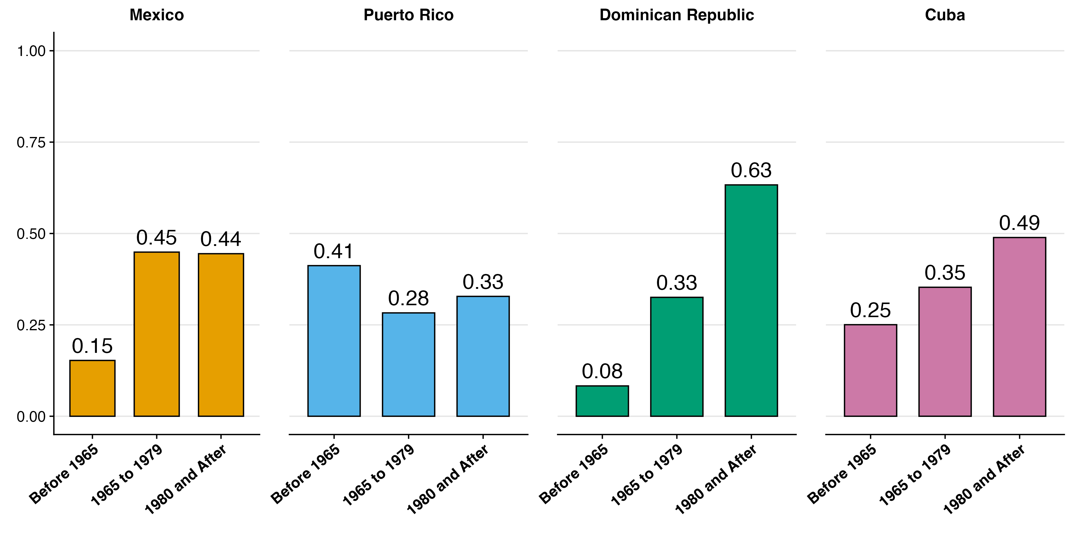
Migration Decade varies by Country
2016-20
Notes:
Looking first at 2020 the ACS, we see significant differences in migration timing between these groups.
In this plot, and in every plot I’ll show, the y axis is the proportion and the x axis is the category people from these countries fall into.
Puerto Ricans, who were granted US citizenship in 1917, show the earliest migration pattern. 41 percent of Puerto Ricans in our analysis migrated to the US before 1965.
Despite being very different, Dominican migrants appear most like Mexican migrants in their migration timing, with only 8 percent reporting having moved here before 1965. However, Dominicans are distinct in that they're the most likely to have migrated more recently – the vast majority arrived in 1980 or after.
(NOT GOING TO READ BUT LEAVING IN CASE IT COMES UP)
Cuban Revolution in 1959 sparked one of the largest refugee movement in US history (Duany 2017). In 1966, given path to US residency.

Slide 7
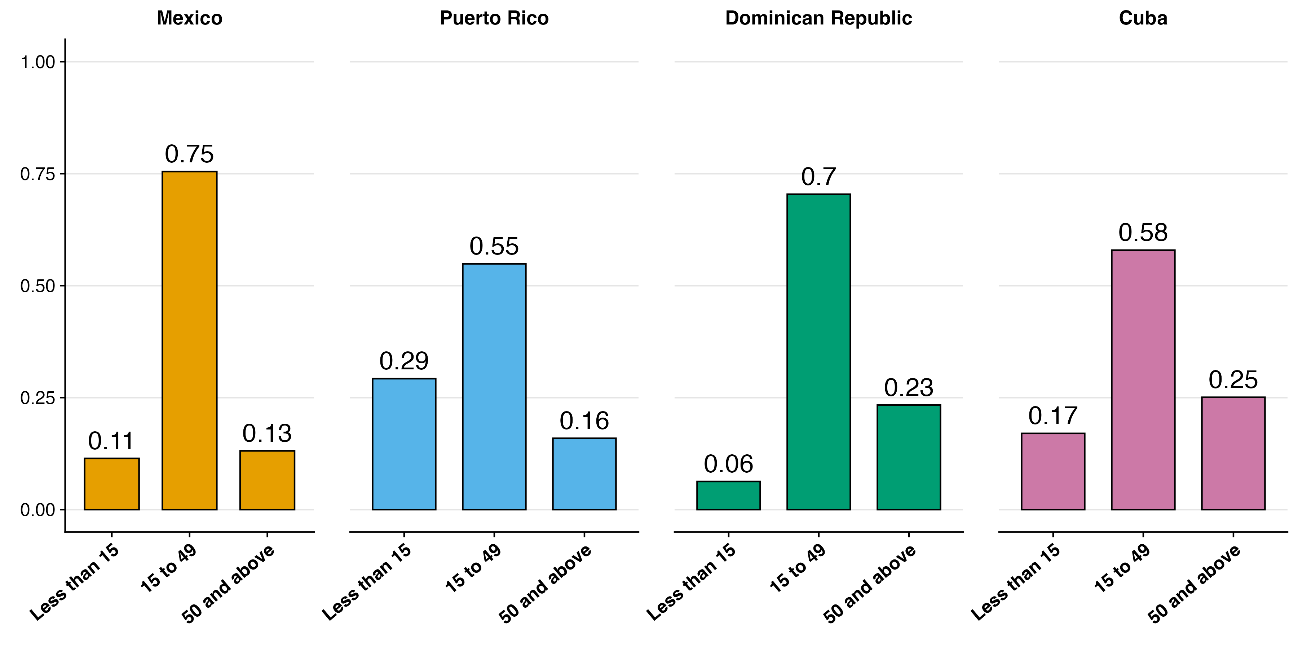
Most people migrated at working ages
2016-20
Notes:
Now let's examine age at migration patterns, which connect closely to the migration timing patterns we just discussed but also impact acculturation levels which we just saw are an important factor for healthy aging.
Across all groups, migrants predominantly moved during working ages (15 to 49) rather than as children. Puerto Ricans stand out as an outlier, with 30% migrating during childhood. Mexicans, in contrast, are much more likely to have moved during the working ages compared to migrants from these countries. Of all Mexican migrants aged 60 and above, 75% say they migrated during these ages.
Notes to self: lower prop migrated less than 15 could be due to mortality,
Cubans and Dominicans are twice as likely as Mexicans to have migrated after age 50.

Slide 8
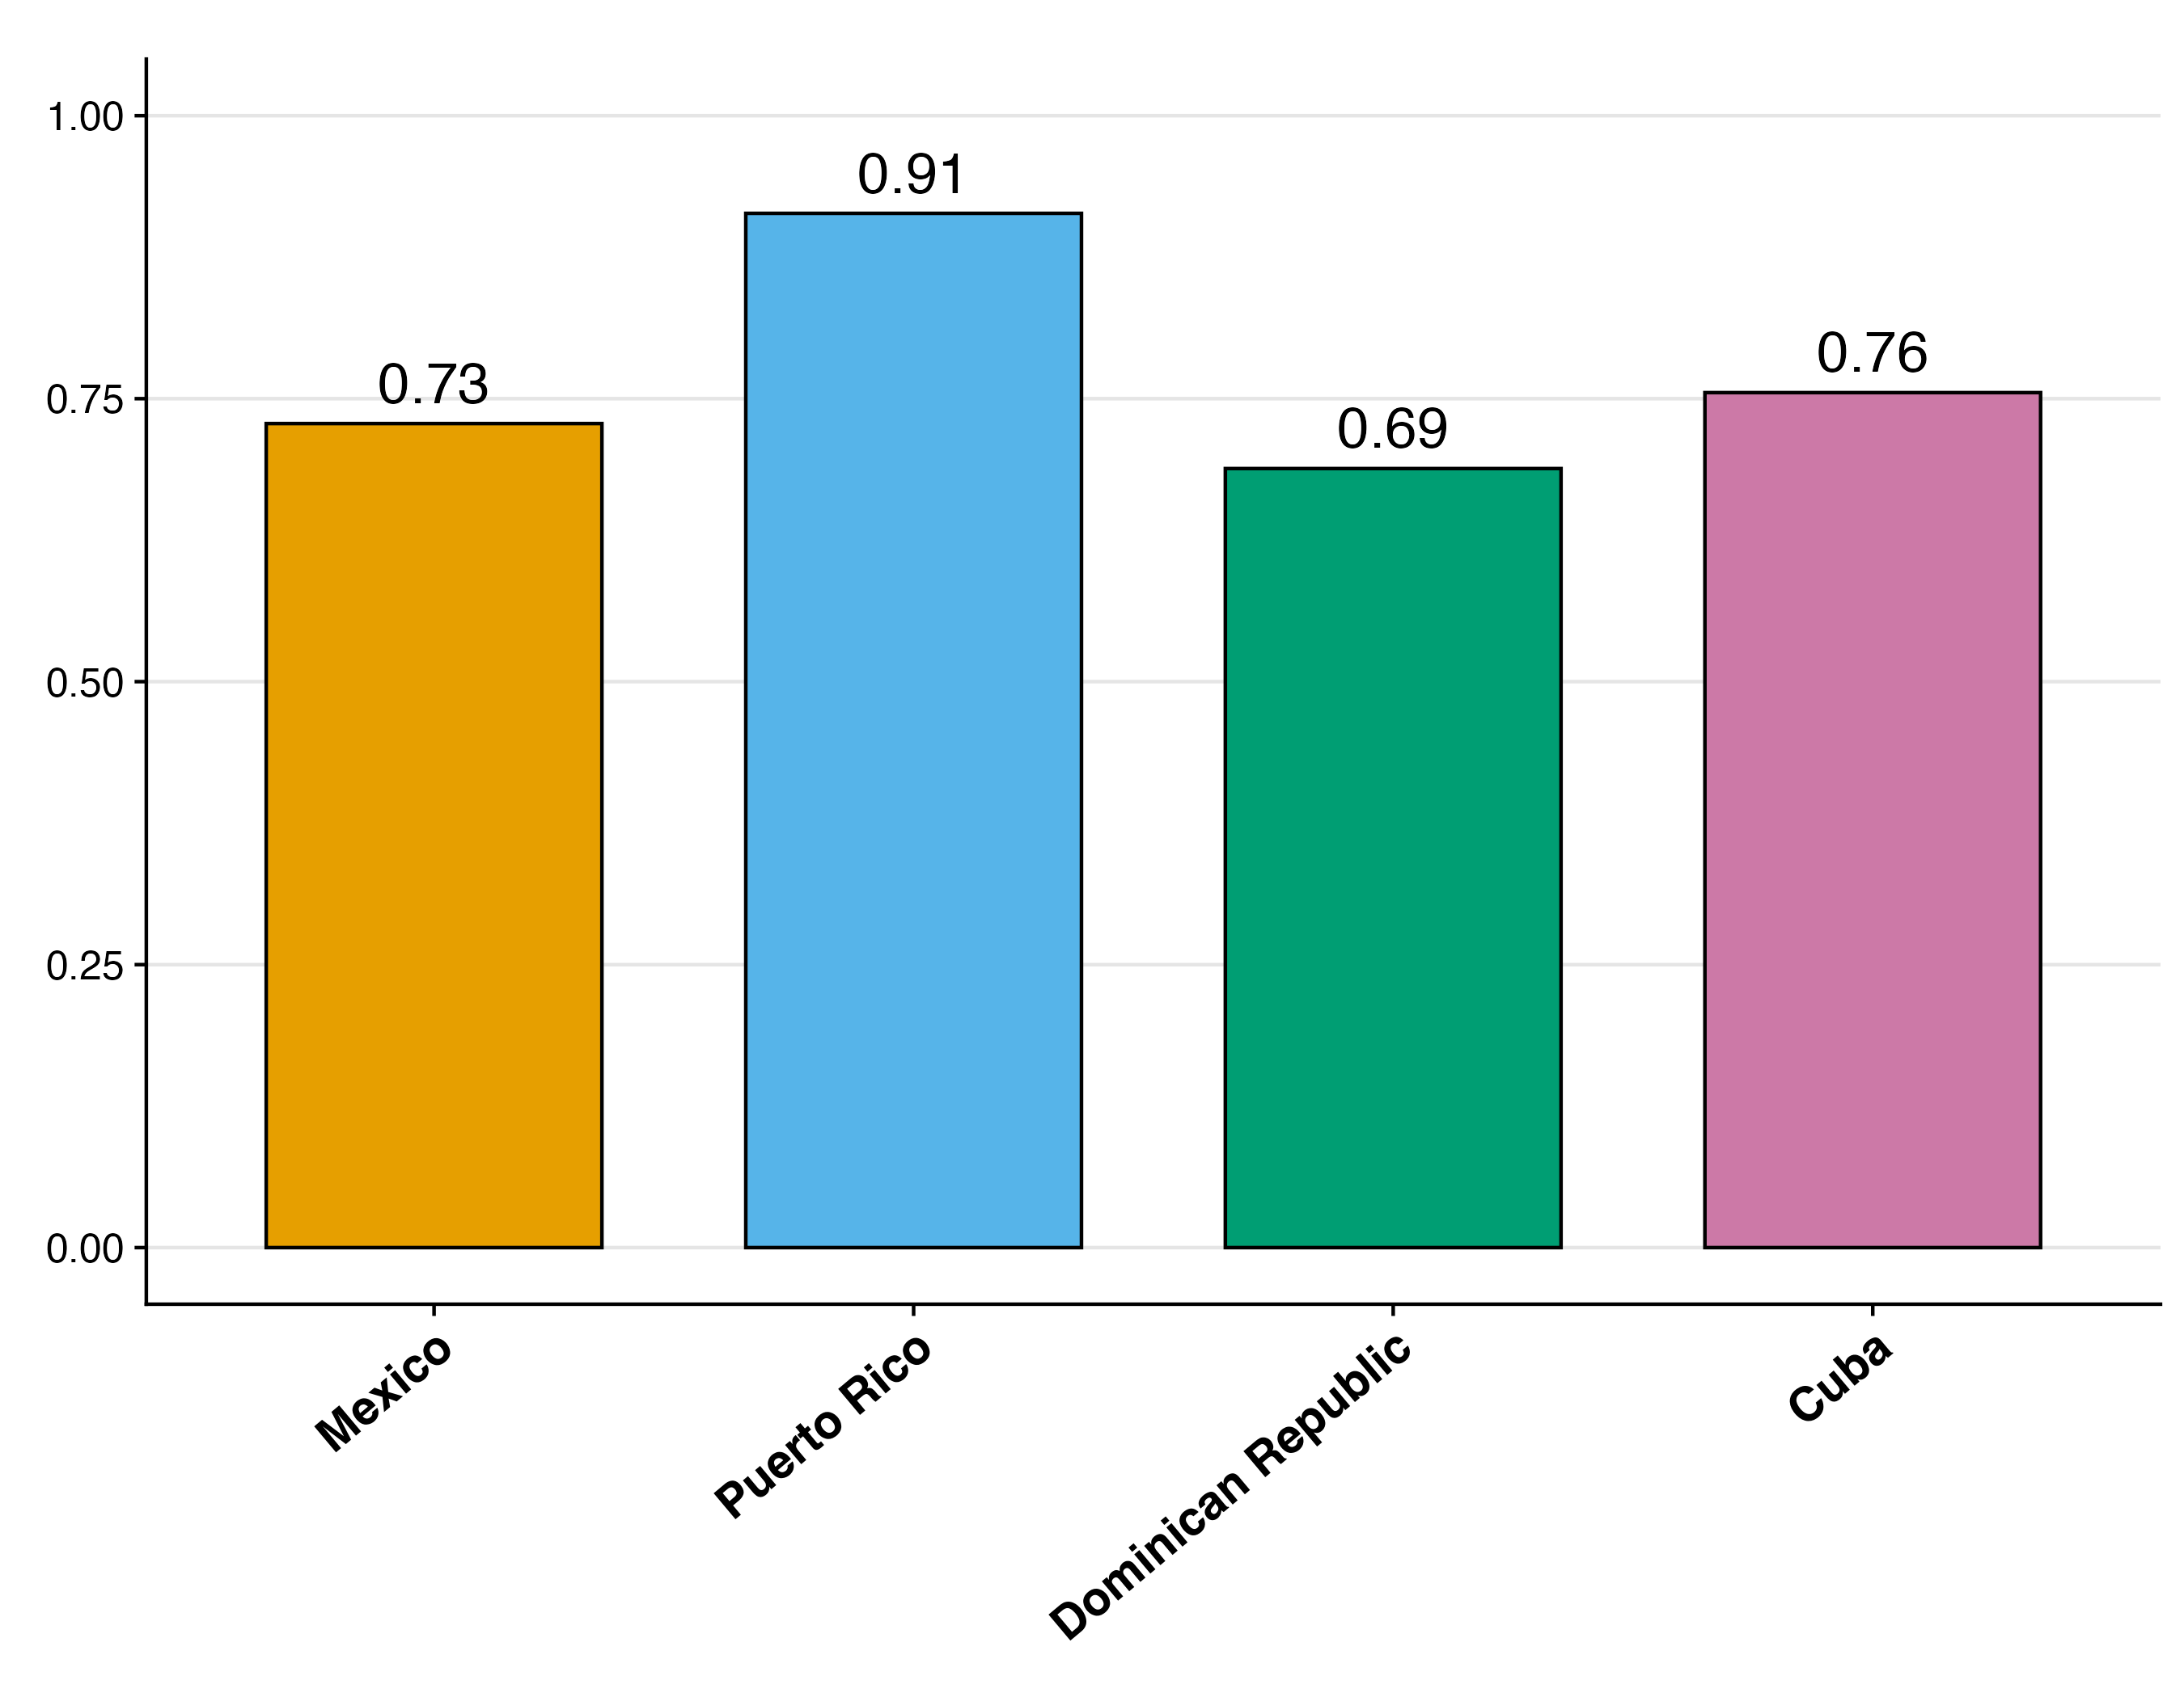
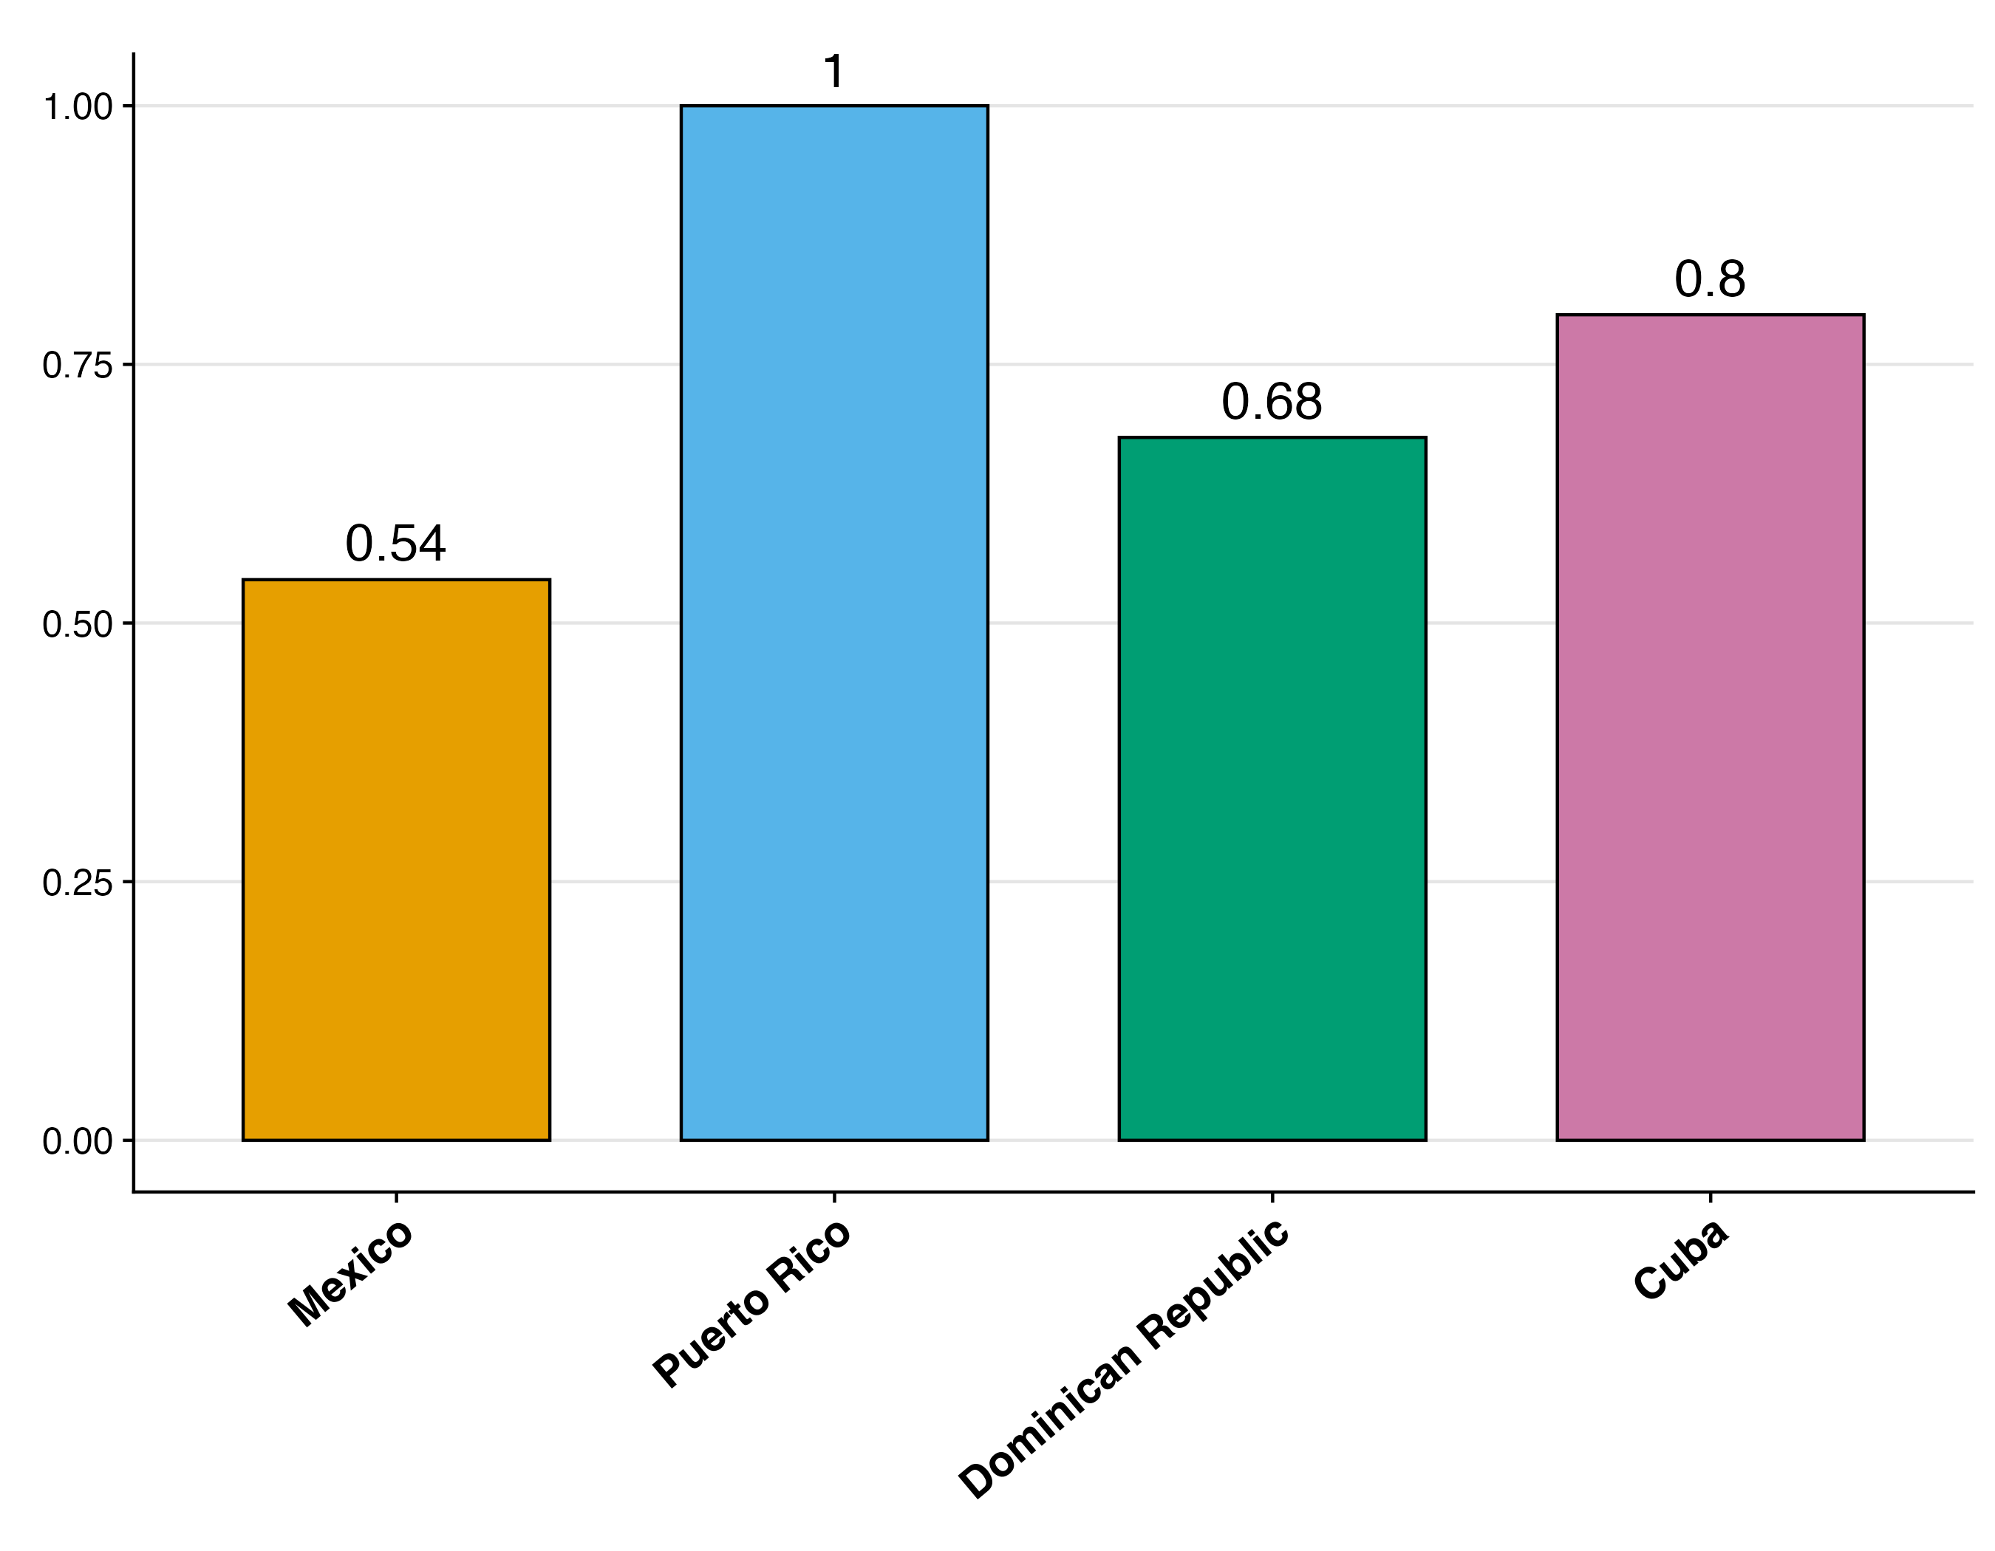
Mexican and Dominican migrants are the least likely to acculturate
2016-20
Proportion English Speakers
Proportion Citizen
Notes:
And that directly impacts acculturation.
Here we find again that Cuban and Dominican migrants are distinct from Mexican migrants.
While these three groups tend to speak English at similar rates, Cuban and Dominican migrants are significantly more likely to become naturalized U.S. citizens compared to Mexicans. Here we see that 80% of Cuban migrants and nearly 70% of Dominicans report having become naturalized citizens, whereas it's only just over half of Mexican migrants that are naturalized citizens.
While the effects of acculturation on health are complex, the point here is that we might expect very different health patterns by birth country because of these different acculturation patterns.

Slide 9
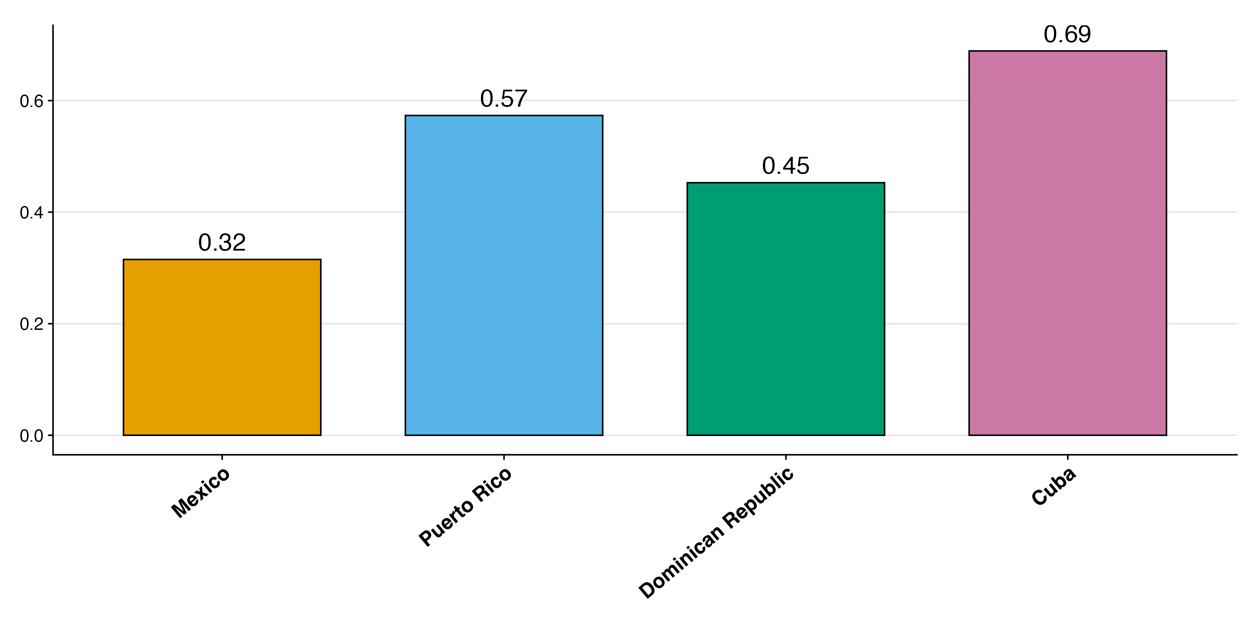
Caribbean Hispanic immigrants tend to be more educated than Mexican immigrants
2016-20
Proportion With At Least Secondary Degree
Notes:
Traditionally, a clearer determinant of healthy aging is education, which we find varies substantially between these groups
Mexican migrants have the lowest rates of secondary education completion, well below Caribbean migrants. Only 30% of them report having completed high school.
And among Caribbean groups, Cubans have the highest rates of high school completion, at 70%, followed by Puerto Ricans, then Dominicans.

Slide 10
What’s driving the lower education among Mexican Immigrants?
Older so need to age adjust?
Age at Migration?
Birth country education levels?
Migrant selectivity?
Notes:
To better understand what might be driving these educational differences, we examined four possible explanations:
It could just be that are age differences between these these groups that we need to adjust for. Which we found don’t make a huge impact.
It could be that within some migrant groups, there are differential numbers of people who migrated to the US during childhood and therefore stayed in school longer because of compulsory schooling age laws
Their birth country might explain it, that is maybe certain groups have had lower schooling attainment norms in their home countries and therefore they come to the US with fewer years of education
And lastly we could be seeing migrant selectivity. It may be that migrants from these Caribbean countries were more positively selected on education than migrants from Mexico.

Slide 11
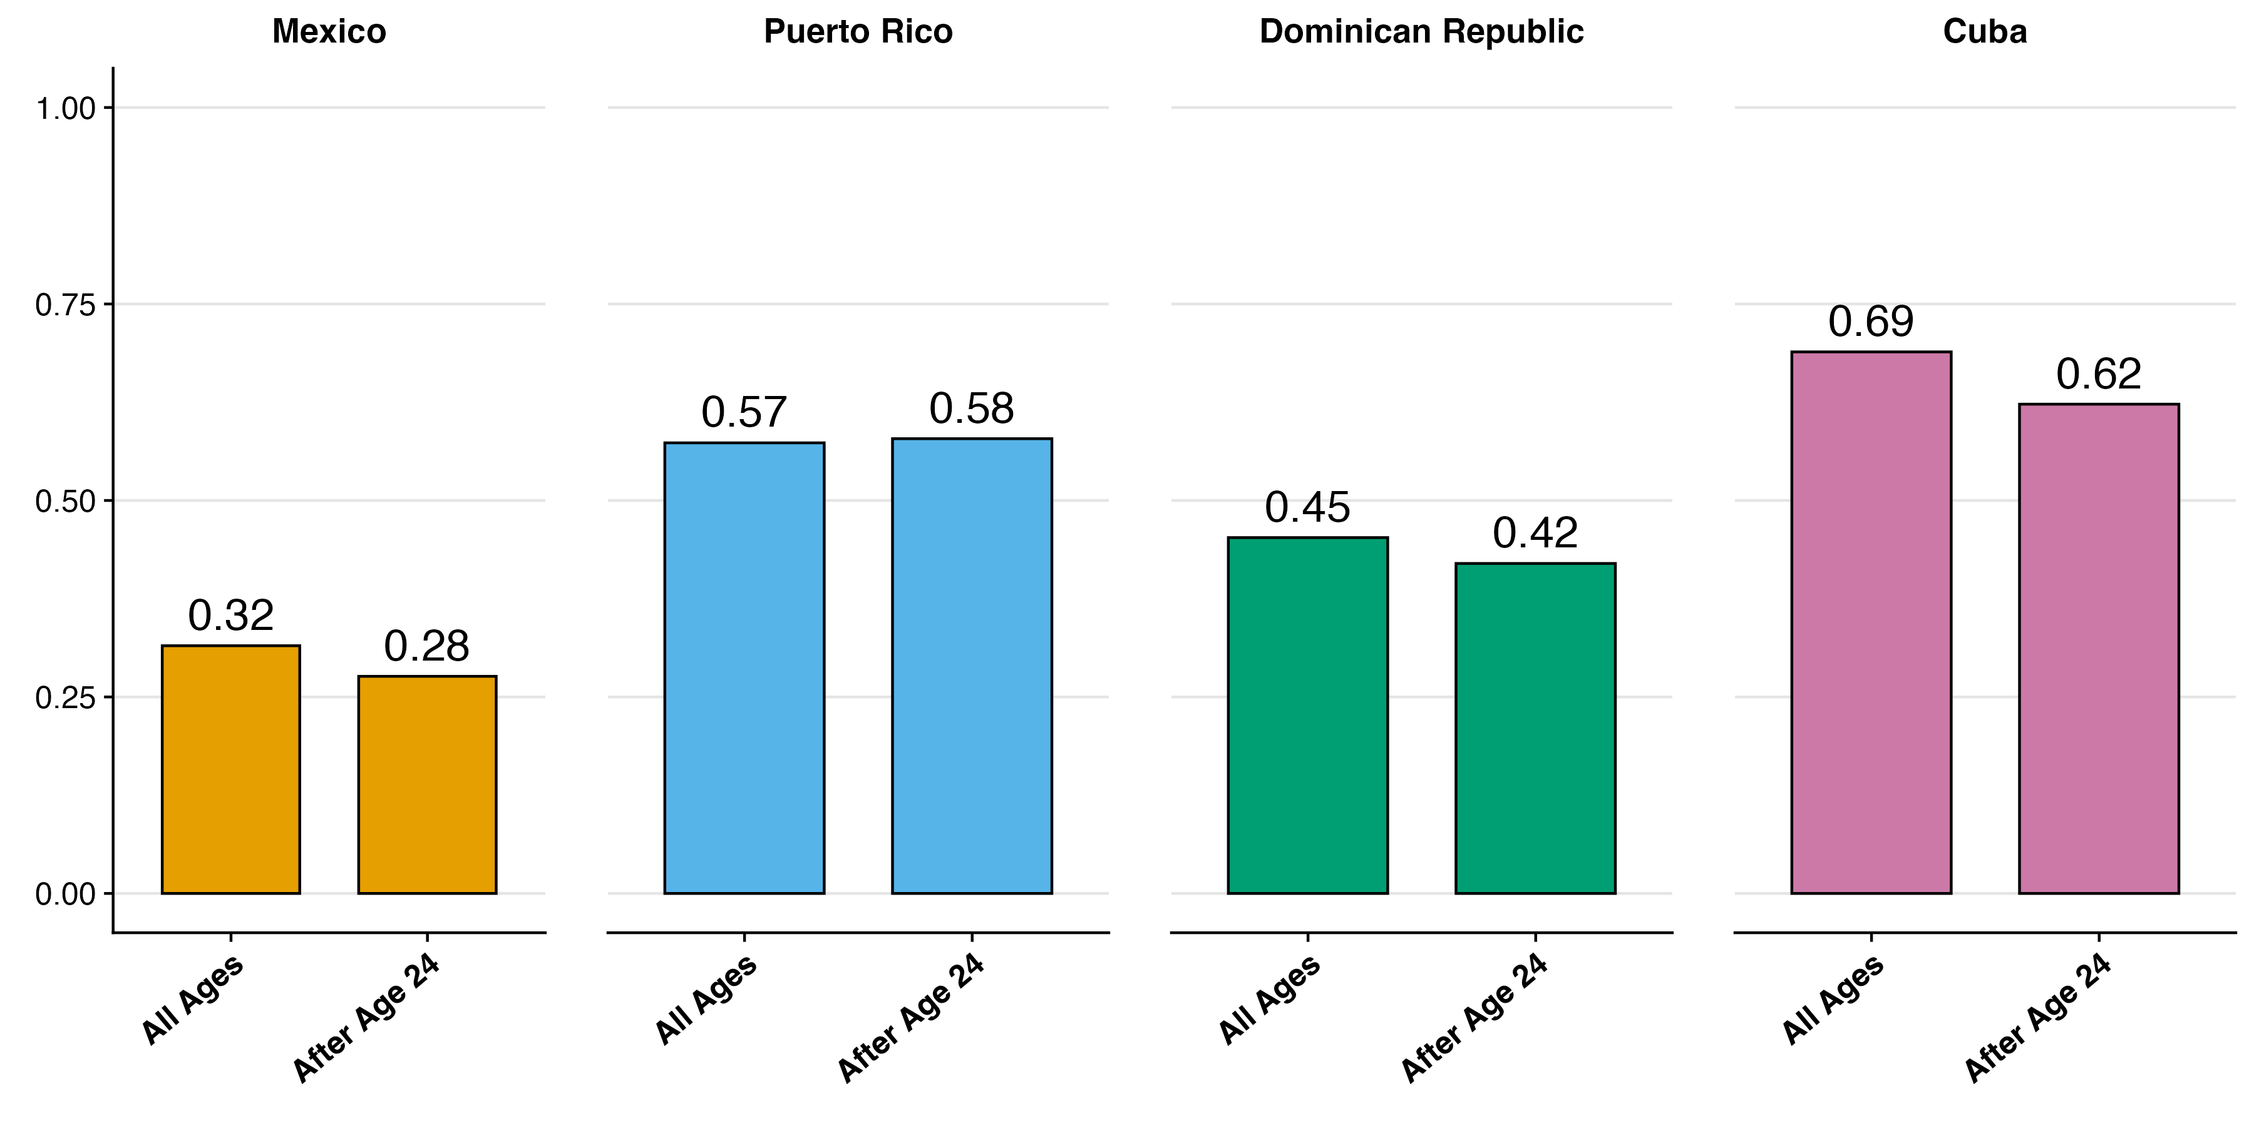
Education Differences are Not Explained by age at Migration
Results hold when controlling
2016-20
Notes:
In order to test whether age at migration can explain these disparities, here we compare education levels of all migrants to those who migrated after age 24.
For each country in this graph, the left bar again shows the secondary education attainment proportion that I just showed you, and the bar to its right shows that same proportion among those who migrated after age 24.
The overall hierarchical patterns remain similar, which implies that age at migration does not explain the educational differences we observe.

Slide 12
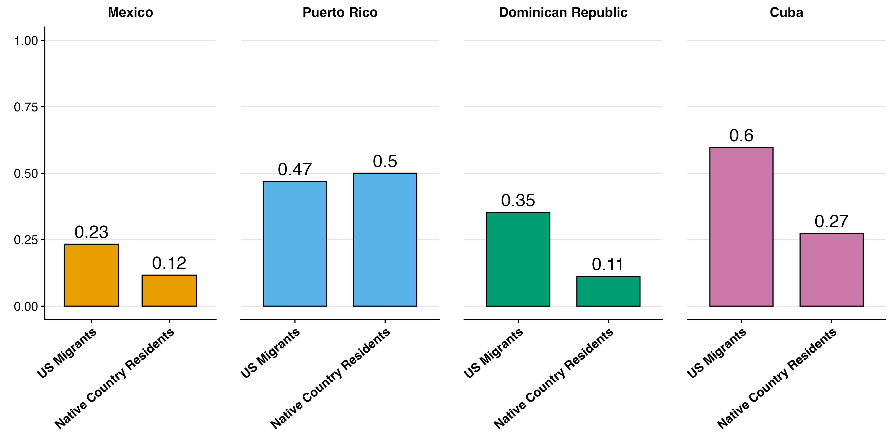
Positive migration selection on education: US migrants are more likely to have completed secondary school compared to those in their birth country – but varies by country
2008-10
Notes:
When we compare education levels of migrants to their native-country resident counterparts, two things stand out.
The first thing we noticed here was that migrant educational patterns largely reflect education levels in their home countries, which is evident in the overall educational hierarchy among these groups, with Cubans in their home country generally having higher educational attainment than Mexicans in their home country, for example.
Second, selectivity patterns differ significantly between these groups. Cuban and Dominican migrants show the strongest positive educational selectivity, whereas Puerto Rican migrants are actually slightly less likely to have a high school degree compared to their native-country counterparts.

Slide 13
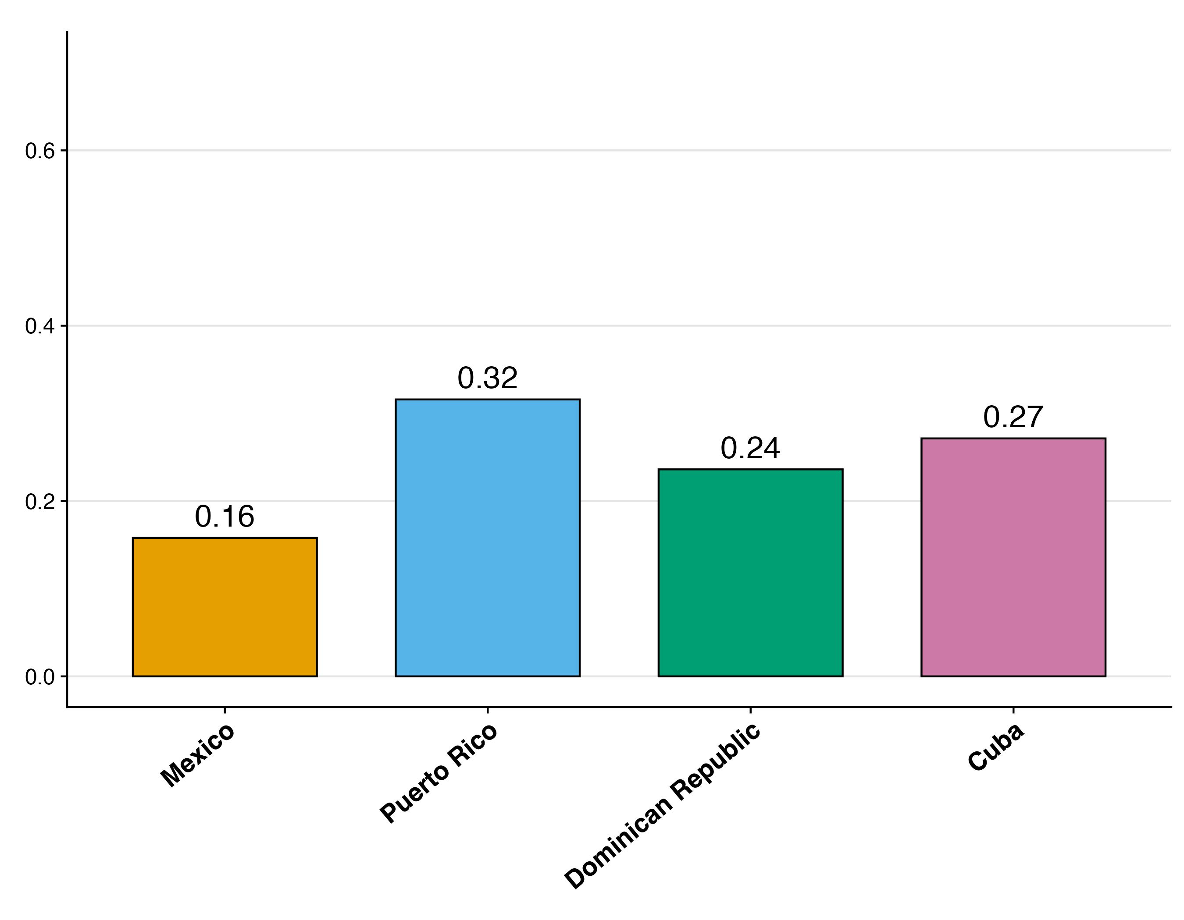
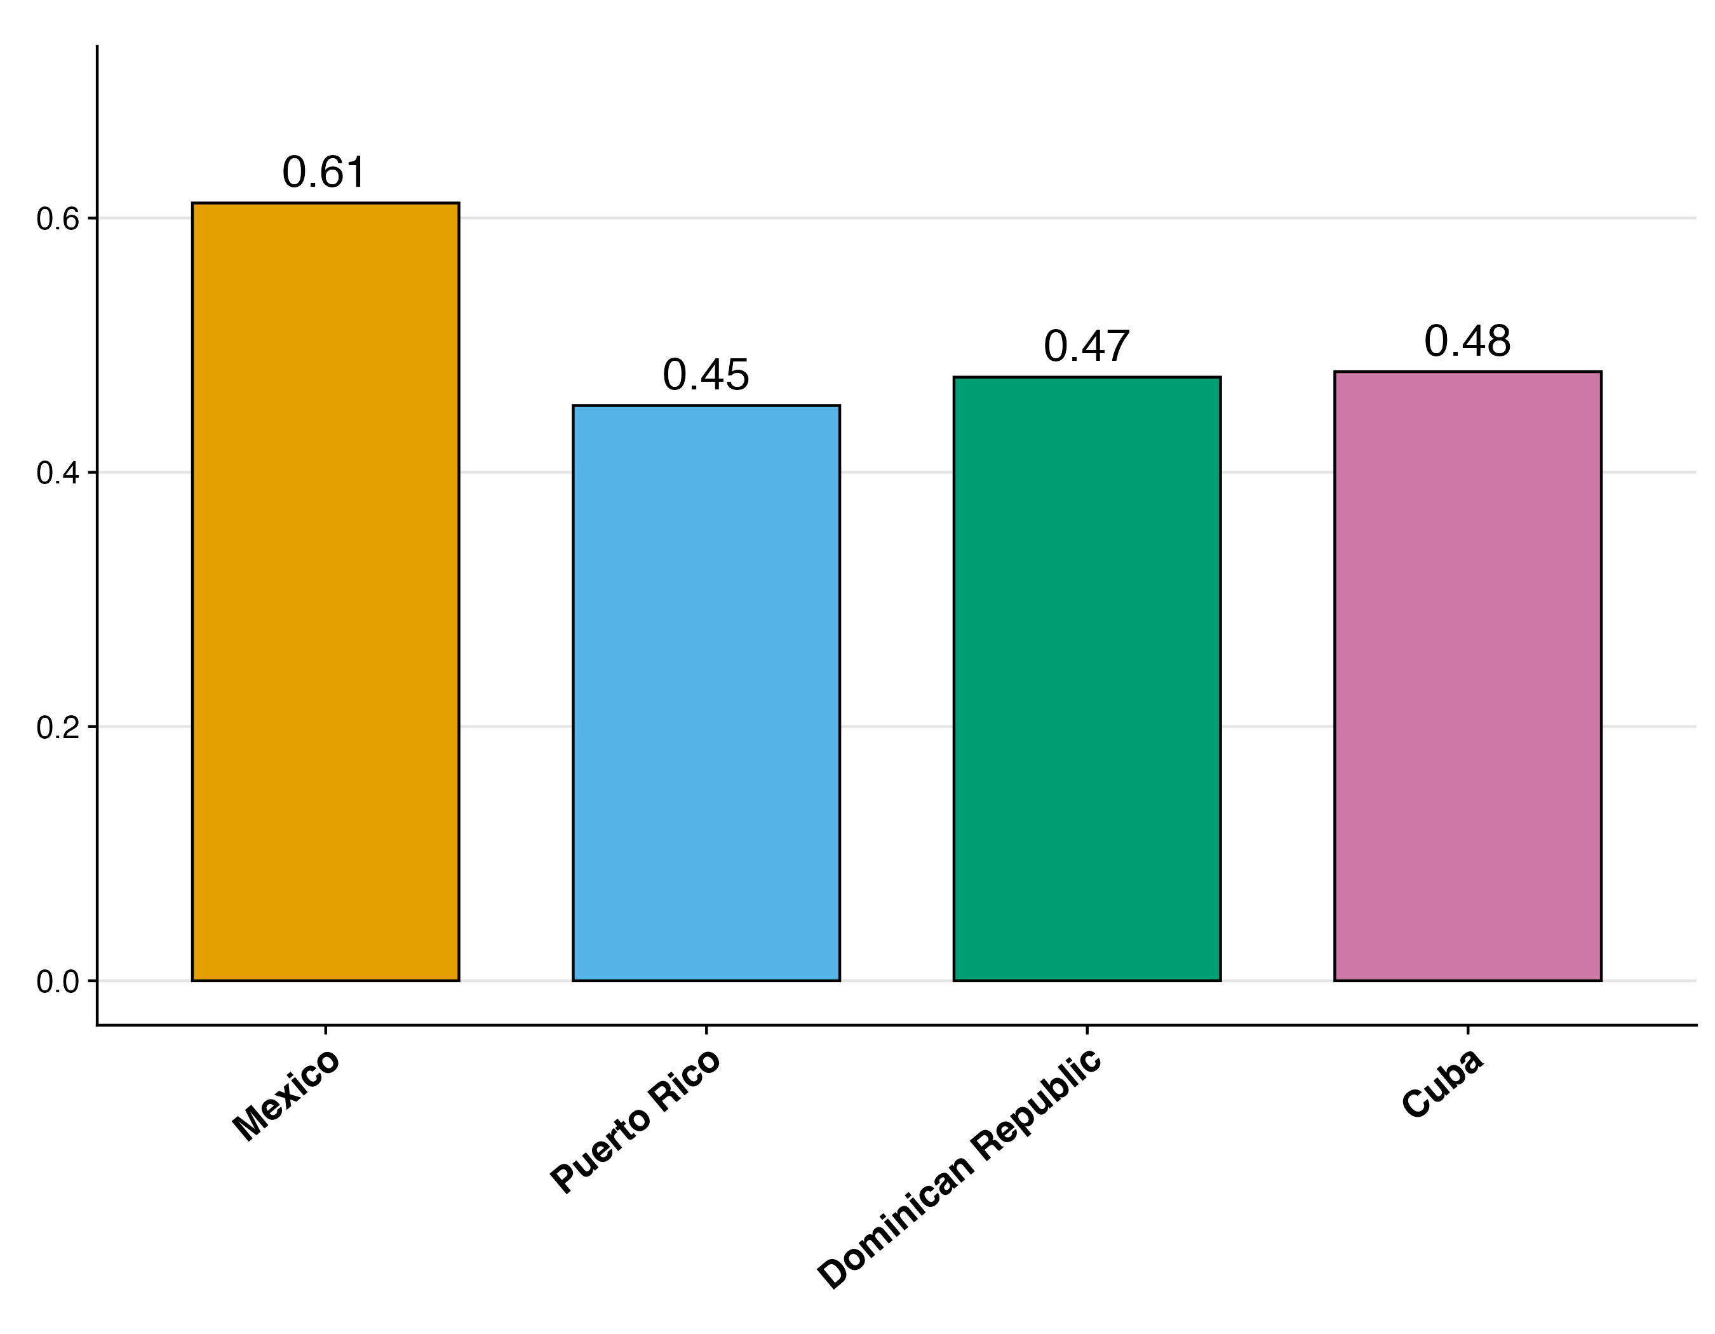
Mexican migrants are the least likely to live alone and most likely to be married
2016-20
Proportion Living Alone
Proportion Married
Notes:
I don’t have time to walk through hypotheses on all these other factors, but these migrant groups also differ in household arrangements.
What stands out here is how relatively few Mexican migrants are likely to be solitary. Only 16% of Mexican migrants over 60 live alone, compared to 32% of Puerto Ricans (twice as many).
Mexican migrants are also much more likely to be married than their Caribbean counterparts.
Again, this is not explained by age or migration timing, so it seems to reflect something more fundamental about population differences by birth country.

Slide 14
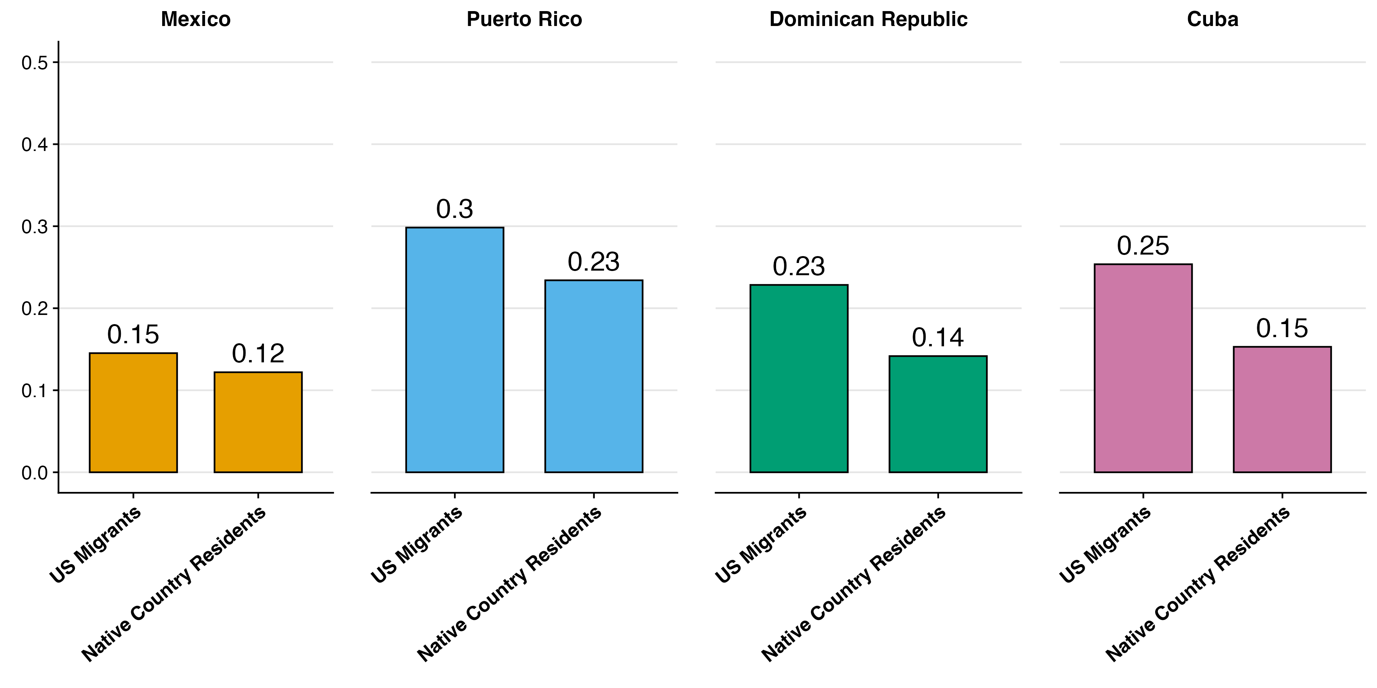
Native country residents are less likely to live alone
Proportion Living Alone
2008-10
Notes:
Overall, however, these US migrants are more likely to live alone than their native-country counterparts, with this difference being more pronounced among Caribbean migrants than Mexicans. For example, 25% of Cuban migrants report living alone, whereas only 15% of Cubans in their home country report the same.
It’s not obvious why or what the implication is, but this is an intriguing fact that calls for further investigation

Slide 15
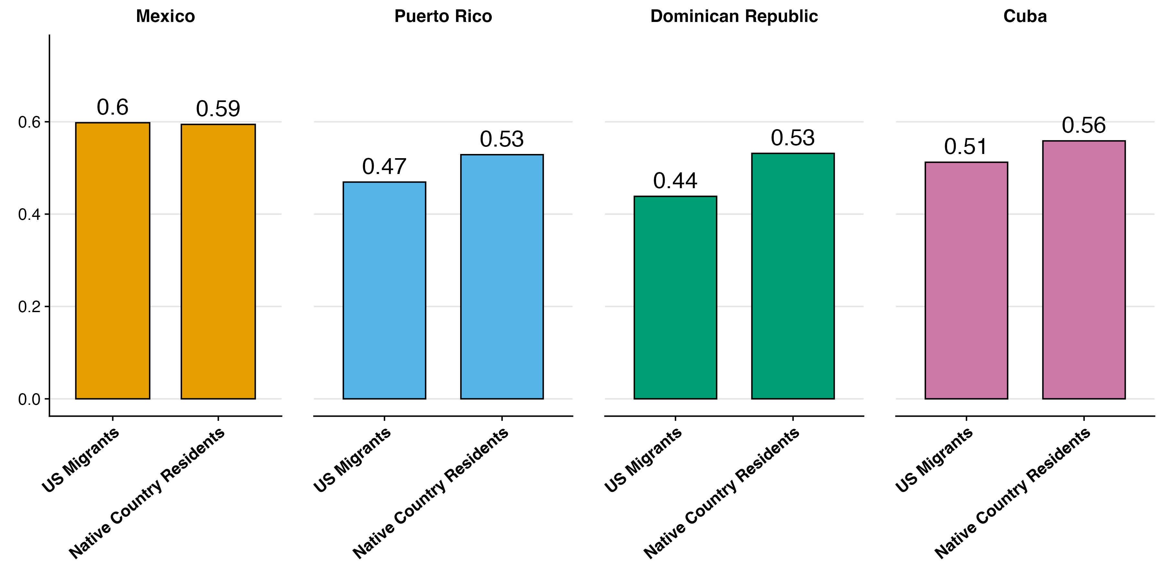
Native country residents are more likely to be married
Proportion Married
2008-10
Notes:
And lastly for sociodemographics, we see similar patterns with marriage.
Mexican migrants are again unique compared to Caribbean migrants.
Where Caribbean migrants are less likely to be married in the US compared to their native-country counterparts, Mexican migrants maintain marriage rates nearly identical to those of Mexicans living in Mexico.
We haven't had time yet to wrap our minds around why this would be, so we'd be very curious to hear people's thoughts on what might be going on here.

Slide 16
Sociodemographic Takeaways
Hispanic migrants have differing sociodemographics by Caribbean birth country
Mexican migrants more likely to have migrated during working ages
Puerto Ricans the most likely arrive before age 15
Compared to Mexican migrants:
Caribbean migrants have higher education and acculturation rates
are more likely to live alone
Dominican and Cuban education selectivity is the strongest
Important for health
Notes:
In summary for these sociodemographics, these Hispanic migrant groups differ substantially from each other and from their native-country counterparts
The key differences we identified were:
Migration patterns vary significantly for all groups, both timing and age of arrival, where Mexican migrants are more likely to have migrated during working ages and Puerto Ricans are the most likely to have migrated before age 15
Caribbean migrants generally have higher educational attainment and citizenship rates compared to Mexican migrants
Caribbean migrants are also relatively more likely to live alone
Selection patterns also vary dramatically, with Dominican and Cuban migrants showing much stronger positive educational selectivity compared to Mexican and Puerto Rican migrants (who actually show some negative selection)
These all have important implications for their respective health outcomes that I'm going to present on next.

Slide 17
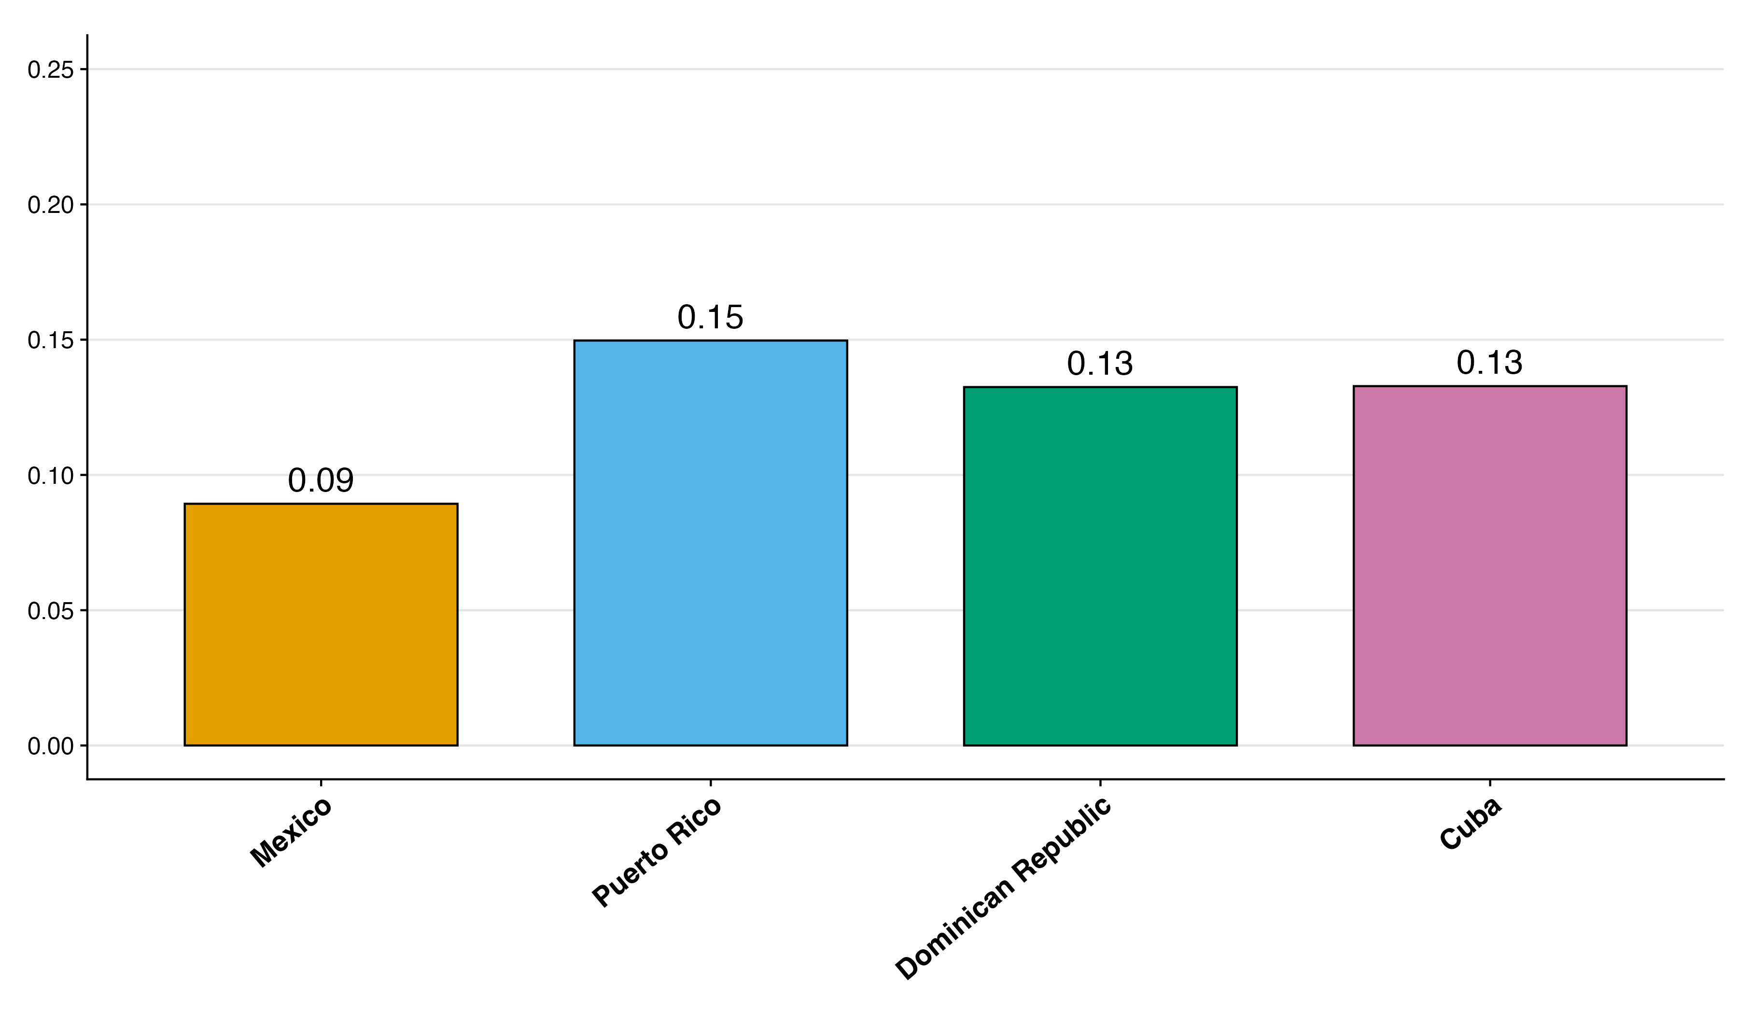
Mexican migrants are the least likely suffer from cognitive difficulty
Notes:
Now I want to examine cognitive difficulty - defined as self-reported difficulty concentrating, remembering, or making decisions. Importantly, these are subjective household reports, not clinical diagnoses.
Here we see a striking paradox: despite being the lowest educated, Mexicans report the lowest rates of cognitive difficulty.
This finding is particularly striking because research consistently shows that lower education and later-life migration are associated with poorer cognitive function - yet Mexicans, despite having both characteristics, report the lowest rates of cognitive difficulty among these four groups.
We tested whether compositional education differences could explain this paradox. But, while education partially mediated the gap between Mexicans and migrants from the Dominican Republic and Cuba, it couldn't account for the Mexican-Puerto Rican difference. In fact, even a comprehensive model that includes all sociodemographic variables previously mentioned as covariates - whether the respondent is married, living alone, age at migration, and others - fails to explain the gap between Mexican and Puerto Rican migrants.
This suggests something more fundamental about these populations - a pattern we'll see reinforced in our next outcome.

Slide 18
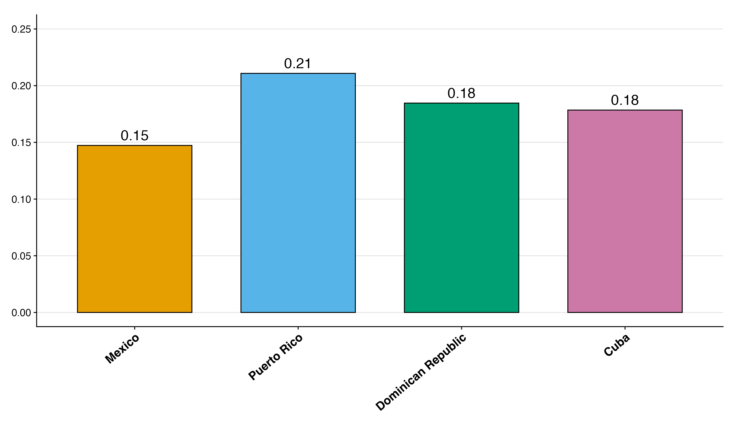
Mexican migrants are the least likely have difficulty living independent
Notes:
Here we're looking at average functional limitations. This measures whether respondents report having any physical, mental, or emotional condition lasting six months or more that makes it difficult or impossible to perform basic activities outside the home alone. So, the taller the bar the more limitations people from these groups report.
Once again, we see the same striking pattern emerge. Mexicans report the lowest rates of functional limitations, despite their sociodemographic profile suggesting they should experience more challenges.
We applied the same analytical approach, testing whether compositional differences could explain these disparities. Just as with cognitive difficulty, education and other sociodemographic factors partially explained the gap between Mexicans and migrants from the Dominican Republic and Cuba. But the Mexican-Puerto Rican difference persisted.

Slide 19
Cognitive and Physical Health Takeaways
Mexican migrants report better health despite lower education and older age at migration
Both cognitive and physical
Mexican migrants are less solitary, a positive for health
But no sociodemographic variables explain their better health
Things are rapidly changing
Notes:
So what are the takeaways here?
What we see is a consistent pattern across two distinct health measures showing that Mexican migrants tend to report better health, especially compared to Puerto Ricans.
The fact that we see identical patterns for both cognitive difficulty and functional limitations, and that none of the important sociodemographic differences can explain the gap between Mexican migrants and Puerto Rican migrants, suggests we're observing a robust phenomenon that deserves deeper investigation.
One last thing to mention here is that these findings are utilizing recent data from 2016-2020, but things are rapidly changing.

Slide 20
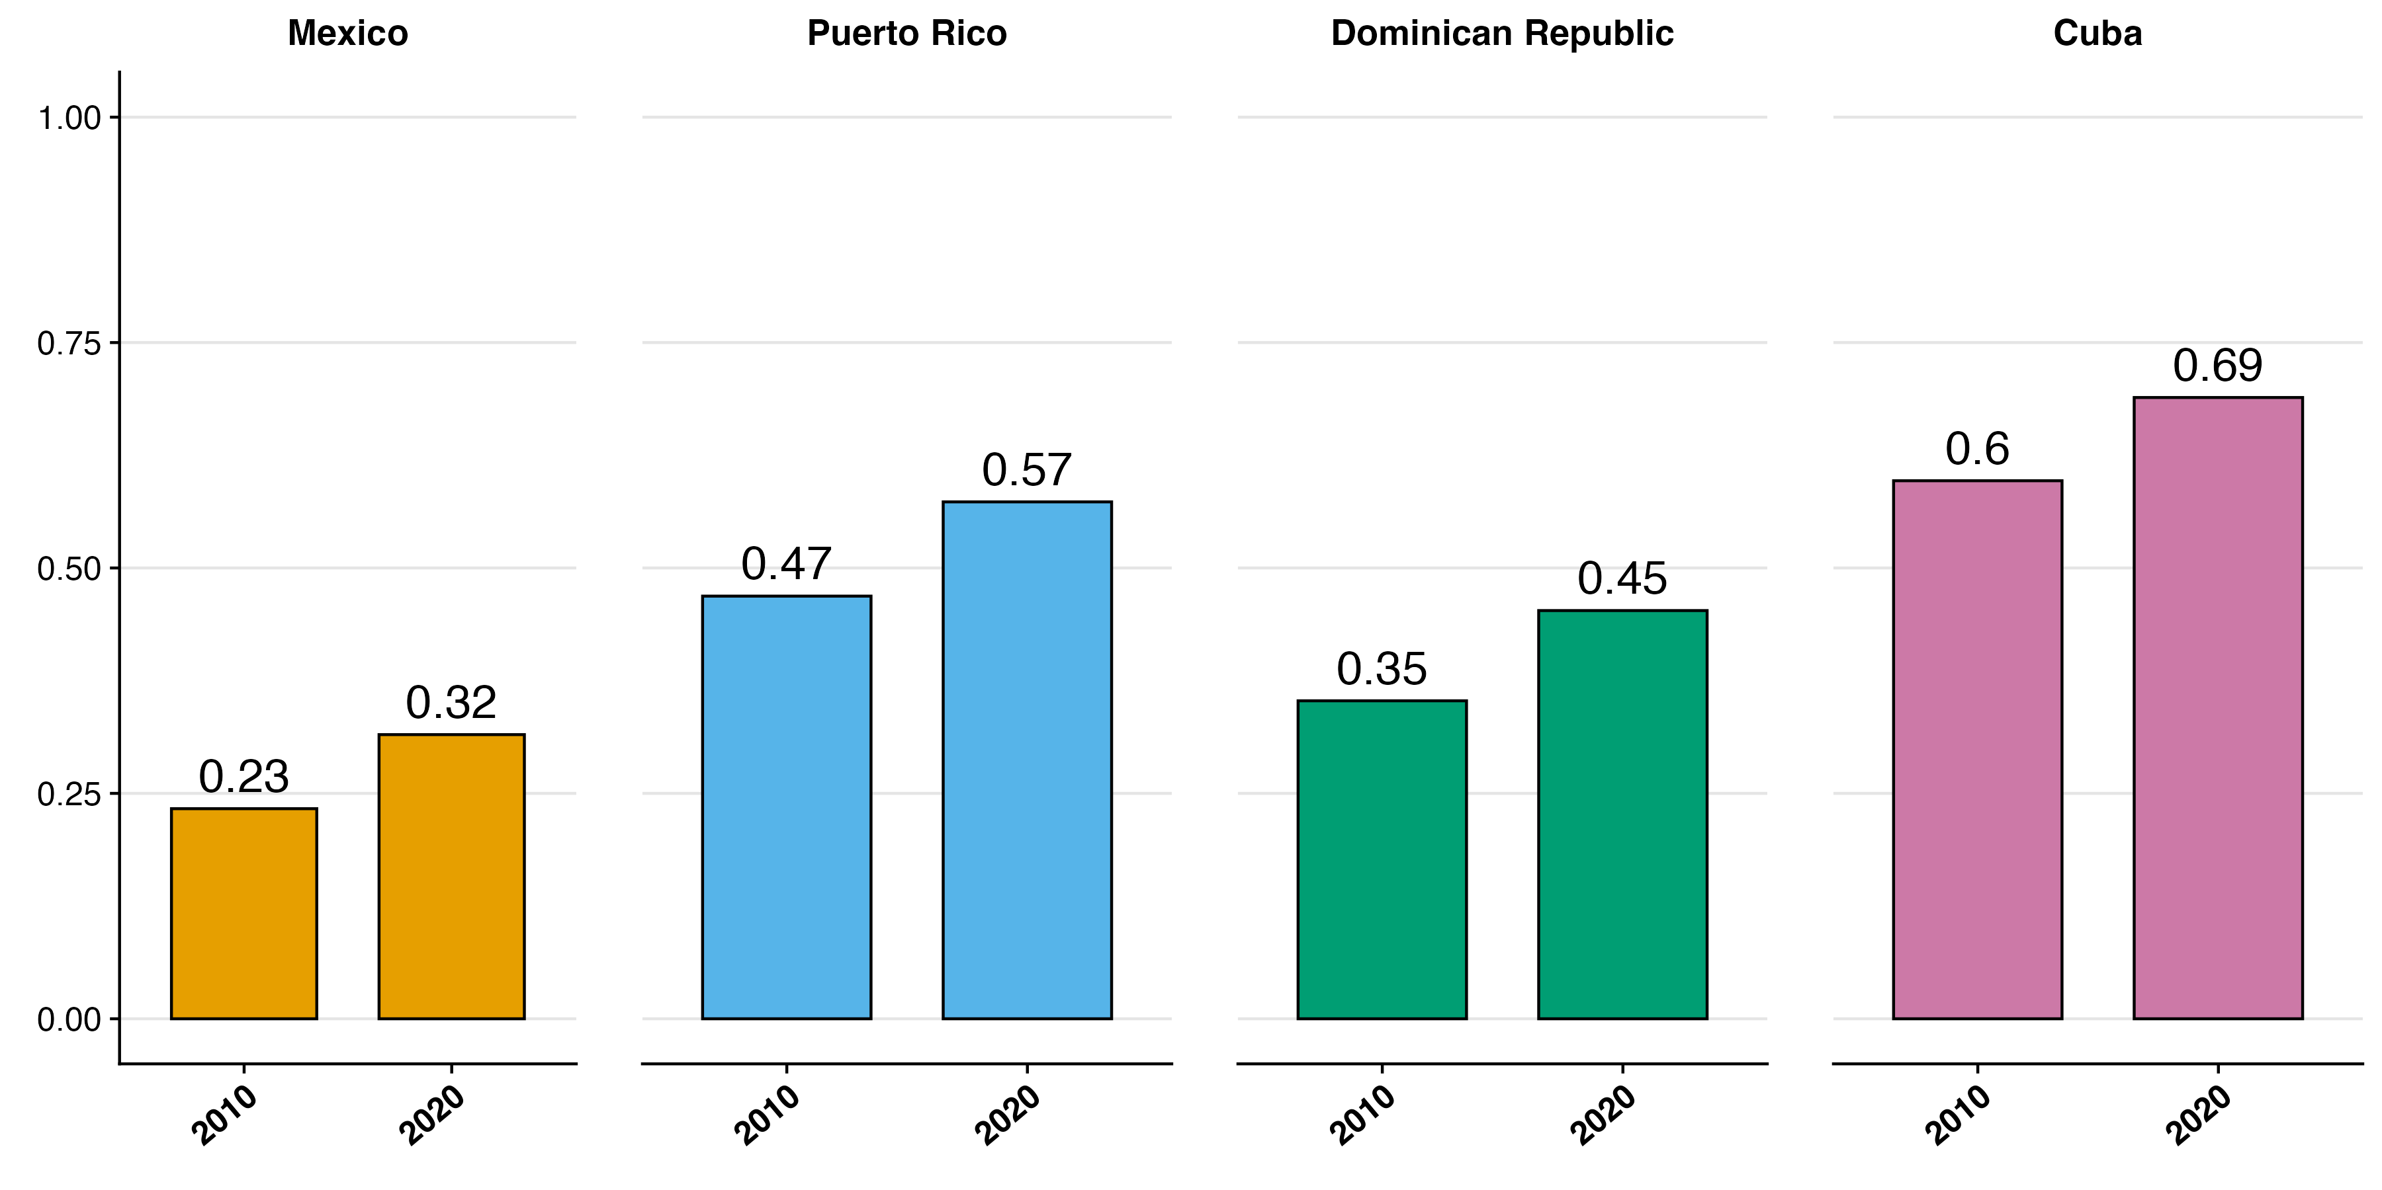
Strong cohort increases in migrant education, even from 2010 to 2020
Notes:
When we compare these migrant groups from 2010 to 2020, we see that they're all becoming more educated across the board.
Although over time, the overall pattern has remained consistent, where Mexicans are the least educated and Cubans are the most, in the future we might see some of these gaps begin to narrow.
This matters because even though education doesn't explain all of the health differences between these groups, it remains one of the strongest predictors of health outcomes.
In other words, we need more current data on both migrants and their native country counterparts to understand how these evolving educational patterns might reshape the health disparities we've documented.

Slide 21
Limitations
Limitations
Return migration not accounted for: need better birth country survey data
Census data has large sample sizes, but does not directly measure health
=> We need better nationally representative data in the Caribbean sending countries, e.g. similar to the Mexican Health and Aging Survey (MHAS)
Notes:
Before I end, I do want to point out a few limitations of this study, however.
For example, we don’t get to see respondent previous migration history and so some of the folks living in their respective native countries might have temporarily lived in the US but moved back by the time they reach old age.
The other major limitation is that the Census doesn’t provide extensive testing information on respondent health, these are self-reported measures and not outcomes produced by any test or diagnosis.
What we need is better nationally representative data in these Caribbean countries that’s comparable to US data, that provides more comprehensive health measures, and also comparable to studies like the Mexican Health and Aging Survey (MHAS).

Slide 22


Caribbean Dementia and Aging Study
New Hispanic Caribbean healthy aging surveys:
Our team is collecting nationally representative CADAS surveys in Puerto Rico and Dominican Republic
Harmonized data in Cuba
Harmonized with global family of Health and Retirement Surveys (HRS) and Mexican MHAS
Includes Harmonized Cognitive Assessment Protocol (HCAP)
This presentation provides background for future CADAS analysis of US Caribbean migrant selectivity
Stay tuned for data release next year
Notes:
That’s why we’re eager to follow this study up with an analysis of the Caribbean American Dementia and Aging Study (CADAS).
We’re still in the middle of data collection, but CADAS will consist of nationally representative samples in Puerto Rico and Dominican Republic harmonized with data from Cuba
Because it’s part of the Harmonized Cognitive Assessment Protocol, it’ll allow us to run comparative analysis of both US data like the Health and Retirement Surveys and Mexican data like MHAS.
In other words, we consider this study a first step in the direction of a more robust eventual analysis using CADAS data.
Stay tuned next year for the public release of that data.

Slide 23

Acknowledgements
“We acknowledge (partial) support from the Center on the Economics and Demography of Aging, P30AG012839″
Contact: ChrisSoria@Berkeley.edu

Slide 24
Additional Slides

Slide 25
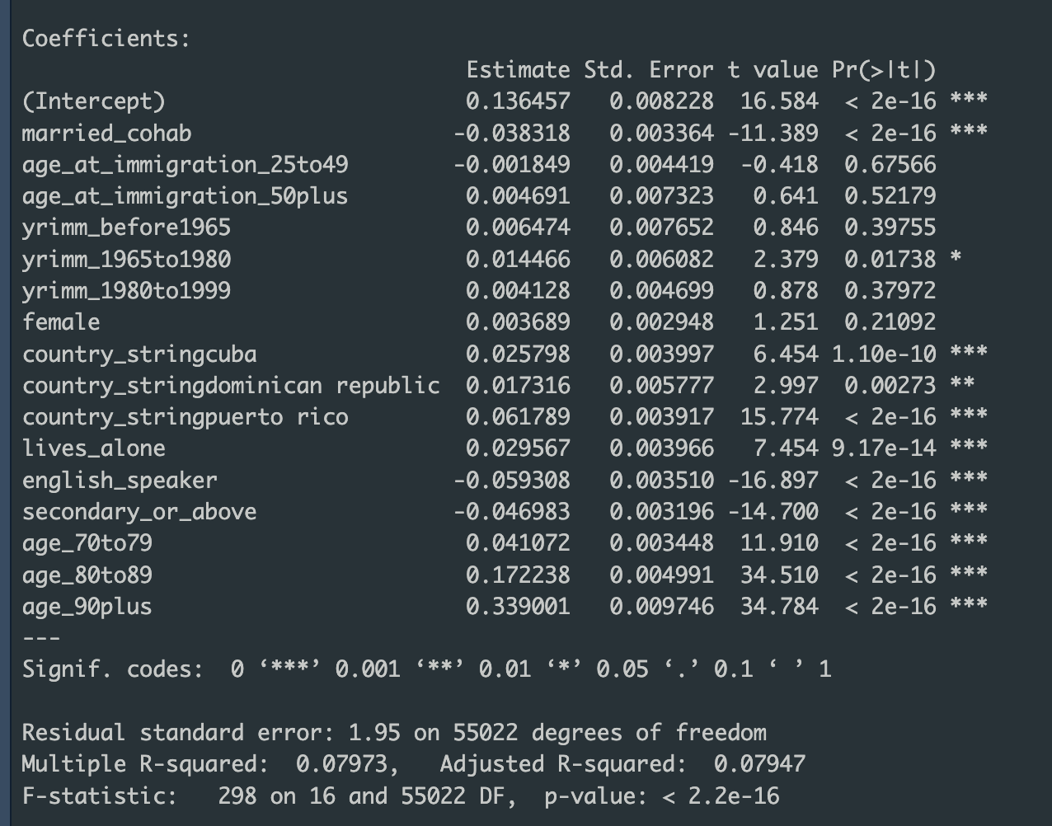
Multivariate model results

Slide 26
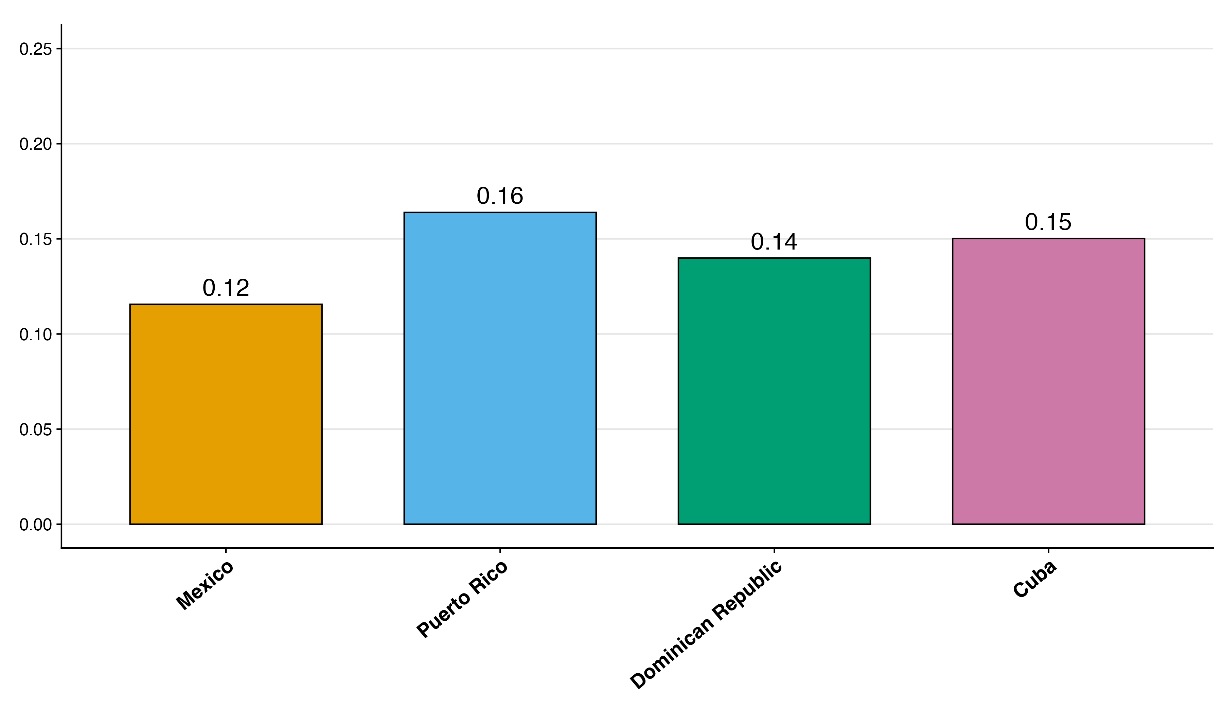
Cognitive difficulty 2010

Slide 27
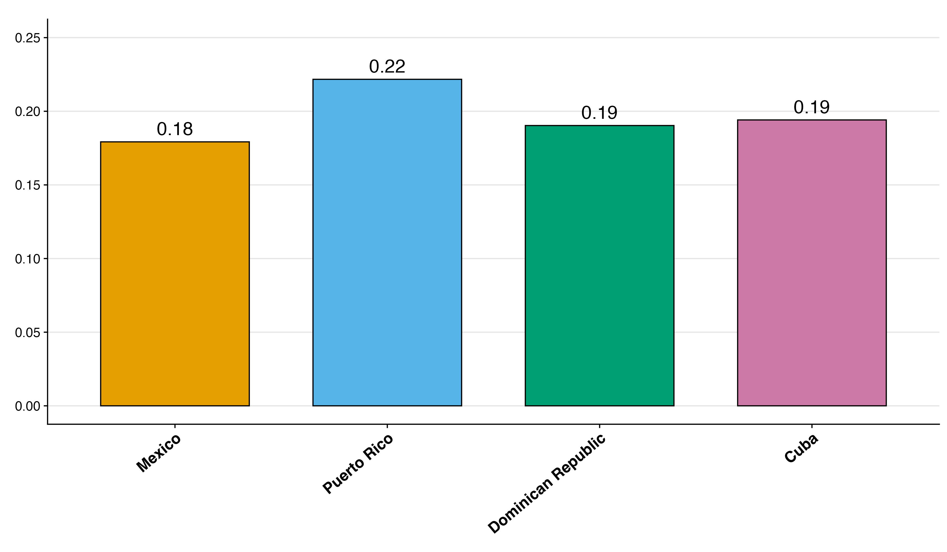
Physical difficulty 2010

Slide 28
Do Mexicans tend to live in more geographically clustered locations?
“The E index for the Mexican born population is substantially greater than those for the remaining immigrant populations, reflecting the fact that Mexicans are the dominant foreign born group in the county.”
Matthew Howard Ruther, 2012
https://www.ojp.gov/pdffiles1/nij/grants/239863.pdf

Slide 29
Do Mexicans have an easier time to the US? Do they tend to stay longer or shorter because of it?
“Consistent with these geographic realities, Mexicans display more of a sojourner pattern of circular migration than do other Latin Americans. Given easy access to the border, trip lengths are shorter, as we would expect. Whereas the average Mexican migrant spent just twenty months in the United States on both first and later trips, the average migrant from the Dominican Republic, Costa Rica, and Nicaragua stayed thirty-eight months on the first trip and forty-three months on later trips.”
Massey, Riosmena, 2010
https://pmc.ncbi.nlm.nih.gov/articles/PMC2932631/

Slide 30
Why would Mexicans choose to naturalize less often?
“We find that while applying for citizenship is an individual decision, both institutional and group variables influence this decision. Consistent with prior research, our results indicate that a more favorable economic environment is correlated with higher naturalization rates and that the clustering of Mexicans discourages naturalization.”
Tamara Woroby and Melissa Groves, 2016
https://www.socialsciencejournal.org/index.php/site/article/download/45/

Slide 31
Why would Mexicans be less likely to live alone?
“…Network-supported migrants have important help in arranging transportation, finding housing and jobs in their place of destination…”
Massey, 1993
https://isfcolombia.uniandes.edu.co/images/2019-intersemestral/14_de_junio/Theories_of_International_Migration.pdf

Slide 32
Existing networks lower the ”cost” of migration
“Migrant networks are webs of social ties that link potential migrants in sending communities to people in receiving societies, and their existence lowers the costs of international movement.”
Massey and España. 1987
https://pubmed.ncbi.nlm.nih.gov/17751562/

Slide 33
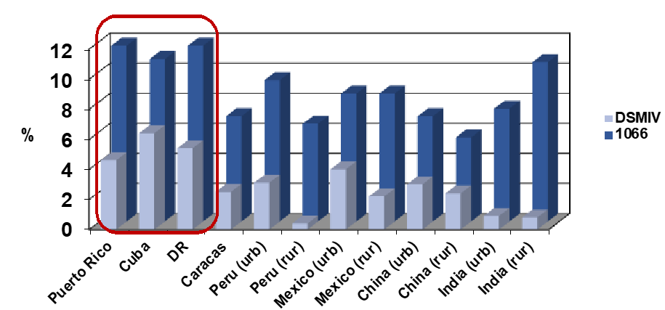
Research on Hispanic groups finds heterogeneity
Llibre Rodriguez J, et al. The Lancet, 2008; 372: 464
Notes:
Research that DOES focus on differences within Hispanic groups finds important differences.
Here we I’m showing data from the 10/66 study (which is not nationally representative and tends to skew towards urban residents), which finds that Hispanics in the Caribbean have generally higher rates of dementia despite having relatively higher life expectancies

Slide 34
Additional slides
Although migration within latin America is increasing
Only about 1% of the population in Mexico is foreign
https://www.oecd.org/en/publications/international-migration-outlook-2024_50b0353e-en/full-report/mexico_d1b0bd46.html
3% of Puerto Rico is foreign
https://www.census.gov/library/stories/2024/05/foreign-born-population-puerto-rico.html
4% of the Dominican republic is foreign
https://www.macrotrends.net/global-metrics/countries/DOM/dominican-republic/net-migration
.1% of Cuba is foreign
https://www.macrotrends.net/global-metrics/countries/CUB/cuba/net-migration

