Slide 1

Caribbean Hispanic Sociodemographic Heterogeneity: Comparing Older Adults by Country and U.S. Migration Status
William H. Dow
Chris Soria
Henry T. Dow
Notes:
Introduce self…
Today I'm going to present research in collaboration with William and Henry Dow on sociodemographic heterogeneity among older Hispanic adults in the United States, with a particular focus on comparing immigrants from different countries of origin.
Our goal is to highlight that these Hispanic migrant groups are different enough from each other to deserve their own spotlight in research and policy discussions.

Slide 2
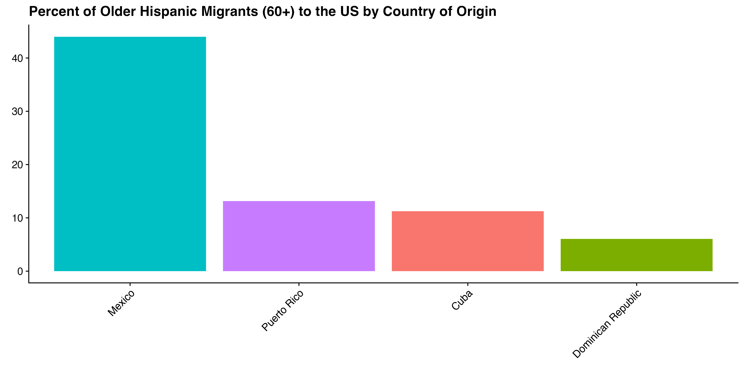
30% of US Hispanic Immigrants are From the Caribbean
Hispanic migrant health is often focused on Mexican immigrants
Caribbean sociodemographics are very different
~44%
~30%
Notes:
While research on Hispanic migrant health has primarily focused on Mexican immigrants, who represent 44 percent of older US Hispanic immigrants, much less attention has been given to Hispanic Caribbean migrants. Migrants from Puerto Rico, Dominican Republic, and Cuba collectively make up about 30 percent of all older US Hispanic immigrants.
However, it’s not just important to highlight these groups because of their size, but also because they’re so different from each other other along the sociodemographics that are so important for healthy aging.

Slide 3
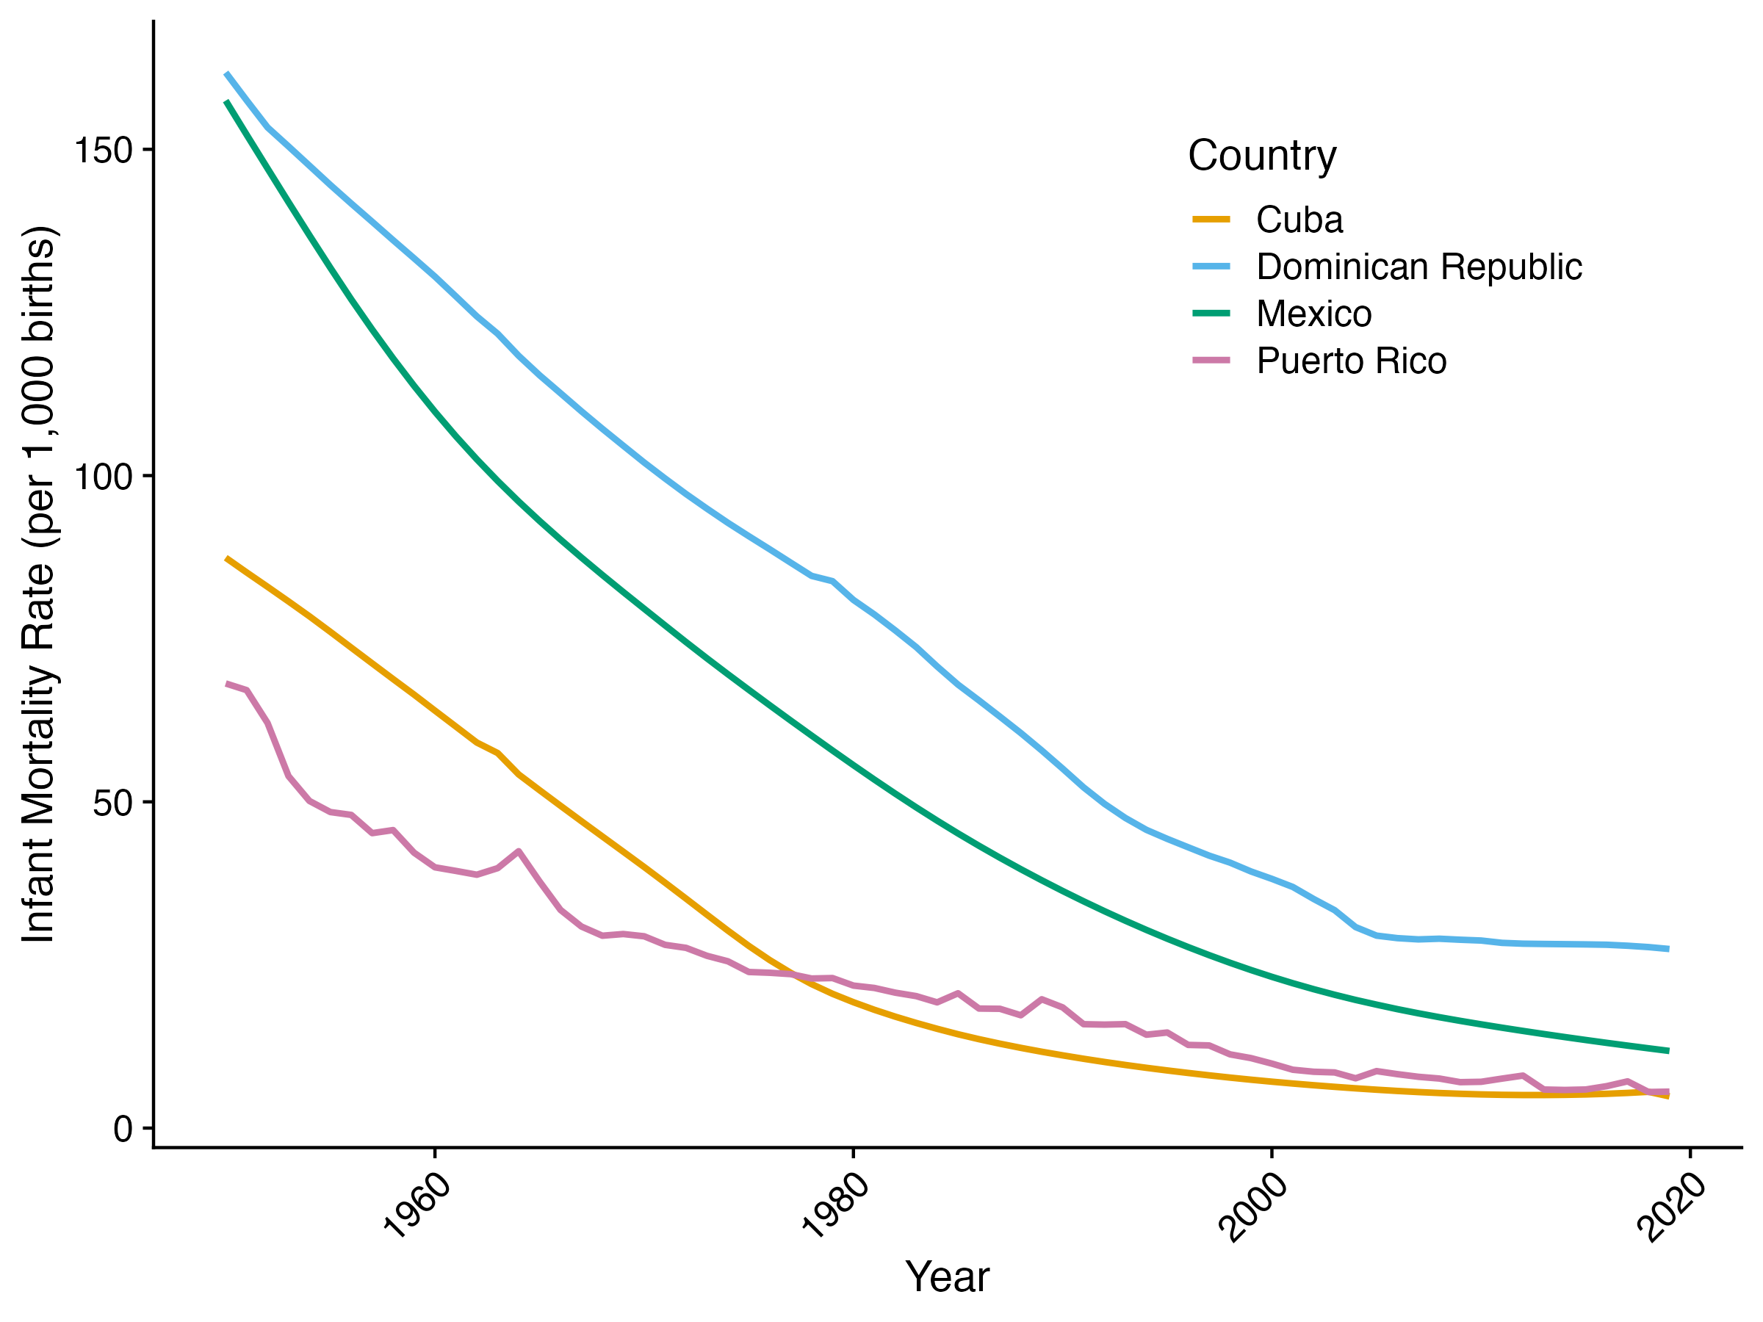
Infant Mortality Rates Represent Health Implies Very Different Early Childhood Conditions
Notes:
These sociodemographic differences stem largely from distinct home country conditions.
Historical infant mortality rates clearly illustrate these disparities.
Looking at this graph, where the x-axis shows time and the y-axis shows infant mortality rates, we see that in 1950, when many people in our study were born, we see dramatically different early childhood environments across these countries.
These early life conditions are important because they will have significant implications for health in later life.

Slide 4
Immigrant Health Differs by Birth Country
Growing literature documents heterogeneity in health outcomes for these migrant groups
E.g., using NHIS to look at morbidity differences smaller samples though
We’re going to look at ACS (2016-20) for larger sample
Sociodemographic determinants of healthy aging in the ACS
Migration Timing: Year / Age
Education
Social Isolation: Marital Status / Living alone
Acculturation: English Speaking / Citizenship
Notes:
While I mentioned these groups are understudied, there is a growing literature showing these Hispanic populations do differ significantly in health outcomes.
Researchers like our chair Marc Garcia (who ended up being quite influential to our research) have used the National Health Interview Survey to document important morbidity differences between these groups.
However, the NHIS offers a relatively small sample size for these populations, requiring researchers to pool data across many years to obtain sufficient numbers - for example, just over 100 Dominican migrants even after pooling.
That's why we chose to analyze data from the 2016-20 American Community Survey, which gives us a much larger sample size and helps us support the health documented in previous research.
More specifically, in our analysis, we focus on key sociodemographic factors in the ACS that influence healthy aging:
Migration timing (year and age of migration)
Educational attainment
Social isolation (marital status and living arrangements)
Acculturation (English speaking ability and citizenship status)

Slide 5

Migrant Selectivity Differs by Country: Comparisons with Older Adults in Birth Countries
International Census Data from IPUMS
Mexico: 2010
Puerto Rico: 2010
Dominican Republic: 2010
Cuba: 2012
US American Community Survey (2008-10)
Notes:
- International

Slide 6

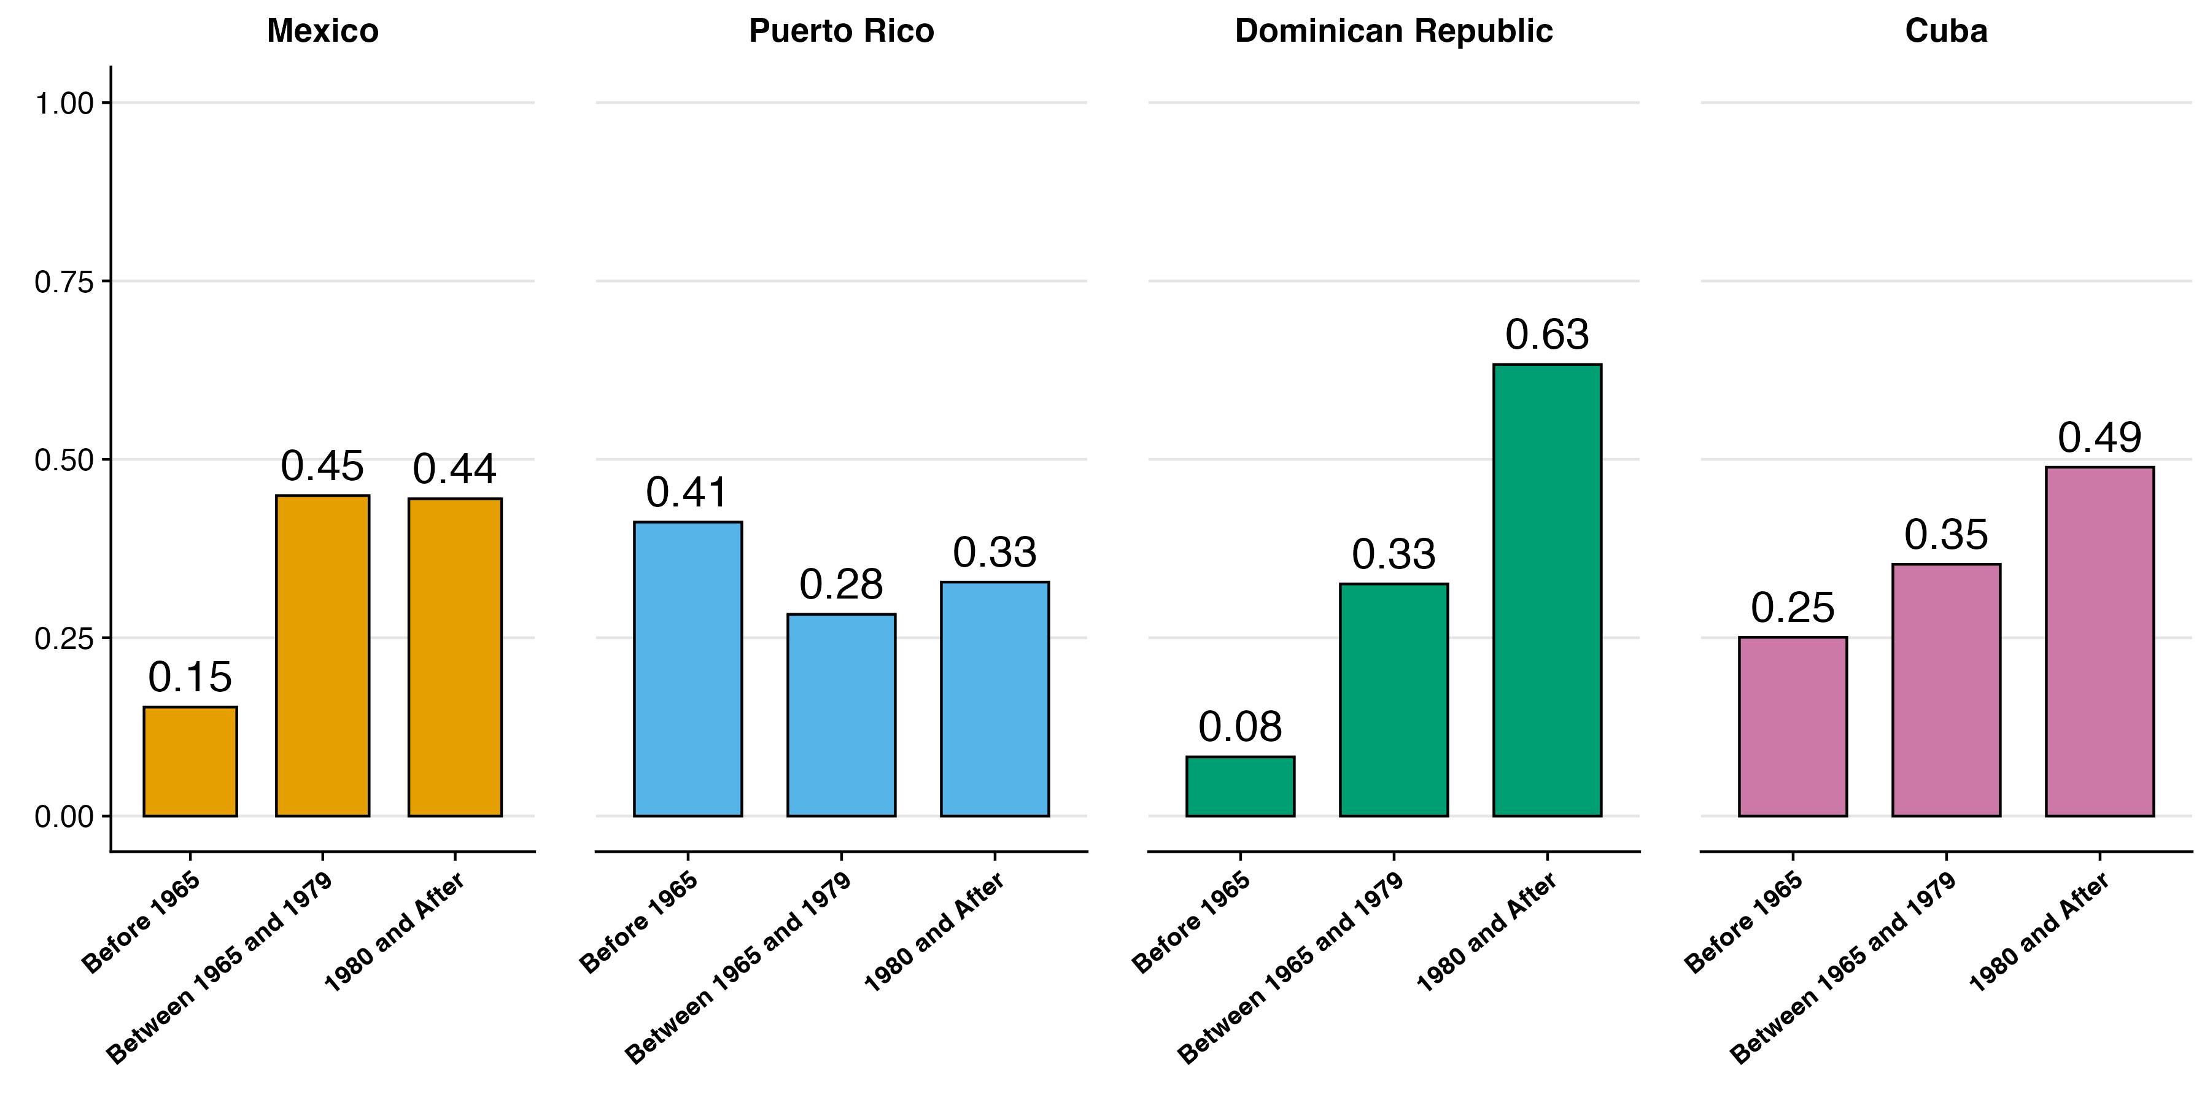
First Results: Migration Cohorts
2016-20
Notes:
Say these verbally
Puerto Rico became a US territory in 1898. In 1917 they were granted US citizenship.
Cuban Revolution in 1959 sparked one of the largest refugee movement in US history (Duany 2017). In 1966, given path to US residency.

Slide 7
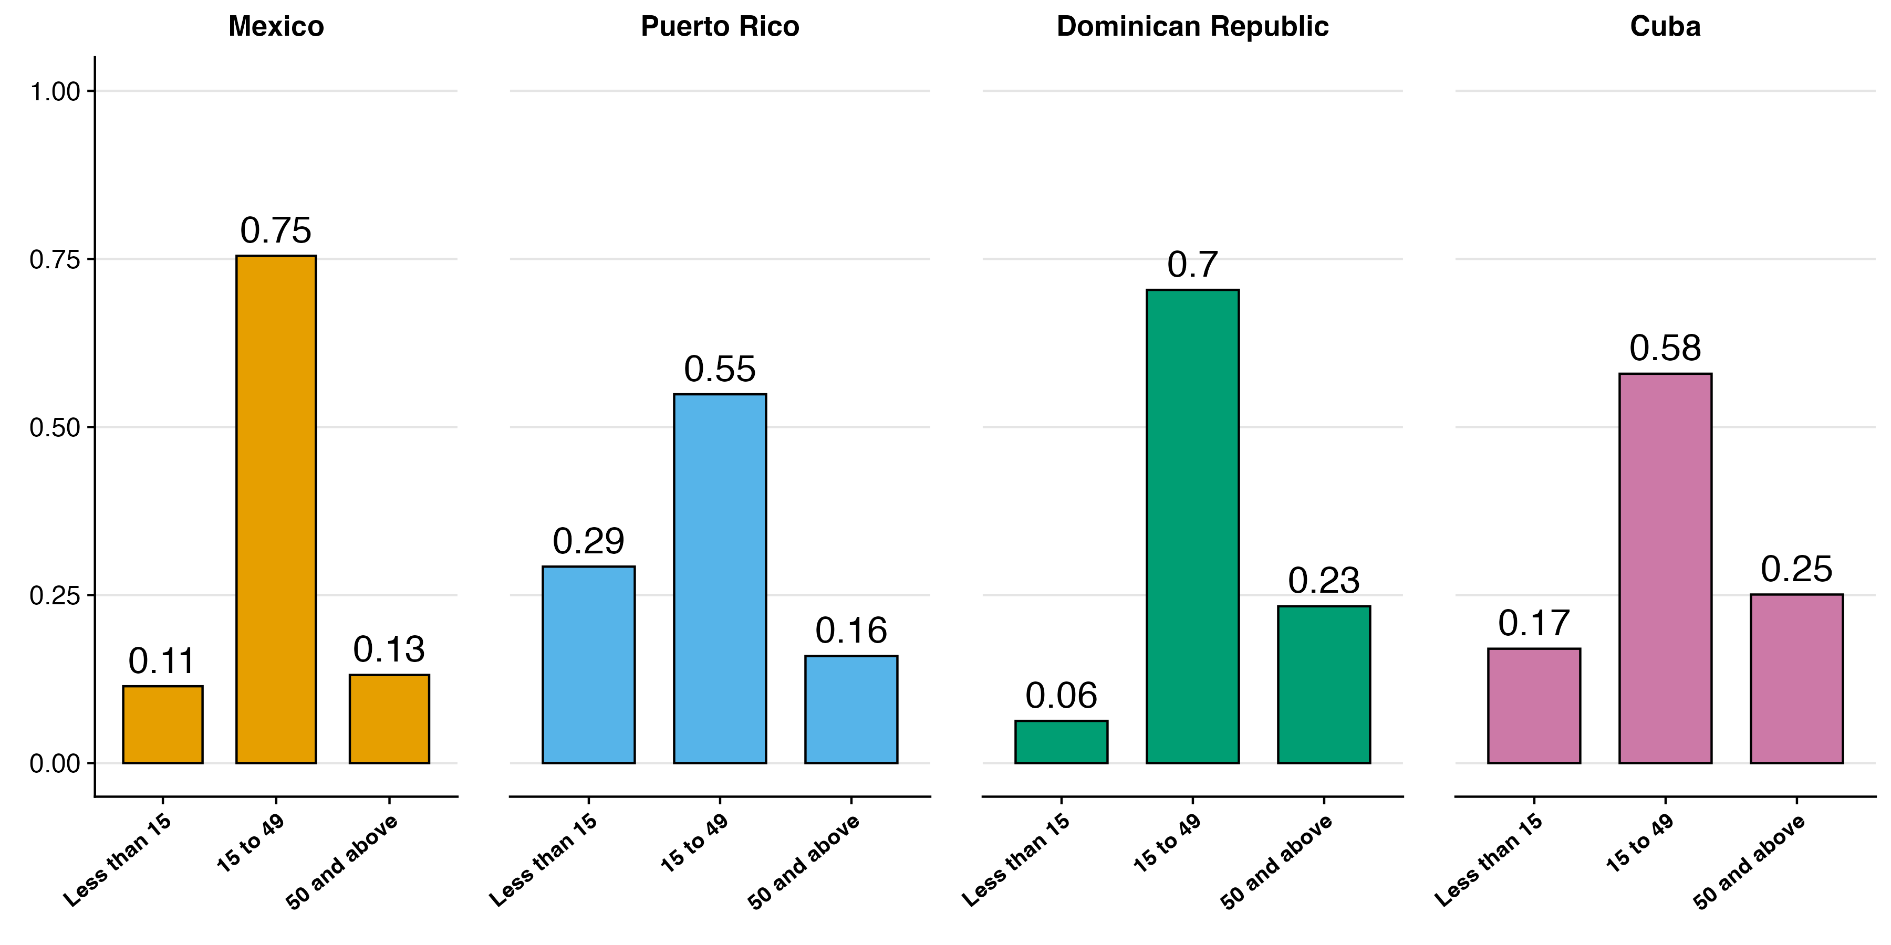
Most people migrated at working ages
2016-20
Notes:
Key points:
Most are not likely to migrate after age 50, except Cuba
Most are migration in working ages
Less than 15 at Puerto Rican

Slide 8
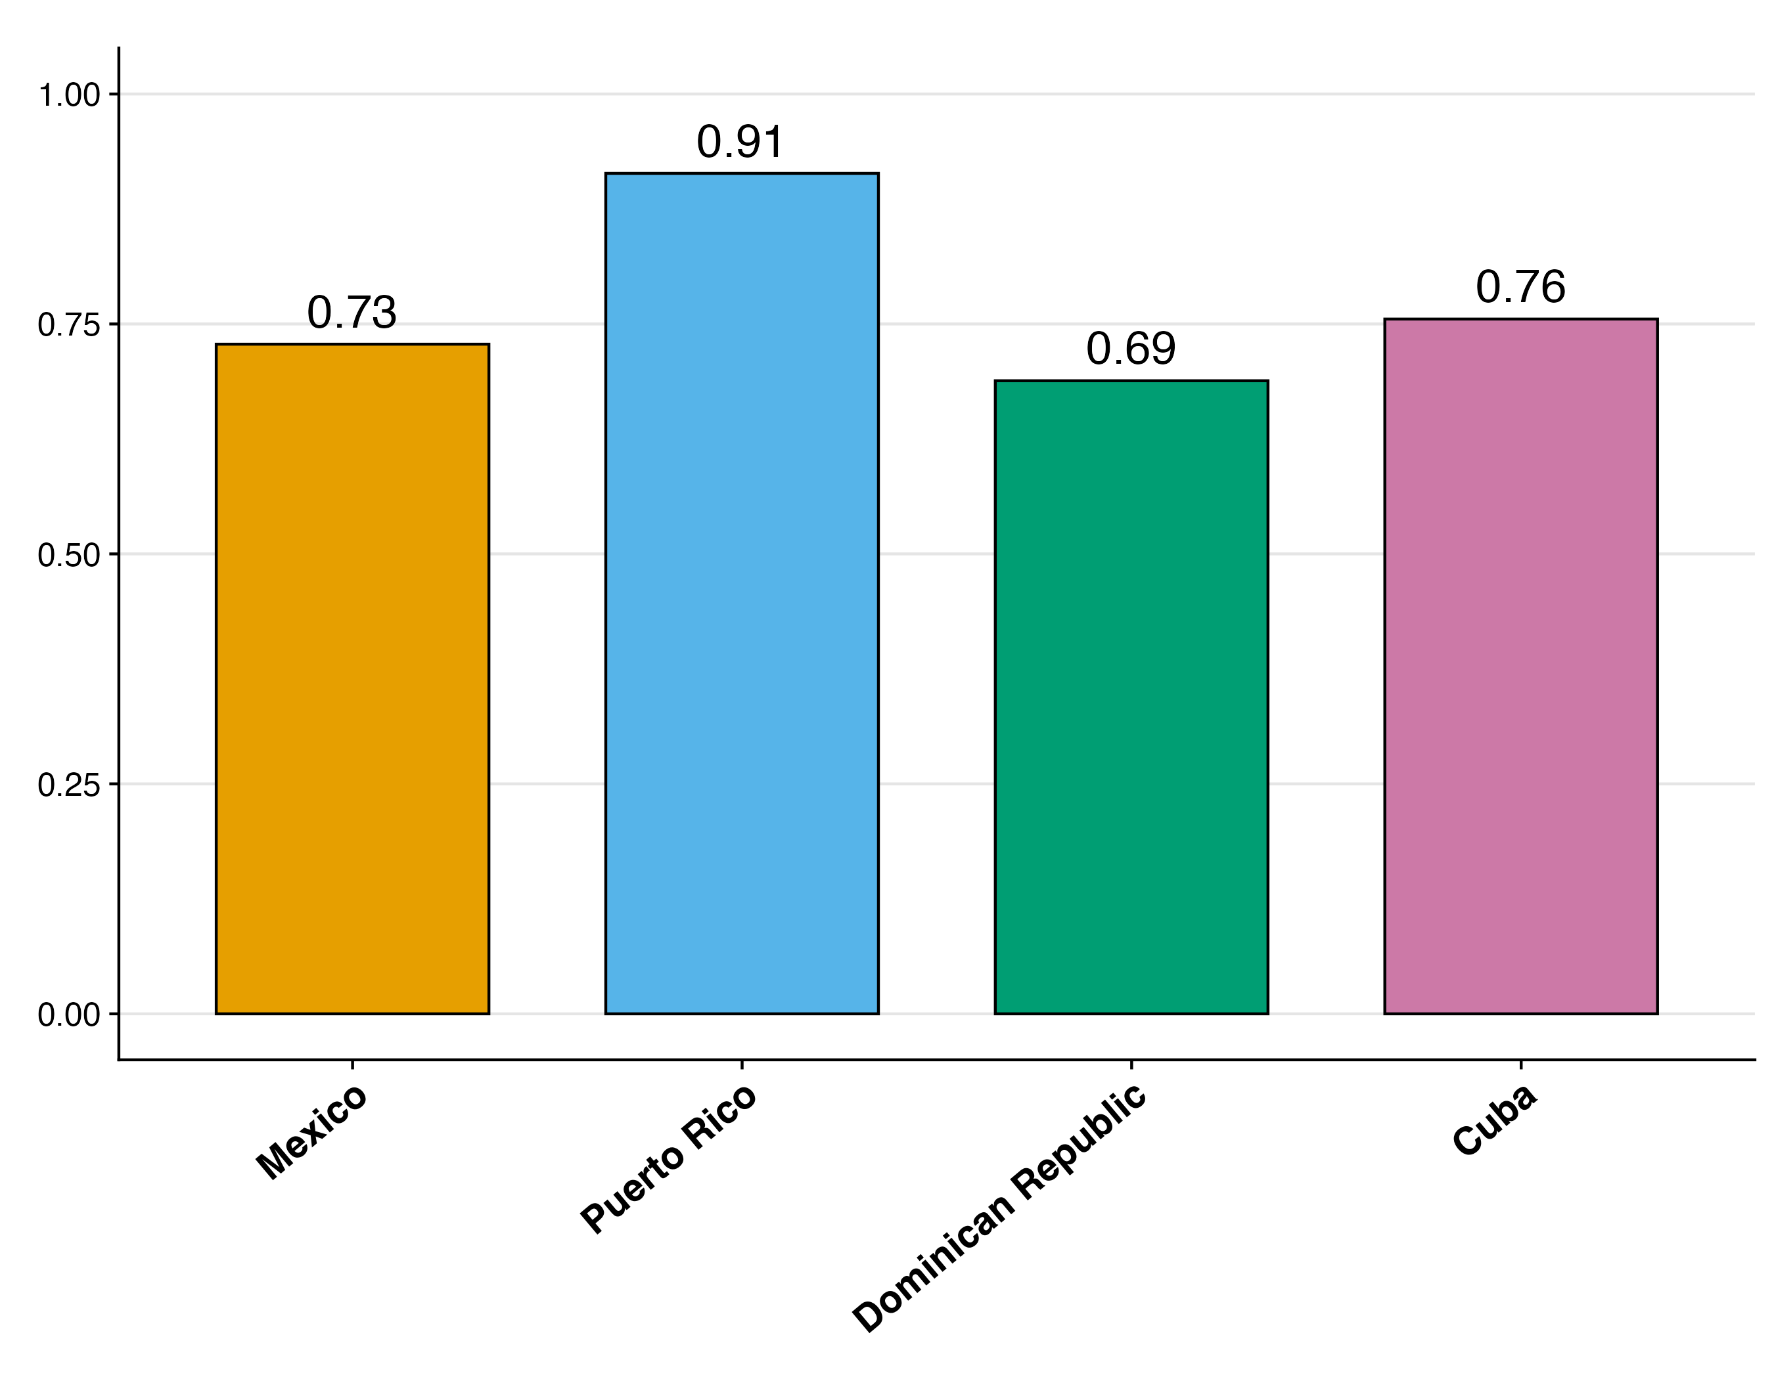
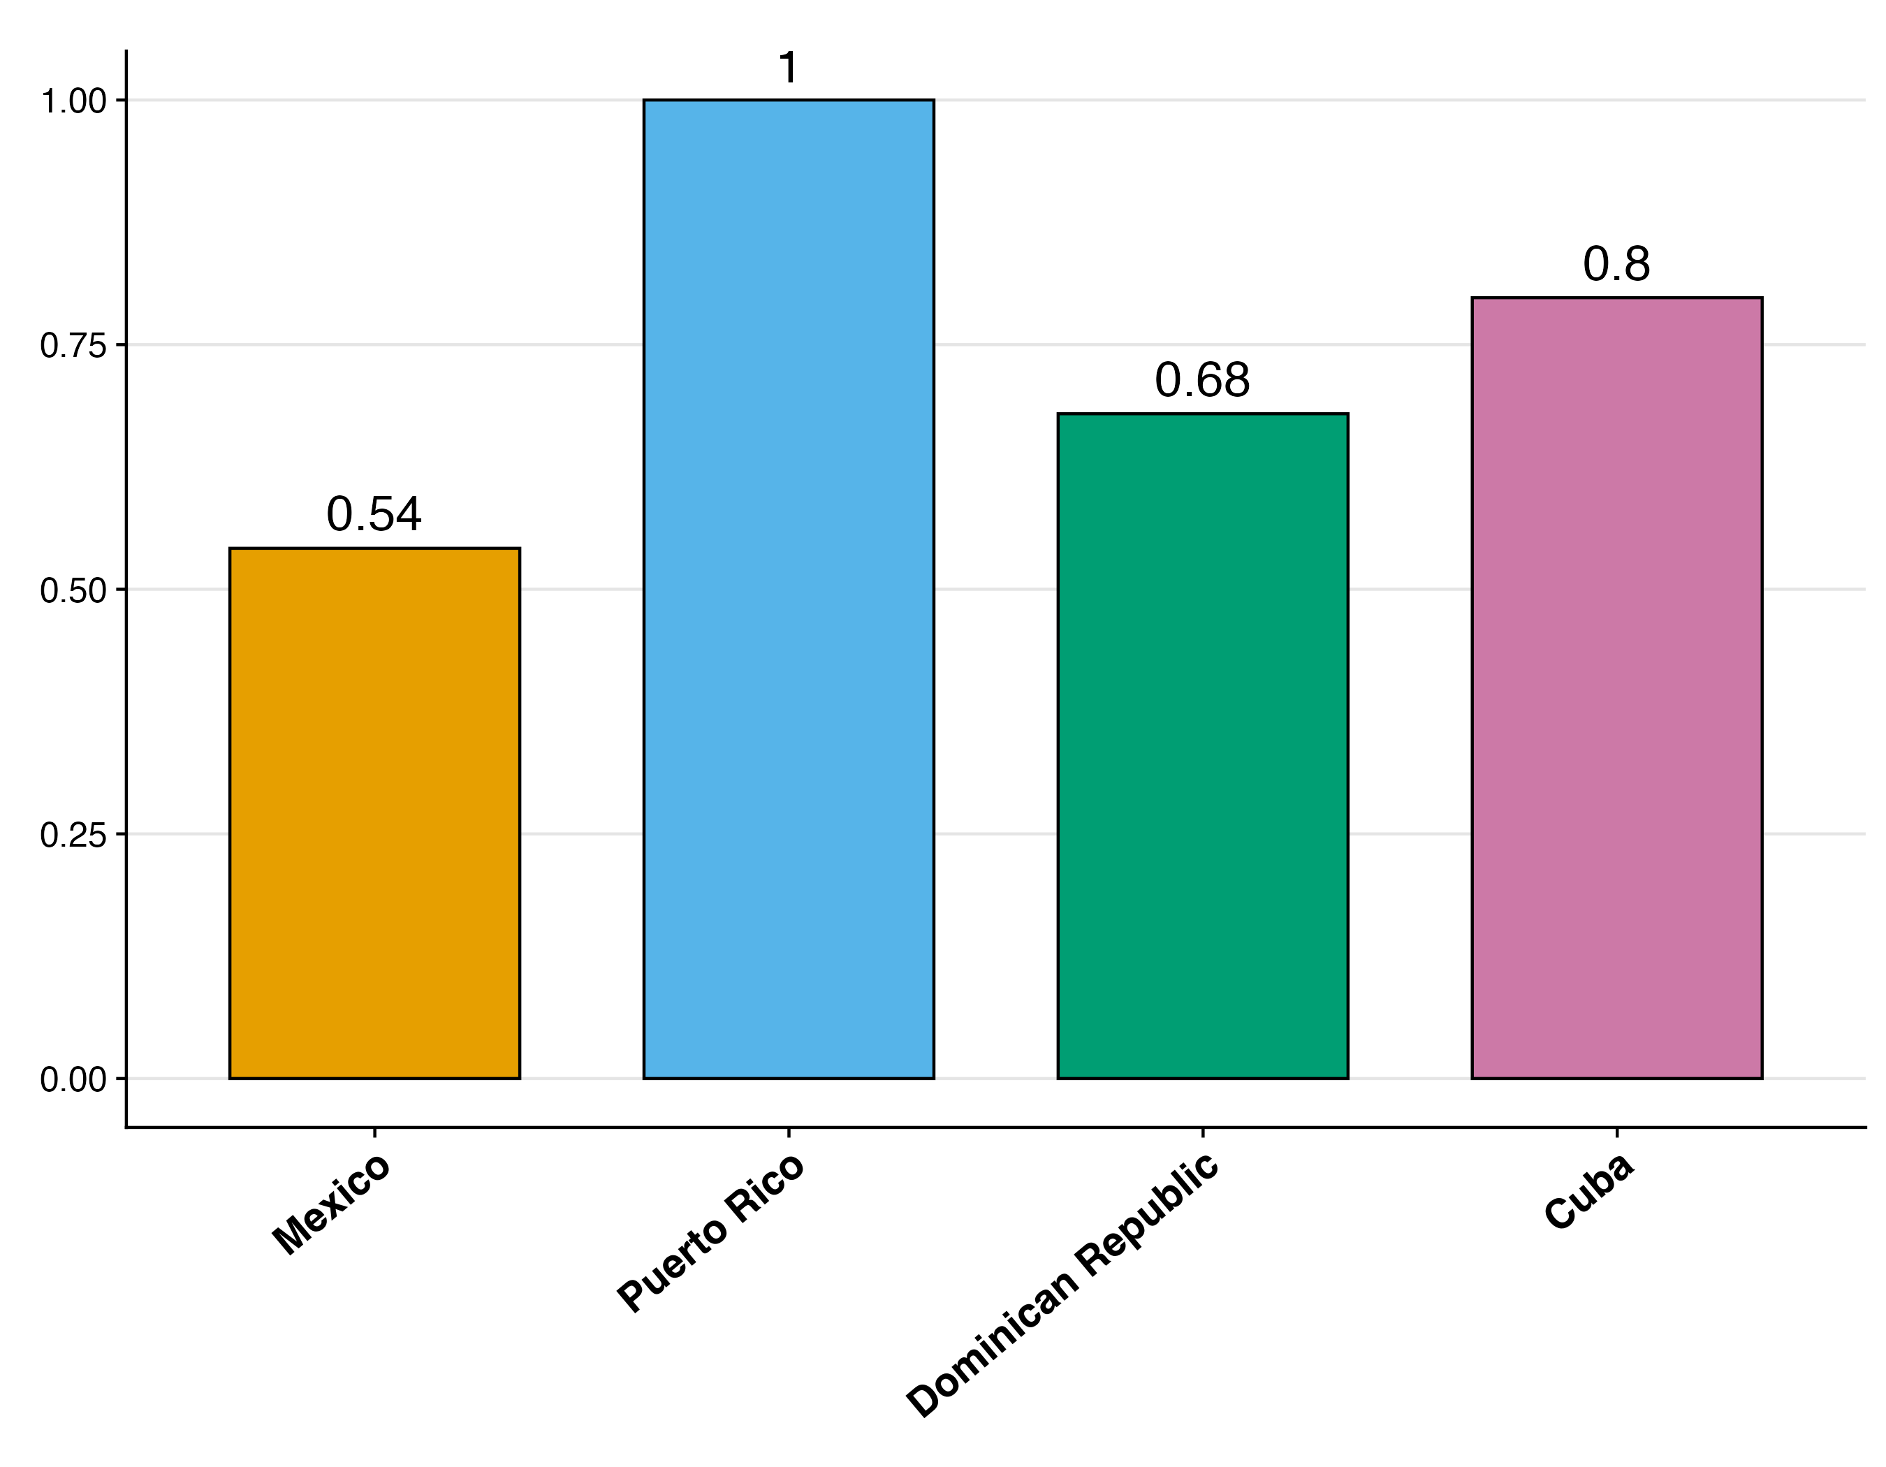
Mexican and Dominican migrants are the least likely to acculturate
2016-20
Proportion English Speakers
Proportion Naturalized Citizen
Notes:
When it comes to acculturation, we find once again that Caribbean migrants are distinct.
Although all groups tend to speak English at similar rates, except for Puerto Ricans who speak English over 90% of the time, Carribean migrants

Slide 9
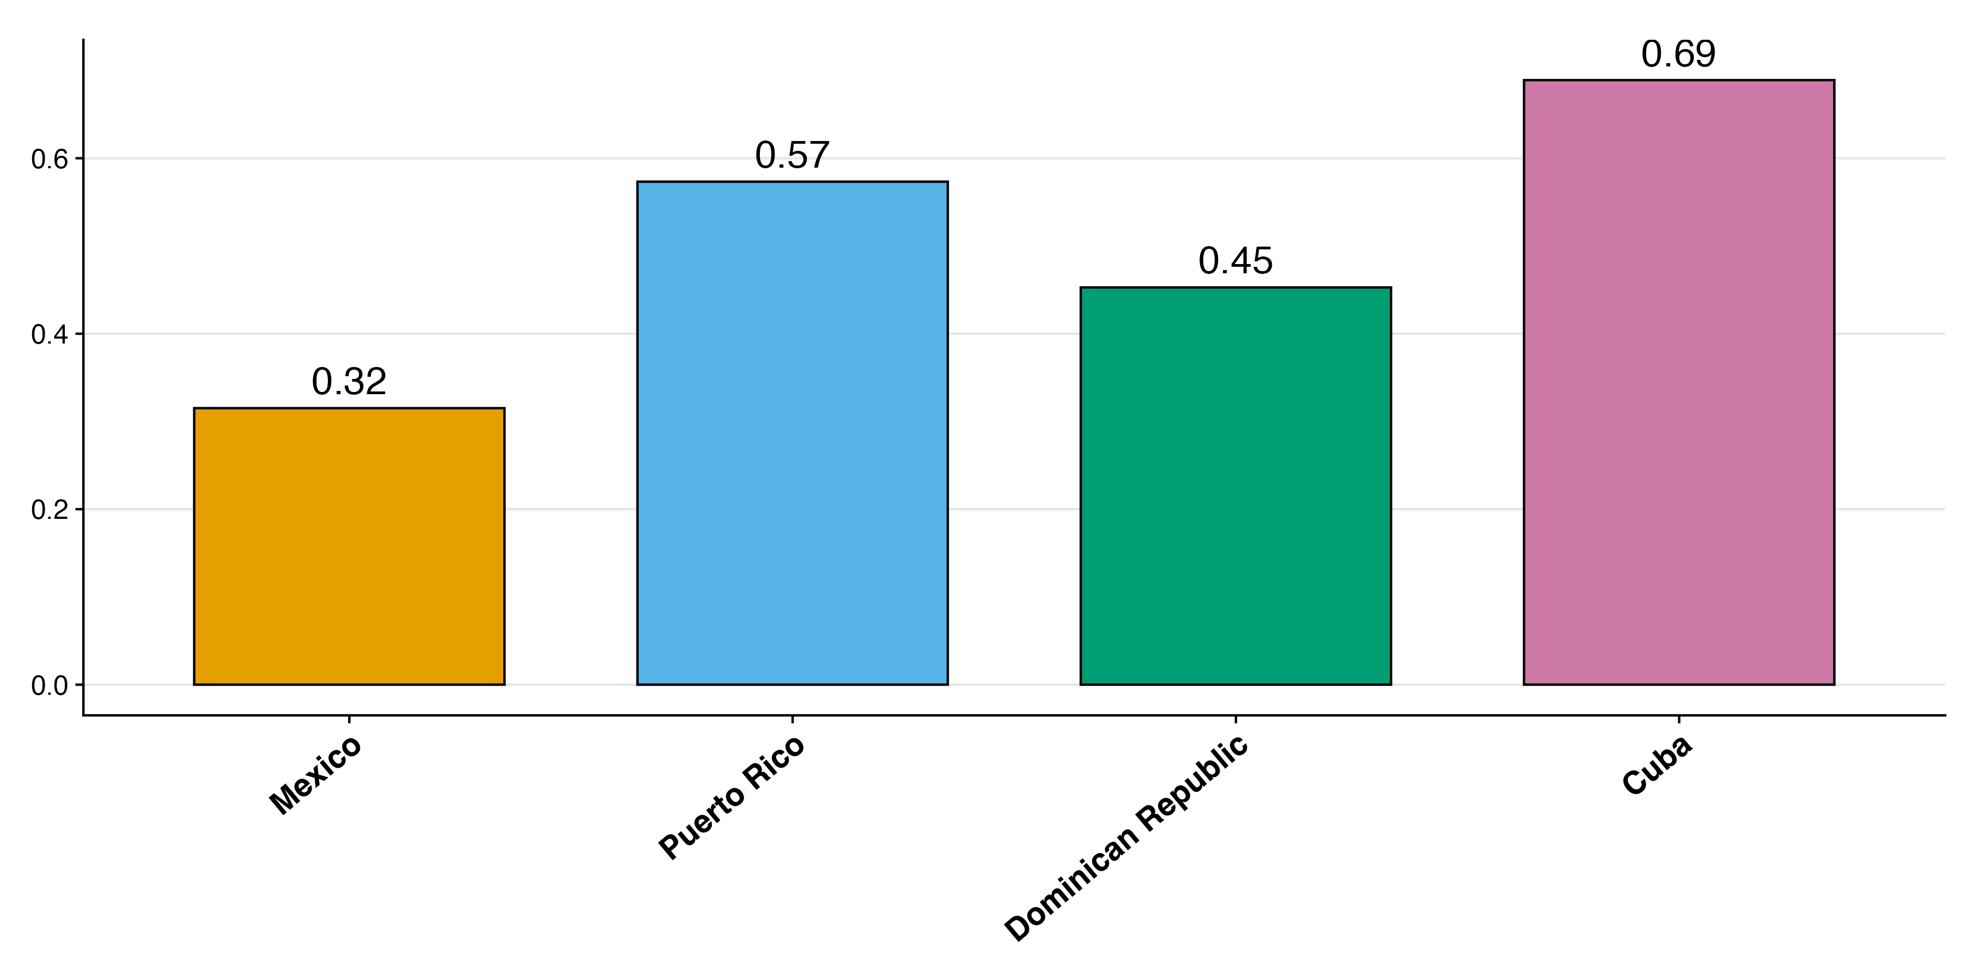
Caribbean Hispanic immigrants tend to be more educated than Mexican immigrants
2016-20
Proportion With At Least Secondary Degree
Notes:
These are really different groups, then how much of that is related to what’s going in their home countries
What stands out - Mexican migrants are the least likely to get at least a secondary degree, which is lower than the average for migrant from the Caribbean
- Specifically, Cuban migrants are the most likely to have at least a high school degree followed by Puerto Ricans, and lastly Dominicans

Slide 10
What’s driving the lower education among Mexican Immigrants?
Older so need to age adjust?
Age at Migration?
Birth country education levels?
Migrant selectivity?
Notes:
All of these are statistically significant

Slide 11
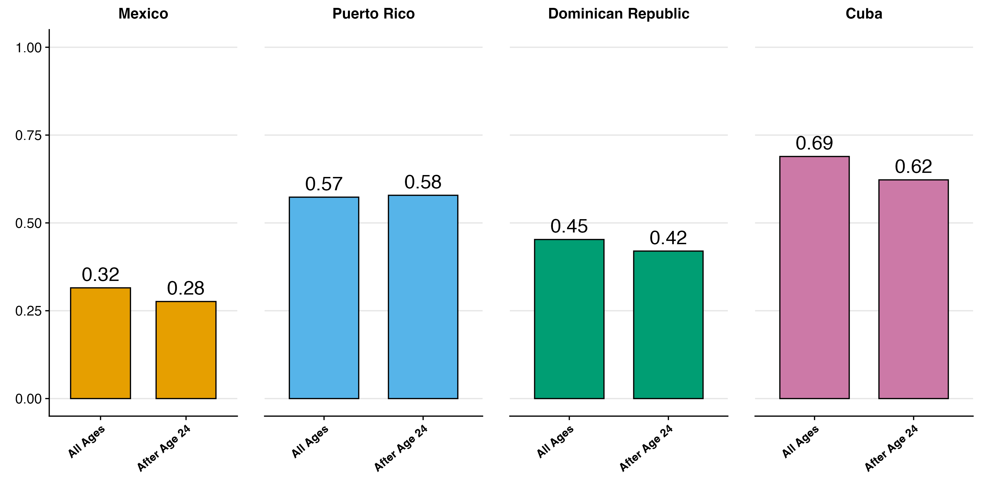
Education Differences are Not Explained by age at Migration
2016-20
Notes:
Here, I’m going to combine the previously shown education bars with bars bars of people only age 24 and above
Education difference remains among those migrants who migrated after age 24 (also robust to regression controls)
It’s not that certain groups are arriving at younger ages that explains the relationship
Subtitle to the graph, results are changes when controlling

Slide 12
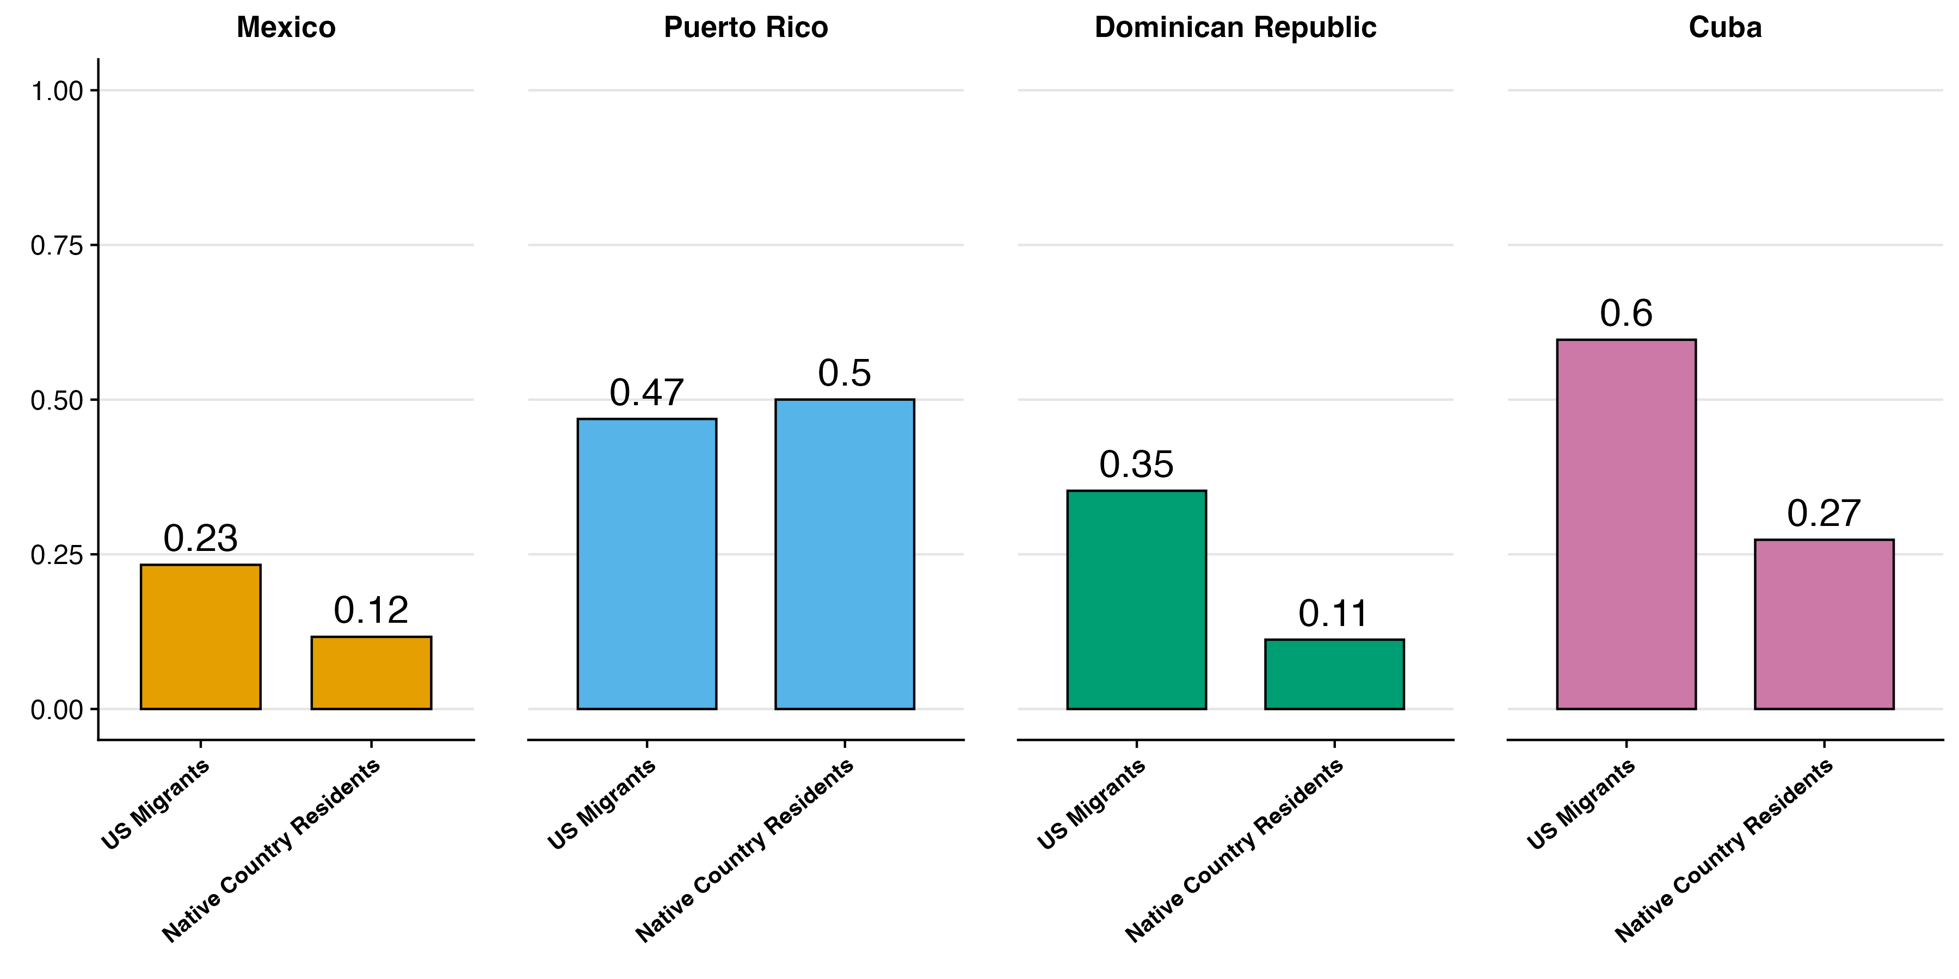
Migrants to the US are far more likely to have at least a secondary degree
2008-10
Notes:
In the less than primary DR is the most selective
Looking at secondary, CU is bigger selection
1 Mexicans in Mexica have lower education
2. But Dominicans have lower education in their home country
3. Dominican migrants have more education than Mexican Migrants
4. Therefore education selectivity varies hugely across countries
5. Same thing about Cuba
6. Puerto Rico is opposite

Slide 13
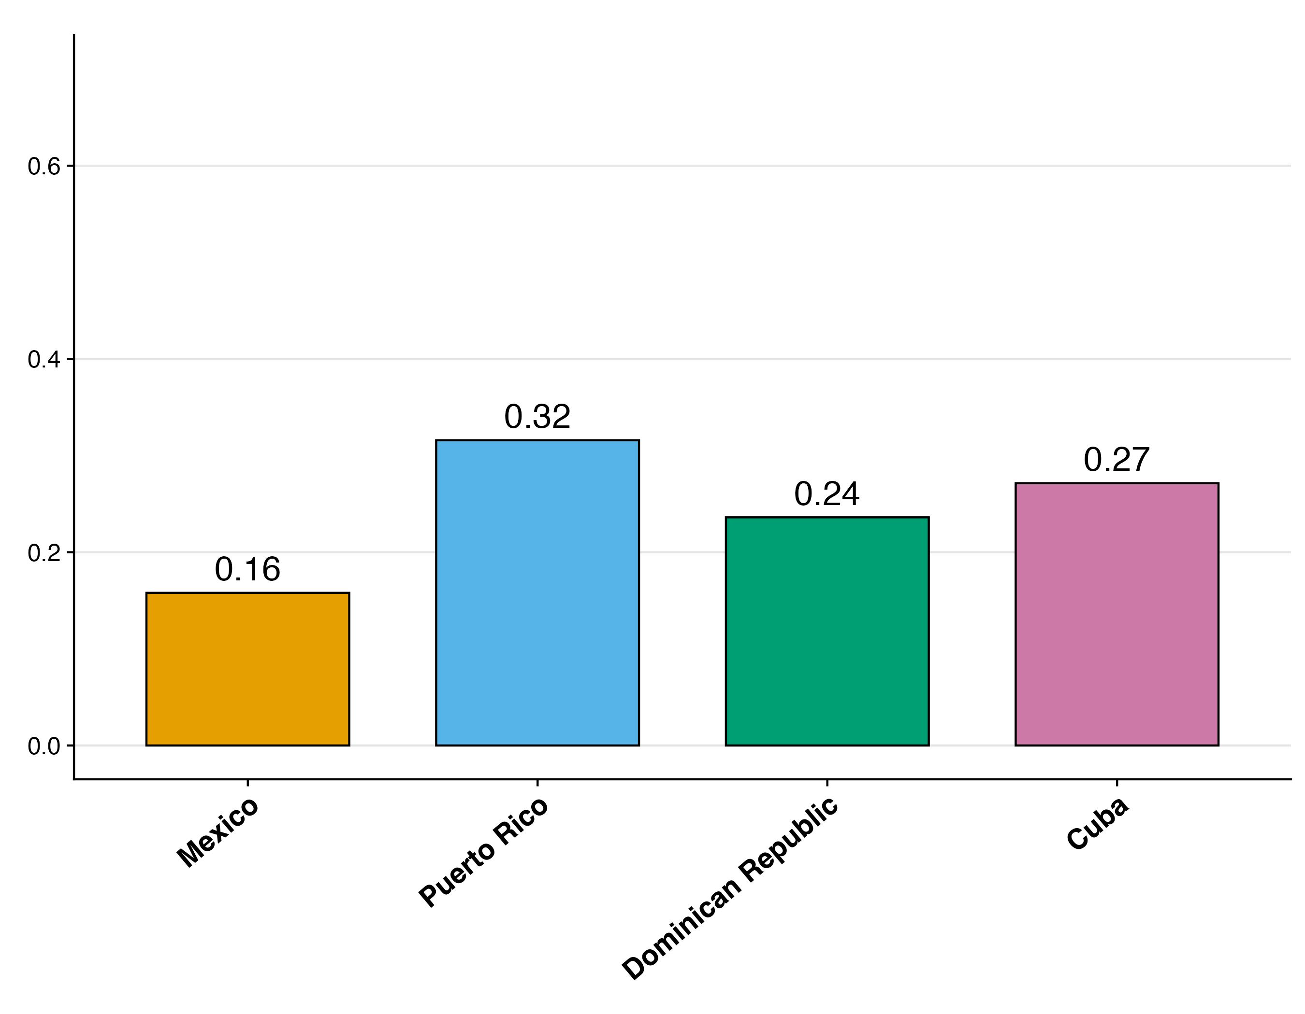
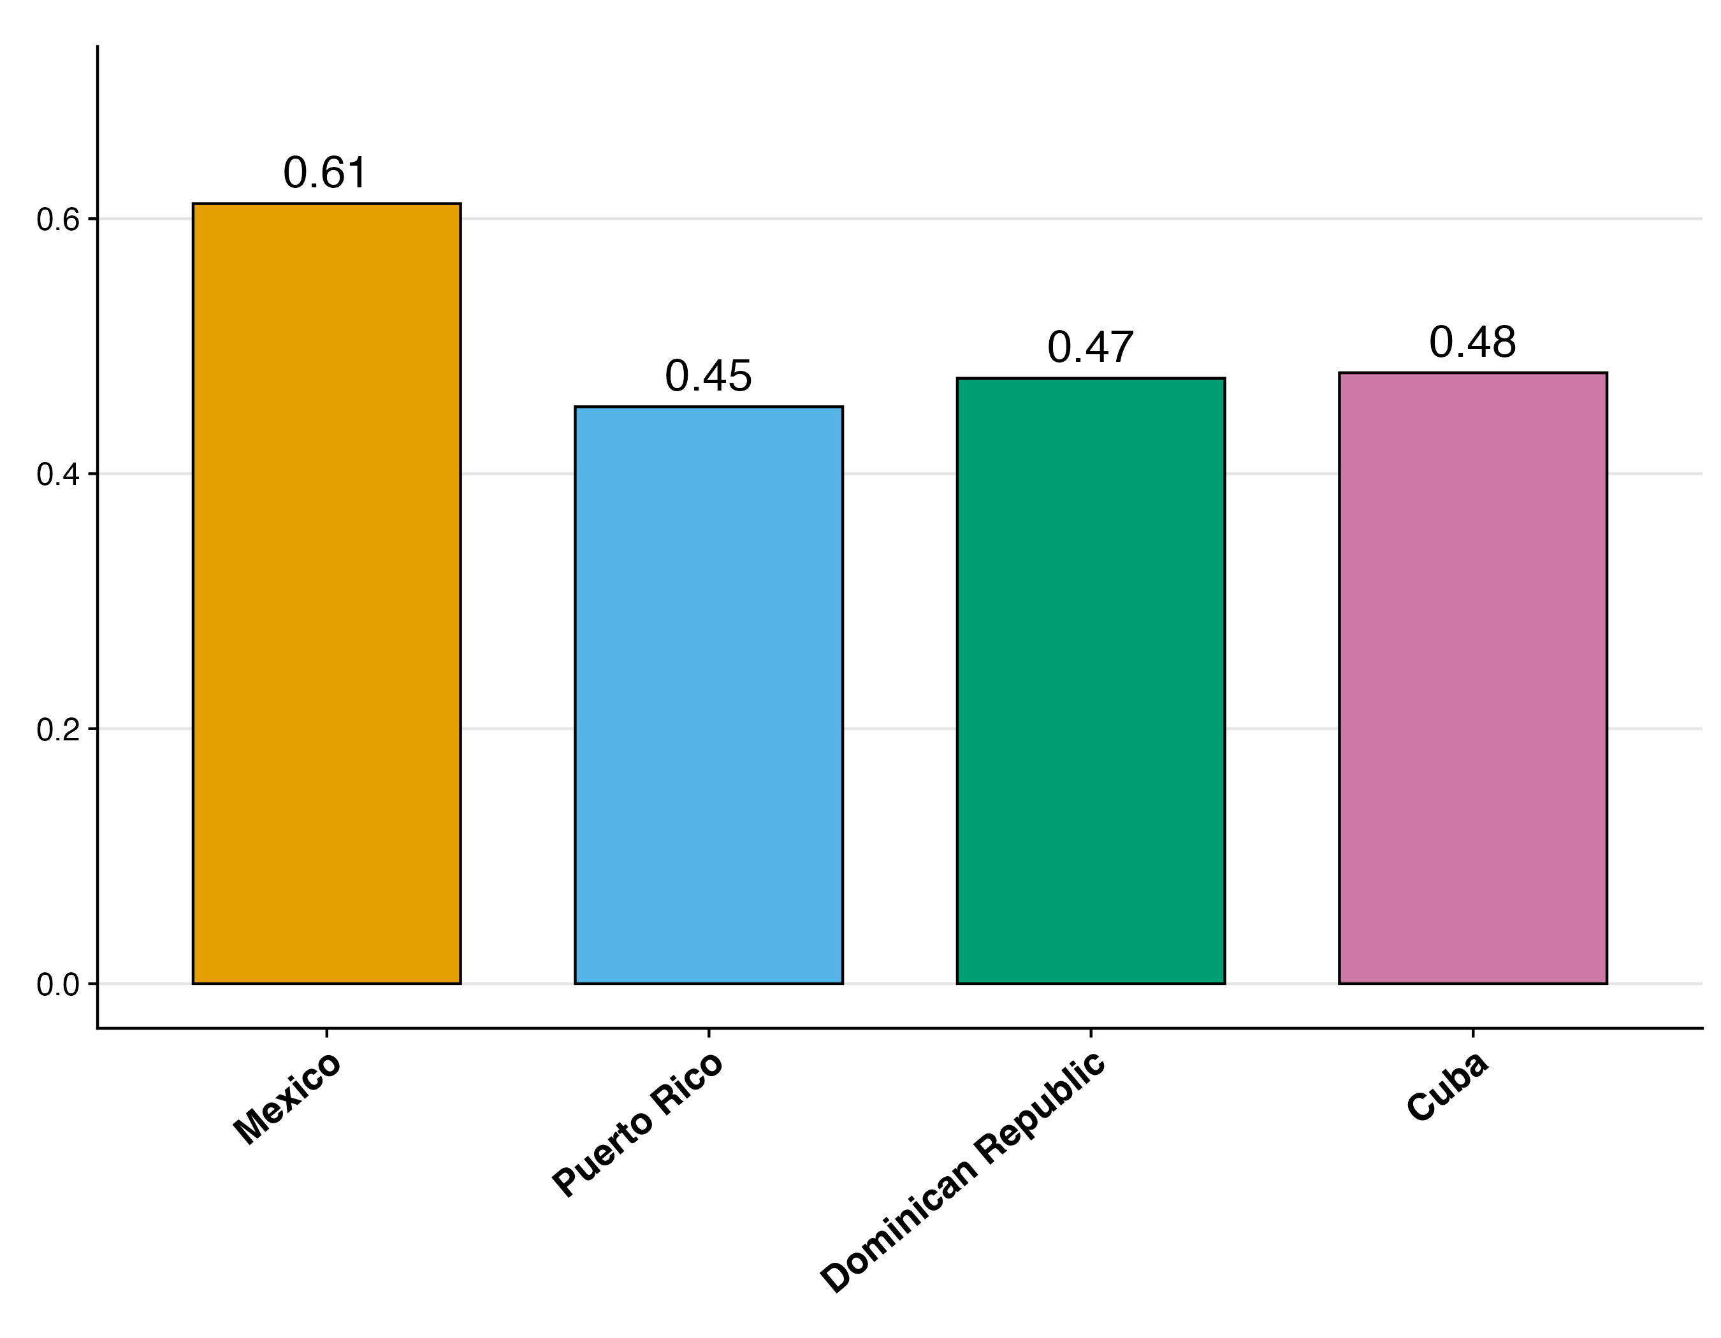
Mexican migrants are the least likely to live alone and most likely to be married
2016-20
Proportion Living Alone
Proportion Married
Notes:
I don’t have time to walk through hypotheses on all these factors
When it comes to household composition, Mexican migrants again stand out compared to Caribbean migrants.
Only 16% of Mexican migrants above the age of 60 live alone. For comparison, Puerto Ricans are twice as likely to live alone.
And a similar pattern shows for proportion married. The majority of Mexican migrants report being married, which is less common amongst the Caribbean migrants.

Slide 14
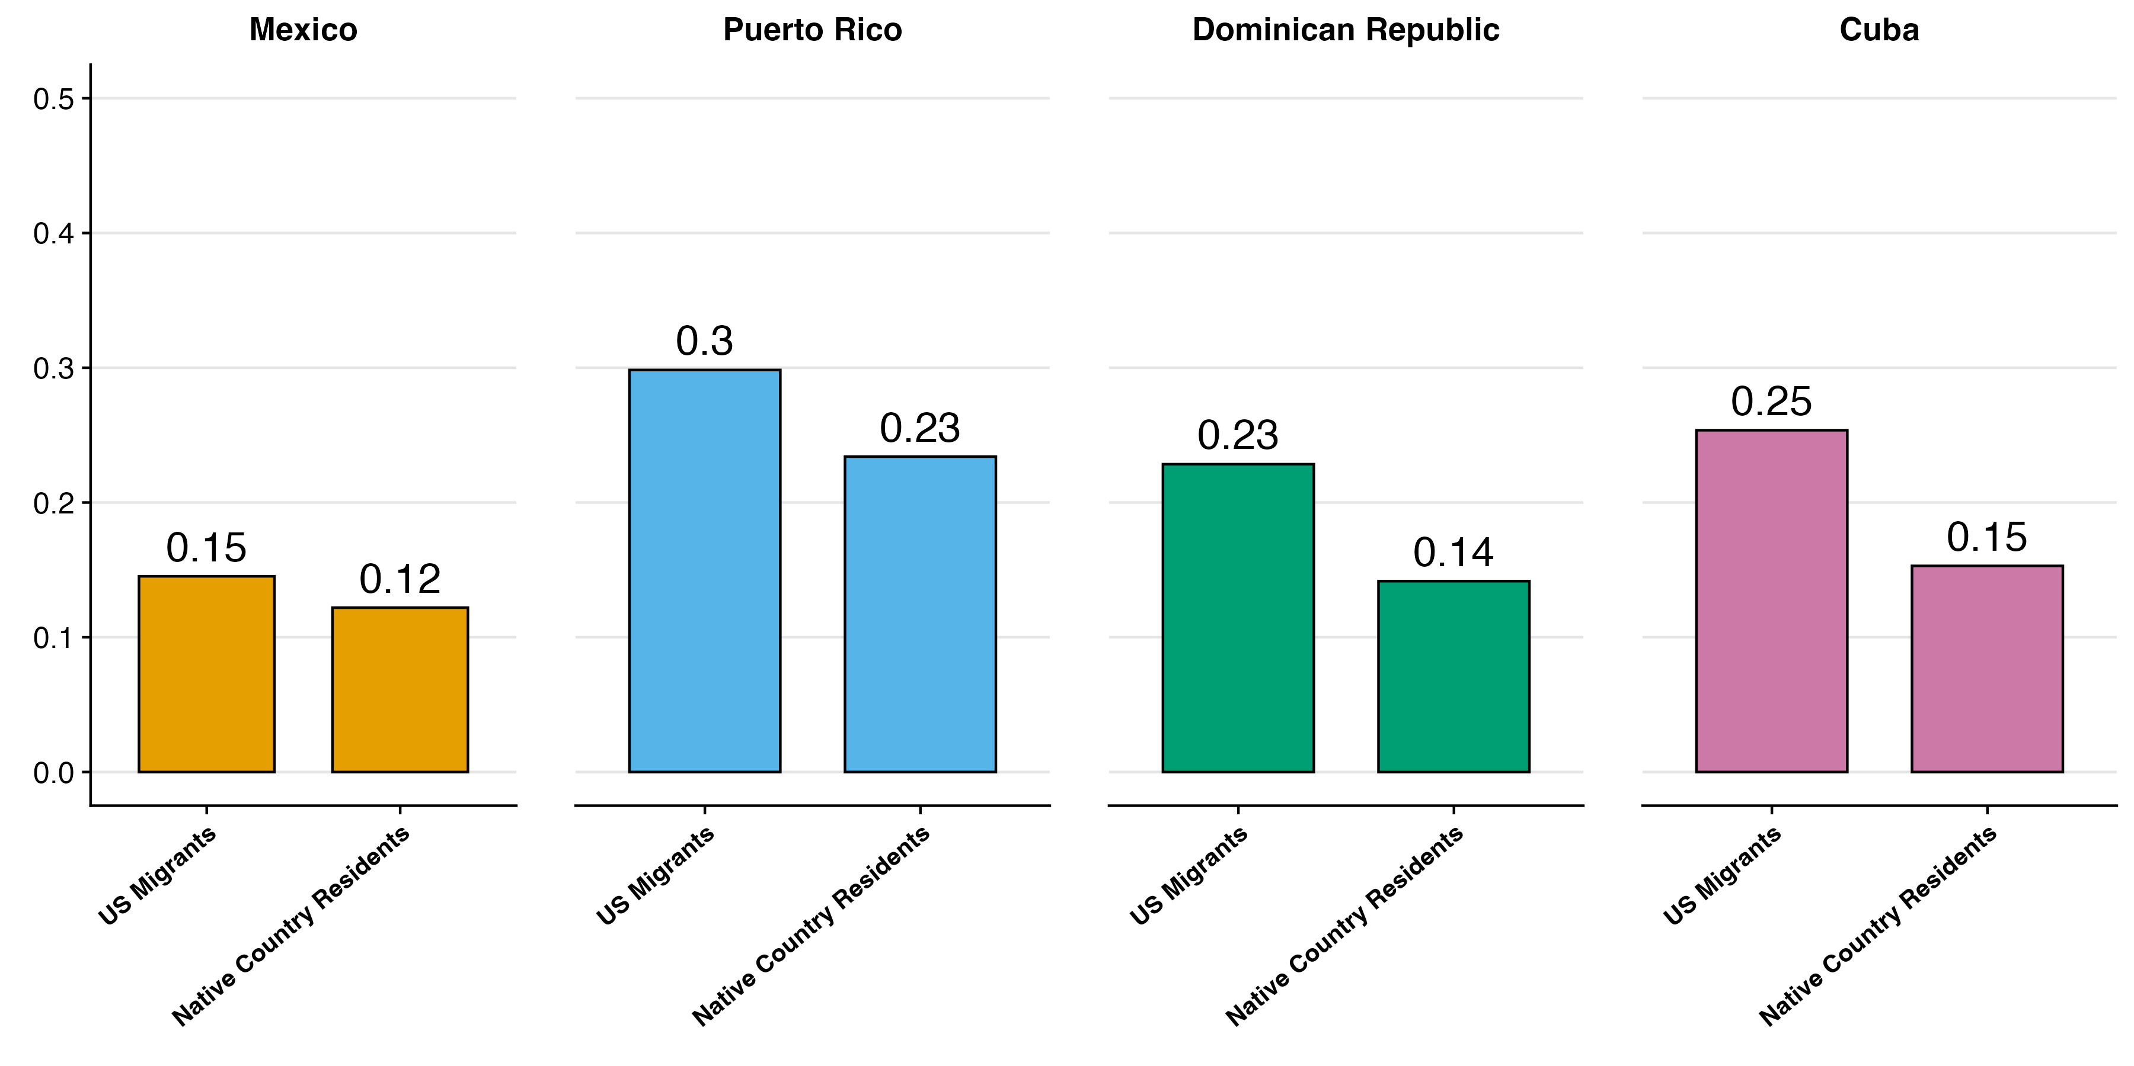
Native country residents are less likely to live alone
Proportion Living Alone
2008-10
Notes:
Again, the biggest difference here is between Dominicans and Cubans
These are averages for men and women combined, if we look at women separately we see they’re more likely to live alone, but the overall pattern is the same

Slide 15
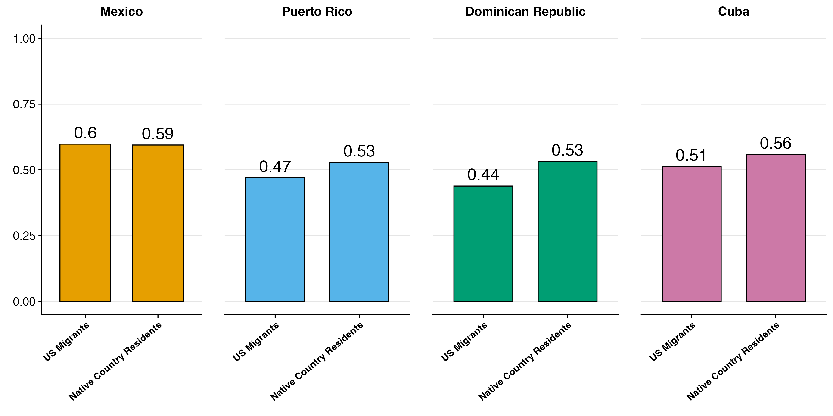
Native country residents are more likely to be married
Proportion Married
2008-10
Notes:
Last there’s marriage and whether people are more likely to live with a partner.
Again, the biggest difference is between Dominican migrants in the US compared to Dominicans still residing in their country.

Slide 16
Discussion
We have unique comparison of migrants to people in their home countries using nationally representative data
Mexican migrants are the least likely to acculturate and the least likely to live alone
Dominican and Cuban education selectivity is the strongest
Education profiles are rapidly changing
Notes:
Caribbean Hispanics very different migration patterns
Different Education and Social Isolation Patterns
Different Selectivity on Education Patterns
Implication is that we need to acknowledge these as separate groups because we would expect immigrant health to be very different
The next step is to analyze a nationally representative sample that combines both these very important sociodemographic
MHAS (Mexican Healthy Aging Survey)
7. If education is this selective, then probably big selection on

Slide 17
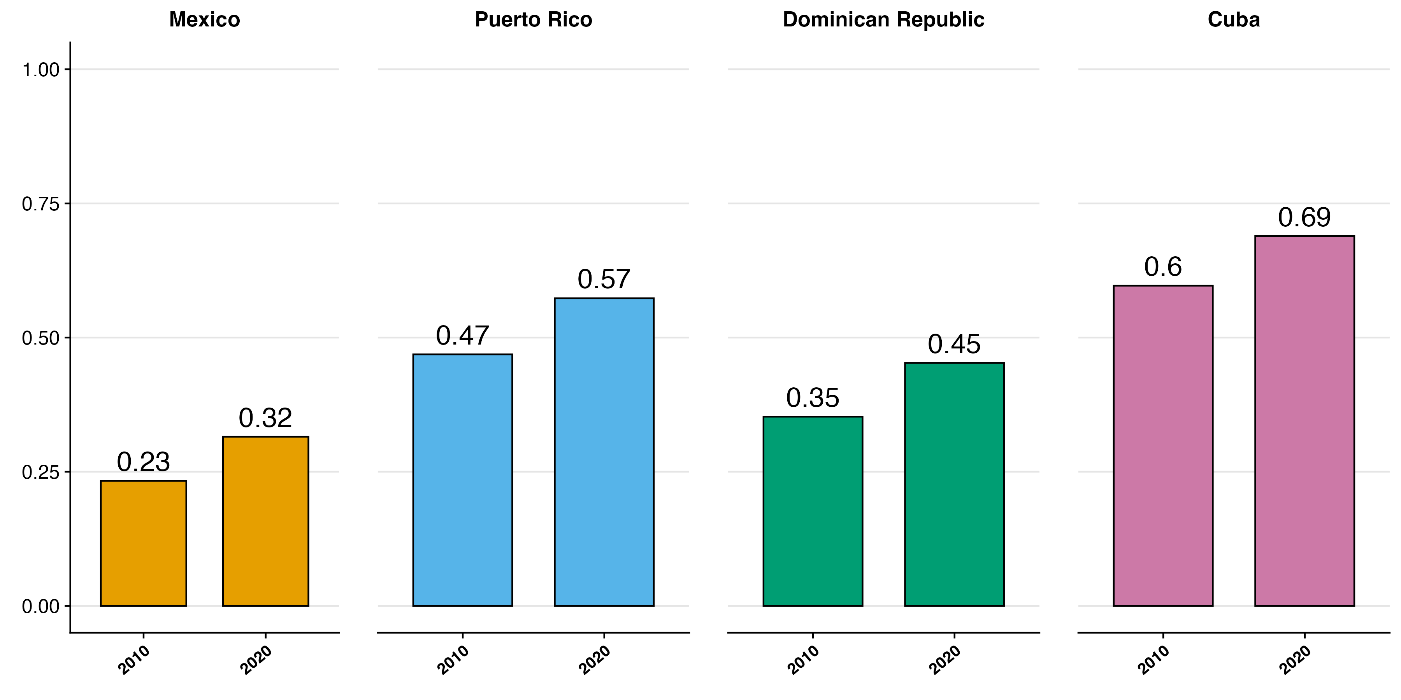
Strong cohort increases in migrant education, even from 2010 to 2020
Notes:
Furthermore, Things are rapidly changing. When we compare these migrant groups in 2010 to 2020, we generally see that they’re becoming more educated.
Again, this matters because education is such a strong predictor of dementia
This implies that studies that use data that’s not up to date might not reflect the true state of current migrant health given how quickly things are changing
In other words, if we want to understand the migrant population, we need current data not just on migrants but also on their native country resident counterparts

Slide 18
Limitations
Limitations
Return migration
Health behaviors throughout the life course
We need nationally representative data that can be compared to the US population

Slide 19


Future Direction
Compare with U.S. Caribbean immigrant population
New nationally representative samples of N=1500 adults ages 65+
Detailed cutting-edge surveys cross-harmonized with:
10/66
newer Harmonized Cognitive Assessment Protocol (HCAP) in U.S. Health and Retirement Study (HRS) and sister studies in Mexico, Chile, China, India, South Africa, Europe, etc.
Notes:
HCAP Network | Harmonized Cognitive Assessment Protocol
Information on return migration
We don’t have information on health (in a nationally representative)

Slide 20
Additional Slides

Slide 21
Our Contributions
US Immigrants from Mexico compared to those from the Hispanic Caribbean (60+)
US Immigrants from these countries compared to their native country resident counterparts
US Immigrants from these countries sociodemographic profiles over time
Mexico
Puerto Rico
Dominican Republic
Cuba
Migrant characteristics
Differences in Selection
Change over time
Notes:
That leads us to our research questions in this paper, which is entirely descriptive.
1. US Immigrants from Mexico compared to those from the Hispanic Caribbean (60+)
2. We wanted to compare these movers to their home country stayers to get a better sense of the selection mechanisms at play
3. Lastly, we wanted to see how these selection patterns are changing over time
We’re going to compare these migrants from Mexico those those from Puerto Rico, the Dominican Republic, and Cuba.

Slide 22
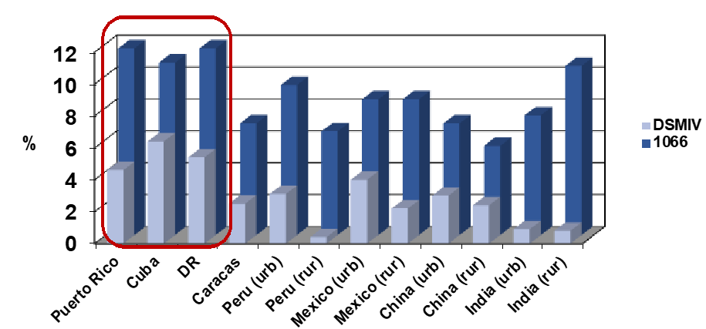
Research on Hispanic groups finds heterogeneity
Llibre Rodriguez J, et al. The Lancet, 2008; 372: 464
Notes:
Research that DOES focus on differences within Hispanic groups finds important differences.
Here we I’m showing data from the 10/66 study (which is not nationally representative and tends to skew towards urban residents), which finds that Hispanics in the Caribbean have generally higher rates of dementia despite having relatively higher life expectancies

Slide 23
Additional slides
Although migration within latin America is increasing
Only about 1% of the population in Mexico is foreign
https://www.oecd.org/en/publications/international-migration-outlook-2024_50b0353e-en/full-report/mexico_d1b0bd46.html
3% of Puerto Rico is foreign
https://www.census.gov/library/stories/2024/05/foreign-born-population-puerto-rico.html
4% of the Dominican republic is foreign
https://www.macrotrends.net/global-metrics/countries/DOM/dominican-republic/net-migration
.1% of Cuba is foreign
https://www.macrotrends.net/global-metrics/countries/CUB/cuba/net-migration

