Slide 1

Caribbean Hispanic Sociodemographic Heterogeneity: Comparing Older Adults by Country and U.S. Migration Status
William H. Dow
Chris Soria
Henry T. Dow
University of California at Berkeley
Notes:
Introduce self…
Today I'm going to present research in collaboration with William and Henry Dow on sociodemographic heterogeneity among older Hispanic adults in the United States, with a particular focus on comparing immigrants from different countries of origin.
Our goal is to highlight that these Hispanic migrant groups are different enough from each other to deserve their own spotlight in research and policy discussions.

Slide 2
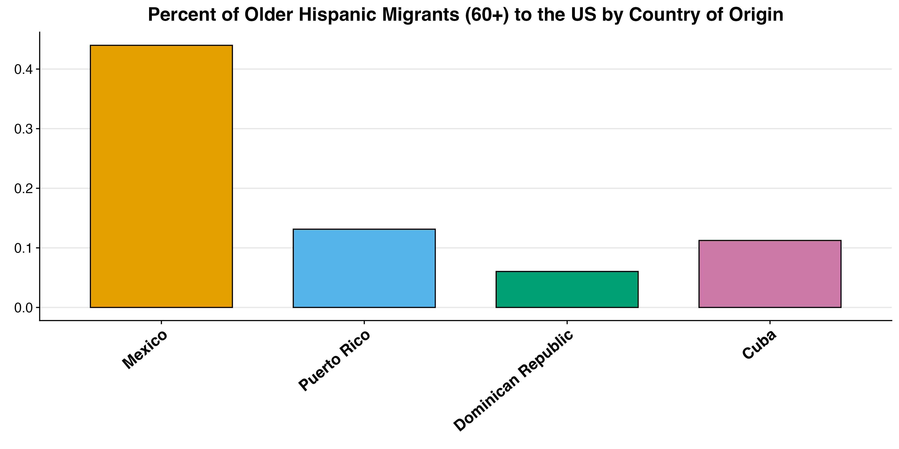
30% of US Hispanic Immigrant Older Adults are from the Caribbean
Hispanic migrant health is often focused on Mexican immigrants
Caribbean sociodemographics are very different
~44%
~30%
Notes:
While research on Hispanic migrant health has primarily focused on Mexican immigrants, who represent 44 percent of older US Hispanic immigrants, much less attention has been given to Hispanic Caribbean migrants. Migrants from Puerto Rico, Dominican Republic, and Cuba collectively make up about 30 percent of all older US Hispanic immigrants.
However, it’s not just important to highlight these groups because of their size, but also because they’re so different from each other other along the sociodemographics that are so important for healthy aging.

Slide 3
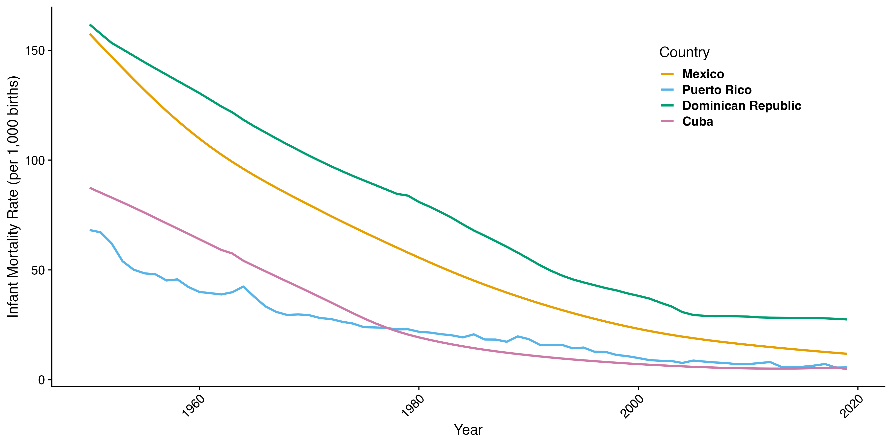
Infant Mortality Rates Show Very Different Early Childhood Conditions
Notes:
These sociodemographic differences stem in part from distinct home country conditions.
Historical infant mortality rates clearly illustrate these disparities.
Looking at this graph, where the x-axis shows time and the y-axis shows infant mortality rates, we see that in 1950, around when many people in our study were born, we see dramatically different early childhood environments across these countries.
These early life conditions are important because they will have significant implications for health in later life.

Slide 4
Immigrant Health Differs by Birth Country
Growing literature documents heterogeneity in immigrant health by birth country
E.g., using NHIS, but small immigrant samples by birth country requires pooling across 15-20 years
We’re going to look at ACS (2016-20) for larger sample
Sociodemographic determinants of healthy aging in the ACS
Migration Timing: Year / Age
Education
Social Isolation: Marital Status / Living alone
Acculturation: English Speaking / Citizenship
Notes:
While I mentioned these groups are understudied, there is a growing literature showing these Hispanic populations do differ significantly in health outcomes by birth country.
Researchers like our chair Marc Garcia (who ended up being quite influential to our research) have used the National Health Interview Survey to document important morbidity differences between these groups.
However, the NHIS offers a relatively small sample size for these populations, requiring researchers to pool data across many years to obtain sufficient numbers - for example, in Marc’s 2018 paper he had to pool across 18 years.
That's why we chose to analyze data from the 2016-20 American Community Survey, which gives us a much larger sample size and complements the health differences documented in previous research.
More specifically, in our analysis, we focus on key sociodemographic factors in the ACS that influence healthy aging:
Migration timing (year and age of migration)
Educational attainment
Social isolation (marital status and living arrangements)
And acculturation (English speaking ability and citizenship status)
Due to a large sample size, all key comparisons are statistically significant and robust to controls.
For simplicity, we present unadjusted averages throughout.

Slide 5

Migrant Selectivity Differs by Country: Comparisons with Older Adults in Birth Countries
International Census Data from IPUMS
Mexico: 2010
Puerto Rico: 2010
Dominican Republic: 2010
Cuba: 2012
US American Community Survey (2008-10)
Across all samples we select for ages 60+
Notes:
To better understand differing selection patterns, we compared US migrants to their native-country resident counterparts using international census data from IPUMS.
Because some Caribbean data are only available around 2010, we also selected census years closest to 2010 in other countries- Mexico, Puerto Rico, and Dominican Republic data are from 2010, and Cuba from 2012. We then compared these with US migrants in ACS 2008-10 data.
Because we're interested in older age migrant health, across all samples we selected only for people that are age 60 plus at the time of being interviewed by the Census.

Slide 6

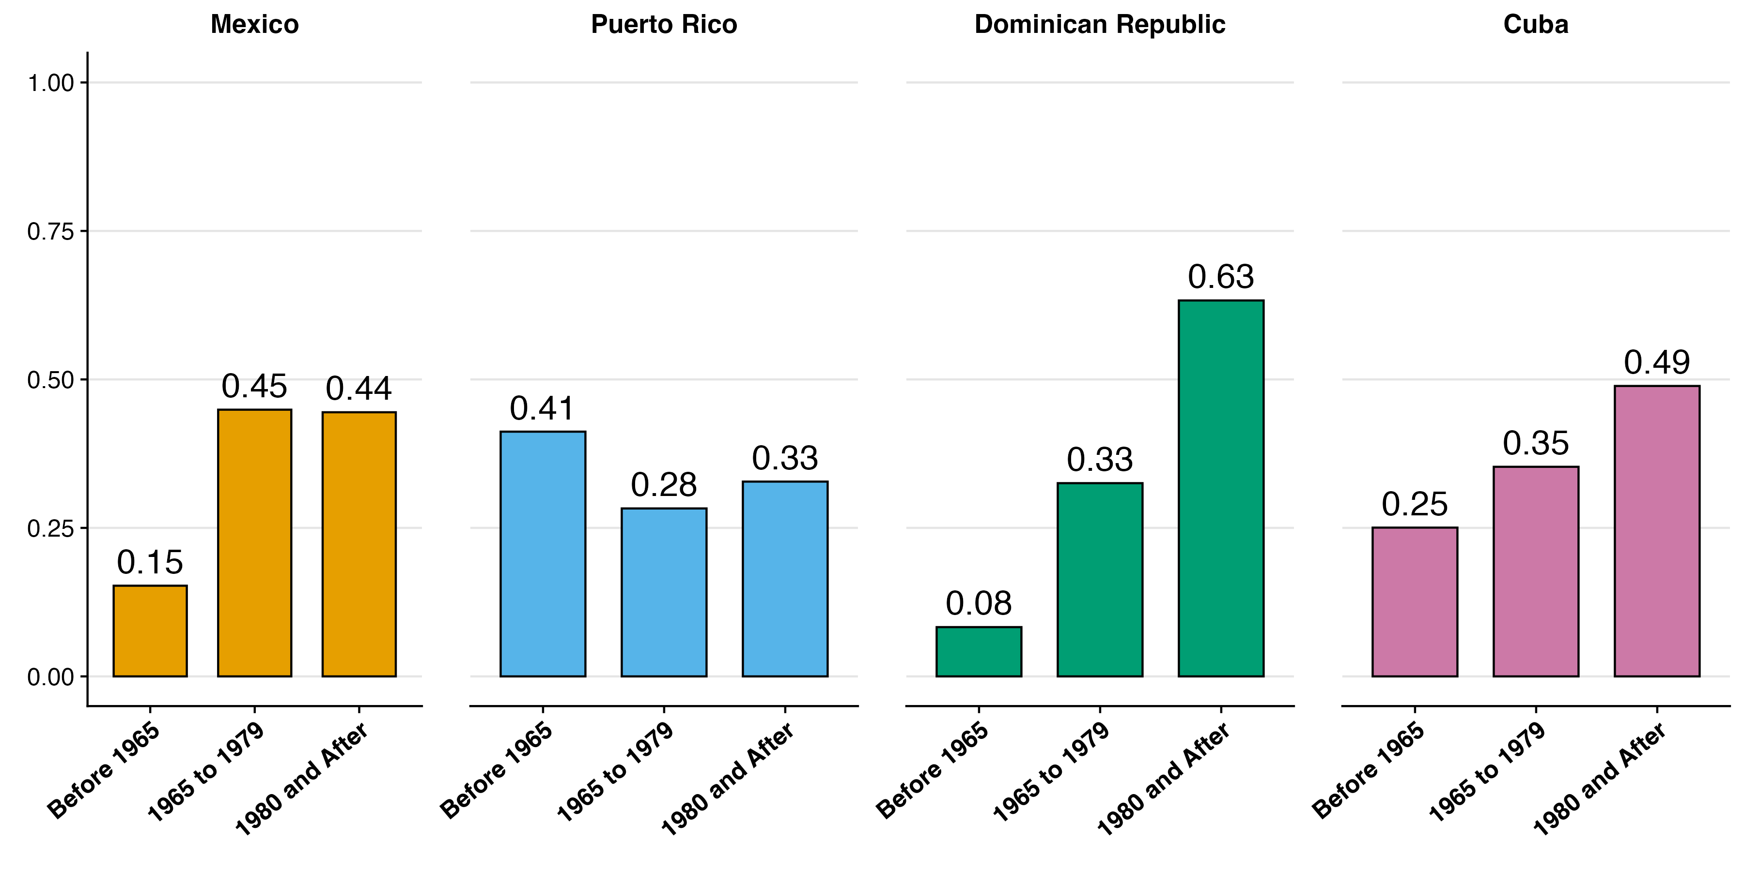
Migration Decade varies by Country
2016-20
Notes:
Looking first at 2020 ACS, we see significant differences in migration timing between these groups.
Puerto Rico, which became a US territory in 1898 and whose residents were granted US citizenship in 1917, shows the earliest migration pattern. 41 percent of Puerto Ricans in our analysis migrated to the US before 1965.
Dominican migrants appear most similar to Mexican migrants in their migration timing, with only 8 percent reporting migration before 1965. However, Dominicans differ substantially from Mexicans in that they're the most likely to have migrated recently – the vast majority arrived in 1980 or after.
(NOT GOING TO READ BUT LEAVING IN CASE IT COMES UP)
Cuban Revolution in 1959 sparked one of the largest refugee movement in US history (Duany 2017). In 1966, given path to US residency.

Slide 7
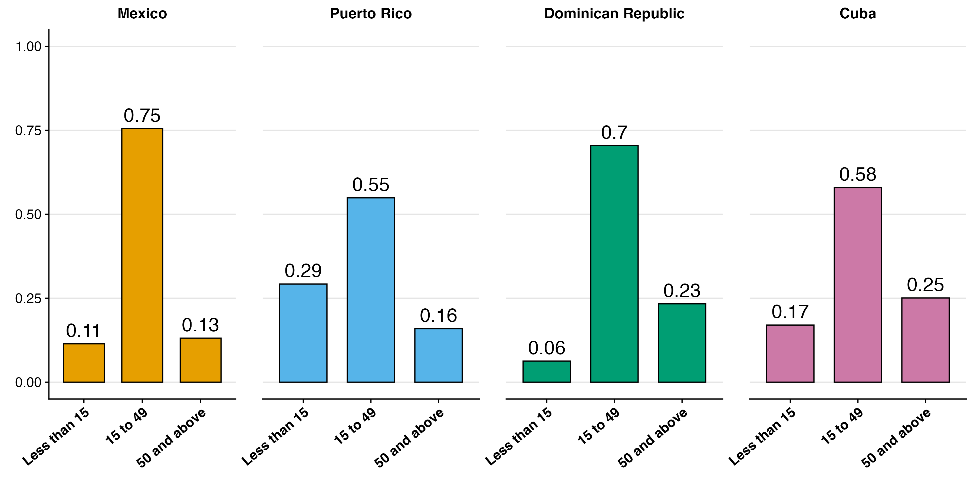
Most people migrated at working ages
2016-20
Notes:
Now let's examine migration age patterns, which connect closely to the migration timing we just discussed but also impact acculturation levels, as the amount of time spent in the US shapes cultural integration.
Across all groups, migrants predominantly moved during working ages (15 to 49) rather than as children. Puerto Ricans stand out as an outlier, with 30% migrating during childhood.
Notably, Cubans and Dominicans are twice as likely as Mexicans to have migrated after age 50.
Notes to self: lower prop migrated less than 15 could be due to mortality,

Slide 8
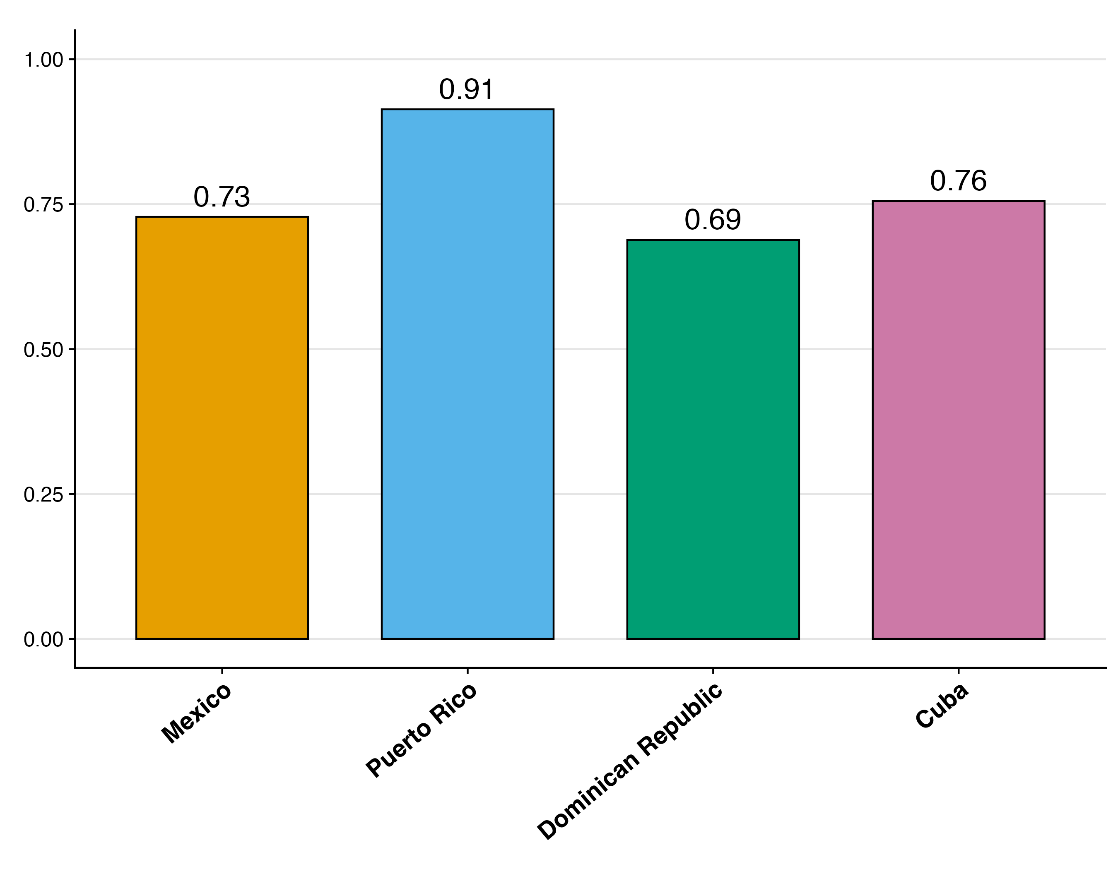
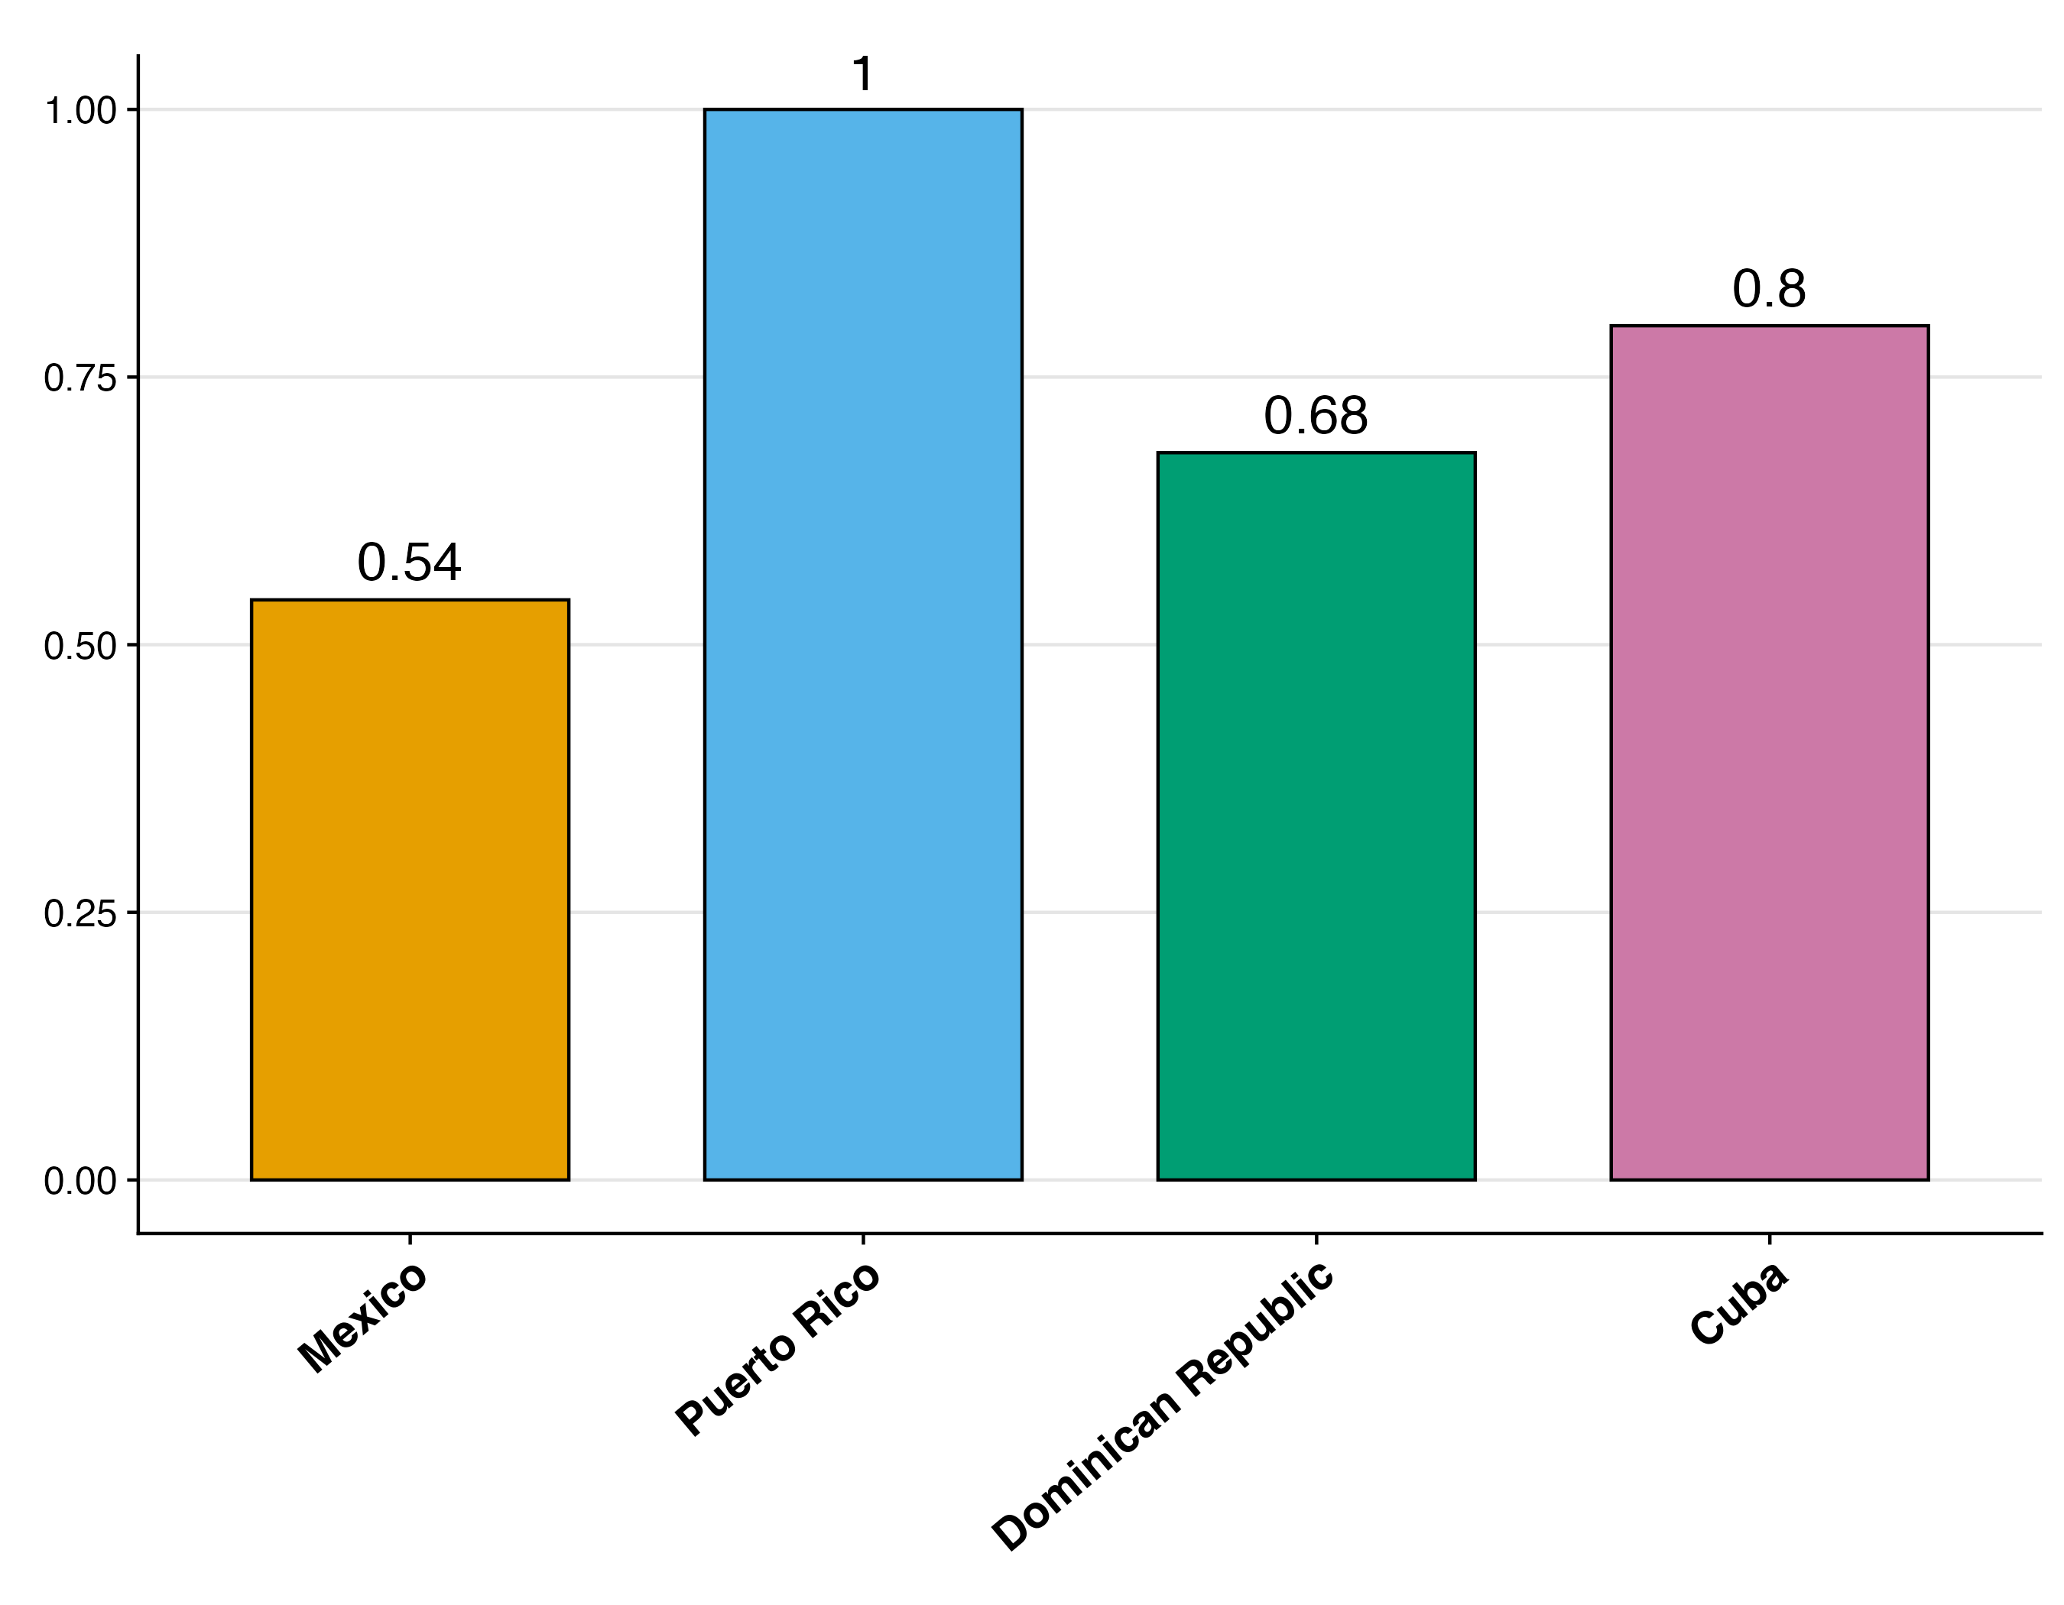
Mexican and Dominican migrants are the least likely to acculturate
2016-20
Proportion English Speakers
Proportion Naturalized Citizen
Notes:
When it comes to acculturation, we find that Cuban and Dominican migrants are distinct from Mexican migrants.
While these three groups tend to speak English at similar rates, Cuban and Dominican migrants are significantly more likely to become naturalized U.S. citizens compared to Mexicans.
It's worth noting, however, that Cubans have historically benefited from a more accessible path to naturalization through policies that allow them to apply for permanent residency after just one year in the United States.

Slide 9
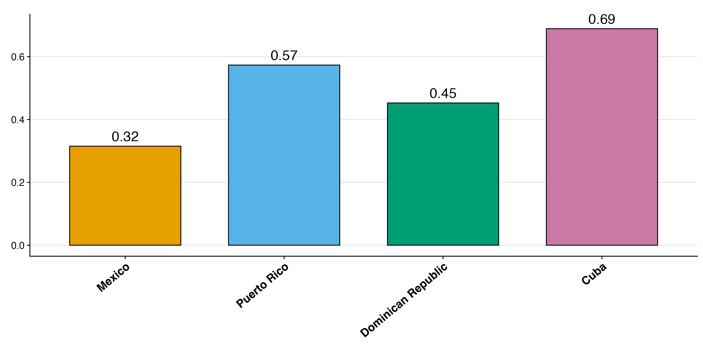
Caribbean Hispanic immigrants tend to be more educated than Mexican immigrants
2016-20
Proportion With At Least Secondary Degree
Notes:
A clearer determinant of healthy aging is education, which we find varies substantially by migrant birth country
Mexican migrants have the lowest rates of secondary education completion, well below Caribbean migrants.
And among Caribbean groups, Cubans have the highest rates of high school completion, followed by Puerto Ricans, then Dominicans.

Slide 10
What’s driving the lower education among Mexican Immigrants?
Older so need to age adjust?
Age at Migration?
Birth country education levels?
Migrant selectivity?
Notes:
In order to better understand what might be driving these differences, we examined four possible explanations:
It could be that there are age differences between migrant groups, however after age adjustment, educational patterns remained mostly the same
It could be that those who migrated in childhood stayed in school longer because of higher compulsory schooling age laws in the U.S.
Their birth country may have had lower schooling attainment norms
And lastly is migrant selectivity. It may be that migrants from other countries were more positively selected on education than migrants from Mexico.

Slide 11
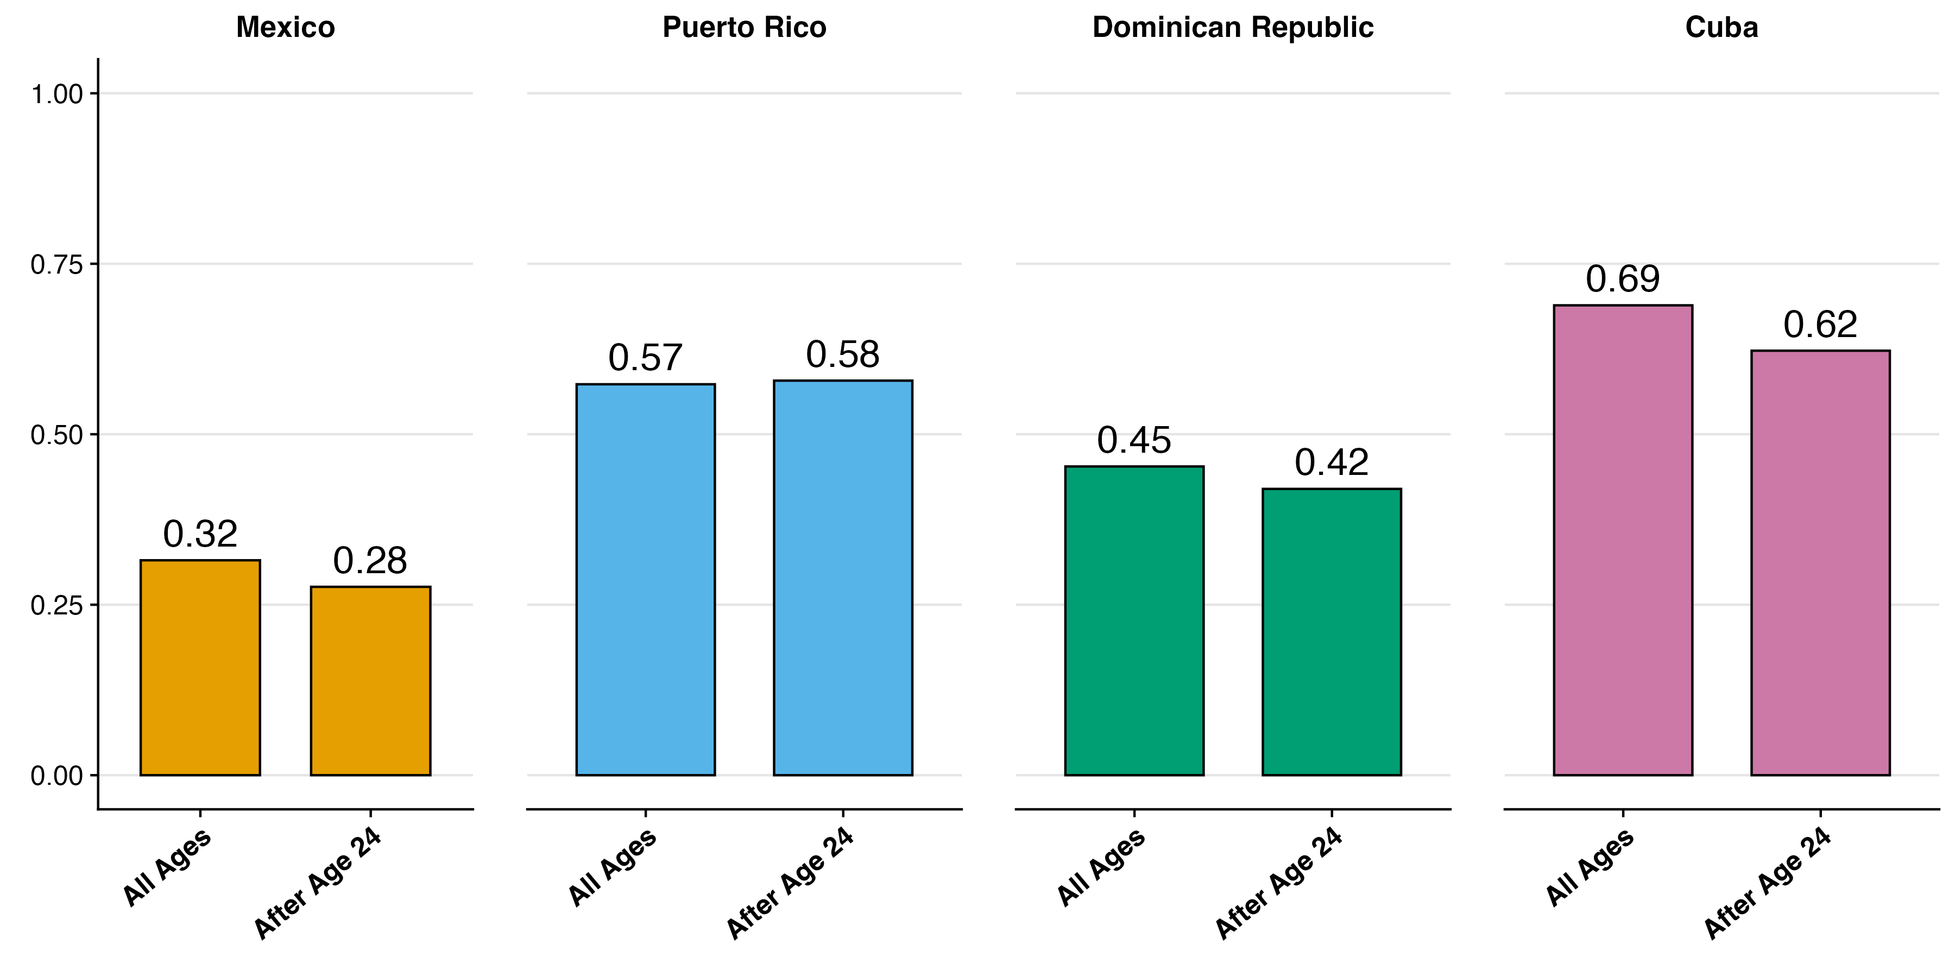
Education Differences are Not Explained by age at Migration
Results hold when controlling
2016-20
Notes:
Here we compare education levels of all migrants to those who migrated after age 24.
For each country in this graph, the left bar bar again shows the secondary education attainment proportion that I just showed you, and the bar to its right shows that same proportion among those who migrated after age 24.
The patterns remain similar here, indicating that age at migration does not explain the educational differences we observe.

Slide 12
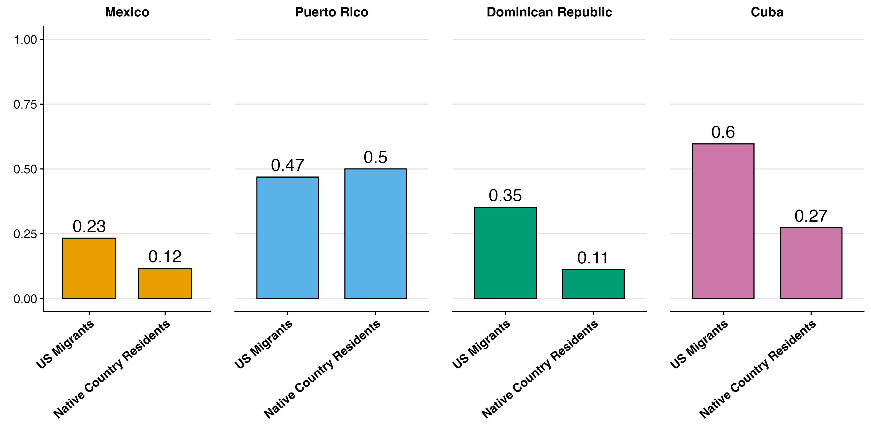
Positive migration selection on education: US migrants are more likely to have completed secondary school compared to those in their birth country – but varies by country
2008-10
Notes:
When we compare education levels of migrants to their native-country resident counterparts, two things stand out.
First, migrant educational patterns largely reflect education levels in their home countries. This is evident in the overall educational hierarchy among these groups, with Cubans in their home country generally having higher educational attainment than Mexicans, for example.
Second, selectivity patterns differ significantly between these groups. Cuban and Dominican migrants show the strongest positive educational selectivity, whereas Puerto Rican migrants are actually slightly less likely to have a high school degree compared to their native-country counterparts.

Slide 13
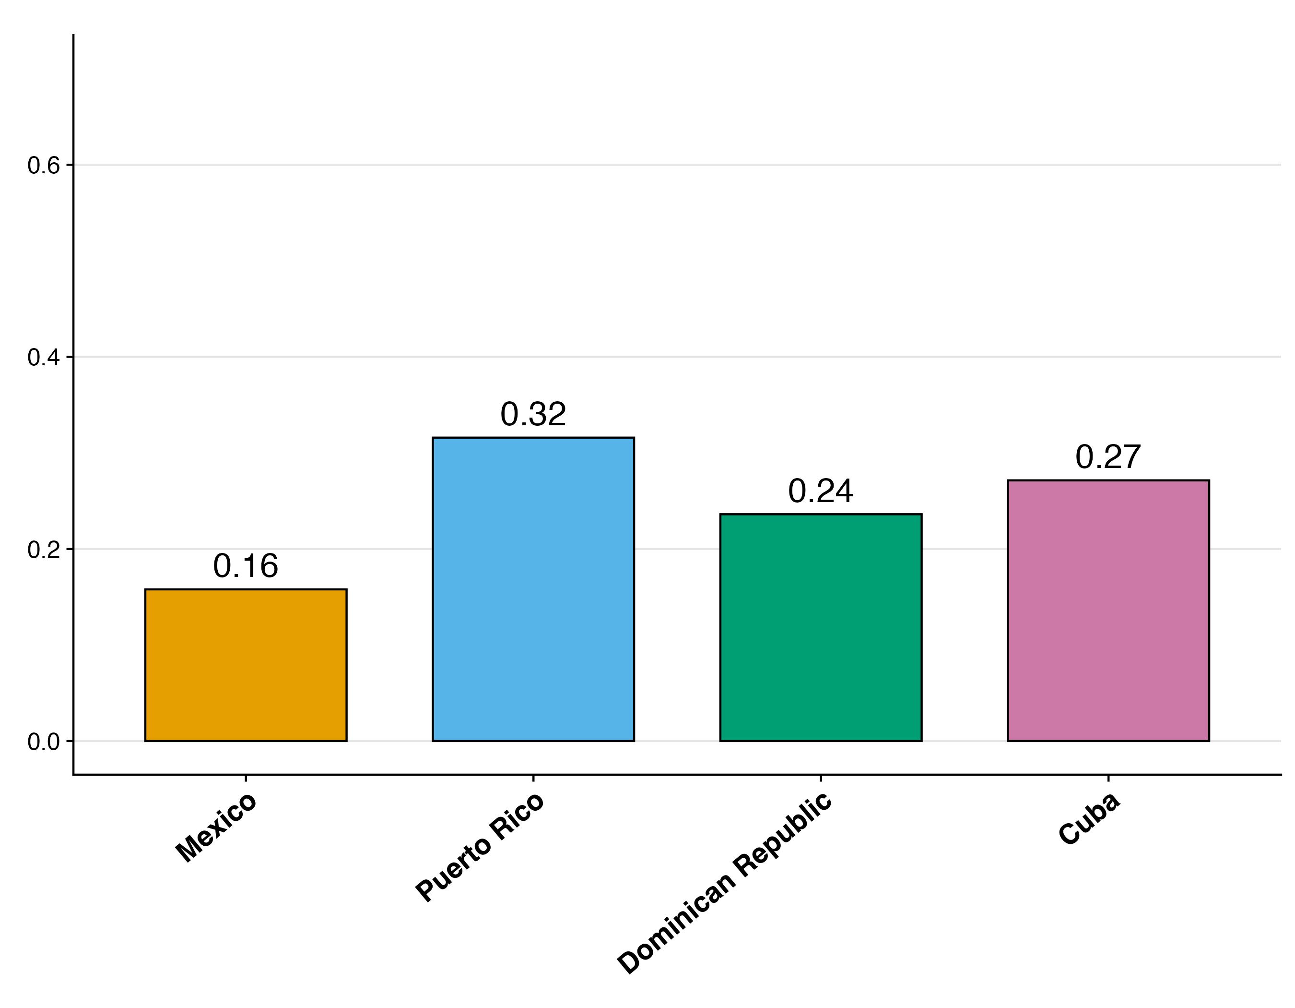
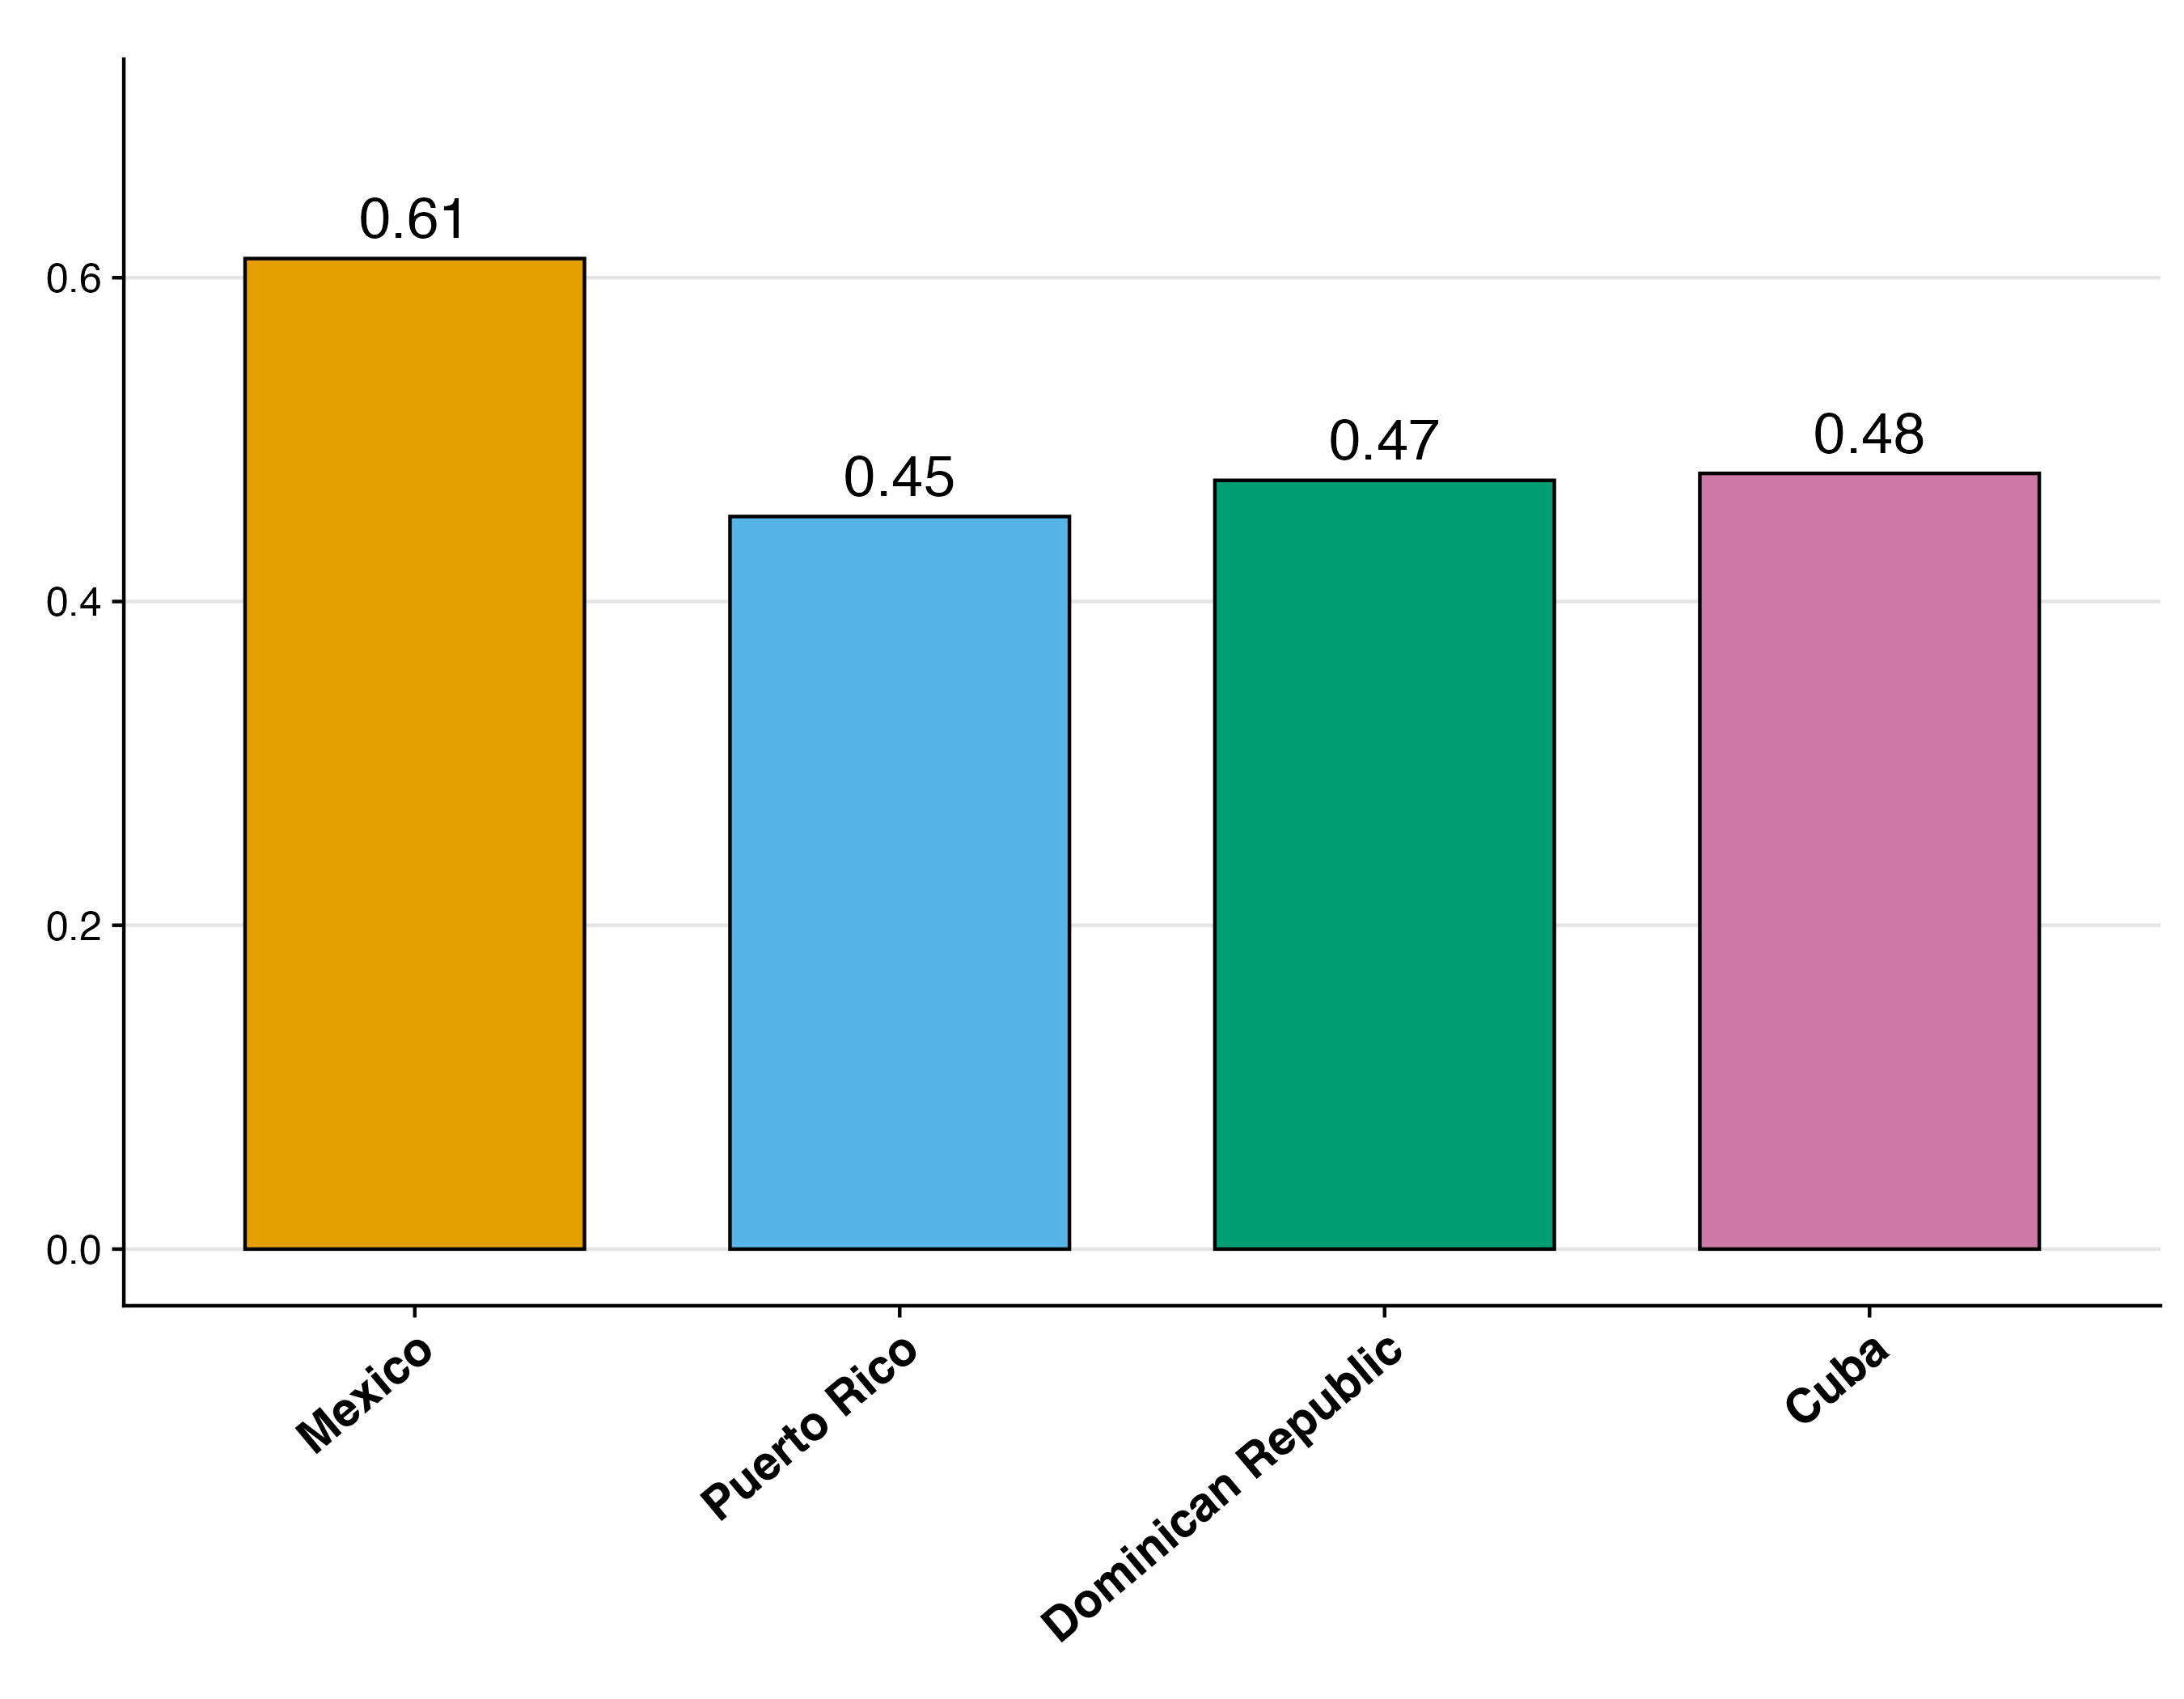
Mexican migrants are the least likely to live alone and most likely to be married
2016-20
Proportion Living Alone
Proportion Married
Notes:
I don’t have time to walk through hypotheses on all these factors, but these groups also differ in household arrangements.
Only 16% of Mexican migrants over 60 live alone, compared to 32% of Puerto Ricans.
Mexican migrants are also more likely to be married than their Caribbean counterparts.
Again, this is not explained by age or migration timing. So it seems to reflect something more fundamental about population differences by birth country, and likely also affects health differences.

Slide 14
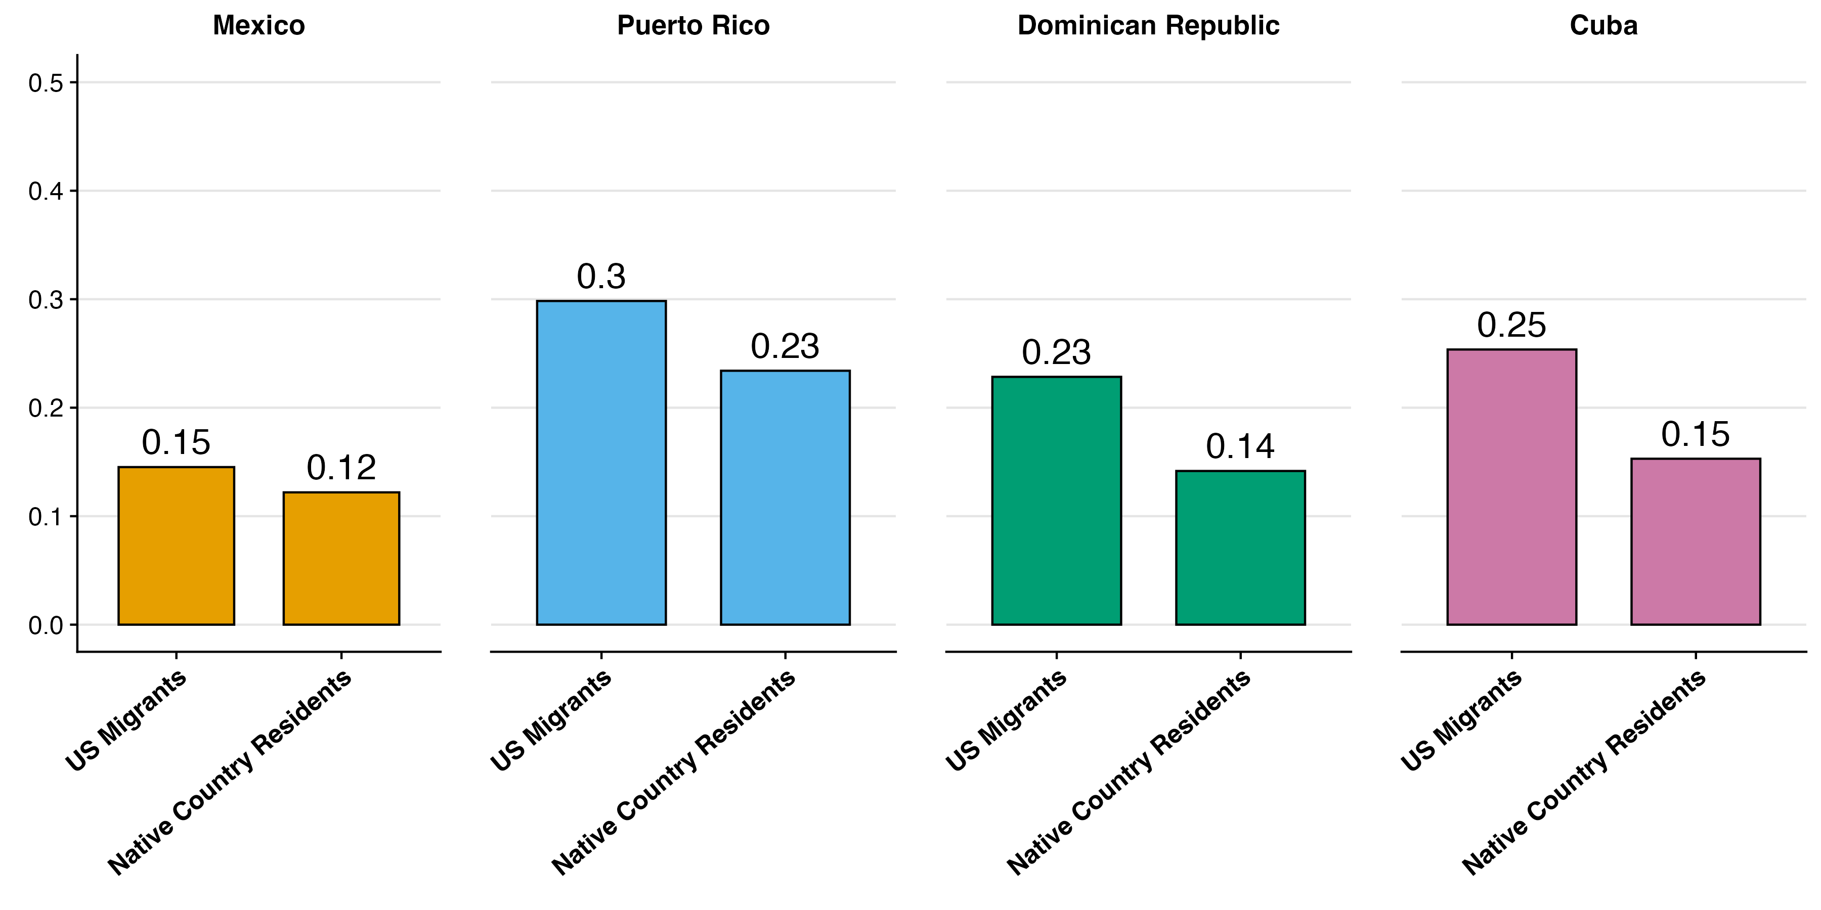
Native country residents are less likely to live alone
Proportion Living Alone
2008-10
Notes:
Migrants are more likely to live alone than their native-country counterparts, with this difference being more pronounced among Caribbean migrants than Mexicans.
It’s not obvious why or what the implication is, but this is an intriguing stylized fact that calls for further investigation

Slide 15
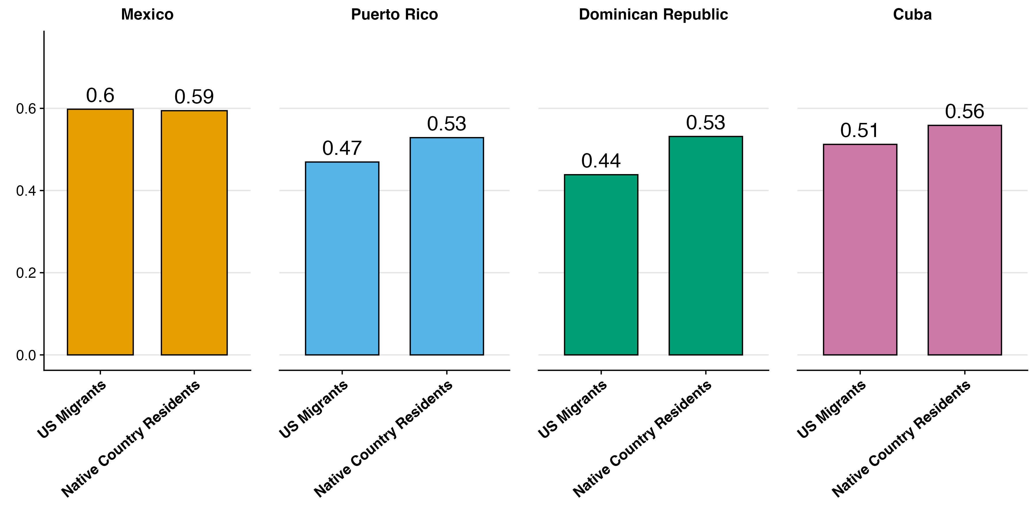
Native country residents are more likely to be married
Proportion Married
2008-10
Notes:
And lastly, we see similar patterns with marriage.
Caribbean migrants are significantly less likely to be married compared to their counterparts in their home countries.
In contrast, Mexican migrants maintain marriage rates nearly identical to those of Mexicans living in Mexico.

Slide 16
Takeaways and Discussion
Hispanic migrants have differing sociodemographics by Caribbean birth country
Compared to Mexican migrants: Caribbean migrants have higher education and acculturation rates, but are more likely to live alone
Dominican and Cuban education selectivity is the strongest
These patterns are rapidly changing
Notes:
In summary, these Hispanic migrant groups differ substantially from each other and from their native-country counterparts, which have important implications for their respective health outcomes.
The key differences we identified were:
Migration patterns vary significantly for all groups, in both timing and age at arrival
Caribbean migrants generally have higher educational attainment and citizenship rates than Mexican migrants
Caribbean migrants are more likely to live alone than Mexican migrants
Selection patterns vary dramatically, with Dominican and Cuban migrants showing much stronger positive educational selectivity compared to Mexican and Puerto Rican migrants

Slide 17
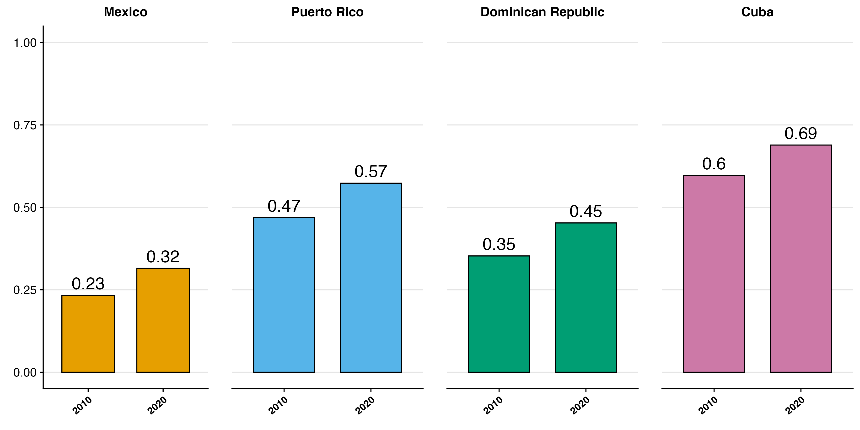
Strong cohort increases in migrant education, even from 2010 to 2020
Notes:
However, things are rapidly changing. When we compare these migrant groups in 2010 to to themselves 2020, we generally see that they’re all more educated.
In other words, we need more current data on both migrants and their native country counterparts.

Slide 18
Limitations
Limitations
Return migration not accounted for: need better birth country survey data
Census data has large sample sizes, but does not directly measure health
=> We need better nationally representative data in the Caribbean sending countries, e.g. similar to the Mexican Health and Aging Survey (MHAS)
Notes:
There are a few limitations to these study, however.
For example, here we’re only viewing a snapshot of where people are at the time of the census, not their previous migration history. In other words, some of the folks living in their respective native countries might have temporarily lived in the US but moved back by the time they reach old age.
The other major limitation is that the Census doesn’t provide information on respondent health, which is ultimately what we’re interested in.
What we need is better nationally representative data in the Caribbean countries that’s comparable to US data, similar the Mexican Health and Aging Survey.

Slide 19


Caribbean Dementia and Aging Study
New Hispanic Caribbean healthy aging surveys:
Our team is collecting nationally representative CADAS surveys in Puerto Rico and Dominican Republic
Harmonized data in Cuba
Harmonized with global family of Health and Retirement Surveys (HRS) and Mexican MHAS
Includes Harmonized Cognitive Assessment Protocol (HCAP)
This presentation provides background for future CADAS analysis of US Caribbean migrant selectivity
Stay tuned for data release next year
Notes:
That’s why we’re eager to follow this study up with an analysis of the Caribbean American Dementia and Aging Study.
We’re still in the middle of data collection, but CADAS data will consist of nationally representative samples in Puerto Rico and Dominican Republic harmonized with data from Cuba
Because it’s part of the Harmonized Cognitive Assessment Protocol, it’ll allow us to run comparative analysis of both US data like the Health and Retirement Surveys and Mexican data like MHAS.
In other words, we consider this study a first step in the direction of a more robust eventual analysis using CADAS data.
Stay tuned next year for the public release.

Slide 20
Additional Slides

Slide 21
Our Contributions
US Immigrants from Mexico compared to those from the Hispanic Caribbean (60+)
US Immigrants from these countries compared to their native country resident counterparts
US Immigrants from these countries sociodemographic profiles over time
Mexico
Puerto Rico
Dominican Republic
Cuba
Migrant characteristics
Differences in Selection
Change over time
Notes:
That leads us to our research questions in this paper, which is entirely descriptive.
1. US Immigrants from Mexico compared to those from the Hispanic Caribbean (60+)
2. We wanted to compare these movers to their home country stayers to get a better sense of the selection mechanisms at play
3. Lastly, we wanted to see how these selection patterns are changing over time
We’re going to compare these migrants from Mexico those those from Puerto Rico, the Dominican Republic, and Cuba.

Slide 22
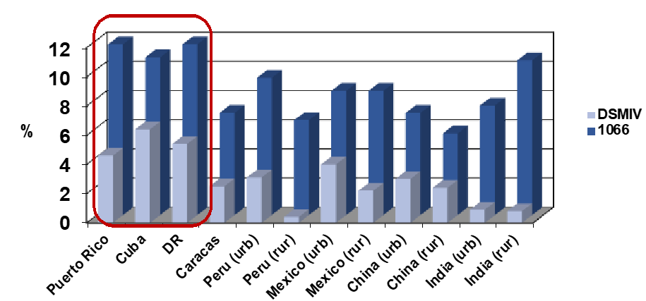
Research on Hispanic groups finds heterogeneity
Llibre Rodriguez J, et al. The Lancet, 2008; 372: 464
Notes:
Research that DOES focus on differences within Hispanic groups finds important differences.
Here we I’m showing data from the 10/66 study (which is not nationally representative and tends to skew towards urban residents), which finds that Hispanics in the Caribbean have generally higher rates of dementia despite having relatively higher life expectancies

Slide 23
Additional slides
Although migration within latin America is increasing
Only about 1% of the population in Mexico is foreign
https://www.oecd.org/en/publications/international-migration-outlook-2024_50b0353e-en/full-report/mexico_d1b0bd46.html
3% of Puerto Rico is foreign
https://www.census.gov/library/stories/2024/05/foreign-born-population-puerto-rico.html
4% of the Dominican republic is foreign
https://www.macrotrends.net/global-metrics/countries/DOM/dominican-republic/net-migration
.1% of Cuba is foreign
https://www.macrotrends.net/global-metrics/countries/CUB/cuba/net-migration

