Slide 1
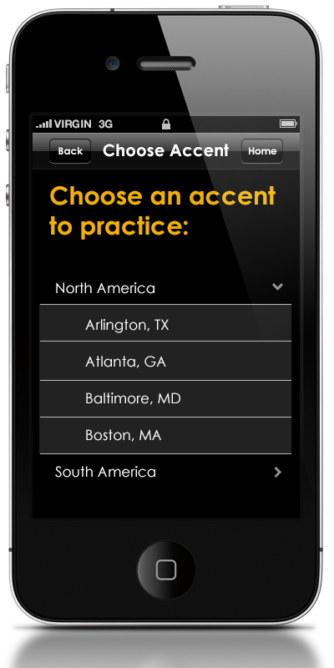
AccPrac
The easy way to develop a new accent at your own pace.

Slide 2
Created for:
Non-native English speakers looking to improve their accents
Actors, performers, and entertainment professionals looking to perfect a regional accent
Travelers looking to better understand how the local population communicates

Slide 3
A large and diverse market typically served by:
Online courses
Seminars
Accent correction apps

Slide 4
Problems?
Online Courses:
Not tailored to the user’s needs
Desktop based
$$$

Slide 5
Problems?
Seminars:
Far away
Limited interaction
Really $$$

Slide 6
Problems?
Other Apps:
Difficult to use
Too general
Usually limited to one accent

Slide 7
AccPrac
Provides feed back based on uses native accent
Allows for practice of regional accents
Simple to use anywhere

Slide 8
Accent Identification

Slide 9
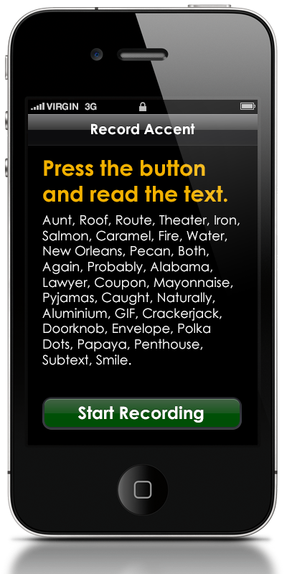
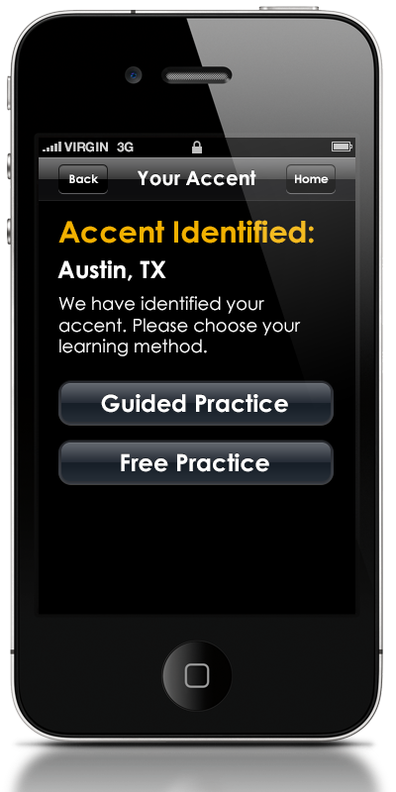
>>>

Slide 10
Guided Practice

Slide 11
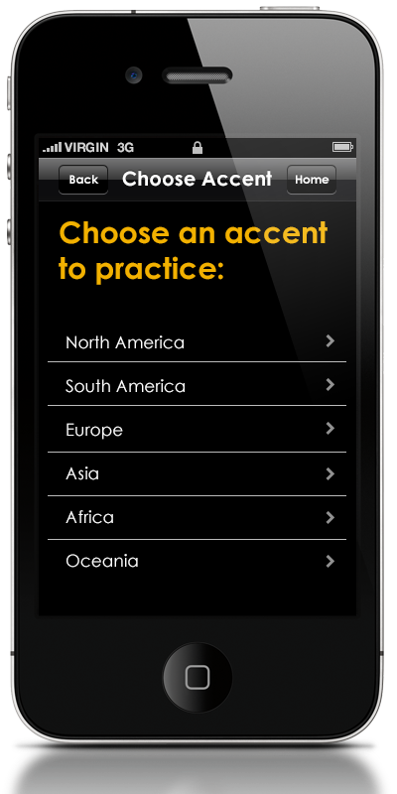

>>>

Slide 12
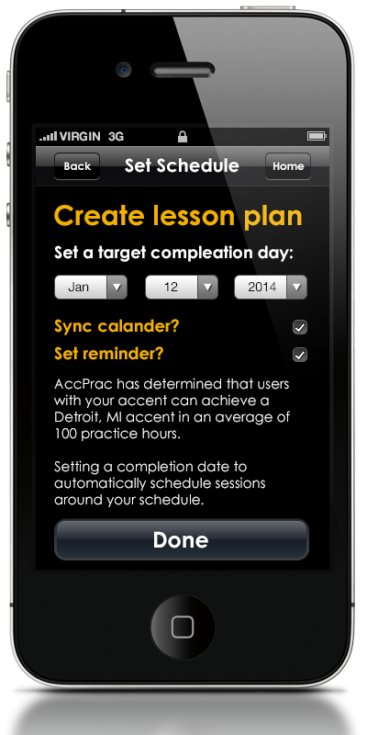
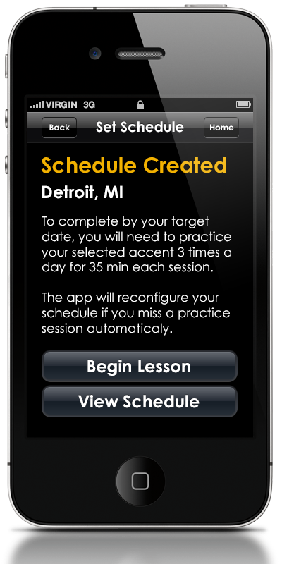
>>>

Slide 13
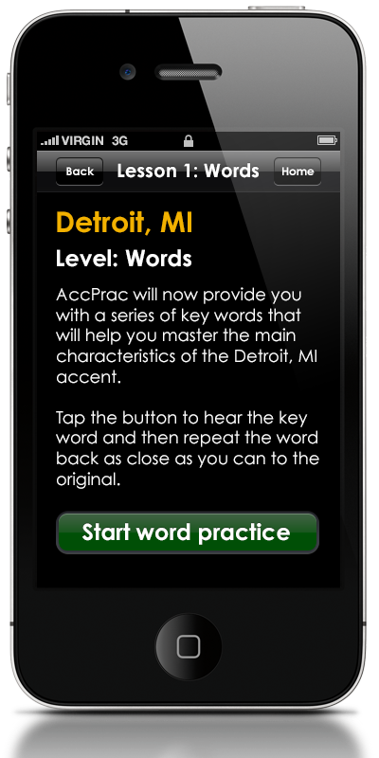
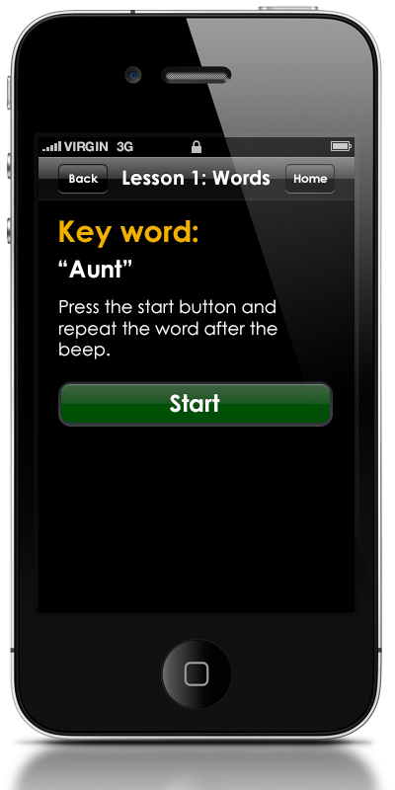
>>>

Slide 14
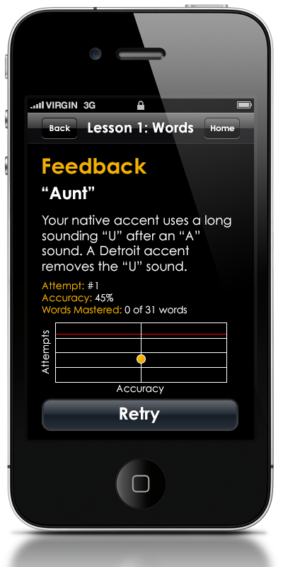
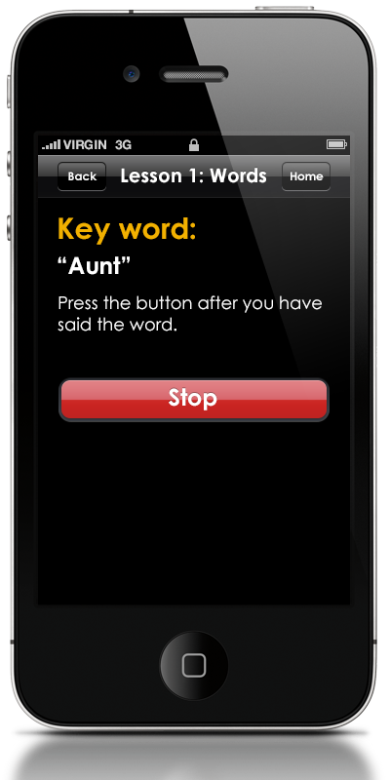
>>>

Slide 15
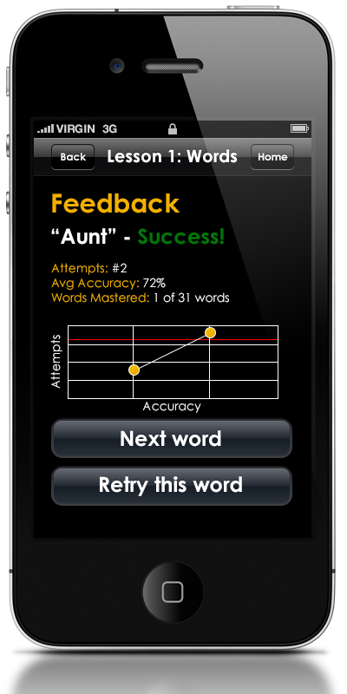

Slide 16
Free Practice

Slide 17

>>>

Slide 18
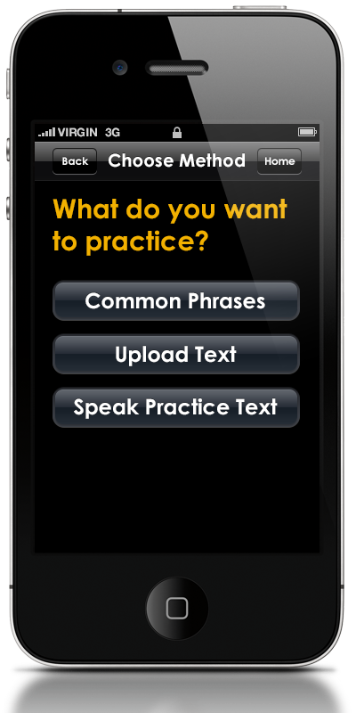
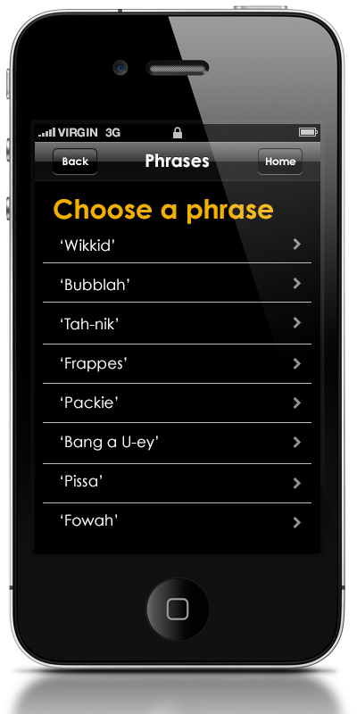
>>>

Slide 19
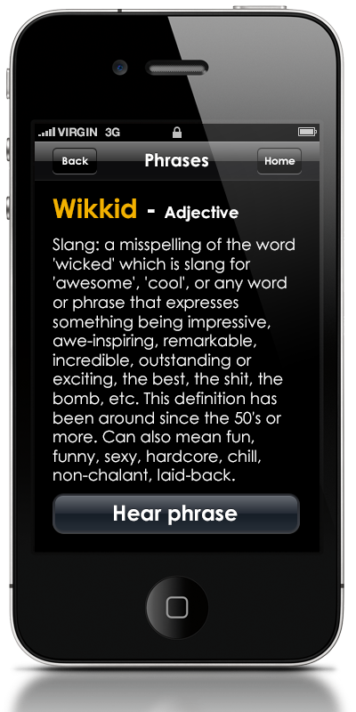
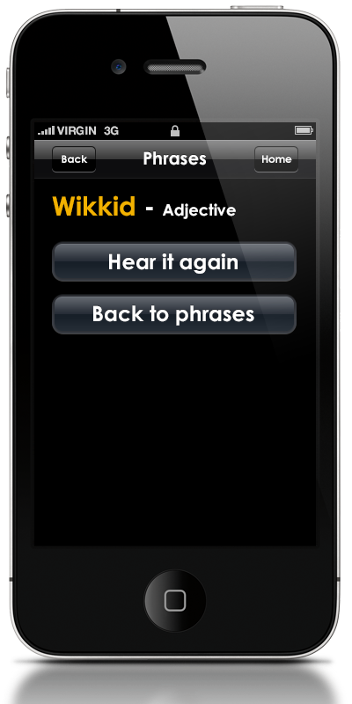
>>>

Slide 20
AccPrac
The easy way to develop a new accent at your own pace.

