Slide 1
What can we learn from voting records of a past congress?

Slide 2
Dataset
Data from UC Irvine Machine Learning Repository - 1984 US House Voting Records
“Key votes” identified by the Congressional Quarterly Almanac
Categorical Data: Votes are Yes, No, and “?”

Slide 3
Limitations
Key Vote Selection¹:
Controversy or impact
Test of presidential power
16 votes - limited data
One year
“?” votes have multiple categories
Voted present - conflict of interest or other reason
“Did not vote or otherwise make a position known”
¹ https://www.jstor.org/stable/439750

Slide 4
However, I still found some interesting
results...

Slide 5
Goals
EDA to look for anything interesting
Classification model to predict Republican or Democrat based on voting record
Cluster analysis to look for more than 2 clusters of voting records
Are there important caucuses within the parties, or a 3 way split between moderate, left-wing, and right-wing voting records?

Slide 6
Exploratory Data Analysis

Slide 7
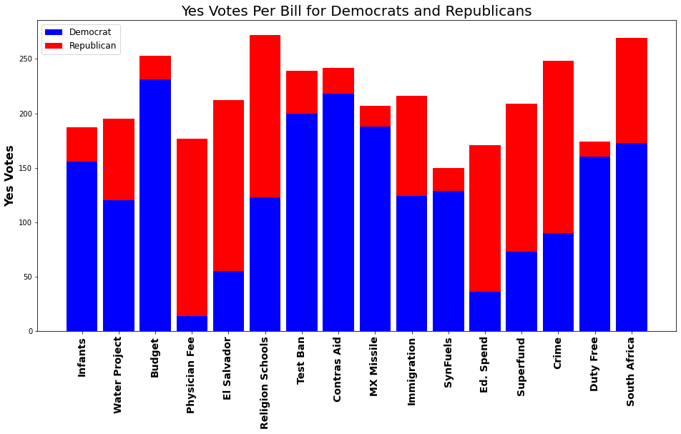
Yes votes

Slide 8
Important features of the data
267 democrats, 168 republicans
Votes are more bipartisan than would be expected for the current congress
Bills cover range of issues
Some bills passed, some did not

Slide 9
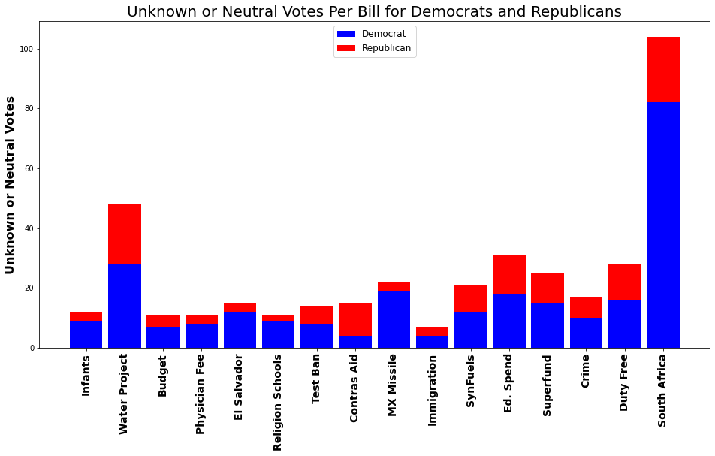
‘?’ votes per bill

Slide 10
Neutral Vote Analysis
“Water Project” - environmental policy bill with environmentalist groups advocating for a ‘No’ vote. Bill passed.¹
“South Africa” - Sanctions on apartheid South Africa. Bill passed²
¹https://scorecard.lcv.org/roll-call-vote/1984-540-water-project-cost-sharing-maintenance-and-repairs
²https://www.congress.gov/bill/98th-congress/house-bill/4230/summary/40?r=92

Slide 11
Classification Model

Slide 12
Prepare and Find Model
Goal: predict Republican or Democrat based on voting record
Outliers:
Look for Republicans and Democrats with very unusual voting pattern for the party. Boxplot of # yes votes.
No important outliers
Tested several models with F1 score for precision-accuracy balance: logistic regression, k-nearest neighbors, bagging classifier, Adaboost, random forest

Slide 13
Final Model
Random Forest: train F1 = 1.0, test F1 = 0.98
No need to change parameters or features
Evaluate (positive and negative class both matter):
Sensitivity (Democrat) - 0.98
Specificity (Republican) - 0.98

Slide 14
Feature Importance
Feature | Feat. Importance
Yes Physician Fee | 0.21
No Physician Fee | 0.19
Yes Budget | 0.09
No Budget | 0.08
No Ed. Spend | 0.05
Yes El Salvador | 0.04
No El Salvador | 0.04
Model predicting Republican vs. Democrat largely on a health care policy vote
Vote on budget is expected to be partisan

Slide 15
Cluster Model

Slide 16
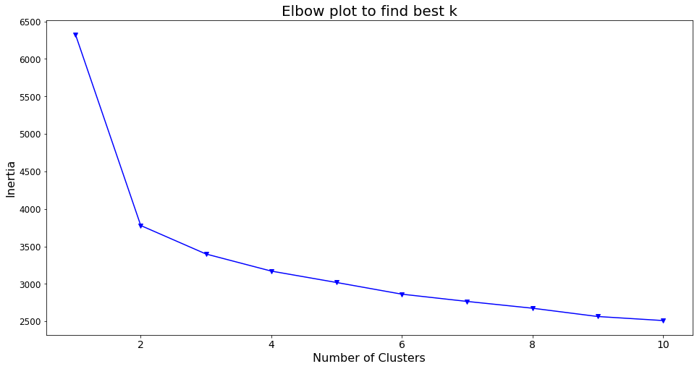
Elbow Plot

Slide 17
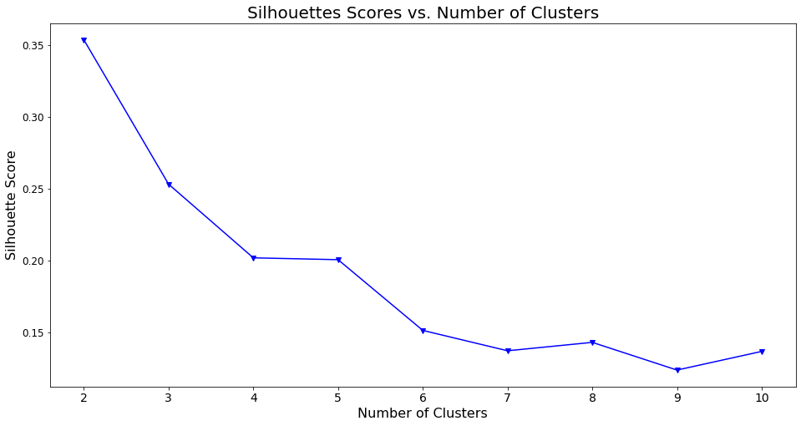
Silhouette Plot

Slide 18
Conclusions and Next Steps
Conclusions:
Caucuses other than parties are not important enough to show up in modeling
Health care policy may be the area that is most likely to divide Republicans and Democrats
Possible Extension
Get data from all votes and model with lasso regularization and logistic regression to see if the conclusions from ‘key votes’ match conclusions from all votes

