Slide 1
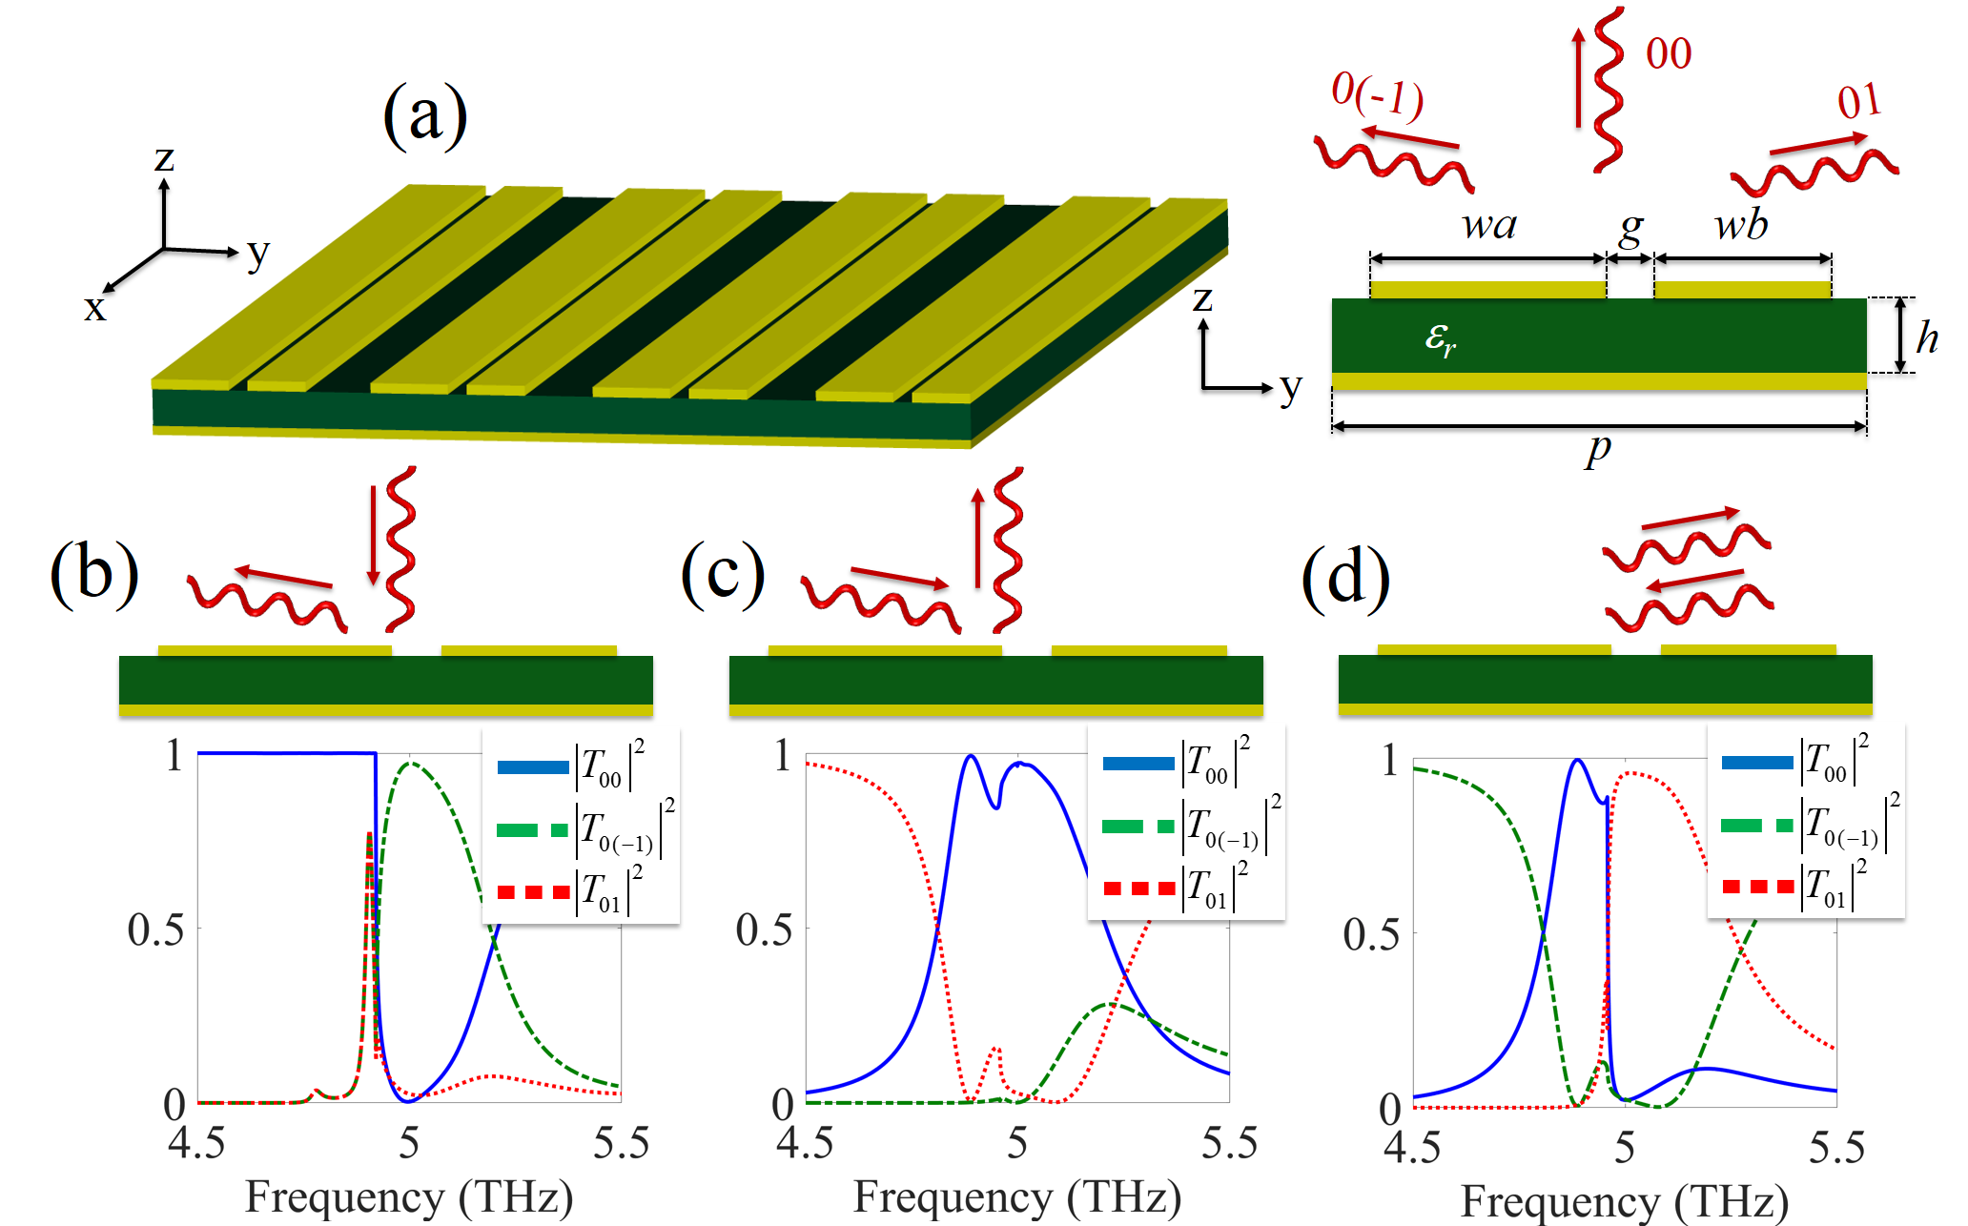

Slide 2
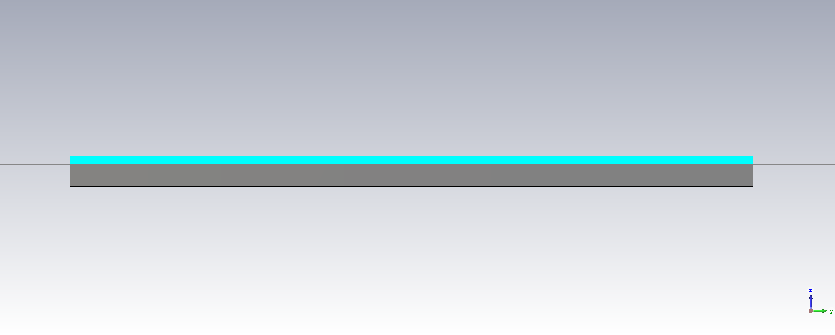
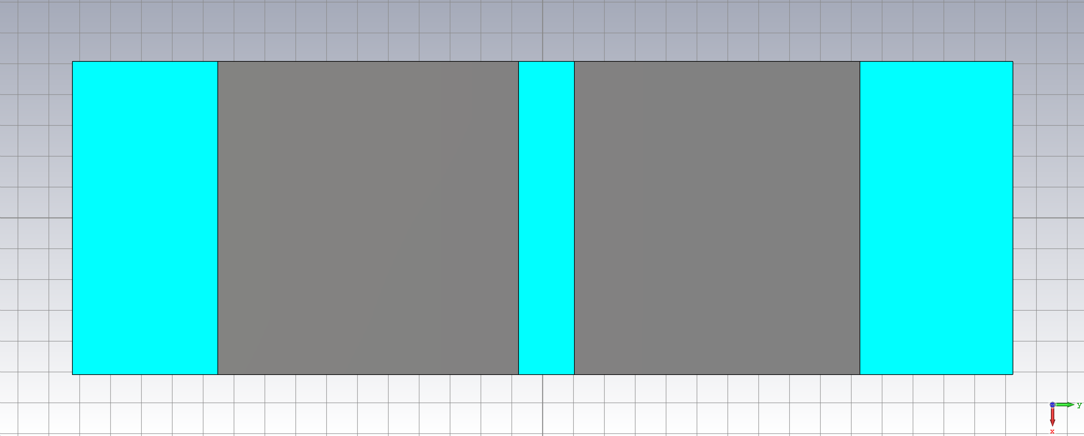
h
p=30/sin(tet)
tet is the angle we wanna send the wave into
swB
swA
p/6
Shift
Shift
Middle of the strip
y=0
Middle of the strip

Slide 3
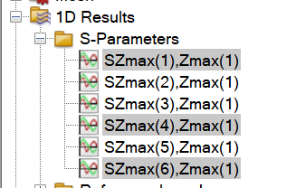
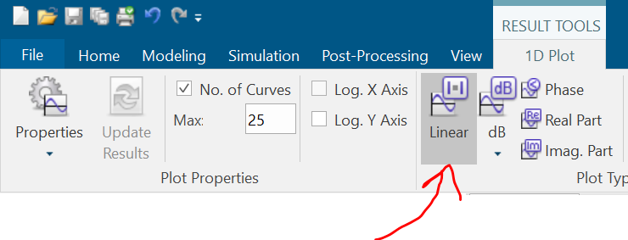
First you set tet and then p will be automatically fixed. Then you change the swB, swA, Shift, h. The parameters that you will be changing during the training are swB, swA, Shift, h, and tet. A few restrictions: 30<tet<90 (30 and 90 not included).
When setting swB, swA, and Shift make sure two strips are not overlapping or going out of the box.
This is how much goes to port 00
This is how much goes to port 01
This is how much goes to port 0(-1)
When looking at the results you should look at the magnitude (linear).

Slide 4
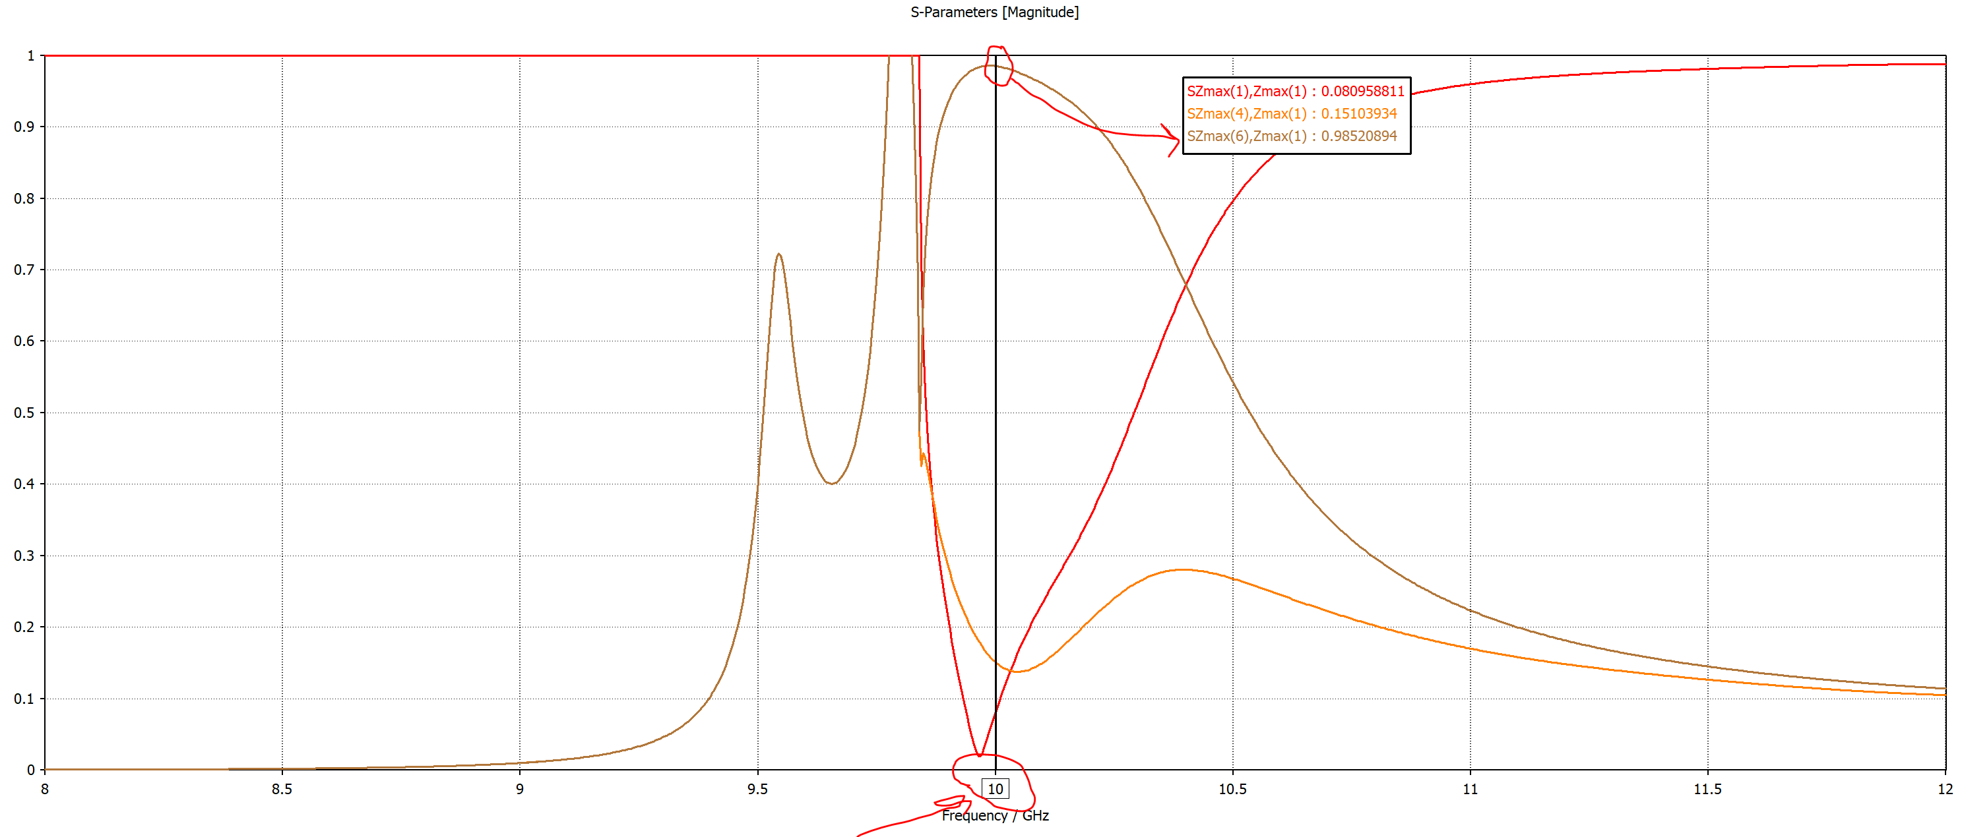
The goal is to maximize the energy going to 0(-1) port at 10 GHz (this is the frequency in which you will gather the data and train your code).
To get the black like in at 10GHz to measure the value right click on the window and choose show axis marker.

Slide 5
The main goal of the project is that after training if I tell you we need a metasurface to send all the incoming energy into 60 degrees (or whatever angle) at 10 GHz your code should give all the parameters without any need to do optimization.

Slide 6
