Slide 1
Team #21
Telegram Bot , Magnetic Compass , Thingspeak

Slide 2
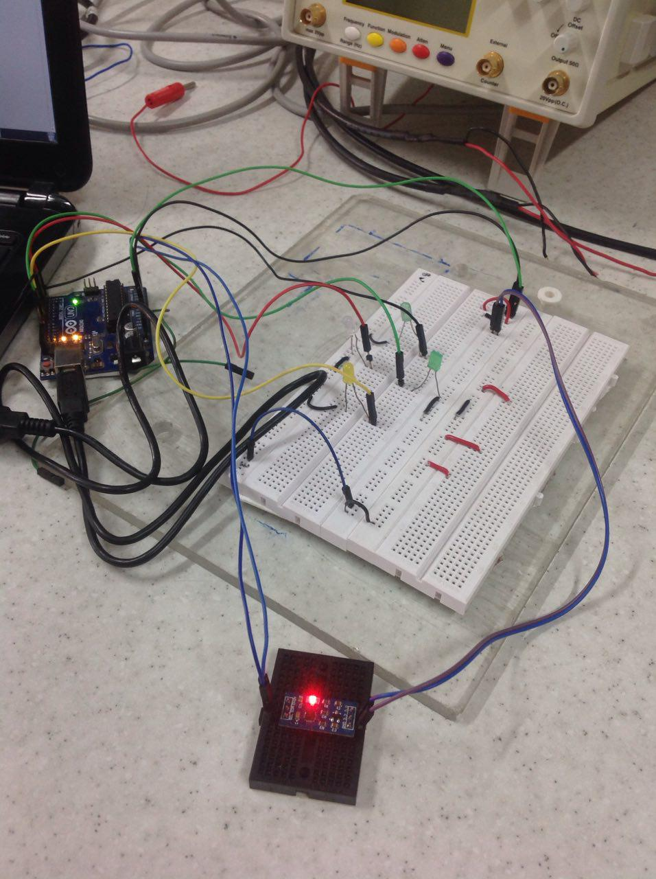
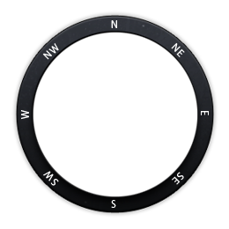
Magnetic Compass

Slide 3
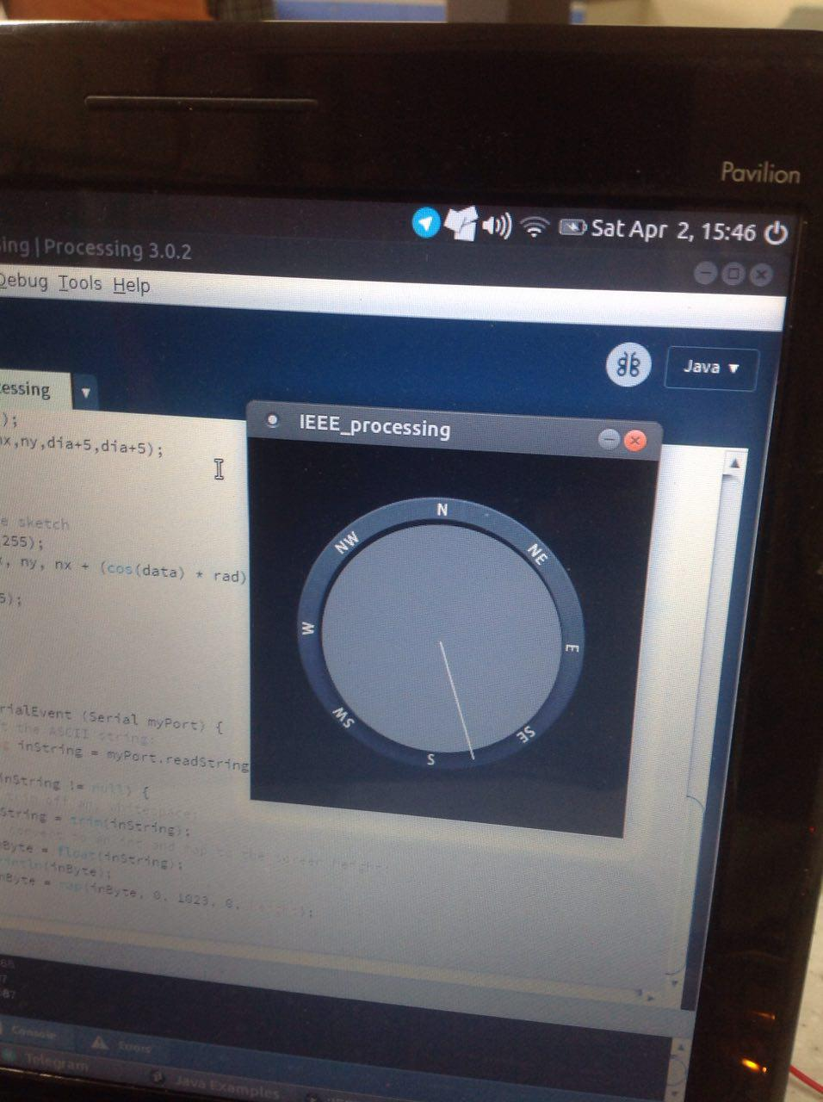

Slide 4
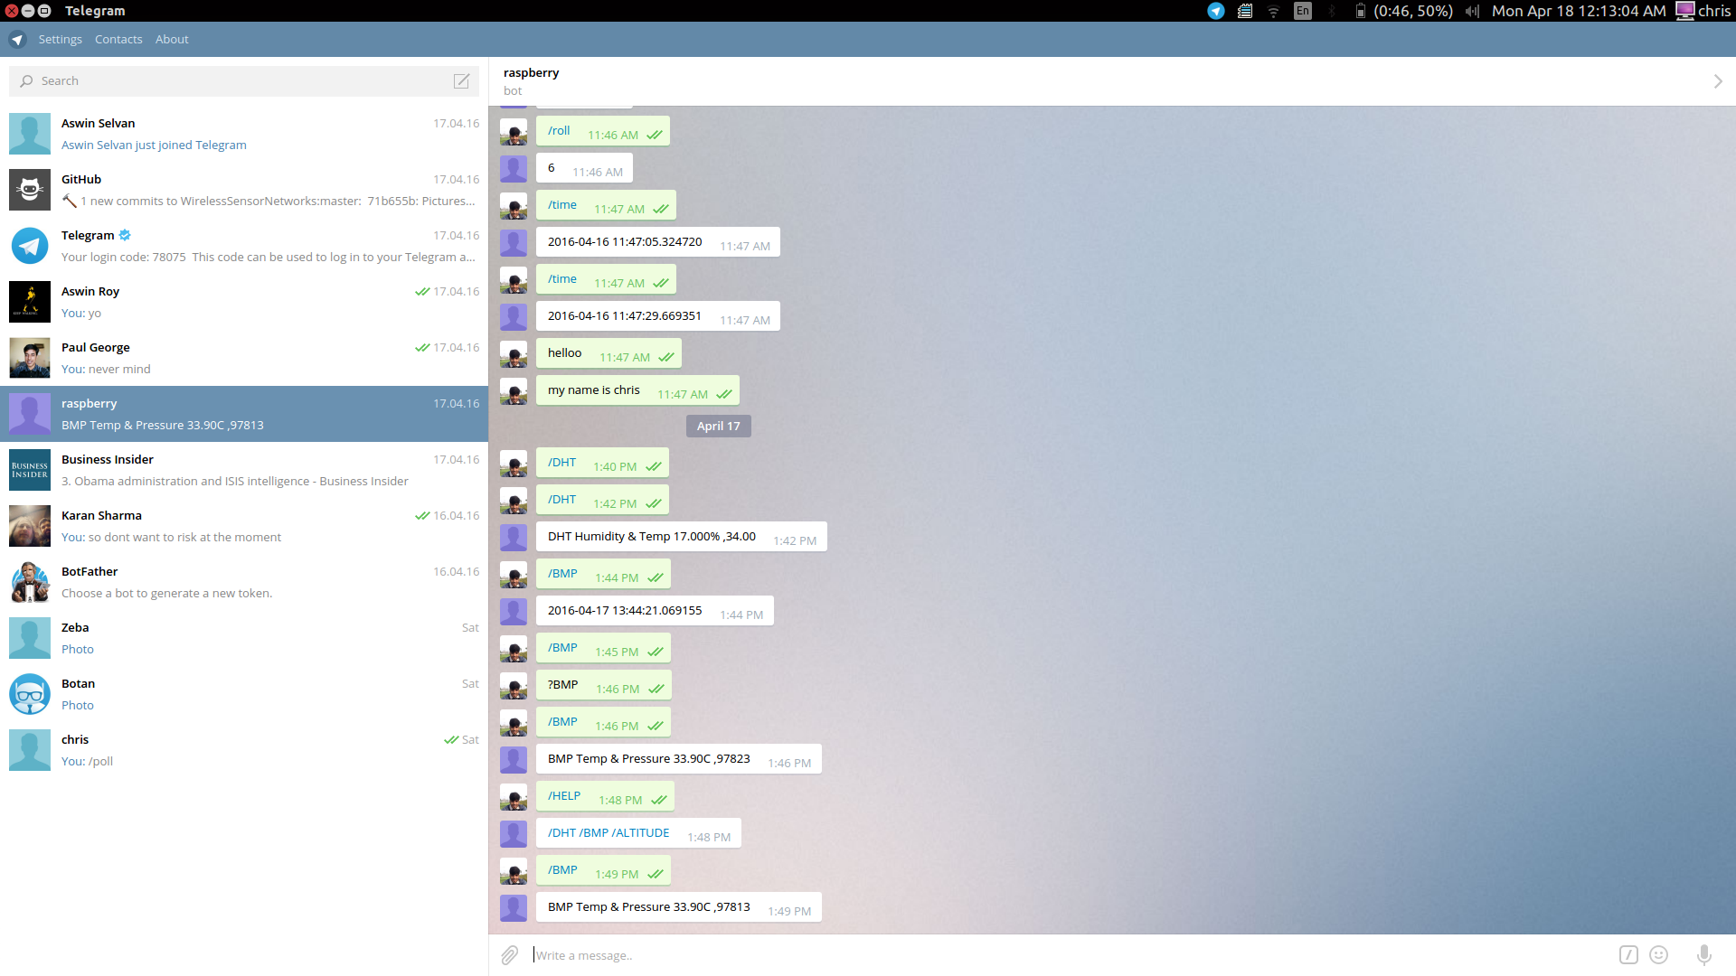
Telegram Bot

Slide 5
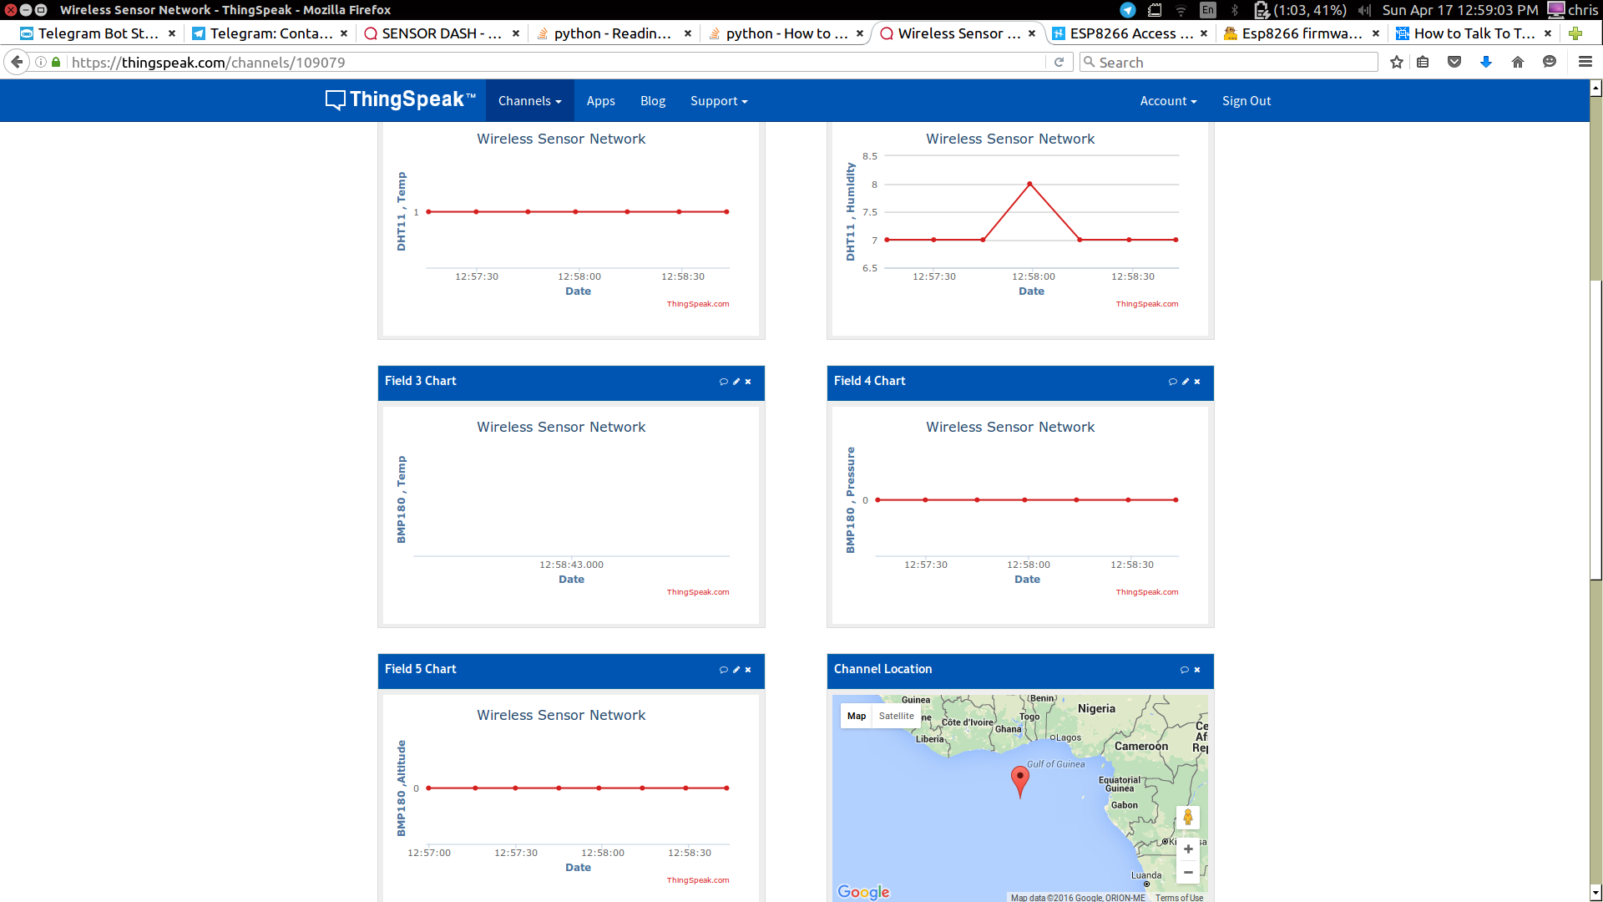
ThingsSpeak.com

Slide 6
