Slide 1


Chris Su
QML REU 2024 – Week 4 Update
Carnegie Mellon University
Mentors: Greg Vetaw, Glen Uehara, Professor Suren Jayasuriya,
Professor Andreas Spanias
NSF Award 2349567

Slide 2
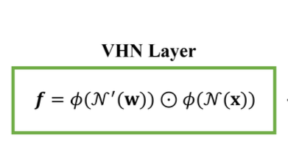
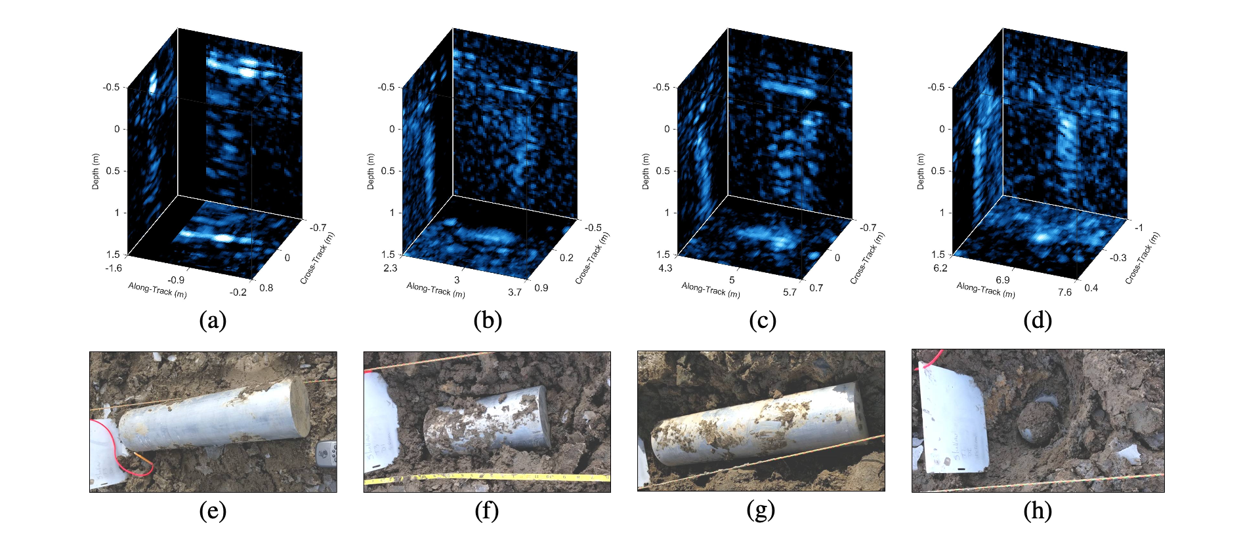
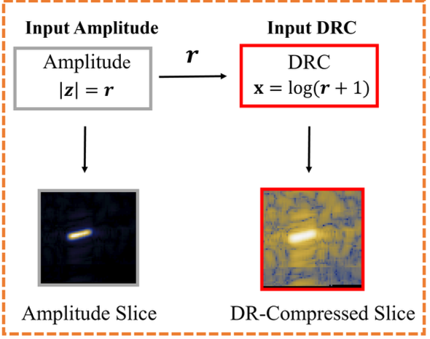
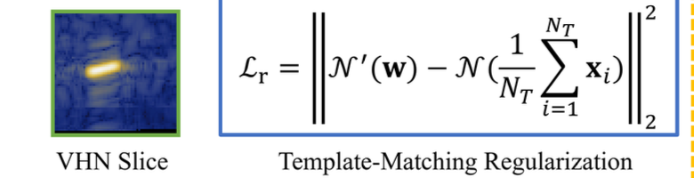
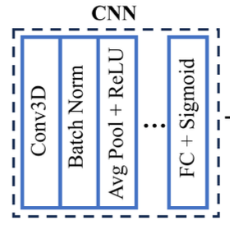
Week 4: Implementation, Debugging & Testing
➔
➔
➔
➔
Classification output!
Sources:
1st img – Williams & Brown et al
2nd img – Vetaw et al

Slide 3
Goals for next week?
See if we can combine the VHN preprocessing layer with quantum feature extraction to get better results?
Explore plausibility of moving the VHN preprocessing layer to quantum

