Slide 1
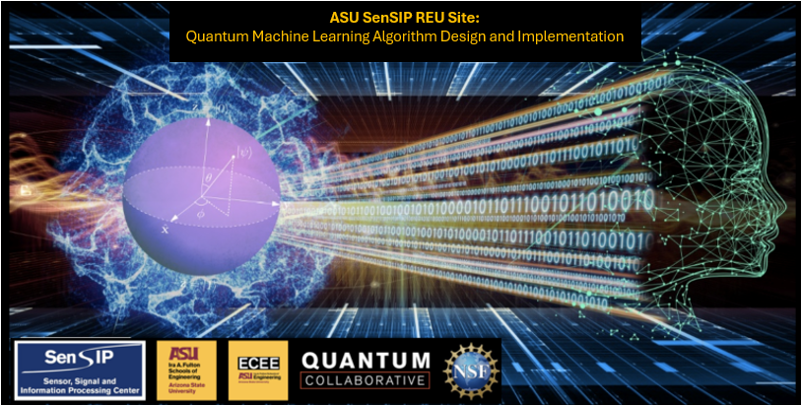

Chris Su
QML REU 2024 – Week 3 Update
Carnegie Mellon University
Mentors: Glen Uehara, Greg Vetaw, Professor Suren Jayasuriya,
Professor Andreas Spanias
NSF Award 2349567

Slide 2
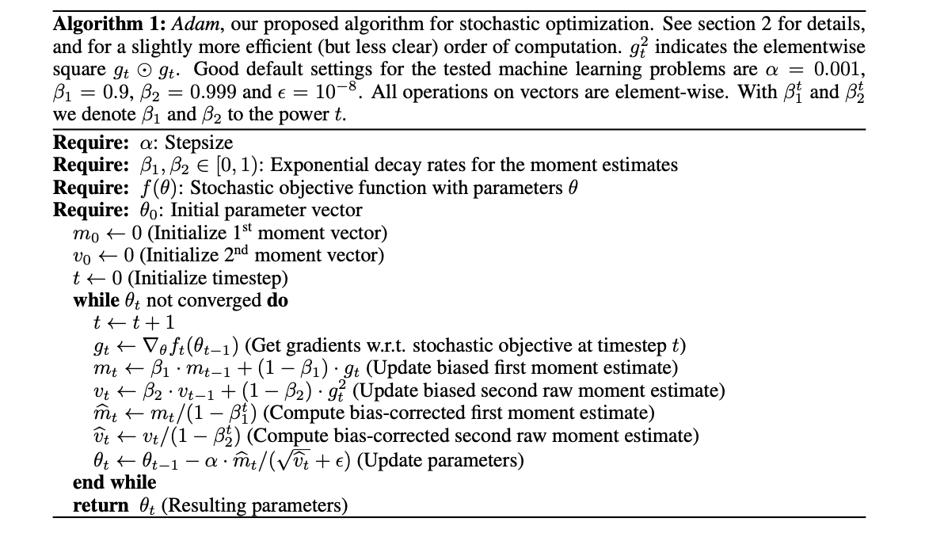
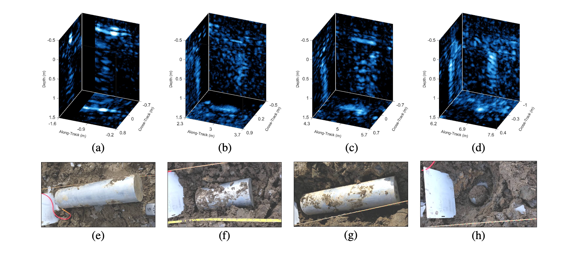
Week 3: Some papers I’ve read this week
New target detection algorithms for volumetric synthetic aperture sonar data - Williams and Brown (Right img)
Three-dimensional convolutional neural networks for target classification with volumetric sonar data – Williams and Brown
Adam: A Method for Stochastic Optimization – P. Kingma and Lei Ba (Left img)

Slide 3
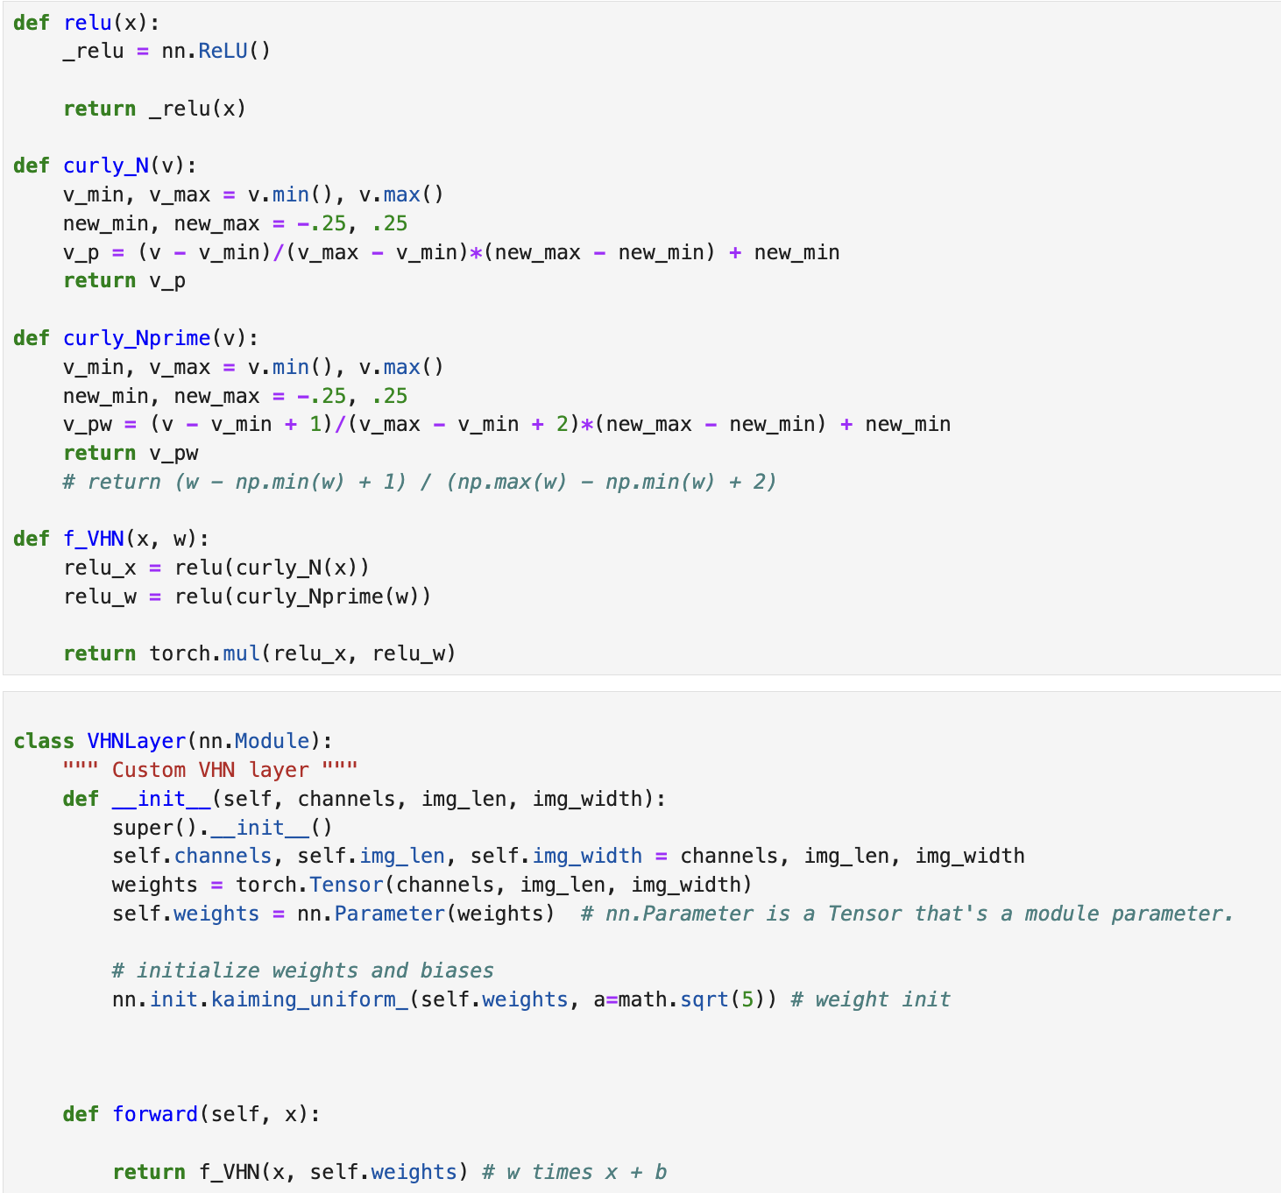
Week 3: Paper Implementation
Attended Glen’s lectures on QML and Quantum Computing
2D implementation of my mentor (Greg’s) 3D CNN VHN architecture on PyTorch
To be tested with 2D SAR data (Synthetic Aperture Radar) instead of SAS (Synthetic Aperture Sonar)
Dataset was found on Kaggle
Minor setback!
Kaggle dataset was for detection not classification
Opens new avenues for investigation?

Slide 4
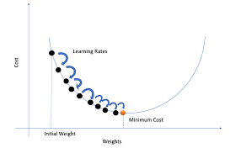
Goals for next week?
Finally got access to Supercomputer Sol so I can start training the 3D data
Derive gradients for the VHN CNN architecture
Debug implementation

