Slide 1
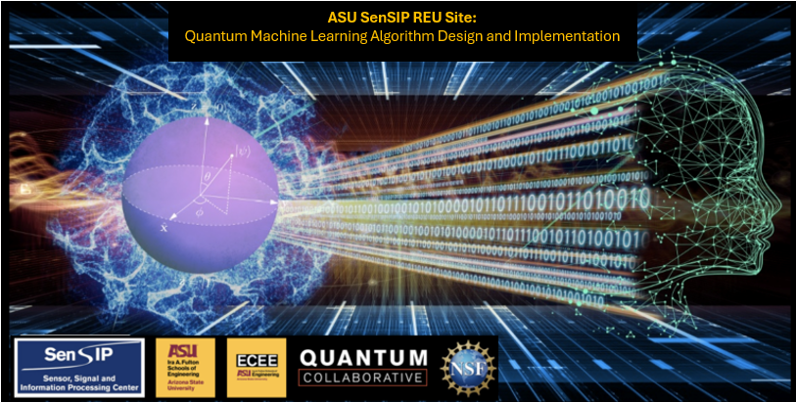

Chris Su
QML REU 2024 – Week 1 Update
Carnegie Mellon University
Mentors: Professor Suren Jayasuriya, Greg Vetaw
NSF Award 2349567

Slide 2
Week 1: May 15 – May 17
Met with Professor Jayasuriya and Greg Vetaw
Tentative research project is analyzing how quantum computing can speed up classical image processing CNN
Learned some introductory digital signal processing
Learned some MATLAB basics

Slide 3
Goals for next week?
A little more learning
Start researching!

