Slide 1


Chris Su
QML REU 2024 – Week 7 Update
Carnegie Mellon University
Mentors: Greg Vetaw, Glen Uehara, Professor Suren Jayasuriya,
Professor Andreas Spanias
NSF Award 2349567

Slide 2
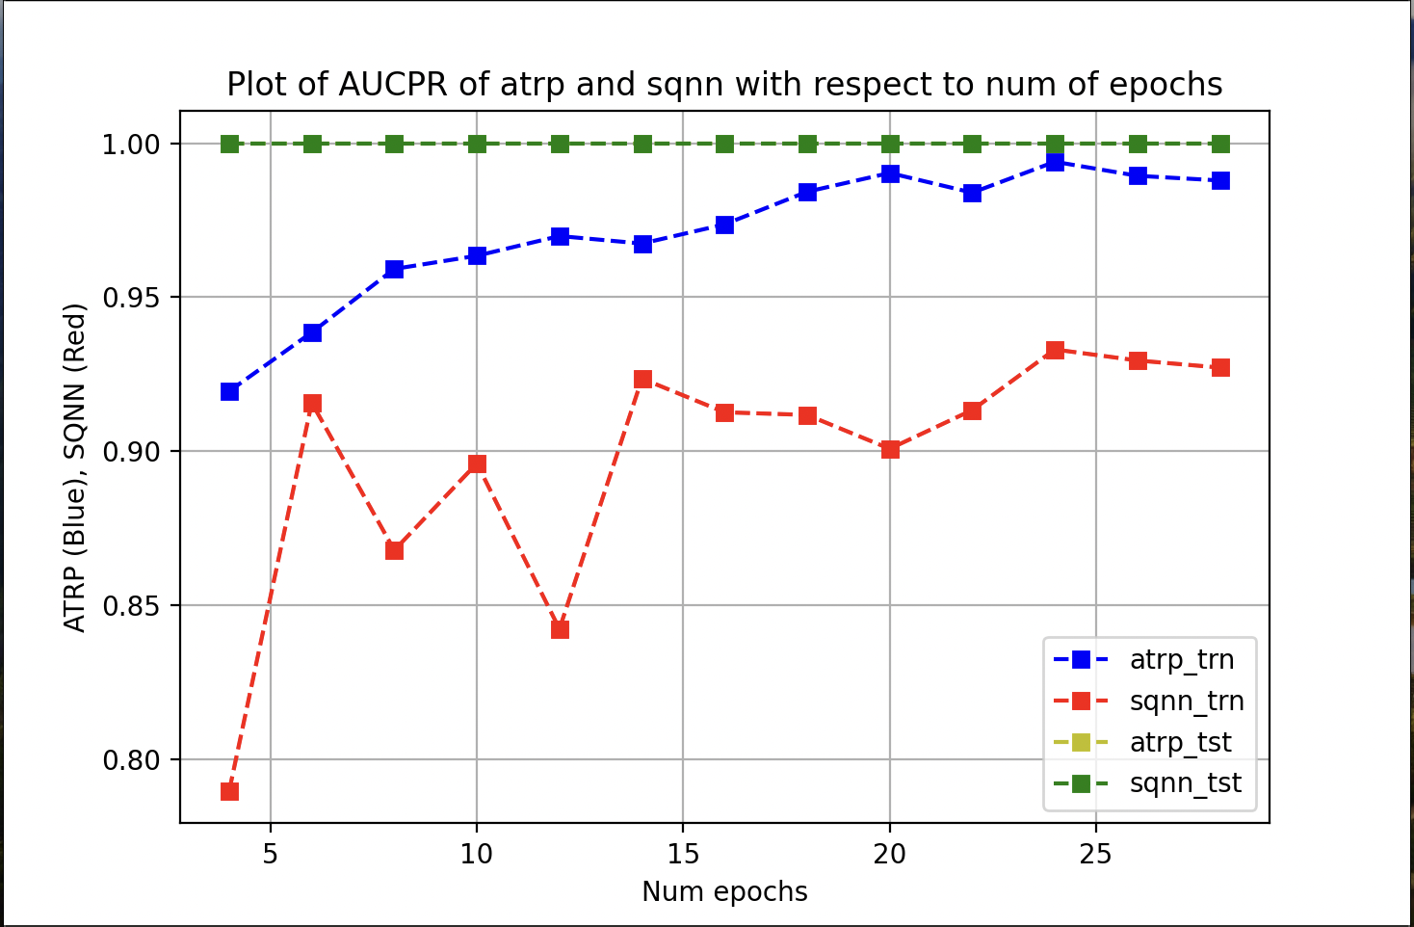
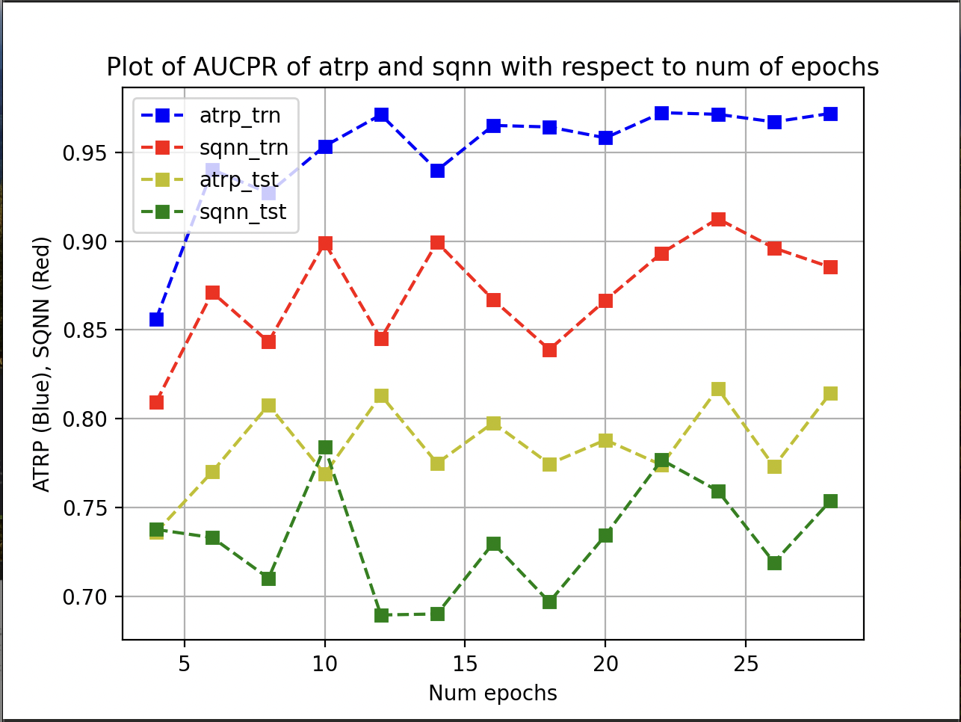
Week 7: Fine Tuning and Implentations
Fine-tuned implementations:
Quantum Preprocessing with Classical Preprocessing Layer and Classical CNN
Classical CNN
Quantum Preprocessing and Classical CNN

Slide 3
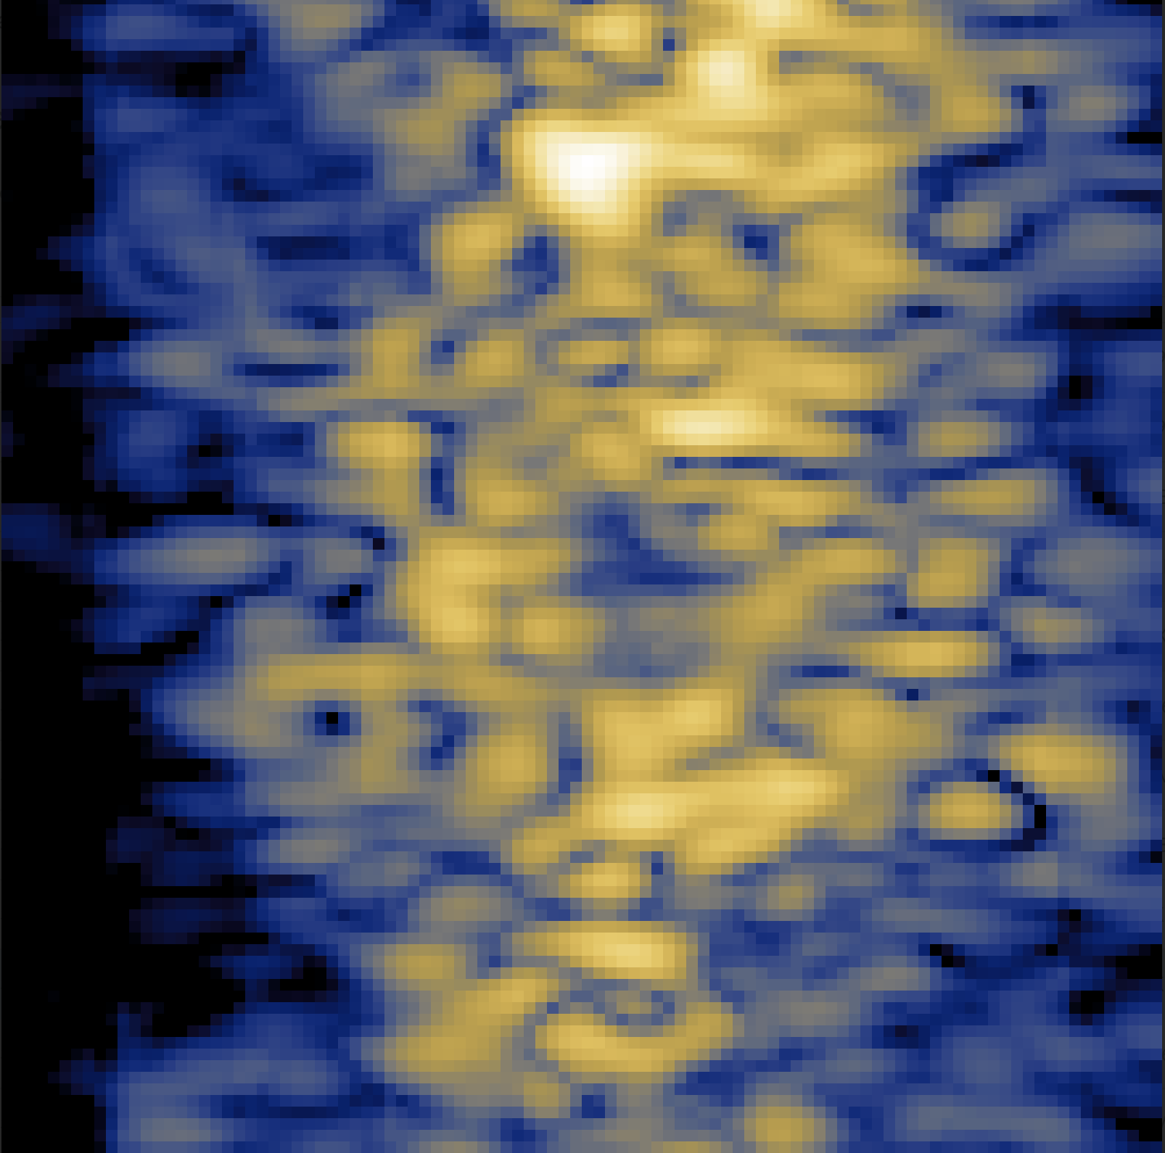
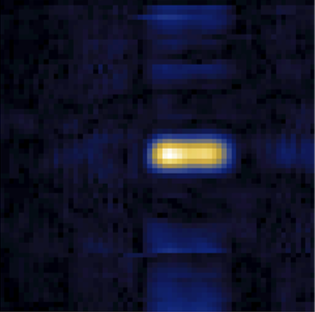
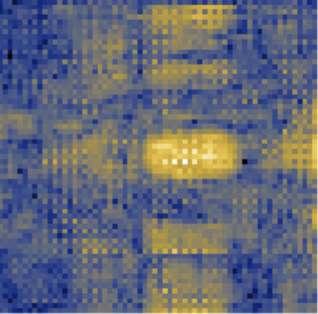
Week 7: Tone Mapping Tests
Tested how well (if at all) the preprocessing layers were tone mapping our images

Slide 4
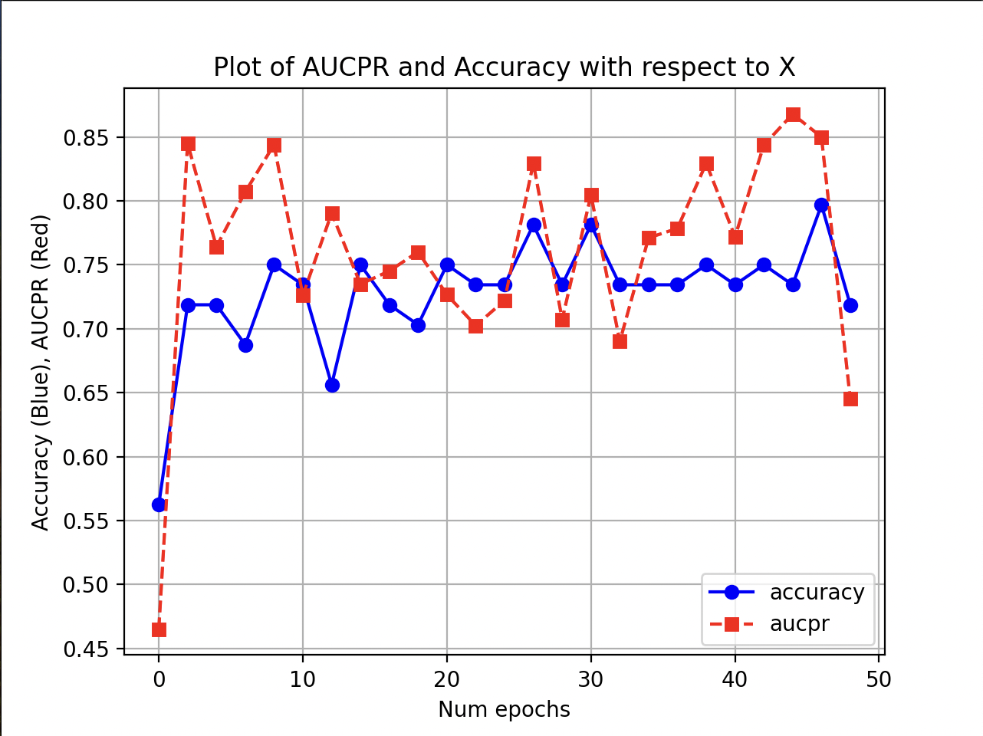
Goals for next week?
Ran into some convergence issues
Maybe change optimizer
Change some hyperparameters
Work on final report
Wrapping up and finishing touches

