Slide 1


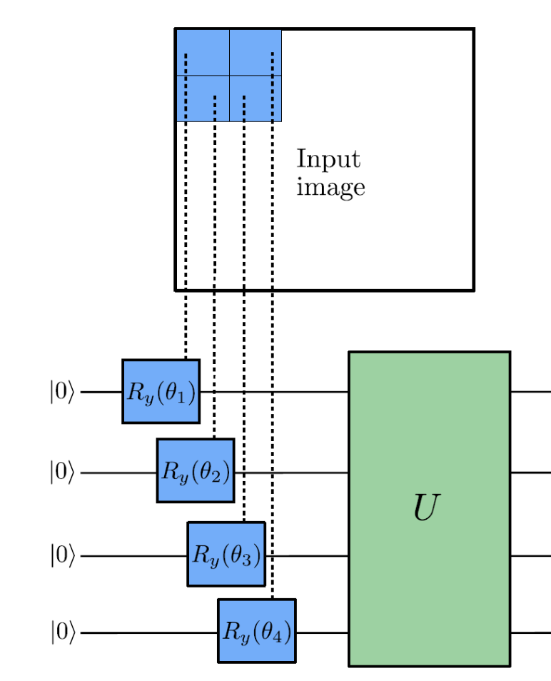
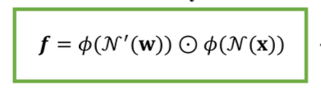
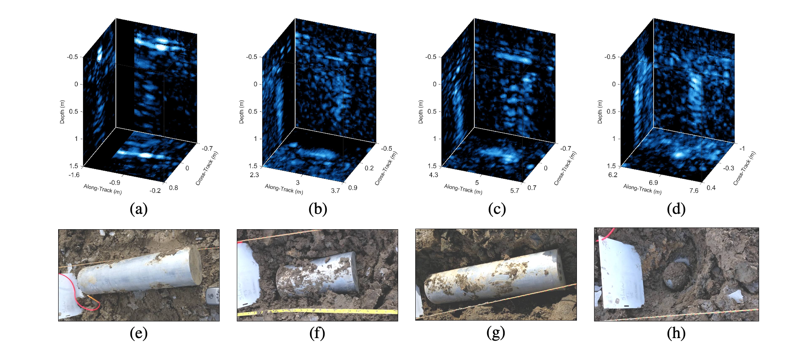
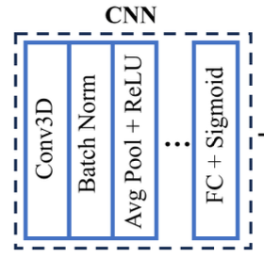


Quantum Preprocessing Layer for 3D-SAS CNN
Chris Su¹, Greg Vetaw², Glen Uehara³, Dr. Suren Jayasuriya², Dr. Andreas Spanias³
[1] Carnegie Mellon University [2] Imaging Lyceum Lab, Arizona State University [3] SenSIP Center, Arizona State University
MOTIVATION
METHOD
EXPECTED RESULTS
Unexploded ordnances (bombs) left by military activity in bodies of water pose an active threat
Proposed hybrid architecture:
Quantum Preprocessing Layer (Fig. 2)
Classical Preprocessing Layer (Fig. 3)
Feeds into:
Classical Convolutional Neural Network (Fig. 4)
Quantum preprocessing layer via either quantum feature extraction or a quanvolutional layer [3] + classical preprocessing (VHN) layer increases precision-recall area under curve
PROBLEM
Develop algorithms with improved efficiency and accuracy
Classify targets and non-targets in 3-D sonar data (Fig. 1)
Figure 2.
REFERENCES
[1] G. Vetaw, “Volumetric Hadamard Normalization for Sub-Bottom SAS ATR”
[2] D. Williams and D. Brown, “New target detection algorithms for volumetric synthetic aperture sonar data,” Proc. of Meetings on Acoustics, vol. 40, p. 070002, Sept. 2020.
[3] Henderson, Maxwell P. et al. “Quanvolutional Neural networks: powering image recognition with quantum circuits.” Quantum Machine Intelligence 2, 2019
Figure 3.
Figure 4.
Figure 1.
REU Site sponsored by NSF Award 2349567
REU Site: Quantum Machine Learning Algorithm Design and Implementation

