Slide 1


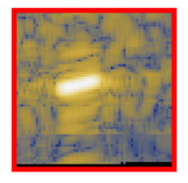
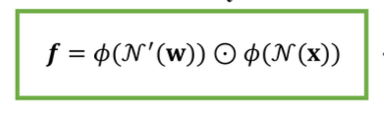
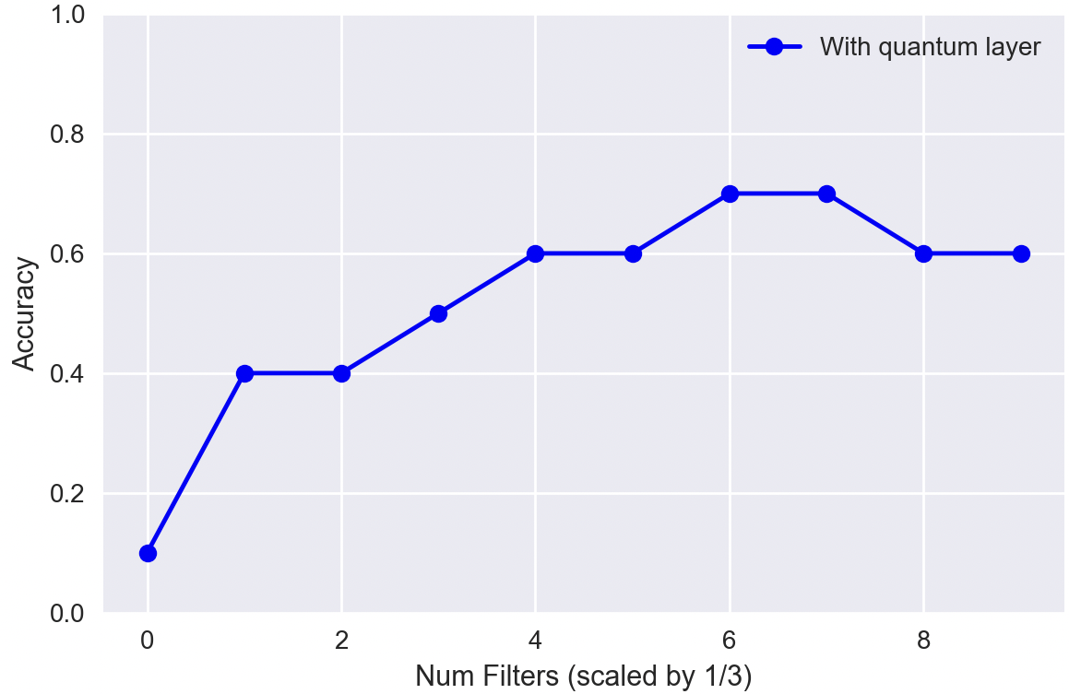
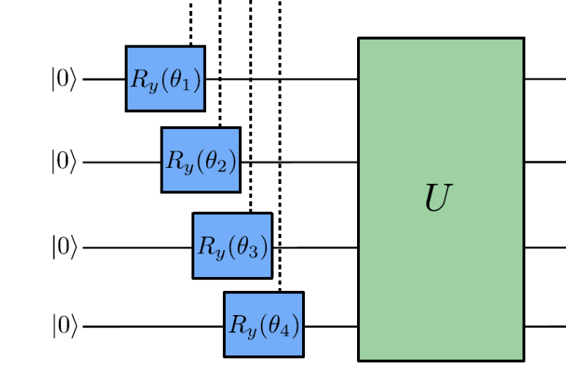
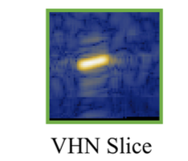
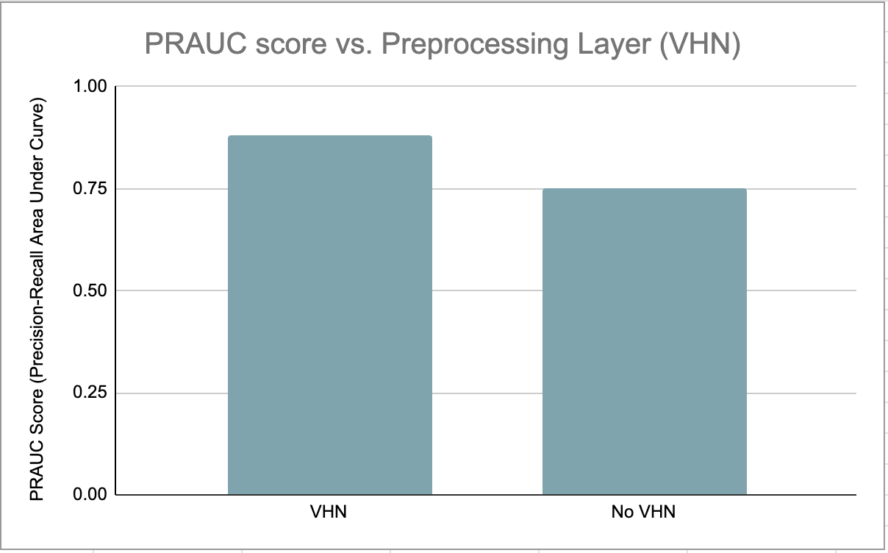
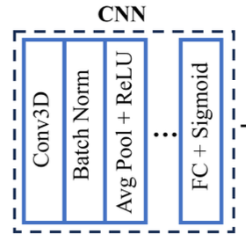
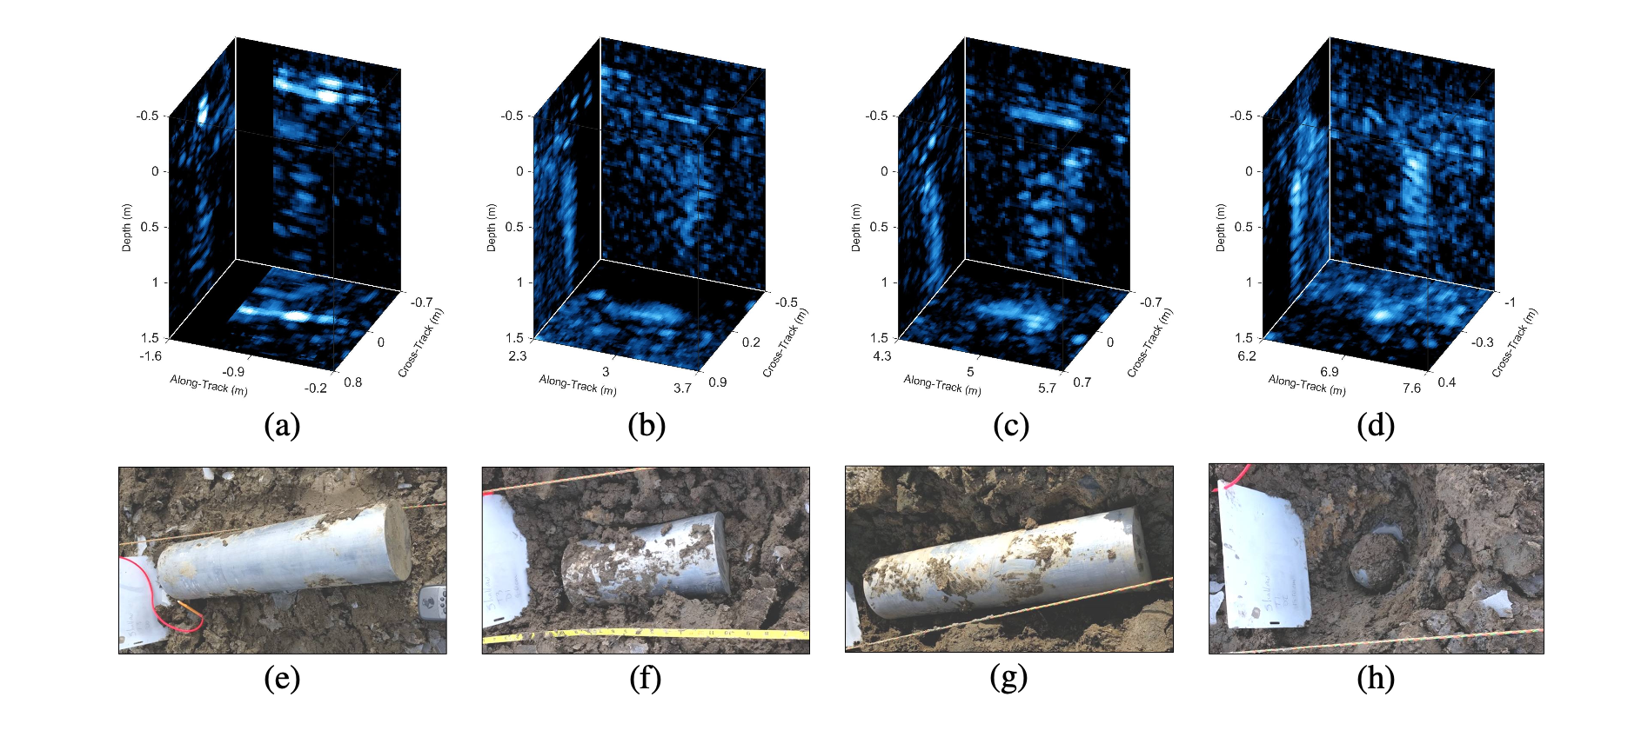


Preprocessing Optimization for Synthetic Aperture Data Classification and Detection
Chris Su¹, Greg Vetaw², Glen Uehara³, Dr. Suren Jayasuriya², Dr. Andreas Spanias³
[1] Carnegie Mellon University [2] Imaging Lyceum Lab, Arizona State University [3] SenSIP Center, Arizona State University
MOTIVATION
METHOD
PRELIMINARY RESULTS
Preprocessing data is crucial for the performance of statistical techniques in ML. Preprocessing layers have successfully been added to CNNs to improve PRAUC score [1].
Increasing fidelity of quantum computers in recent years has produced new opportunities for efficiency and precision recall score optimization.
Pictured: Quantum convolutional kernels increasing accuracy w.r.t filter count
Input
…………………………….
………………….
Pictured: CNN performance with preprocessing (left) and without (right)
…….…..……
..….
…………………..……………………………….…….
REFERENCES
PROBLEM
…….
[1] G. Vetaw, “Volumetric Hadamard Normalization for Sub-Bottom SAS ATR”
[2] D. Williams and D. Brown, “New target detection algorithms for volumetric synthetic aperture sonar data,” Proc. of Meetings on Acoustics, vol. 40, p. 070002, Sept. 2020.
[3] Henderson, Maxwell P. et al. “Quanvolutional Neural networks: powering image recognition with quantum circuits.” Quantum Machine Intelligence 2, 2019
[4] Uehara, G. S., Spanias, A., & Clark, W.. Quantum information processing algorithms with emphasis on machine learning. In IEEE IISA, July 2021.
[5] Miller, L., Uehara, G., & Spanias, A. (2024, March). Quantum Image Fusion Methods for Remote Sensing. In 2024 IEEE Aerospace Conference (pp. 1-9). IEEE.
Develop preprocessing layers to improve efficiency and accuracy
Classify targets and non-targets in 3D sonar data (Figure 1)
Proposed Hybrid Architecture
Figure 1.
REU Site sponsored by NSF Award 2349567
REU Site: Quantum Machine Learning Algorithm Design and Implementation

