Slide 1
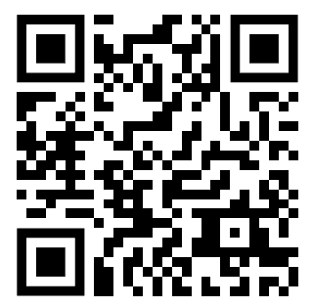
Questionnaire
Site ID
A|B|C
[0-9]
[0-9]
[0-9]
[0-9]
DOB
---
---
Y
Y
Y
Y
M
M
D
D
Symptoms today
Ate breakfast?
Yes
No
Headache
Back pain
Dizziness
Cramps

