Slide 1

Dummy Security Architecture review (SAR) Summary Report
Dabire Christ-Fortune, the security expert
03/07/2022 – Final 1.0

Slide 2

Agenda
Project Scope
Project Summary
Application Architecture
Application Component Details
Data Flow Diagram
Identified Threats and Remediation
Appendix

Slide 3
Project scope
DUMMY Corporation is a cloud based technology platform that provides ecommerce platforms to vendors.
Application uses Firewall for blocking malicious requests
Application uses a Proxy wall for filtering https requests
Application uses 3-layered architecture
API layer interacts with business logic and backend/database service
Application interacts with third party server
Database server is SQL server

Slide 4
Project summary

Slide 5
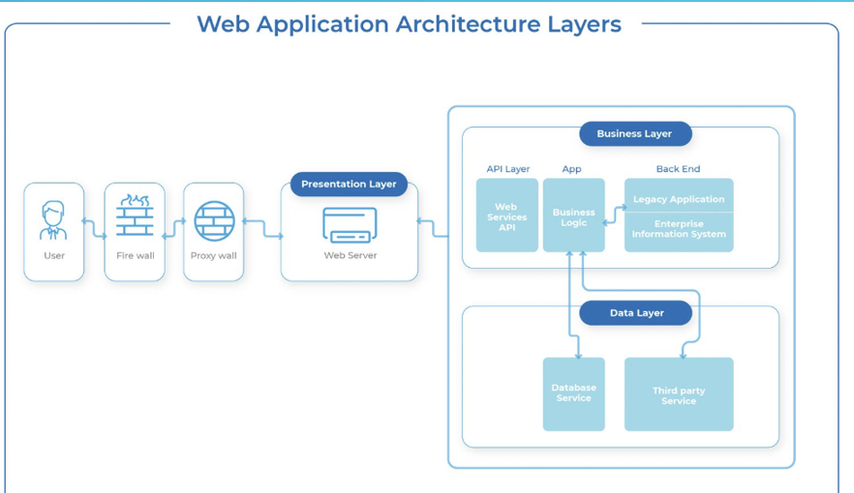
Project Architecture

Slide 6
Application component details
Component Name | Component Description
Firewall | This is a web application firewall that monitors and controls incoming and outgoing network traffic based on predefined security policies. Its primary purpose is to protect the network from unauthorized access and cyberattacks by filtering traffic based on parameters such as IP addresses, ports, protocols, and application types.
Proxy wall | This is a proxy server that is used to act as intermediary between clients and servers on a network, allowing clients to make requests to servers indirectly through the proxy. The use of a proxy server is to provide improved performance by caching frequently accessed resources, enhanced security by filtering and blocking certain types of traffic, and anonymity by hiding the client's IP address from the server.
Web Server | This is an application web server that hosts the application. The web server processes the request, retrieves the necessary resources (such as HTML files, images, or scripts), and sends them back to the client in the form of a response.
Business Layer | The business layer contains the business logic and rules that govern the behavior and functionality of the application, and is responsible for processing and manipulating data in accordance with those rules. It also contains the API Layer, its logic and application implementation
Data Layer | By encapsulating the data storage and retrieval functions within a dedicated layer, the data layer allows for better code organization and promotes modularity, making it easier to modify and update the application's data storage and retrieval functionality without affecting other layers of the application. It also contains the Third Party service.

Slide 7
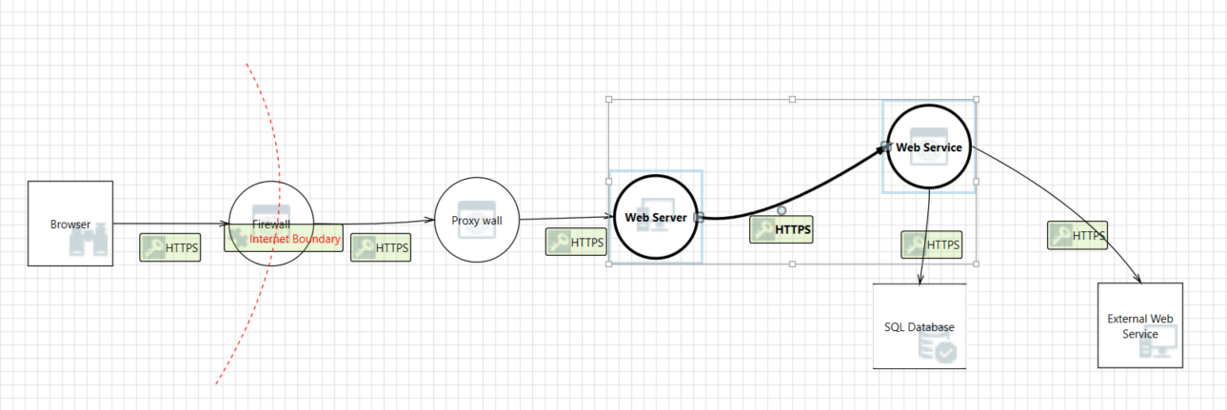
Data flow diagram

Slide 8
SNO | THREAT TITLE | MORE INFO | SEVERITY (Critical, High, Medium, Low) | STRIDE MODEL CATEGORY | SUGGESTIONS
THREAT01 | DDOS not enabled on Firewall | Denial of Service (DoS) involves an attacker attempting to disrupt or disable the normal functioning of a system or network. In the case of a Distributed Denial of Service (DDoS) attack, an attacker can flood a target system with a large volume of traffic, overwhelming its capacity and making it unavailable to legitimate users. If the firewall is not configured to detect and mitigate DDoS attacks, the system may be vulnerable to such attacks, leading to downtime and disruption of service. | Critical | Denial of Service | To mitigate this threat, it's important to implement proper DoS and DDoS protection measures, such as configuring firewalls to detect and block suspicious traffic, using rate limiting and throttling mechanisms, and deploying specialized anti-DDoS solutions. Additionally, regular testing and monitoring should be conducted to identify and address potential vulnerabilities in the system.
THREAT02 | Database is not encrypted | Information Disclosure involves an attacker gaining unauthorized access to sensitive information, such as personal or financial data. In the case of a database that is not encrypted, an attacker could potentially gain access to the sensitive information stored within the database by intercepting traffic, exploiting vulnerabilities, or using other attack techniques. | Critical | Information Disclosure | To mitigate this threat, it's important to implement strong encryption measures to protect sensitive data stored in databases. This may include using encryption algorithms to encrypt data at rest, as well as implementing secure communication protocols to protect data in transit. Additionally, access to the database should be carefully controlled and monitored, and strong authentication and access control measures should be put in place to limit access to authorized personnel only
THREAT03 | User input is not validated at server side | Spoofing involves an attacker impersonating a legitimate user or system in order to gain unauthorized access to resources or to perform malicious actions. In the case of user input not being validated at the server side, an attacker could potentially submit malicious input to the server, pretending to be a legitimate user. This could lead to a variety of security issues, such as injection attacks or privilege escalation. | Critical | Spoofing | To mitigate this threat, it's important to implement proper input validation measures on the server side, such as input validation routines, type checking, and data sanitization. Additionally, access to sensitive data should be carefully controlled and monitored, and authentication and access control measures should be put in place to limit access to authorized personnel only
THREAT04 | Logs are not backed up on a different server | Data Tampering involves an attacker modifying or manipulating data in order to cause harm or gain unauthorized access to resources. In the case of logs not being backed up on a different server, an attacker could potentially tamper with the logs on the original server, which could allow them to cover up their tracks or hide their actions. This could make it difficult or impossible to detect malicious activity, which could have serious consequences for the security of the system. | Critical | Tampering | To mitigate this threat, it's important to implement proper backup and disaster recovery procedures, including regular backups of logs to a separate, secure location. Additionally, access to log files should be restricted to authorized personnel only, and any changes to logs should be carefully monitored and audited.

Slide 9
SNO | THREAT TITLE | MORE INFO | SEVERITY (Critical=0,High=1,Medium=2,Low=3) | STRIDE MODEL CATEGORY | SUGGESTIONS

Slide 10
APPENDIX

Slide 11
Review comments
SNO | Feedback Received | Feedback Given By | Status | Comments
1 | Firewall upgrade is In Progress | Senior Architect at Dummy Corporation | To be Discussed | Approval awaited from all stakeholders before an update in the Summary report
2 | Database Encryption implementation is In Progress | Senior Architect at Dummy Corporation | To be Discussed | Approval awaited from all stakeholders before an update in the Summary report
3
4

Slide 12
Thank you

