Slide 1
Get drunk on the code.
Steven Christou
Cloudbees
www.cloudbees.com
June 18, 2014
#jenkinsconf

Slide 2

About Me
Worked at Oracle as a contractor, and Redpriarie as an intern.
Contributed code to Hudson, and Jenkins.
Lead developer of Cobertura - an OSS code coverage utility.

Slide 3
Before writing a new plugin,
I ask myself:
Does the plugin already exist (Or
could it be done with pre-existing plugins)?
Could it be created as a new feature (pull request)?

Slide 4
Agenda
Beginner Section:
  Installing maven and creating hello world plugin.
  How to execute hello world plugin.
Intermediate Section:
  Write a Root Action
  Write a new Builder (also Console Notes)
Advanced Section:
  Writing CLI Command

Slide 5
Beginners Section
Install Maven and create hello world program

Slide 6
What is Maven?
Software Project Management and Comprehension Tool.
Uses pom.xml file for managing dependencies.
Allow for similar file structures.

Slide 7
Installing Maven
Go to http://maven.apache.org/download.cgi
Download latest release
Install in /usr/share/maven/
Add to $PATH
Ubuntu: sudo apt-get install maven
Mac: brew install maven

Slide 8
Let’s get started already!!
https://wiki.jenkins-ci.org/display/JENKINS/Plugin+tutorial for setting up settings.xml file.
Either execute:
  mvn hpi:create
  mvn -U org.jenkins-ci.tools:maven-hpi-plugin:create

Slide 9
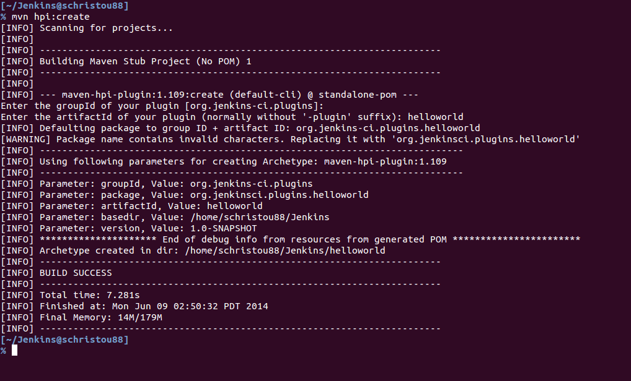
Console output

Slide 10
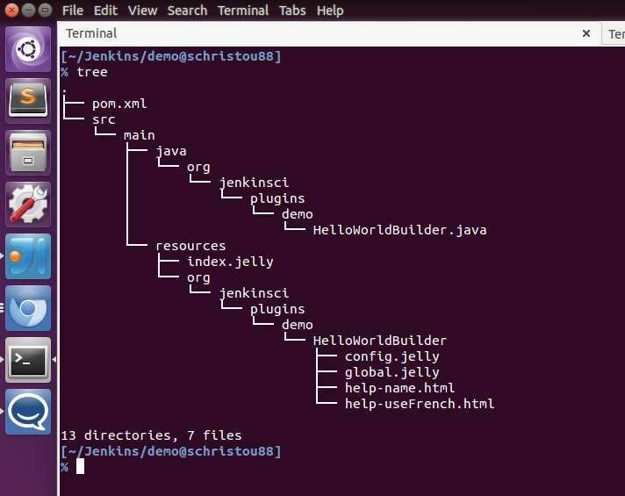
Tree Structure of default plugin

Slide 11
Live Demo Time...

Slide 12
Live testing of plugin
Execute: mvn hpi:run

Slide 13
Intermediate Section
How to write a Root Action

Slide 14
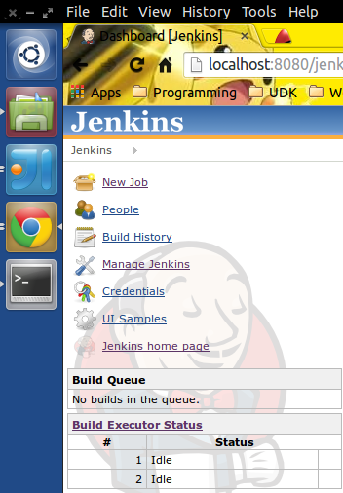
What is a Root Action?

Slide 15
Why create a root action?
Companies with several Jenkins instances could create links to their other Jenkins masters.
If open source project, could have link to their home page.

Slide 16
This demo will…
Create a new Root Action
Link main page to Company URL (Let’s say we link to jenkins-ci.org).

Slide 17
Live Demo Time...

Slide 18
Intermediate Section
How to write a Builder

Slide 19
Why create a builder?
If a builder for a new application does not exist.
Companies that write their own applications/build scripts can create builders oriented around their organization.

Slide 20
Live Demo Time...

Slide 21
Advanced Section
How to write a CLI Command

Slide 22
CLI Commands in Jenkins?
Jenkins allows for CLI Command execution to do many things like:
  Run a job
  Delete a job
  Create a Node
  Execute groovy script
  And many more things. But let’s add a new operation

Slide 23
Why Write a CLI Command?
Exposing administrative commands to admins.
Exposing data and operations to build inside Jenkins.

Slide 24
This demo will...
We will write a cli operation to execute 2 jobs.
CLI Command called “execute-two-jobs”.
We have two arguments “job1” and “job2”.

Slide 25
Live Demo Time...

Slide 26
Let’s test this example
Command line execute:
  java -jar jenkins-cli.jar -s http://localhost:8080/jenkins/ execute-two-jobs --first job1 --second job2

Slide 27
Credits and more information
Jesse Glick – Borrowed information from multiple slides he has.
This plugin and slides can be obtained from:
  http://github.com/christ66/demo-plugin.git
Questions:
  Twitter: @schristou88
  IRC: schristou
  Github ID: christ66

Slide 28










Thank You To Our Sponsors
Platinum
Gold
Silver

