Slide 1
v1 run @ /ye/yelabstore2/spatial/sid/v1/star_alignment

Slide 2
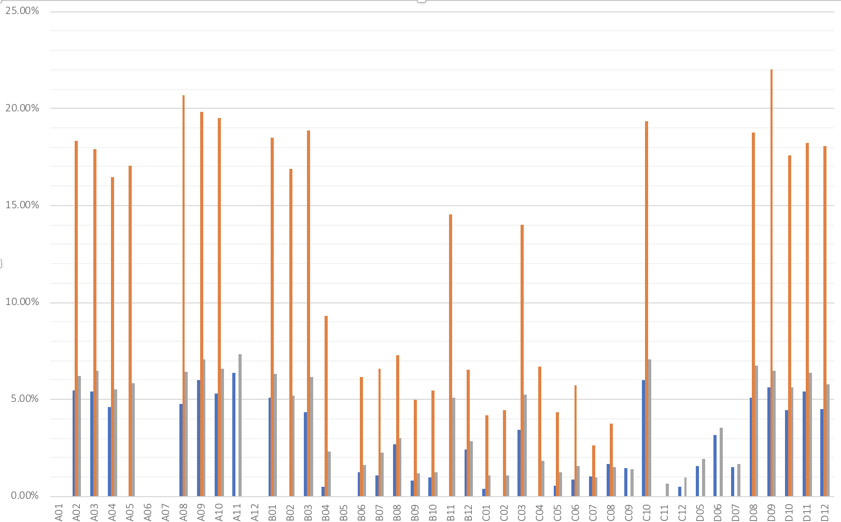
Several different trimgalore and STAR params
No trimming
Default scRNA-seq trimming
‘Relaxed’ aligning
Percent mapped
Well #

Slide 3
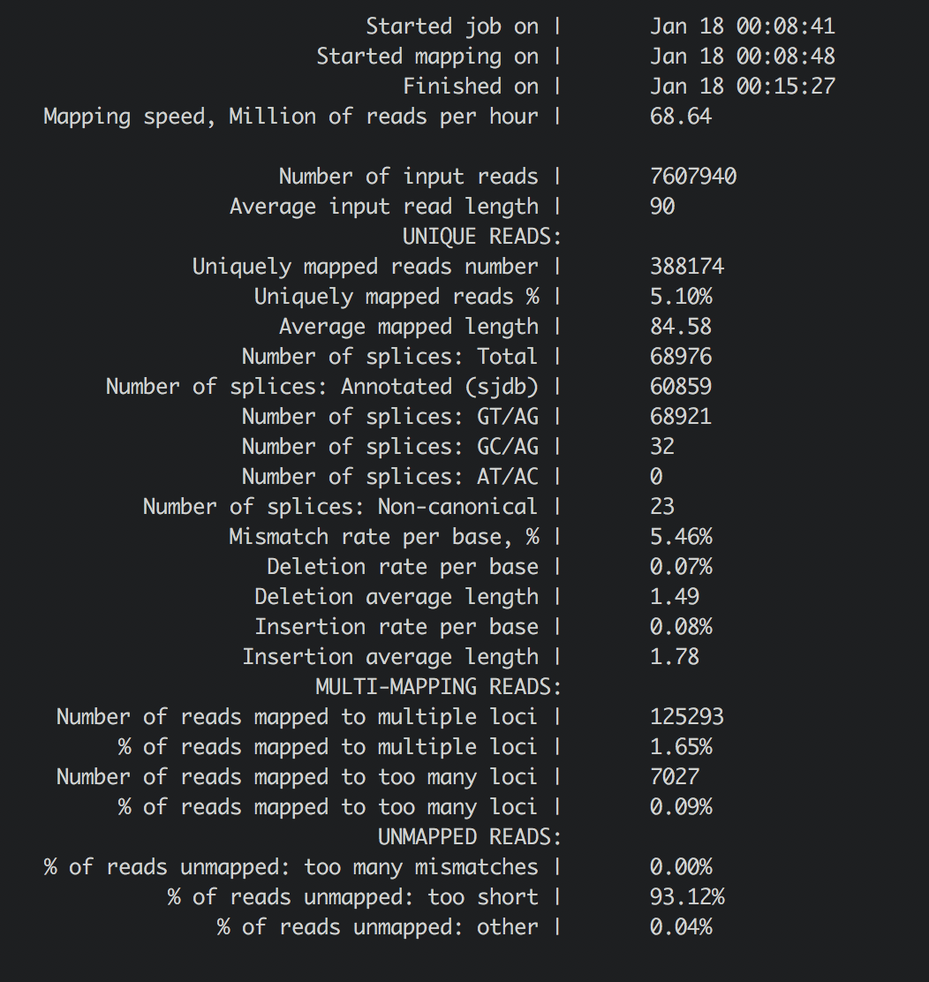
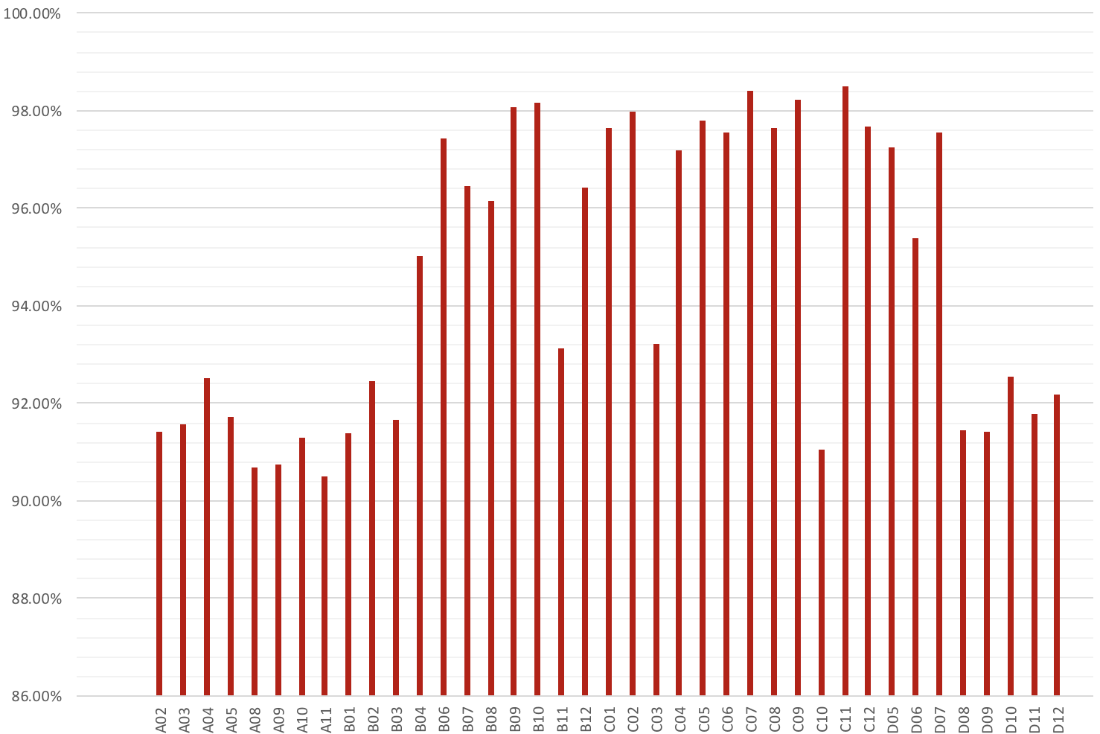
Default scRNA-seq params
Percent of reads too short
Well #
STAR example output

Slide 4
Trim galore parameters
--trim-n: remove n’s from beginning of read if present
-a AAAAAAAA: trim polyA
---clip_R1 9 remove the 9 bp of poor quality at end
STAR parameters
/ye/yelabstore/10x.ref/refdata-cellranger-mm10-1.2.0/star: mm10 STAR indexed transcriptome
--outFilterScoreMinOverLread 0.3
--outFilterMatchNminOverLread 0.3
https://github.com/alexdobin/STAR/issues/169

Slide 5
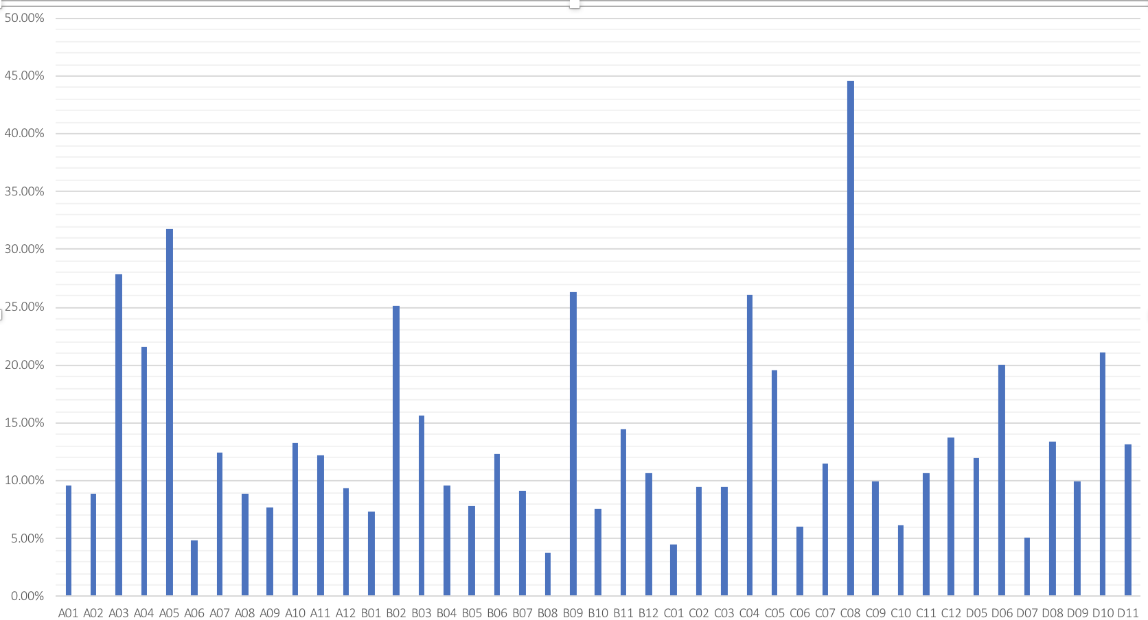
UMI attached no trimming, relaxed params
UMI attached
Percent mapped
Well #

Slide 6
1/18 run @ /ye/yelabstore2/spatial/XYZ_20180112

Slide 7
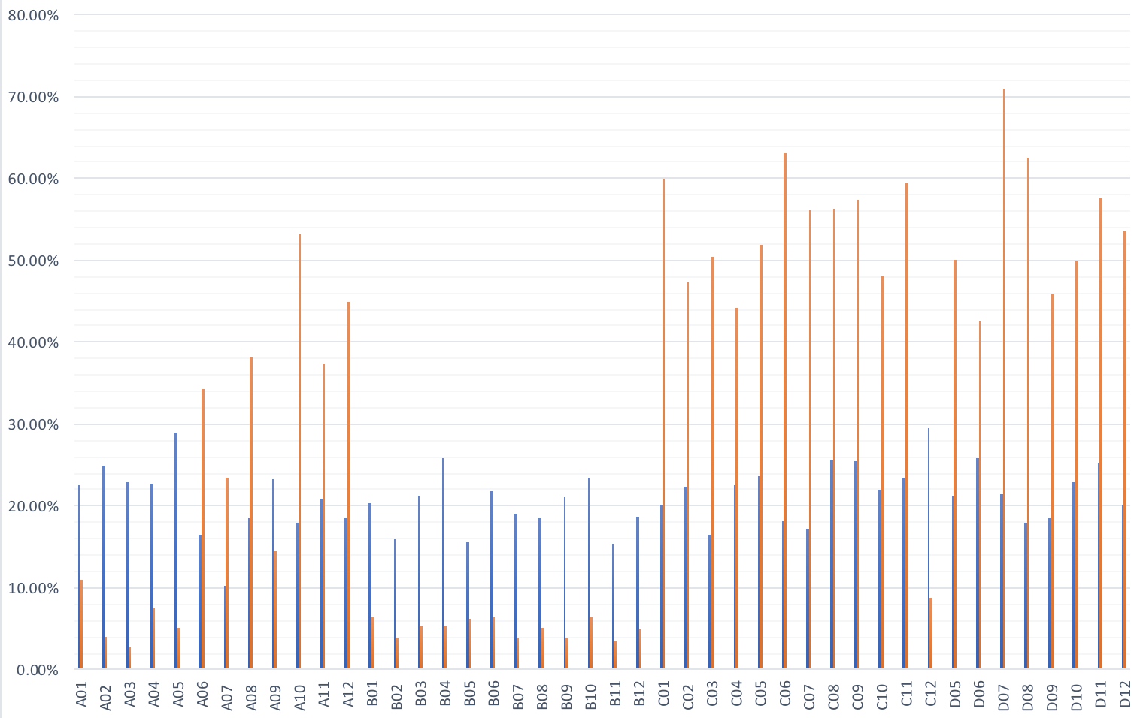
Filtering PhiX reads before mapping to mm10
Mm10 (after phix removal)
phix
Percent mapped
Well #

Slide 8
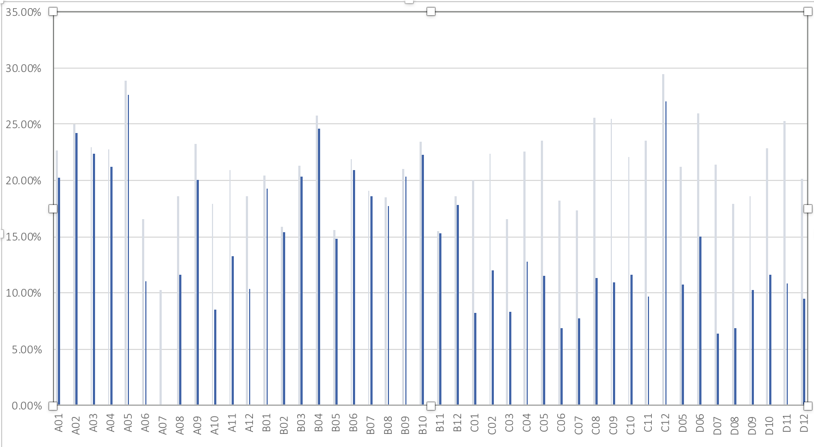
With/without filtering PhiX reads
before
after
Percent mapped
Well #

