Slide 1

From SHACL constraints to Form-Based RDF Authoring: an RML use case
Turning a specification into a user interface
Christal Mangolopa
Masters student in Computer Science and Engineering at ULiège, Faculty of Applied Science
Notes:
My work is about a very specific problem: how can we make the process of mapping heterogeneous data to RDF easier and more structured?
I approached this problem by combining two technologies: RDF Mapping Language (RML), for defining mappings, and SHApe Constraint Language (SHACL), as a way of describing and validating the structure of those mappings.
----
I am not going to present interoperability as a whole today. Instead, I want to use my project as one concrete example of an interoperability problem, and of one possible technical approach to it.
--------
A practical exploration of interoperability between heterogeneous data and RDF

Slide 2




The Problem
Data rarely starts as RDF…
Notes:
Imagine you're a researcher. You have collected data from several sources over time. Some of it is in CSV, some comes from a JSON API, some is stored in a database. Now you want to make this information available in a common, machine-readable representation so that it can be combined with other data.
In this presentation, I'll use RDF as that target representation.
--------
Research and real-world data rarely starts as RDF.
Data comes from diferent heterogeneous sources and representations. We can have CSV files, JSON documents, relational databases, XML files, etc.
If we want to integrate this information into an RDF-based environment,
(When I say RDF here, I mean RDF as the target data model, independently of how that RDF graph is serialized.)
we need some way of describing how the original data should be interpreted and transformed.
So the question becomes:
How do we describe that transformation in a way that can be understood and executed by machines?
This is where RML comes in.

Slide 3
The Problem
Data rarely starts as RDF…
Turtle serialization
people.csv
@prefix ex: <http://example.org/> .
ex:Alice a ex:Person ;
ex:age 25 .
ex:Bob a ex:Person ;
ex:age 31 .
name age
Alice 25
Bob 31
…How do we describe the transformation?
Notes:
TODO: Add Animations
We start with our small two-column CSV file.
On the right, we expressed the information as an RDF graph. For Alice, we are saying that she is an instance of Person and that her age is 25. We can express the same information for Bob.
Notice that this transformation is not just changing a file extension. Someone has to decide that each row represents a person, that the column called age should become an age property, and which vocabulary or identifier to use?
Those are semantic decisions. They require knowledge about the data and the domain.
First of all, can such transformation be automated ?

Slide 4
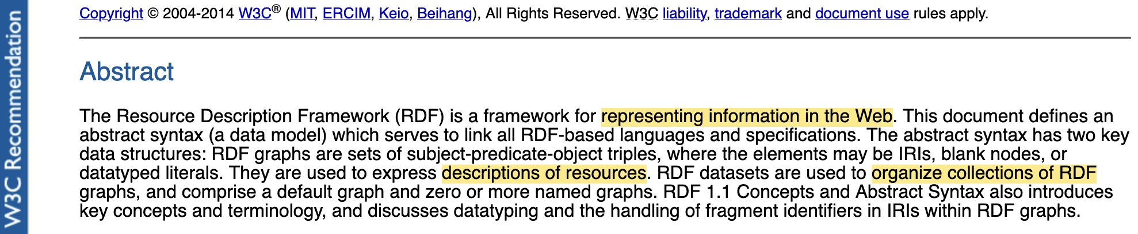
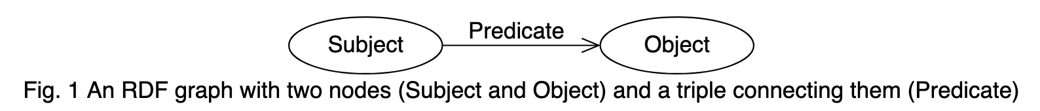
RDF, a data model for KG
Source: RDF 1.1 Concepts and Abstract Syntax. W3C Recommendation. World Wide Web Consortium (W3C), Feb. 2014. url:https://www.w3.org/TR/rdf11-concepts/
Notes:
A quick note about what RDF is , and why it is relevant to use it for the question of interoperability.
RDF stands for Resource Description Framework (RDF). It is a framework for representing information in the Web. It is used for describing ressources and organise collection of those graphs.
The core structure of the abstract syntax is a set of triples, each consisting of a subject, a predicate and an object.
TODO: add that each of those elements is described by an Idenditifier or a litteral of the object.
-----
A set of such triples is called an RDF graph. An RDF graph can be visualized as a directed diagram, in which each triple is represented as a node-arc-node link.

Slide 5
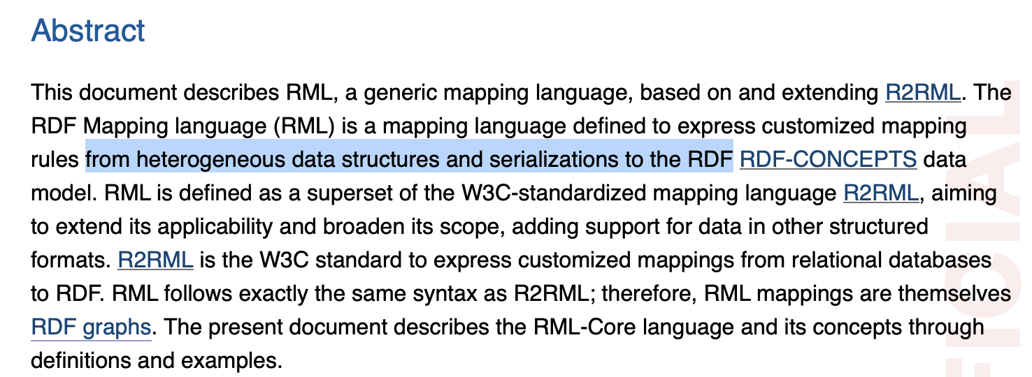
RDF Mapping Language (RML)
The bridge
Source: RDF Mapping Language (RML) url:https://rml.io/specs/rml/
Notes:
RML provides a declarative way of describing mappings from heterogeneous data sources to RDF.
For example, instead of manually creating RDF triples from a CSV file, we can describe that a particular column corresponds to a particular RDF property, or that a particular value should be used to construct an RDF resource.
The important point for my project is that RML gives us a structured representation of this transformation.
Let’s see what it looks like for our small csv

Slide 6
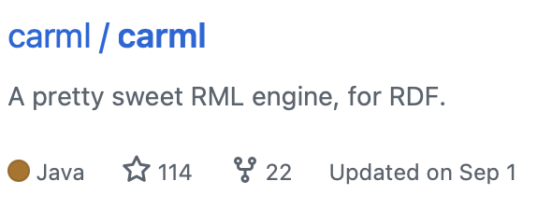
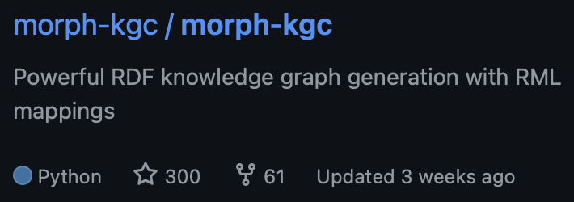
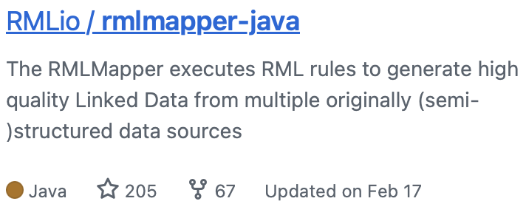
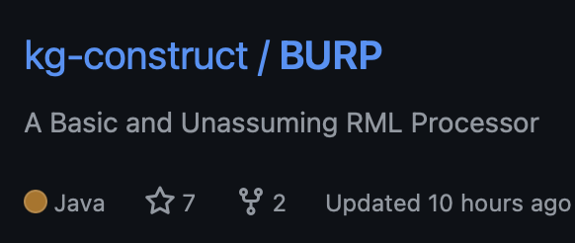
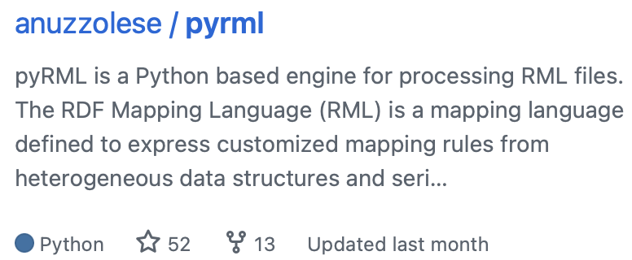
The Problem
Turtle serialization
@prefix ex: <http://example.org/> .
ex:Alice a ex:Person ;
ex:age 25 .
ex:Bob a ex:Person ;
ex:age 31 .
Turtle serialization
M
L
@prefix rml: <http://w3id.org/rml/> .
@prefix ex: <http://example.org/> .
@prefix xsd: <http://www.w3.org/2001/XMLSchema#> .
ex:PersonMapping a rml:TriplesMap ;
rml:logicalSource [
rml:source [ a rml:RelativePathSource ;
rml:root rml:MappingDirectory ;
rml:path "people.csv" ] ;
rml:referenceFormulation rml:CSV
] ;
rml:subjectMap [
rml:template "http://example.org/{name}" ;
rml:class ex:Person
] ;
rml:predicateObjectMap [
rml:predicate ex:age ;
rml:objectMap [
rml:reference "age" ;
rml:datatype xsd:integer
]
] .
people.csv
name age
Alice 25
Bob 31
…Who will describe the transformation?
Notes:
In the middle is our RML describing the mapping. To create triples, we define a tripleMap, in it a SubjectMap, and a PredicateObjectMap, in it a PredicateMap, and an ObjectMap.
Now, see the formalisme seems familiar. Indeed, this Mapping is itself an RDF graph!
From that graph, Tools already exist to execute such a mapping, for example RMLMapper, BURP and so on. So running the transformation is not the problem.
The problem is writing it. As we saw, a mapping contains semantic decisions: what each row represents, which property to use, which identifiers to create. So who is going to write this RML mapping?
Ideally, the researcher, who knows the data best. They know what each column means and what the result should represent. But they may not be familiar with RDF, or with the RDF Mapping Language.
On the other side, someone who knows RML well may not understand the domain data in the same depth.
So there is a gap between domain knowledge and the technical representation of the mapping. My project asks whether we can reduce this gap, without hiding the structure and constraints of the standard.
-----
But there is another problem.
A mapping written directly in RML assumes that the person creating it understands the mapping language, RDF concepts, and the syntax involved.
And this leads to the central question of my project.

Slide 7
RML ontology
Notes:
Here is an overview of its ontology.
Because RML is itself a graph, we can view it as simple an RDF graph with a set of specific constraints.
In general, When it comes to graphs, we often want constraints on our data: for example, that every person has exactly one age. That is where SHACL comes in.

Slide 8
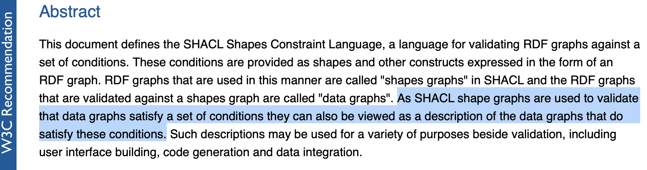
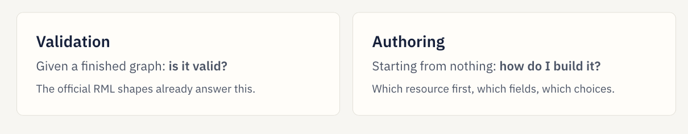
SHApe Constraint Language (SHACL)
SHACL as the bridge
Source: Shapes Constraint Language (SHACL) W3C Recommendation 20 June 2017. url:https://www.w3.org/TR/shacl/
Notes:
SHACL is a language that provides a declarative way to describe constraints over RDF graphs. SHACL is mostly used for validation: you give it a graph, and it tells you whether the graph conforms.
In my project, I explored whether this structured description of constraints could also be used to drive a form for creating RML mappings.
Instead of asking the user to write the mapping directly, we describe what a valid mapping should contain and use that structure to guide the user.

Slide 9
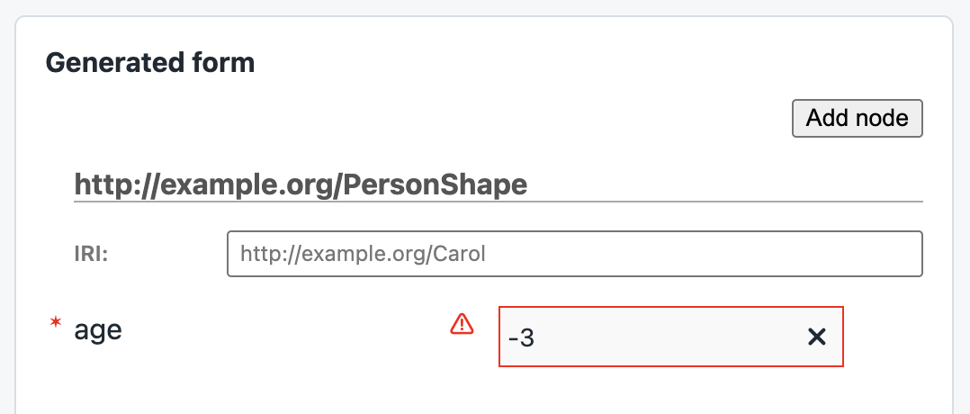
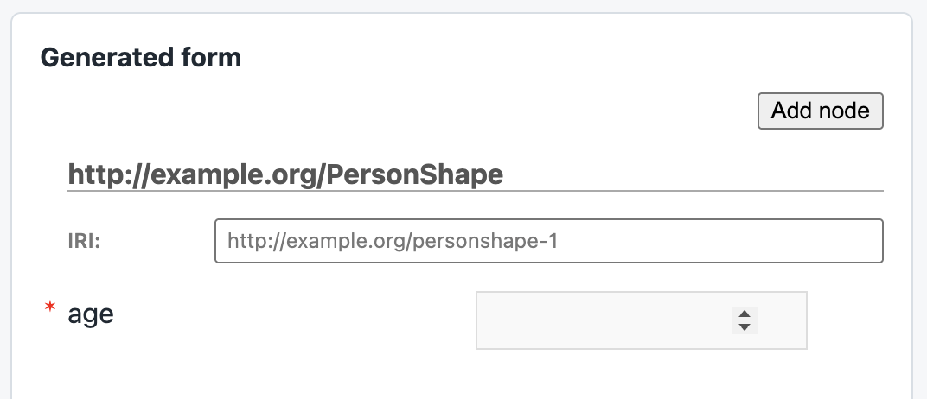
SHACL, an example
SHACL
Turtle serialization
@prefix sh: <http://www.w3.org/ns/shacl#> .
@prefix xsd: <http://www.w3.org/2001/XMLSchema#> .
@prefix ex: <http://example.org/> .
ex:PersonShape a sh:NodeShape ;
sh:targetClass ex:Person ; # applies to every ex:Person
sh:property [
sh:path ex:age ;
sh:datatype xsd:integer ; # the age is an integer
sh:minCount 1 ; # at least one age
sh:maxCount 1 ; # at most one age
sh:minInclusive 0 ; # not negative
] .
Notes:
Let’s go back to Alice and Bob. Here is a shape for our people. (Note, that the SHACL language is itself a graph.)
In plain words, it says: every Person must have exactly one age, and that age must be a whole number, not negative.
Alice and Bob conform to this shape. But if I write that Carol is a Person with the age “-3”, a SHACL validator will report an error.
So a shape is a description of what valid data looks like. And this gives us an idea: if we know what valid data looks like, maybe we can use it to help people create that data in the first place.
For instance, with a form that leads user to create RDF graph that will be valid by default.

Slide 10
SHACL, an example
SHACL
Turtle serialization
@prefix sh: <http://www.w3.org/ns/shacl#> .
@prefix xsd: <http://www.w3.org/2001/XMLSchema#> .
@prefix ex: <http://example.org/> .
ex:PersonShape a sh:NodeShape ;
sh:targetClass ex:Person ; # applies to every ex:Person
sh:property [
sh:path ex:age ;
sh:datatype xsd:integer ; # the age is an integer
sh:minCount 1 ; # at least one age
sh:maxCount 1 ; # at most one age
sh:minInclusive 0 ; # not negative
] .
Notes:
Let’s go back to Alice and Bob. Here is a shape for our people. (Note, that the SHACL language is itself a graph.)
In plain words, it says: every Person must have exactly one age, and that age must be a whole number, not negative.
Alice and Bob conform to this shape. But if I write that Carol is a Person with the age “-3”, a SHACL validator will report an error.
So a shape is a description of what valid data looks like. And this gives us an idea: if we know what valid data looks like, maybe we can use it to help people create that data in the first place.
For instance, with a form that leads user to create RDF graph that will be valid by default.

Slide 11
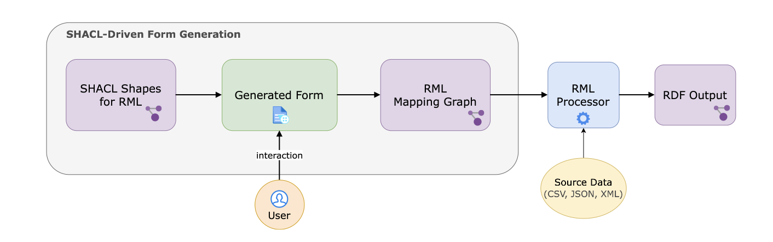
Workflow
Notes:
So , lets summarize, the over all workflow becomes this one:
The RML specification comes with SHACL shapes that describe what a valid mapping contains. From these shapes, we generate a form. The user fills in the form, with their knowledge of the data, and the form produces an RML mapping. That mapping is then executed by an RML engine on the source data, and we get RDF.
The user never writes the mapping by hand, but the result still follows the structure of the standard. Let me show you.

Slide 12
A Prototype SHACL-Driven Form Generator for RML
Demo
(Demo)
https://christalisation.github.io/darmstadt-shacl-form/rml/
Notes:
Create file in terminal
Generate le rml dan form
Load le ttl.
Ouvrir terminal et do mapping
Comme back to the slides to show the graph.
Here is the form, generated from the RML shapes. I want to map our people.csv file.
First I describe the source: the file, and that it is a CSV. Then the subject: each row becomes a person, with an identifier built from the name column. Then I add one property: age, taken from the age column, as an integer.
On the side you can see the mapping being written as I fill in the form.
I export it, run it with RMLMapper… and we get exactly the graph we wanted at the beginning: Alice and Bob, with their ages.

Slide 13
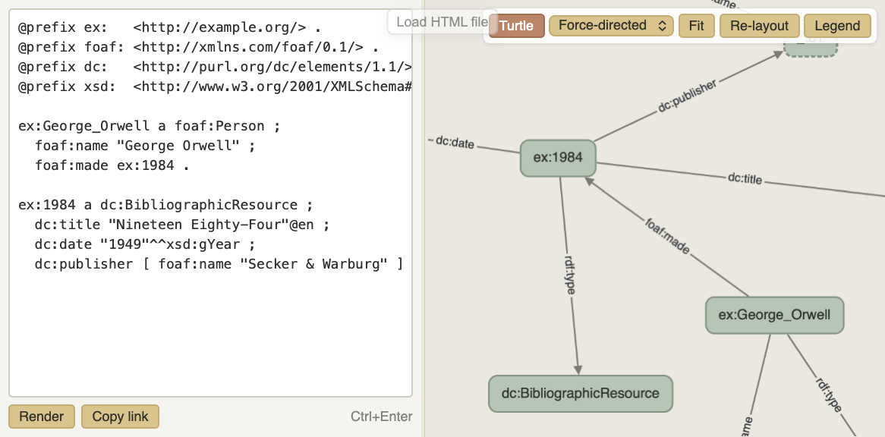
Demo: Output RDF viewer
Notes:
Create file in terminal
Generate le rml dan form
Load le ttl.
Ouvrir terminal et do mapping
Comme back to the slides to show the graph.
Here is the form, generated from the RML shapes. I want to map our people.csv file.
First I describe the source: the file, and that it is a CSV. Then the subject: each row becomes a person, with an identifier built from the name column. Then I add one property: age, taken from the age column, as an integer.
On the side you can see the mapping being written as I fill in the form.
I export it, run it with RMLMapper… and we get exactly the graph we wanted at the beginning: Alice and Bob, with their ages.

Slide 14
Some challenges…
CHALLENGE 3
Not every constraint is a field
Some constraints are a field: “age is an integer” → number field
Others describe a whole structure, written in another shape
Notes:
(So, it is possible. But it was not straightforward, and several design decisions were needed.)
Some of the challenging faced during the conceptualisation and then the implementation where:
(read slide)
First, some constraints translate directly into a widget: “the age is an integer” becomes a number field. Others don’t. For example, when a property must contain another structured element, described in a separate shape, the form has to decide to open a nested sub-form, and where.
Second, SHACL describes what a valid graph must satisfy. It does not describe how to build one: where the user starts, (what to ask first, which choice comes before which field.)
So I had to add requirements that are specific to authoring RDF. For example, the possibility to reuse a node that already exists instead of creating a copy, because in RDF a copy is a different thing. Or choosing the namespace used for the identifiers the form creates.
And one limitation I still have: some shapes were written only for validation, and they still appear in the form even though there is nothing for the user to fill in.
--------
Some of the challenging faced during the conceptualisation and then the implementation where:
Authoring needs decisions SHACL does not encode

Slide 15
Some challenges…
CHALLENGE 2
A choice comes before the fields
SHACL says what is valid, not how to build it
Where does the user start? What is asked first?
Notes:
(So, it is possible. But it was not straightforward, and several design decisions were needed.)
Some of the challenging faced during the conceptualisation and then the implementation where:
(read slide)
First, some constraints translate directly into a widget: “the age is an integer” becomes a number field. Others don’t. For example, when a property must contain another structured element, described in a separate shape, the form has to decide to open a nested sub-form, and where.
Second, SHACL describes what a valid graph must satisfy. It does not describe how to build one: where the user starts, (what to ask first, which choice comes before which field.)
So I had to add requirements that are specific to authoring RDF. For example, the possibility to reuse a node that already exists instead of creating a copy, because in RDF a copy is a different thing. Or choosing the namespace used for the identifiers the form creates.
And one limitation I still have: some shapes were written only for validation, and they still appear in the form even though there is nothing for the user to fill in.
--------
Some of the challenging faced during the conceptualisation and then the implementation where:
Authoring needs decisions SHACL does not encode

Slide 16
Some challenges…
CHALLENGE 3
Create, link or reuse
RDF is a graph: one element can be used in two places
A copy is a different node, even if it is valid
Extra requirements: reuse a node, choose identifiers
Notes:
(So, it is possible. But it was not straightforward, and several design decisions were needed.)
Some of the challenging faced during the conceptualisation and then the implementation where:
(read slide)
First, some constraints translate directly into a widget: “the age is an integer” becomes a number field. Others don’t. For example, when a property must contain another structured element, described in a separate shape, the form has to decide to open a nested sub-form, and where.
Second, SHACL describes what a valid graph must satisfy. It does not describe how to build one: where the user starts, (what to ask first, which choice comes before which field.)
So I had to add requirements that are specific to authoring RDF. For example, the possibility to reuse a node that already exists instead of creating a copy, because in RDF a copy is a different thing. Or choosing the namespace used for the identifiers the form creates.
And one limitation I still have: some shapes were written only for validation, and they still appear in the form even though there is nothing for the user to fill in.
--------
Some of the challenging faced during the conceptualisation and then the implementation where:
Authoring needs decisions SHACL does not encode

Slide 17
Some challenges…
Not every constraints become a field or a widget directly
SHACL says what is valid, not what can be build, nor how to build it.
  Needs decisions SHACL does not encode: entry points, node identity
  Needs extra requirements: reuse a created node, choose identifiers
How a shape is written changes the form you get.
Notes:
(So, it is possible. But it was not straightforward, and several design decisions were needed.)
Some of the challenging faced during the conceptualisation and then the implementation where:
(read slide)
First, some constraints translate directly into a widget: “the age is an integer” becomes a number field. Others don’t. For example, when a property must contain another structured element, described in a separate shape, the form has to decide to open a nested sub-form, and where.
Second, SHACL describes what a valid graph must satisfy. It does not describe how to build one: where the user starts, (what to ask first, which choice comes before which field.)
So I had to add requirements that are specific to authoring RDF. For example, the possibility to reuse a node that already exists instead of creating a copy, because in RDF a copy is a different thing. Or choosing the namespace used for the identifiers the form creates.
And one limitation I still have: some shapes were written only for validation, and they still appear in the form even though there is nothing for the user to fill in.
--------
Some of the challenging faced during the conceptualisation and then the implementation where:
Authoring needs decisions SHACL does not encode

Slide 18
Take-away
A specification says what is valid, can be described with SHACL
RML authouring through its SHACL shapes is possible, but needs added requirements.
When writing SHACL, it is worth thinking about authoring, not only about validation.
Notes:
If I had to summarise in one sentence: a specification tells you what valid data looks like, but a user interface needs more than that. It needs an entry point, an order, and choices about identity and reuse.
And for those of you who write specifications or application profiles: the way you write your shapes directly changes the forms that can be generated from them. So it is worth thinking about authoring, not only validation, when designing them.

Slide 19
… Interested in testing the tool ?
christal.mangolopa@student.uliege.be
https://christalisation.github.io/darmstadt-shacl-form/
Thank you !
Notes:
So if you are curious, I am looking for a few people for a short tutorial/. You could write a small shape and see it become a form, and try writing a mapping for your own data. It is also a nice way to learn a bit of SHACL and RML.
The code is on GitHub, the link is on the slide. I’m happy to take questions.
-------
Stress that I am looking for people to test the prototype.

