Slide 1
A SIMPLE GUIDE
FOR THE HR TEAM
AI
Plan
Agents
Your goal
Improve
Act
Check
From chatting with AI
to working with AI.
Notes:
Today I want to explain AI agents in simple terms, show what I have built with them, and suggest how we could use them in HR.

Slide 2
An AI that
gets things done
Plan
Normal AI answers your question.
An AI agent takes a goal, works on it step by step, uses tools, and checks its own result.
Your goal
Improve
Act
Think of it as an AI employee, not an AI search box.
Check
WHAT IS AN AI AGENT
02 / 14
Notes:
A chatbot answers and stops. An agent gets a goal and loops: plan, act with tools, check the result, improve, until the job is done.

Slide 3
Chat AI vs AI Agent
LLM / CHAT AI
AI AGENT
The brain
Brain + hands + a schedule
ChatGPT · Claude · Gemini
Hermes · Claude Code · Codex
01
You ask a question
01
You give it a goal
02
It gives an answer
02
It plans and does the work
03
It stops and waits
03
It reports back when done
LLM = the brain. Agent = brain + hands + a schedule.
CHAT AI VS AI AGENT
03 / 14
Notes:
ChatGPT, Claude and Gemini are the brains. An agent like Hermes, Claude Code or Codex wraps a brain with tools and a schedule, so it can actually do the work.

Slide 4






What an agent can do
that chat can’t
Works on a schedule
Uses tools
Thinks in steps
Runs tasks at set times, without being asked
Browses the web, edits files, runs apps
Breaks a goal into steps and decides what’s next
Has a persona
Learns skills
Works in a team
A fixed role, tone and set of rules
Install new abilities, like apps on a phone
Hands work to other agents in a workflow
WHAT AGENTS CAN DO
04 / 14
Notes:
These six things separate an agent from a chatbot: schedules, tools, step-by-step thinking, a persona, installable skills, and teamwork with other agents.

Slide 5




What every agent
is made of
WHO IT IS
WHAT IT CAN DO
WHAT IT REMEMBERS
Soul
Skills
Memory
Personality, role and rules, written in one file
Step-by-step playbooks and tools it can use
Notes about you, your work and past tasks
Model
Picked per job: a small, fast model for simple tasks, a stronger one for judgment and creative work.
THE BRAIN UNDERNEATH
THE BUILDING BLOCKS
05 / 14
Notes:
An agent is a model plus three things. The model is the brain, and you choose it per job: cheap and fast for simple work, stronger for judgment. Soul is its character and job description, Skills are its playbooks, Memory is its experience with you.

Slide 6
8
My own
AI team
8 agents, running 24/7 on one small server. I manage them from Discord.
WHAT I AM BUILDING
06 / 14
Notes:
This is what I have been building: a small team of AI agents that run all day on one cheap server. I talk to them through Discord, like a team chat.

Slide 7







How my team is structured
Me
CEO
Receives my tasks,
delegates, reports back
Researcher
Designer
Engineer
Trading analyst
Health coach
Marketing
Travel planner
Daily news and markets
Visuals and UI/UX
Builds and fixes the system
Reviews my trading journal
Routine and nutrition check-ins
Content and captions
Trips and itineraries
MY AI TEAM
07 / 14
Notes:
I give tasks to my CEO agent. It breaks them down, hands them to the right specialist, then reports back to me. Each specialist has its own role and personality.

Slide 8
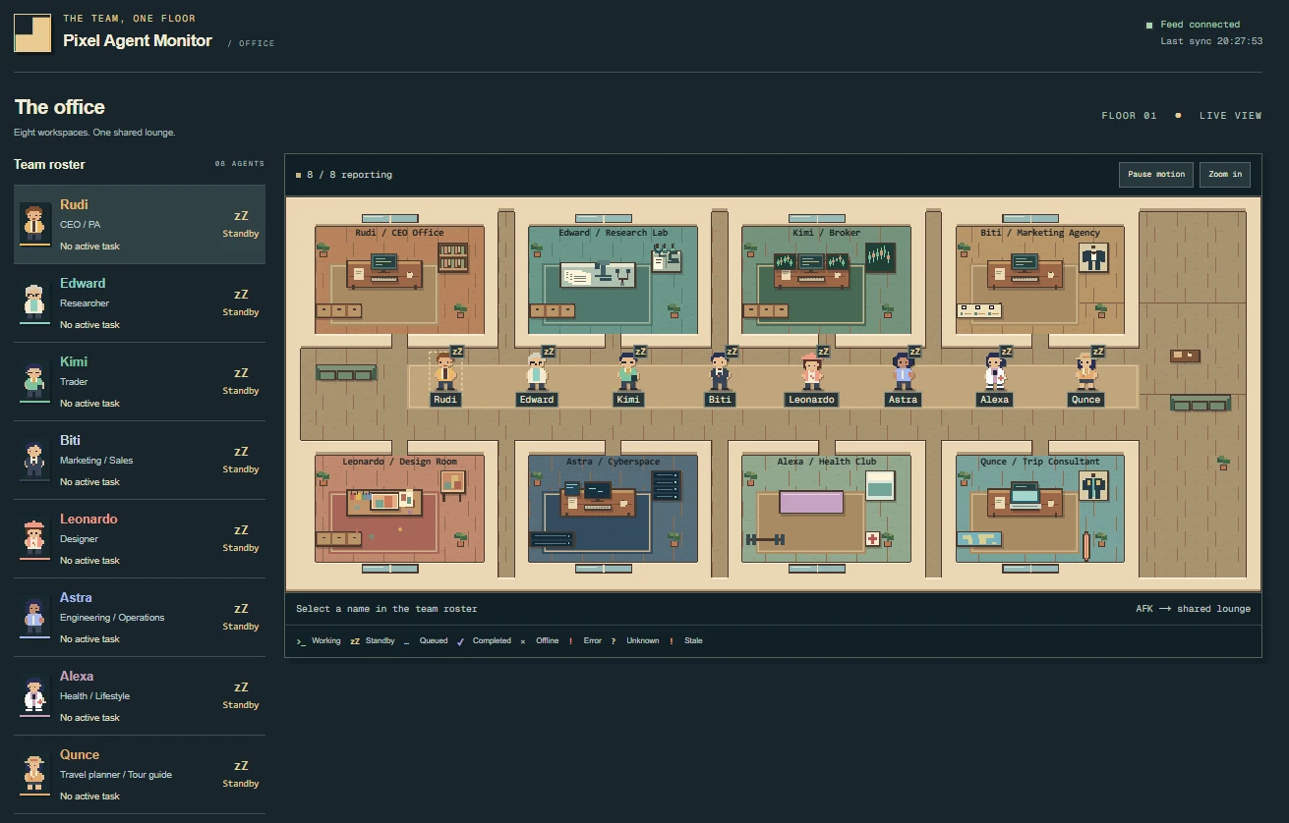
Their office,
live
A live dashboard built by my engineer agent. Every agent has a desk, so I can see at a glance who is working and who is on standby.
Working
Queued
Standby
THE OFFICE
08 / 14
Notes:
This is a live office view my engineer agent built for the team. Each character is an agent; when one is working on a task you can see it move to its desk.

Slide 9




One request, a whole team
“Make a visual and a caption for tomorrow’s post”
ME
CEO
Designer
Marketing
CEO
Me
Plans and delegates
Designs the visual
Writes the caption
Checks it all together
Approves before posting
On autopilot every day: the researcher scans the news → the CEO sends me a daily report. No prompt needed.
HOW WORK FLOWS
09 / 14
Notes:
One message from me becomes a small project: the CEO plans it, the designer makes the visual, marketing writes the caption, the CEO checks it, and I approve. Some work also runs on its own every day.

Slide 10
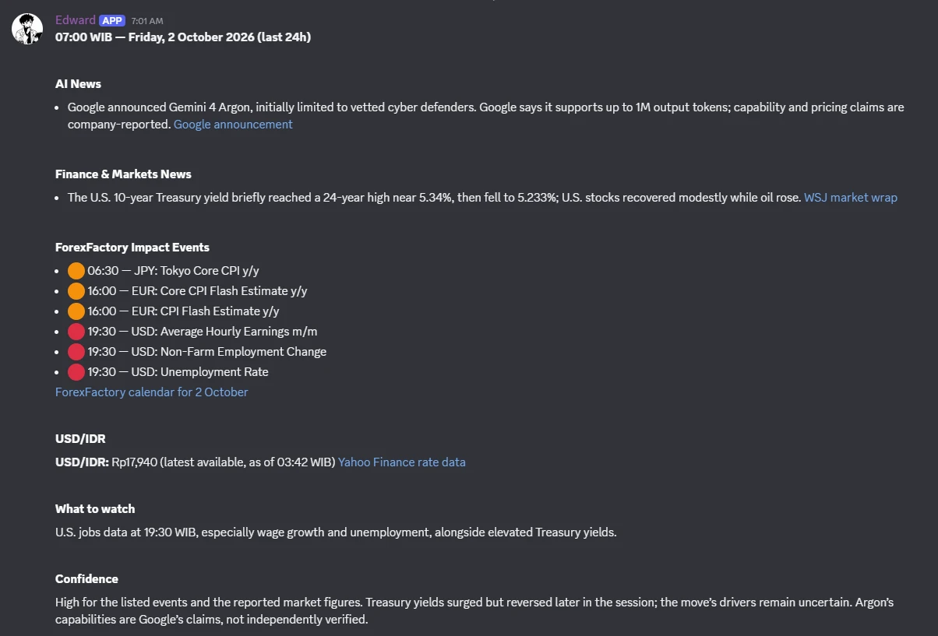
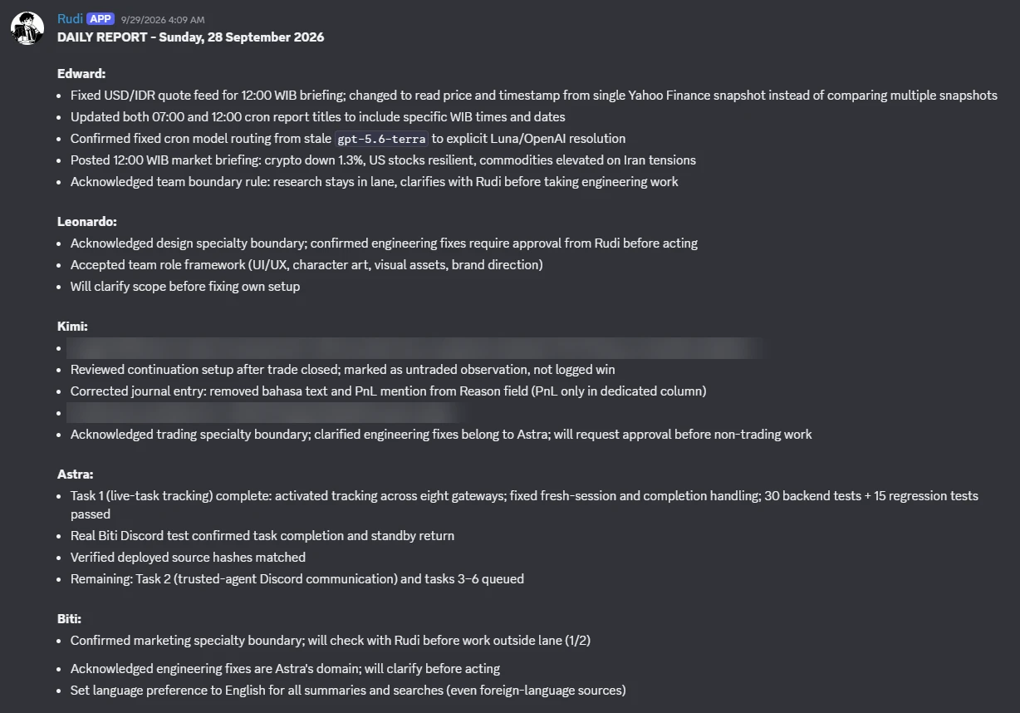
Real output, every morning
Researcher
07:00 NEWS BRIEF
CEO
DAILY REPORT ON EVERYONE’S WORK
AGENTS AT WORK
10 / 14
Notes:
Left: the researcher posts a news brief at 7 AM with the day's key events. Right: the CEO sends me one daily report summarising what every agent did.

Slide 11
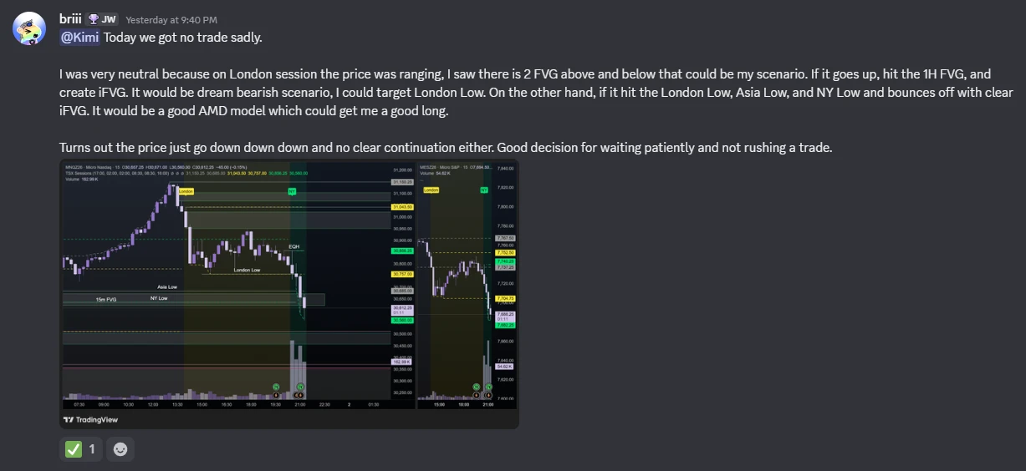
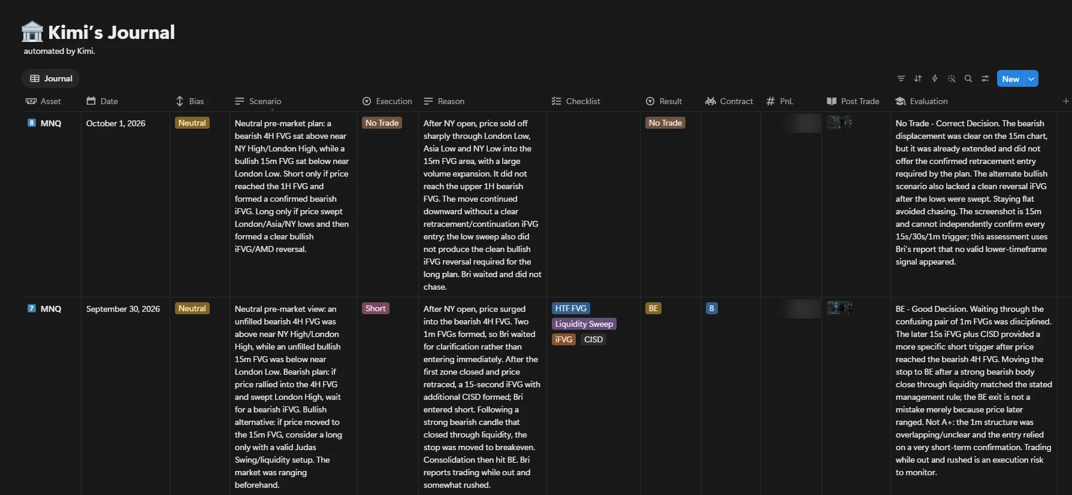

From my notes to a clean journal
1 · I SEND MY NOTES + CHART
2 · THE AGENT REVIEWS AND LOGS IT
Trading analyst: turns a casual chat message into a structured journal entry, with a review of the decision.
AGENTS AT WORK
11 / 14
Notes:
I just chat with the trading analyst like a person: what I saw and what I did, plus a chart. It turns that into a clean journal entry in Notion, with the plan, the reason, and an honest review of the decision.

Slide 12
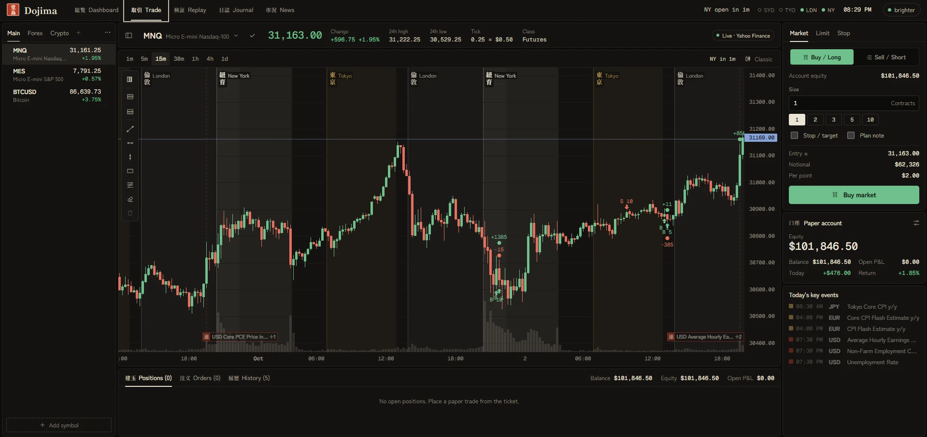



Dojima
A trading-practice web app I built with Claude Code, without writing the code myself.
Frontend
What you see: charts, journal, themes
Backend
The engine: orders, replay, login
I describe it → Claude Code builds it → it goes live
Database
The memory: accounts and trades
BUILT WITH AN AGENT
12 / 14
Notes:
Dojima is a full trading-practice app with paper money. I am not a programmer: I describe what I want, Claude Code (an AI agent) writes the code and publishes it. It has a frontend you see, a backend that runs the logic, and a database that stores the data.

Slide 13







An AI team
for HR
HR team
Job descriptions
Drafts JDs from a short brief
One orchestrator that understands HR, with a specialist for each job.
Recruitment
Screening notes and interview kits
Head of HR
agent
Onboarding
Checklists and first-week plans
HR reports
Weekly and monthly summaries
Policy Q&A
Answers staff questions from the handbook
Training
Learning plans and materials
HR still reviews and approves everything.
AI AGENTS FOR HR
13 / 14
Notes:
Same idea as my team, applied to HR. One Head of HR agent receives requests from the HR team and delegates to specialists: job descriptions, recruitment, onboarding, reports, policy questions and training. HR still reviews and approves everything.

Slide 14
THANK YOU
AI AGENTS · A SIMPLE GUIDE
Start
?
small.
One agent.
One task.
One week.
Questions?
Notes:
My suggestion: start small with one agent and one task, see it working within a week, then grow from there.

