Slide 1

IPL 2022 Data analysis
Presented by
Vishal A (Enrollment no. EBEON0322584829)
Batch – 2021-7250
Center- Bangalore-EXL
Trainer - SV Kartik

Slide 2
Contents
Introduction
Tools used
Import Libraries
Load dataset
Visualization
Analysis
Conclusion
Future Scope

Slide 3
Introduction
Every sporting event today generates a lot of data about the game, which is used to analyze the performance of players, teams, and every event of the game. So the use of data science is in every sport today. Currently, IPL 2022 is one of the popular sporting events being held in India. So, we take this data to analysis using python.

Slide 4



Tools Used
Python programming language, Google colab website, Pandas, Plotly.

Slide 5
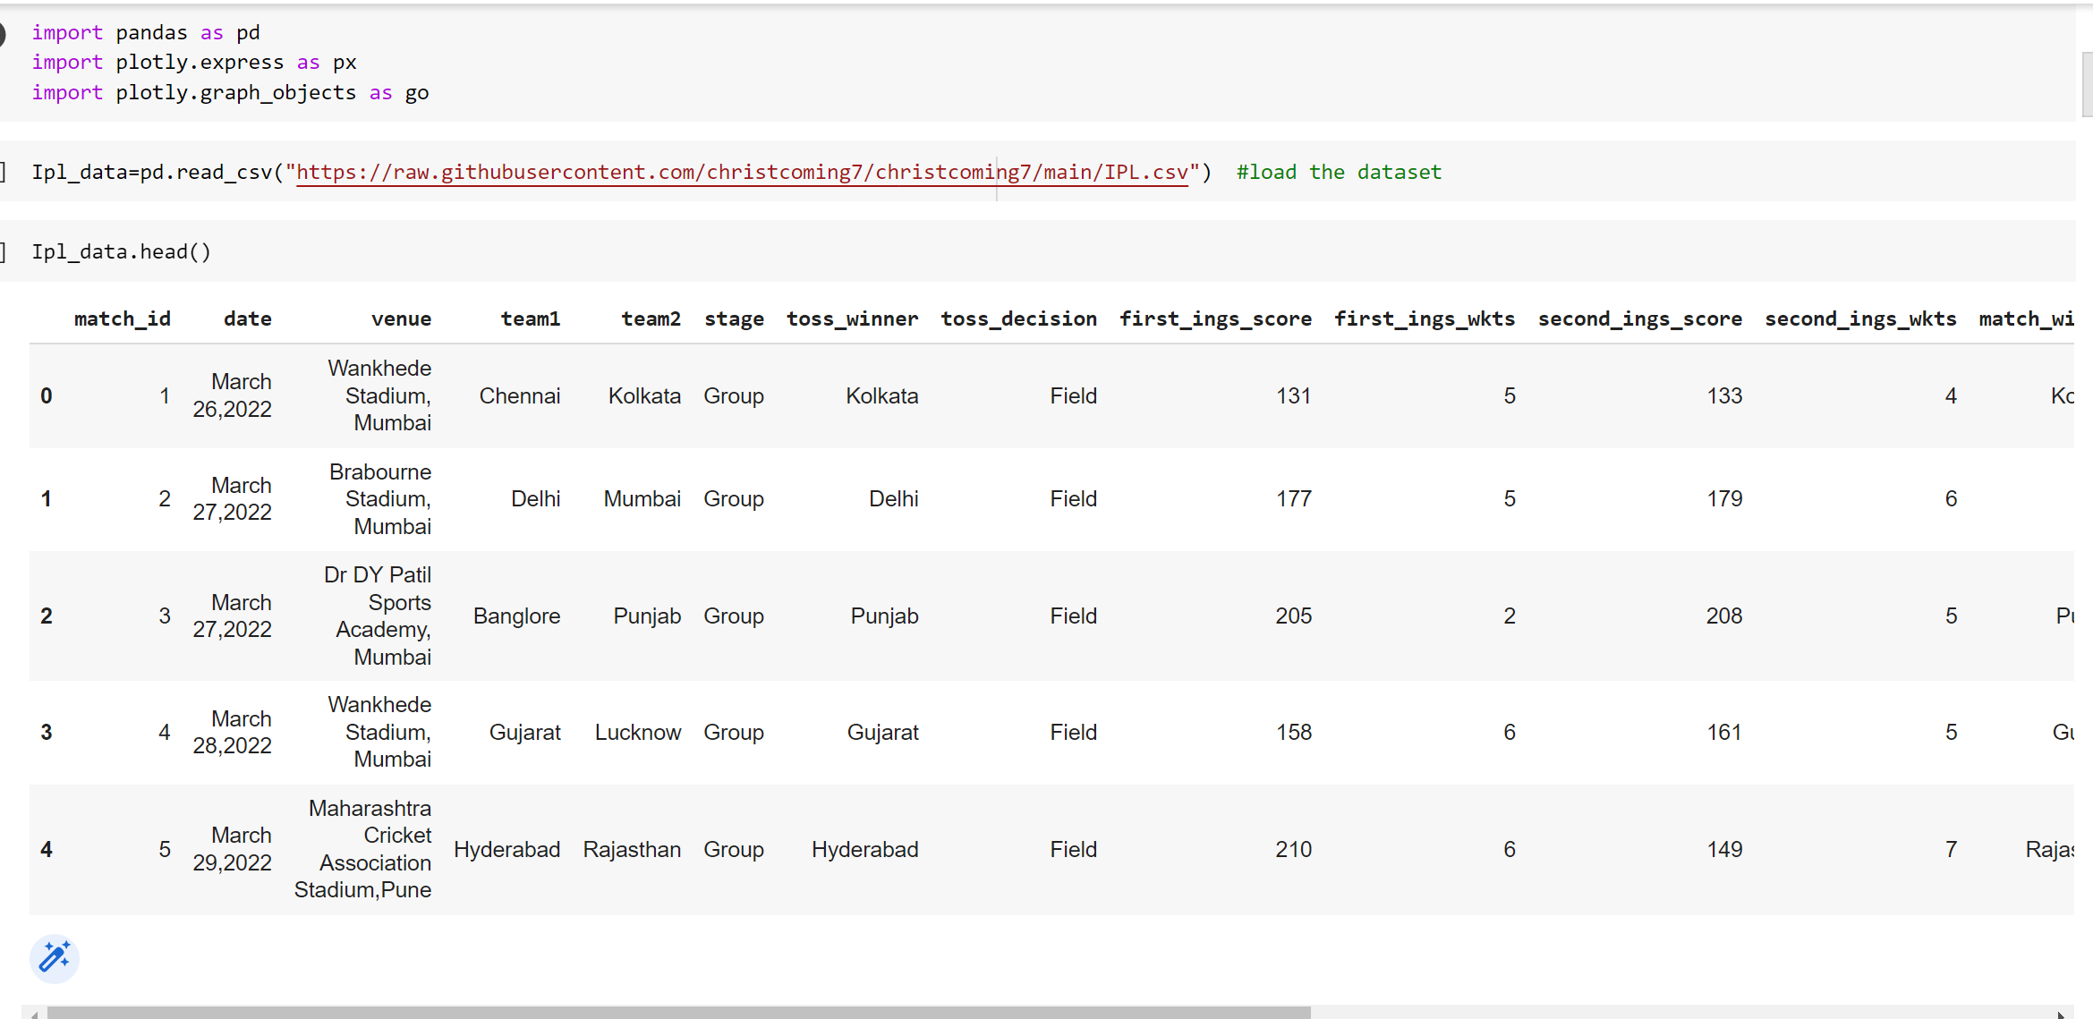
Now let’s start this project by importing the necessary Python libraries and the dataset:

Slide 6
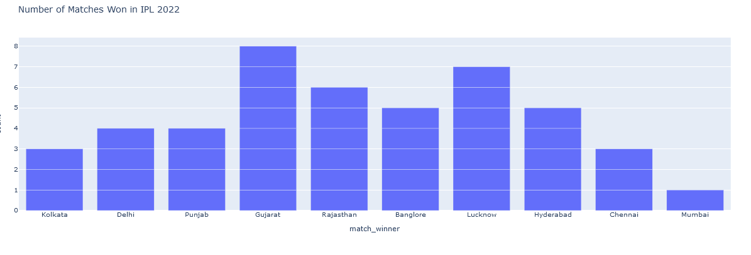
The maximum number of match winner in IPL-2022.

Slide 7
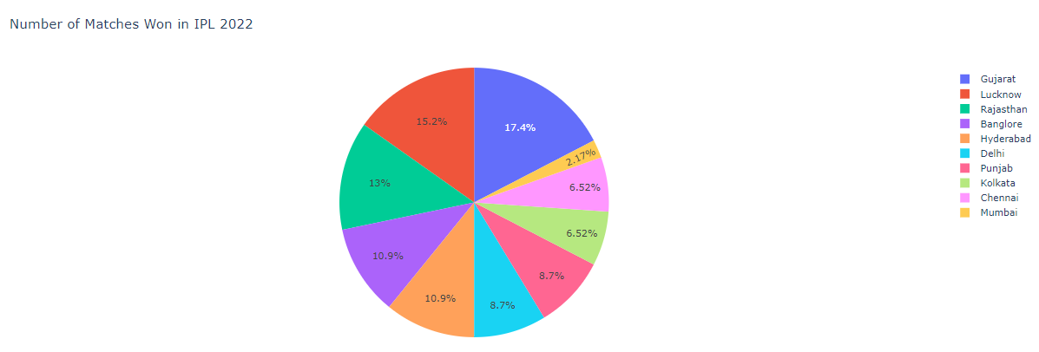
In this chart we can see match winner percentage:

Slide 8
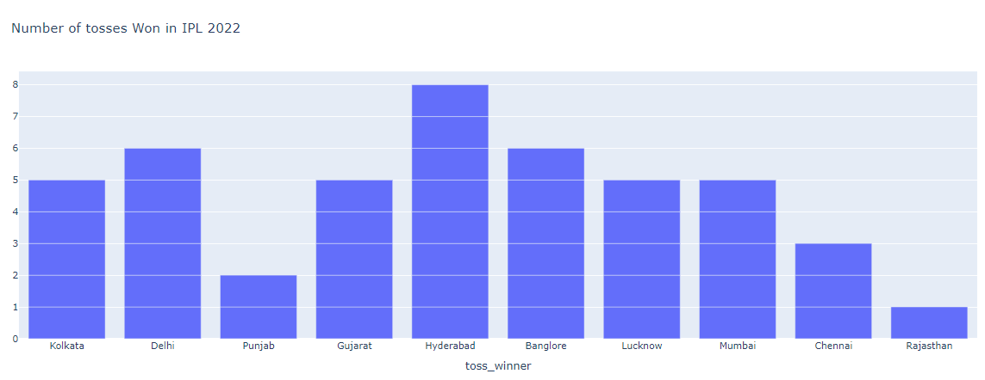
The maximum times of toss winner:

Slide 9
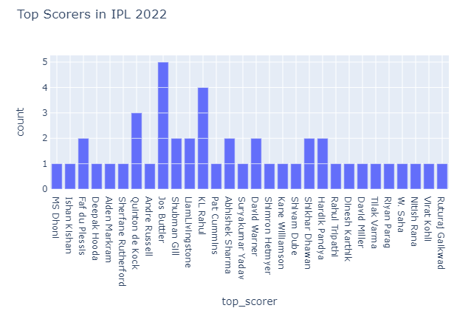
Jos Buttler has been a top scorer in 5 matches.

Slide 10
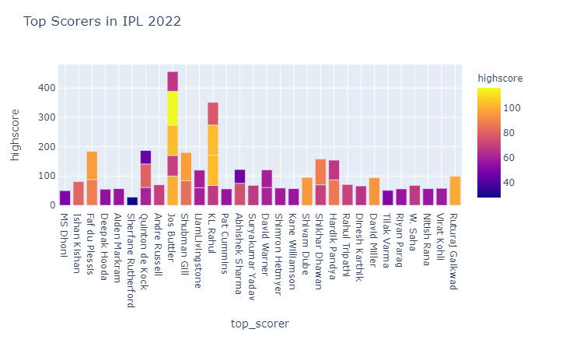
Let’s analyze it deeply by including the runs scored by the top scorers:

Slide 11
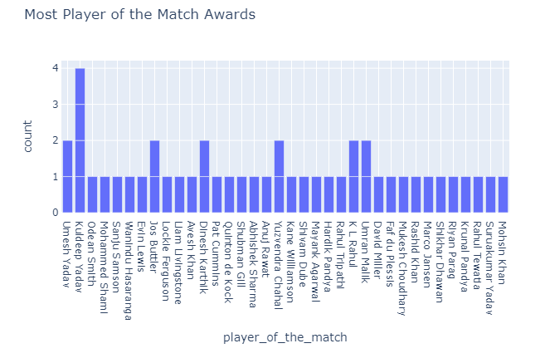
Now let’s have a look at the most player of the match awards till now in IPL 2022:

Slide 12
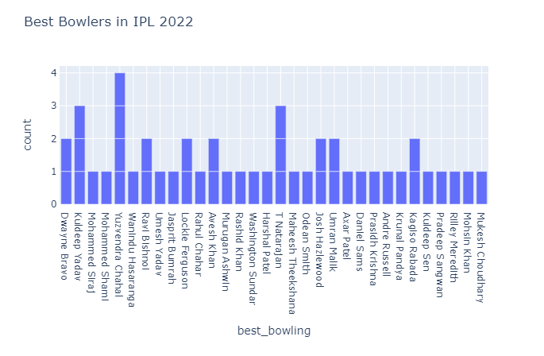
Now let’s have a look at the bowlers with the best bowling figures in most of the matches:

Slide 13
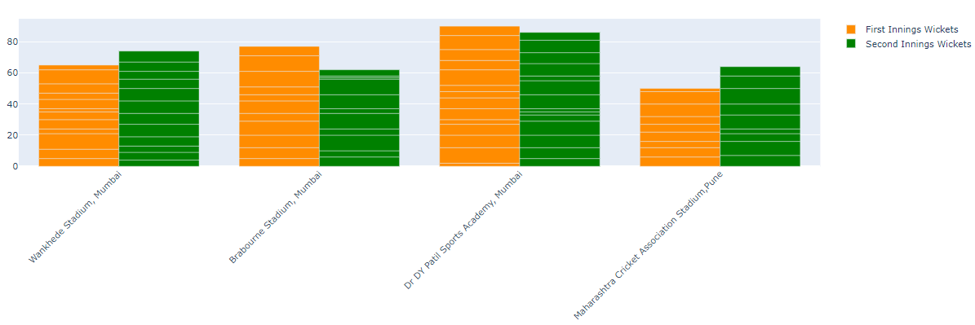
Now let’s have a look at whether most of the wickets fall while setting the target or while chasing the target:

Slide 14
Conclusion
Perform the task of IPL 2022 analysis using Python.
IPL 2022 was going great for Gujrat as a new team in this year.
Jos Buttler and KL Rahul have been great with the bat, and Yuzvendra Chahal and Kuldeep Yadav have been great with the bowl.

Slide 15
Future Scope
In future our target is to predict that in IPL, Which Indian cricket ground is batting friendly and which ground is bowling friendly using machine learning algorithm.

Slide 16
Thank you

