Slide 1
Hotel Booking System
Relational Database Design & Implementation
Group Members
YAMEOGO Claudine (Déléguée)
OUEDRAOGO Adèle
TRAORE Aminata Jannine Esmelle
KAGAMBEGA Saturnin
DEHOUMON Christelle Alvine
ZABRE Yenderima Elvine

Slide 2
Scenario Overview — Entities & Relationships
The Hotel Booking System manages guests, rooms, reservations, services and invoices — all in a fully normalized relational database.
7 Entities — Primary Keys
5 Relationships — Foreign Keys
guests
guest_id
Hotel guests / customers
room_types → rooms
1:M
FK: rooms.type_id
room_types
type_id
Room categories + price
guests → bookings
1:M
rooms
room_id
Individual physical rooms
FK: bookings.guest_id
bookings
booking_id
Reservation records
rooms → bookings
1:M
FK: bookings.room_id
services
service_id
Extra services
bookings ↔ invoices
1:1
invoices
invoice_id
Financial invoices
FK: invoices.booking_id UNIQUE
bookings ↔ services
booking_services
bs_id
Junction table M:N
M:N
FK: via booking_services
2 / 6

Slide 3
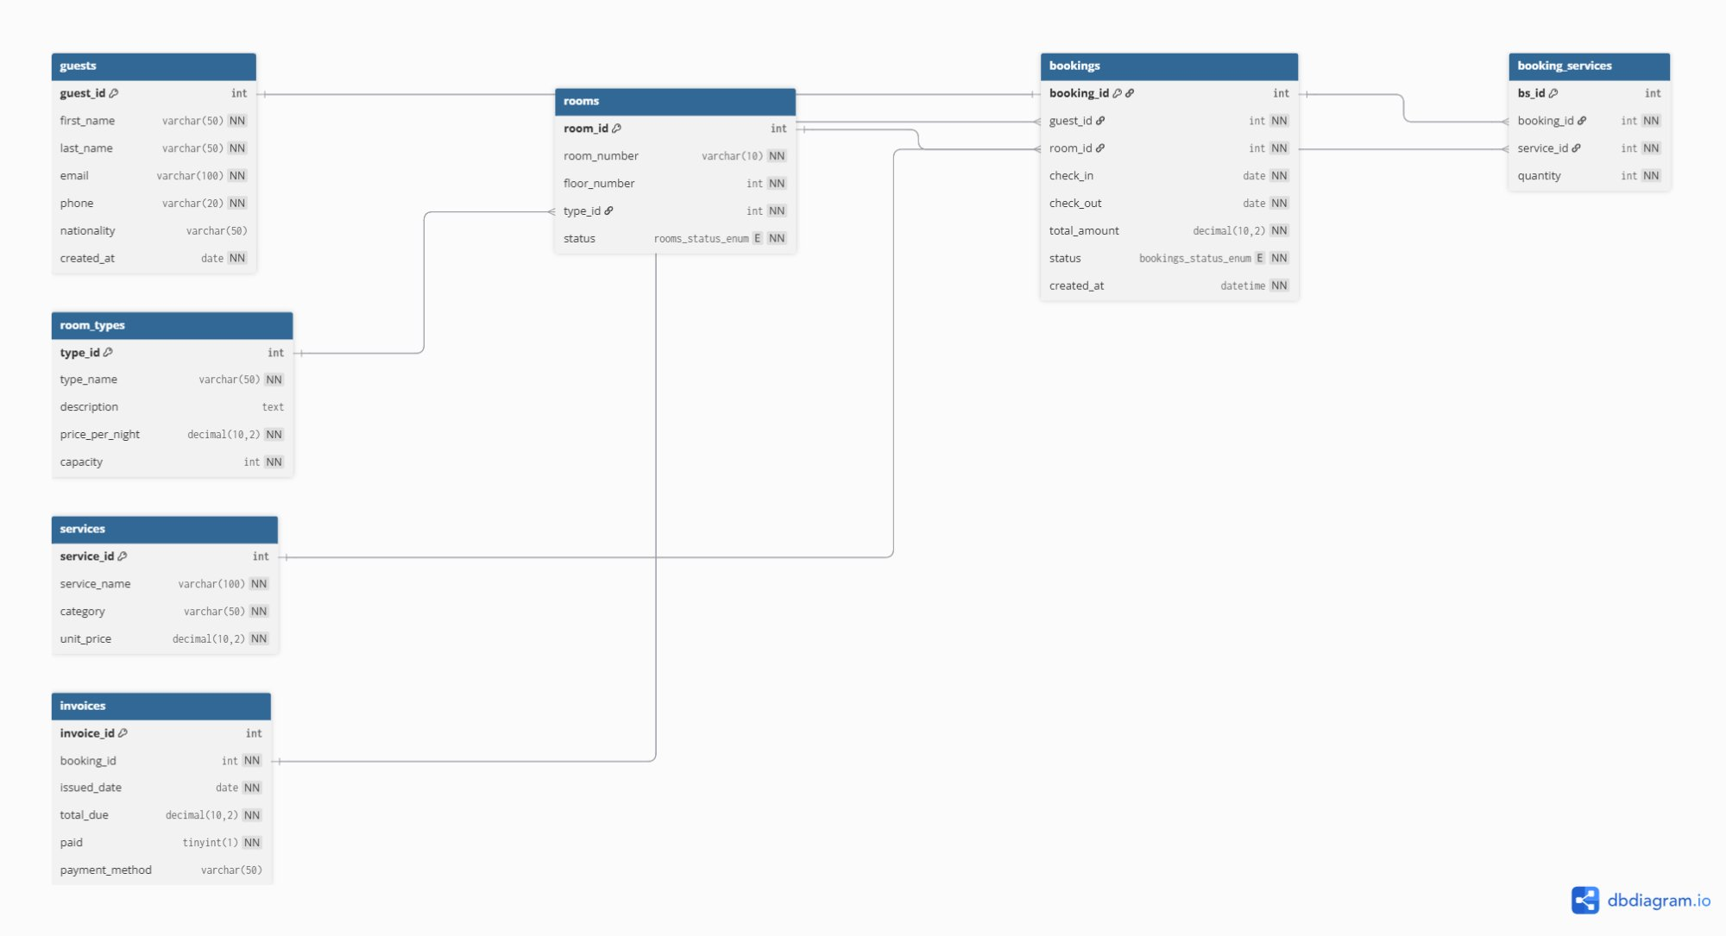
Schema Diagram — Entity Relationship Diagram (ERD)
PK = Primary Key | FK = Foreign Key | NN = Not Null | E = ENUM | Generated with dbdiagram.io
3 / 6

Slide 4
Normalization Walkthrough — UNF → 1NF → 2NF → 3NF
UNF — Starting point (one large unnormalized table)
Booking(booking_id, guest_name, guest_email, guest_phone, room_number, room_type, price_per_night, check_in, check_out, total_amount, services_used, invoice_total, paid)
1NF Violation
2NF Violation
3NF Violation
services_used is multi-valued
Partial dependency on composite key
Transitive dependency
A guest can use Breakfast + Spa + Shuttle in one booking. Storing them as a comma-separated string violates atomicity — each cell must hold one value only.
With composite key (booking_id, service_id), guest_email depends only on booking_id — not the full key. This partial dependency duplicates guest data for every service used.
price_per_night depends on room_type, not on room_id directly. Chain: room_id → room_type → price_per_night. Price is duplicated for every Standard room.
Fix → Create booking_services junction table: each service becomes a separate row with its own quantity.
Fix → Separate guests, bookings, services into independent tables. Each FK reference eliminates duplication.
Fix → Extract room_types table. rooms.type_id (FK) references it. Price stored once per type — never duplicated.
Final schema is in 3NF — every non-key attribute depends on the whole key and nothing but the key ✓
4 / 6

Slide 5
Key Design Decisions
ENUM
ON DELETE RESTRICT
rooms.status: available / occupied / maintenance
bookings.status: confirmed / cancelled / completed
→ Database rejects any invalid value automatically.
Applied on guests→bookings and rooms→bookings.
→ Prevents deleting a guest or room that still has
active bookings. Protects data integrity.
ON DELETE CASCADE
ON UPDATE CASCADE
Applied only on booking_services.
→ If a booking is deleted, all its linked services
are removed automatically. No orphan rows.
Applied on all foreign keys.
→ If a primary key changes, all referencing rows
update automatically. No broken references.
DECIMAL(10,2)
UNIQUE on booking_id
Used for price_per_night, total_amount, total_due,
unit_price.
→ Avoids floating-point errors in monetary values.
In the invoices table.
→ Enforces the strict 1:1 relationship between
one booking and exactly one invoice.
5 / 6

Slide 6
Most Complex Query — Revenue Report per Room Type
SQL Code
Why it is the most complex query
SELECT
rt.type_name,
COUNT(b.booking_id)
AS total_bookings,
SUM(b.total_amount)
AS total_revenue,
AVG(b.total_amount)
AS avg_booking_value,
MAX(b.total_amount)
AS highest_booking
FROM room_types rt
INNER JOIN rooms r
ON rt.type_id = r.type_id
INNER JOIN bookings b
ON r.room_id = b.room_id
GROUP BY rt.type_name
HAVING SUM(b.total_amount)
> 200000
ORDER BY total_revenue DESC;
1
3 tables joined
room_types → rooms → bookings using 2 INNER JOINs. Each JOIN adds a condition that must match — the engine processes all three tables together.
2
5 aggregate functions
COUNT, SUM, AVG, MAX all computed in one single query. Each function calculates a different statistic on the same grouped data.
3
GROUP BY
Results are grouped by rt.type_name. All bookings of the same room type are collapsed into one summary row.
4
HAVING > 200 000 FCFA
Filters AFTER grouping — only room types whose total revenue exceeds 200,000 FCFA appear. WHERE cannot filter on aggregates; HAVING can.
5
ORDER BY DESC
Final results sorted from highest to lowest revenue, making the report immediately readable for business analysis.
6 / 6

