Slide 1
netflix-dataVisualization
File created on: 8/11/2024 9:27:06 PM

Slide 2
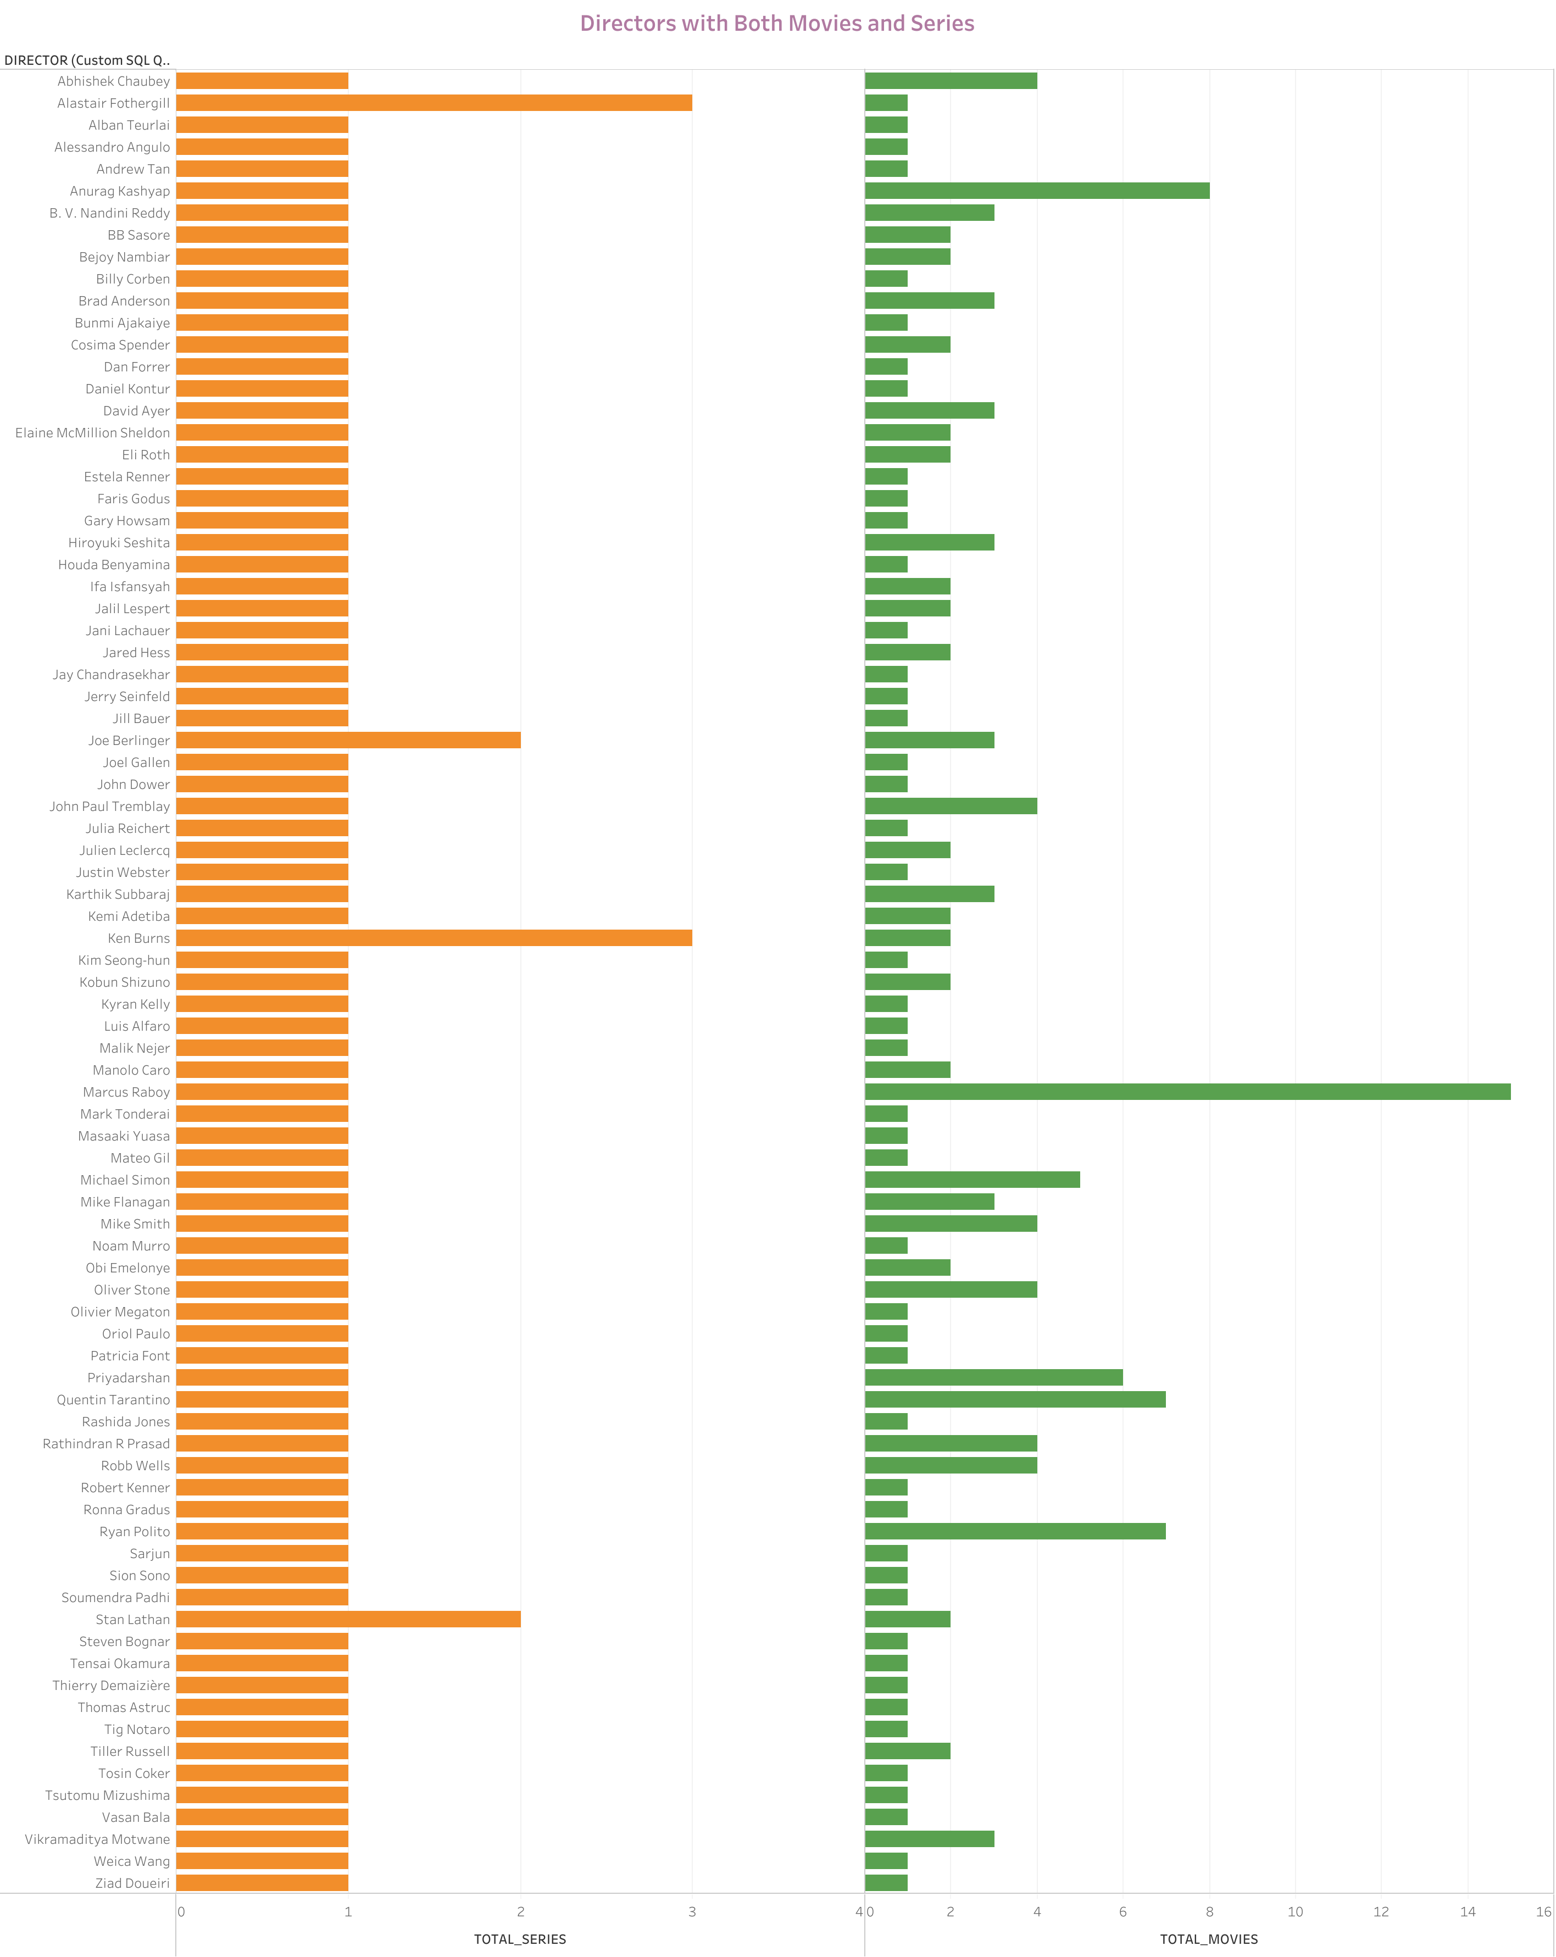

Slide 3
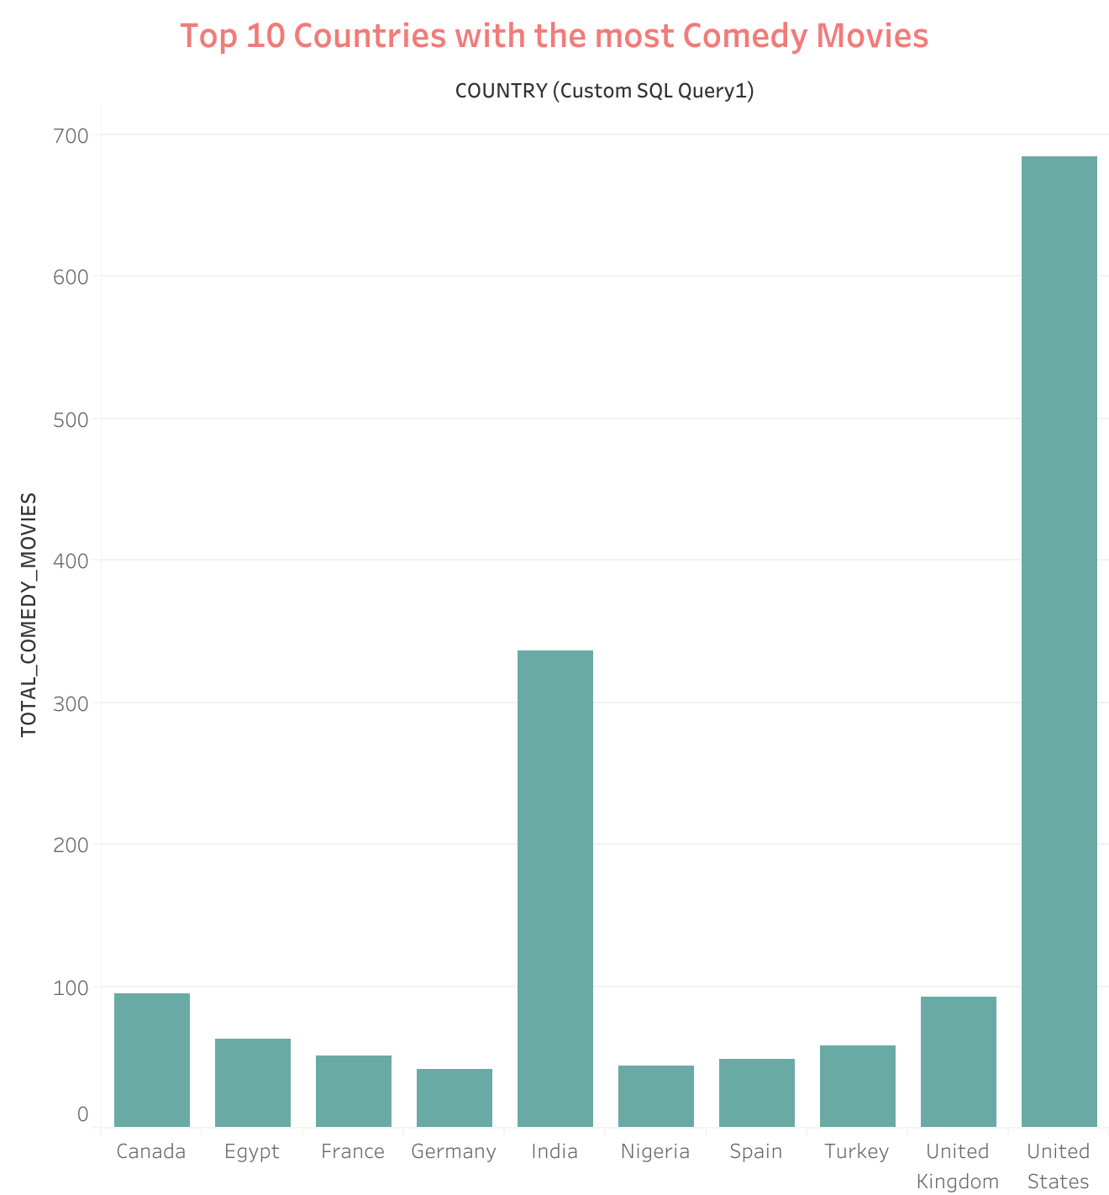

Slide 4
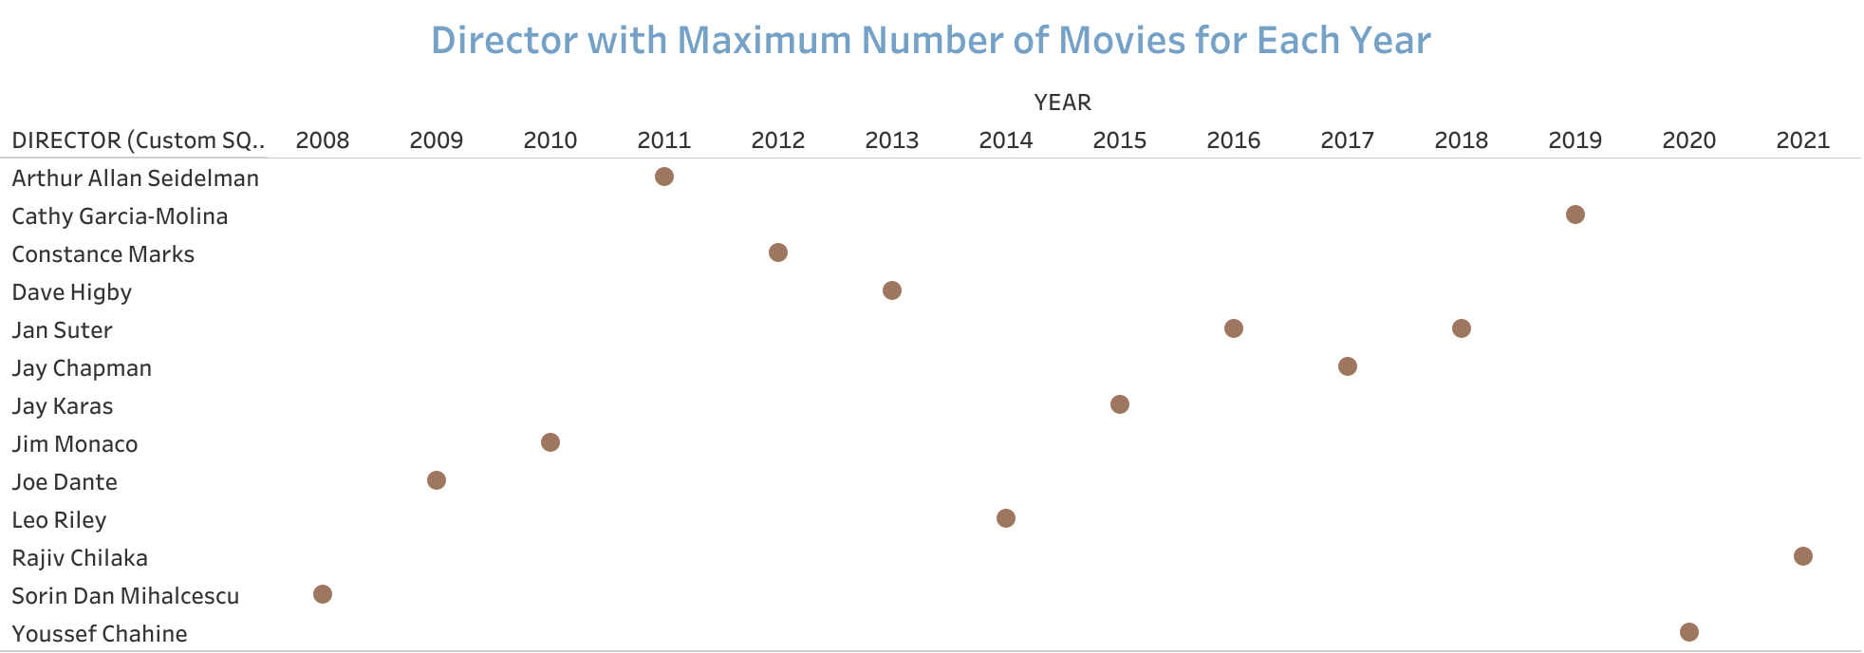

Slide 5
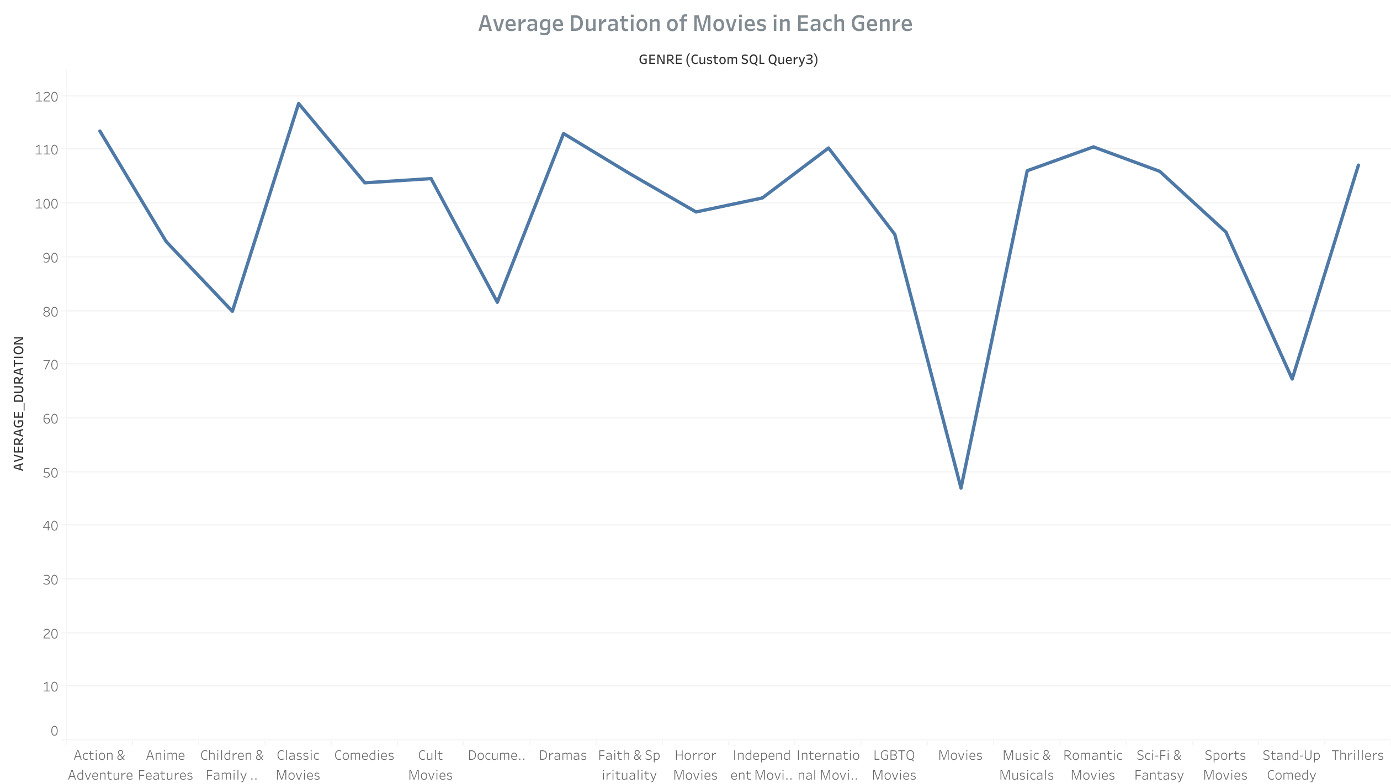

Slide 6
