Slide 1
Turn based Strategy Game in Effect
Christian Ambs, Master INF, 7376687

Slide 2
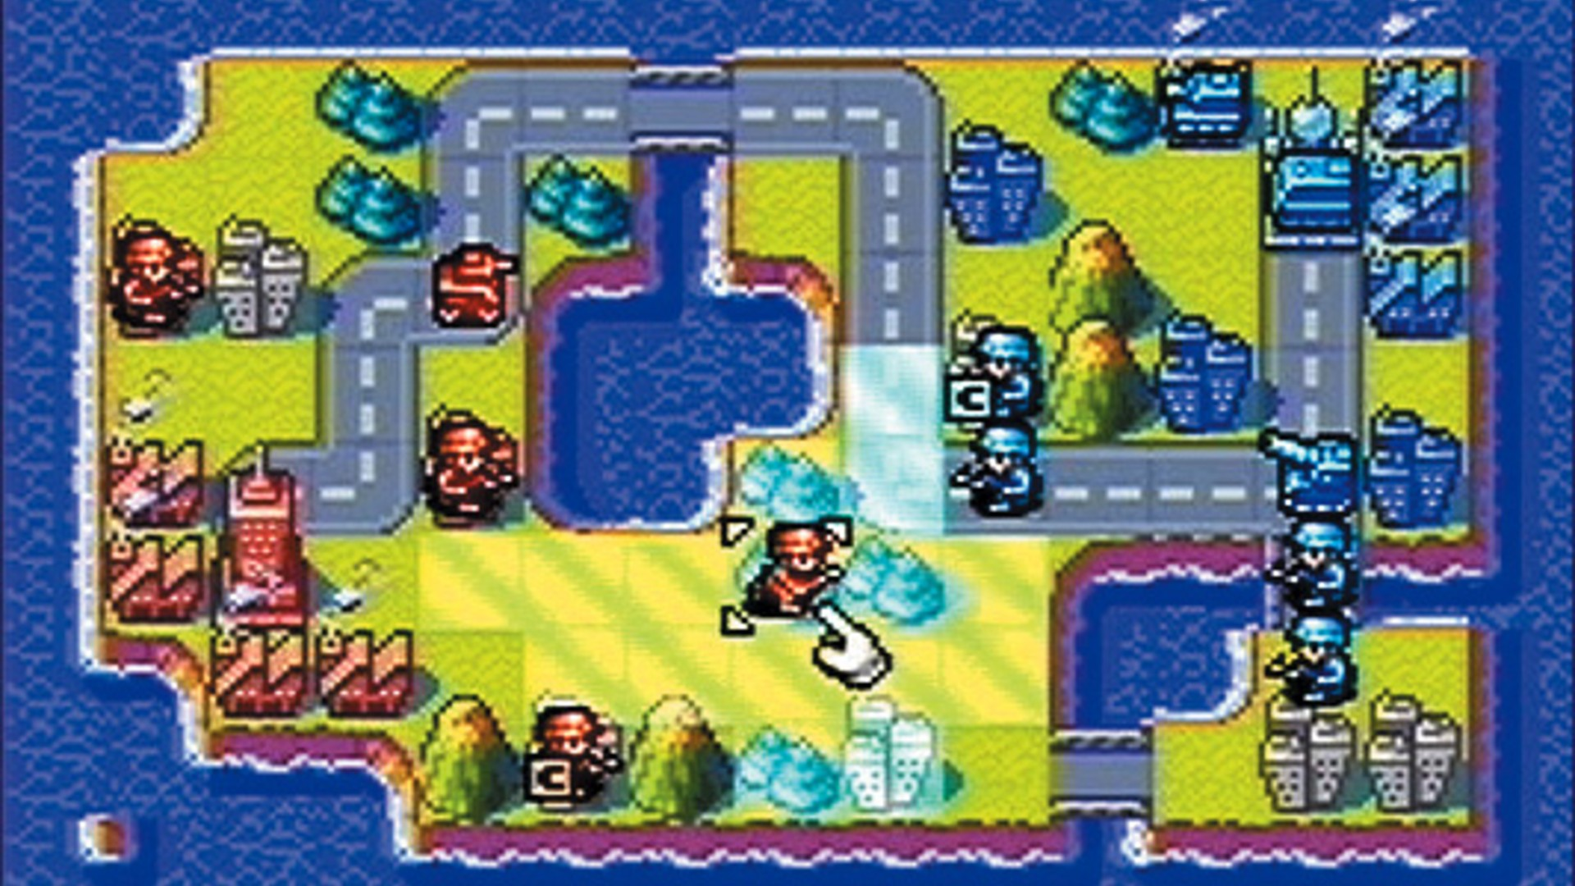
Problem and Motivation
Building a turn-based strategy game inspired by Fire Emblem
These games feature layered calculations for damage and hit chance
I wanted to model these rules using Effekt’s features
I also wanted levels and maps to be customizable without changing code

Slide 3
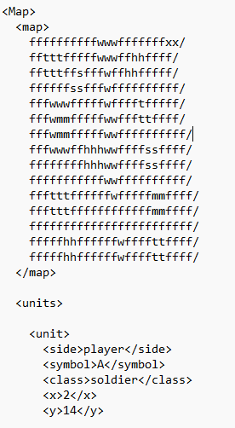
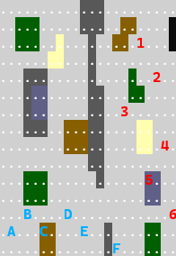
Project Overview
Console-based UI and input
Grid-based map with different tile types
Maps are generated from a text file
Units with different weapons and classes

Slide 4
Combat calculation
Needs to resolve various bonuses and matchups
Weapon matchups
Terrain bonuses
Class bonuses and matchups
Damage calculation is split into three phases

Slide 5
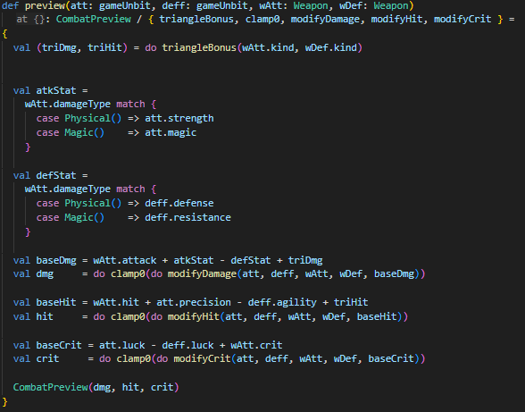
Preview
Computes the base damage without modifiers
Displays preview stats

Slide 6
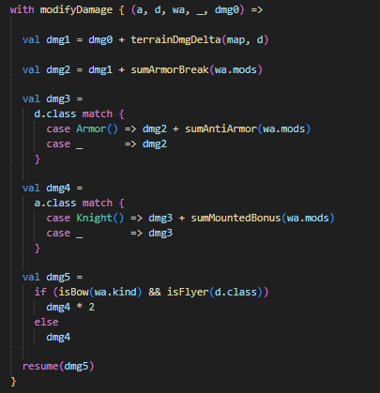

previewPure
Handles the rules for the effects used in the preview
Applies the rules for the various bonuses

Slide 7
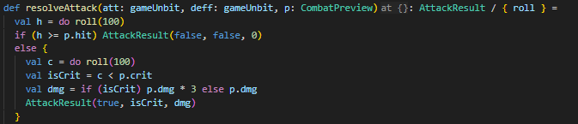
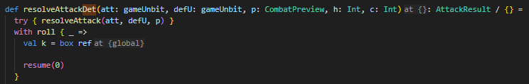

ResolveAttack
Applies randomness for hit and crit
Calculates the damage applied to the unit
Rolls can be made deterministic

Slide 8
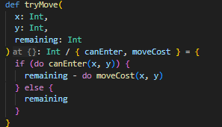
Movement
Needs to take different class movement rules into account
Calculates optimal paths for enemies and reachable tiles
The expand function computes optimal paths using a Dijkstra-style algorithm
tryMove is used for cursor movement

Slide 9
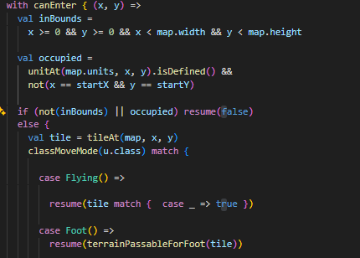
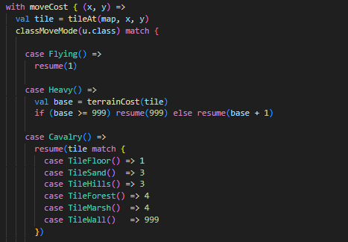
Handler WithUnitMovement Rules
Applies movement costs for different classes
Defines which units can enter which tiles

Slide 10
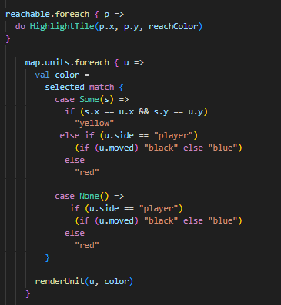

Renderer
Effects are used to represent different drawing operations
These effects are handled in withConsole

Slide 11
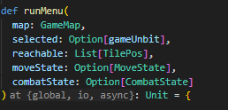

Other design choices
Map parsing errors are handled via the ParseError effect
Player input and game state are handled recursively
State is generally not mutated

Slide 12
Challenges and Conclusion
The Project was excuted without major problems

Slide 13
Demo

