Slide 1










LFP State of Charge Estimation: Why it matters and why it’s hard…
Christian Pilling – Solar and Storage Live 2024
Notes:
-

Slide 2

Why do we estimate SoC?
We cannot measure SoC directly!
How much energy is available from my system?
How much power is available from my system in the immediate future?
V
Model Based Estimators
Q
Pack Calculations
Energy
SoC
T
Power
I
R
Plett, G. (n.d.). Lecture notes and recordings for ECE5720: Battery Management and Control. Retrieved from http://mocha-java.uccs.edu/ECE5720/index.html
2
Notes:
SoC is a measure of how many Ampere Hours remain within the cell!
We cannot measure SOC directly, we can only measure voltage temperature and current. – then model based estimators, then pack calculations. To get to metrics that we really care about like How much energy is available, how much power is available.
-The pack calculations require additional parameters like capacity and internal resistance.
But SOC is by far the most important of these (it underpins both energy and power estimates and can change quite rapidly)
- SOC is a state variable ( a variable that can change quite rapidly)
The internal resistance and capacity of the cell are parameters that change much slower (as the cell degrades).
SOC estimation is one of the core functions of whats called the Battery Management System.

Slide 3
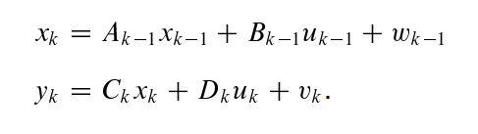
General model form required for the linear Kalman Filter
We want our estimator to help us estimate this. (Cannot directly measure it)
Process noise
Uncertainty in the system dynamics (Model uncertainty / unmodelled dynamics, Input uncertainty)
State equation
Output equation
Sensor noise
Uncertainty in the measurement
For linear systems all probability density functions remain Gaussian if the stochastic inputs are Gaussian. (We need everything to stay Gaussian so we can describe distributions entirely using mean and covariance)
The following are assumed to be Gaussian distributed:
State (even though it is fixed, from the filter’s perspective it is modelled as an unknown random variable
Modelled output
Process noise
Measurement noise
Deterministic: Model matrices (A,B,C,D), control input
(Covariance ≈ Uncertainty / Spread of a random variables distribution and ).
Note: Most popular nonlinear Kalman filters simply linearise the models they are applied to

Slide 4
Kalman Filter SOC Estimation Example
Initial state estimate
Output Estimate
Predict next state (SOC)
(using your state equation, the previous state, and the previous load)
Correct Predicted state (SOC) based on difference between predicted and measured cell voltage
Loop for every timestep…
Measure cell voltage
Predict Cell Voltage
(using your output equation, the predicted state, and measured input)
Compute Kalman Gain
Leaves out uncertainty….
Notes:
https://eatron.com/battery-management-at-the-edge-vs-in-the-cloud-which-is-best/#:~:text=Lower%20latency%3A%20Edge%20computing%20can,be%20transferred%20to%20the%20cloud.
https://www.energy-storage.news/do-lfp-battery-systems-deliver-lower-returns-than-nmc-ones/

Slide 5
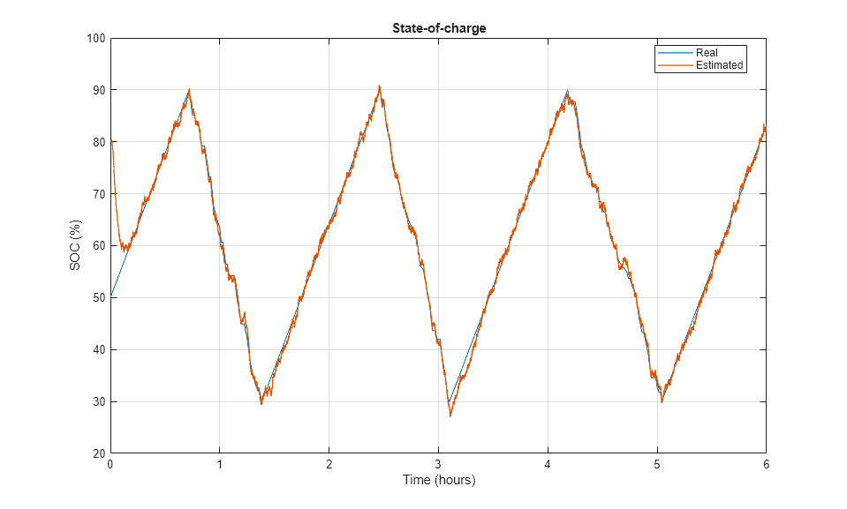

Slide 6
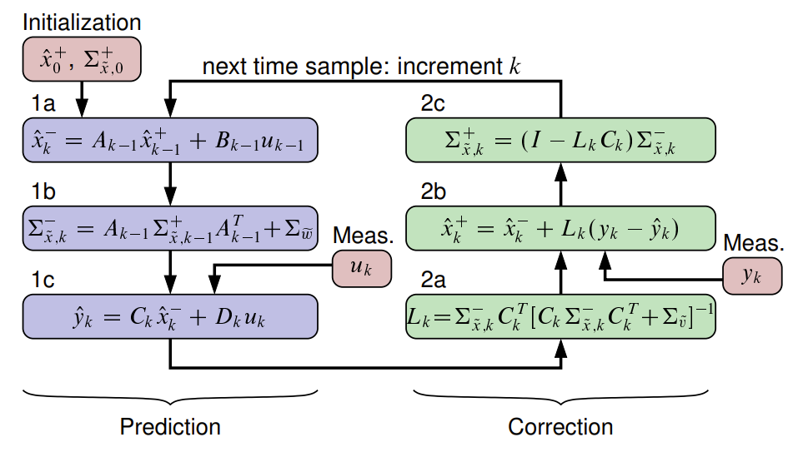
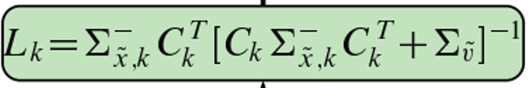
Linear Kalman Filter
Best estimate of the current state uses the previous estimate and the previous input, [Note: mean of the process noise = 0]
The state prediction uncertainty gets updated after the measurement. (Expected to decrease)
Update Estimate using Kalman gain, predicted output and measured output
Innovation
Calcualte estimate covariance (= estimate uncertainty) using previous estimate’s uncertainty and process noise. (Needed for the Kalman gain later)
Calculate our best prediction of the the output given our best estimate of the current state from 1a and the current input u_k. [Note: mean of the sensor noise = 0]
Kalman gain is the most critical aspect!
Large/small Lk = large/small correction to estimate prediction
Essentially captures how uncertain am I in my estimate, how much is the output affected by the state in question, and how certain am I in my output measurement.
Uncertainty in estimate
Connection between the sate and the output
Divided by uncertainty in my innovation. (low = high Lk)

Slide 7

Nonlinear Kalman Filter
Our cell models are actually nonlinear (Look up tables are very nonlinear eg OCV as a function of SoC)
Extended Kalman Filter – Linearise the model at every given point in time for it’s present operating condition (using Taylor series expansion)
Sigma-point (Unscented Kalman Filter) – Statistical/empirical linearisation of the model at each point in time. (Better than EKF at same comp. cost)
Particle filters – Removes assumption of Gaussian distributions (approximates distributions via histograms and Monte-Carlo integration techniques to find expectations and uncertainties) (High comp. cost)

Slide 8
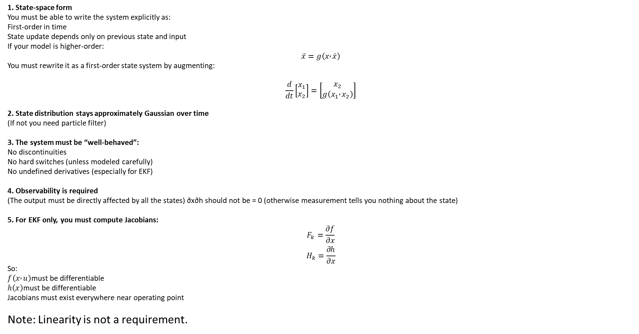
Core requirements for EKF and UKF
1. State-space form
You must be able to write the system explicitly as:
First-order in time
State update depends only on previous state and input
If your model is higher-order:
$$\ddot{x}=g\left(x , \dot{x}\right)$$
You must rewrite it as a first-order state system by augmenting:
$$\frac{d}{dt}\left[\begin{matrix}x_{1} \\ x_{2}\end{matrix}\right]=\left[\begin{matrix}x_{2} \\ g\left(x_{1} , x_{2}\right)\end{matrix}\right]$$
2. State distribution stays approximately Gaussian over time
(If not you need particle filter)
3. The system must be “well-behaved”:
No discontinuities
No hard switches (unless modeled carefully)
No undefined derivatives (especially for EKF)
4. Observability is required
(The output must be directly affected by all the states) ∂x∂h​ should not be = 0 (otherwise measurement tells you nothing about the state)
5. For EKF only, you must compute Jacobians:
$$F_{k}=\frac{∂f}{∂x}$$
$$H_{k}=\frac{∂h}{∂x}$$
So:
$f\left(x , u\right)$must be differentiable
$h\left(x\right)$must be differentiable
Jacobians must exist everywhere near operating point
Note: Linearity is not a requirement.

