Slide 1
Announcements – Jan 19
First Homework will come out today at be due at class time next Friday.
TA offices hours and SI sessions TBA. Office hours will start next week.
Quiz 2 trivia – The correct answer was the IBM PC. IBM was late to the pc game. The IBM PC came out in 1981. 19% got the question correct. The most common answer was the Commodore PET.

Slide 2
1.2 Applications of Propositional Logic
Translating English Statements
You can take 144 only if you have completed 110 unless you have advisor approval.
First, assign variables:
t: take 144
c: completed 110
a: instructor approval
Does this work?
c v a → t
NO! This is says you can take the class if you’ve met the conditions, but not that the conditions are required.

Slide 3
1.2 Applications of Propositional Logic
Translating English Statements
You can take 144 only if you have completed 110 unless you have advisor approval.
First, assign variables:
t: take 144
c: completed 110
a: advisor approval
t → (c v a)
This is correct. If you’re in the class, then it must be true that you’ve completed 110 or got approval.

Slide 4
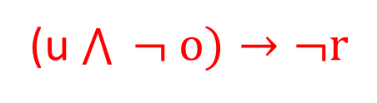
1.2 Applications of Propositional Logic
Translating English Statements
You cannot ride the rollercoaster if you are under 4 feet tall unless you are older than 16 years.
First, assign variables:
r: ride the rollercoaster
u: under 4 feet tall
o: older than 16
(u $\bigwedge{ ¬ o})→¬r$

Slide 5
1.2 Applications of Propositional Logic
System Specifications
Requirements for systems are often expressed in English. They must be interpreted as logic. Then we must make sure we can satisfy the conditions.

Slide 6
1.2 Applications of Propositional Logic
System Specifications
The diagnostic message is stored in the buffer or it is retransmitted.
The diagnostic message is not stored in the buffer.
If the diagnostic message is stored in the buffer, then it is retransmitted.

Slide 7
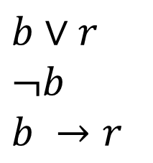
The diagnostic message is stored in the buffer or it is retransmitted.
The diagnostic message is not stored in the buffer.
If the diagnostic message is stored in the buffer, then it is retransmitted.
b: diagnostic message stored in buffer
r: message is retransmitted
$b∨r$
$¬b$
$b →r$
We want to know if we can satisfy the specification. We can if the specification is consistent. This means there’s an assignment that make all specifications true.

Slide 8
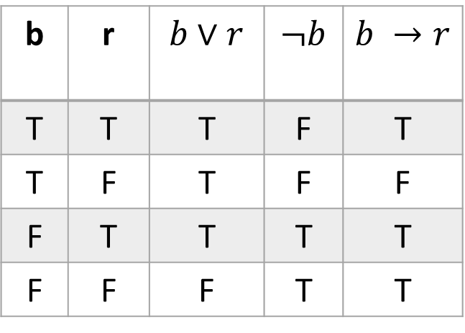
The diagnostic message is stored in the buffer or it is retransmitted.
The diagnostic message is not stored in the buffer.
If the diagnostic message is stored in the buffer, then it is retransmitted.
b: diagnostic message stored in buffer
r: message is retransmitted
b | r | $b∨r$ | $¬b$ | $b →r$
T | T | T | F | T
T | F | T | F | F
F | T | T | T | T
F | F | F | T | T
$b∨r$
$¬b$
$b →r$

Slide 9
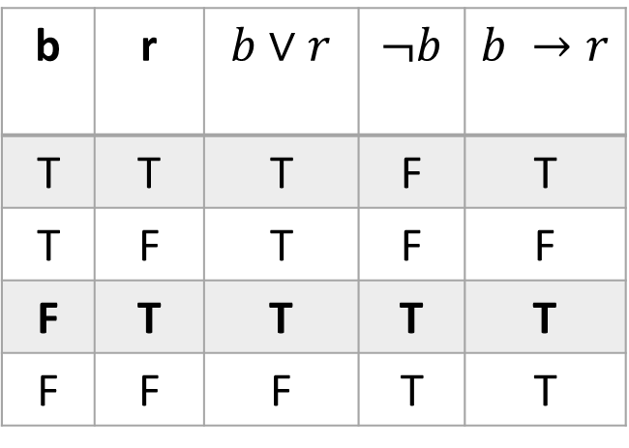
The diagnostic message is stored in the buffer or it is retransmitted.
The diagnostic message is not stored in the buffer.
If the diagnostic message is stored in the buffer, then it is retransmitted.
b: diagnostic message stored in buffer
r: message is retransmitted
b | r | $b∨r$ | $¬b$ | $b →r$
T | T | T | F | T
T | F | T | F | F
F | T | T | T | T
F | F | F | T | T
$b∨r$
$¬b$
$b →r$
b = False
r = True
Works

Slide 10
The diagnostic message is stored in the buffer or it is retransmitted.
The diagnostic message is not stored in the buffer.
If the diagnostic message is stored in the buffer, then it is retransmitted.
What if we add the condition
4. The diagnostic message is stored in the buffer.
Now we are no longer consistent because our only possible solution no longer works.
b = False
r = True

Slide 11
1.2 Applications of Propositional Logic
Logic Puzzles

Slide 12
Knights and Knaves
There are a series of puzzles based on a mythical island of knights and knaves. Knights always tell the truth. Knaves always lie. The goal is to figure out who is a knight and who is a knave based on what they say.
For Example:
You meet two characters, Doof and Perry. Doof says: “At least one of is a knave.” Perry says nothing.
Can you tell what each character is?
How do you know?

Slide 13
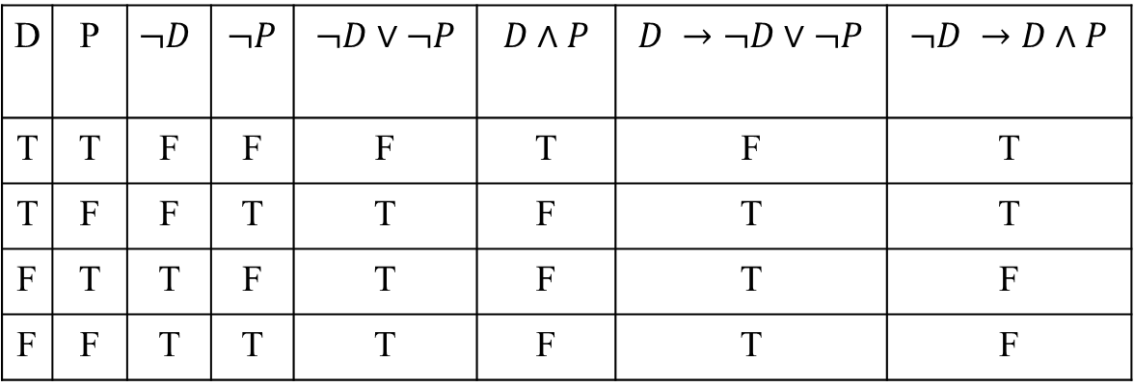

Knights and Knaves
Doof says: “At least one of is a knave.” Perry says nothing.
D: D is knight
P: P is knight
$D →¬D∨¬P$
$¬D →D∧P$
D | P | $$¬D$$ | $¬P$ | $¬D∨¬P$ | $D∧P$ | $D →¬D∨¬P$ | $¬D →D∧P$
T | T | F | F | F | T | F | T
T | F | F | T | T | F | T | T
F | T | T | F | T | F | T | F
F | F | T | T | T | F | T | F
So Doof is a knight and Perry is a knave is consistent.

Slide 14
Knights and Knaves
Doof says: “At least one of is a knave.” Perry says nothing.
Another way to think of it:
If Doof is knight then what he says is true so Perry must be a knave. Perry says nothing so there is no contradiction there.
But we have to make sure this is the only possible solution.
If Doof is a knave then what he says is false, so there are no knaves, so Doof is a knight =><= (contradiction)
Therefore, Doof is a knight and Perry is a knave.

Slide 15
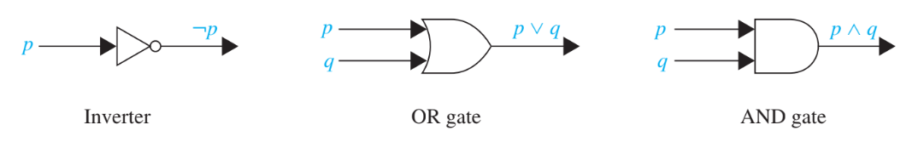
1.2 Applications of Propositional Logic
Logic Circuits

Slide 16
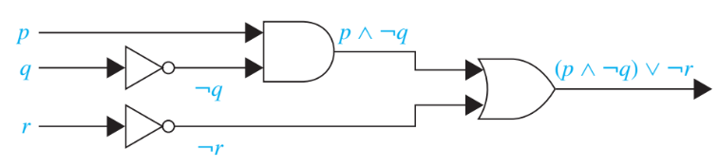
Logic Circuits
Determine the output for the combinatorial circuit.

Slide 17
Logic Circuits
Determine the output for the combinatorial circuit.

Slide 18
Logic Circuits
Determine the output for the combinatorial circuit.

Slide 19
Logic Circuits
Determine the output for the combinatorial circuit.

Slide 20
Logic Circuits
Determine the output for the combinatorial circuit.

Slide 21
Logic Circuits
Build a digital circuit that produces the output (p ν ㄱr) Λ (ㄱp ν (q ν ㄱr)).

Slide 22
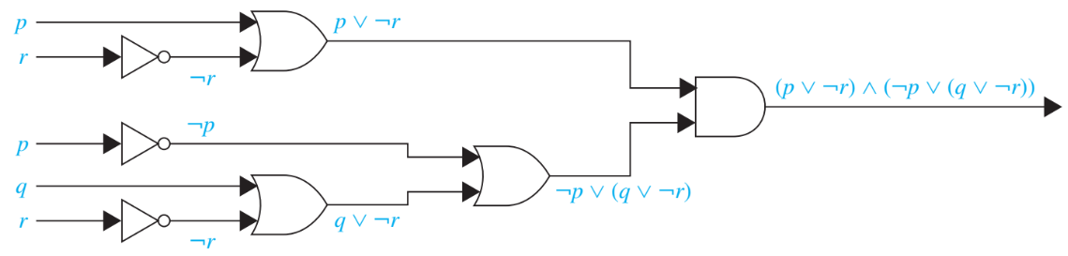
Logic Circuits
Build a digital circuit that produces the output (p ν ㄱr) Λ (ㄱp ν (q ν ㄱr)).

Slide 23
End of Section 1.2 Starting Section 1.3

Slide 24


Two Categories of Propositions
Deﬁnition: Tautology
A proposition that always evaluates to true.
Deﬁnition: Contradiction
A proposition that always evaluates to false.

Slide 25

Two Categories of Propositions
Deﬁnition: Tautology
A proposition that always evaluates to true.
examples: T, p $∨¬$p
Deﬁnition: Contradiction
A proposition that always evaluates to false.
examples: F, p $∧$ $¬$p

Slide 26
Determining Tautologies
How can we determine whether a proposition is a tautology or a contradiction?
One way is to use a truth table.
To show something IS a tautology this way one would have to have complete truth table that shows the proposition evaluates to true for all possible combinations of values of the logical variables.
To show it’s NOT a tautology one only has to find one assignment of variables under which the proposition evaluates to false
(Likewise for a contradiction)

Slide 27
For example, show whether
p⊕ (q∧ r)
is a tautology or a contradiction or neither?
F⊕ (F∧ F) = F⊕F = F
so not a tautology
T⊕ (F∧ F) = T⊕F = T
so not a contradiction

Slide 28
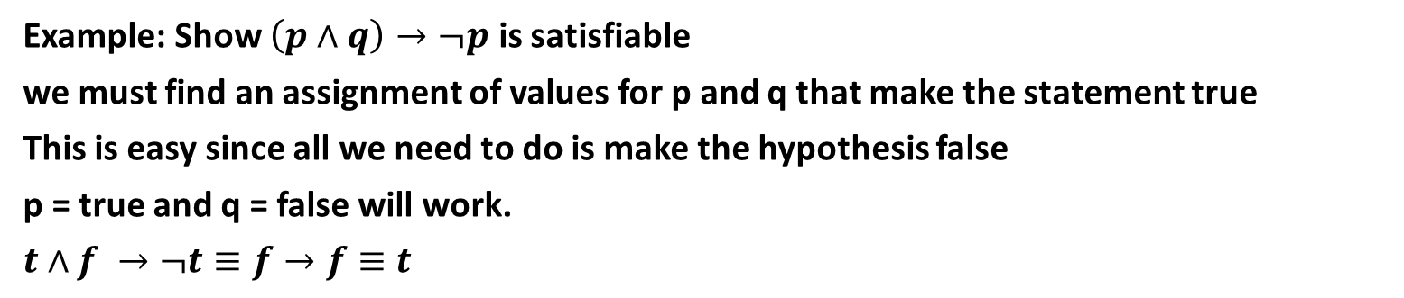
Satisfiable Proposition
A proposition is Satisfiable if there is an assignment of truth values to its variables that makes it true.
In other words: a proposition is satisfiable iff it is not a contradiction.
Example: Show $\left(p∧q\right)→¬p$ is satisfiable
we must find an assignment of values for p and q that make the statement true
This is easy since all we need to do is make the hypothesis false
p = true and q = false will work.
$t∧f →¬t≡f→f≡t$
Notes:
Do problem 62a from book.

Slide 29
Biconditionals and Logical Equivalence
Deﬁnition: Logically Equivalent
Compound propositions p and q are logically equivalent (p ≡ q)
if p ↔ q is a tautology.
In other words, the truth tables for p and q are the same.

Slide 30
Showing Propositions are Logically Equivalent
Just like we can use truth tables to show a proposition is a tautology, we can also use truth tables to show to propositions are equivalent.
For example, are the propositions
p → q and
¬p ∨ q equivalent?
p | q | ¬p | p → q | ¬p ∨ q
T | T
T | F
F | T
F | F

Slide 31
Showing Propositions are Logically Equivalent
Just like we can use truth tables to show a proposition is a tautology, we can also use truth tables to show to propositions are equivalent.
For example, are the propositions
p → q and
¬p ∨ q equivalent?
p | q | ¬p | p → q | ¬p ∨ q
T | T | F
T | F | F
F | T | T
F | F | T

Slide 32
Showing Propositions are Logically Equivalent
Just like we can use truth tables to show a proposition is a tautology, we can also use truth tables to show to propositions are equivalent.
For example, are the propositions
p → q and
¬p ∨ q equivalent?
Yes!
p | q | ¬p | p → q | ¬p ∨ q
T | T | F | T | T
T | F | F | F | F
F | T | T | T | T
F | F | T | T | T

Slide 33
Is Exclusive Or Associative?
p | q | r | p$⨁q$ | q$⨁r$ | (p$⨁q$) $⨁$r | p$⨁$(q$⨁r$)
T | T | T | F | F | T | T
T | T | F | F | T | F | F
T | F | T | T | T | F | F
T | F | F | T | F | T | T
F | T | T | T | F | F | F
F | T | F | T | T | T | T
F | F | T | F | T | T | T
F | F | F | F | F | F | F
So: (p⨁q) ⨁r $≡$ p⨁(q⨁r)
And we can write p⨁q ⨁r without ambiguity
Notes:
Note that multiple exclusive ors are true if an odd number are true

Slide 34
So Are All Our Operators Associative?
Let’s do a quiz to figure out if and, or, and implication are also associative.
Notes:
FTF and FFF both “work”

Slide 35


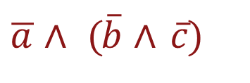
De Morgan’s Laws
p ∧ q ≡ p ∨ q
p ∨ q ≡ p ∧ q
Example(s):
a ∨ (b ∨ c)
≡
$$\overline{a}∧\overline{(b∨c)}$$
≡
$\overline{a}∧ (\overline{b}$ $∧ \overline{c})$

Slide 36
De Morgan’s Laws
So we see that DeMorgan’s laws generalize.
$$\overline{p_{1}∨p_{2}∨…∨p_{n}}≡\overline{p_{1}}∧\overline{p_{2}}∧…∧\overline{p_{n}}$$
$$\overline{p_{1}∧p_{2}∧…∧p_{n}}≡\overline{p_{1}}∨\overline{p_{2}}∨…∨\overline{p_{n}}$$

Slide 37
More DeMorgan
The defendants who’ve paid their fine or scheduled an appeal are OK. We want to report the others.

Slide 38
More DeMorgan
The defendants who’ve paid their fine or scheduled an appeal are OK. We want to report the others.
So say
p: is paid fine
s: is scheduled appeal
Your fellow programmer has written
if (not p or not s):
#report them
Do you need to fix the code?

Slide 39
More DeMorgan
The defendants who’ve paid their fine or scheduled an appeal are OK. We want to report the others.
So say
p: is paid fine
s: is scheduled appeal
Your fellow programmer has written
if (not p or not s): #report them
Do you need to fix the code? Yes! not(p or s) = not p and not s

Slide 40
More DeMorgan
Suppose we were skeptical that DeMorgan's laws work.
How can we demonstrate that they are correct?
Construct truth tables!

