Slide 1
My Language of Choice
Experiences with Kotlin

Slide 2



Who am I
Christian Dräger
Software Developer from Berlin
    christian-draeger
    _chris_draeger_
    christian-draeger

Slide 3



What’s Kotlin
Statically Typed
Open Source
sponsored by Jetbrains
the better Java?
Island of Kotlin (near St Petersburg)

Slide 4
Who is using Kotlin?
compiles to different platforms
  JVM, Android, JS, C (native), iOS
runs like a charm on the JVM and Android
dedicated Kotlin support in Spring Framework 5.0+

Slide 5
May 2017 (Google I/O):
„Today the Android team is excited to announce that we are officially adding support for the Kotlin programming language. Kotlin is a brilliantly designed, mature language that we believe will make Android development faster and more fun.“

Slide 6


Slide 7
Why it Rocks?
feels like Java as it always should be
low learning curve without surprises
very well documented with huge community
a lot of nice language features
Java interop (on the JVM)

Slide 8

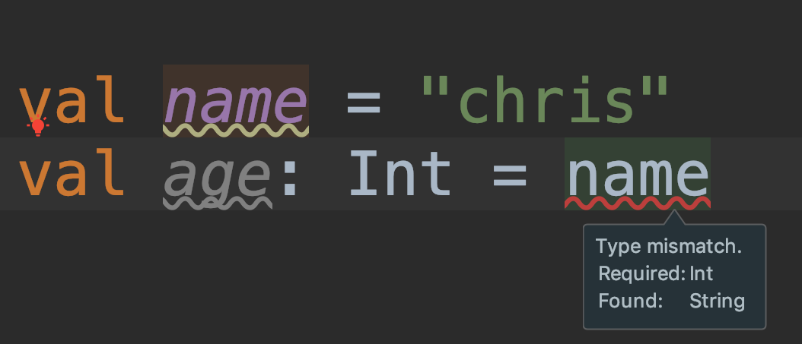
type inference
val foo = listOf("foo", "bar")
val bar = mutableListOf("foo", "bar")
val map = mapOf("foo" to 1, "bar" to 2)
reduces boilerplate - increases readability

Slide 9

type alias
typealias PersonIndex = Map<String, Person>
handy for functional types or a types with type
parameters which is used multiple times in a codebase
will behave exactly the same like
Map<String, Person> but is explizit and increases
readability

Slide 10

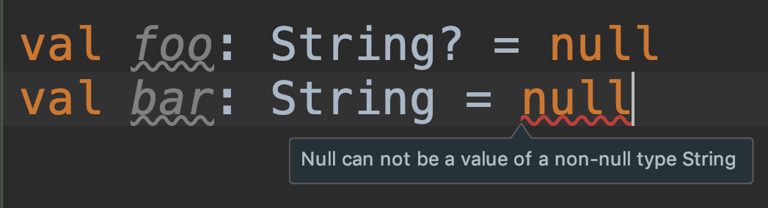
null-safety
Types are not nullable
if needed you have to make it explizit by adding ? at end of Type

Slide 11

String handling
val multiline: String =
"""
foo,
bar
""".trimIndent()
val name = "chris"
println("hey I'm $name")

Slide 12

extension functions
// with block body syntax
fun String.codeFreeze(): String {
return "codefreeze-$this"
}
"Chris".codeFreeze()
// will add „codefreeze-“ at the beginning
// with expression body syntax
fun String.codeFreeze(): String = "codefreeze-$this"

Slide 13

data classes
generating
  getters
  setters (if var)
  equals / hashcode
  copy
  toString
  "Person(name=John, email=foo@bar.tld)"
reduces boilerplate
data class Person(
    var name: String,
    val email: String
    )

Slide 14

default arguments
class MyClass {
@Test
fun `can print Person with default arguments`() {
println(Person("john").toString())
}
}
data class Person(
val name: String = "chris",
val email: String = "foo@bar.tld"
)
will print "Person(name=john, email=foo@bar.tld)"

Slide 15

named arguments
class MyClass {
val person = Person(email = "bla@blub.de", name = "john")
}
data class Person(
val name: String,
val email: String
)
builder pattern out-of-the-box 👍
increase readability

Slide 16

a lot more nice features and facts
a lot more intuitive and easy to use stream api compared to Java
Coroutines
Kotlin DSL
Perfect IntelliJ Support (not surprisingly)
uses existing and mature ecosystem of Java
  buildtools: e.g. Maven, Gradle
  Can use Java Libs out-of-the-box
easy to get started, especially if you did Java or Swift before

Slide 17


testing
this deserves an extra session to be honest.
in short, all testing libs you from Java will work
there are a lot of nice dedicated kotlin testing libs popping up atm
to dig deeper i highly recommend
this nice Talk I saw at the
Kotlin Conf 2018 in Amsterdam:
  https://youtu.be/RX_g65J14H0

Slide 18

puzzlers
every language has it weaknesses
you can find some funny puzzlers over here:
  https://github.com/angryziber/kotlin-puzzlers
  the community is constantly fixing these things

Slide 19

experiences / strategies to get started
just add kotlin compiler plugin and kotlin-stdlib to your existing Java Project
  convert a Java class to Kotlin
  run all tests - build should still be green
    generate trust by doing baby-steps
write your tests in kotlin for the beginning
…

Slide 20

let’s hack

