Slide 1

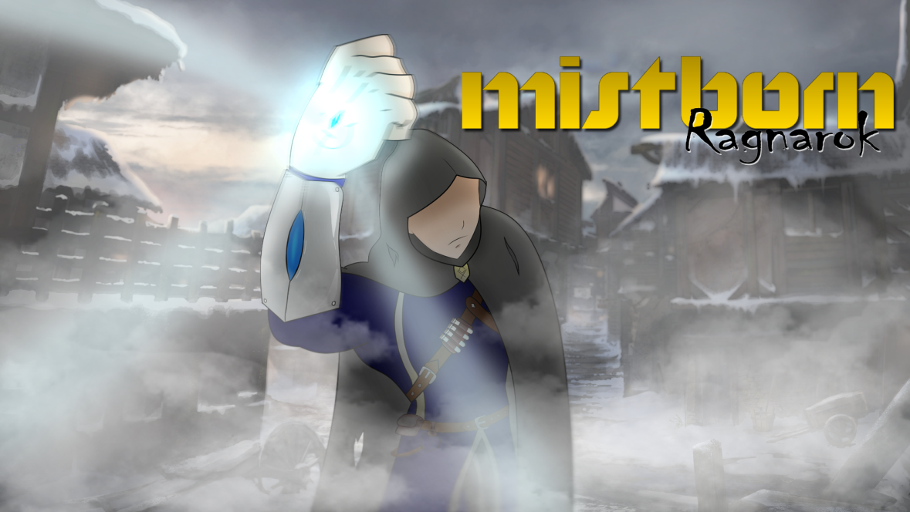
Mistborn – Ragnarok Aggressive Pigeon Game Studio COMP 376 PROJECT PROTOTYPE PRESENTATION
Christian Plourde – 26572499
Ayush Kharade - 40042388
Daniel Vellucci – 27416288
Samer Yazbeck – 40049573
Luciano Porchet - 40048537
“All Paths Lead To Ruin”

Slide 2
CHANGES
Combining potions – dropped
Initial plan to leave extra materials in hidden locations in game – dropped
Instead have chest to collect metals when low
Allows us to provide player with notes and letters explaining the lore
Response to critiques : Adding calm moments in the game such as walking in a level.
Strong opportunity in Level 1 (Walk through the forest) good moment to explain character’s story and thoughts.

Slide 3
PROGRESS REPORT
Completed Mechanics
Platforming
Ladders
Iron and Steel Abilities
Regular Enemies (Bandits)
Combat with Pushing and Pulling
Level 1 Layout
In Progress Mechanics
Pewter Ability
Sound Design
Mechanics to Complete
Ranged Enemy
Highlighting Interactables
Koloss Enemy
Boss Fight
Level 2 Layout
Boss Level Layout

Slide 4
DEVELOPMENT PLAN
Work in parallel to develop Level 2 and Boss Level
IMPORTANT TASK: Highlighting interactables when iron or steel is active.
Will make it easier for player to find objects that they can use. Otherwise the puzzles will be very difficult to solve.
Experimentation with Unity’s shader graphs to implement this.
Implement ranged enemy.
Koloss enemy might be dropped if time does not permit or enemy does not fit well into the game.
Implement collectible lore notes (time permitting)

Slide 5
Thank YOU Any Questions?

