Slide 1

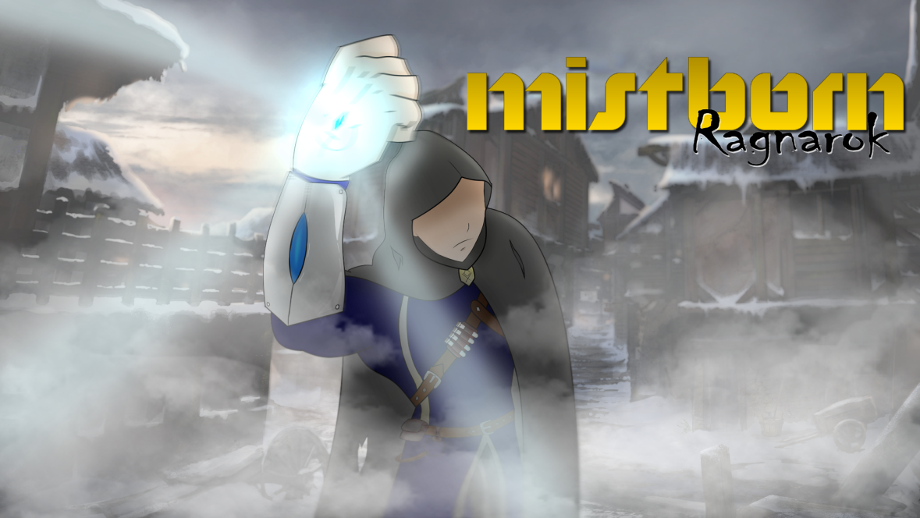
Mistborn – Ragnarok Aggressive Pigeon Game Studio COMP 376 Project Proposal
Christian Plourde – 26572499
Ayush Kharade - 40042388
Daniel Vellucci – 27416288
Samer Yazbeck – 40049573
Luciano Porchet - 40048537
“All Paths Lead To Ruin”

Slide 2
Introduction
Action/Platformer/Puzzle (3D)
PC
Everyone ages 12 and up
Trine (2009) meets Captain Claw (1997)
Medieval/Fantasy/Apocalyptic setting
Mistborn Trilogy – Brandon Sanderson

Slide 3
Story AND SETTING
Cold, desolate world where ash falls constantly from the sky and mists come out during the night
Fiery red sun
Yora
Cast ashore after attack at sea
Abandoned village
Snapping after traumatic events
Thumping sound coming from Well of Ascension
Mastery of new found abilities to overcome what awaits at the Well
Notes:
After a brutal attack at sea, Yora, the main character, wakes up after being cast ashore in a small rescue boat to the sights of an abandoned village. The world around him is cold and desolate and ash perpetually falls from the sky, covering the landscape in a black blanket. Due to the Lord Ruler’s influence after seizing the power at the Well of Ascension 1000 years ago, the planet lies dangerously close to the sun – a fiery red ball in the sky. The Well has since been replenished and our protagonist feels it beckoning to him. The traumatic experience of the attack preceding his shipwreck have snapped Yora, awakening the Mistborn powers he was genetically predisposed to. As the prophecies foretold, the Hero of Ages must once again travel to the Well of Ascension and seize its power. What awaits him there will require mastery of his newly acquired powers to overcome and save the world from impending doom.

Slide 4

Game Mechanics
Traditional Platforming Mechanics such as running and jumping popularized during the days of the NES.
A tried and true formula that people still enjoy to this day.

Slide 5

Game Mechanics
We also aim to have puzzles in our levels inspired by games such as Limbo.
Our aim is to have the player think to reach certain rewards.

